Slide 1


Review of the South Dublin County Development Plan 2016-2022
Preparation of a new Development Plan 2022-2028
Presentation to SPC 28th May 2020
Notes:
Appendix 3:
Tier 1: Serviced Zoned Land This zoning comprises lands that are able to connect to existing development services, i.e. road and footpath access including public lighting, foul sewer drainage, surface water drainage and water supply, for which there is service capacity available, and can therefore accommodate new development. These lands will generally be positioned within the existing built-up footprint of a settlement or contiguous to existing developed lands. The location and geographical extent of such lands shall be determined by the planning authority at a settlement scale as an integral part of the plan-making process and shall include assessment of available development services. Inclusion in Tier 1 will generally require the lands to within the footprint of or spatially sequential within the identified settlement
Tier 2: Serviceable Zoned Land This zoning comprises lands that are not currently sufficiently serviced to support new development but have potential to become fully serviced within the life of the plan i.e. the lands are currently constrained due to the need to deliver some or all development services required to support new development, i.e. road or footpath access including lighting, foul sewer drainage, surface water drainage, water supply and/or additional service capacity.
These lands may be positioned within the existing built-up footprint of a settlement, or contiguous to existing developed lands or to tier 1 zoned lands, where required to fulfil the spatially sequential approach to the location of the new development within the identified settlement.
The potential for delivery of the required services and/or capacity to support new development must be identified and specific details provided by the planning authority at the time of publication of both the draft and final development or area plan.
This infrastructural assessment must be aligned with the approved infrastructural investment programme(s) of the relevant delivery agency(ies), for example, Irish Water, or be based on a written commitment by the relevant delivery agency to provide the identified infrastructure within a specified timescale (i.e. within the lifetime of the plan). The planning authority may also commit to the delivery of the required and identified infrastructure in its own infrastructural investment programme (i.e. Budgeted Capital Programme) in order to support certain lands for zoning.
The written infrastructural assessment of the planning authority must:
include a reasonable estimate of the full cost of delivery of the required infrastructure to the identified zoned lands;
Set out (a) above at both the draft plan and final plan stages of the plan making process.
Current development or area plans may include zoned lands that cannot be serviced during the life of a development or area plan by reference to the infrastructural assessment of the planning authority. This means that they cannot be categorised as either Tier 1 lands or Tier 2 lands per the above and therefore are not developable within the plan period. Such lands should not be zoned for development or included within a development plan core strategy for calculation purposes.
Further guidance will be provided in updated Statutory Guidelines that will be issued under s.28 of the Planning & Development Act, 2000 (as amended).

Slide 2

Introduction
Purpose of a Development Plan
Timelines & Process
Key themes at Pre-Draft Stage
SPC consultation and feedback
Identification of SPC key issues
2022 - 2028 Development Plan - Density Framework
Notes:
Appendix 3:
Tier 1: Serviced Zoned Land This zoning comprises lands that are able to connect to existing development services, i.e. road and footpath access including public lighting, foul sewer drainage, surface water drainage and water supply, for which there is service capacity available, and can therefore accommodate new development. These lands will generally be positioned within the existing built-up footprint of a settlement or contiguous to existing developed lands. The location and geographical extent of such lands shall be determined by the planning authority at a settlement scale as an integral part of the plan-making process and shall include assessment of available development services. Inclusion in Tier 1 will generally require the lands to within the footprint of or spatially sequential within the identified settlement
Tier 2: Serviceable Zoned Land This zoning comprises lands that are not currently sufficiently serviced to support new development but have potential to become fully serviced within the life of the plan i.e. the lands are currently constrained due to the need to deliver some or all development services required to support new development, i.e. road or footpath access including lighting, foul sewer drainage, surface water drainage, water supply and/or additional service capacity.
These lands may be positioned within the existing built-up footprint of a settlement, or contiguous to existing developed lands or to tier 1 zoned lands, where required to fulfil the spatially sequential approach to the location of the new development within the identified settlement.
The potential for delivery of the required services and/or capacity to support new development must be identified and specific details provided by the planning authority at the time of publication of both the draft and final development or area plan.
This infrastructural assessment must be aligned with the approved infrastructural investment programme(s) of the relevant delivery agency(ies), for example, Irish Water, or be based on a written commitment by the relevant delivery agency to provide the identified infrastructure within a specified timescale (i.e. within the lifetime of the plan). The planning authority may also commit to the delivery of the required and identified infrastructure in its own infrastructural investment programme (i.e. Budgeted Capital Programme) in order to support certain lands for zoning.
The written infrastructural assessment of the planning authority must:
include a reasonable estimate of the full cost of delivery of the required infrastructure to the identified zoned lands;
Set out (a) above at both the draft plan and final plan stages of the plan making process.
Current development or area plans may include zoned lands that cannot be serviced during the life of a development or area plan by reference to the infrastructural assessment of the planning authority. This means that they cannot be categorised as either Tier 1 lands or Tier 2 lands per the above and therefore are not developable within the plan period. Such lands should not be zoned for development or included within a development plan core strategy for calculation purposes.
Further guidance will be provided in updated Statutory Guidelines that will be issued under s.28 of the Planning & Development Act, 2000 (as amended).

Slide 3
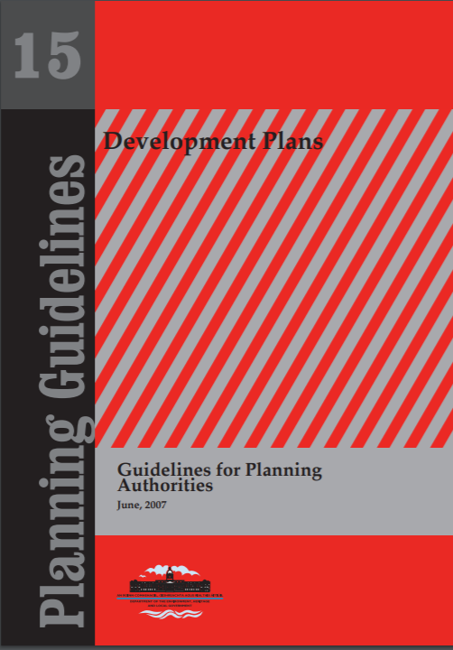
Purpose
To deliver an overall strategy for the proper planning and sustainable development of South County Dublin
Set out the planning and development objectives of the planning authority for a six-year period in both a written statement and maps
Set out a ‘core strategy’ for location and quantum of housing and employment
2022 - 2028 Development Plan - Density Framework
Notes:
Appendix 3:
Tier 1: Serviced Zoned Land This zoning comprises lands that are able to connect to existing development services, i.e. road and footpath access including public lighting, foul sewer drainage, surface water drainage and water supply, for which there is service capacity available, and can therefore accommodate new development. These lands will generally be positioned within the existing built-up footprint of a settlement or contiguous to existing developed lands. The location and geographical extent of such lands shall be determined by the planning authority at a settlement scale as an integral part of the plan-making process and shall include assessment of available development services. Inclusion in Tier 1 will generally require the lands to within the footprint of or spatially sequential within the identified settlement
Tier 2: Serviceable Zoned Land This zoning comprises lands that are not currently sufficiently serviced to support new development but have potential to become fully serviced within the life of the plan i.e. the lands are currently constrained due to the need to deliver some or all development services required to support new development, i.e. road or footpath access including lighting, foul sewer drainage, surface water drainage, water supply and/or additional service capacity.
These lands may be positioned within the existing built-up footprint of a settlement, or contiguous to existing developed lands or to tier 1 zoned lands, where required to fulfil the spatially sequential approach to the location of the new development within the identified settlement.
The potential for delivery of the required services and/or capacity to support new development must be identified and specific details provided by the planning authority at the time of publication of both the draft and final development or area plan.
This infrastructural assessment must be aligned with the approved infrastructural investment programme(s) of the relevant delivery agency(ies), for example, Irish Water, or be based on a written commitment by the relevant delivery agency to provide the identified infrastructure within a specified timescale (i.e. within the lifetime of the plan). The planning authority may also commit to the delivery of the required and identified infrastructure in its own infrastructural investment programme (i.e. Budgeted Capital Programme) in order to support certain lands for zoning.
The written infrastructural assessment of the planning authority must:
include a reasonable estimate of the full cost of delivery of the required infrastructure to the identified zoned lands;
Set out (a) above at both the draft plan and final plan stages of the plan making process.
Current development or area plans may include zoned lands that cannot be serviced during the life of a development or area plan by reference to the infrastructural assessment of the planning authority. This means that they cannot be categorised as either Tier 1 lands or Tier 2 lands per the above and therefore are not developable within the plan period. Such lands should not be zoned for development or included within a development plan core strategy for calculation purposes.
Further guidance will be provided in updated Statutory Guidelines that will be issued under s.28 of the Planning & Development Act, 2000 (as amended).

Slide 4

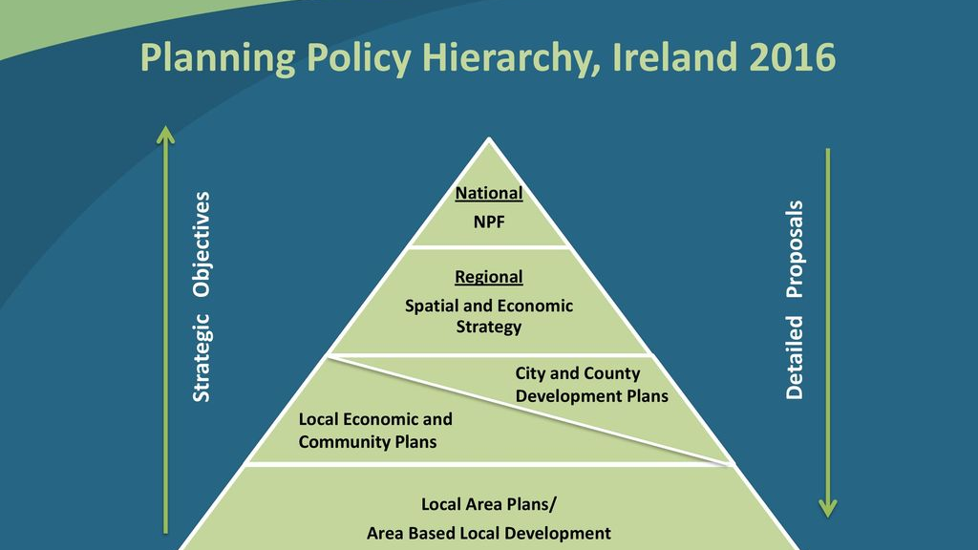
Context – A Hierarchy of Plans
2022 - 2028 Development Plan - Density Framework
Notes:
Appendix 3:
Tier 1: Serviced Zoned Land This zoning comprises lands that are able to connect to existing development services, i.e. road and footpath access including public lighting, foul sewer drainage, surface water drainage and water supply, for which there is service capacity available, and can therefore accommodate new development. These lands will generally be positioned within the existing built-up footprint of a settlement or contiguous to existing developed lands. The location and geographical extent of such lands shall be determined by the planning authority at a settlement scale as an integral part of the plan-making process and shall include assessment of available development services. Inclusion in Tier 1 will generally require the lands to within the footprint of or spatially sequential within the identified settlement
Tier 2: Serviceable Zoned Land This zoning comprises lands that are not currently sufficiently serviced to support new development but have potential to become fully serviced within the life of the plan i.e. the lands are currently constrained due to the need to deliver some or all development services required to support new development, i.e. road or footpath access including lighting, foul sewer drainage, surface water drainage, water supply and/or additional service capacity.
These lands may be positioned within the existing built-up footprint of a settlement, or contiguous to existing developed lands or to tier 1 zoned lands, where required to fulfil the spatially sequential approach to the location of the new development within the identified settlement.
The potential for delivery of the required services and/or capacity to support new development must be identified and specific details provided by the planning authority at the time of publication of both the draft and final development or area plan.
This infrastructural assessment must be aligned with the approved infrastructural investment programme(s) of the relevant delivery agency(ies), for example, Irish Water, or be based on a written commitment by the relevant delivery agency to provide the identified infrastructure within a specified timescale (i.e. within the lifetime of the plan). The planning authority may also commit to the delivery of the required and identified infrastructure in its own infrastructural investment programme (i.e. Budgeted Capital Programme) in order to support certain lands for zoning.
The written infrastructural assessment of the planning authority must:
include a reasonable estimate of the full cost of delivery of the required infrastructure to the identified zoned lands;
Set out (a) above at both the draft plan and final plan stages of the plan making process.
Current development or area plans may include zoned lands that cannot be serviced during the life of a development or area plan by reference to the infrastructural assessment of the planning authority. This means that they cannot be categorised as either Tier 1 lands or Tier 2 lands per the above and therefore are not developable within the plan period. Such lands should not be zoned for development or included within a development plan core strategy for calculation purposes.
Further guidance will be provided in updated Statutory Guidelines that will be issued under s.28 of the Planning & Development Act, 2000 (as amended).

Slide 5
MANDATORY OBJECTIVES
Zoning of Land
Services for Communities
Social, community, cultural integration with planning
Conservation & Protection of the Environment
Compliance with objectives of river basin management plans
CORE STRATEGY
SEA
Regeneration areas
Development & Renewal
Preservation of Landscape Character
Infrastructure facilitation/provision
Recreational amenities
AA
Sustainable settlement/transport strategies
  Reduce energy demand;
  Reduce anthropogenic greenhouse gas emissions;
  Address adaptation to climate change
Protection of Structures & preservation of character of ACAs
Housing Strategy
SFRA
Notes:
Zoning of land
The development and renewal of areas in need of regeneration – to prevent adverse effects on existing amenities, urban decay, anti-social, shortage of houses or land
Provision/facilitation of infrastructure – includes transport, energy & comms; water supply & wastewater (water services strategic plan); waste recovery & disposal facilities; ancillary facilities
Housing Strategy & Core Strategy including provision of accommodation for travellers
Conservation and protection of the environment
Management of features of the landscape, preservation of character etc
Promotion of compliance with objectives in river basin management plans – includes Ground water regs and surface water regs
Integration of planning with social, community and cultural requirements of the area
Provision of services for the community – including schools, creche, other educational and childcare facilities
Protection of structures of and preservation of character of Architectural Conservation Areas
Preservation, improvement and extension of amenities and recreational amenities
The control of siting of development having regard to Major Accidents Directive (SEVESO sites)
Promotion of sustainable settlement and transport strategies including measures to:
Reduce energy demand;
Reduce anthropogenic greenhouse gas emissions;
Address adaptation to climate change location, layout & design
Preservation of public rights of way

Slide 6
Timelines & Process
1
31st July 2020 Commence Process, 8 week public consultation
Pre-Draft – Public consultation on strategic issues to inform preparation of Draft Plan
1
June 2021
Draft Plan prepared and considered by Members for display
2
July-September 2021
Public Consultation on Draft Plan
3
4
Plan adopted in June & comes into effect in August 2022
Stage 1
Strategic Issues Papers
99 weeks
Stage 2
Draft Plan
Stage 3
Amendments
March-April 2022
Public Consultation on Amendments
2022 - 2028 Development Plan - Density Framework
Notes:
Appendix 3:
Tier 1: Serviced Zoned Land This zoning comprises lands that are able to connect to existing development services, i.e. road and footpath access including public lighting, foul sewer drainage, surface water drainage and water supply, for which there is service capacity available, and can therefore accommodate new development. These lands will generally be positioned within the existing built-up footprint of a settlement or contiguous to existing developed lands. The location and geographical extent of such lands shall be determined by the planning authority at a settlement scale as an integral part of the plan-making process and shall include assessment of available development services. Inclusion in Tier 1 will generally require the lands to within the footprint of or spatially sequential within the identified settlement
Tier 2: Serviceable Zoned Land This zoning comprises lands that are not currently sufficiently serviced to support new development but have potential to become fully serviced within the life of the plan i.e. the lands are currently constrained due to the need to deliver some or all development services required to support new development, i.e. road or footpath access including lighting, foul sewer drainage, surface water drainage, water supply and/or additional service capacity.
These lands may be positioned within the existing built-up footprint of a settlement, or contiguous to existing developed lands or to tier 1 zoned lands, where required to fulfil the spatially sequential approach to the location of the new development within the identified settlement.
The potential for delivery of the required services and/or capacity to support new development must be identified and specific details provided by the planning authority at the time of publication of both the draft and final development or area plan.
This infrastructural assessment must be aligned with the approved infrastructural investment programme(s) of the relevant delivery agency(ies), for example, Irish Water, or be based on a written commitment by the relevant delivery agency to provide the identified infrastructure within a specified timescale (i.e. within the lifetime of the plan). The planning authority may also commit to the delivery of the required and identified infrastructure in its own infrastructural investment programme (i.e. Budgeted Capital Programme) in order to support certain lands for zoning.
The written infrastructural assessment of the planning authority must:
include a reasonable estimate of the full cost of delivery of the required infrastructure to the identified zoned lands;
Set out (a) above at both the draft plan and final plan stages of the plan making process.
Current development or area plans may include zoned lands that cannot be serviced during the life of a development or area plan by reference to the infrastructural assessment of the planning authority. This means that they cannot be categorised as either Tier 1 lands or Tier 2 lands per the above and therefore are not developable within the plan period. Such lands should not be zoned for development or included within a development plan core strategy for calculation purposes.
Further guidance will be provided in updated Statutory Guidelines that will be issued under s.28 of the Planning & Development Act, 2000 (as amended).

Slide 7

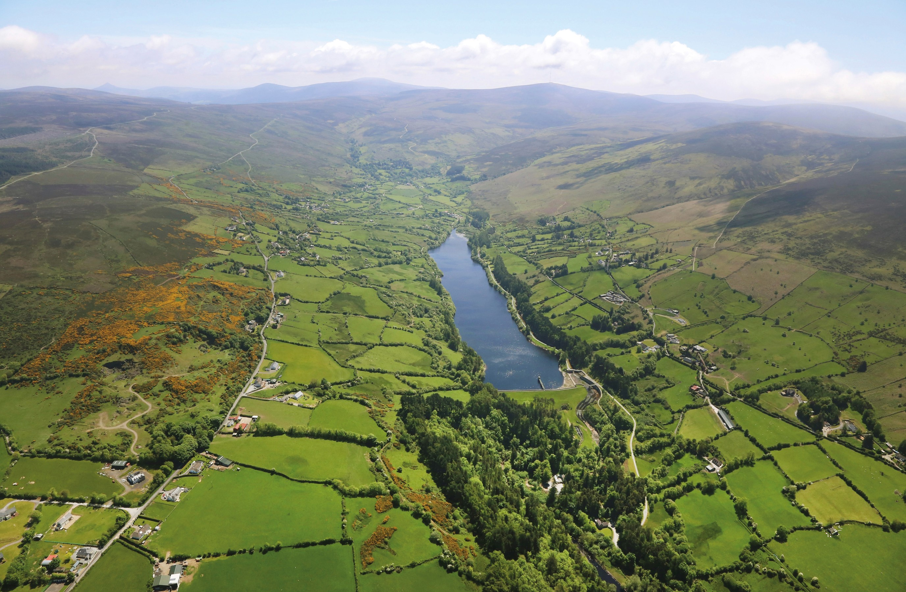






Pre-Draft – 8 Strategic Themes
Population Growth and Housing
Infrastructure and Utilities
Natural Heritage and Biodiversity
Built Environment and Placemaking
Community Infrastructure
Economic Development and Employment
Climate Action
Sustainable Movement
2022 - 2028 Development Plan - Density Framework
Notes:
Appendix 3:
Tier 1: Serviced Zoned Land This zoning comprises lands that are able to connect to existing development services, i.e. road and footpath access including public lighting, foul sewer drainage, surface water drainage and water supply, for which there is service capacity available, and can therefore accommodate new development. These lands will generally be positioned within the existing built-up footprint of a settlement or contiguous to existing developed lands. The location and geographical extent of such lands shall be determined by the planning authority at a settlement scale as an integral part of the plan-making process and shall include assessment of available development services. Inclusion in Tier 1 will generally require the lands to within the footprint of or spatially sequential within the identified settlement
Tier 2: Serviceable Zoned Land This zoning comprises lands that are not currently sufficiently serviced to support new development but have potential to become fully serviced within the life of the plan i.e. the lands are currently constrained due to the need to deliver some or all development services required to support new development, i.e. road or footpath access including lighting, foul sewer drainage, surface water drainage, water supply and/or additional service capacity.
These lands may be positioned within the existing built-up footprint of a settlement, or contiguous to existing developed lands or to tier 1 zoned lands, where required to fulfil the spatially sequential approach to the location of the new development within the identified settlement.
The potential for delivery of the required services and/or capacity to support new development must be identified and specific details provided by the planning authority at the time of publication of both the draft and final development or area plan.
This infrastructural assessment must be aligned with the approved infrastructural investment programme(s) of the relevant delivery agency(ies), for example, Irish Water, or be based on a written commitment by the relevant delivery agency to provide the identified infrastructure within a specified timescale (i.e. within the lifetime of the plan). The planning authority may also commit to the delivery of the required and identified infrastructure in its own infrastructural investment programme (i.e. Budgeted Capital Programme) in order to support certain lands for zoning.
The written infrastructural assessment of the planning authority must:
include a reasonable estimate of the full cost of delivery of the required infrastructure to the identified zoned lands;
Set out (a) above at both the draft plan and final plan stages of the plan making process.
Current development or area plans may include zoned lands that cannot be serviced during the life of a development or area plan by reference to the infrastructural assessment of the planning authority. This means that they cannot be categorised as either Tier 1 lands or Tier 2 lands per the above and therefore are not developable within the plan period. Such lands should not be zoned for development or included within a development plan core strategy for calculation purposes.
Further guidance will be provided in updated Statutory Guidelines that will be issued under s.28 of the Planning & Development Act, 2000 (as amended).

Slide 8
SPC Consultation and Feedback – Policy Formulation
SPC meetings
Between meetings?
Identification of SPC key issues
Formulation of relevant policies
2022 - 2028 Development Plan - Density Framework
Notes:
Appendix 3:
Tier 1: Serviced Zoned Land This zoning comprises lands that are able to connect to existing development services, i.e. road and footpath access including public lighting, foul sewer drainage, surface water drainage and water supply, for which there is service capacity available, and can therefore accommodate new development. These lands will generally be positioned within the existing built-up footprint of a settlement or contiguous to existing developed lands. The location and geographical extent of such lands shall be determined by the planning authority at a settlement scale as an integral part of the plan-making process and shall include assessment of available development services. Inclusion in Tier 1 will generally require the lands to within the footprint of or spatially sequential within the identified settlement
Tier 2: Serviceable Zoned Land This zoning comprises lands that are not currently sufficiently serviced to support new development but have potential to become fully serviced within the life of the plan i.e. the lands are currently constrained due to the need to deliver some or all development services required to support new development, i.e. road or footpath access including lighting, foul sewer drainage, surface water drainage, water supply and/or additional service capacity.
These lands may be positioned within the existing built-up footprint of a settlement, or contiguous to existing developed lands or to tier 1 zoned lands, where required to fulfil the spatially sequential approach to the location of the new development within the identified settlement.
The potential for delivery of the required services and/or capacity to support new development must be identified and specific details provided by the planning authority at the time of publication of both the draft and final development or area plan.
This infrastructural assessment must be aligned with the approved infrastructural investment programme(s) of the relevant delivery agency(ies), for example, Irish Water, or be based on a written commitment by the relevant delivery agency to provide the identified infrastructure within a specified timescale (i.e. within the lifetime of the plan). The planning authority may also commit to the delivery of the required and identified infrastructure in its own infrastructural investment programme (i.e. Budgeted Capital Programme) in order to support certain lands for zoning.
The written infrastructural assessment of the planning authority must:
include a reasonable estimate of the full cost of delivery of the required infrastructure to the identified zoned lands;
Set out (a) above at both the draft plan and final plan stages of the plan making process.
Current development or area plans may include zoned lands that cannot be serviced during the life of a development or area plan by reference to the infrastructural assessment of the planning authority. This means that they cannot be categorised as either Tier 1 lands or Tier 2 lands per the above and therefore are not developable within the plan period. Such lands should not be zoned for development or included within a development plan core strategy for calculation purposes.
Further guidance will be provided in updated Statutory Guidelines that will be issued under s.28 of the Planning & Development Act, 2000 (as amended).

