Slide 1
SHD Application:
Kennelsfort Road Lower, Palmerstown.
SDCC Ref: SHD3ABP-307092-20
Applicant: Randelswood Holdings Ltd.
26/05/2020
Fiona Redmond
Senior Executive Planner

Slide 2
Strategic Housing Development
Planning and Development (Housing) and Residential Tenancies Act 2016
Planning and Development (Strategic Housing Development) Regulations 2017
Section 4 applications for strategic housing development (SHD) are to be made directly to An Bord Pleanála.
Steps
Pre-Application Consultation with Planning Authority
Pre- Application with An Bord Pleanala (ABP) and the Planning Authority
Planning Application lodged with ABP

Slide 3
Strategic Housing Development
At the next Area Committee meeting, or the municipal district meeting for each municipal district concerned, as appropriate, the Planning Authority shall inform the relevant elected members of the following:
- The details of the application;
- The consultations that have taken place in relation to the proposed development with both the Planning Authority and An Bord Pleanála;
Details of the Notice of Opinion issued by An Bord Pleanála.
A summary of the views of the relevant elected members on the proposed development as expressed at the meeting shall be attached to the report of the Chief Executive and shall be submitted within 8 weeks of the lodgement of the application to ABP.

Slide 4
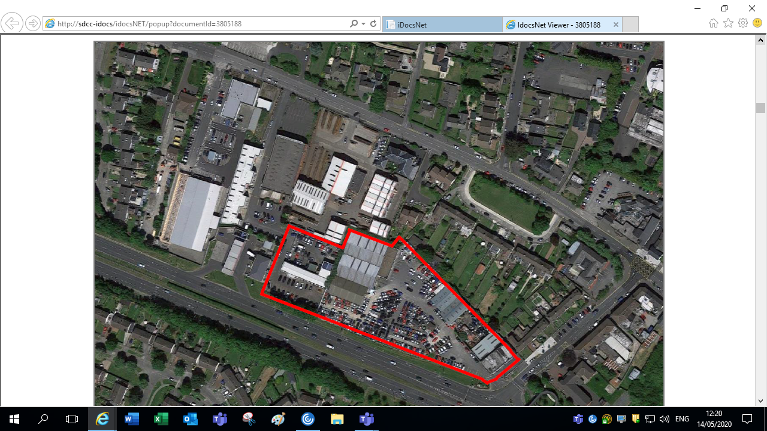
Timelines
SHD Lodged with ABP on 21/04/2020.
5 Weeks* Observations
8 Wks SDCC* report due to ABP 20th July.
Decision due from ABP 16 weeks* after
application lodged with ABP.
*S.251A order extended the planning timeframes
during the COVID-19 emergency
Consultations
S.247 Pre-Planning meeting held with SDCC on 18th July 2019.
A Pre-Planning meeting was held on 11th December 2019 with An Bord Pleanala, the applicant and SDCC.

Slide 5
Site Context

Slide 6
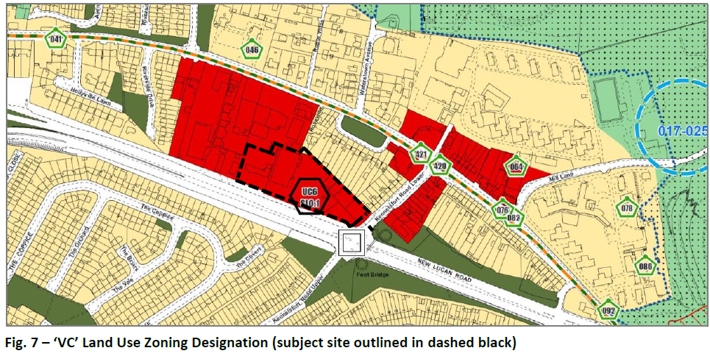
Site Zoning in South Dublin County Development Plan 2016-2022

Slide 7
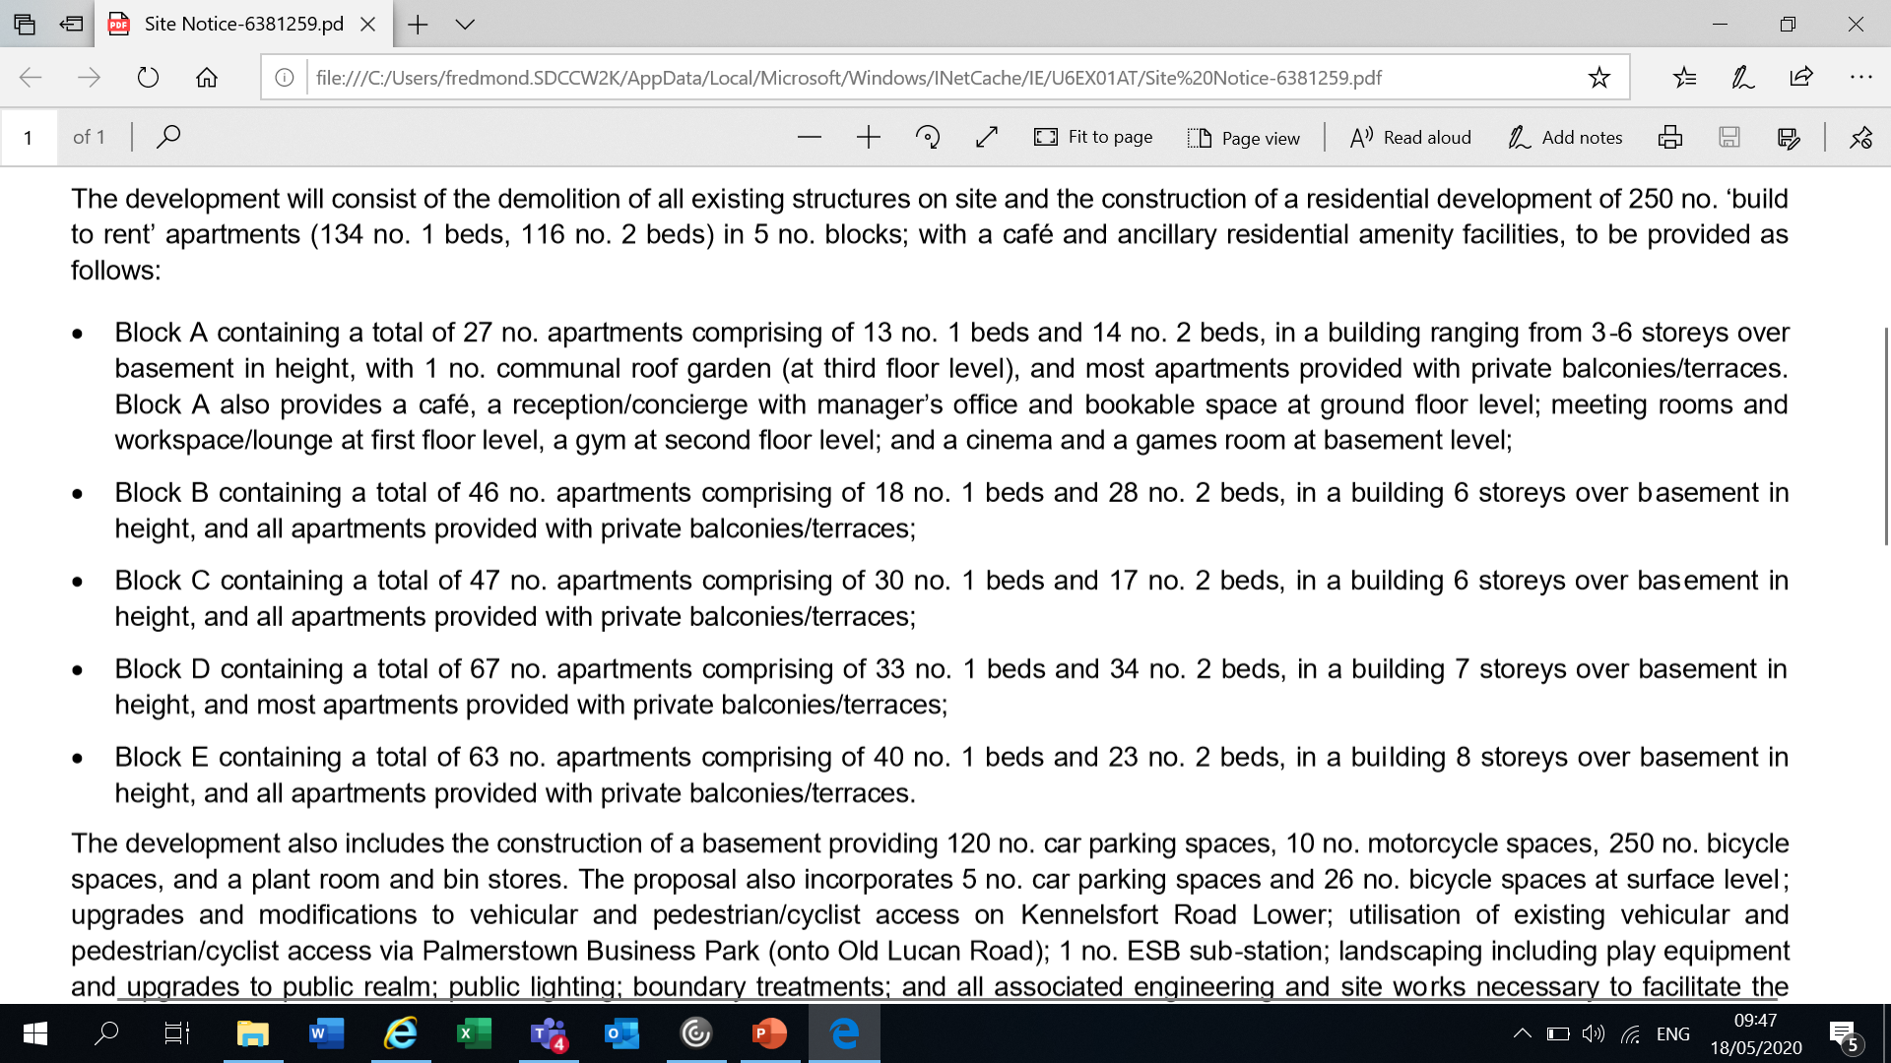
Proposed Development

Slide 8
Proposed Development (continued)

Slide 9
Key Development Statistics
Site Area: 1.2708 ha
No. of units: 250 (25 Part V)
Density units p. ha.: 197
Car Parking: 125
Bicycle Parking: 276
Dual Aspect 50%
Single Aspect: 50%

Slide 10
ABP Opinion – Summary of Items requiring clarification/ amendment
Item 1- Development Strategy
Further consideration/justification of the documents as they relate to:
- Alignment, massing, scale and articulation of blocks when viewed along the R148. Design strategy to provide for optimal architectural response to the site and to have regard to Urban Design Manual. Design depths and disposition of blocks, particularly Block A. Block C in terms of impact on residential properties to the north and interface with public open space. Quality of proposed open space and public realm. Landscaping proposals, finishes etc.
The further consideration of these issues may require an amendment to the documents and/or design proposals submitted.
Item 2 – Residential Amenity
Further consideration/justification of the documents as they relate to:
- Extent of dual aspect, sunlight and daylight in apartments, residential amenities of properties to the north, quality and location of residential support facilities.

Slide 11
ABP Opinion cont’d
Item 3 – Pedestrian/ Cycle Permeability and Car Parking
Further consideration/justification of the documents as they relate to:
- Quality of public realm, future pedestrian and cyclist connections through to the Lucan Road. Clarity on upgrade works to the right of way. Extent of car parking. Justification for through route.
Item 4 – Drainage
Further consideration/justification of the documents as they relate to:
- Assessment of surface water attenuation volumes, site specific soil tests, SuDS design etc.

Slide 12
Summary of Specific Information to be submitted with the application:
1- Impact on Residential Amenity of existing residents – including analysis of daylight, overshadowing and overlooking.
2- Architectural Report accompanied by photomontages.
3- Phasing Plan.
4- A site layout plan indicating what areas, if any, are to be taken in charge by the planning authority.
5- Materials and finishes.
6- Landscaping masterplan
7- Resident Support Facilities- report required on support facilities, resident service and amenity areas.

Slide 13
Summary of Specific Information to be submitted with the application:
8- Management and Operation of BTR Scheme and Building Lifecycle Report.
9- Build to Rent Legal Agreement
10- Housing Quality Assessment
11- Childcare assessment - demand analysis and the likely demand for childcare places resulting from the proposed development, if any.
12- Quality Audit and Mobility Management Plan
13- Noise Impact Assessment
14- Operational Waste Management Plan.
15- Microclimate Study

Slide 14
MASTERPLAN: PROPOSED USES

Slide 15
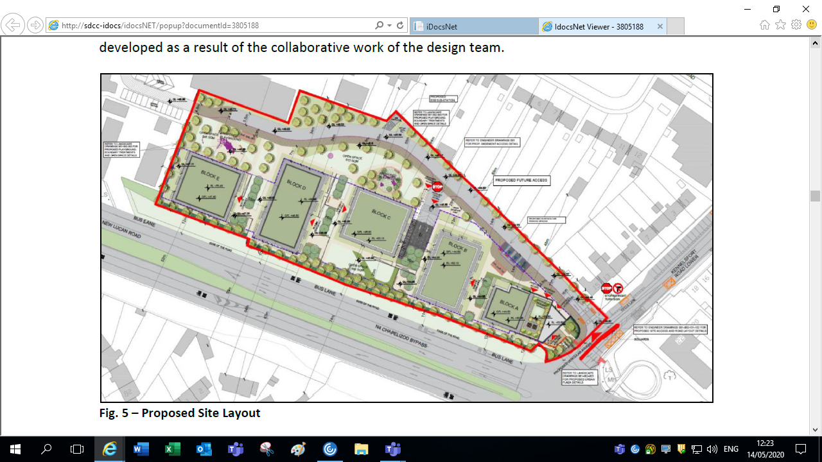
Proposed Site Plan

Slide 16
Open Space Areas

Slide 17
Proposed Heights

Slide 18
Photomontages
Cre

Slide 19
Cre

Slide 20
Cre

Slide 21
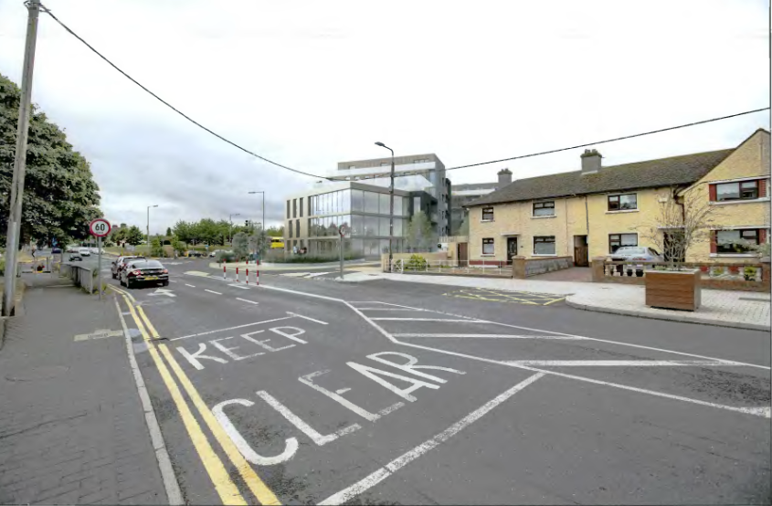
CGI Image
Cre

Slide 22
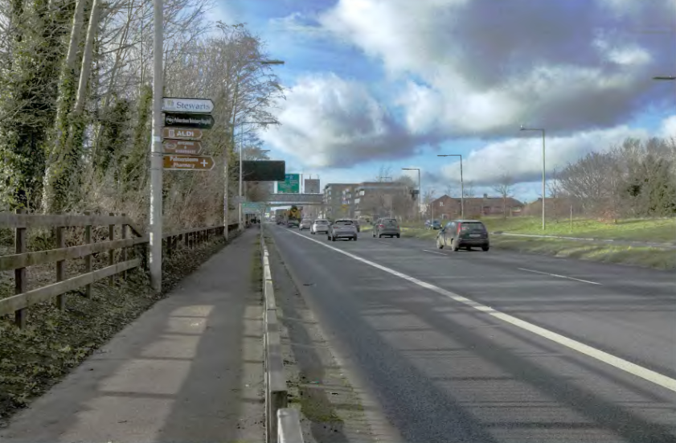
Cre
CGI Image

Slide 23
Cre
CGI Image

Slide 24
Cre
CGI Image

Slide 25
CGI Image
Cre

Slide 26
Thank You
Comments

Slide 27
Site Notice
Cre

Slide 28
Site Notice
Cre

