Slide 1
Update on Waste Management Plan / WERLA Priorities
Damien McNulty (Senior Executive Engineer)
May 2020 Environment, Public Realm and Climate Change SPC Meeting

Slide 2
Waste Management Plan
Plan outlines the Environmental Inspections to be carried for 2020.
Waste – Litter – Water – Air – Noise
It addresses the Regional Waste Management Plan priorities.
Addresses SDCC specific needs.
Identifies Statutory Inspections.
Plan and its outcomes graded by the EPA.

Slide 3
Waste Inspections
51 Permitted Waste Facilities & 114 Authroised Waste Collectors
Inspections of facilities handling Hazardous Waste
Garages, Labs, Vets, Nursing Homes, Dentists
Construction & Demolition Waste Activities
Household Waste Surveys and Household Waste Complaints
Illegal Waste and Dumping Activities
Producer Responsibility Inspections.
460 Major Producers of Packaging, 142 Tyre Retailers, 50+ Secondhand Car Importers

Slide 4
National / WERLA Priorities
Illegal Waste Activities
Illegal Dumping – Illegal waste collections (Man in the Van) – Waste Bye-Laws
Construction & Demolition Waste
Traceability of waste (Sites of Origin-Waste Collectors-Disposal sites)
End of Life Vehicles
Examining Authorised Treatment Facilities and identify rouge operators.
Waste Collections – Household & Commercial
Waste Collector Compliance – Brown Bin Role out – Waste Bye Law compliance
Multi Agency Sites of Interest

Slide 5
Impact of Covid 19
Waste Permitted Facilities
Majority closed from 13th March until 18th May.
Increased quantities of waste held on sites.
Contractors involved in emergency construction works experienced difficulties in disposing of waste.
Unauthorised storage of ELV’s due to closure of ATF’s.
Increased pressure of certain sectors remaining open to meet demand.
Household Waste/Back Garden Complaints Increased
130% increase in Household Waste/Back Garden burning complaints in April 2020 compared to April 2019
Increased incidents of Illegal dumping.
Increased levels of household waste being dumped.
Comparing March/April 2020 to 2019 increase of 280 tonnes of waste collected by Public Realm Crews.

Slide 6
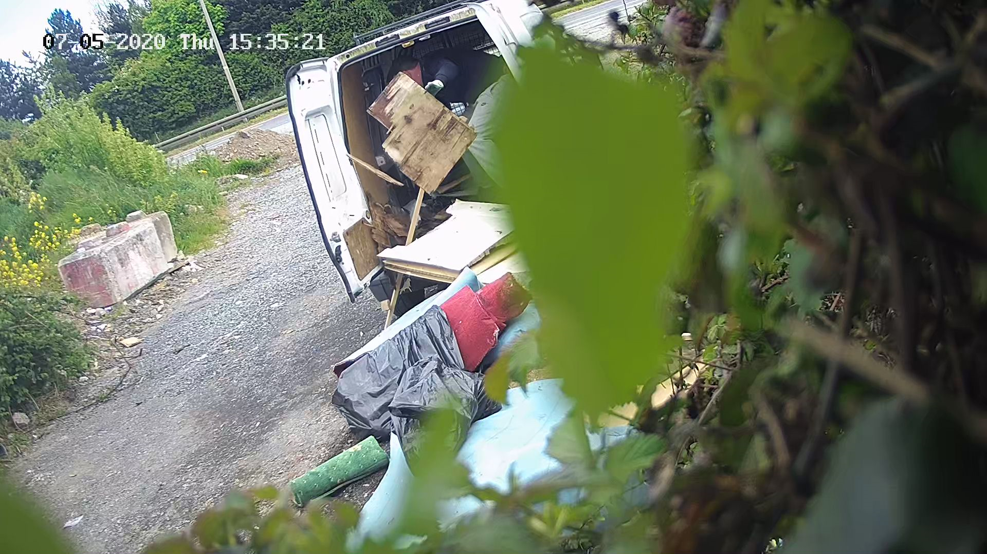
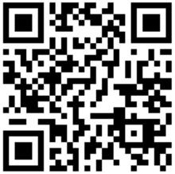
Current Actions
2020 Anti-Dumping Initiative
SDCC requested to submit projects & include issues experienced with Covid 19.
4 Schemes approved to a total value of €86,000
Covert Surveillance of Dumping Sites
Sites identified based on established patterns of dumping. Since 8th April we have carried out surveillance of 5 waste black spots resulting in detection of 26 incidents of illegal dumping.
Litter Bins and Bring Bank Monitoring through QR Codes
SDCC will be installing QR Codes at Bring Banks and bins. Public will be able to scan the QR code to alert SDCC when bins are full/need attention. Bring Bank collectors notified immediately collection is required. Other customer friendly information being considered

Slide 7
Current Actions
2020 Anti-Dumping Initiative cont…
Pilot Bring Bank Upgrade/CCTV
Two existing Bring Banks will be identified for up grade works that will form the basis future development of Bring Banks in SDCC. Upgrades will look to improve aesthetics/accessibility and incorporate CCTV, audible warnings etc with the aim to improve public perception of the facility.
Reduce Litter & Dog Fouling in Public Parks
Paw Fall and Litter Surveys to be carried out 4 parks. The report will quantify the issue and highlight measures for improvements to be implemented.

Slide 8
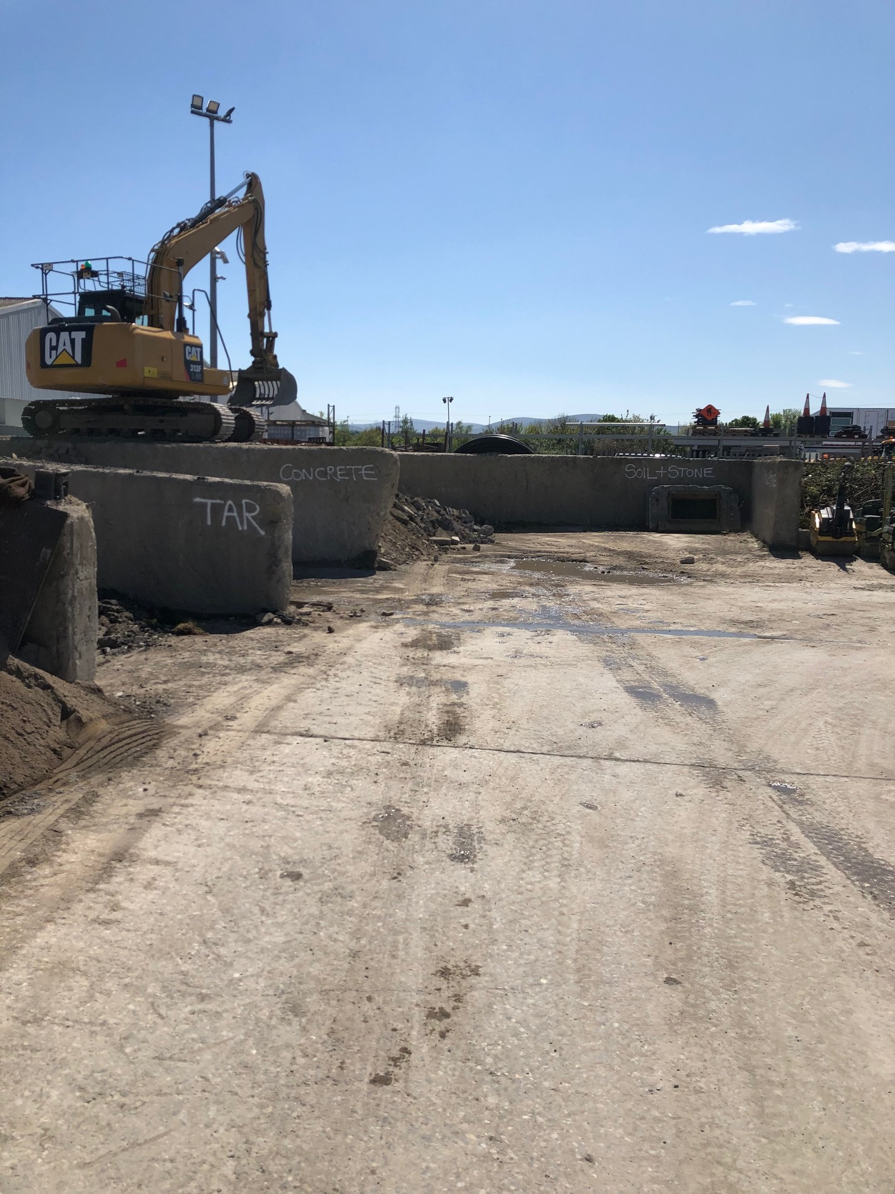
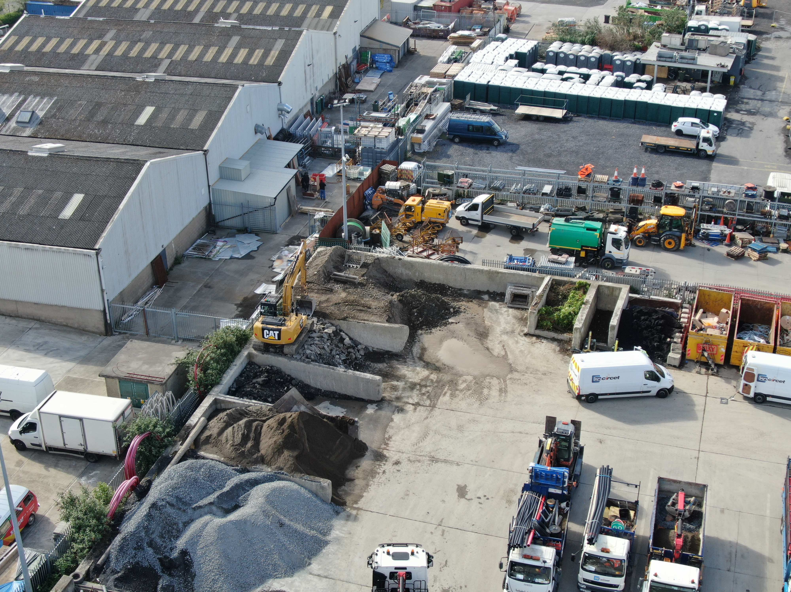
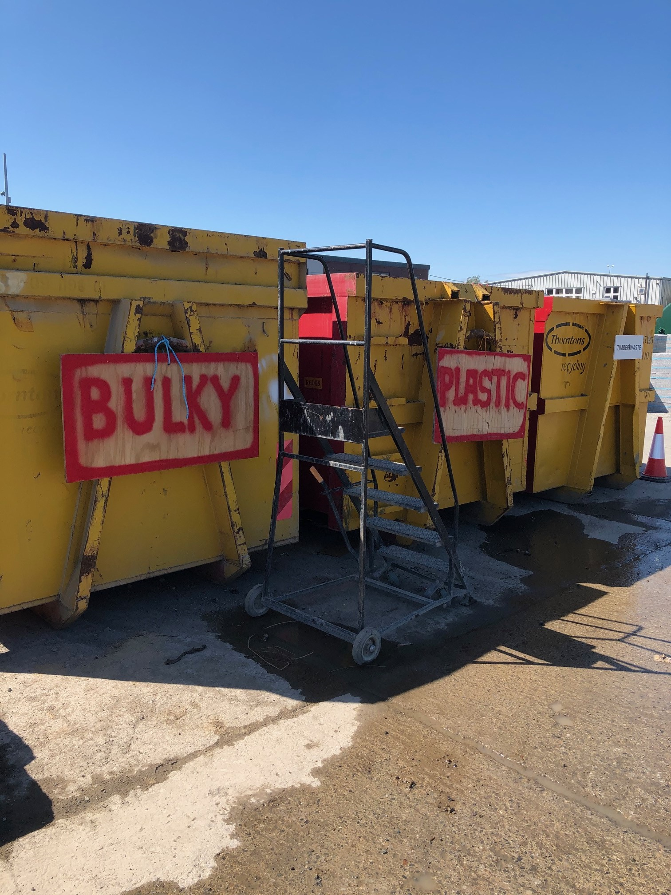
Current Actions
Remote Inspections

Slide 9
Thank you
May 2020 Environment, Public Realm and Climate Change SPC Meeting

