Slide 1
Litter Management Plan 2020-2022 Litter and Waste Enforcement update
Environment, Public Realm & Climate Change SPC
27th May 2020

Slide 2
Litter Management Plan 2020-2022
Objectives in the Plan to prevent and control litter through:
Management of the Public Realm
Communication, awareness and education
Litter and Waste Enforcement and Regulation

Slide 3
Litter & Waste Enforcement in the context of Covid 19
March and April 2020 compared to March and April 2019:
33% increase in volume of dumped material collected
13% less litter collected from litter bins
42% more collected from Bottle banks due to increased demand
Increase in complaints related to non disposal of household waste

Slide 4
Actions taken by Environment
Waste collection services throughout the county maintained
Increased Litter Warden patrols
Dumping removed by Public Realm crews
County wide surveillance to identify illegal dumpers
Increased collections from bottle banks

Slide 5
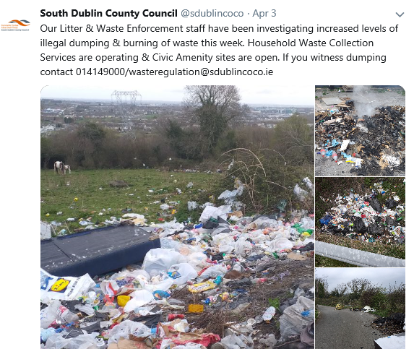
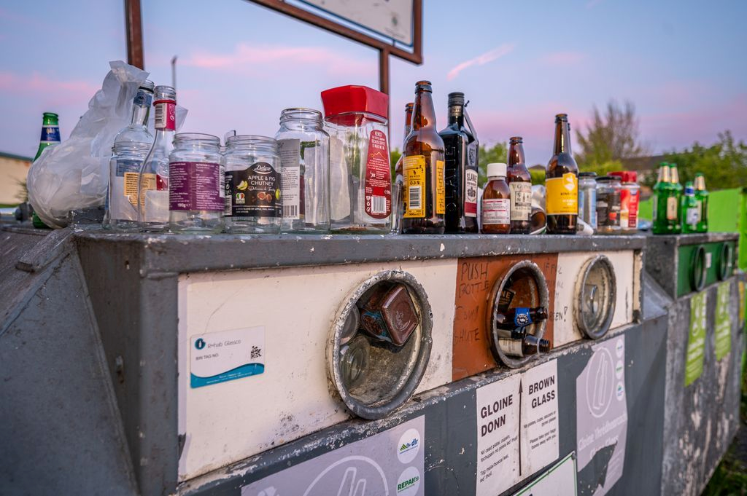
Social Media Campaigns

Slide 6
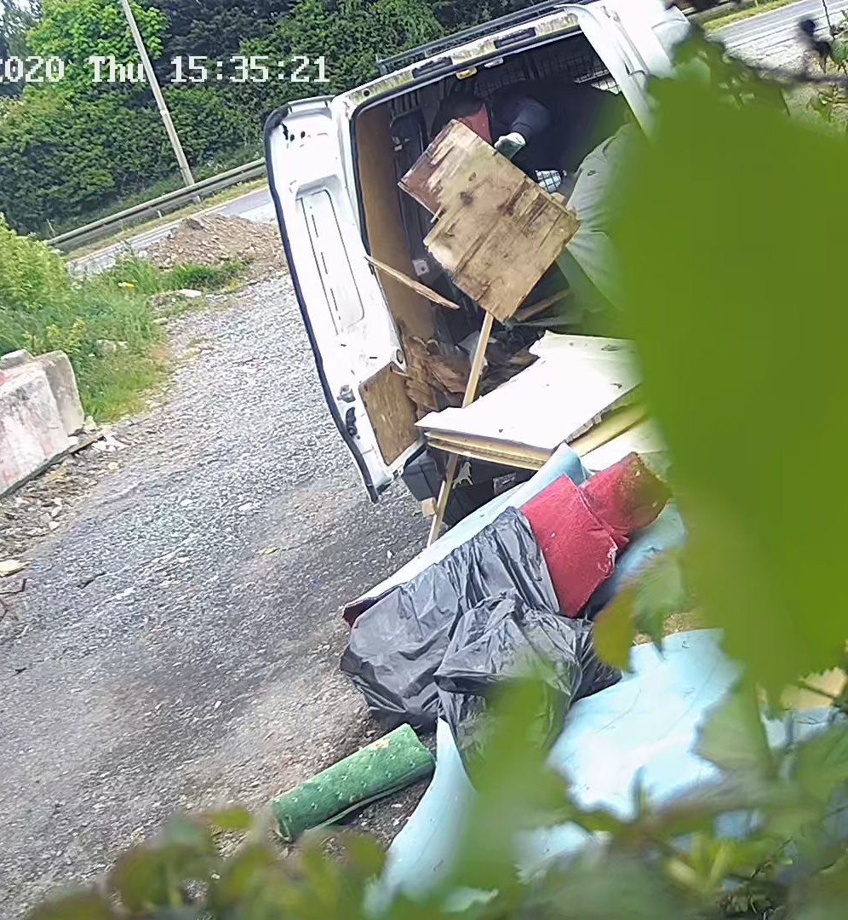
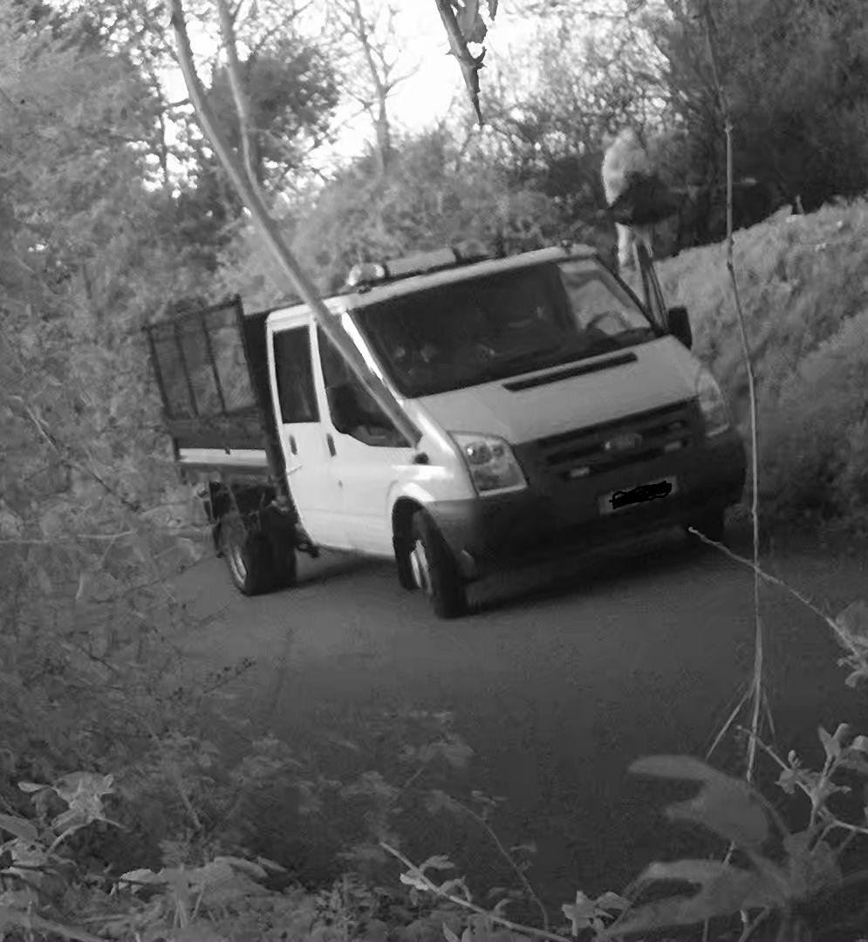

Slide 7
