Slide 1


South Dublin County Council
Climate Action
Innovation Fund 2019/2020

Slide 2
2019 Climate Innovation Fund
€250,000 budget approved
12 Applications for funding

Slide 3
Appraisal
Establish a strong link with at least one of the 130 CCAP actions.
Fully developed and ready to proceed.
Preliminary cost estimate had to have been carried out.
SDCC procurement rules had to be accepted.
Alternative funding streams or partial funding to be considered.
Innovative projects that adopted new technology were favoured.
Proposals benefitting communities including citizen engagement.
Value for money and equivalent payback period established.

Slide 4

ECO Driver Training
Cost - €2,400
Status – Complete
Related CCAP Action : T1 – Implement Transport Energy Management System
Improved driver performance
Average fuel savings of 8%
Fuel Efficient Drivers = Safer Drivers = Good Risk Management
Counteract the cost of rising fuel prices
Reduce running costs and emissions

Slide 5
Kiltipper Park EV Charging Infrastructure
Cost - €10,000
Status – Complete
Related CCAP Action : T21 – Expand the availability of EV and other facilities for non-fossil fuel powered vehicle charging points in the County

Slide 6
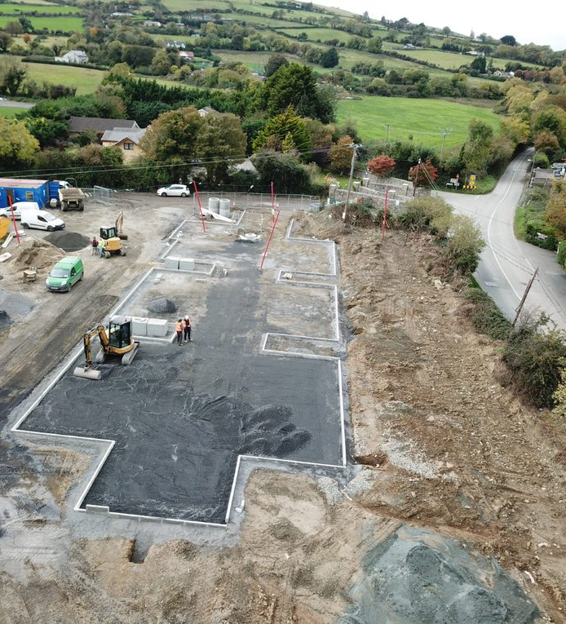
SuDS at Kiltipper Park
Cost - €57,635.87
Status - Complete
Related CCAP Action : F6 Implement and demonstrate SuDS guidelines in own buildings SDZs and LAPs

Slide 7
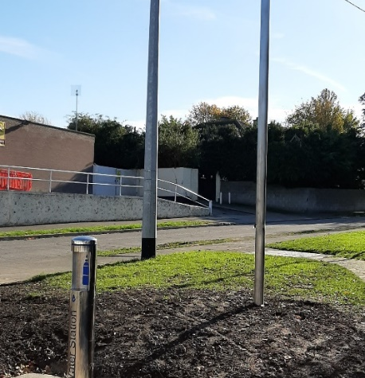
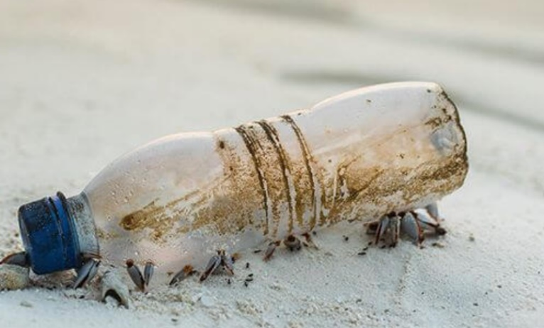
Potable Water Stations
Cost - €59,152.29
Status – 90% Complete
Related CCAP Action : R21 Identify pilot locations for water access points

Slide 8
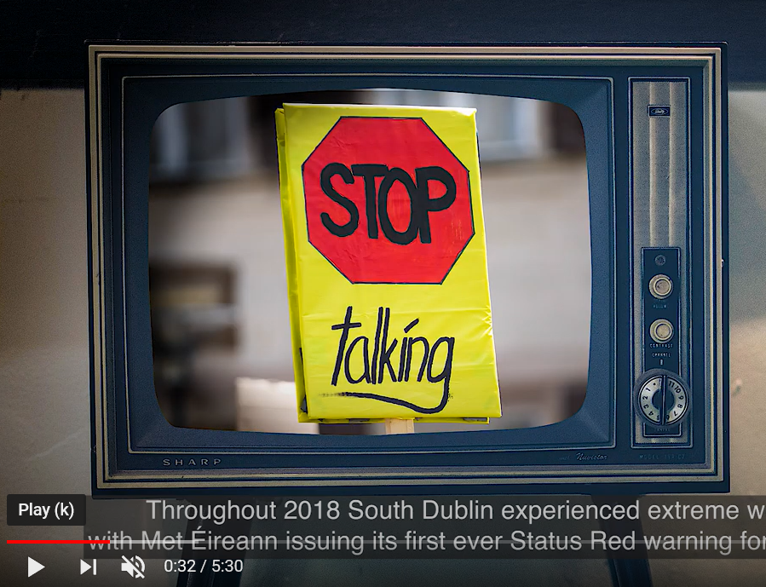

CCAP Promotional Video
Cost - €6,826.50
Status - Complete
Related CCAP Action : E3 – Prepare South Dublin Sustainable Energy and Climate Action Plan
https://youtu.be/RAqwDULMTU0

Slide 9
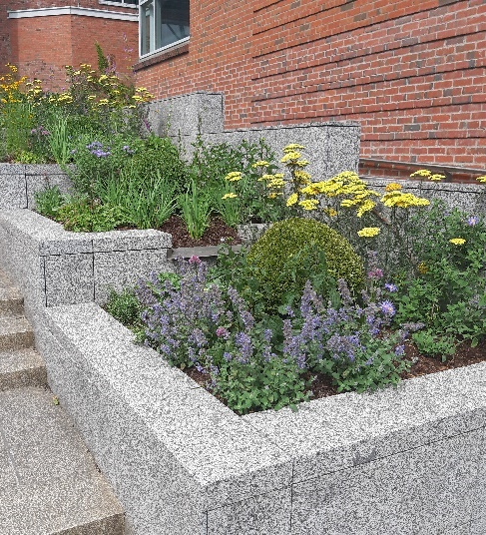
Pollinator Planters
Cost - €1,425.00
Status - Complete
Related CCAP Action : N25 Manage and monitor identified ‘pollinator protection sites’

Slide 10

Climate Action Community Workshops
Cost - €3,690
Status – Incomplete (3 out of 5 completed, 2 outstanding due to Covid-19)
Related CCAP Action : R18 Support and promote Tidy Town initiatives in County

Slide 11

2019 Climate Action Project Proposals awaiting funding support

Slide 12
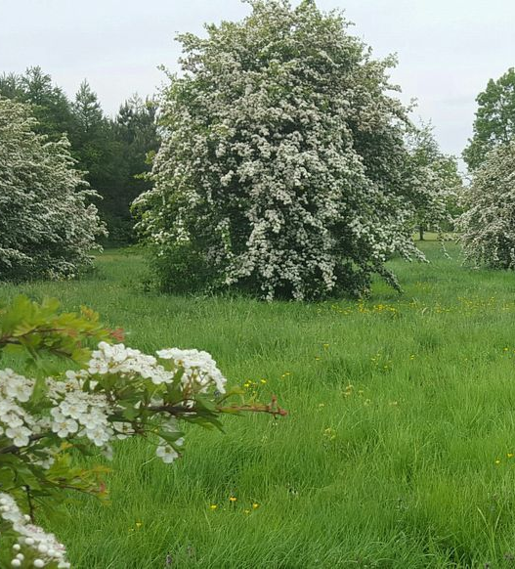
Rehabilitation of Rural Hedgerows
Cost - €73,146.55
Status – For Consideration 2020
Related CCAP Action : N14 Increase tree canopy cover in the County through annual planting and maintenance

Slide 13
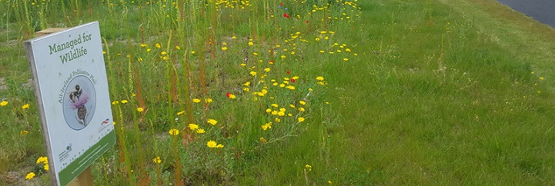
Roadside Pollinator Planting
Cost - €50,000
Status – For consideration 2020
Related CCAP Action : N25 Manage and monitor identified ‘pollinator protection sites’

Slide 14
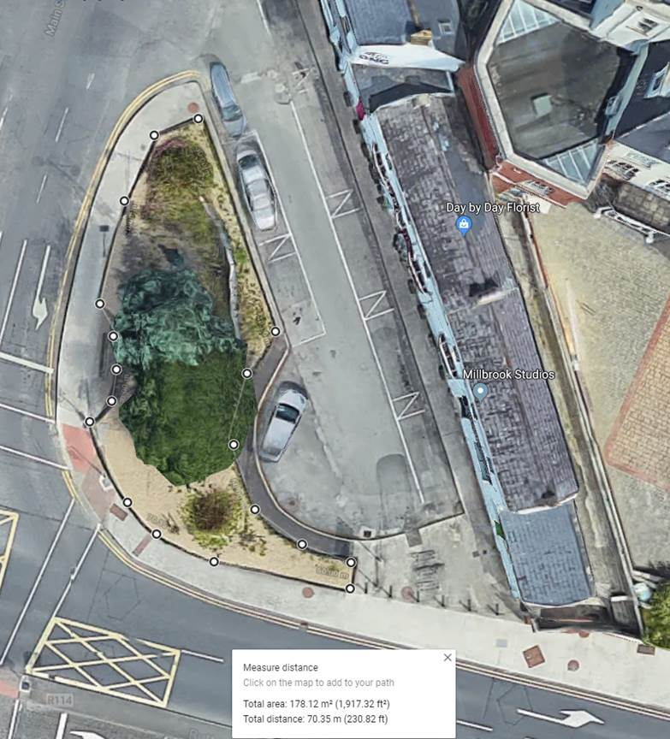
Pollinator Perennials
Cost - €18,000
Status – For Consideration 2020
Related CCAP Action : N24 Incorporate actions from the notional pollinator plan into Green Infrastructure Strategy

Slide 15
EV Charging Tandy’s Lane, Adamstown
Cost - €32,205.60
Status – For Consideration 2020
Related CCAP Action : T21 – Expand the availability of EV and other facilities for non-fossil fuel powered vehicle charging points in the County

Slide 16
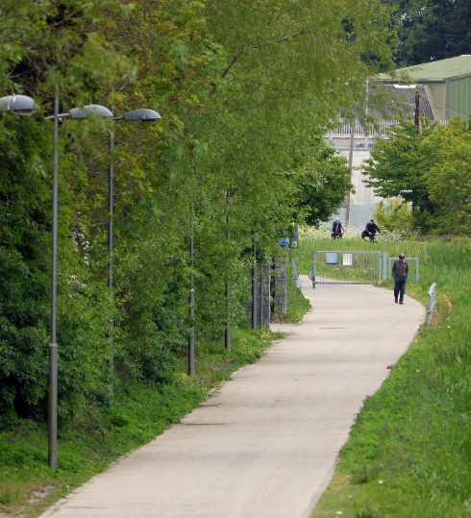
Grand Canal LED Upgrade
Cost - €50,000 (To be re-evaluated)
Status – For consideration 2020
Related CCAP Action : E17 Replace 4,000 SOX lamps with LEDs

Slide 17
Climate Innovation Fund 2020
€300,000 budget approved
€130,000 Electric Vehicle Infrastructure
€10,000 Regional EV Strategy
€20,000 Electric Staff Pool Car & Bikes
€20,000 Citizen Engagement Workshops
€20,000 Electric Cargo Bicycles
€10,000 Sustainable Business Projects
€10,000 Climate & Biodiversity SM Video
€25,000 Pollinator Community Project
€25,000 Primary School Cycle Projects

Slide 18
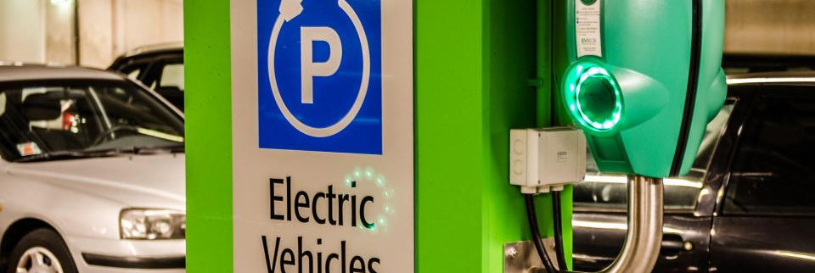
Regional EV Charging Strategy
Cost €10,000
Status – In progress
Related CCAP Action : T7 – The Council will undertake an assessment of the number of existing and potential future electric vehicle charge points in its jurisdiction

Slide 19

Countywide EV Charging Points
Expected Cost - €130,000
Status – Awaiting report
Related CCAP Action : T21 – Expand the availability of EV and other facilities for non-fossil fuel powered vehicle charging points in the County

Slide 20
SDCC Staff EV Pool Car
Expected Cost - €20,000
Status – Under consideration
Related CCAP Action : T15 – SDCC will continue to seek new and expand on existing partnerships to encourage sustainable travel and safer travel behaviours

Slide 21
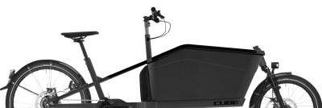
Electric Cargo Bicycles
Expected Cost - €20,000
Status – Under consideration
Related CCAP Action : T2 – Ongoing replacement of Council vehicles with more energy efficient alternatives, including Evs

Slide 22
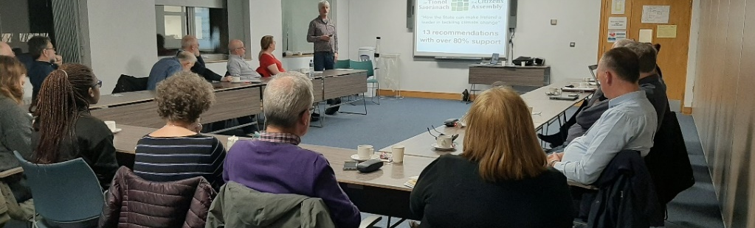
Citizen Engagement Workshops
Expected Cost - €20,000
Status – Under Consideration
Related CCAP Action : N27 Support local communities with biodiversity education

Slide 23
Climate & Biodiversity Social Media Video
Expected Cost - €10,000
Status – Under Consideration
Related CCAP Action : N6 Finalise draft Biodiversity Action Plan

Slide 24
Primary School Bicycle Parking
Expected Cost - €15,000
Status – Under Consideration
Related CCAP Action : T15 – SDCC will continue to seek new and expand on existing partnerships to encourage sustainable travel and safer travel behaviours

Slide 25
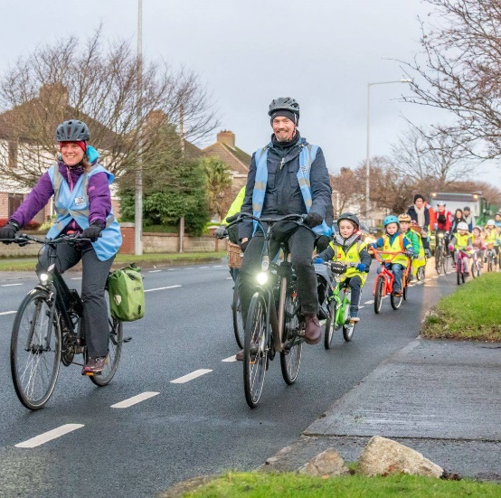
Cycle training – Train the trainer
Expected Cost - €10,000
Status – Under Consideration
Related CCAP Action : T19 – Cycle training programme for 6th class students

Slide 26
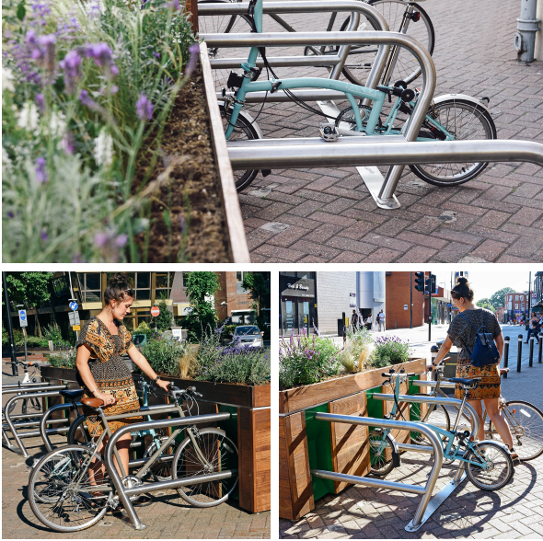
Pollinator Citizen Engagement Project
Expected Cost - €25,000
Status – Under Consideration
Related CCAP Action : N19 Provide opportunities for community engagement, involvement and activities to raise awareness

Slide 27
Sustainable Business Projects
Expected Cost - €20,000
Status – Under Consideration
Related CCAP Action : R27 – The Council will strengthen existing networks and create new climate change links to encourage all business community stakeholders to engage with climate change action and enhance existing projects and initiatives. Interests areas could include energy efficiency measures, renewable energy opportunities, climate adaptation and resilience measures, access to funding sources etc.

