Slide 1
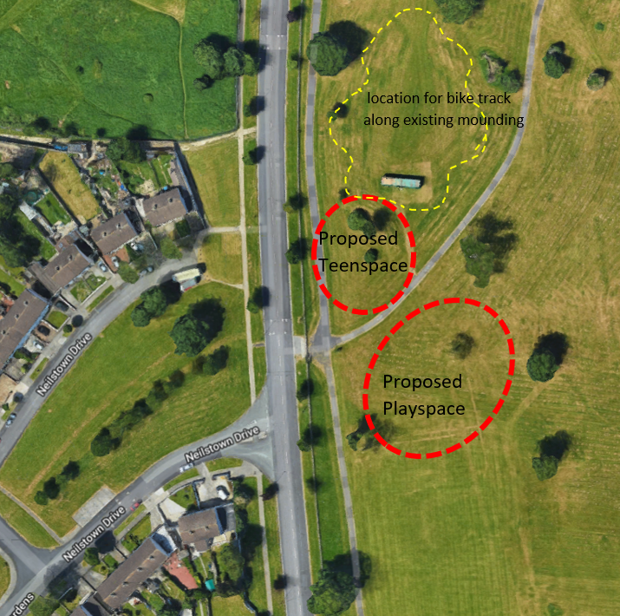
Collinstown ParK
Playground and Teenspace

Slide 2
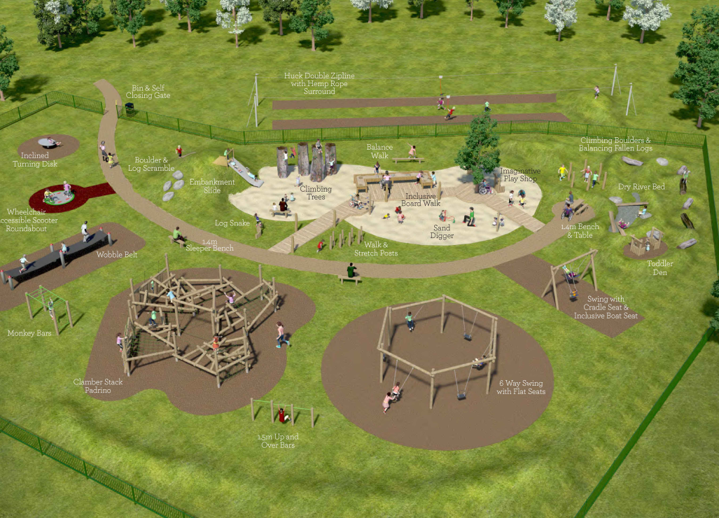
PLAYGROUND DESIGN

Slide 3
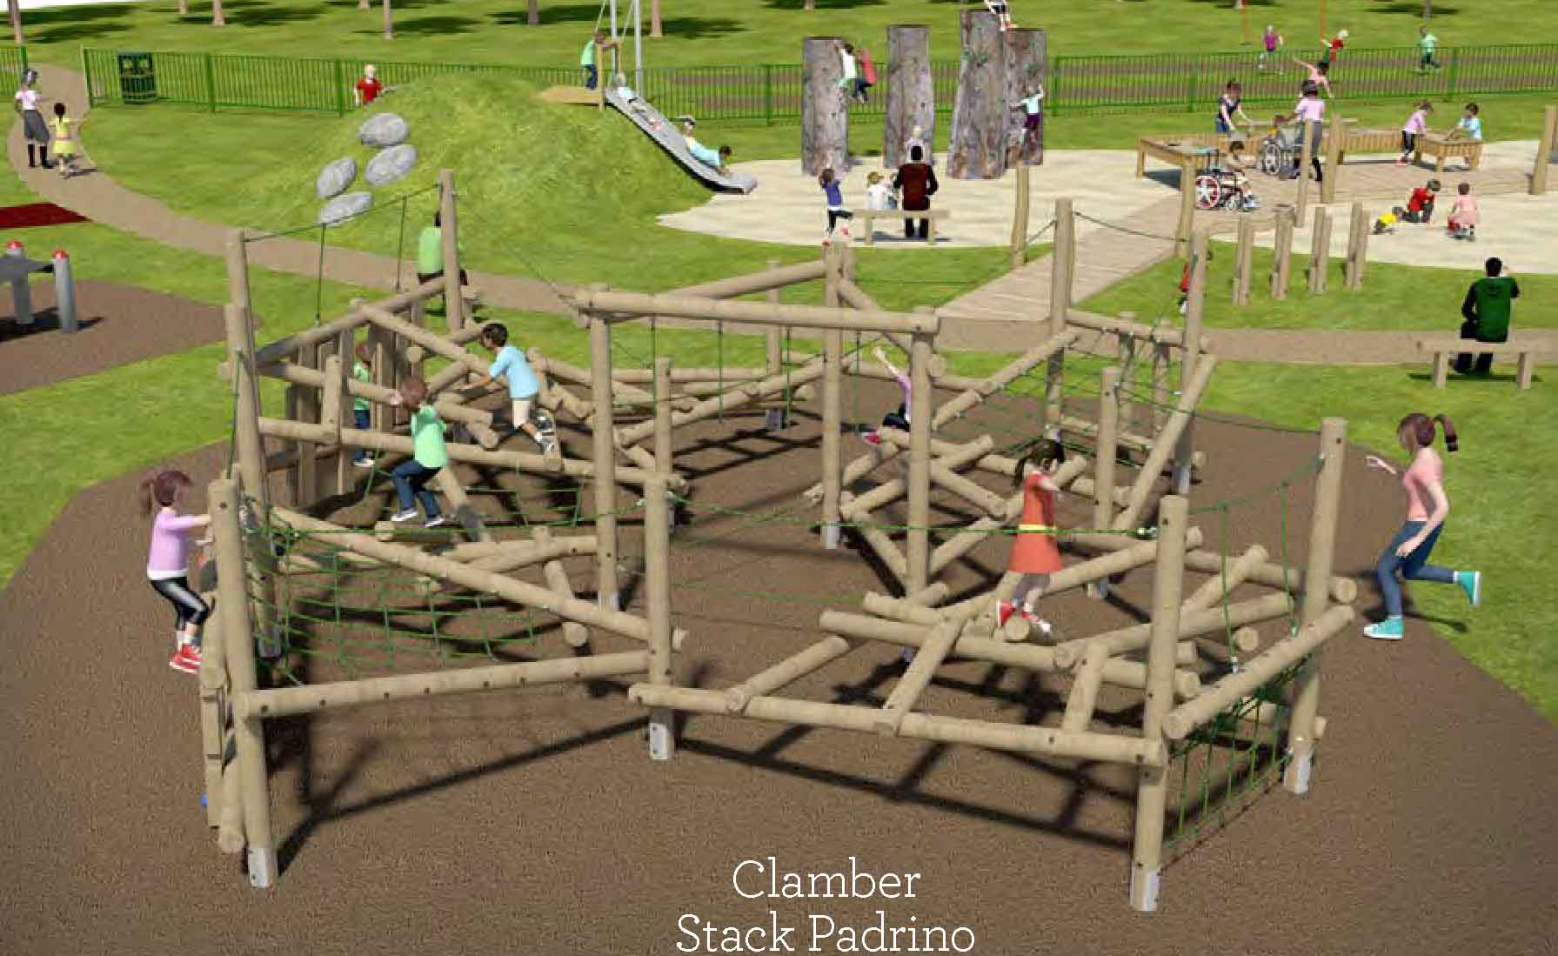

Slide 4
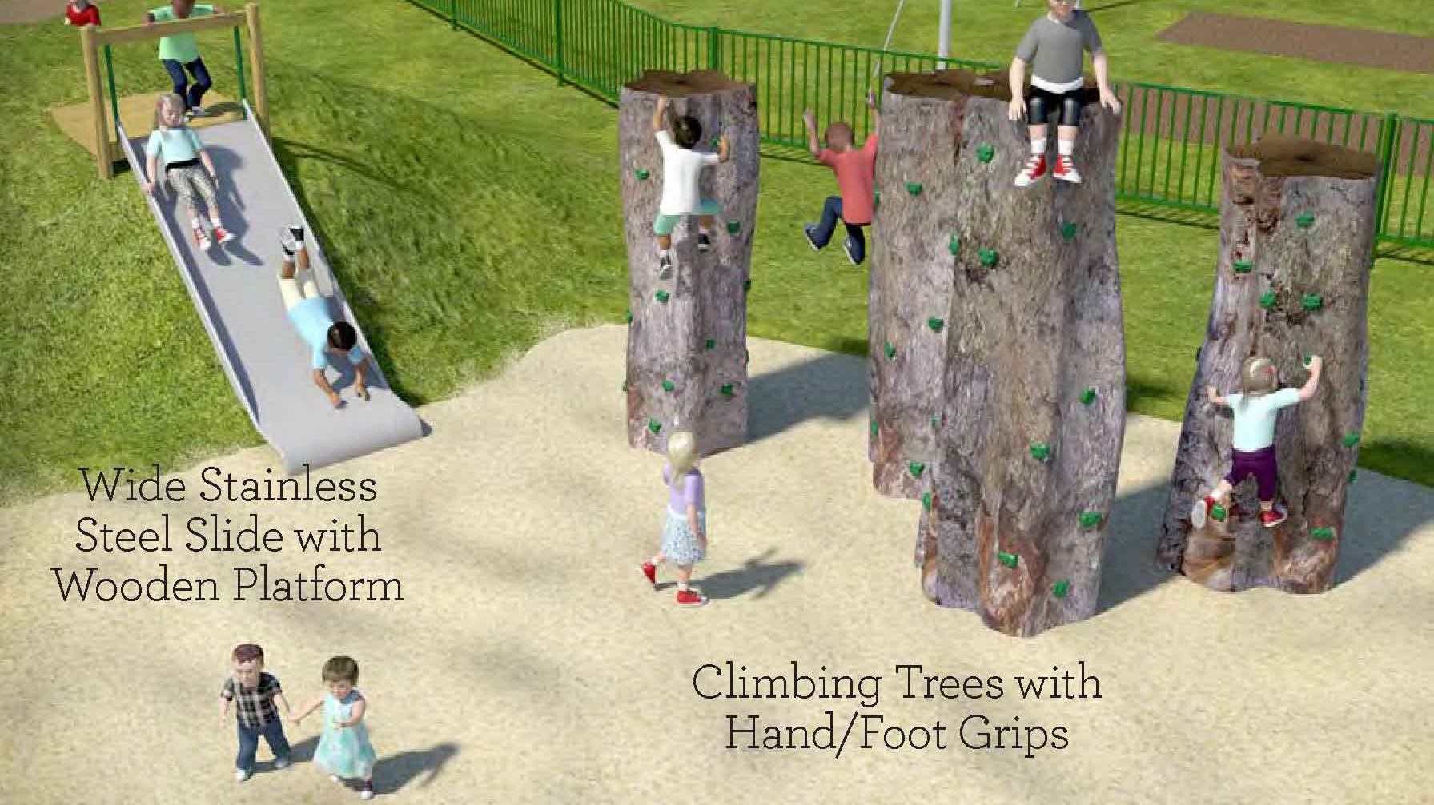

Slide 5
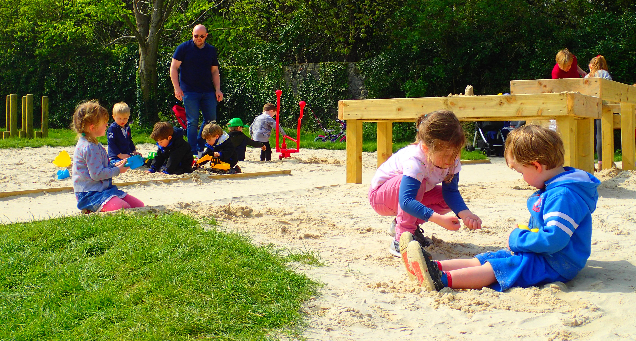
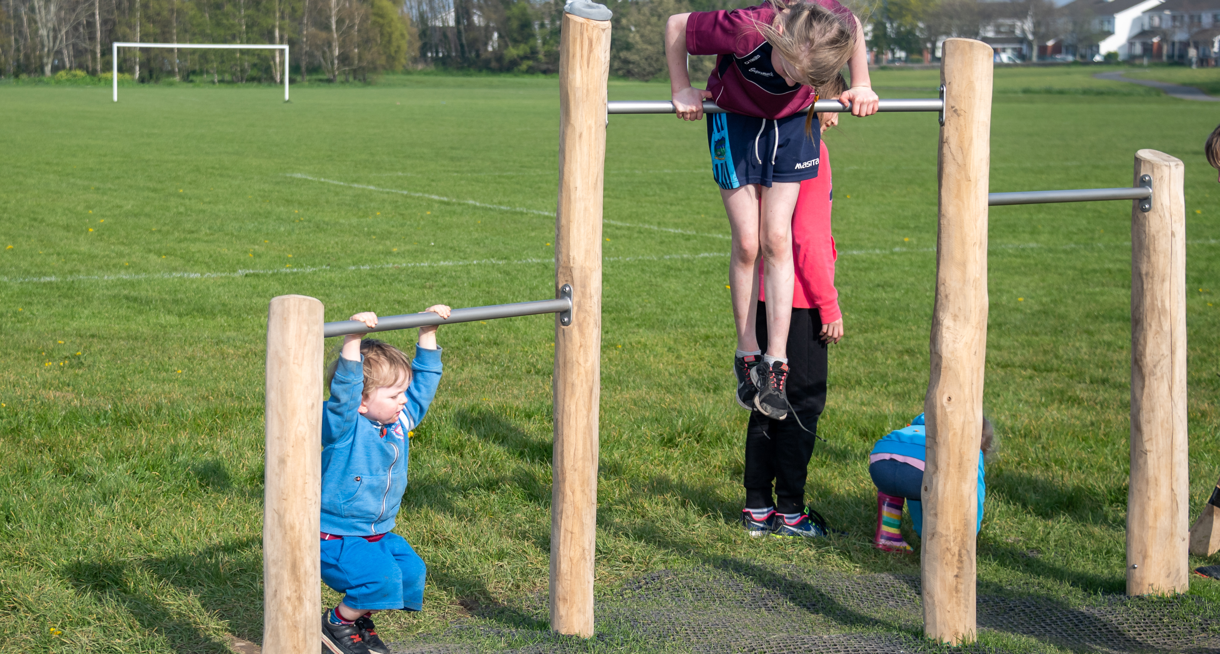
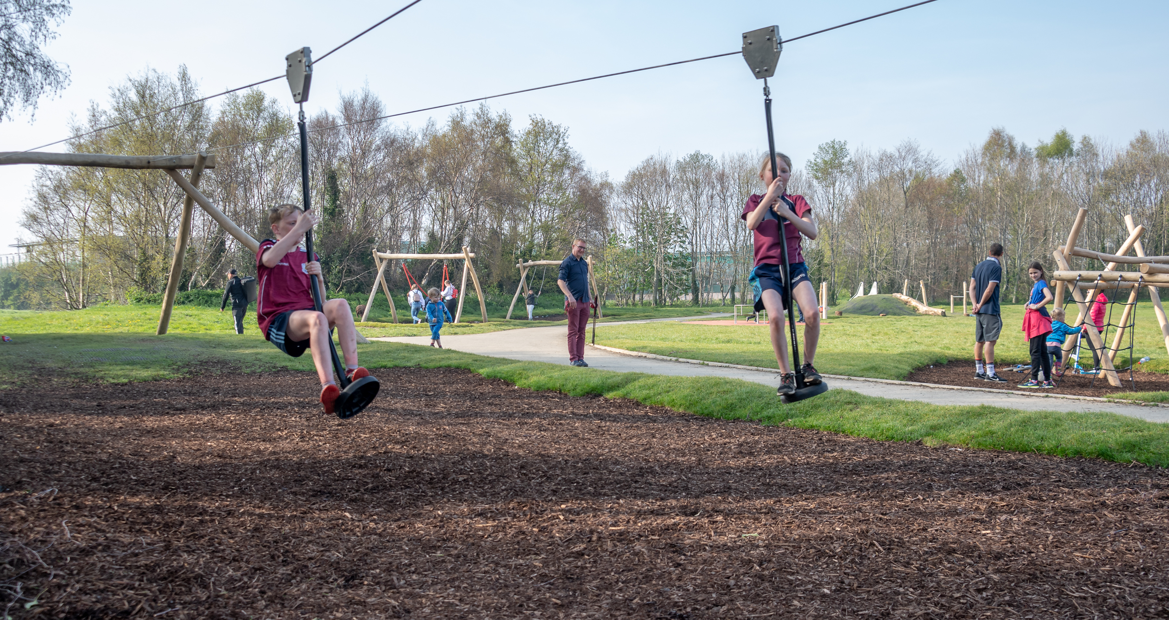
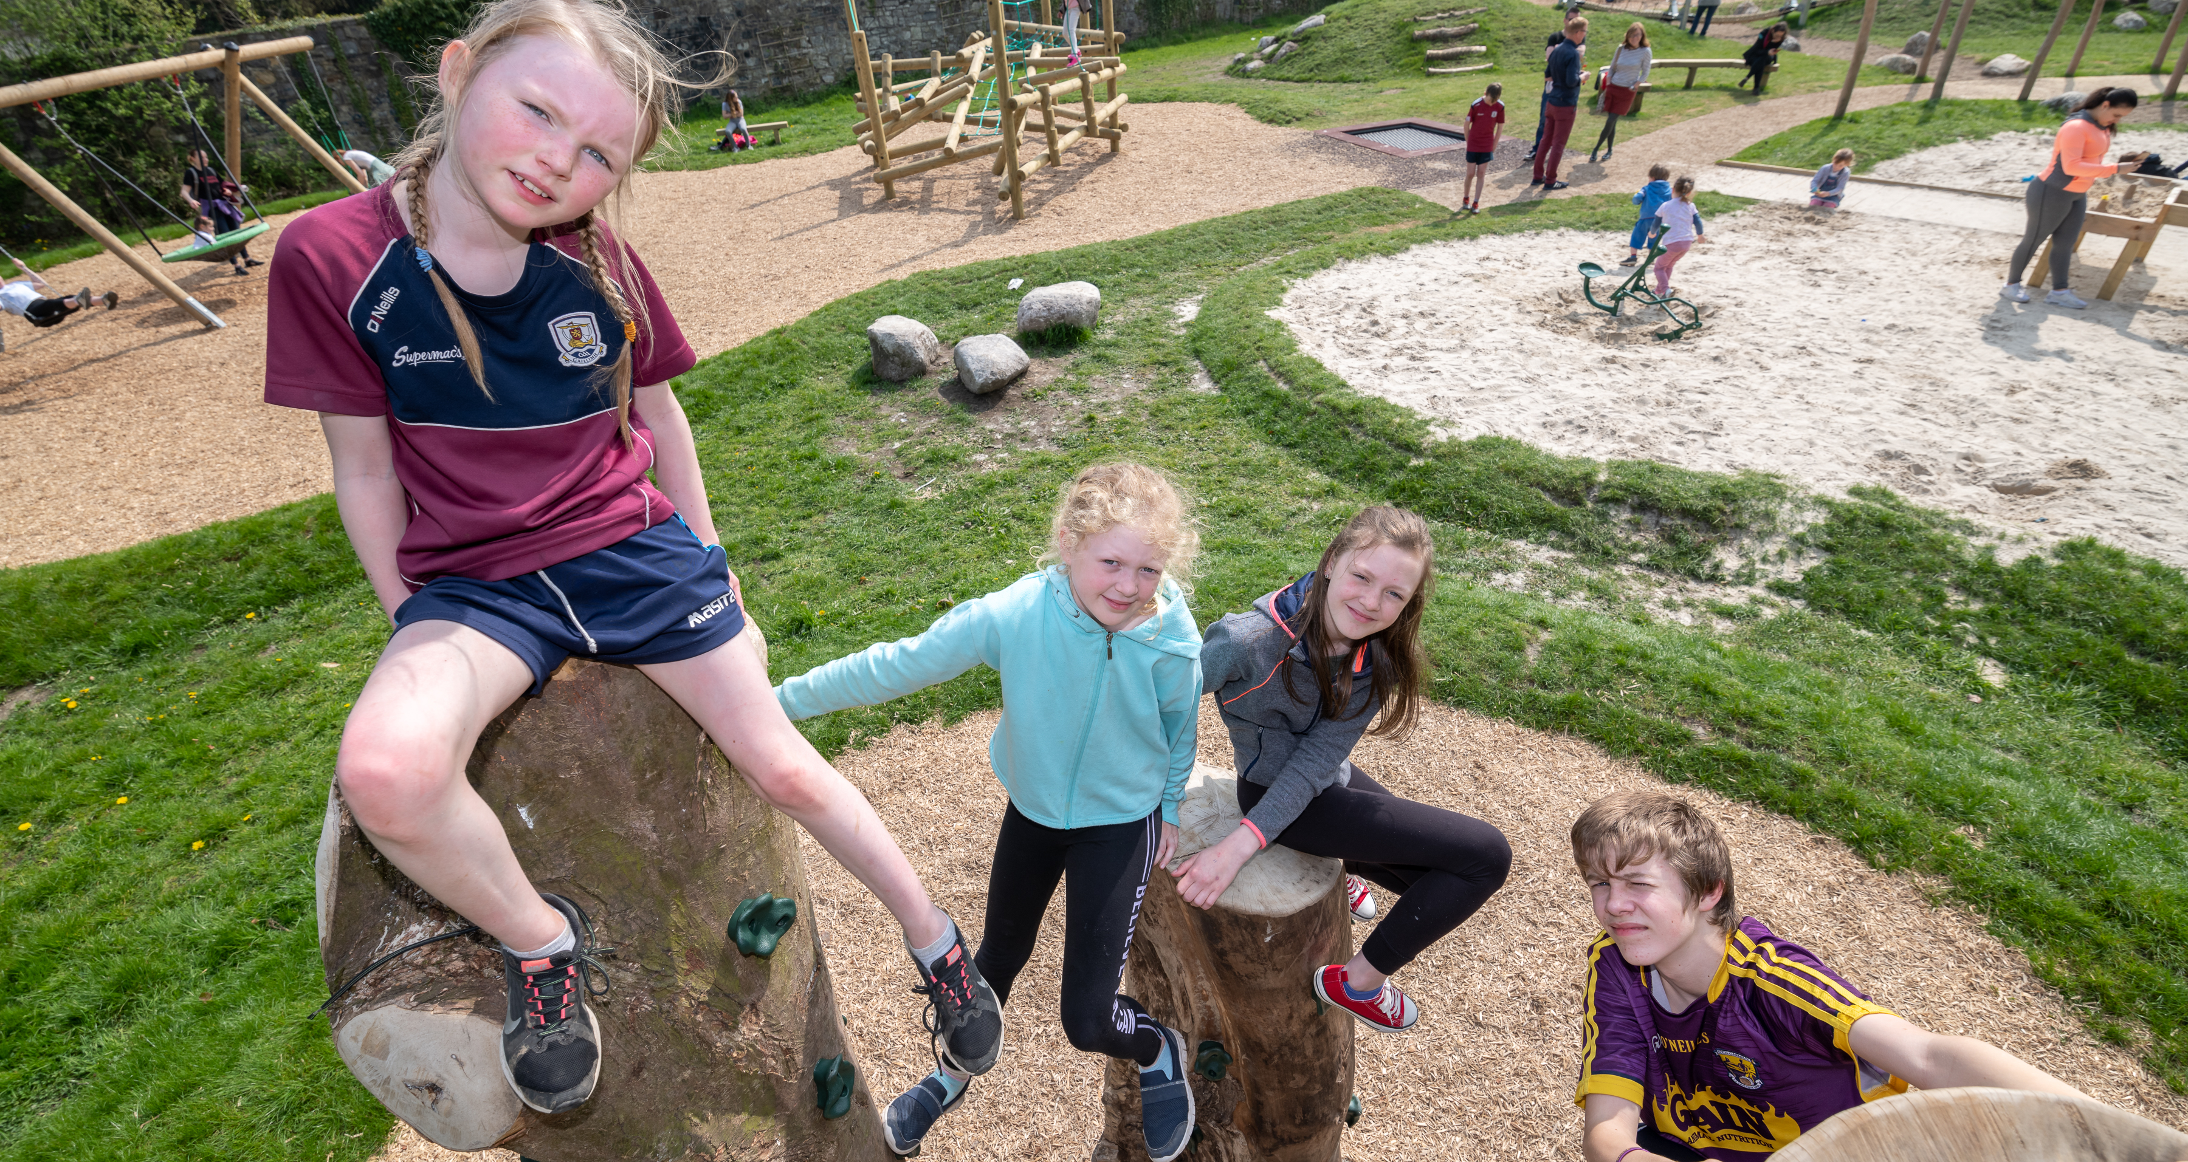

Slide 6
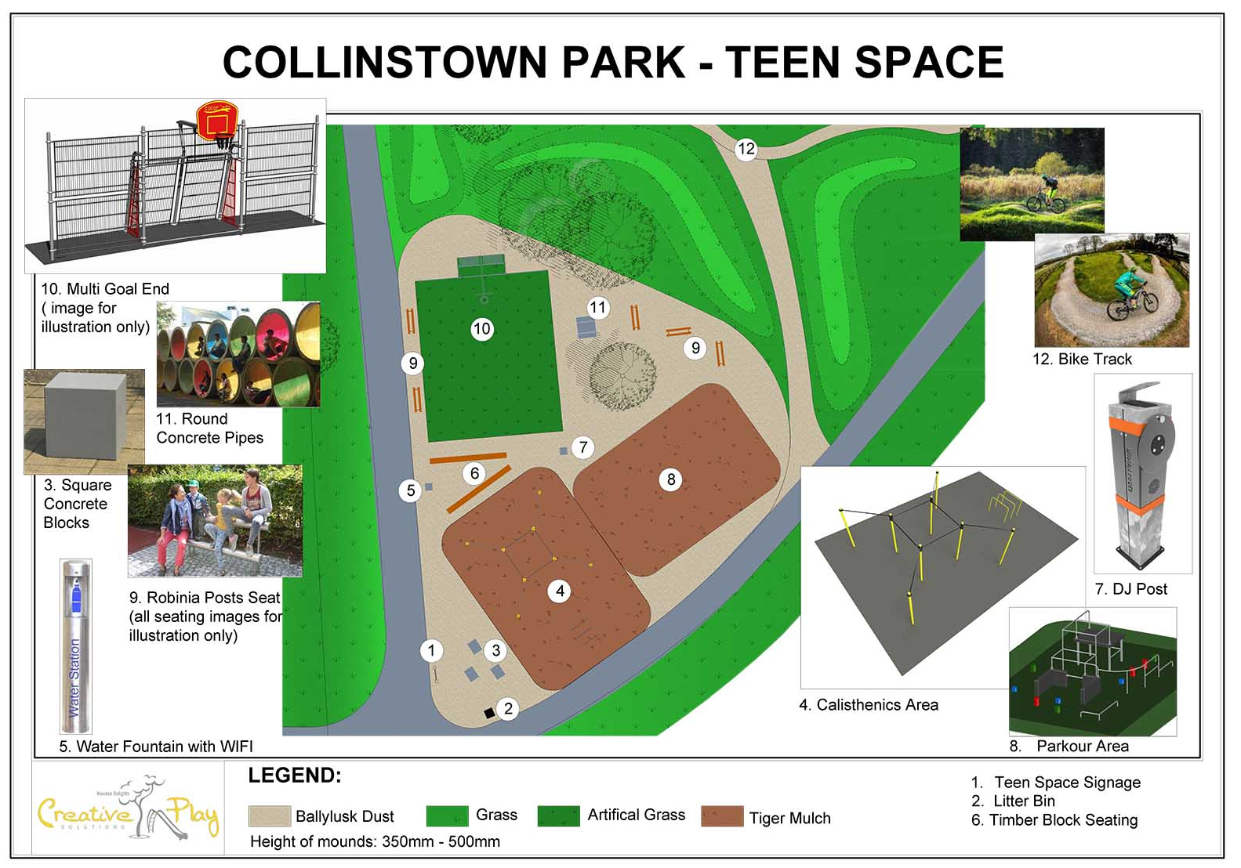

Slide 7
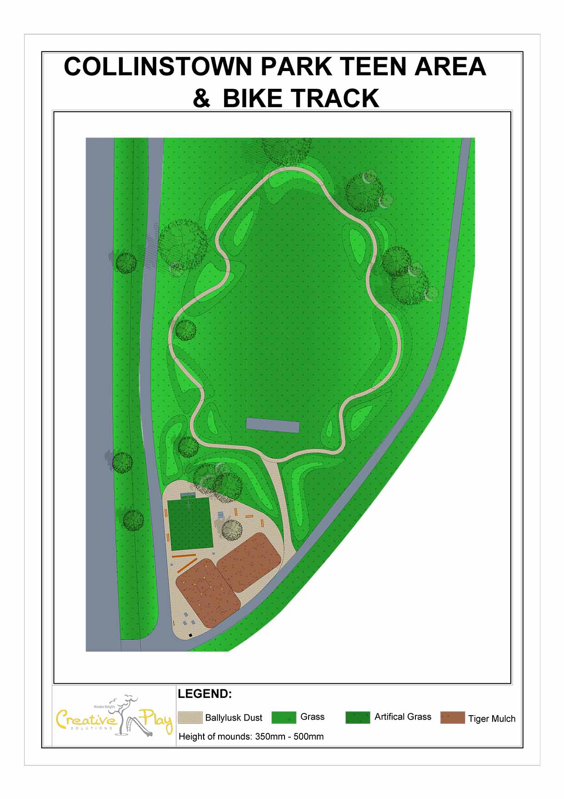
Teenspace Facilities
Parkour course. Parkour or free running is an activity or sport of moving rapidly through an area, negotiating obstacles by running, jumping, and climbing. It will consist of large concrete blocks spaced out at intervals as well as a network of metal bars.
There is also a Calisthenics area. Calisthenics involves gymnastic exercises designed to develop muscular tone and physical vigour. Users can scan the equipment with their smartphones to see videos and gain tips on how to use the equipment.
Cool Seating
Music Post
Water font for hydration.
Multi Use Games Area consisting of a goals and a basketball hoop
Looped mountain bike trail.

Slide 8
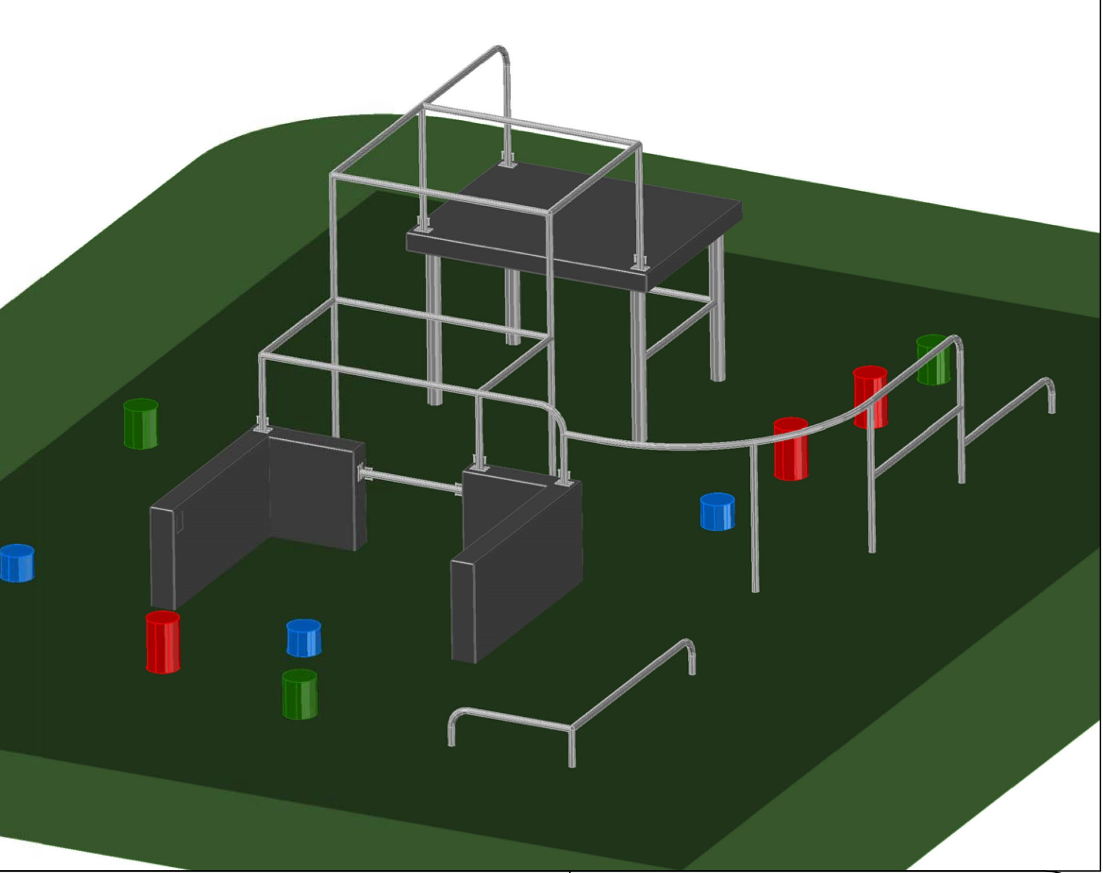
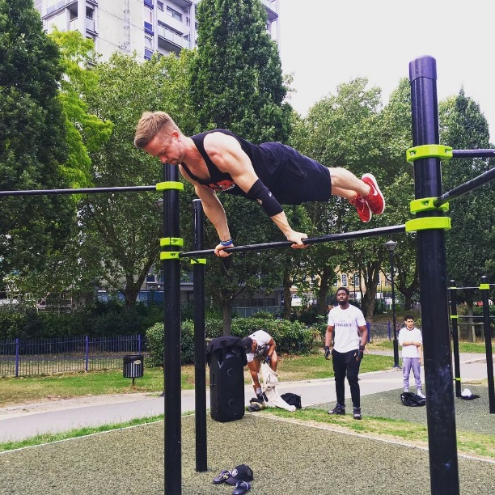
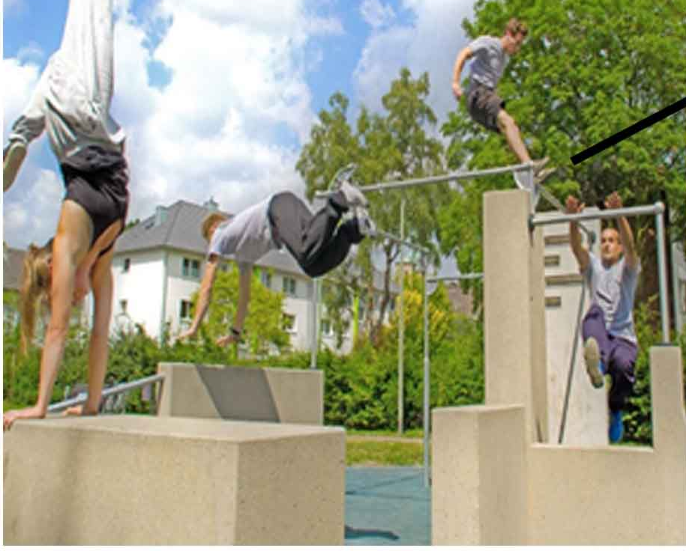

Slide 9
