Slide 1
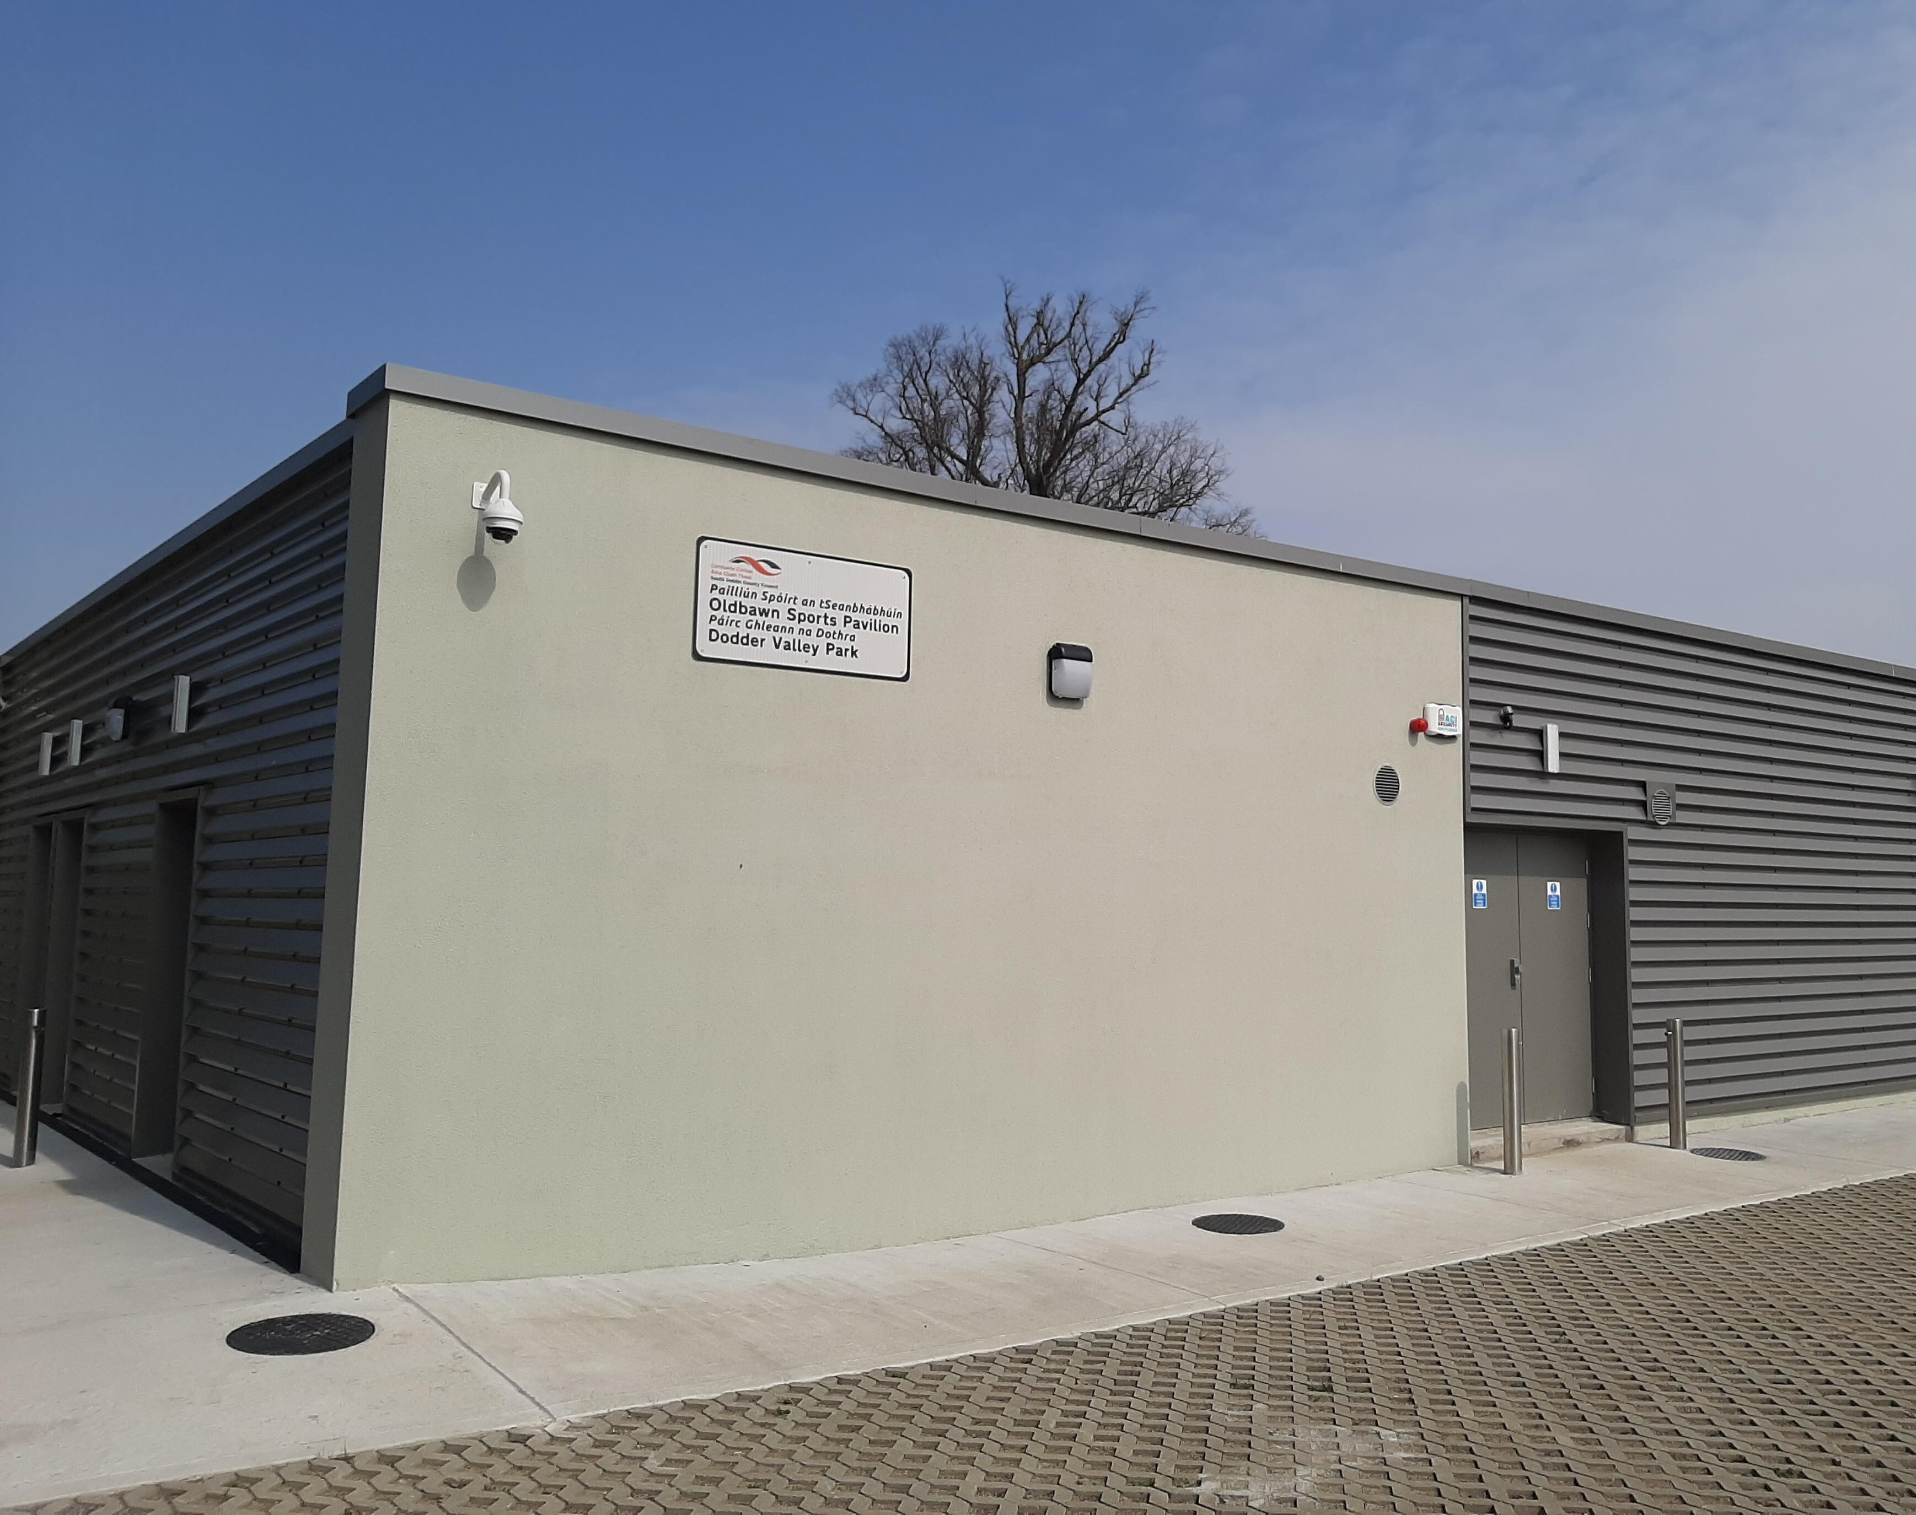
Pavilions & Pitch Allocation/Booking System
Environment, Public Realm & Climate Change SPC
27th May 2020

Slide 2
Background
South Dublin County Council is currently rolling out a Pavilion Programme to provide new changing and storage pavilions in various parks across the County. The first building is located in Dodder Valley Park at Old Bawn, Tallaght, Dublin 24.
In order to manage bookings, process payments and provide secure access to the pavilions a booking system that will integrate with the building access system is being developed. In line with this, a pitch allocation/booking system is being developed by Prodigy Sports Ltd t/a BookaPitch to stream the administration of this process and allows us to monitor the usage of the pitches, which will inform the maintenance programme and feed into the Council’s Sports Pitch Strategy.

Slide 3
Tender process
Consultations took place with the Councils ICT Department and it was decided that a bespoke system was required to link in with the construction of the first pavilion and proposed locking system.
On 14th October 2019, a tender issued for these services.
In January 2020, Prodigy Sports Ltd t/a BookaPitch were appointed to provide these services, design and develop a booking system that would integrate with a building access management system.
Work began on the development early February.

Slide 4
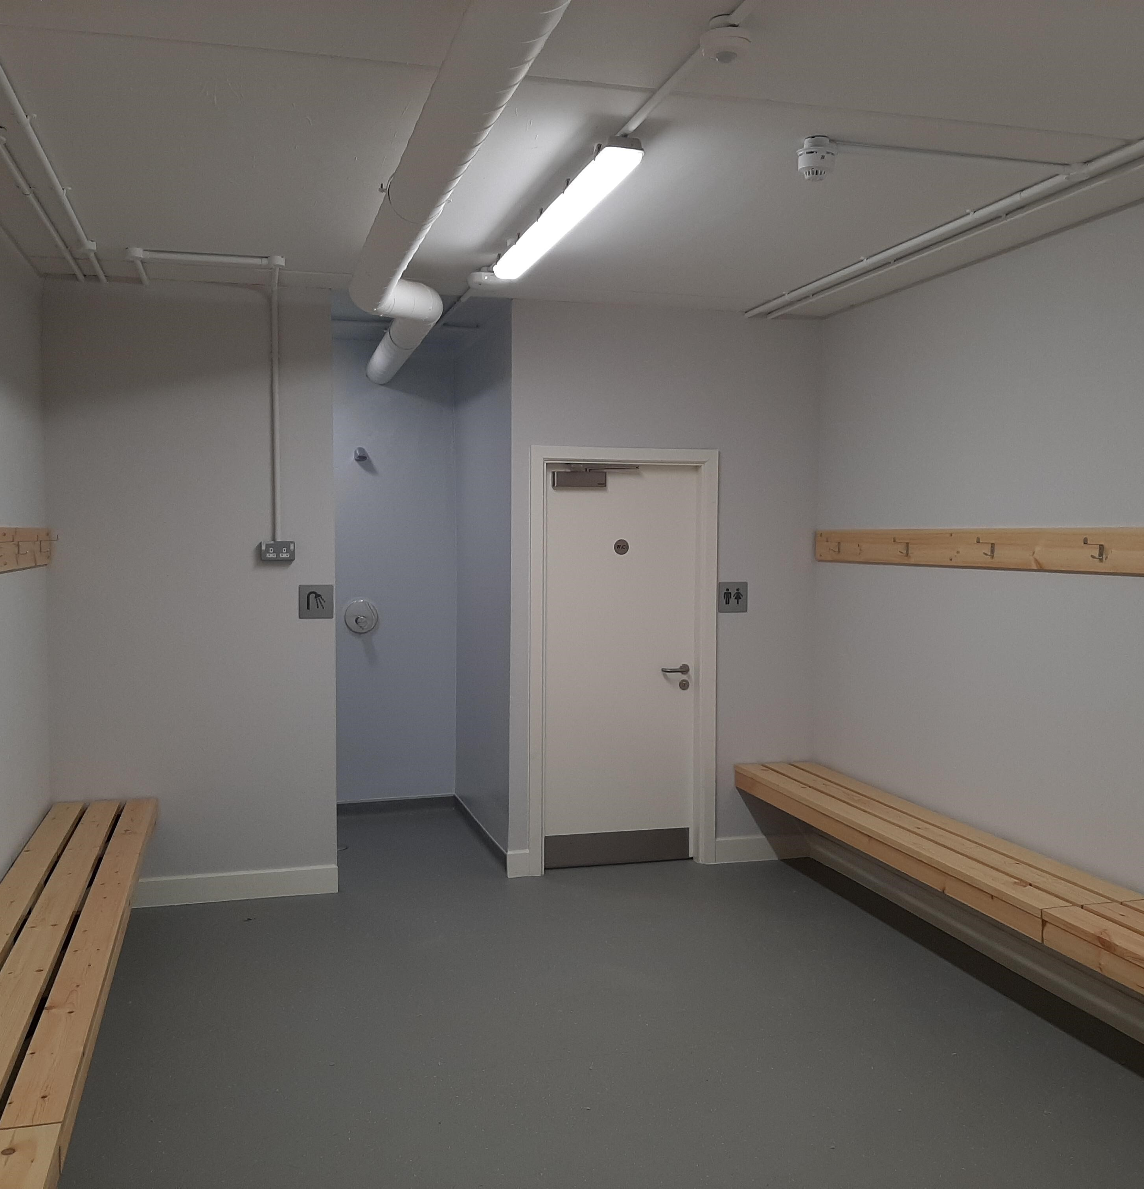
Progress to date
The core of the pavilion booking system has been developed.
An access test was carried out in April whereby a member of staff booked a slot on the testing site, downloaded the App required and successfully gained entry to the Dodder Valley Park Pavilion.
Photographs of the newly built pavilion and descriptions are currently being added to the site.
As other pavilions from the programme are built, they will be added to the site for use.

Slide 5
How to use the system
Clubs will be required to download app and register with the booking system for a once off nominal fee. Once registered, clubs will have access to all pavilions (when built). However, it is possible to restrict to a specific pavilion if required.
Once approved the club will automatically be sent a confirmation email and link to create a password. Club to set up their own password and there will be a “forgot password” facility
Clubs can then access a real time online calendar for each facility
Ability to book multiple facilities at the same time if required (i.e 2 changing rooms and referee room). Minimum time slot a club can book is one hour
Booking requests made by credit card
Can only book 4 weeks in advance (avoid block booking). Pay weekly or upfront option available
A reminder will be sent one hour before booking by SMS
Ability to upload photos of room being booked, to act as a security to show how room was left after use

Slide 6
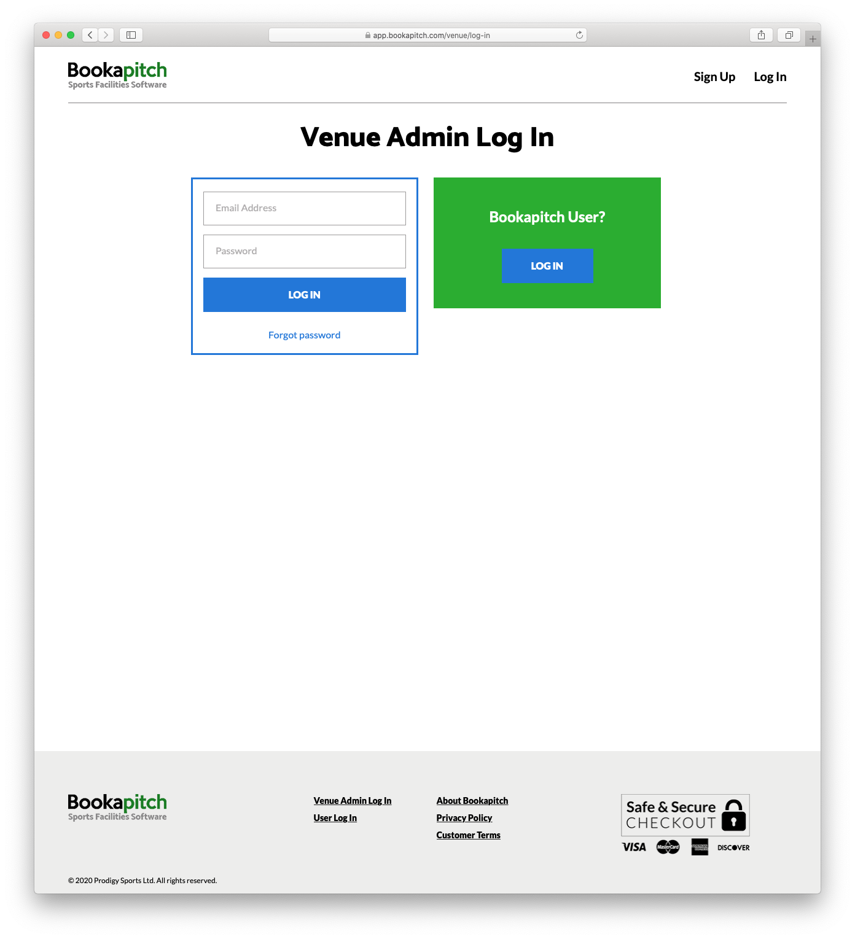
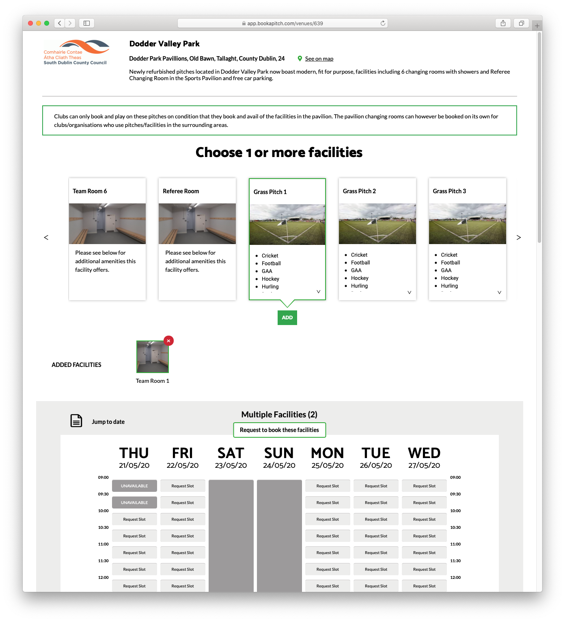
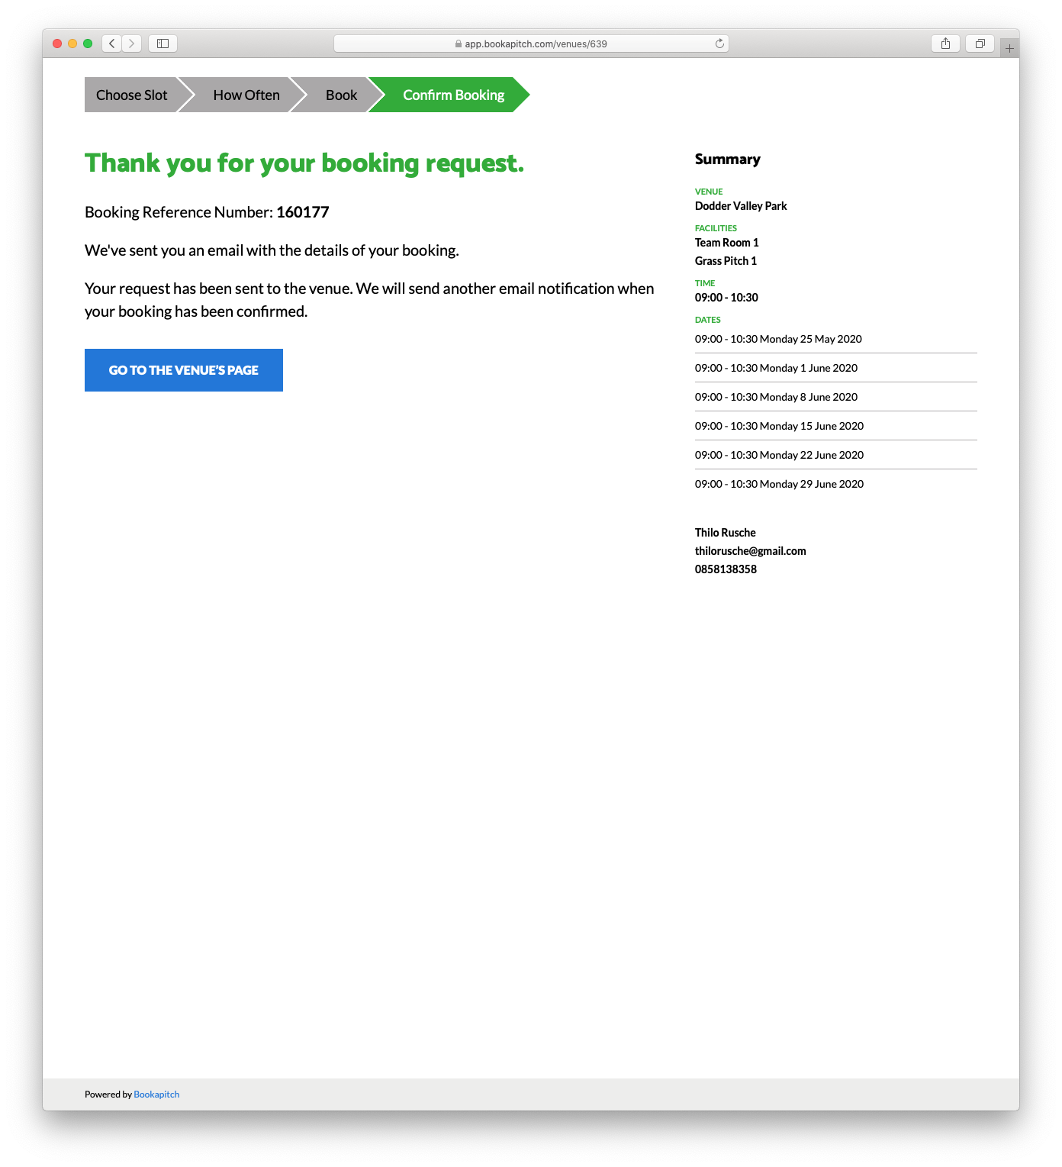
Screenshots from the system

Slide 7
Next steps….
Integration of payment system into booking system and final touches to be included.
June/July all clubs will be invited to an online training and launch event.
All clubs will be provided with 30 second FAQ videos on how to book the Pavilions and use the Access Control System
Technical support (Mon – Sun, 9am -9pm Dublin based)
Development of the Pitch Allocation & Booking System. This system will be in place to gather data such as;
Monitor usage (gauge activity)
No of clubs availing of pitches
Inform maintenance schedule of pitches, priority to most used pitches
Inform of underuse and encourage shared pitches

