Slide 1
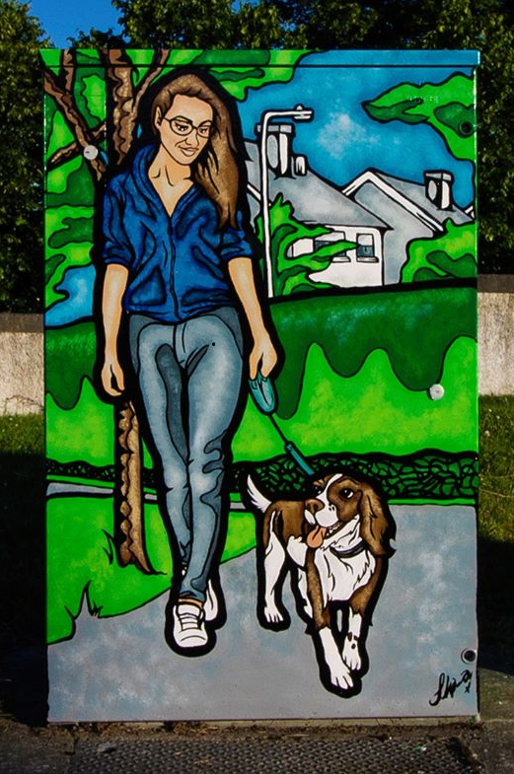
South Dublin Canvas 2020
“Suburban Paradise” @ Firhouse Road/Knocklyn Road

Slide 2
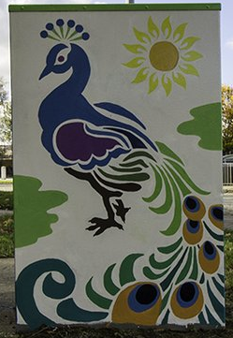
The South Dublin Canvas project uses traffic light control boxes to exhibit high quality, creative artwork to the public.
Traffic light control boxes make perfect canvases to showcase community art as they are always naturally located in high footfall – high traffic areas.
Newcastle Road, Lucan

Slide 3
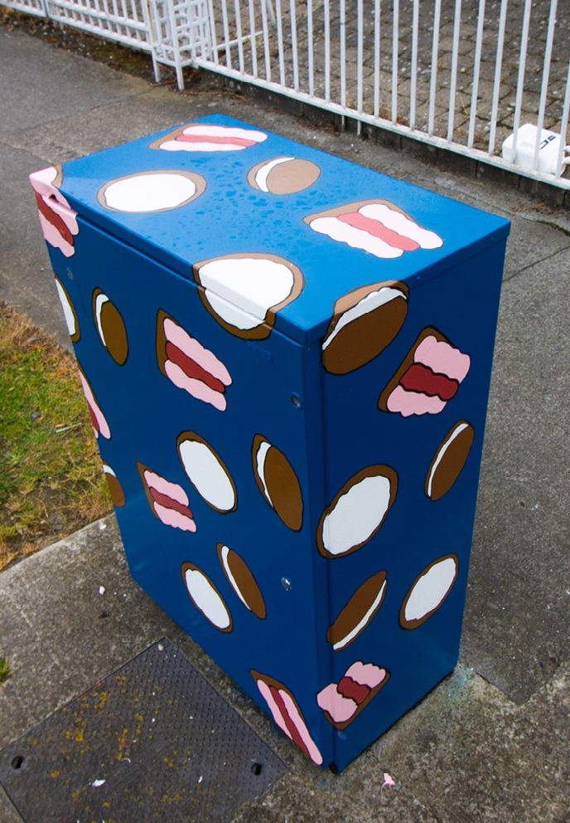
2020 Projected Timeline
Callout commences – Monday 25th May
Submission deadline – Friday 19th June
Selection process – Monday 22nd June – Friday 26th June (tbc)
Artwork to be completed by end of September 2020.
“Jacobs” @ Belgard Square East (Windsor Motors), Tallaght

Slide 4
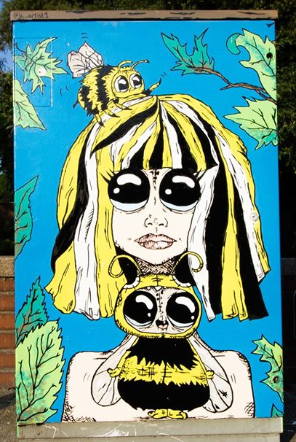
17 proposed locations across SDCC
Tallaght South
  R126 / Fettercairn
Templeogue/Terenure
  College Drive, Wainsford Road
  Limekiln Road, St James Road
  Wellington Lane, Limekiln Rd
Rathfarnham
  Rathfarnham Castle, Rahfarnham
  Willbrook Road, Rathfarnham (opposite Yellow House)
“Save the bees” @ Grange Road/Nutgrove Avenue, Rathfarnham

Slide 5

Tallaght Central
  Killinarden House Tallaght
  Old Bawn Road/Killininny
  Citywest Shopping Centre, Citywest Rd, Citywest
  Scoil Aoife, Citywest
Lucan
  Griffeen Ave, Balgaddy
  Castlegate Way/Adamstown Avenue
Clondalkin
  Newland Road/Fonthill Road North, Ronanstown
  Woodford Walk, Knockmitten
  New Nangor Road/ Woodford Walk, Clondalkin
  Fonthill Road – Dunawley
  Station Rd/Ninth Lock Road
“Quali-tea Time” @ Main Road, Castle Tymon

