Slide 1
SHD Application Ref: SHD3ABP-306602-20
Applicant: Glenveagh Homes Ltd
Site: Citywest Road, Magna Drive
Presentation to Tallaght ACM 23/03/2020
Jim Johnston
Senior Executive Planner

Slide 2
Timelines
SHD Lodged with ABP on 10/02/20
5 Week Obs by 5.30pm 16/03/20
8 Wks SDCC report due to ABP 29/04/20
16 Week Decision Issued by ABP 02/06/20
Consultations
A S.247 pre-planning meeting was held with SDCC on 07/03/19
A pre-planning meeting was held on 12/06/19 with An Bord Pleanala, the applicant and SDCC.

Slide 3
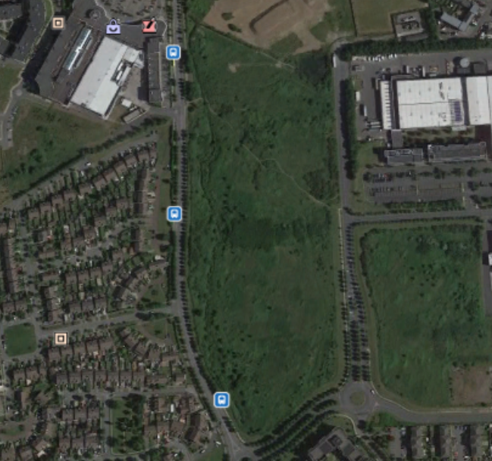

Slide 4
Proposed Development
A) 353 apartments in 7 blocks (with balconies or terraces [including communal terraces]) with the following mix:
22 no. studio, 65 no. 1 bedroom, 242 no. 2 bedroom, 24 no. 3 bedroom
Block 1 (6 storeys with a part 7 storey level) of 57 no. apartments;
Block 2 is (6 storeys with a part 7 storey level) of 47 no. apartments;
Block 3 (6 storeys over undercroft/semi-basement with a part 7 storey level) of 56 no. apartments with car parking and ancillary plant/storage at basement level;
Block 4 (6 storeys over undercroft/semi-basement with a part 7 storey level) of 56 no. apartments with car parking and ancillary plant/storage at basement level;
Block 5 (6 storeys with a part 7 storey level) of 47 no. apartments;
Block 6 (6 storeys over undercroft/semi-basement with a part 7 storey level) of 58 no. apartments with car parking and ancillary plant/storage at basement level;
Block 7 is 6 storeys of 32 no. apartments (creche of c. 587.8 sq. m at ground and first floor) with outdoor play area;
B) 89 houses (51 no. 2 bedroom, 20 no. 3 bedroom & 18 no. 4 bedroom); House Types 1A, 2A, 4, 4A - 3 storey to front [2 storey to rear] remainder of house types 2 storey;
C) 21 duplex apartments (17 no. 2 bedroom & 4 no. 3 bedroom) in 2 no. 3 storey buildings;
D) Community building including management office (c. 141 sq. m - single storey), 3 no. single storey ESB substations, single storey bicycle and bin stores;
E) 401 car parking spaces (including 3 no. car sharing spaces) to serve overall development and 364 no. bicycle spaces ([for apartments] with apartment bicycle storage provided internally at ground floor level for Apartment Blocks 1-7);
F) Provision of public open space areas within the development (including playground areas and communal open space areas); all ancillary landscape works, public lighting, planting and boundary treatments including regrading/re-profiling of site where required as well as provision of footpaths and cycle paths;
G) Vehicular access to the proposed development will be from the Citywest Road (N82) and will include pedestrian crossings and works to facilitate access (including vehicular and footpath/ bridges over stream/ditch), secondary vehicular and pedestrian access to boundary to lands to north (currently under construction) and pedestrian to boundary to Magna Drive;
H) Provision of Surface water and underground attenuation and all ancillary site development works;

Slide 5
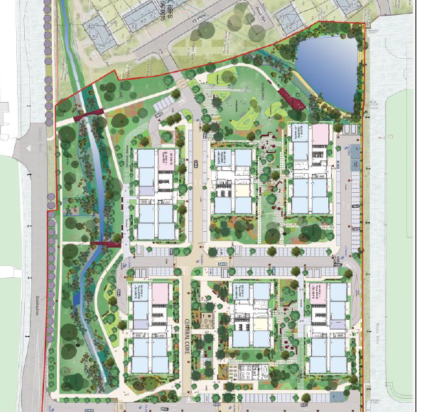

Slide 6
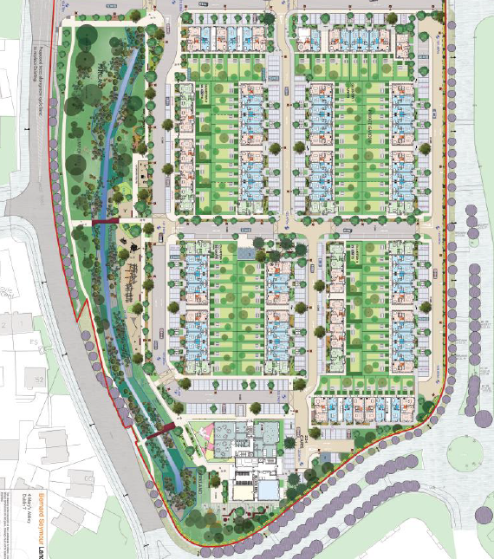

Slide 7
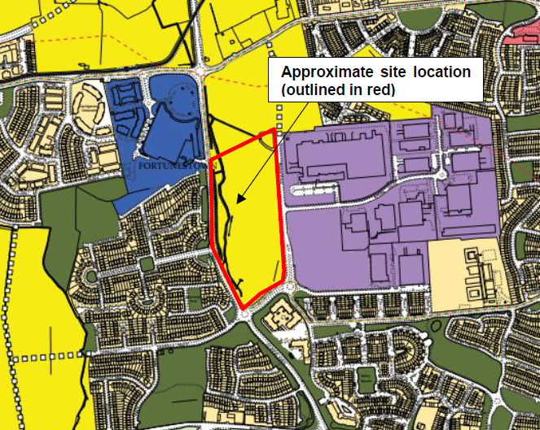

Slide 8
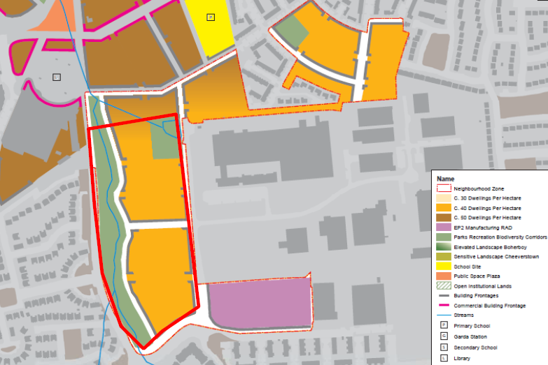

Slide 9
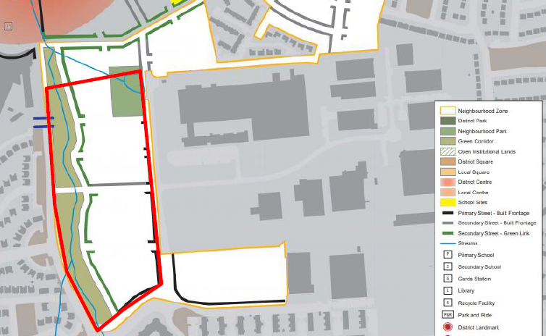

Slide 10
ABP Comments:
The design and layout of attenuation pond at the northern end of the site, with regard to objective CRN 4 of the LAP, which states that the attenuation pond shall be retained as a local feature within a neighbourhood park. Roads/car parking layout in this area should create high standard of public access and amenity.
pedestrian, cycle and vehicular permeability with the adjoining permitted residential development to the north
a link between the public open space at the attenuation pond and the linear park at the western side of the site (see LAP objective G18, which states that linked open space hierarchy shall be implemented fully across the Plan Lands and that all proposed development shall contribute to the achievement of this integrated Green Infrastructure Network where relevant and at a minimum rate of 14% of A1 zoned lands)
Southern end of the site facing Citywest Road and The Belfry – the proposed treatment of the design and layout should reflect the prominent location of this aspect of the development and crate a high standard of design and finish which would make a positive contribution to the public realm and achieve a strong frontage to Citywest Road/facing The Belfry.
Ensure Vehicular, Pedestrian and Cycle Permeability with
The residential development to the north of the site (SD18A/0015)
Magna Drive at the eastern site boundary, with regard to the existence of a strong desire line between bus stops and pedestrian/cycle routes on Citywest Road/N82 and the employment land uses to the east of the development site.

Slide 11
Other issues related to:
Statement of Material Contravention (if applicable) regarding Objectives CR2b and VC6b of the LAP. Section 6.3.3 regarding residential density and section 6.3.5 regarding building height.
Tenure of proposed development
Design statement re design/layout re LAP and national design guidance
Existing and proposed ground levels across the site and re watercourse to west
Landscaping scheme – trees/hedgerows – play areas – linear park
Landscape and visual impact assessment with 3D modelling
Parking details
Taking in charge locations to be shown
Public lighting
Surface water drainage
Flood risk assessment
Daylight/sunlight analysis
Rationale for proposed childcare provision
A building lifecycle report
Bat survey and ecology report
AA screening report

Slide 12
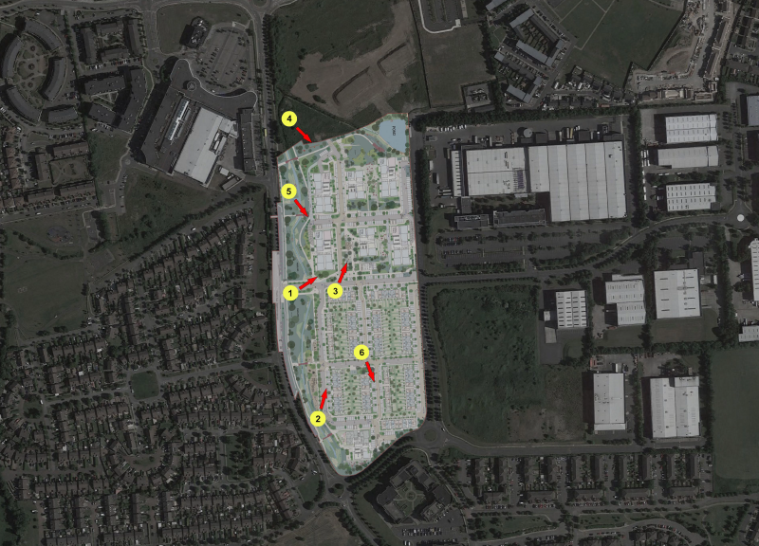

Slide 13
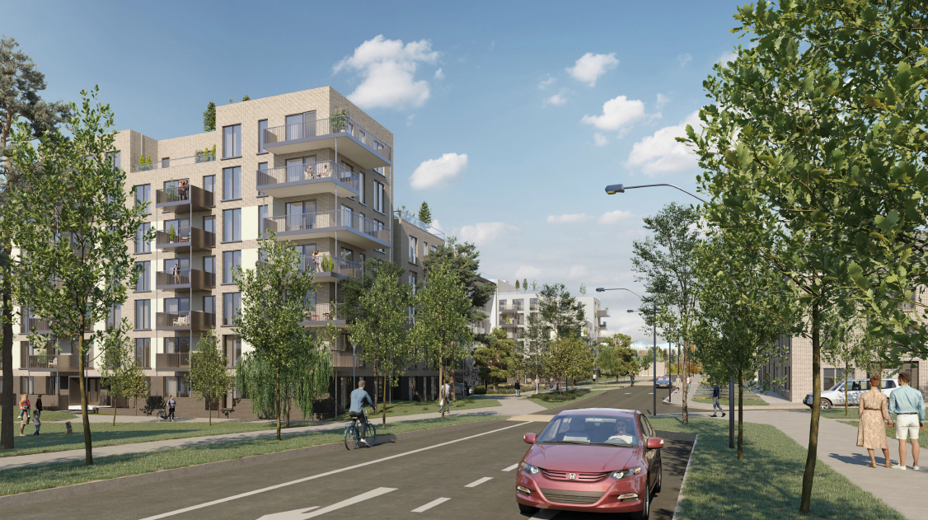

Slide 14
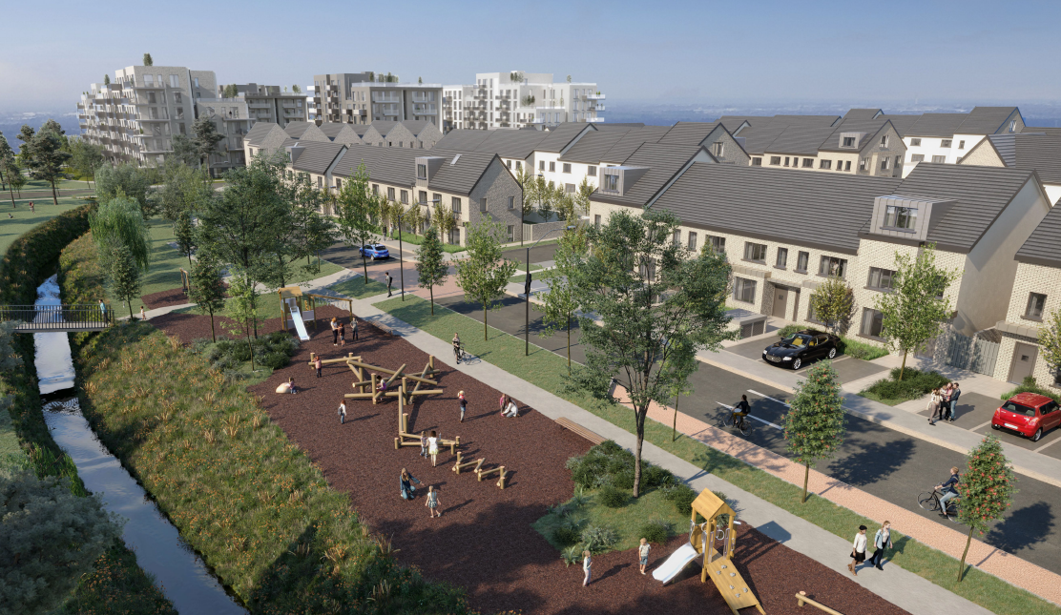

Slide 15
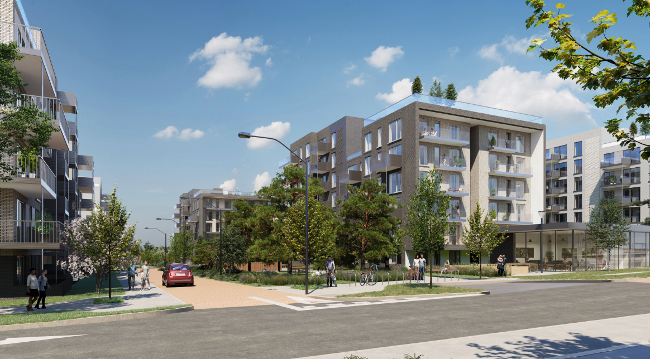

Slide 16
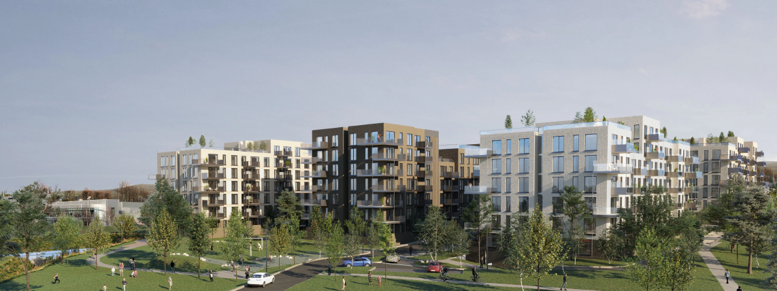

Slide 17
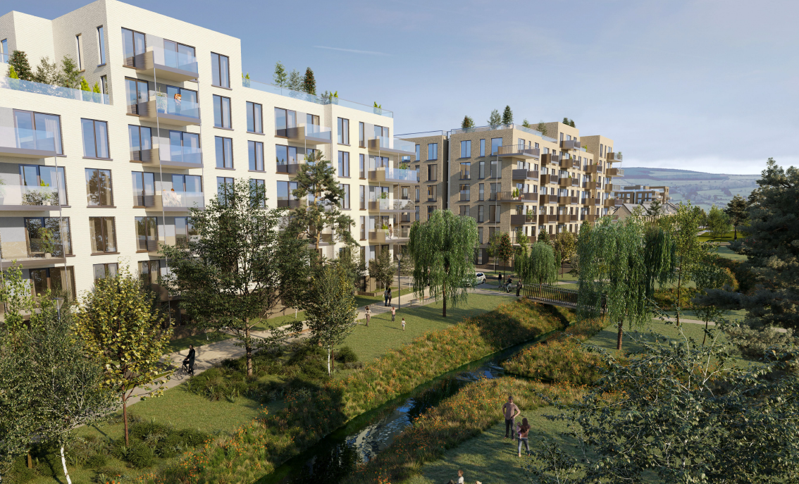

Slide 18
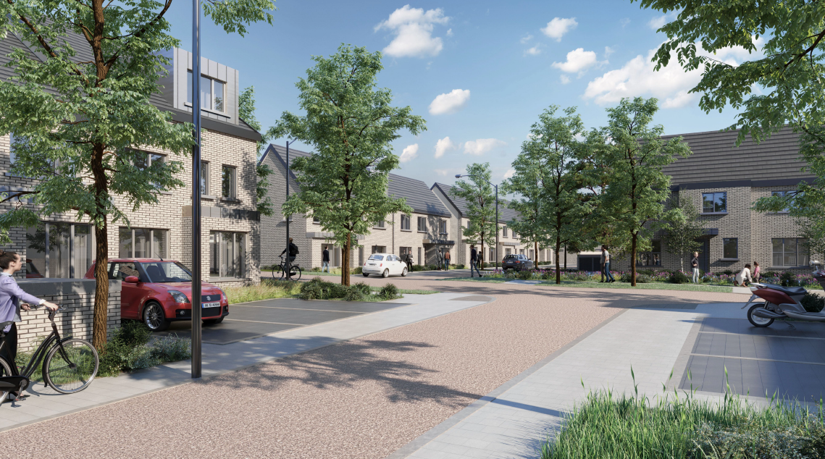

Slide 19
Statistics for Proposed Development:
444 units comprising
353 apartments
89 houses
21 duplex apartments
353 apartments - in 7 blocks
22 studio = 6%
65 1bedroom = 18%
242 2bedroom = 68%
24 3bedroom = 7%
89 houses
51 2bed
20 3bed
18 4bed
21 duplex apartments in two 3 storey buildings;
17 2beds
4 3beds)
Site Area: 7.4ha.
Density: 60 units per ha. (444 units on 7.4ha)
Height: Apartments Blocks 1,2,3,4,5,6,7 (six to seven storeys)
Dual Aspect: 50%
Public Open Space: 31% (2.3ha)
Communal External Amenity Space: 3,838 sq m
Community building (including management office): (141sqm.)
Car Parking Spaces: 401
Cycle Parking Spaces: 364

Slide 20
Thank You
Questions

Slide 22
SHD Application Ref:SHD3ABP-306705-20
Applicant: Airton rd, Greenhills road,Tallaght
Presentation to Tallaght ACM 25th May 2020
Jim Johnston
Senior Executive Planner

Slide 23
Timelines
SHD Lodged with ABP on 19/02/20
5 Week Obs by 5.30pm 23/03/20
8 Wks SDCC report due to ABP 07/05/20
16 Week Decision Issued by ABP 08/06/20
Consultations
S.247 pre-planning meeting held with SDCC on 03/05/19 (SHD1-SPP015/19)
A pre-planning meeting was held on 07/10/19 with An Bord Pleanala, the applicant and SDCC.

Slide 24
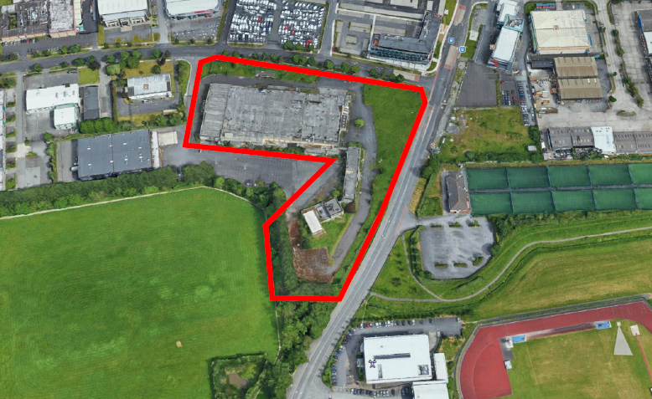

Slide 25
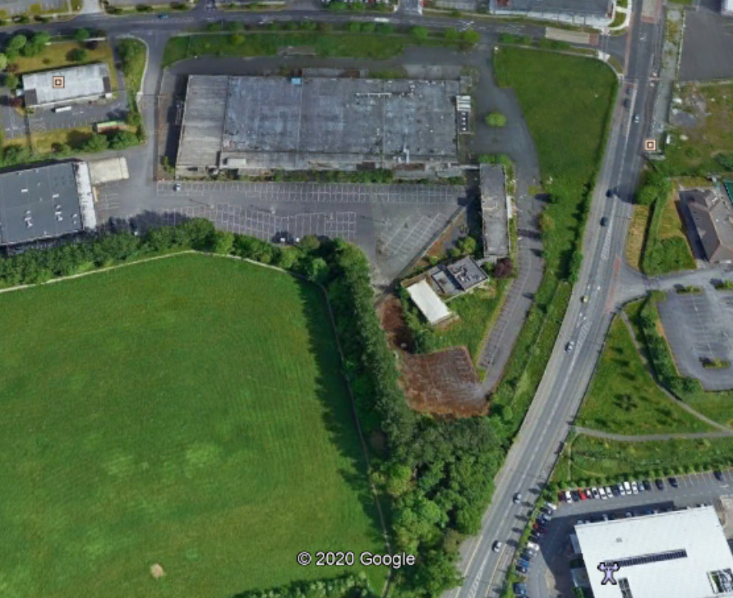

Slide 26
Proposed Development Gallaghers:
Demolition of existing factory/warehouse buildings on site (total floor area c.10,076.8 sqm).
Construction of 502 apartments (comprising 197 1-bed; 257 2-bed; and 48 3-bed units) within 6 blocks ranging in height from 4 to 8 storeys. All residential units provided with associated private balconies/terraces to the north/south/east/west elevations.
Provision of residential amenity facilities, 3 retail units, creche, and services/bin store areas (total non-residential floor area c.1,839 sq.m).
A total of 202 car parking spaces (at basement and undercroft levels) and 584 bicycle parking spaces.
Vehicular/pedestrian/cyclist accesses from Greenhills Road and Airton Road. Provision of road improvements and pedestrian crossings.
All associated site development works, open spaces, landscaping, boundary treatments, plant areas, pv panels (at roof level), waste management areas, and services provision (including ESB substations).
An EIA has been prepared in respect of the proposed development.

Slide 27
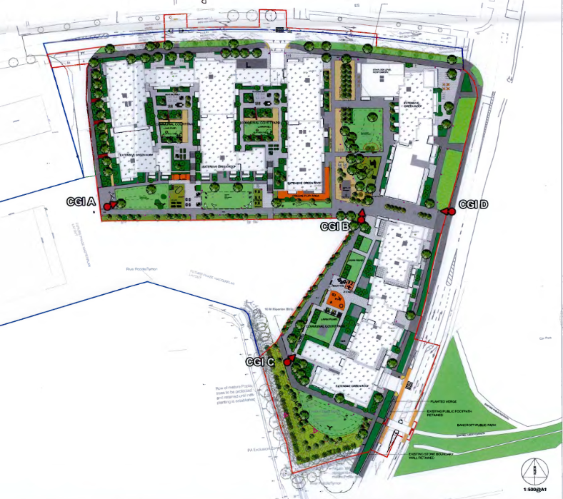

Slide 28
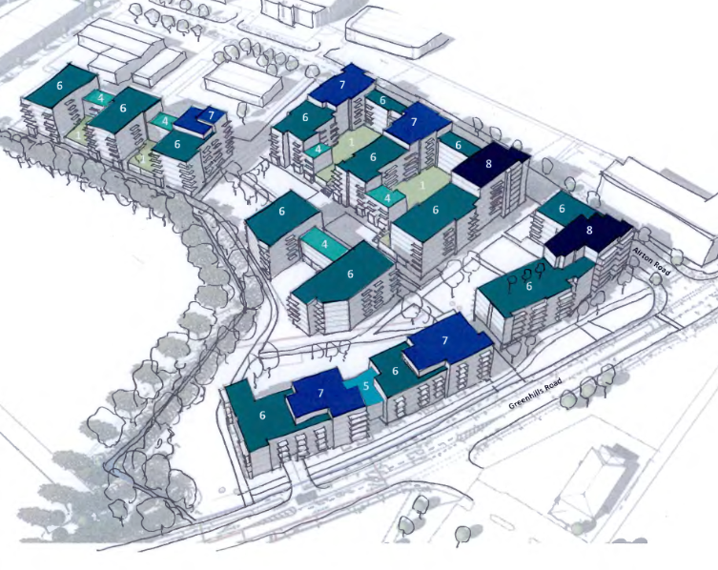

Slide 29
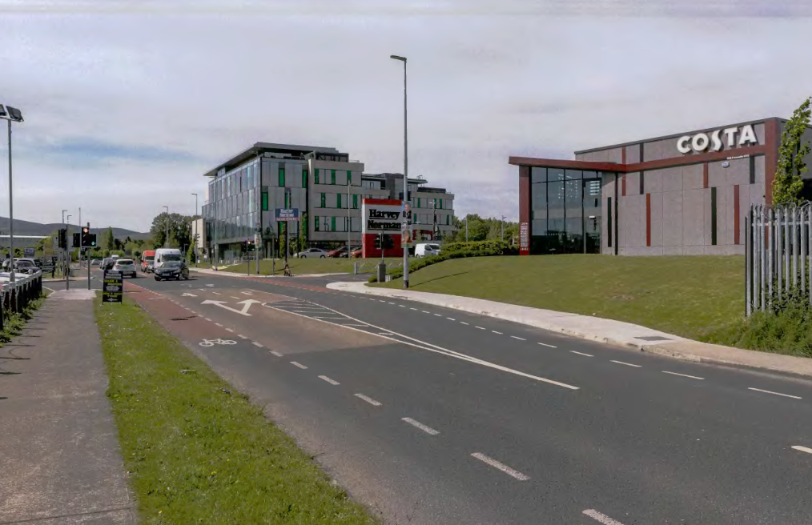

Slide 30
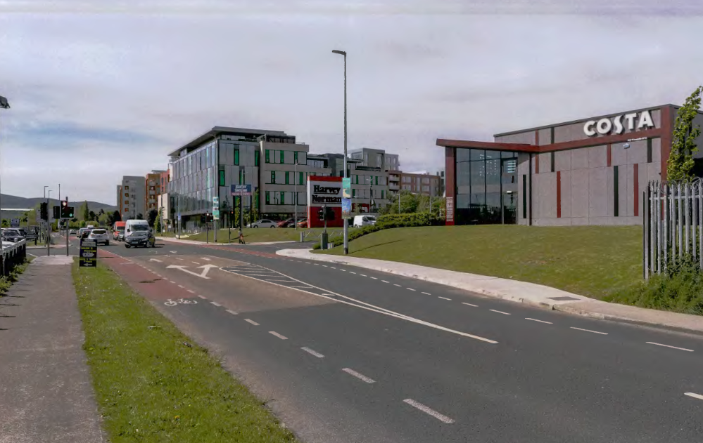

Slide 31
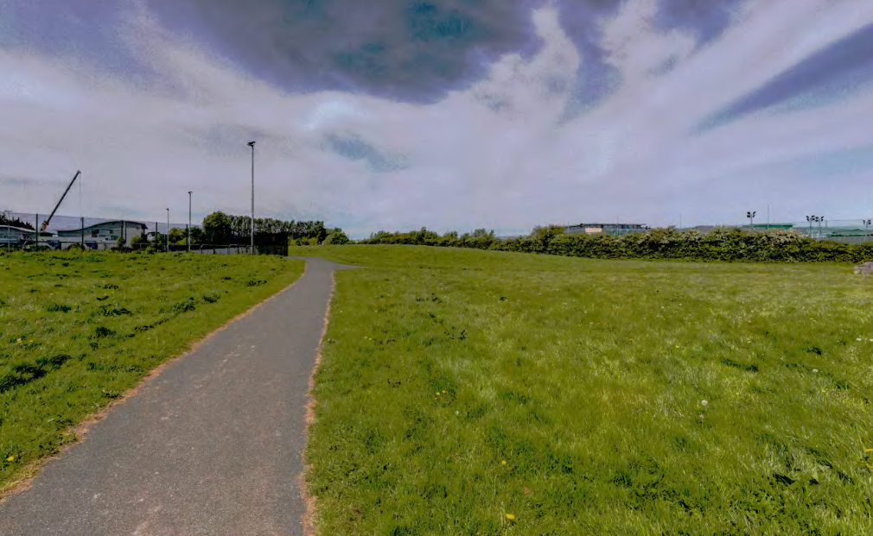

Slide 32
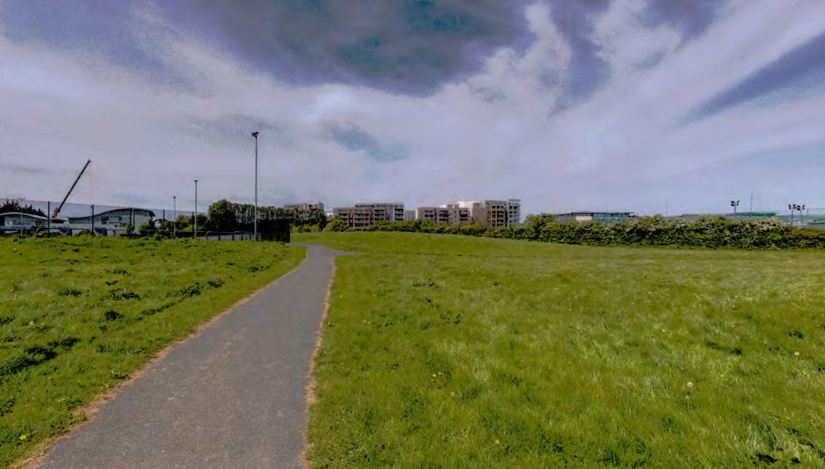

Slide 33
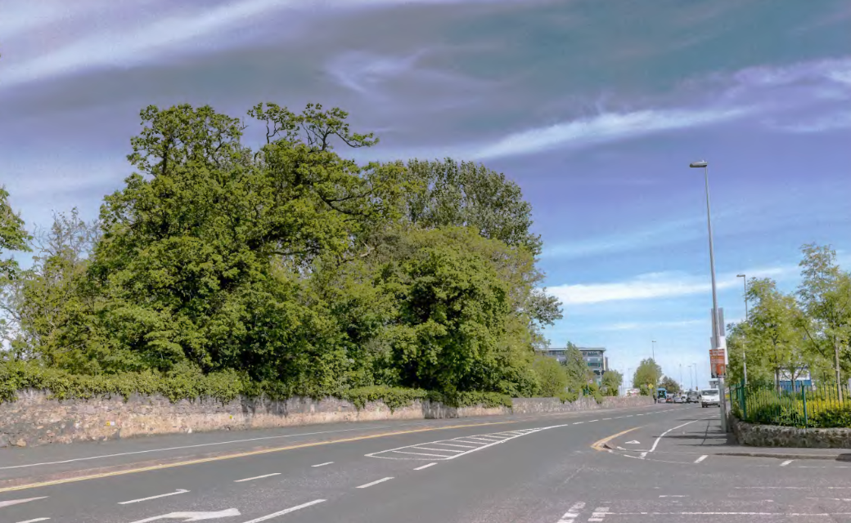

Slide 34
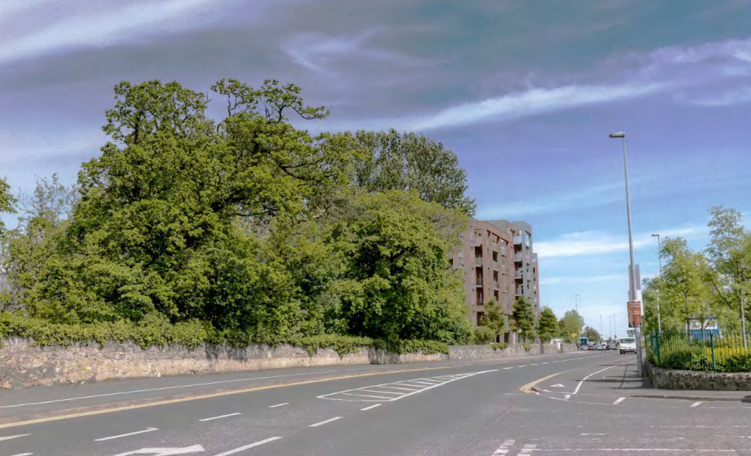

Slide 35
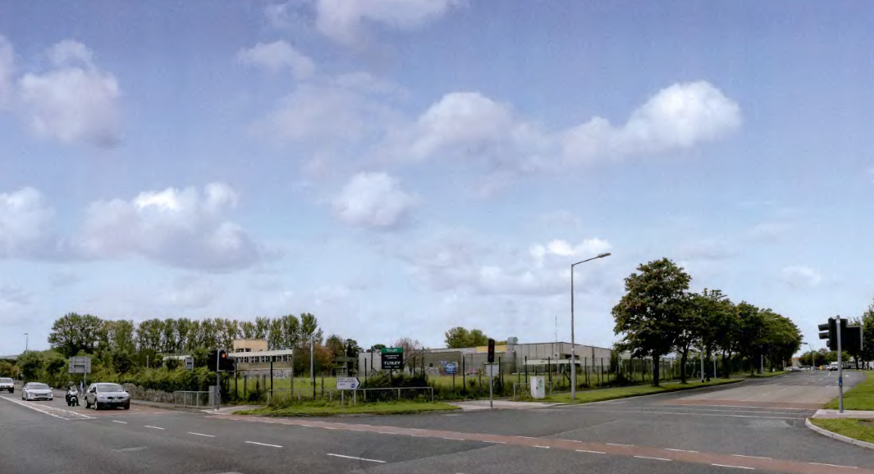

Slide 36
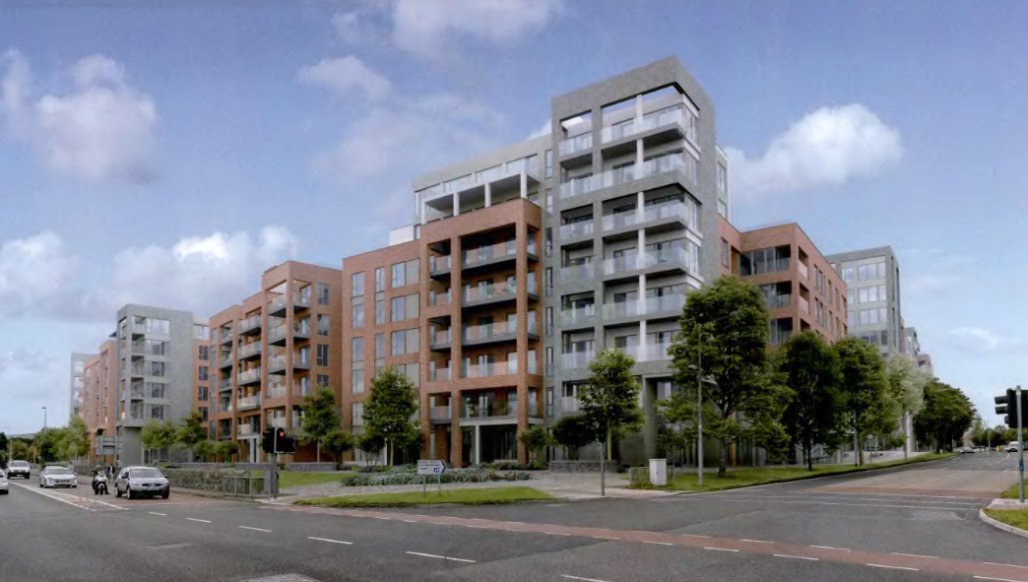

Slide 37
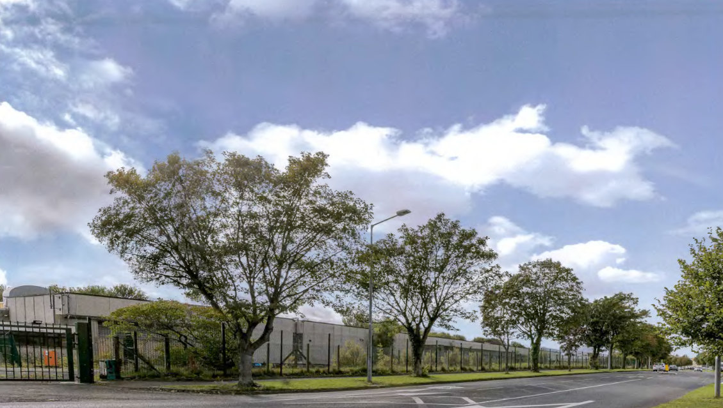

Slide 38
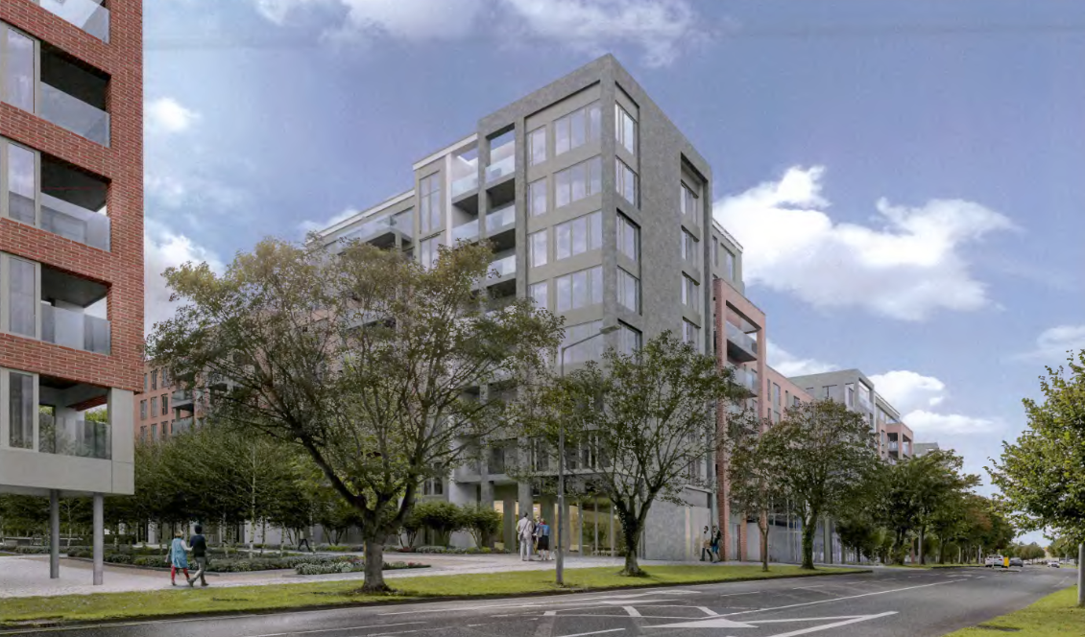

Slide 39
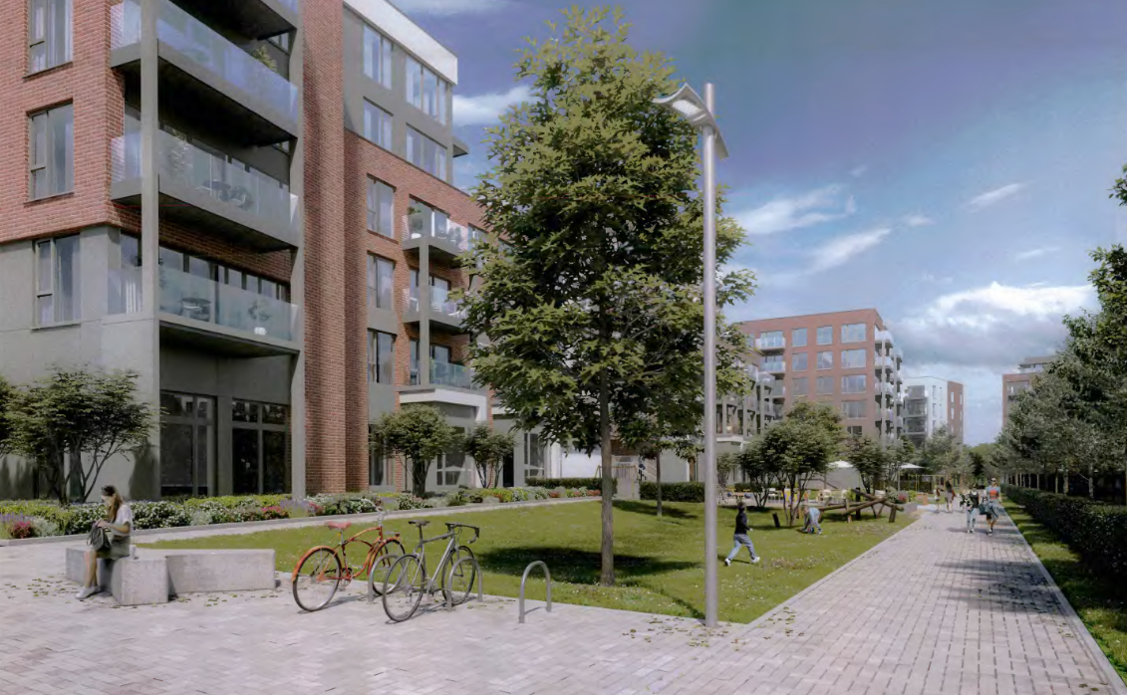

Slide 40
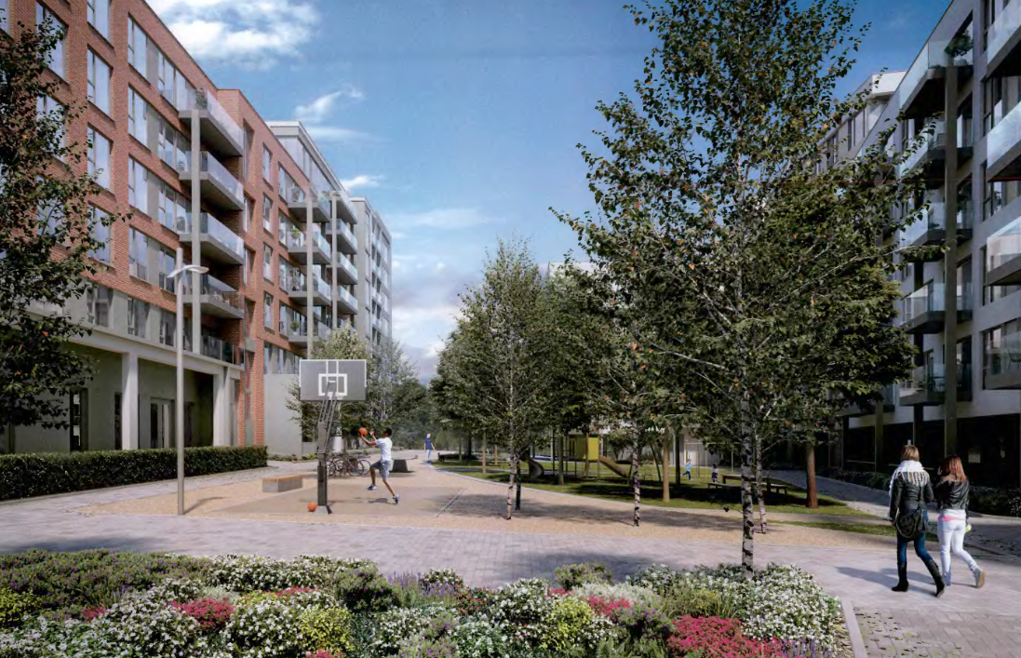

Slide 41
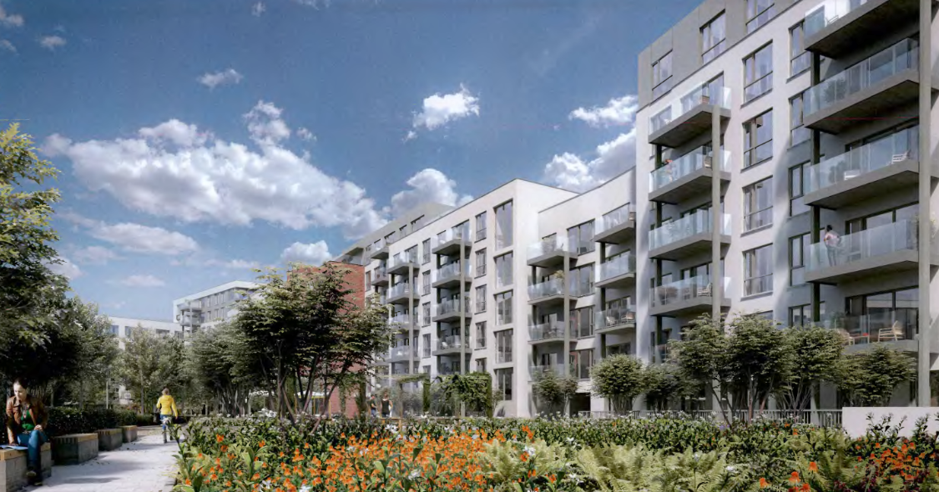

Slide 42
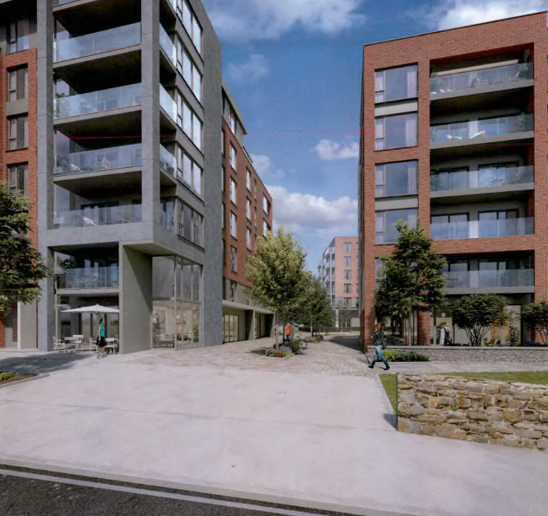

Slide 43
ABP Comments
1. Principle of Proposal
Further consideration/justification of the documents as they relate to the principle of the proposed development in the context of the overall re-development of lands within the applicant’s ownership, as outlined in the blue in the submitted documentation. The applicant should satisfy themselves that the design strategy for the site, as outlines in red, provides the optimal outcome for the overall lands and should address why the proposed development could not be considered to be ad hoc, piecemeal, premature development in the absence of proposals for the redevelopment of the wider lands within the applicants ownership at this location. The further consideration of these issues may require an amendment to the documents and/or design proposals submitted.
2. Urban Design and Active Frontage
(i) Further consideration of the documents as they relate to the detailed design of the proposed development. The documentation submitted at application stage should demonstrate that the elevational treatments, external finishes, materials and detailing of the proposed buildings, together with the landscaping and surface/boundary treatments of the outdoor spaces would be of a sufficient quality to ensure that the proposed development makes a positive contribution to the character of the area over the long term. The interface between the proposed blocks and the public realm should also be addressed.
(ii) Further consideration and/or justification of the documents as they relate to the ground floor uses of the proposed scheme, in particular along Greenhills Road, Airton Road and surrounding the ‘Courtyard Open Space’ in terms of the creation of an active and vibrant streetscape at this location. A Design Statement addressing the criteria contained within section 11.2.4 of the South Dublin County Development Plan 2016 in relation to development within such regeneration zones should be submitted.

Slide 44
Other issues raised by the Board:
1. Daylight/Sunlight analysis
2. Contour/site level map accurately and legibly showing levels across the site.
3. Layout and design of the proposed areas of open space to ensure that these are attractive, accessible areas – including a detailed landscaping plan
4. Construction and Demolition Waste Management Plan.
5. Waste Management Details.
6. Ecological Impact Assessment.
7. A life cycle report: proposed materials, finishes and detailing which seek to create a distinctive character for the development.
8. A schedule of floor areas for all proposed units.
9. surface water management - Flood Risk Assessment.
10. transport and parking.

Slide 45
Statistics for Proposed Development:
502 apartments:
- 197 1-Bed (39%).
- 257 2-Bed (51%); and
- 48 3-Bed (10%)
Residential communal facilities 704 sqm comprising
- 465sqm in block C
- 93sqm in block D
- 146sqm in block E-F
Commercial facilities 811 sqm comprising
- 329 sqm Creche (44 spaces) in block C
- 187sqm retail unit in block C
- 161sqm retail unit in block D
- 134sqm retail unit in block D
Site Area: 2.79ha
Density: 202 units per ha
Plot Ratio: 1.8
Site Coverage: 40%
Building Height: 4 – 8 storeys
Dual Aspect: 43.8%
Car Parking Spaces: 282
Cycle Parking Spaces: 584

Slide 46
Thank You
Questions

