Slide 1
South Dublin Libraries
Response to the
COVID-19 Pandemic

Slide 2
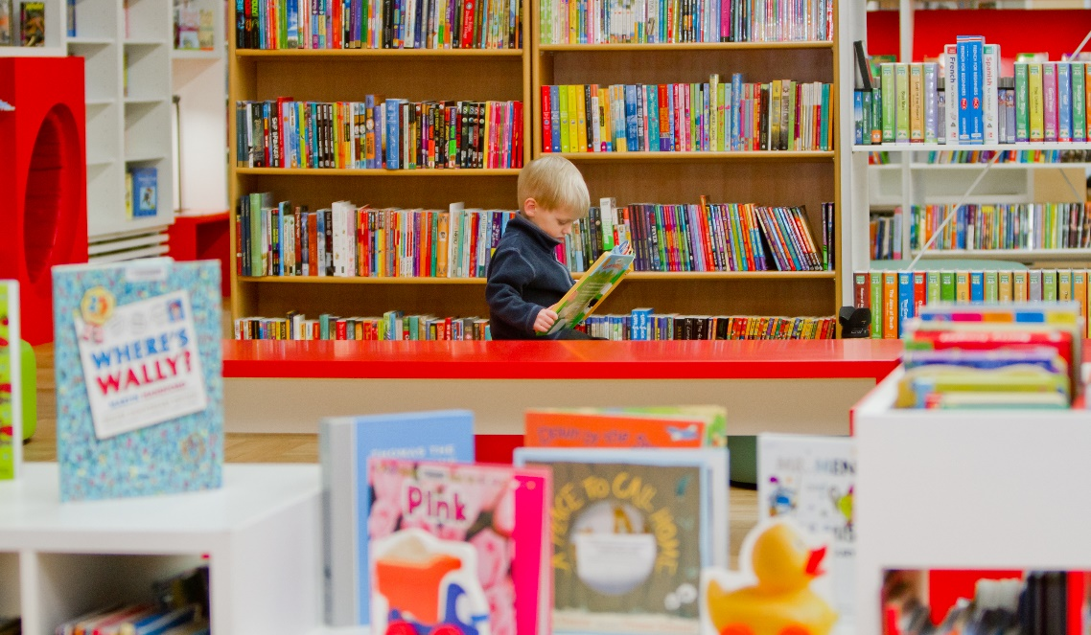
Closure of our branch libraries on 13th March, our Libraries continue to deliver a comprehensive programme of events and activities across social media platforms. Our online presence has strengthened greatly over the past number of weeks.
Reach out and engage with the community including live streamed Storytelling sessions, Craft sessions, Photography exhibitions, Local history talks and much more.

Slide 3
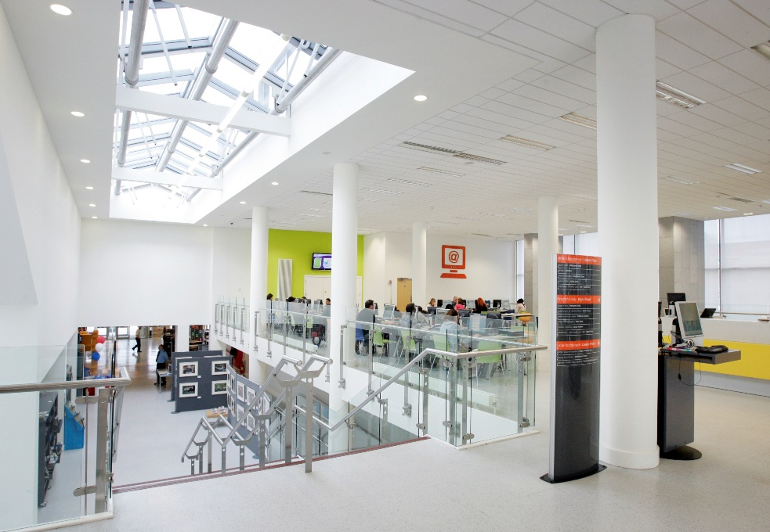
We continue to deliver programmes under the LGMA national initiatives of Right to Read, Healthy Ireland and Work Matters.
SDCC libraries in conjunction with LEO are organising a talk in May with Lecturer and Trainer, Dorcas Reamonn on the topic ‘How to Galvanise Your Online Business.’
Online talk for the Migrant Teacher Project, who provide support to fully qualified teachers outside Ireland seeking employment here.

Slide 4
Creative Cocooners is a programme of events designed to engage with our cocooners and their families, creating a nice intergenerational connection in these difficult times. Events include:
Aoife Munn Gardening videos x 3 -
20th May - Ogham workshop, live talk via Zoom
20th May - The Singing Librarian - live music show via Facebook live
27th May - JFK and the Summer of 1963 - history talk via Facebook
28th May - Coping and Anxiety Management Skills - live talk via Zoom
20th - 31st May - SDL Gardening competition - borrowers submit photos of their gardens, featured on social media and 1st, 2nd, 3rd prize available
4th June - Mandala and meditation with Patricia Fitzgerald - live talk via Zoom

Slide 5
Healthy Ireland at Your Library
Four wellbeing and coping health talks during the Covid-19 lockdown.
Anxiety
What Drives our Behaviour
Parenting and Home-schooling.
Mindfulness
The online events, hosted by Jacci Jones, Psychotherapist and Life-Coach culminated in a live Zoom event on May 1st
These events are now available on the South Dublin Libraries website, Vimeo and South Dublin social media platforms.
Activity work sheets and day-diary sheets are also available to help boost wellbeing and to help people stay in the moment and record their feelings each day - these pages are printable and can be used by children as well as adults.

Slide 6
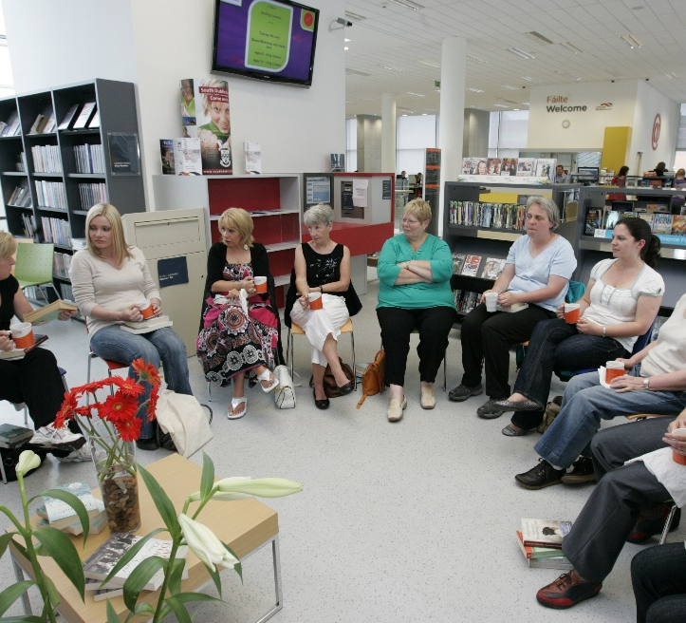
Stay Connected
Huge uptake of South Dublin Library online resources including E-books, E-audio, Newspaper Articles, Language Learning and Community Education Courses available at https://www.sdcc.ie/en/services/sport-and-recreation/libraries/library-services/online-resources/

Slide 7
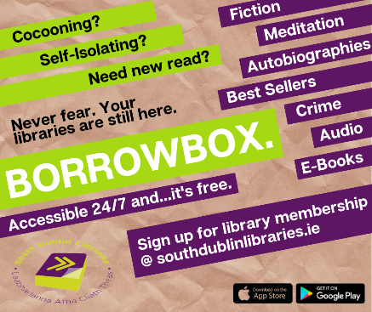
238,676 online items
issued in April 2020 from South
Dublin Libraries

Slide 8
Online Resources
March Increase on February |  | April increase on March
Borrowbox Total | 41% | Borrowbox Total | 51%
Borrowbox eAudio | 21% | Borrowbox eAudio | 50%
Borrowbox eBook | 69% | Borrowbox eBook | 51%
eMagazines | 33% | eMagazines | 18%
Enclopaedia Britannica | 341% | Enclopaedia Britannica | 61%
Tumblebooks | 673% | Tumblebooks | 9%
Universal Class | 544% | Universal Class | 236%
Press Reader | 458% | Press Reader | 488%

Slide 9
Project Sums Maths
Libraries offering online classes to Higher Level and Ordinary Level maths students with the help of volunteer maths tutors.
Our Local Studies Team have prepared a step by step guide on how to complete the History Research project.

Slide 10
Fun Activities for Children
Continuing our commitment and rollout of STEM activities, The Harry Potter Science Show was presented by Anyone4Science through our social media. It garnered a huge amount of reach and engagement, with an unparalleled reach of 28,513 and an engagement of 1,652. The event was hugely popular with around 770 people viewing the live stream and the recording is still available for future viewing and re-use.

Slide 11
History at Your Fingertips
Planned local history talks, events and genealogy sessions
Family History Blogs
History of Tallaght
History all Around Us: Rathfarnham Colouring Book
Workshops on Civil Records, Census, Parish Records, Griffith’s Valuation, Gravestone, and Cemetery Records, and using Newspapers for family history research.

Slide 12
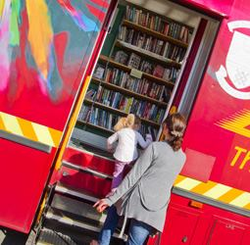
Housebound Library Service
Phased return to Library Opening
Planned delivery of books to those Housebound
Order and collect service initially
Follow Government Guidelines around health and safety

