Slide 1
Update on Library Capital Projects
May 2020

Slide 2
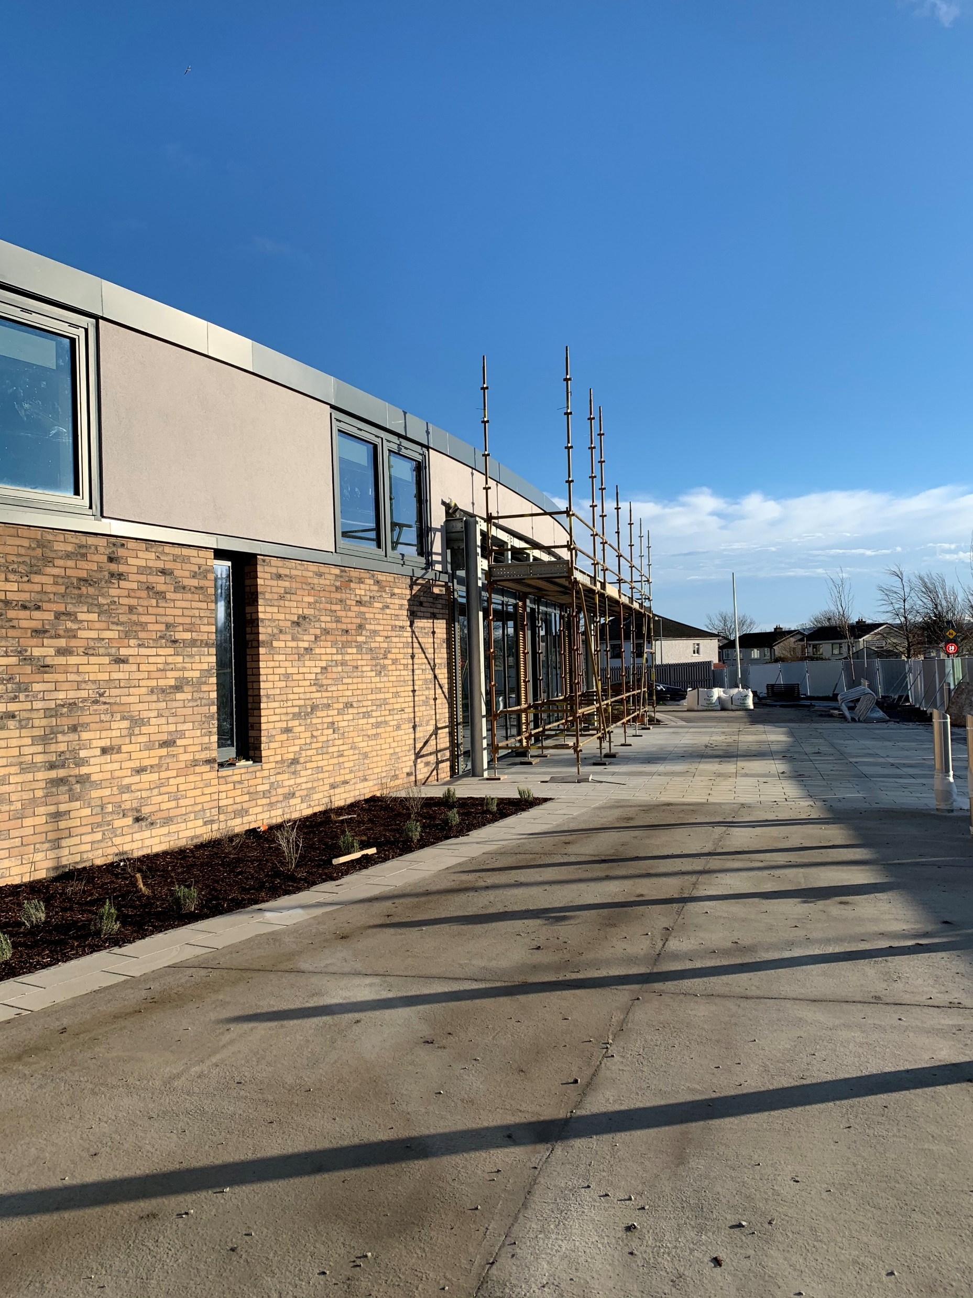
North Clondalkin Library
Townlink are back at work on site. They should finish the inside of the library in 4/5 weeks.
Shelving is with suppliers already and they will start work onsite within next couple of weeks with a completion date by the end of June.
Loose furniture will commence end of June to be completed by end July.
Libraries working on tender for RFID, PCs and TV screens.
Estimated opening September /October 2020.

Slide 3
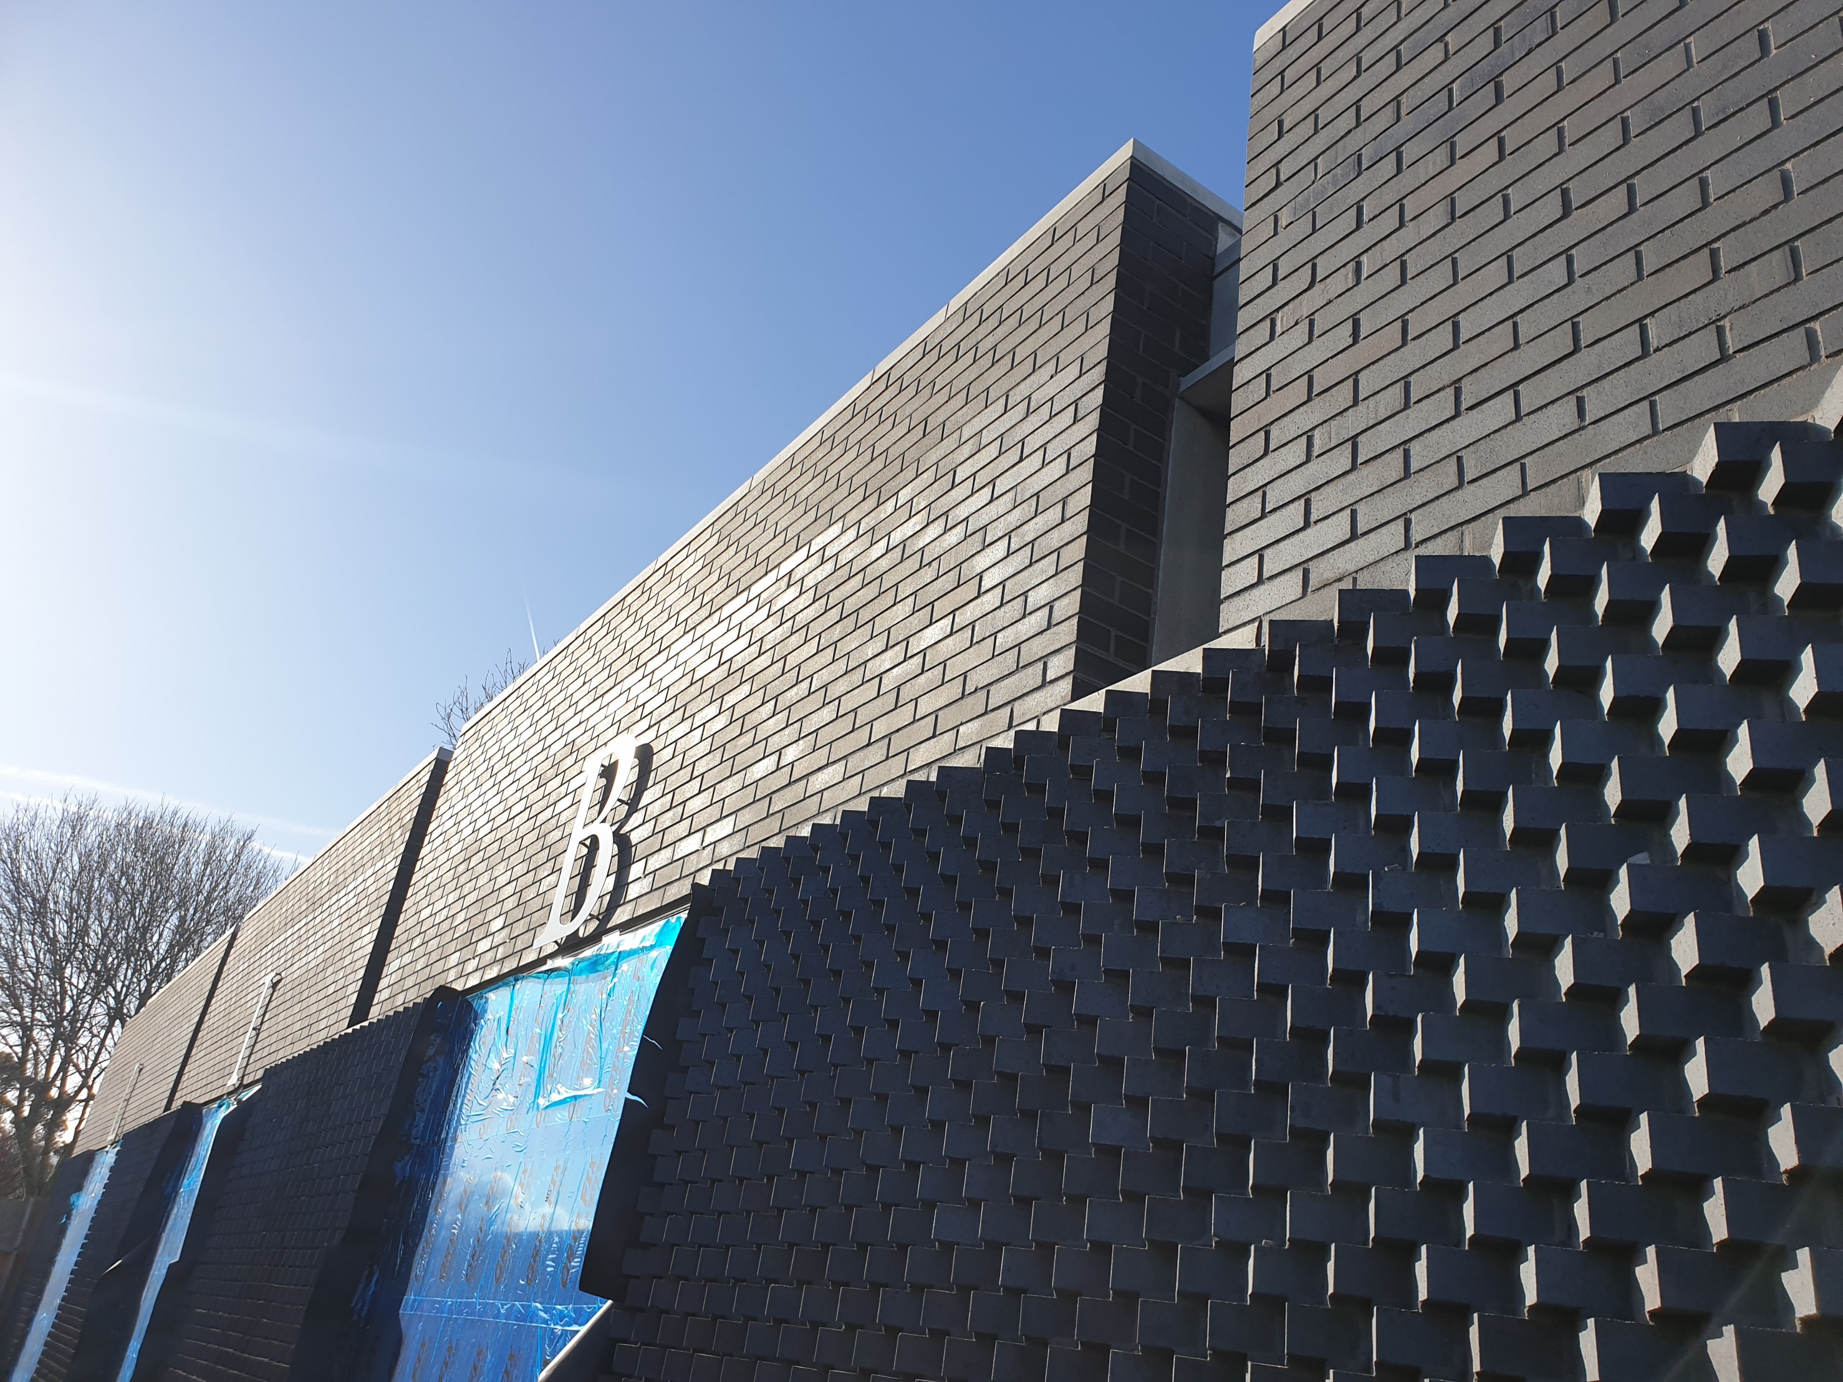
Castletymon Library
Contractor had 12 weeks remaining when lockdown commenced.
Started to remobilise on site this week. In compliance with the criteria set out in return to work roadmap, the contractor will be carrying out mostly external works during the next 3 weeks.
Awaiting an updated programme from the contractor but given the time lost and new protocols on safe working due to Covid-19, we would expect that the project will not be completed until the 4th quarter of the year.

Slide 4
Rathcoole Library- Planned proposal
Library to be developed as part of SDCC’s wider housing development in the Rathcoole Area.
Rathcoole is an established South Dublin village that has been, and will continue to be, subject to significant development.
Rathcoole is home to a cluster of existing and planned schools, both primary and secondary, with large student numbers.
The current SDCC development proposal at Rathcoole provides an opportunity to provide the service in conjunction with, and for, both the existing population and the new residents of the village.
The proposal is at feasibility stage.

