Slide 1
Cruinniú TV South Dublin Create • Make • Participate 13th June 2020
A webcast that brings together a variety of artists and organisations from across South Dublin County to showcase projects, workshops, readings, and performances.
Launching webcast on Saturday 13th June at 11:00am. Streaming it over a variety of sites. The 2 sites that will be on our promo materials are: Cruinniu na nOg South Dublin Facebook Page https://bit.ly/CruinniuSDFacebook Cruinniu na nOg South Dublin Instagram https://bit.ly/CruinniuSDInstagram For the overall webcast: https://bit.ly/CruinniuTVSD
Co-hosted by Jack Jones, Alex Lyons, and Ashley Makombe, viewers will be able to create, make and participate in a variety of creative experiences.

Slide 2
Programme
Staying In but Keeping Creative by Studio 12 A creative project for 9-12 year olds
Dance it out Together with Olwyn Lyons A fun, high energy dance workshop that draws influences from urban and contemporary dance styles. Suitable for all levels and abilities.
Play Apart by Freshly Ground Theatre Performance based on short scripts submitted by young people aged 4-18years
What’s Your Name by Mother Tongues and photographer Enzo Testa Discover the stories your friends' names and engage in some "language science" too!
Are you real because I am not sure I am by Kama Dominika and Eoin O'Loughlin Dance Performance the 2019 Emergence Young Choreographers Showcase.
Tales from the Garbo Story Cave Children's writer Margaret Callan Bergin will create and tell the story The Extraordinary Adventures of Spike The Squirrel & Ruby Robin

Slide 3
Programme
Resilient/Resilience by Jo Caslin, Rua Red & Contact Studio Young people will create a large scale gallery exhibition leading a street art installation on the outside wall of Rua Red later this year.
Staying Connected with South Dublin Libraries Video science fun with Dr Brain and a montage of creative projects and artworks completed by local children in the run up to 13th June.
Music Generation SD Virtual Jam Students from Rathcoole and Clondalkin hubs come together to deliver an exciting virtual performance.
There's a Giant on the Beach by TCA, SubSounds, Kingswood Youth Choir & MyCraft Young Designers A digital photo album with original musical soundtrack based on the fantasy Island of Lilliput.
JEMZ - Young Female Voices in Music New songs by 4 young female musicians from South County Dublin. Jo-Ellen Donohoe, Eimear O’Neill, Megan McGarry and Zoe Lord Bisset are participants in SubSounds.
Isolation by Tallaght Young Filmmakers A new film made from video diaries of their experience during the COVID-19 epidemic. Isolation captures a snapshot of their time in isolation. It is a montage of moments from each day in their lives

Slide 4
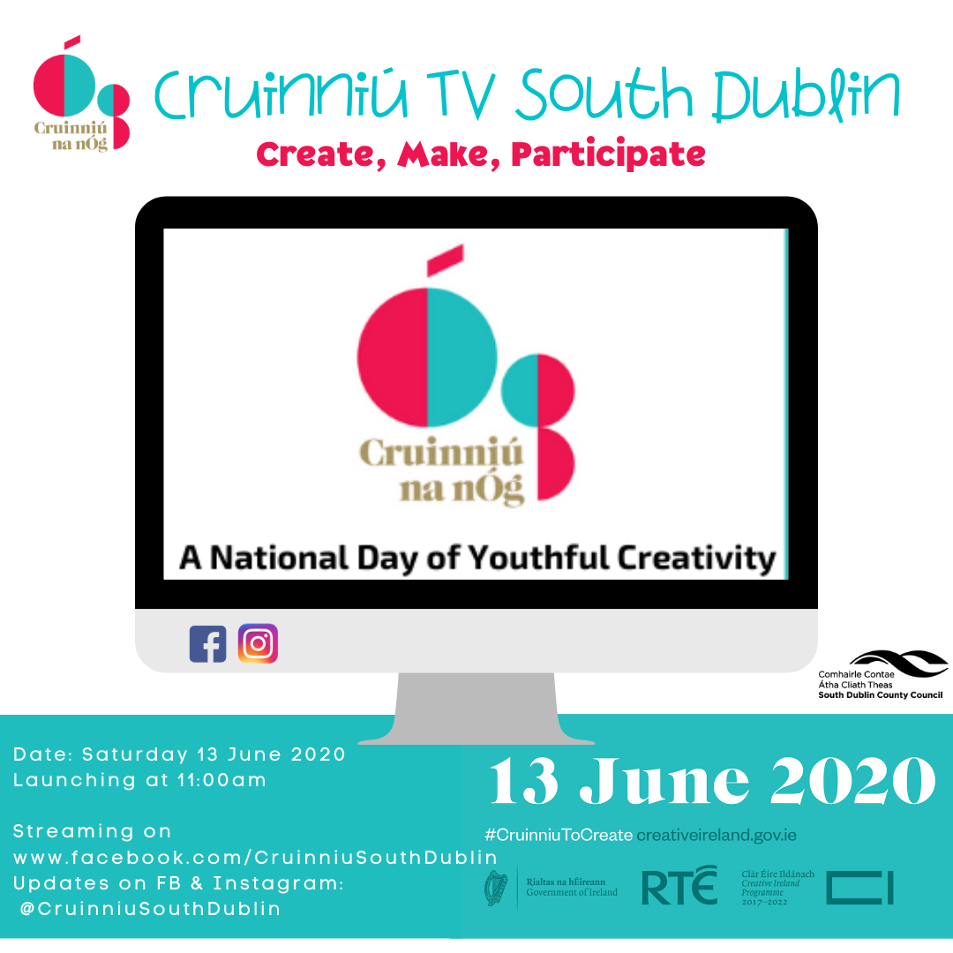

Slide 5
Creative Ireland South Dublin Creative Communities
Has a diverse flavour that blends traditional cultural identities with the emerging expressions of culture.
Culture and Creativity plays an essential role in the lives of our communities, building connection and well being, and offering insight about our experience and where we live.
Resulting in projects and events that have captured the public imagination and created many shared public moments.

Slide 6
Creative Ireland South Dublin
Strand 1 Awards: Artists in Collaborative Practice Ciaran Taylor and White Cane Studio explore personal experiences in a work for stage In The Dark. Filmmaker Eoin Heaney, with the support of filmmaker Coco Yanyan Liu, and Dr Jun Ni, creates a new short film Hear Me Now that explores with the Chinese Irish community in South Dublin, social identity, gender status and cultural crisis.
Strand 1 Awards: Incubation Award Wishful Thinking is a project designed to provide professional development support as well as production support to Matchbox Productions. Element include mentoring and support, a production shoot and a premiere of the work by the four young artists.

Slide 7
Creative Ireland South Dublin
Strand 2 Project Awards Naomh Bríd – Saol agus Oidhreacht: Muintir Chrónáin presents a musical story. Magdalene Research Programme: Rua Red action research programme and studio hub. Project Gallery: South Dublin Libraries presents a series of exhibitions that range from educational, local and artistic mediums. How I came to Here/Cesair: TCA with Solo Sirens will present a large scale participatory performance. Arts in the Golden Years: South Dublin Libraries a series of arts events aimed at older people, which will also be dementia-friendly.

