Slide 1
Community Call Help Desk
Report to Social, Community and Equality Strategic Policy Committee
19th May 2020

Slide 2
Community Call Help Desk

Slide 3
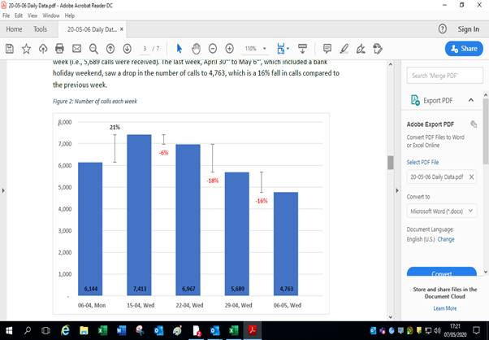
Community Call Help Desk
National Trend

Slide 4
Community Call Help Desk

Slide 5
Community Call Help Desk

Slide 6
Community Call Help Desk

Slide 7
Community Call Help Desk

