Slide 1
Economic Enterprise & Tourism Development SPC
May 13th 2020
Grange Castle Business Park Project Updates

Slide 2
Contents
Projects Overview and Update
Business Park Development – Client Company Update
New Business – Update

Slide 3
Grange Castle –Projects Overview May 2020
Grange Castle West Access Road
Pocket Park and Castle Conservation
Small Works /Upgrade Projects
Aryzta entrance
Cycle Track upgrades
Grand Canal Greenway CCTV Upgrade

Slide 4
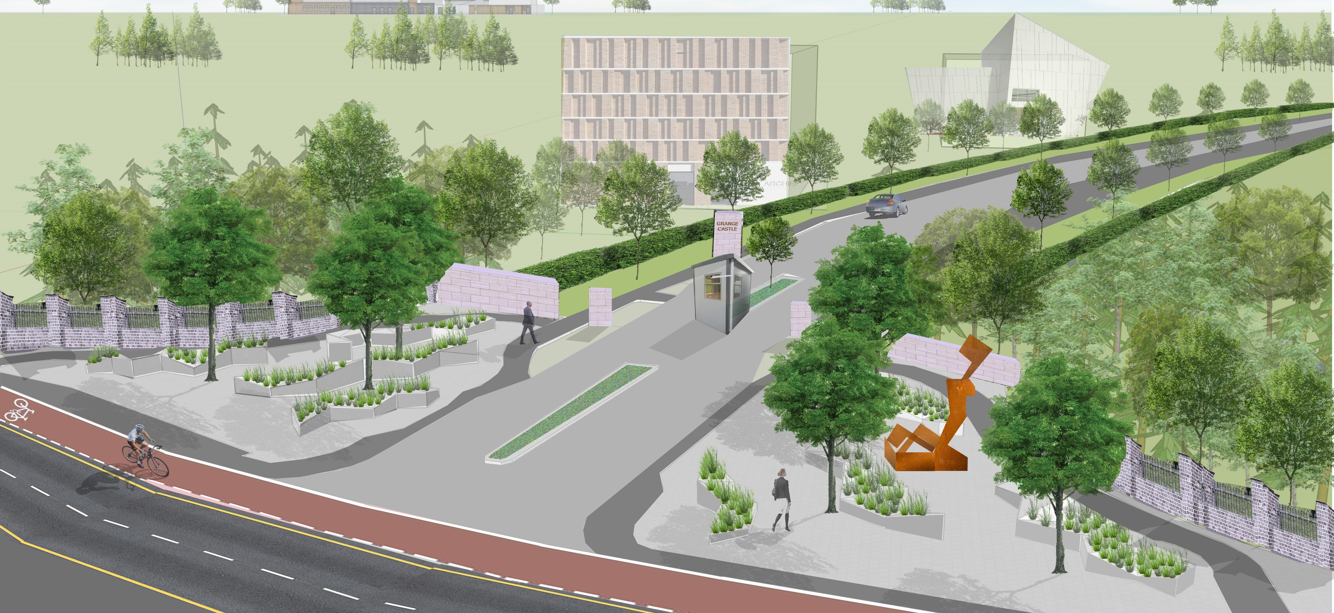
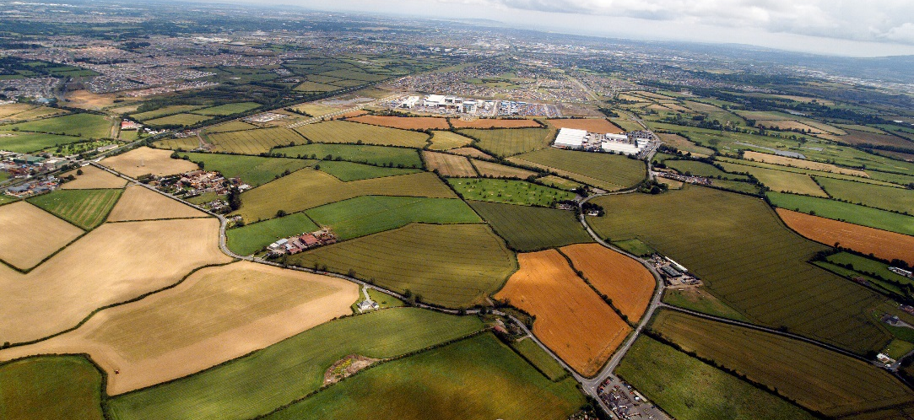
Grange Castle West Access Road
Contract commenced 18th March 2020
Due to Covid 19 restrictions – temporary cessation of works
Recommencing 18th May 2020
18 month Contract
Service Corridor & Access to GC West Lands
Standard as in existing Business Park
Value €12.6 million

Slide 5

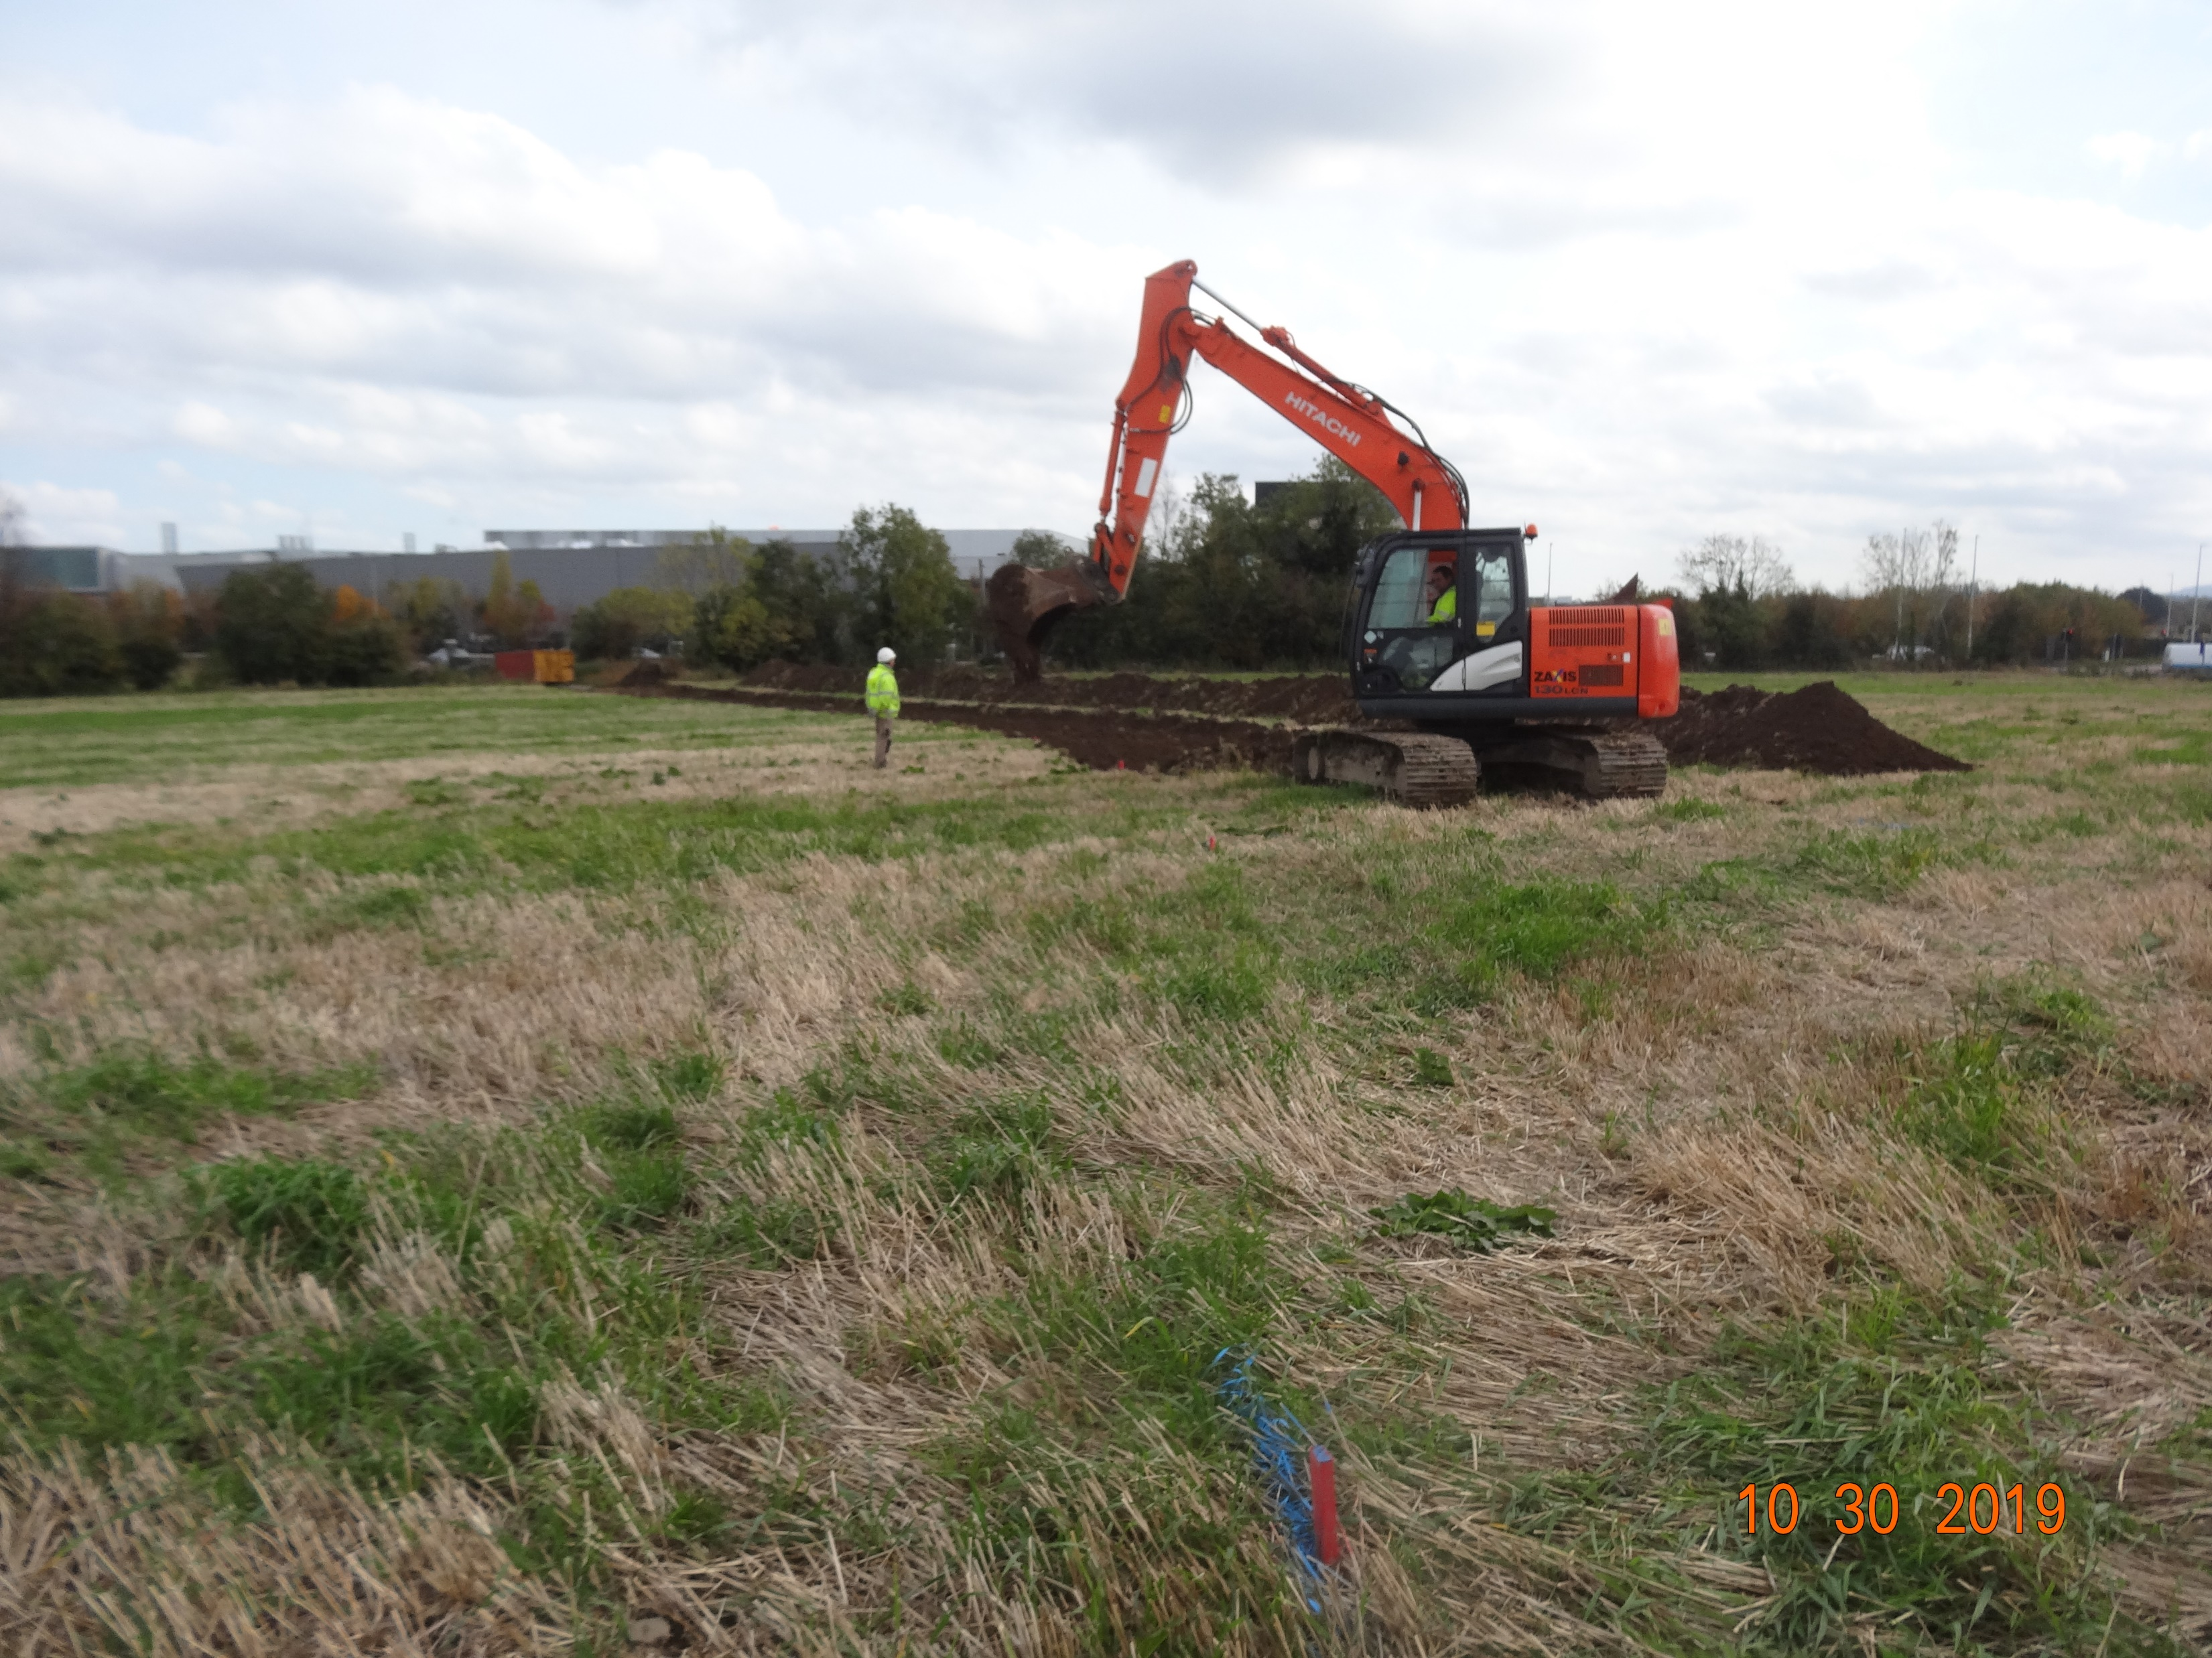
INFRASTRUCTURAL PLAN LAYOUT
Grange Castle West
Notes:
Site availability

Slide 6
Pocket Park
Pocket Park & Castle Conservation
    Tower House c.1580
Registered Monument
Archaeology
Access to Castle Structure
  Restricted guided access
Information Panels
  History
  Biodiversity
  Archaeology

Slide 7
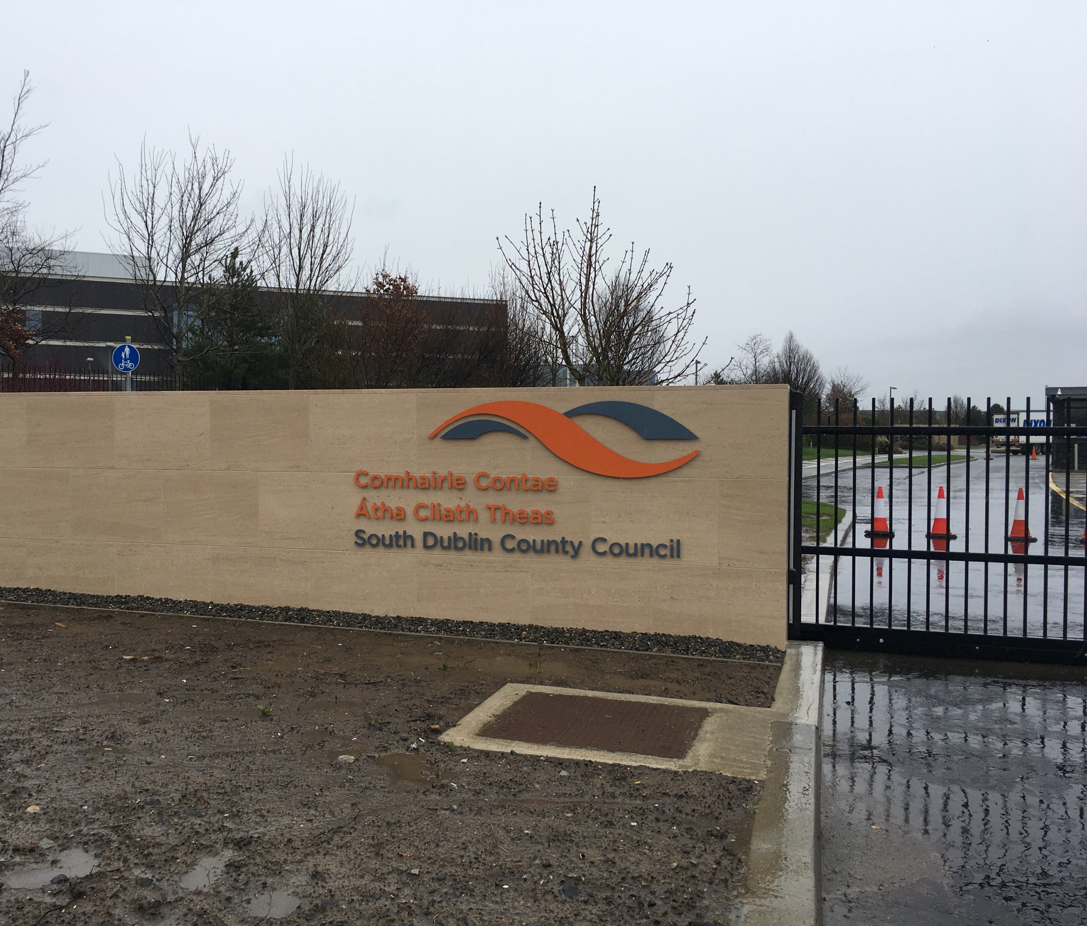
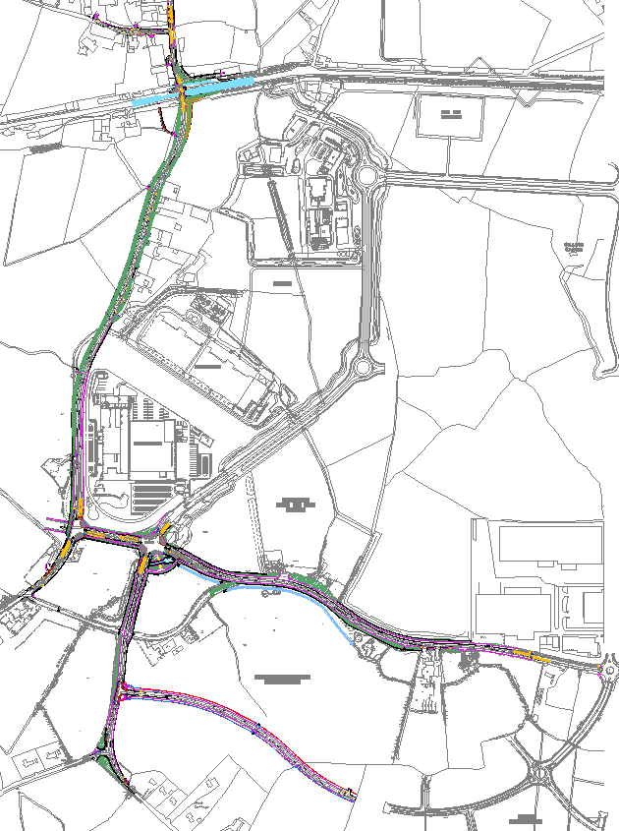
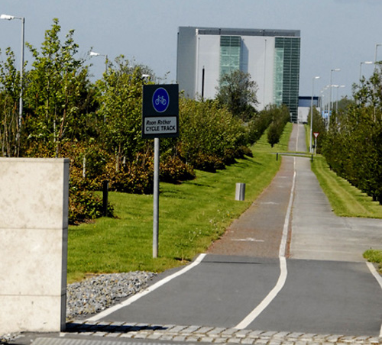
Small Works – Aryzta Entrance
Completion of R120/R134
Entrance aesthetic
Internal upgrades
New Bus Stop
Bus Route change

Slide 8
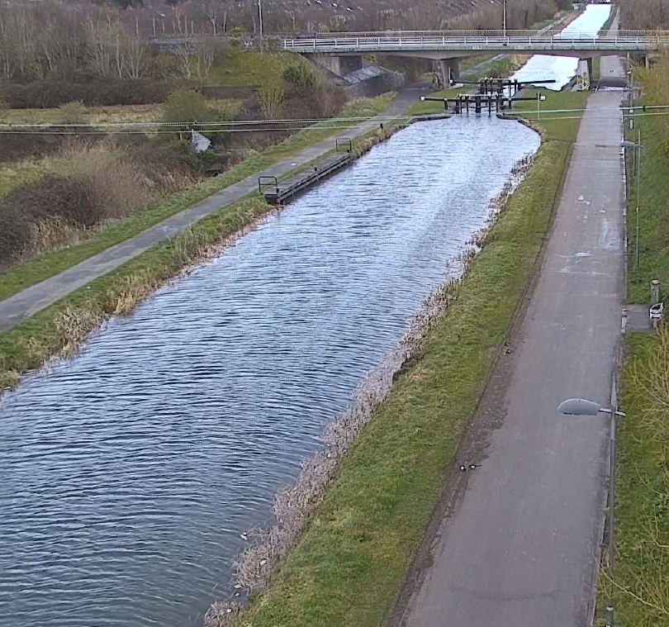
Grand Canal Greenway – CCTV Upgrade
Anti- Social Behaviour /Vandalism
Reduction in use as Greenway
High Spec Anti Vandal Poles
Longer range CCTV
Visibilty reinstated
Multi-agency approach
Illegal dumping

Slide 9
Client Companies Updates
Projects at Construction
Cyrus One Data Centre – Grange Castle South – expected completion Autumn 2020
Planning [further to S183 Disposals]
Microsoft
Amazon
Expansion
Takeda
Grifols
Edgeconnex
Google

Slide 10
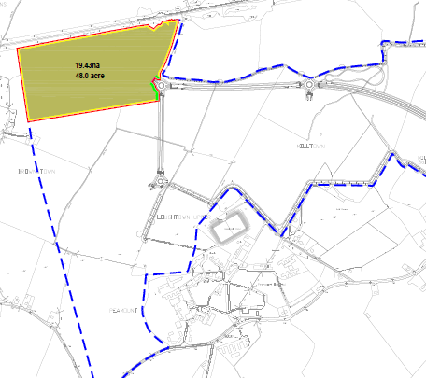
S183 Disposal
May Co Co Meeting
48 Acres at Grange Castle West
Subject to Terms & Conditions as listed in Headed Item Report.
To Lens Media for Media Park

Slide 11
Lens Media Development Proposal for Site
Full Service Media Park
1st in Ireland
Film, TV & Digital Content Production Studio Campus
Cater for International Markets
185,000 sq. ft Production Space
100,000 sq. ft Workshop Space
1000 sq. ft Production Offices
12 Sound Stages
9 to be constructed initially

Slide 12
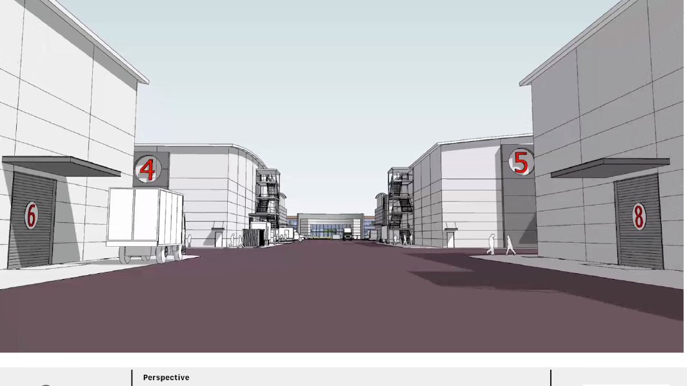

Slide 13
Economic Development of the County
€125 million invested in Development of the Media Park
1800 New Jobs
Plus c. 1800 Ancillary jobs
Ratio typical of similar facilities elsewhere
Construction stage 1200 -1500 jobs
c. 150 Consultants /Advisers on the project

Slide 14
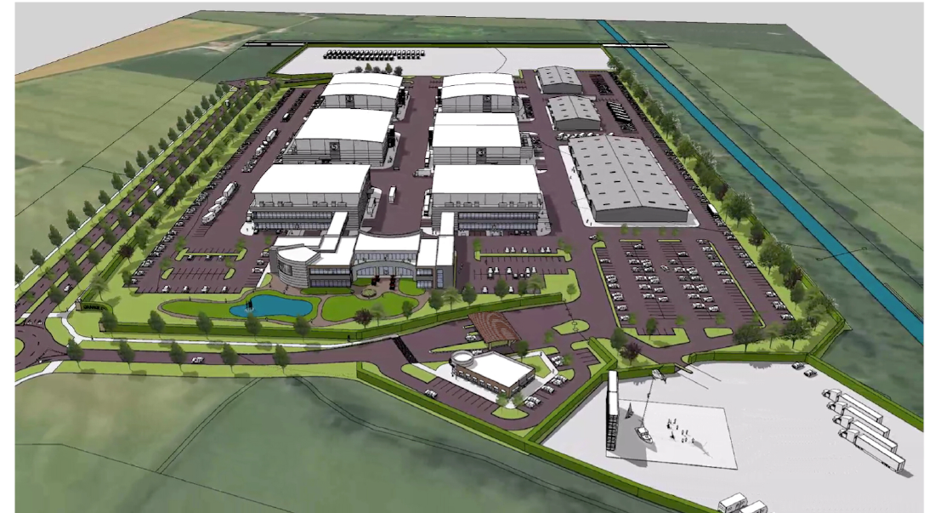

Slide 15
