Slide 1

Clonburris (Phase 1)
Housing Proposals
Council Meeting
11th May 2020

Slide 2

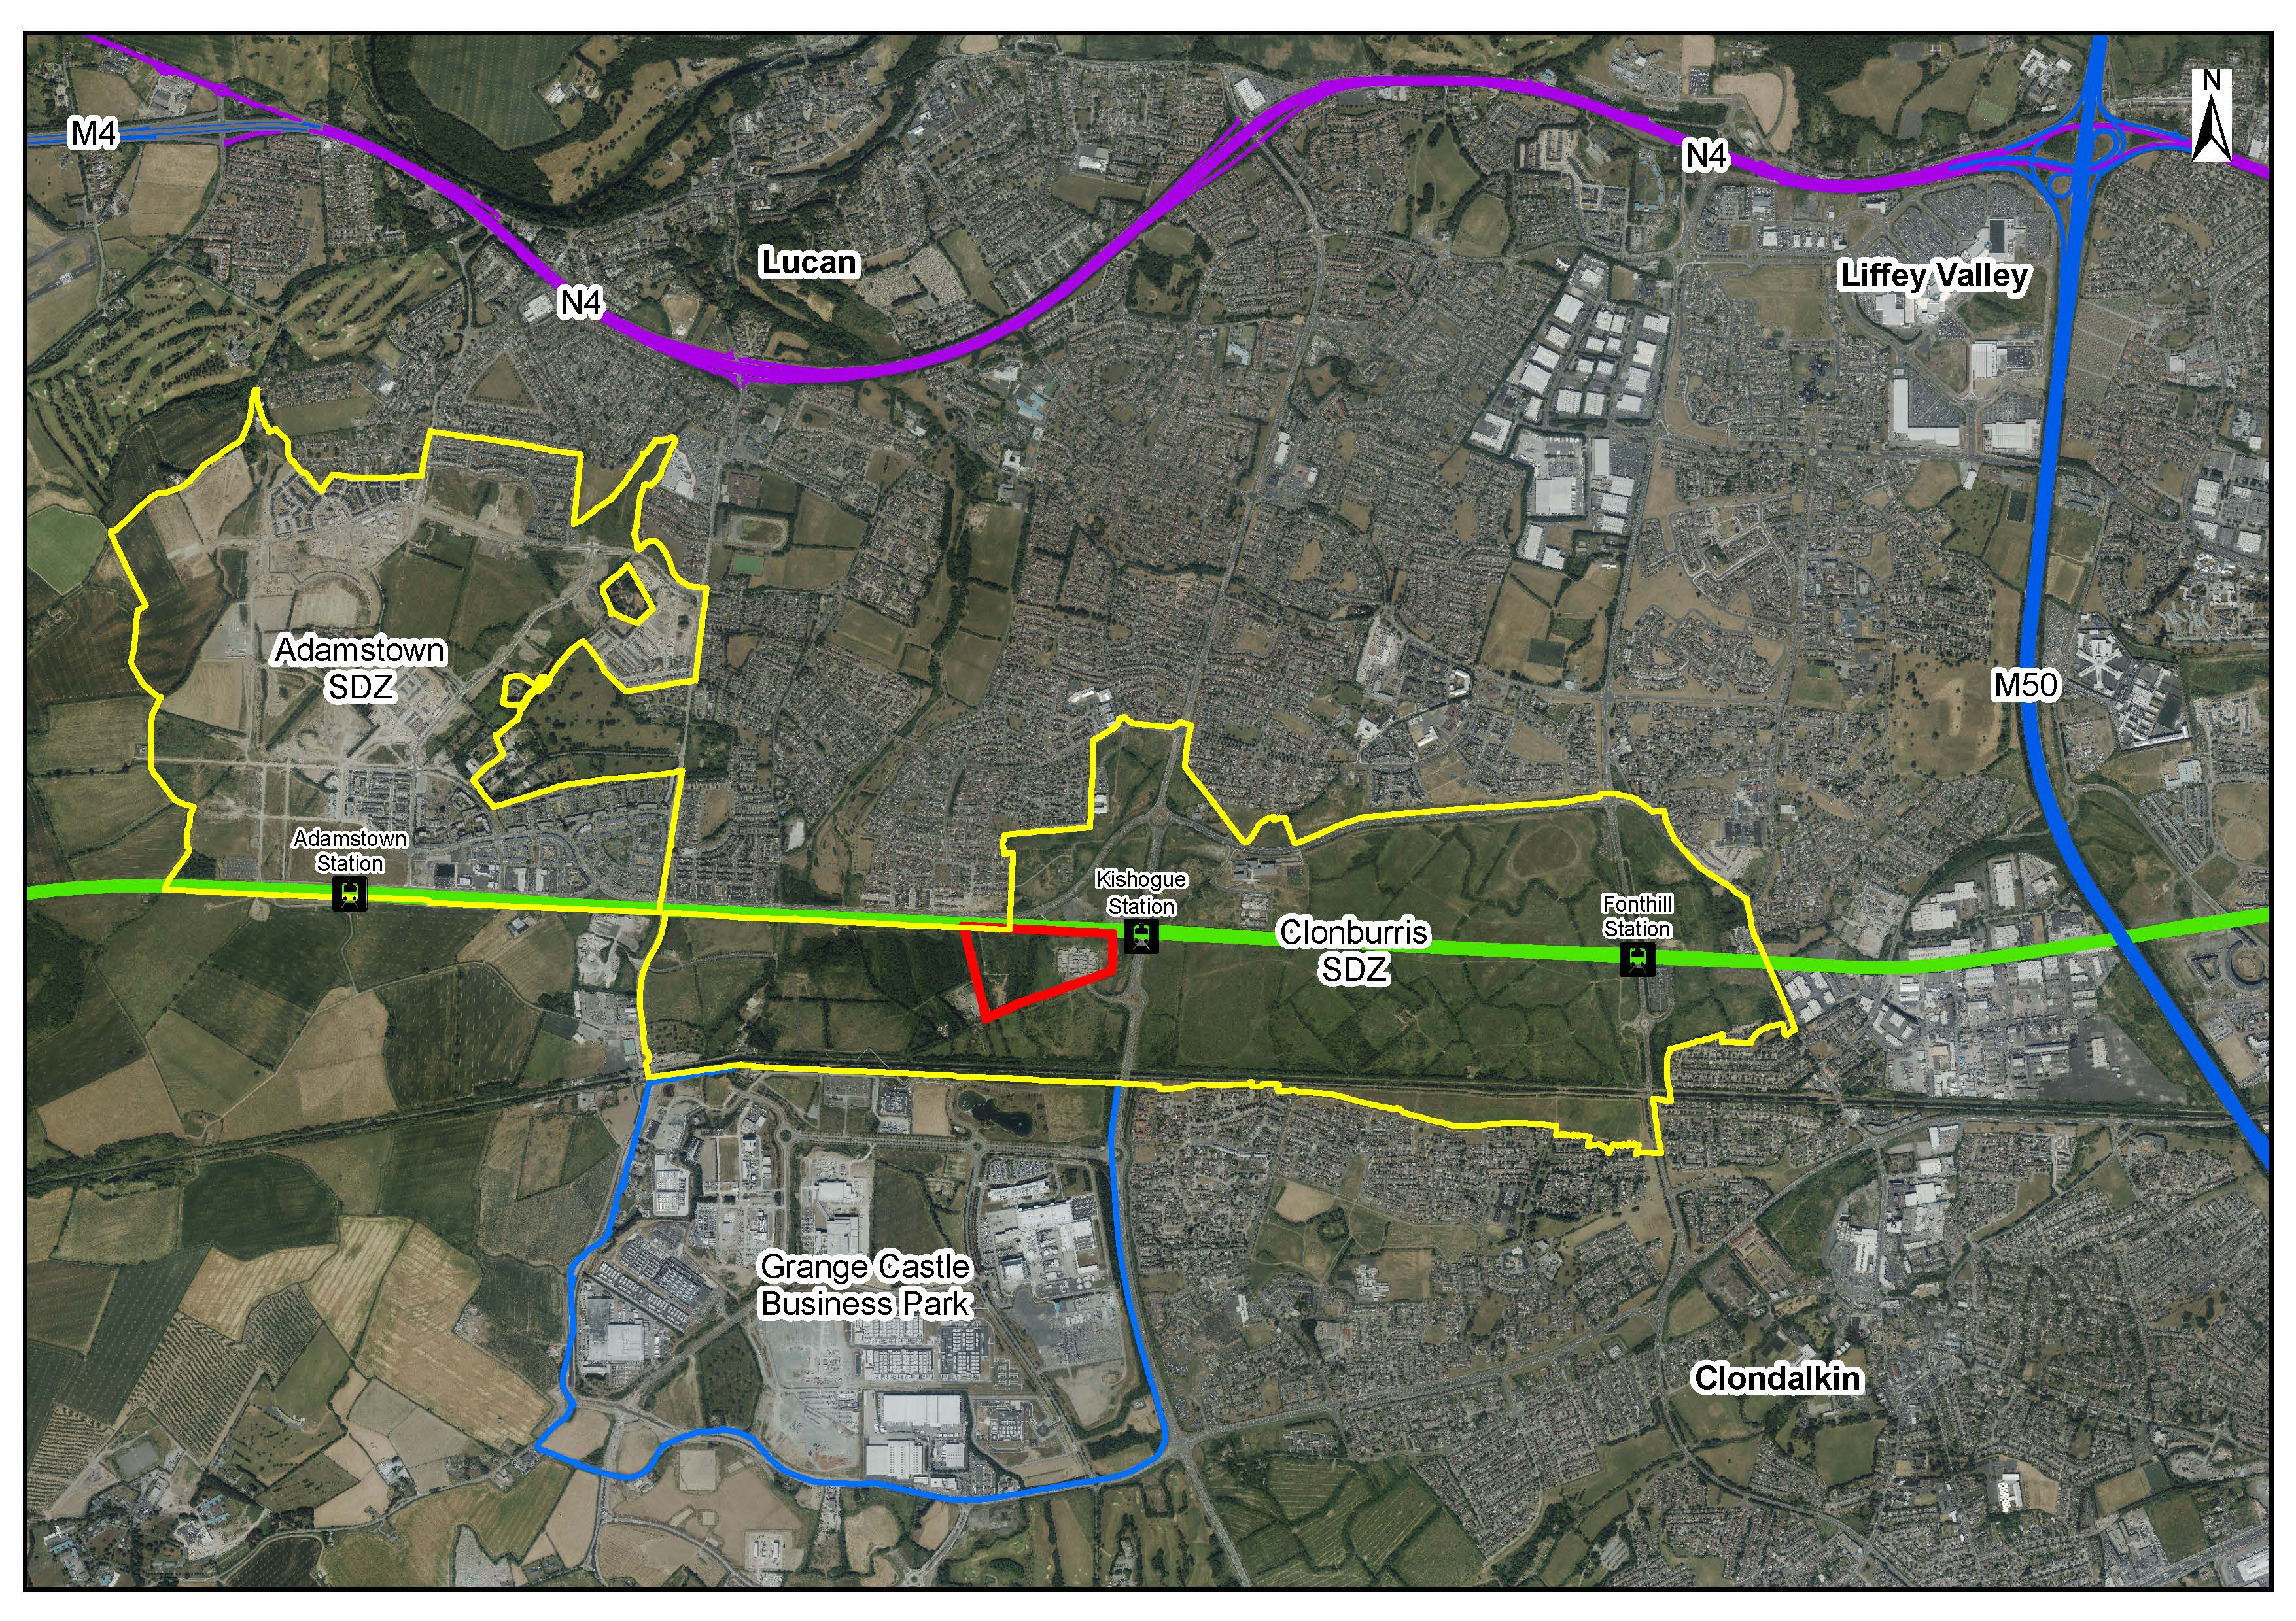
Clonburris SDZ & Phase 1 KSW

Slide 3
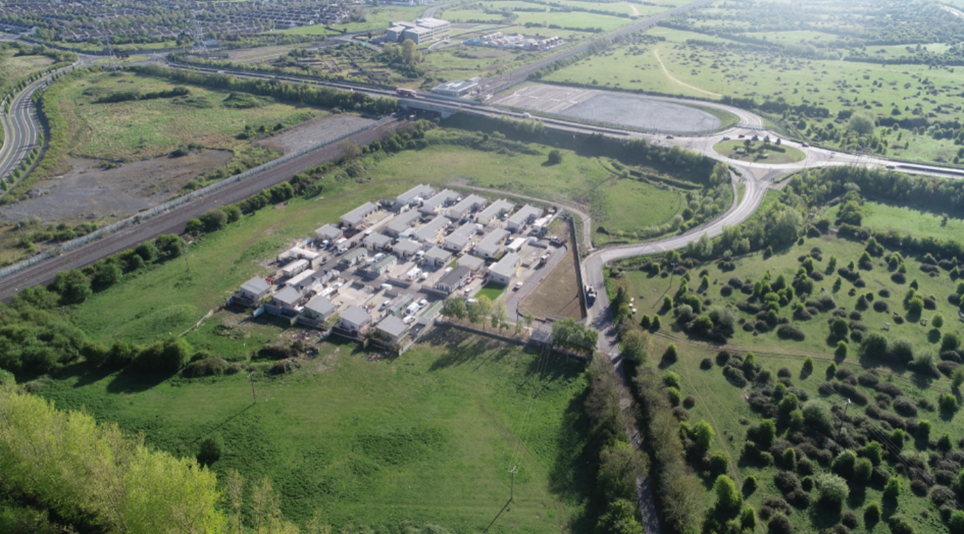
Context
Location
SDZ
11k homes
Council owned lands / 2,600 homes
Phase 1 in Kishogue South West
Zoned for new residential (Dev Plan)
Kick start SDZ development

Slide 4
Potential
Phase 1 master plan
9.69 hectares
Sustainable, quality new neighbourhood
Connectivity, transport & education links
High quality green amenity areas (2.29ha)
Layout & typologies- capacity for ≈ 274 homes
1-bed 15%; 2-bed 28%, 3-bed 49%; 4-bed 8%
Existing accommodation on site

Slide 5
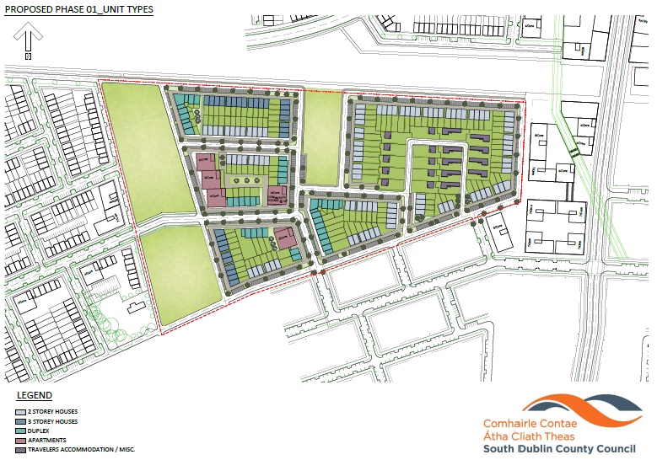
Potential

Slide 6
Tenure
Affordable Homes:
Policy objective DHPLG / Council
SSF provisional approval → unlock land for accelerated delivery
Demand! 2,586 Expressions of interest
  2,106 for Clonburris 1,028 / 666 / 412
Opportunities for buyers & provides stability
Early to market in SDZ / prices / location
Affordable rental–policy?, AHB partner, cluster, market (30% discount?), costs, modelling

Slide 7
Tenure
Social Homes:
274 social homes not feasible (policy)
1/3 provides social mix
Private Homes:
Sufficient privately held land in adjacent areas
No private homes proposed in Phase 1
Proposed Tenure Mix | 1-bed | 2-bed | 3-bed | 4-bed | Total
Social | 8 | 15 | 59 | 8 | 90
Affordable | 32 | 62 | 75 | 15 | 184
Total | 40 | 77 | 134 | 23 | 274

Slide 8
Indicative Tenure Layout
Subject to detailed design & consultation

Slide 9

Affordable Sale Price
Market Price assessment ??
Affordable Price (minimum -10%)
Forego value of Council land to achieve affordable homes
Anticipated construction costs (apartments)
Serviced sites fund (max €50k per affordable home -can be weighed across types)
Market demand, fluctuations & projections

Slide 10
Possible Affordable Prices
Home Type | 1-bed | 2-bed | 3-bed | 4-bed
Projected Market Value | €180k | €240k | €290k | €325k
Max. Affordable Price 10% discount | €162k | €216k | €261k | €292k
Mortgage Requirement (1st Time Buyer) | €146k | €194k | €235k | €263k
Indicative monthly mortgage repayment (RIHL-2.995% fixed, incl. MPI) | €688 | €908 | €1,099 | €1,231
Approx. Income Level Required | €28k | €38k | €48k | €51k

Slide 11
Existing Accommodation
10 bays, 10 group houses and small, adjacent community facility
Existing vacancies
Some families looking for social housing
Overcrowding on some bays
Relocate/integrate community facility
Consultation with families, LTACC & other reps to reach agreement

Slide 12
Land value
Council owned land = asset
Subject to Members’ discretion (s.183)
Value included in projected building costs
Subsidise affordable prices
Support social housing
Design team / Part 8 late 2020
AHB Partner for Affordable Rental
Design & build procurement / finance & sale
First homes in 2022
Delivery

Slide 13
Key Considerations
Proposal & tenure mix / prices?
Will land value hold through procurement?
Procurement must support prices - if not, proposal may require amendment
National affordable housing scheme
Land value foregone / trade-off for delivering affordable housing
Land disposal–licence to build & step-in rights

Slide 14
Next Steps
Members’ agreement to:
progress detailed design & Part 8 on types & tenures
procurement of contractor & appointment of AHB Partner
Affordable sale prices at 10% discount
proceed ultimately to land disposal (s.183)
facilitate accelerated delivery of much needed social & affordable homes

