Slide 1







Local Enterprise Office
South Dublin
Response to the
COVID-19 Pandemic

Slide 2
Local Enterprise Office
Supports
https://www.localenterprise.ie/response/

Slide 3
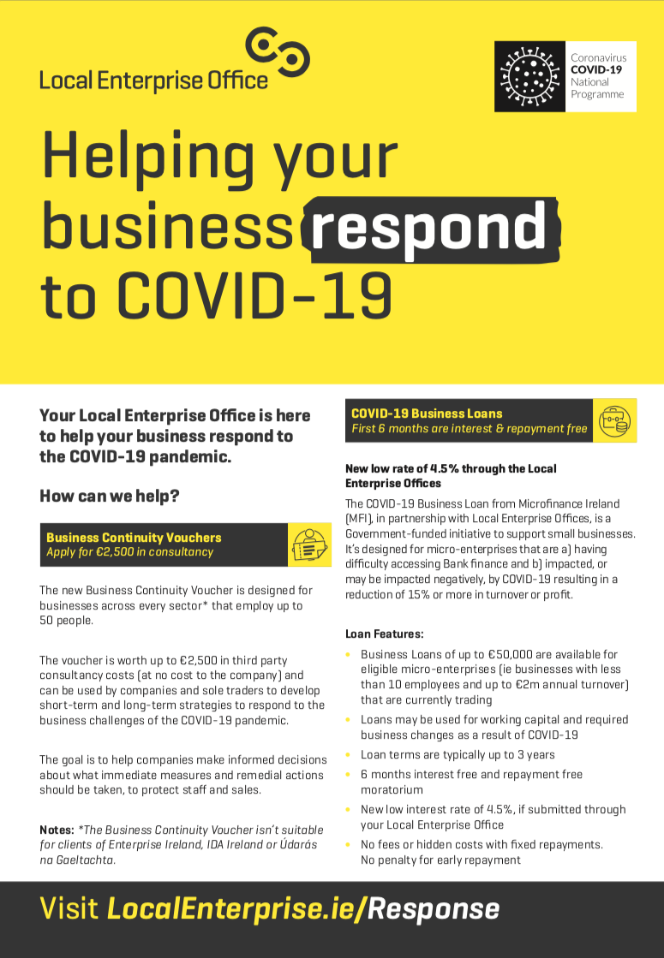
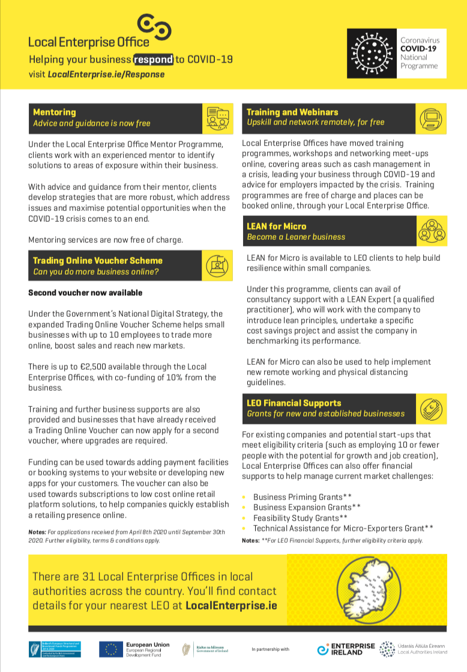
https://www.localenterprise.ie/response/
Local Enterprise Office Supports
Comprehensive list detailing all Local Enterprise Office supports available to SMEs during the emergency
BCV / TOV / MFI Loans / Financial Grants / Training & Mentoring / LEAN for Micro
Available to download from the Local Enterprise Office Response site

Slide 4

Business Continuity
Voucher

Slide 5
Business Continuity Voucher
Worth up to €2,500 in 3rd party
consultancy costs
Designed for businesses across every sector that employ up to 50 people
Make informed decisions about what immediate measures and remedial actions should be taken, to protect staff and sales

Slide 6
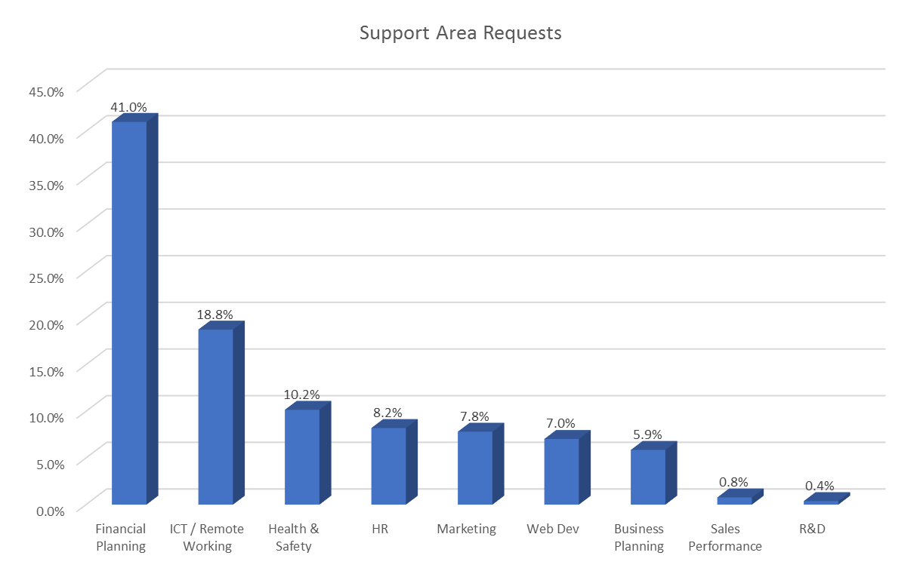
Business Continuity Application Applications
Applications to 10th May excess 360
Approval rate 90%
Support for Financial Planning / support key concern

Slide 7
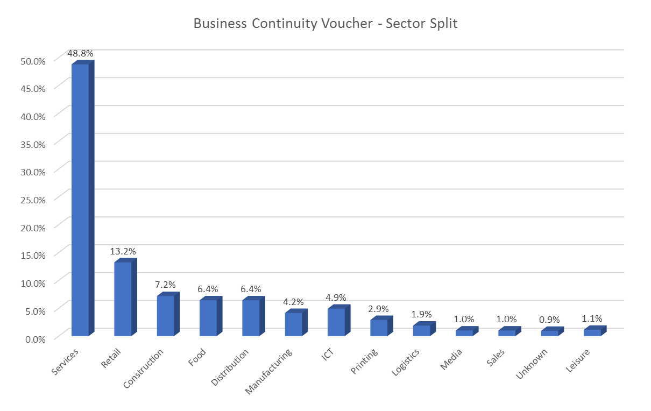
Breakdown of Applications by Sector

Slide 8

Trading Online
Voucher

Slide 9

Expansion of the
TOV Scheme
Up to €2,500 for ecommerce and digital marketing activities (70% – 30% split)
Match-funding for TOV application has been reduced from 50% to 10%
2nd application for a TOV is now permitted for ecommerce system upgrades

Slide 10
Expansion of the
TOV Scheme
Additional Workshops organised – now running weekly in South Dublin ( 5 held during March / April) with almost 300 attendees
Plus availability on additional Open National ‘TOV Workshops’
Formal Applications for TOVs have significantly increased –
In excess of 50 Formal Applications approved / in process for approval currently
(Average approvals annually – 50)

Slide 11

Online Training
& Mentoring

Slide 12

Cash Management in a Crisis
2-hour sessions over 5 days
Small cohorts (16 max) to keep sessions interactive and relevant to participants
Topics include: managing debtors and creditors sensibly; funding options available to SMEs during the crisis

Slide 13
Leading Your Business Through COVID-19
2-hour sessions over 5 days
Small cohorts (16 max) to keep sessions interactive and relevant to participants
Topics include: creativity and problem solving; scenario planning your finances; leading yourself and others well

Slide 14
Other Online Programmes
Virtual Networking
Selling Online / Moving your business online
Lean Workplace Organisation
Webinars in topics such as remote working and video conferencing tools for SMEs
Online 1-1 mentoring

Slide 15
Local Enterprise Office – South Dublin
Communications……………………..

Slide 16

LOCAL NEWSPAPER ADVERTISING

Slide 17
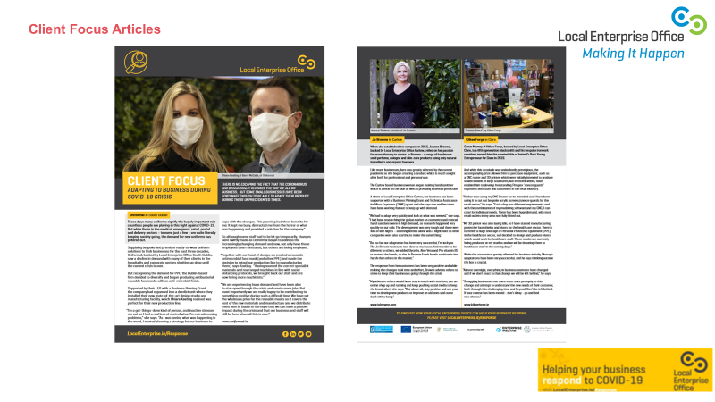
National Client Focused Campaign
PRESS COVERAGE

Slide 18
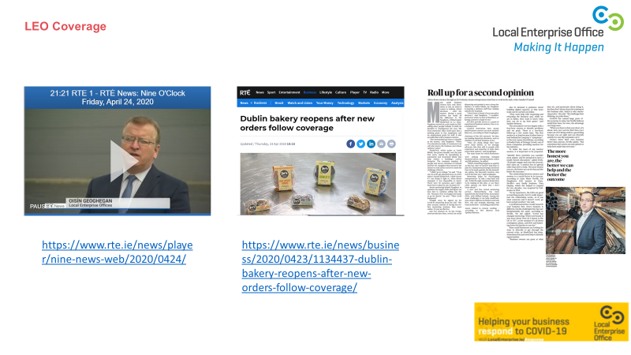

Slide 19
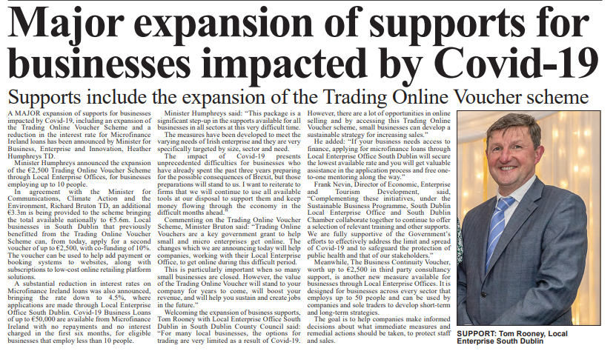
Media Articles
Media Articles
Press Releases
Public Notices
Tenders
Admin
Intranet
Major expansion of support for businesses impacted by Covid 19
Return to List
Documents
The Echo
Weekly Articles / Press Releases on Support for Business
On-line Business Journals

Slide 20
Thank You
Tom Rooney
Head of Enterprise – LEO South Dublin

