Slide 1
Killinarden Housing Proposals
Council Meeting
9th March 2020

Slide 2
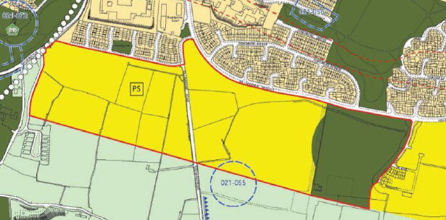
Context
Council owned lands
500 homes capacity (medium density)
Zoned for new residential (Dev Plan)
Elder Heath success (Council/AHB)

Slide 3
Opportunity
Preliminary master plan
Vision:
Sustainable, quality new neighbourhood
Edge of city / foothills of Dublin Mountains
Links to nature, communities, education, employment
New community and sporting facility
Facilitated by scale and nature of proposal.
Complemented by Killinarden Pk proposals

Slide 4
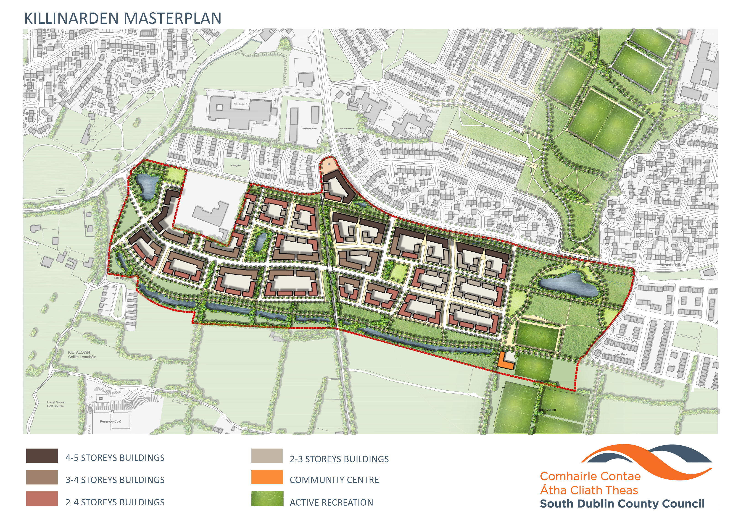
Opportunity

Slide 5
Tenure Mix
Affordable Homes:
Policy objective DHPLG / Council
SSF provisional approval → unlock land for accelerated delivery
Opportunities for buyers & provides stability
2,345 Expressions of interest
1,515 for Killinarden 382 / 401 / 732 Risk?
But: first to market / pricing / RIHL
Affordable rental?

Slide 6
Tenure Mix
Social Homes:
500 social homes not feasible (policy/location)
100 = integration / meets some need
Private Homes:
Tenure integration & stability
Success of existing adjacent developments
Accelerated delivery / scale and capacity
Competitive tender to support:
Pricing of affordable homes / project funding / community facility / income for future land acquisition

Slide 7
Proposed Tenure Mix
Proposed Tenure Mix | 1-bed apartment | 2 bed apartment /duplex | 3 bed house /duplex | 4 bed house | Total
Affordable |  | 113 | 185 | 2 | 300
Social | 15 | 15 | 60 | 10 | 100
Private |  |  | 95 | 5 | 100
Total | 15 | 128 | 340 | 17 | 500

Slide 8
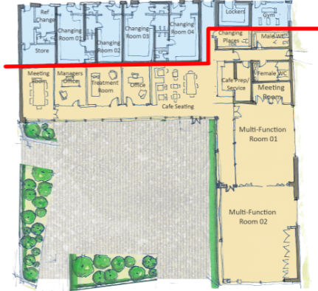
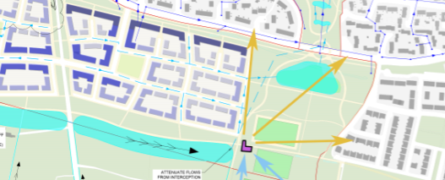
Proposed Community
& Sporting Facility
adjacent new community/sports facility
connecting and meeting needs of existing and new residents/communities
Will be enhanced by Killinarden Pk proposals
Sacred Heart FC

Slide 9
Affordable Sale Price
Market Price
Affordable Price (minimum -10%)
Value of Council land (forego value to achieve more affordable homes?)
Anticipated construction costs (apartments)
Serviced sites fund
(max. €50k per affordable home but can be weighed across types)
Market demand & projected future prices

Slide 10
Provisional Affordable Sale Price
Home Type | 2-bed | 3-bed | 4-bed
Projected Market Value | €250,000 | €310,000 | €340,000
Projected Maximum Affordable Home Price (15%) | €212,500 | €263,500 | €289,000
Mortgage Requirement (1st Time Buyer) | €191,250 | €237,150 | €260,100
Indicative monthly mortgage repayment (RIHL-2.995% fixed, including MPI) | €894 | €1,109 | €1,216
Projected Income Level Required | €37,500 | €47,000 | €50,000

Slide 11
Land value
Council owned land = asset
Subject to Members’ discretion (ultimately land disposal required)
Included in projected building costs
Used to subsidise affordable home prices
Competing considerations
Balanced proposal
Delivers affordability, community facility and some value for future acquisition

Slide 12
Key Considerations
Proposal & tenure mix / prices?
Will land value hold through procurement?
Sufficient market interest for competitive procurement process?
Procurement must support prices - if not, proposal may require amendment
National affordable housing scheme
Land value foregone / trade-off for delivering affordable housing

Slide 13
Next Steps
Members’ agreement to:
progress type & tenure mix as outlined
competitive procurement process to appoint joint venture partner
approve partner to bring outline masterplan to planning stage
proceed to land disposal (s.183)
facilitate accelerated delivery of much needed (affordable) homes

