Slide 1
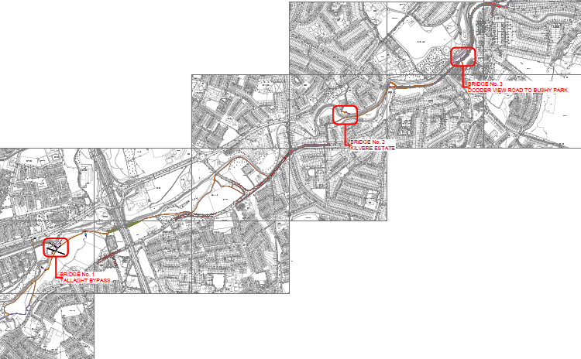
DODDER GREENWAY Phase 1 – Bridges

Slide 4
Bridge 1 – Firhouse Road

Slide 5
Bridge 2 – Kilvere Estate

Slide 6
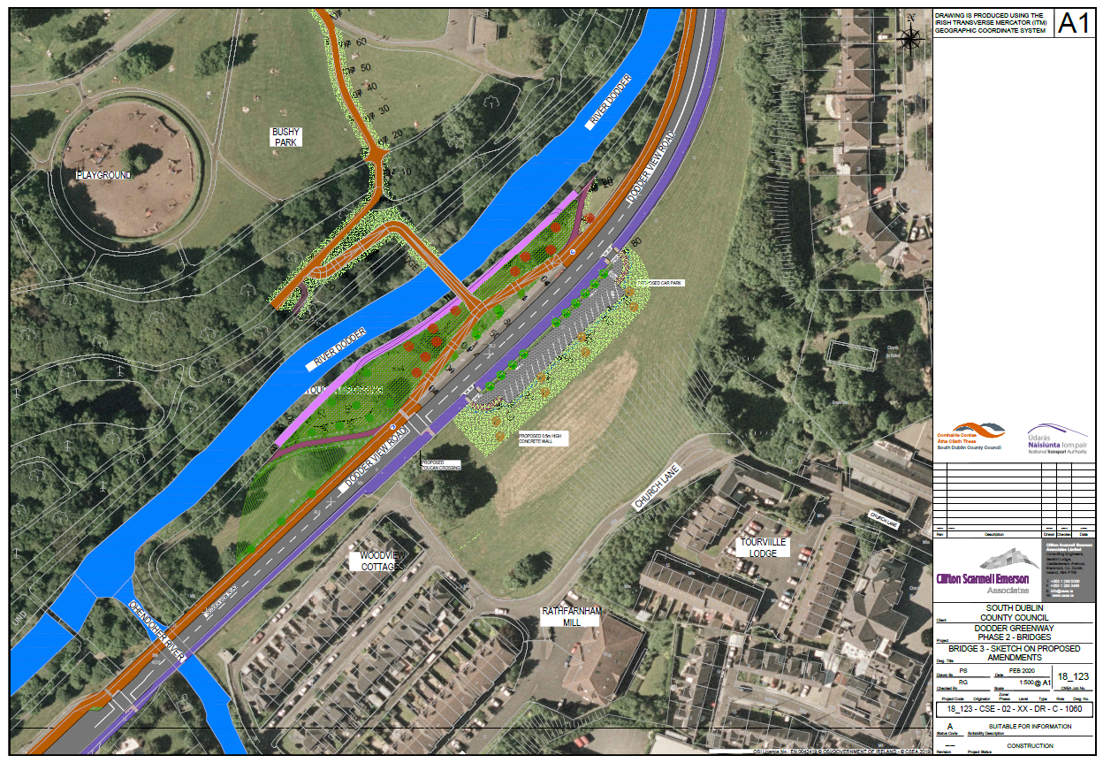
Bridge 3 – Bushy Park

Slide 7
Project Background 2012 Feasibility
Feasibility carried out in 2012.
Greenway to be on a par with the best greenways in the world.
Over 17km long, linking Sir John Rogerson’s Quay to the entrance to the Bohernabreena reservoirs at Glenasmole
South Dublin County Council are responsible for 14km of the scheme from the Bohernabreena Reservoir to Orwell Park in Rathfarnham.

Slide 8
Public Engagement
In 2017 a number of general & individual public presentations were held in County Hall;
General Public Information Event.
Tallaght Community Council.
Knocklyon Network.
Partas Community Centre, Bolbrook.
With project briefing events, media articles and social media posts around this time a huge effort was made to raise awareness in the local community regarding the project and associated Part 8 process.
Dublin Mountain Partnership.
Killtipper Care Nursing Home.
Dodder Action Group.
Thomas Davis GAA.

Slide 9
Planning Background
Local Councillors of Rathfarnham, Templeogue, Terenure and the Tallaght Area were briefed on the project in County Hall on June 13th 2017.
The proposed development and accompanying Appropriate Assessment report were placed on public display for the statutory period of 8 weeks in 2017 from June 22nd to August 18th.
During this period submissions were accepted online or by post.
A total of 49 submissions were received, some with multiple items.
Councillors voted for Part 8 approval at the Oct 2017 Council Meeting.

Slide 10
Commencement of Works
Due to the complexity of the Project it is to be split into 3 phases.
Phase 1 – Bridges (Construction commenced – Completion due Jan 2021)
Phase 2 – Parkland links (Tender April 2020)
Phase 3 – On Road Works (Tender Q3 2020)
On Feb 4th, 2020 Murphy International Ltd were appointed as the Main Contractor to construct Phase 1 – Bridges.
On Feb 13th, 2020 an information email was issued to all Councillors informing of the appointment of Murphy International and impending commencement of the works.
Letter drops were carried out to residents and an information evening was held Feb 26th

Slide 11
Ecological Protection Measures
Ecologist appointed to supervise the Works
Bridges will be clear span, prefabricated off-site and craned into place.
Site clearance completed before the bird nesting season (1st March).
Invasive species treatment plan in place for Bridge 2.
Tree Protection Plan for three bridges.
Lighting design to minimise impacts on Bats.

Slide 12
Thank you
Any Questions?

