Slide 1
South Dublin Digital Strategy 2020 - 2023

Slide 2
Introduction
South Dublin County Councils Digital Strategy is focused on proactively responding to a changing environment. We want to help our communities be successful and active participants in the digital era.
The Digital Strategy seeks to build on National and Local plans - Creating opportunities for residents, visitors and businesses by addressing the challenges of the digital age.
‘Digital’ is not just about the technology or the content. It is about people. That is why this strategy focusses particularly on digital adoption.
Digital adoption means more widespread use of broadband services, with more people and businesses gaining the ability to use digital tools as they are intended and to the fullest extent.

Slide 3
South Dublin's Digital Readiness
In 2018, Indecon international economic consultancy produced a Digital Readiness Assessment (DRA) report for South Dublin. Covering both activities of households and businesses in the region, as well as the activities of the Council itself. Measuring from a wide range of sources including the Central Statistics Office and internal surveys.
South Dublin County Council has successfully implemented a policy of delivering online services including online payments, grant applications, library services, fix your street and more.
Free public Wi-Fi is available in 9 of South Dublin villages, community centres and in all of our library branches with over 170 PCs available throughout our branch network. Digital skills development programmes are also offered at our libraries and community centres.
Many businesses in South Dublin are already trading successfully online but many more could benefit from introducing an online dimension to their activities.
Approximately 92% of premises in South Dublin have access to High-speed Broadband.
Three surveys were also performed in 2019 to gain some insight into citizens (council website, social media, libraries, PPN), community groups (LCDC) and businesses (South Dublin Chamber) digital experiences, practices and challenges.

Slide 4
Strategy Process – Consultation & Results
Extensive consultations were carried out (Citizen & Community and Business). The results were used to produce a strengths, weaknesses, threats and opportunities analysis (SWOT) for South Dublin. This summarises the overall position of South Dublin in the context of the developing digital readiness. Based around the key areas of Digital Skills, Economy, Infrastructure and Services.
Strengths Highly educated population. Location - central major city, high quality transport network, motorways, rail and buses. Committed Local Authority (innovative, leader) with skilled staff. | Weaknesses Fear of using internet, data protection and concerns around sharing personal information online. Lack of understanding of the potential of the digital economy/society. No definitive measure on the level of use by the community or enterprise.
Opportunities Economic growth and job creation. Vibrant community sector. More accessible services. | Threats Cyber security. Social exclusion - sections of community being left behind. Reduced sales opportunities.

Slide 5
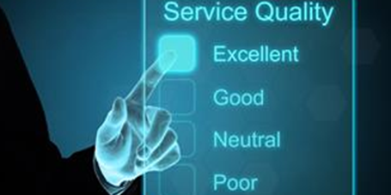
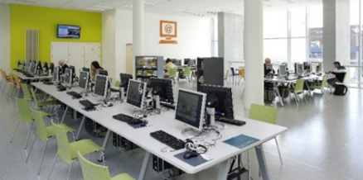
Themes of the Digital Strategy
Building on strategies put together at national level, public consultation and the DRA set the context in forming the four core strategic themes of South Dublin’s Digital Strategy –
Digital Infrastructure - Facilitate the development of high-speed broadband and digital infrastructure to all citizens and businesses.
Digital Skills - Champion inclusion and lifelong learning to ensure our communities are digitally skilled, confident and literate.
Digital Economy - Support business to build the skills and knowledge required to thrive in the digital future of South Dublin.
Digital Services - Enhance the delivery of South Dublin County Councils services by increasing the capability of its online services and platforms.

Slide 6
Key Objectives & Actions
Improve access to high-speed broadband and digital infrastructure/ technology to help our communities succeed in the digital world. Ensuring it is universally accessible, understood and used to the greatest extent possible by all citizens.
Look at the necessities of our different communities and identify the digital infrastructure gaps. Promoting funding streams to enhance access to digital technology to enable communities to fully engage with the digital society.
The development of a Broadband Connection Point in Glenasmole Community Centre. Providing onsite high-speed broadband access to those living and working in the area, while they await the rollout of the NBP fibre.
Review and enhance our libraries ICT infrastructure - computers and workstations, smart devices, 3D printers and meeting space technology.
Ensure citizens have the skills needed to participate fully in the digital world, through collaboration and by continuing to build on the skills development programmes offered at our community centres and libraries.
Further the County Library Services level of digital interaction with citizens and its role in providing training in digital technologies to those who require it.
Increase the digital skills of our citizens by collaborating with organisations that deliver education and training in digital skills. Ensuring greater citizen engagement and inclusion.
Assist organisations that aim to increase young people's awareness of, and engagement in digital skills attainment.
Encourage Age friendly technologies & skills, utilising Age Action Irelands Digital Training programme.

Slide 7
Key Objectives & Actions
Collaborate with SME’S to assist them in realising the benefits for their business of going digital and how to improve their digital skills.
Connect small businesses with the relevant training and resources to improve their online presence and digital capabilities, programme in place with the Chamber.
Support small businesses in South Dublin to enhance their online trading presence, through the Trading Online Vouchers and training.
Enhance SMEs knowledge in the online procurement processes.
With a "Digital First" ICT strategy for local authorities and with a high usage of e-government services in Ireland, South Dublin County Council is to increase the availability of online services and platforms.
Delivery of an online Integrated Housing System.
Development of an e-Planning Portal - Enabling online submissions of planning applications.
Delivery of a webcast for live council meetings.
Continue to provide relevant data in ‘open data’ format – enhancing engagements with innovators and data users on how to use data better, and how to improve and maintain open data.
Delivery of a Park Pavilions online access control and booking system. Exploring the expansion of this platform to enable the booking of sports pitches.

Slide 8
Conclusion
This strategy seeks to address citizens priorities to improve Digital Infrastructure, improve Digital Skills training, improve the opportunities for business and improve Council services.
This requires continuous organisational learning for South Dublin County Council - testing, iterating, improving and monitoring progress.
Performance will be measured through the delivery and levels of digital engagement, the number of premises with high-speed broadband access and the take up of digital services.
Existing inter-agency arrangements and projects will be further developed in the implementation of this strategy, supporting the key performance indicators.

Slide 9
Thank you! Questions?

