Slide 1
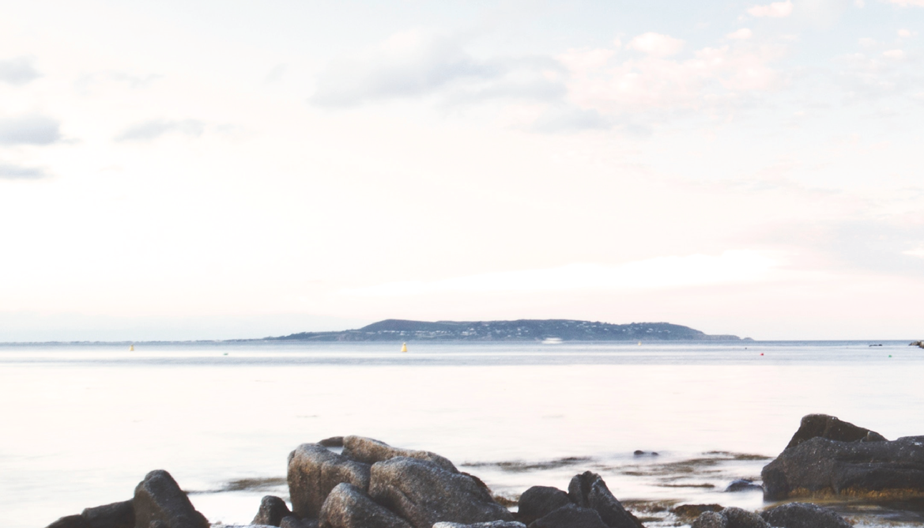



Climate Action Regional Offices (CAROs) – Local Authorities leading on Climate Action
Environment, Public Realm and Climate Change SPC SPC, South Dublin City Council
Tuesday 25th February 2020

Slide 2

The darkest blue is Dublin's coldest temperature during that time, the darkest red is Dublin's warmest.
Source @edhawkins #ShowYourstripes National Centre for Atmospheric Science, University of Reading.
Data: Berkeley Earth, NOAA, UK Met Office, MeteoSwiss, MeteoSwiss, DWD

Slide 3
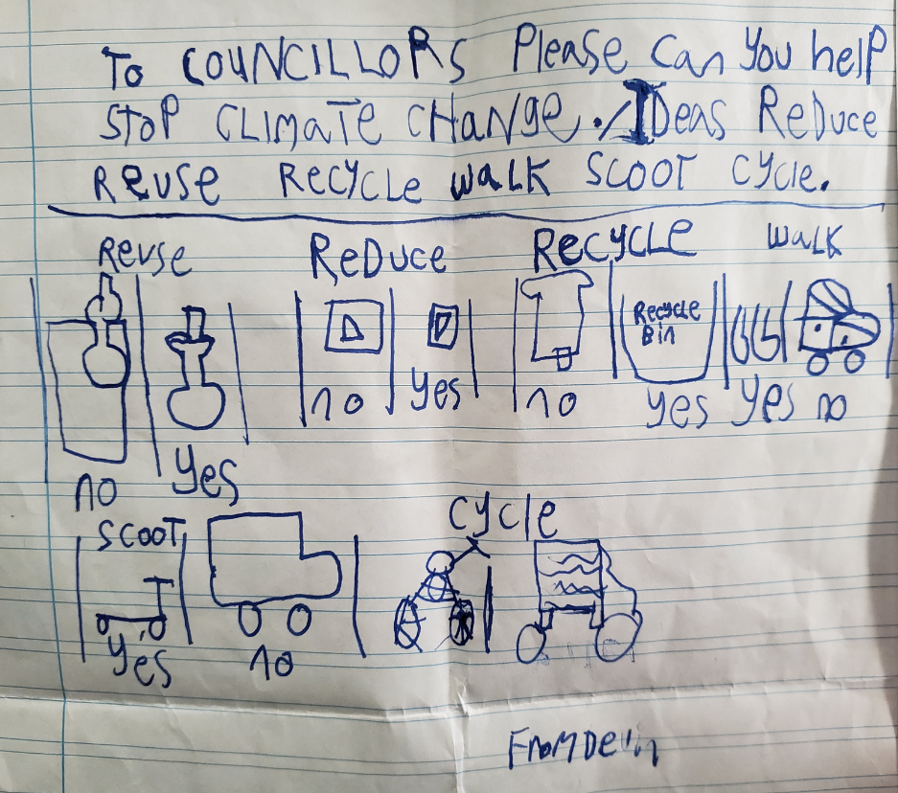

Slide 4

Presentation Outline
CARO Background
CARO Work Programme
Dublin Climate Change Action Plans
Mitigation and Adaptation examples

Slide 5

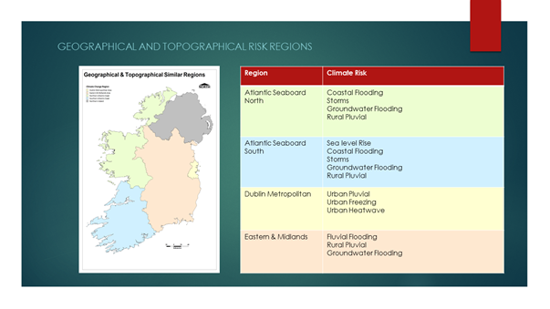



Slide 6
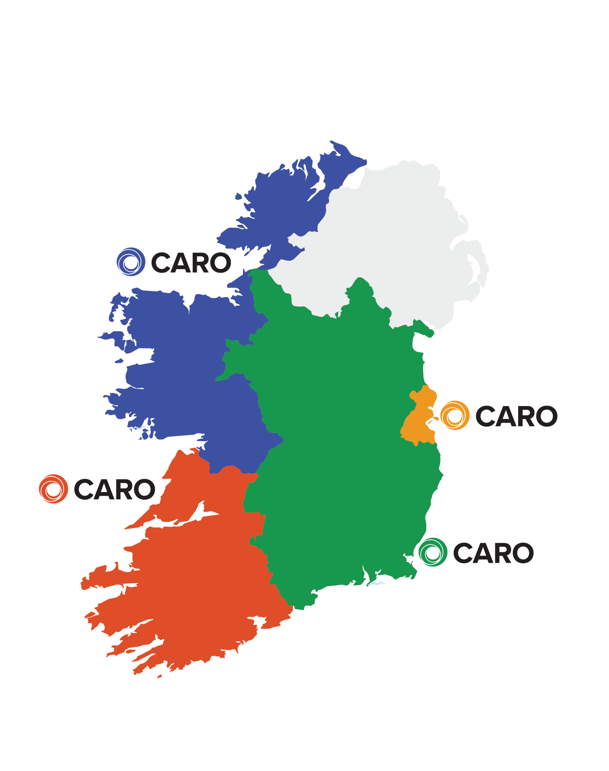





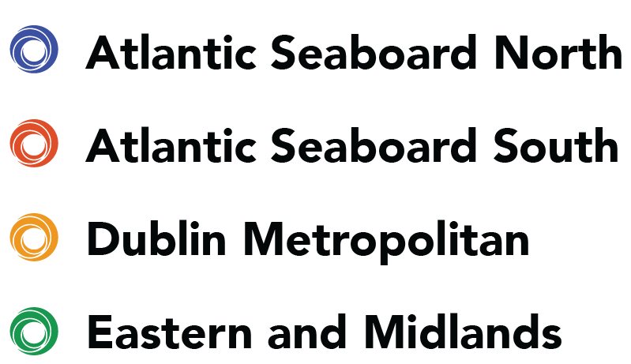



Climate Action Regional Offices - CARO
5 year funding from DCCAE
CARO Mandated to:
Build on Experience & Expertise
Drive Climate Action & Build Capacity within LA Sector
Coordinate Engagement across Various Agencies and Government Departments
Translate Sectoral Efforts to Local Level

Slide 7
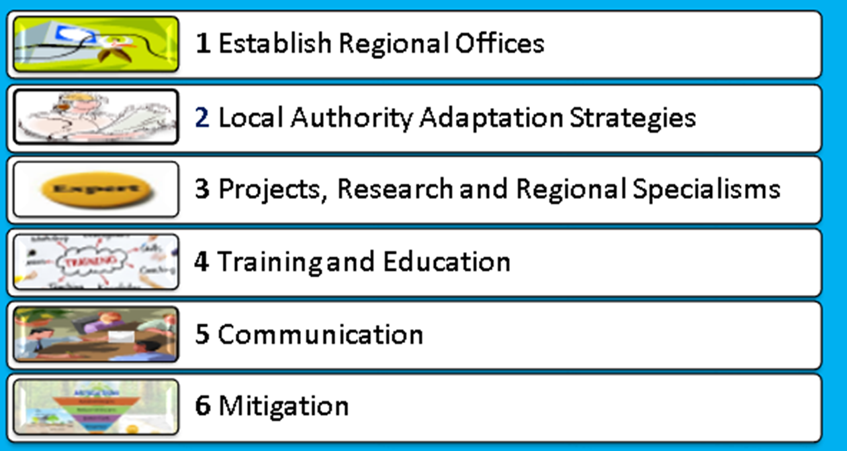
CARO – Work Programme 2019/2020

Slide 8




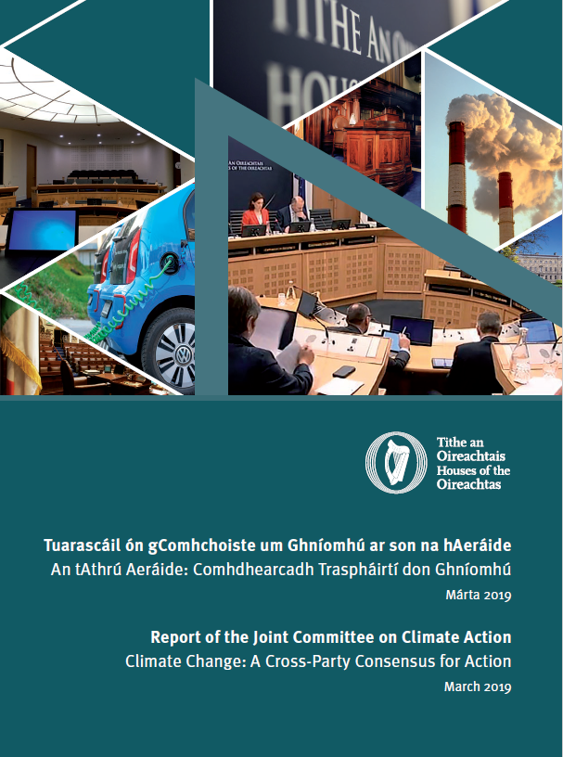

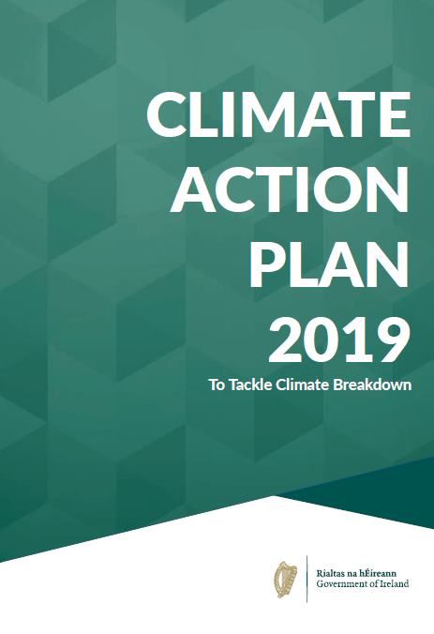
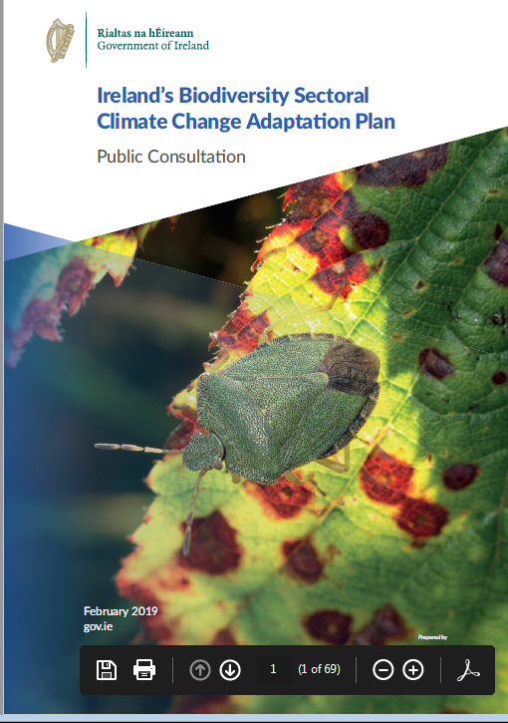
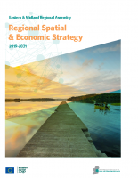
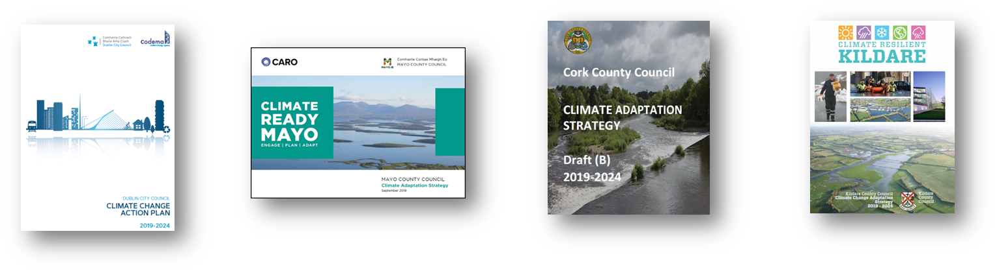
Climate Policy – Global to Local
International Conventions
European Climate Directives
National Climate Policy
Sectoral Plans
Local Authority Climate Change Adaptation/Action Plans

Slide 9
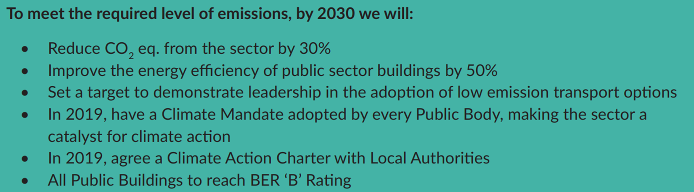
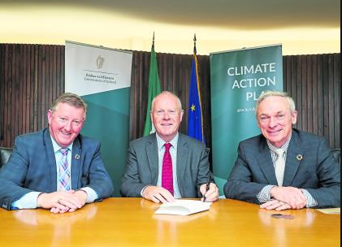
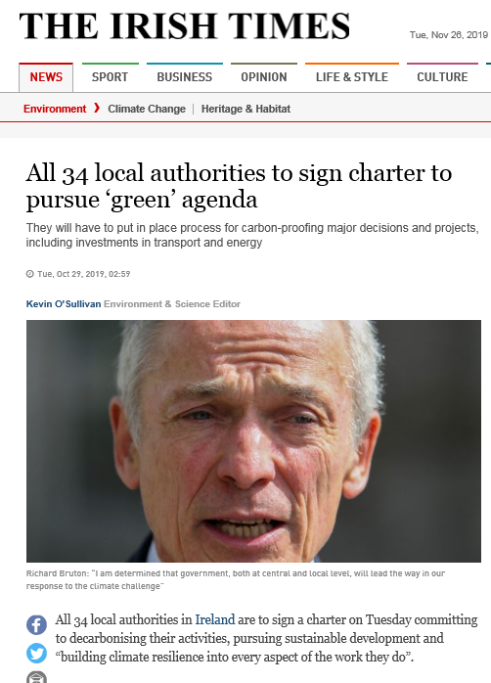
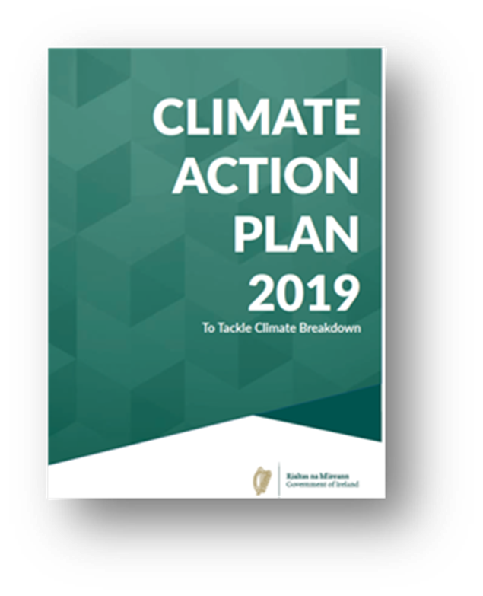

Slide 10
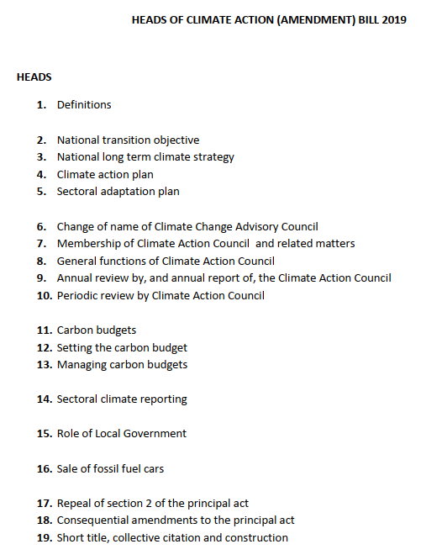

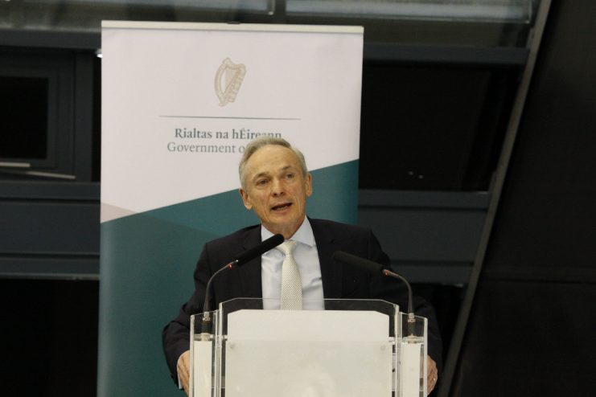

Heads of Bill – Climate Action

Slide 11
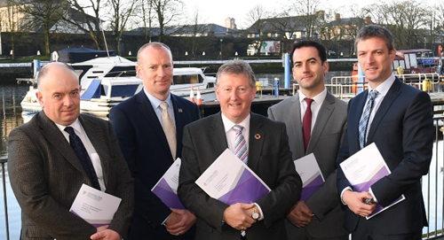
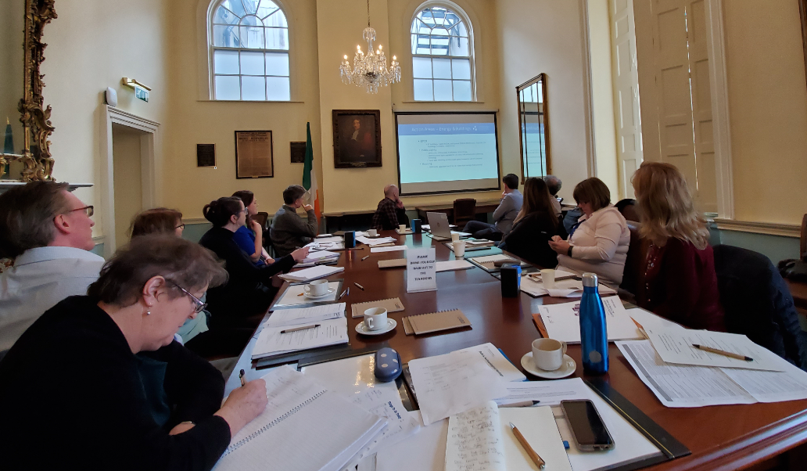
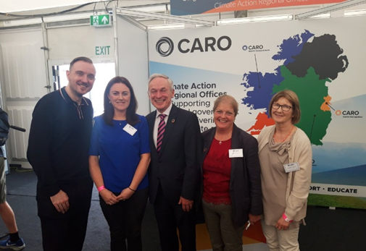
1 Establish Regional Offices
CAROs were established in Q3 2018 – as per CCMA / LGMA Business Case.
Teams of blended experience – Regional Co-ordinator, Executive, Assistant and SSO staff structure
Governance structure in place – National, Regional to Local level
Links with Regional Assemblies and LA Strategic Policy Committees (SPCs) etc.

Slide 12
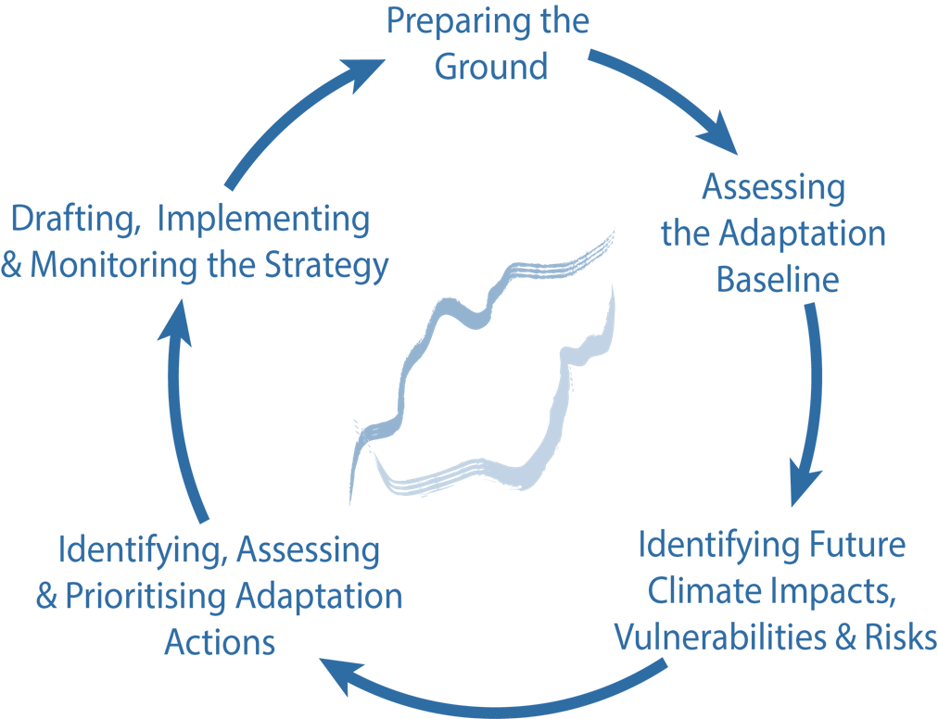
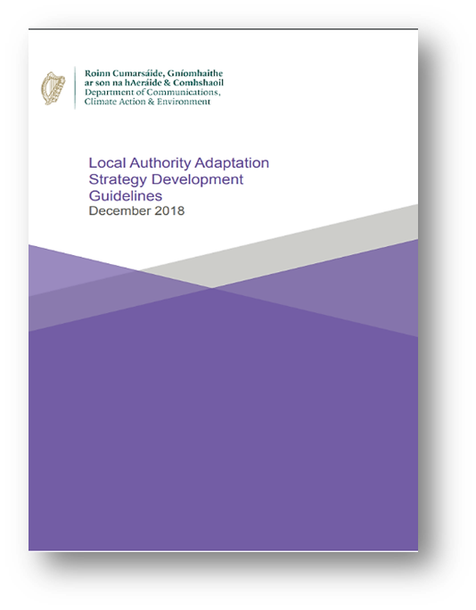
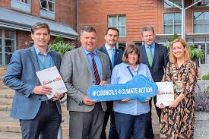
2 Local Authority Adaptation Strategies / Climate Change Action Plans
CAROs had input into all 31 LA Strategies – incl. workshops, public consultation, SEA/AA, Chief Executive’s report etc.
Collaboration with range of stakeholders – Climate Ireland, Energy Agencies etc.
All LA Strategies have been approved and submitted to DCCAE Q3 2019.
CAROs have prepared guidance ‘Implementing Local Authority Climate Adaptation Strategies’

Slide 13

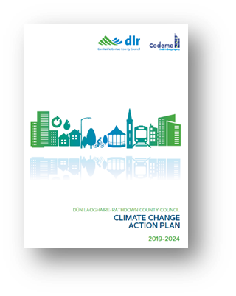



Dublin Climate Change Action Plans 2019-2024
Dublin CCAPs in development since 2016 in conjunction with Codema – Dublin’s Energy Agency
Regional Strategy for DLAs in 2016
Workshops across all Dublin LAs 2017/18
Draft CCAPs Public Consultation Feb/March 2019
Full SEA/AA required
960+ attendees at Public Information Events
560 submissions to CCAPs
Sept 2019 – Finalised and submitted to DDCAE
www.dublinclimatechange.ie

Slide 14
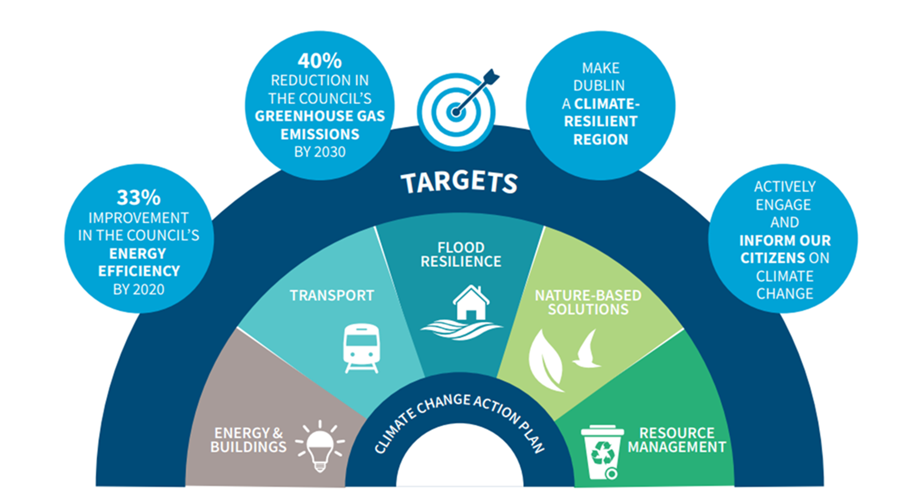


Slide 15
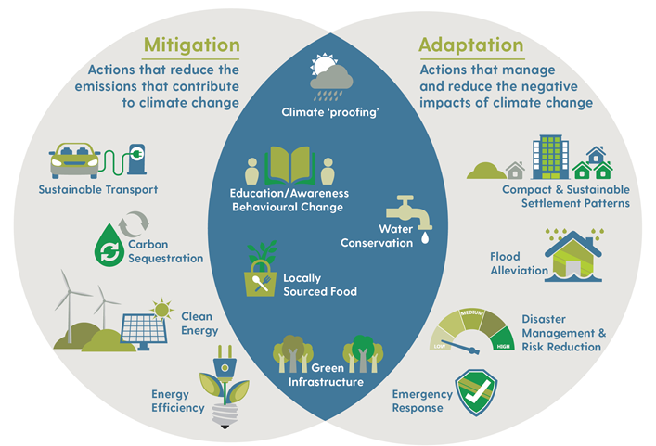

Slide 16
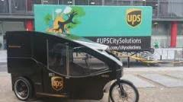
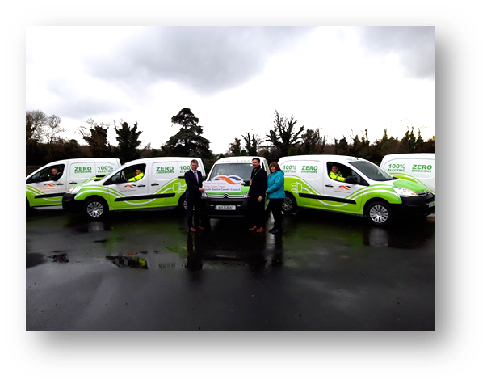
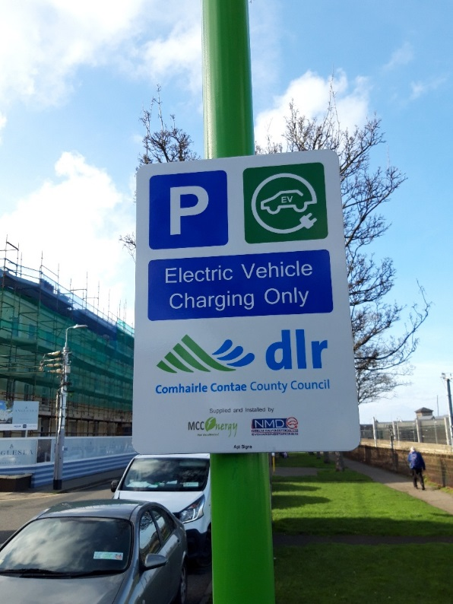

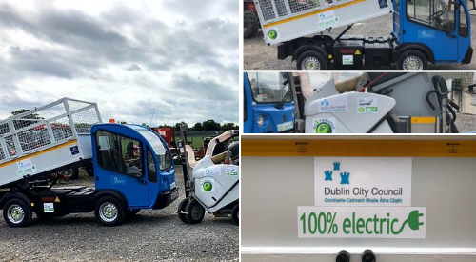
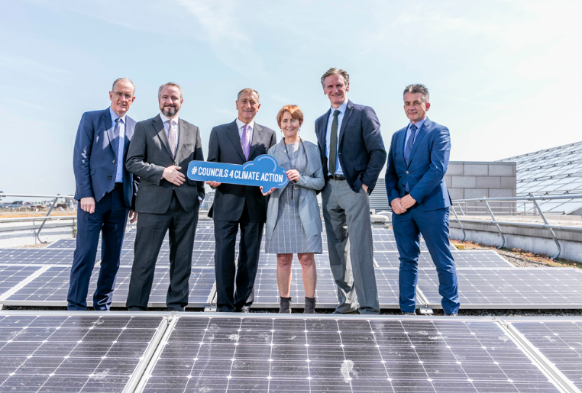

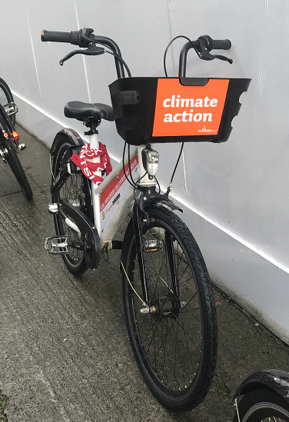
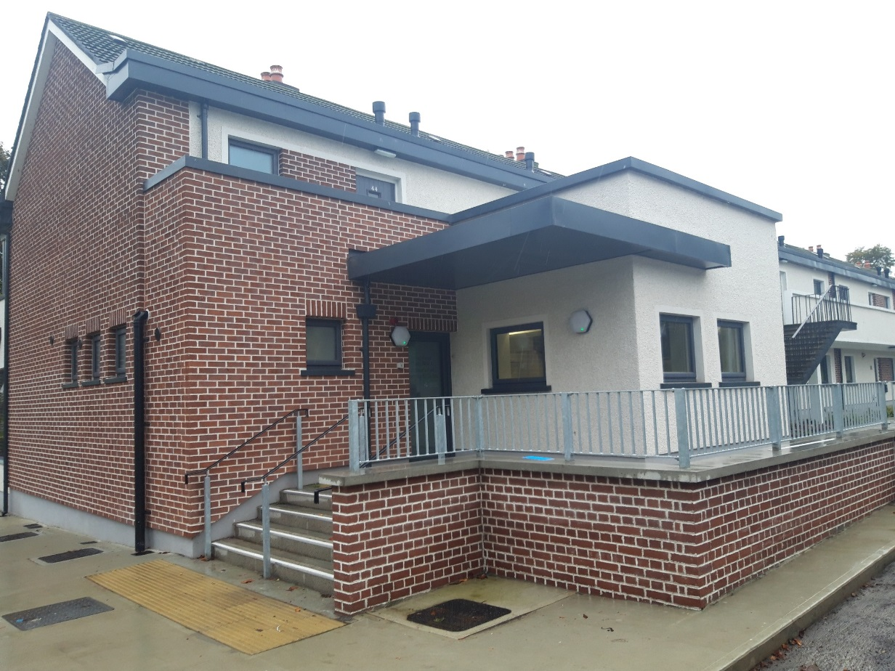
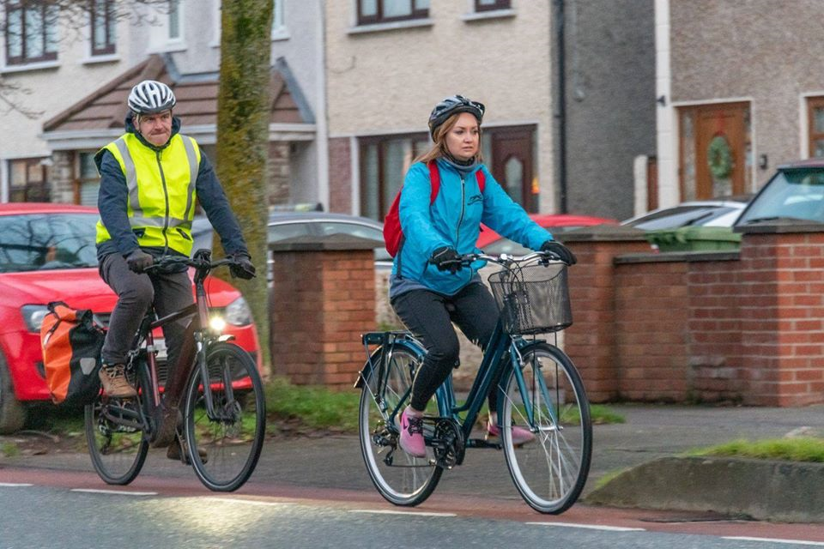
Climate Action – Mitigation Examples

Slide 17
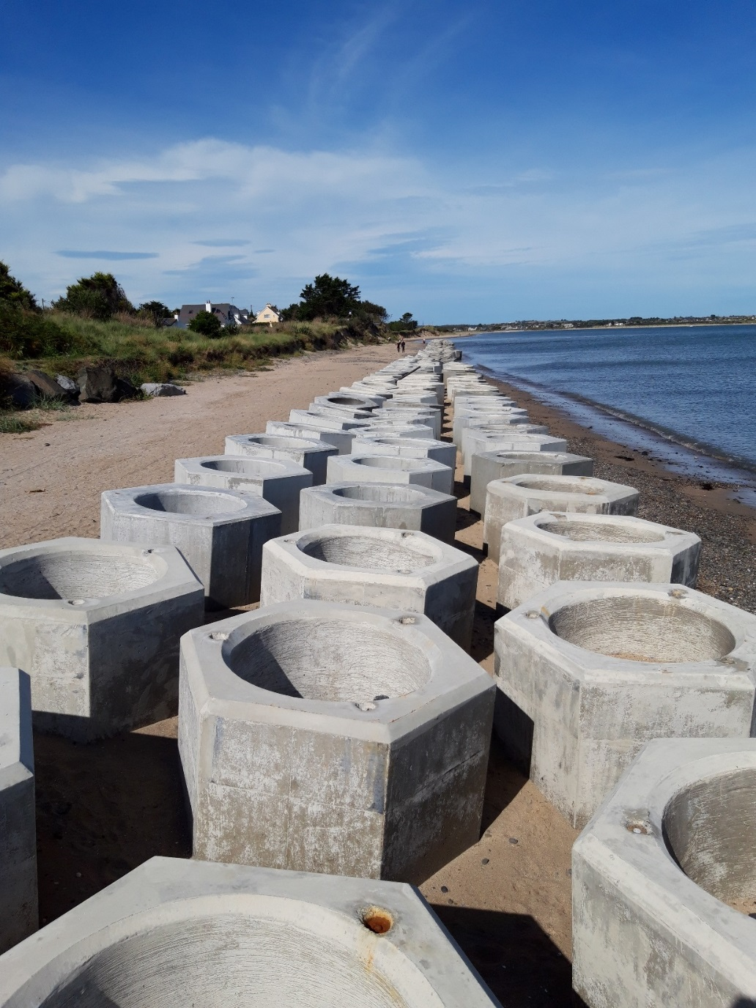
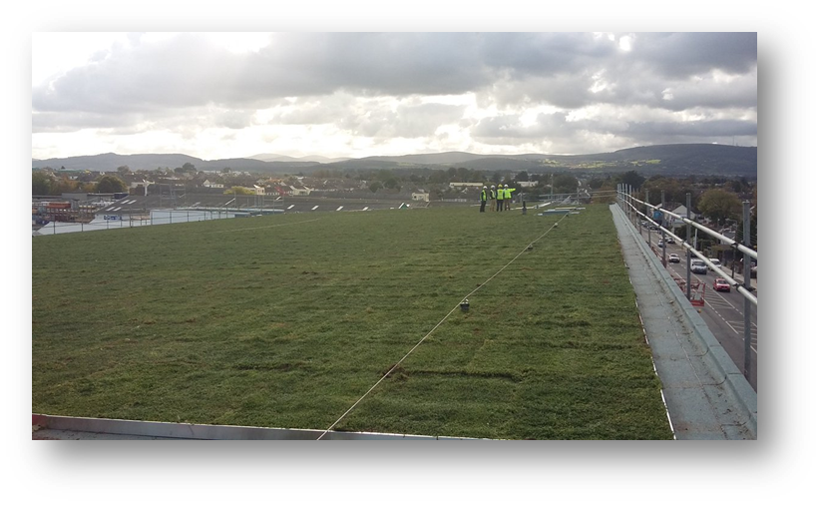
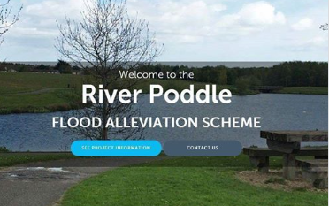
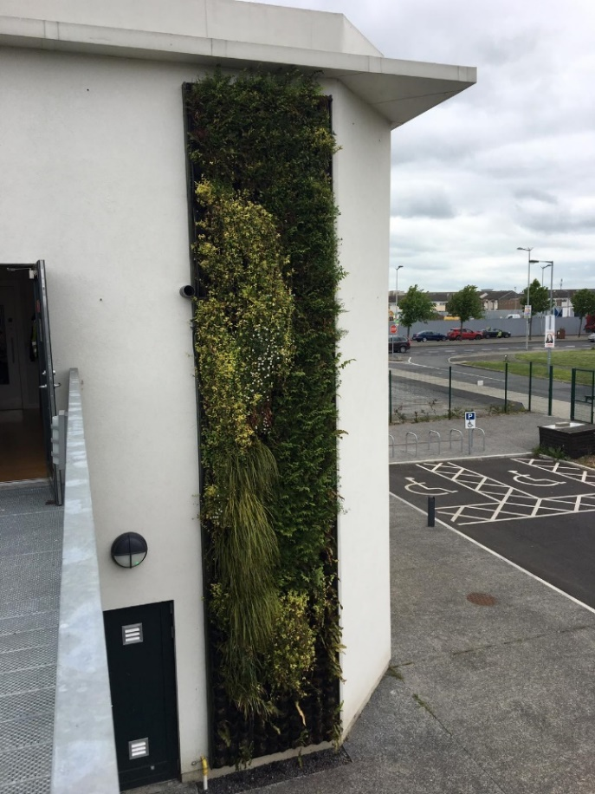
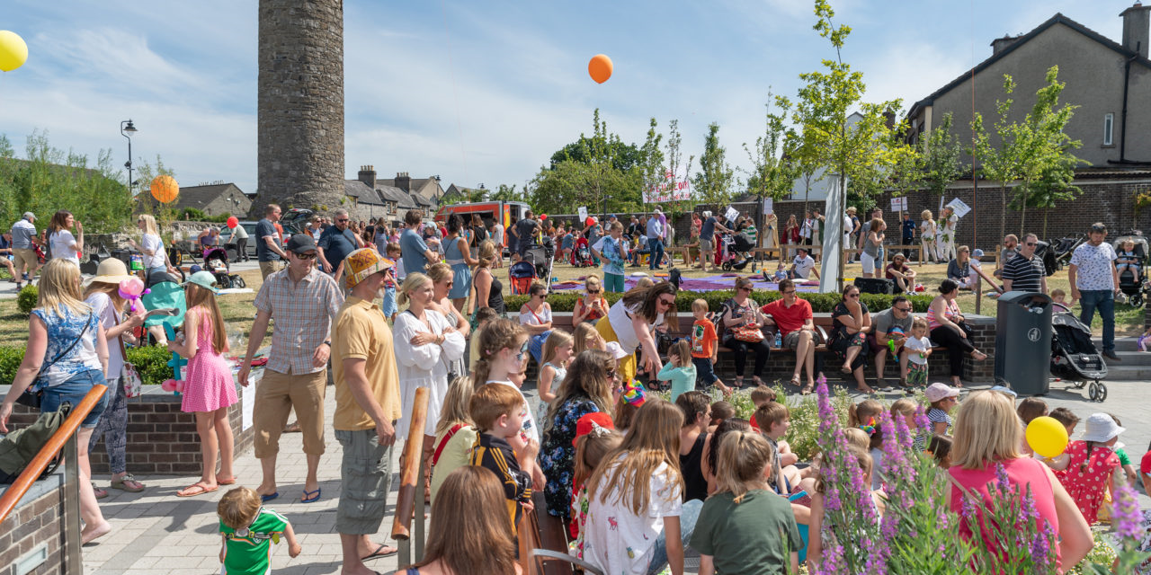

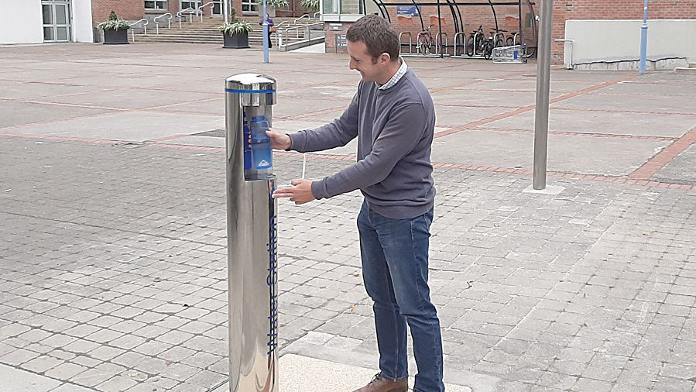
Climate Action – Adaptation Examples

Slide 18
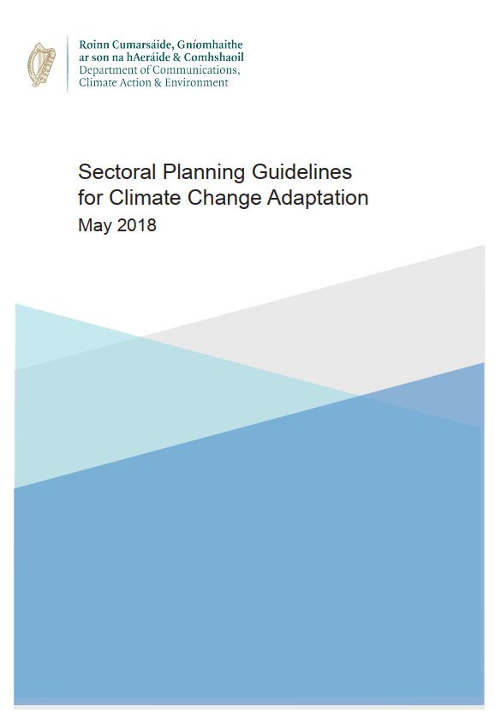
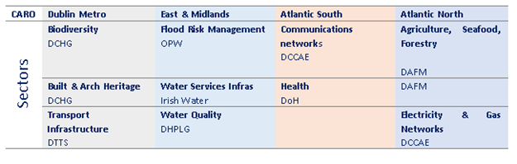
Sectoral Adaptation Plans – September 2019
Agriculture, Forestry and Seafood
Biodiversity
Built and Archaeological Heritage
Transport infrastructure
Electricity and Gas Networks
Communications Networks
Flood Risk Management
Water Quality and Water Services Infrastructure
Health​

Slide 19












3 Projects, Research and Regional Specialisms
CAROs providing link between science and practice
Liaise with 3rd level institutions & Research Co-ordination Group.
Engage with Regions and EU / International stakeholders
Provide technical support to LAs in partnership with relevant Energy Agencies i.e. Codema, 3CEA,TEA
All of society approach – case studies from 31 LAs.

Slide 20
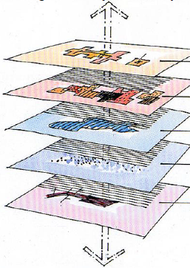
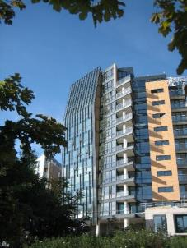


SDCC District Heating
Process starting point - County Development Plan
Chapter 10 – urban based policy response incl. Waste Heat & District Heating
Interreg NWE Project - funding and best practice
AMAZON Planning Application – planning condition
Part 8 and Climate Action Fund 2018

Slide 21





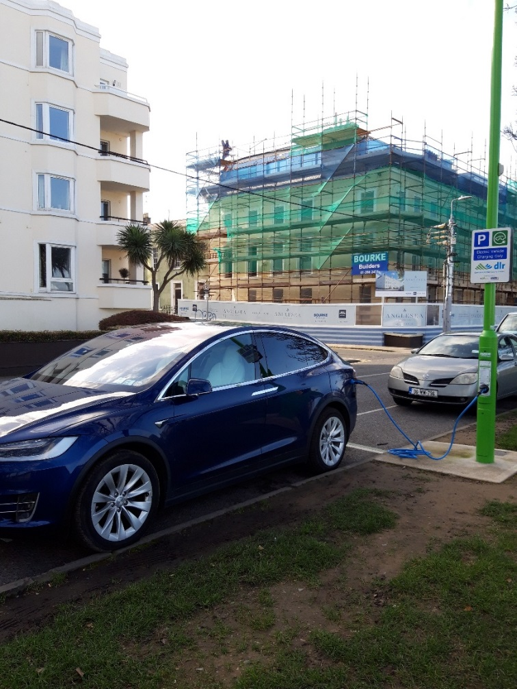
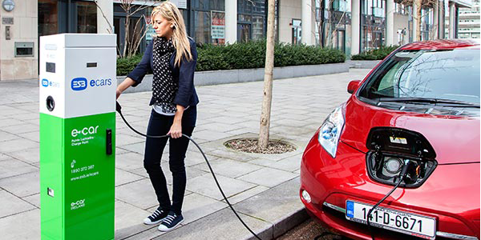
Regional Electric Vehicle Assessment
Combined Dublin Region Assessment led by FCC
Advise on strategy for Dublin region
On-street public parking and at public places or facilities under the control of the local authorities.
Locations, technologies, payment options etc.
Projects timeline - March to early June

Slide 22
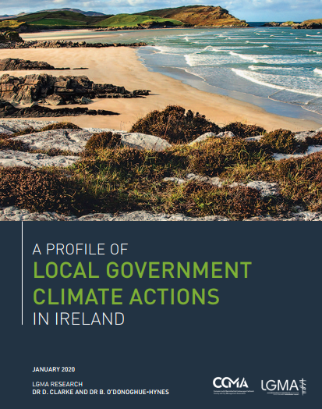
LGMA Climate Action Report
Questionnaire issued to all LAs in 2019 Baseline via CAROs
SDCC Piloted Questionnaire
Baseline of Climate Action within LAs
Half of all Las will achieve energy savings beyond their 2030 targets
€120m in energy efficiency projects preventing more than 60,000 tonnes of CO₂
Sustainable transport development, flood risk management, water conservation, waste management, nature-based solutions and public engagement
https://www.lgma.ie/en/publications/local-authority-sector-reports/a-profile-of-local-government-climate-actions-in-ireland.pdf

Slide 23

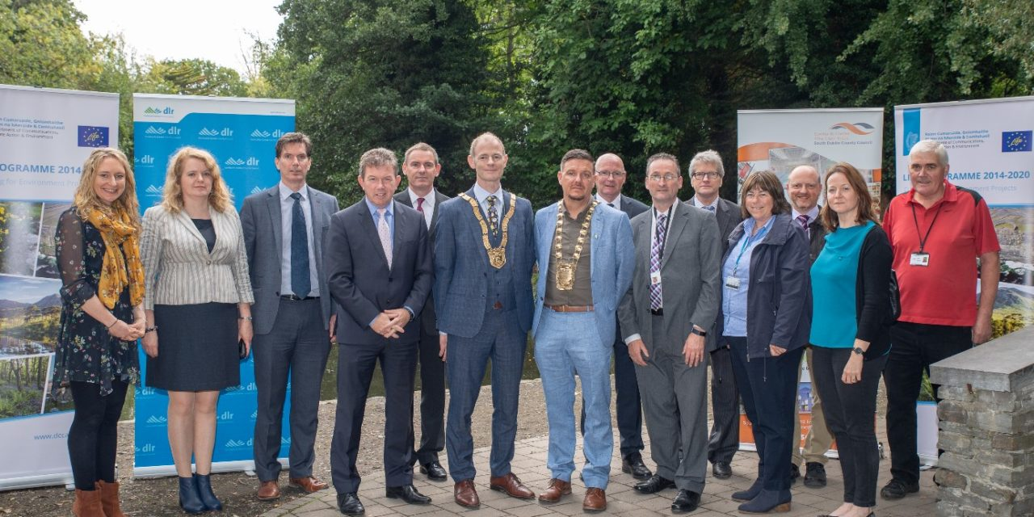

Dublin Urban Rivers – EU LIFE
Aims to improve water quality in rivers and streams
Focus on domestic drainage misconnections
€2.54 million over a four year period from August 2018 to June 2022
50% funding from the EU LIFE Fund Programme
SDCC will be the lead authority
https://www.sdcc.ie/en/services/environment/dublin-urban-rivers-life/project-background/

Slide 24

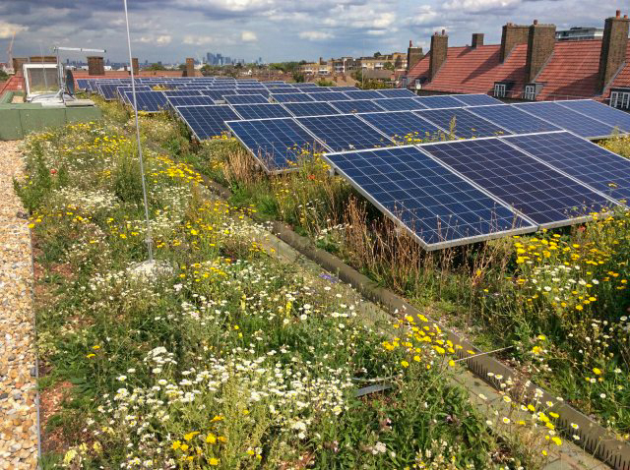

Climate Action Fund 2020
Information sessions 5th and 10th February
Expression of Interest Form to be submitted by 6th March
  DLA Regional Proposal: Green Roofs and Solar Installations
  Change X Community Proposal ?
  Other areas – E.g. Landfills/Land banks?
Bisolar Roof, Clapham Park, London – www.livingroofs.org

Slide 25

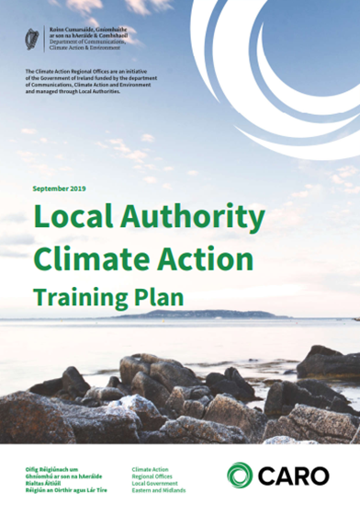





4 Training and Education
Need to train and up-skill approx. 29,000 LA staff and 1,000 Councillors
Climate Action Training Plan – agreed by LGMA/CCMA Q4 2019.
Links with stakeholders including Climate Ireland, SEAI, Met Éireann, EPA, IPA.
Training in partnership with the Environmental Services Training Group
Pilots to be undertaken Q2 2020.
Training in additional technical areas i.e. spatial planning etc.

Slide 26


Climate and Biodiversity Action Workshop
Wood Quay Venue -Dec 4th
Contact Michael Ewing Development@ien.ie
http://len.ie/resources/climate-action-training/#CAT3

Slide 27






5 Communications
CARO has prepared a Communications Strategy – links to LGMA / CCMA.
Participated in National Dialogue on Climate Action – national to local level.
  Pilots in Kildare, Dublin and Mayo in 2019
CARO branding and social media - national website in development.
Variety of public engagement – younger citizens, outdoor film screenings, artists, CCAP public consultations etc.
Continue to explore linkages across LAs – Arts, Culture, Tourism, Business etc.

Slide 28

Climate Action – Awareness and Engagement

Slide 29


Slide 30






Climate Action – Awareness and Engagement

Slide 31





6 Mitigation
All LAs report annually through SEAI’s Monitoring & Reporting process.
27 LAs Adaptation Strategies, 4 Dublin LAs have Climate Action Plans
General Scheme Climate Action Amendment Bill – Head 15 – Local Authority Climate Action Plan
LAs have broad mitigation role – public lighting, housing, leisure centres, public buildings, fleet etc.
Significant role for spatial planning in enabling mitigation and adaptation.

Slide 32



Mitigation Baseline – (SDCC)

Slide 33



Flooding Projects
Local Authorities work on a range of flood alleviation projects from small to large scale
LAs work with Office of Public Works on major Flood Defence Schemes
Assessment of these schemes – ‘Areas of Further Alleviation’ – AFAs
CFRAMS – main vehicle for meeting the requirements of the EU Floods Directive.
www.floodinfo.ie – details flood risk for 300 areas throughout Ireland – both urban and rural context
Need for more sustainable drainage in Urban areas.

Slide 34


Public Lighting Projects
Public Lighting is one of the largest energy users for Local Authorities.
Almost 500,000 public lights across the Country.
As parts of the public lighting network are over 40 years old, it is estimated that replacing bulbs with low energy equipment would see local authorities significantly reduce annual lighting costs.
Traditional SOX lamps are being phased out and replaced with LED lights.
LA Climate Action Charter 2019 – 50% improvement in energy efficiency by 2030

Slide 35

Spatial Planning
Planning system is an established means to implement and integrate climate change.
Evolving policy hierarchy with regard to climate and spatial planning policy.
4 Dublin CCAPs – Action E4 relates to City / County Development Plan and climate policy
EMRA Regional Spatial & Economic Strategy – adopted June 2019 – signposts climate action
CARO has published a Discussion Paper – ‘Planning for Climate Action in City / County Development Plans’
CARO led workshops for Planners in 2020 aligned to Development Plan process

Slide 36

Take home messages
Local Authorities can be leaders on climate action for the wider community
All of Government and all of society approach is needed
Adaptation and Mitigation must be undertaken in parallel
Key role for all LA staff and Elected Members in driving climate action across all functions

Slide 37



Go raibh maith agaibh david.dodd@dublincity.ie
@DublinCARO
#Councils4ClimateAction

Slide 38



Electric Vehicles
Climate Action Plan 2019 –1m EVs by 2030
Regional EV Group – Dublin LAs, CARO, Smart Dublin and SEAI
  Fleet Transition
  Plans for EV Charger infrastructure
Recent SEAI grant support for LA installation of charging points.
Need for Strategic overview of the Dublin Region that will inform EV requirements.
CARO sits on DHPLG EV Working Group – addressing planning policy, regulations etc.

Slide 39


Dublin Rural LEADER Funding
Theme 1 - Economic Development
Theme 2 – Social Inclusion
Theme 3 - Environment
Protection and Sustainable use of Water Resources
Protection and Improvement of Local Biodiversity
Development of Renewable Energy

Slide 40





LA Adaptation Plan Development - Methodology

Slide 41




Coastal Erosion
Storm surges, strong waves and tidal actions are resulting in increased coastal erosion.
Adaptation actions encompasses taking a wide range of actions that can be classified as soft, green or grey measures.
Difficult decisions and significant funding will be needed to safeguard coastal communities and assets.
Increased evidence base for identifying coastal erosion projects – OPW, Geological Survey of Ireland etc.

