Slide 1
South Dublin Sports Pitch Strategy – Action Plan
Strategic Policy Committee
February 2020

Slide 2
SPORTS PITCH STRATEGY: 5 ACTIONS TO OPTIMISE CAPACITY
No.: | Action: | Location: | Priority
1 | Increase maintenance of pitches to improve match play equivalents | Targeted: Areas of high use, high demand, growing population | Ongoing Lifetime of strategy
2 | Develop revised allocation policy; including pitch sharing and multipurpose use of facilities | County wide | 2020 onwards
3 | Reserve ability to change configuration of pitches. | Targeted as tastes, demographics and / or local needs change | On-going
4 | Provide new pitches to meet capacity issues | New development areas, areas of growing population | 2020 onwards
5 | Provide AGPs to augment long term capacity and meet training need | 3-5 across county | 2020 onwards

Slide 3
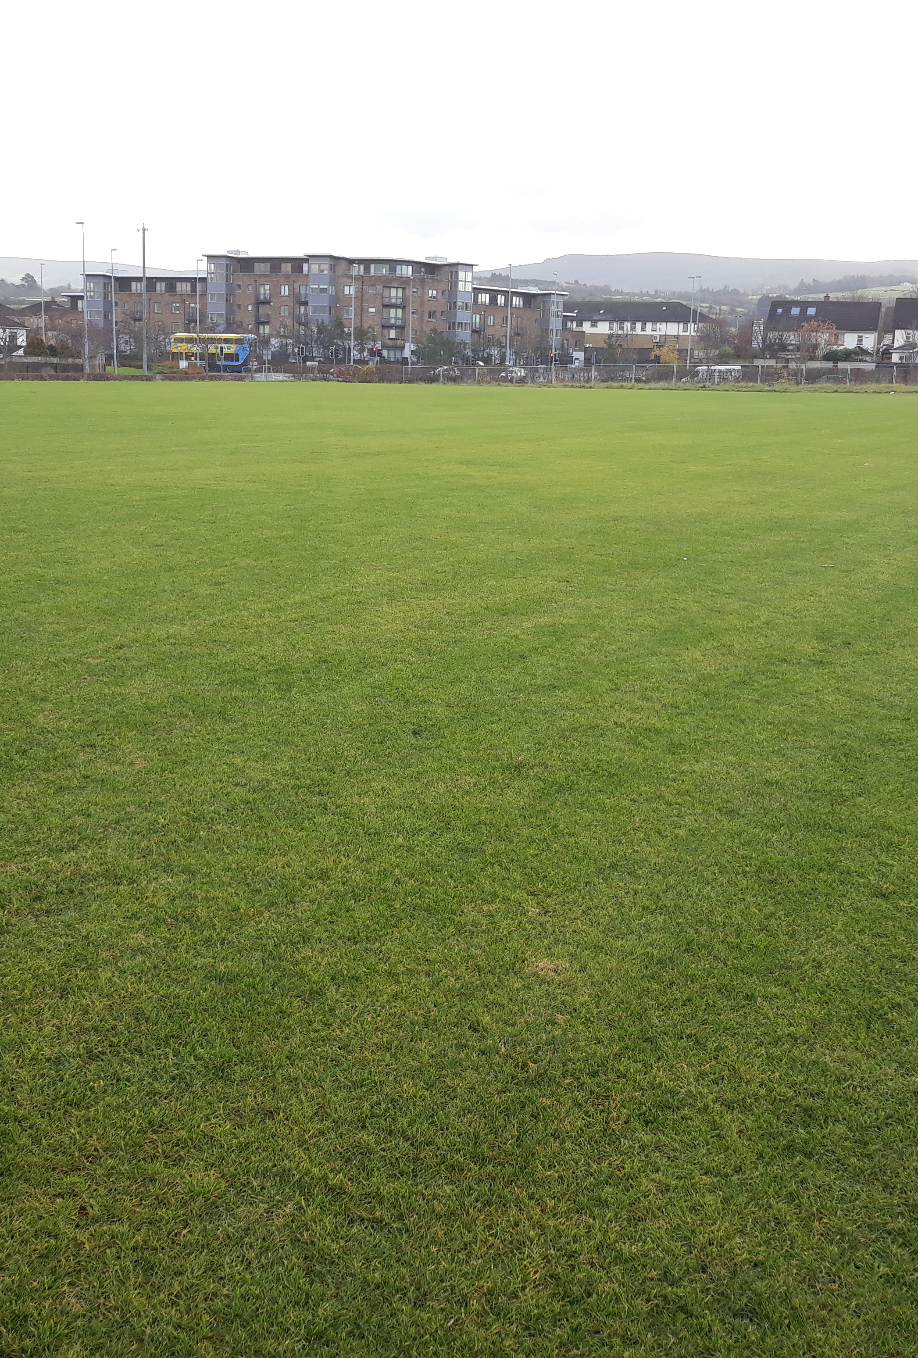
Maintenance of existing pitches:
Annual maintenance regimes: provide intensive maintenance to existing pitches
Maintain capital investment to facilitate increased match play on existing pitches:
Firhouse pitches (3 pitches completed)
Tymon pitches (2 completed and 1 underway)
Jobstown Park and Butler McGee Park (2 pitches completed)
Dodder Valley Old Bawn (existing pitch enhancements)
Capital investment in pitches to be continued based on needs assessment.
2019 SCG allocation for pitch works: €350,000.
Continue high level of communication between the council and clubs
Target higher use sites, shared sites and sites with high amount of community use
Continue on a rolling basis.
Training pitches / facilites under-catered for; putting pressure on pitch quality
Allocation via Revenue budget (€313,000 proposed for 2020) for aeration, top dressing, goal mouth and damaged area repairs, provision / replacement of goal posts etc.)
Completion of Upgrade of Athletics Track, Lucan
Notes:
The maintenance of pitches is important in terms of increasing capacity as it impacts on the quality of the pitch.
By improving the quality of pitches, the playing capacity of each pitch is increased allowing it to accommodate more matches.
If improvements are made to the current pitches in terms of drainage or maintenance regimes this will improve the carrying capacity of each pitch and the overall supply within the area. This means that pitches will suffer less wear and tear and allow more matches throughout the season without a detriment to the surface.

Slide 4
Develop a revised allocation model in association with on-line booking system:
Review of current allocation model to increase pitch use efficiencies; consider:
Target shared usage of currently under-used or over subscribed locations
Review match fixtures to examine match pitch allocations.
Develop revised allocation policy; including pitch sharing and multipurpose use of facilities
Maintain flexibility in pitch designation and configuration to match changing demographics or local need.
Revise current charging / fee structure versus economic cost
Considerations to be included: capacity in the area, club buy-in, over usage of pitches and management of same.
Improve on-line communication. Automate pitch allocation, pitch booking and pavilion booking systems
Booking systems will generate usage reports and allow pitch provision to be planned to meet demand.
Book-a-pitch system currently being designed
There will be an obligation to report usage.
Use of pitches and quality of pitches to be reviewed.
Notes:
As per slide

Slide 5
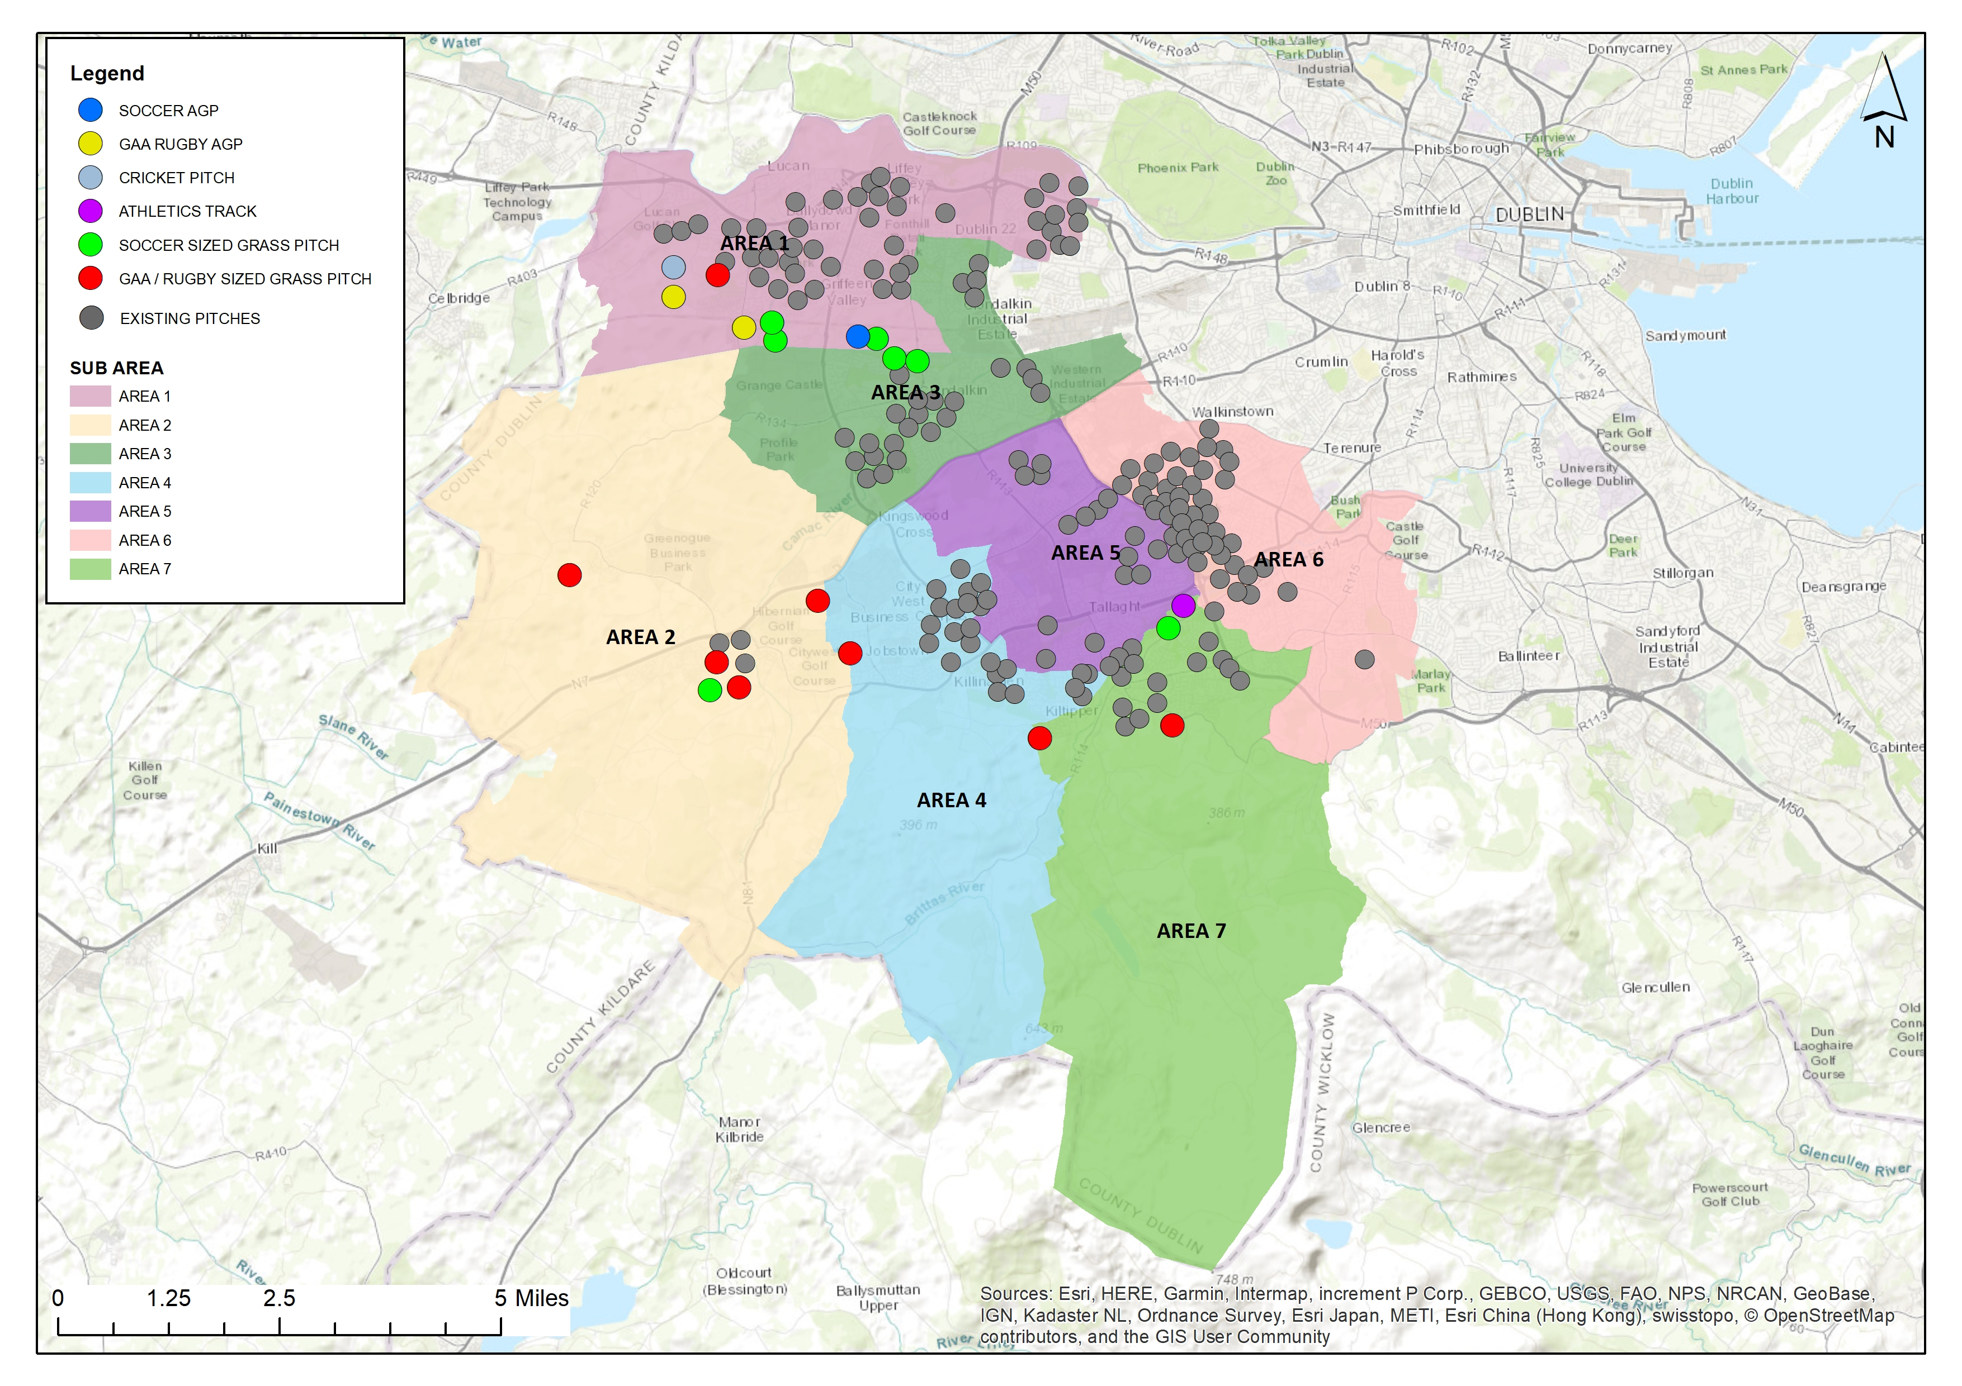
Meet the need for new pitch provision in areas of population growth
Notes:
Dodder Valley Mt Carmel: (1 athletics track, 1 soccer pitch)
Adamstown SDZ parks (1 multi sport sized AGP, 1 GAA pitch, 1 cricket pitch)
Clonburris SDZ parks (1 multi sport sized AGP, 1 soccer sized AGP, 5 soccer pitches)
Kiltipper Park Phase 2 (Draft plan: 1 GAA sized pitch)
Fortunestown LAP area (1-2 pitches)
Firhouse/ Ballycullen LAP area (1 GAA sized pitch)
Newcastle LAP area (1 small sized pitch)
Rathcoole area (3-4 pitches in conjunction with GAA)

Slide 6
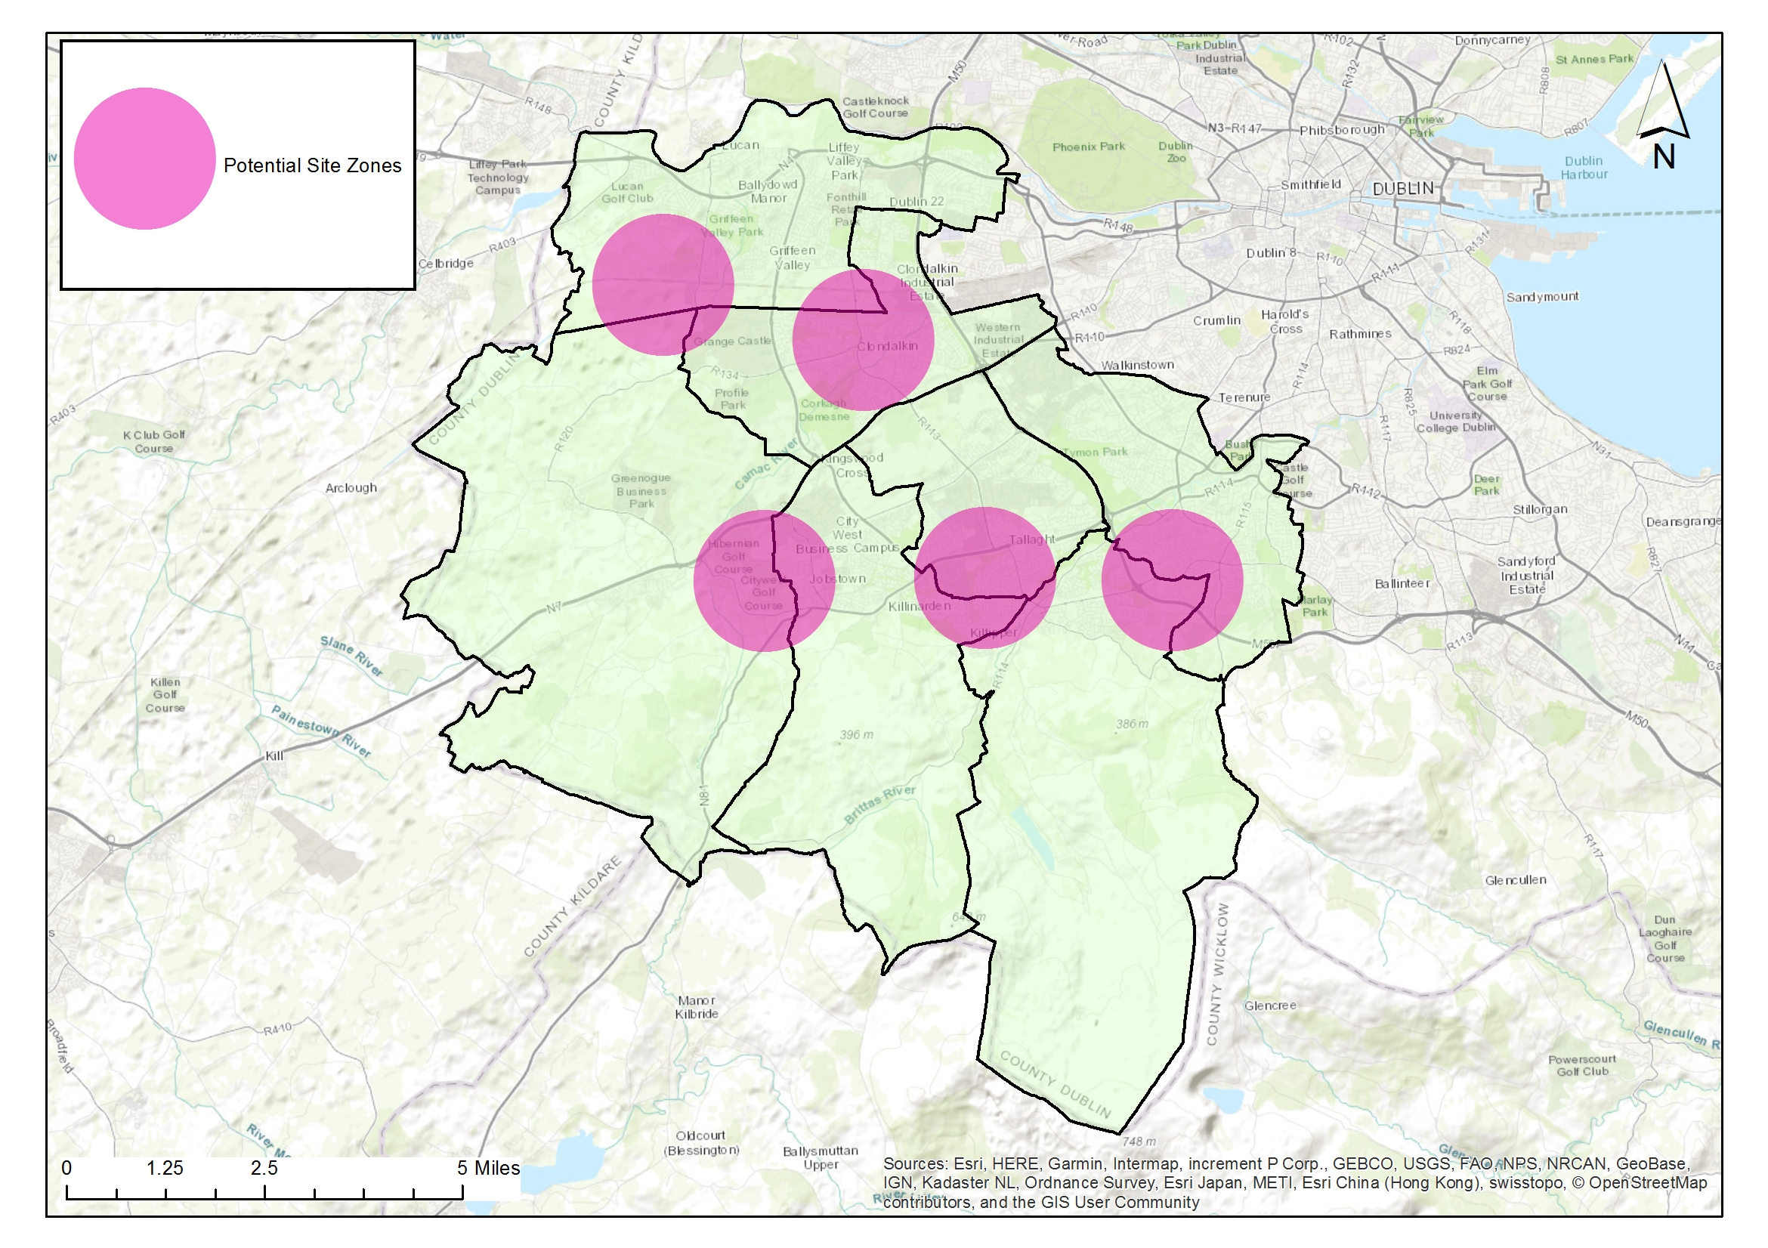
Provide 3-5 Artificial Grass Pitches (AGPs) to increase provision, usage and provide for training need.
The multi-use nature of AGP pitches should lead to sports hubs and efficiencies in use (GAA, Soccer and Rugby Union)
High capital outlay required; high use and meeting community demand shall be built into management structures
Provision to be made for replacement / repair over lifetime of the facility
AGP’s provide pitch capacity to meet increased population growth in higher density/ urban locations
AGP’s meet demand for increased match play
AGP’s remove training pressure from grass pitches with resultant higher standard of grass pitches.
Strategic locations, new development and high population areas; facilitates high use, late evening and flood lighting.
AGP’s provide all weather, year-round facilites. Provide ancillary facilites as required to maximise use.
AGP’s meet demand for training provision which is not currently being met.
AGPs:
Adamstown SDZ
Clonburris SDZ
Fortunestown LAP area / Rathcoole/ Newcastle area
Tallaght LAP
Ballycullen / Firhouse LAP
€3million provided within 2019-2021 capital budget for Astro Programme
Notes:
As per slide

Slide 7
Ancillary facilities
Current pavilion programme (subject to funding):
Dodder Valley Old Bawn (at construction stage)
Griffeen Valley Park (North) (at planning stage)
Corkagh Park (West)
Tymon Park (West of M50)
Dodder Valley Mt Carmel
Griffeen Valley Park (Arthur Griffith Park)
Collinstown Park
Changing facilites:
Provision of facilites based on:
Size of open space and number of pitches accommodated.
Nos of teams
Nos of players
Nos of clubs / community groups to be accommodated
Evidence of need
Storage Areas:
In larger parks with new pavilions:
Some storage to be provided in new changing rooms or will be provided in a railed off area adjacent to a pavilion
In open spaces without pavilions / changing rooms:
Railed off areas for storage of heavy-duty pitch infrastructure e.g. goalposts etc. will be considered.
These areas should ideally be in well overlooked areas with plenty of passive surveillance.
Hierarchy of provision: High usage areas with several clubs and pitches.
Funding:
Subject to funding:
May be sourced by sports capital grants, large scale infrastructure grants
Sports Governing body or club contributions could be facilitated
Security of Provision:
All ancillary facilites provided within public lands are linked to sports pitch use to allow for future proofing of provision and ownership of facilites is not limited to a club or sport. Facility shall remain available to SDCC.
Notes:
As per slide

