Slide 1
Whitestown Way
Older Persons Accommodation
Proposed Ageing Well Partnership
Housing SPC Meeting
20th February 2020

Slide 2
Project Partners

Slide 3
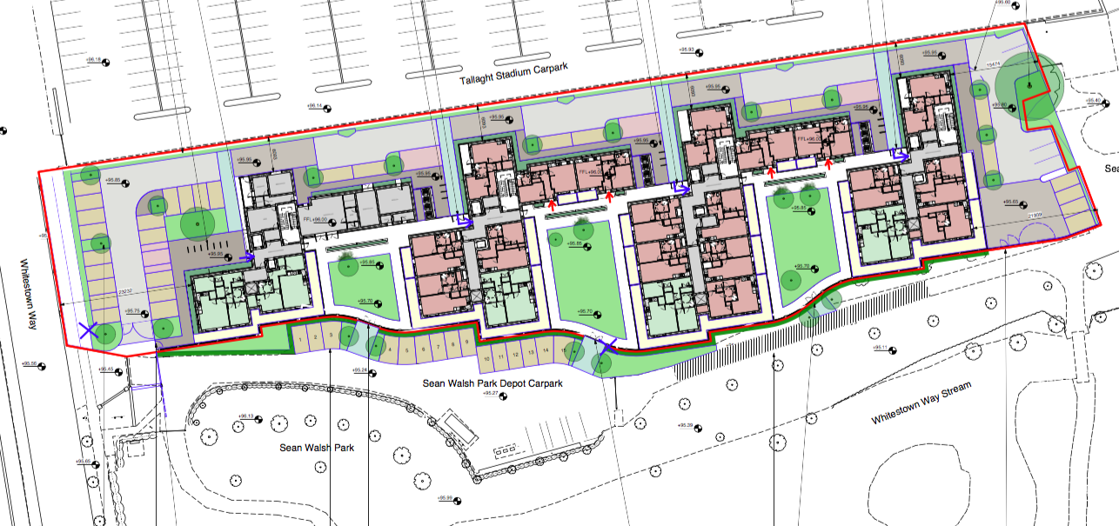
81 Older Persons’ Homes at Whitestown Way, Tallaght

Slide 4
Project Timelines
2017: Site identified & EOIs sought from AHBs
Cluid Housing appointed
2018: Final design & public consultation
Part 8 approved by Elected Members
2019: Ageing Well partnership concept proposed
Partner consultation
2020: Commence construction
Project partner MoU
Right-sizing policy and tenant engagement
2021: Projected opening of development?

Slide 5
Critical Success Factors
Tenants
Voluntary engagement
No cost
Not intrusive
On site supports
Partners
Memorandum of Understanding
Effective collaboration
Cumulative buy-in & commitment to services

Slide 6
Clúid Housing & Clann Service

Slide 7
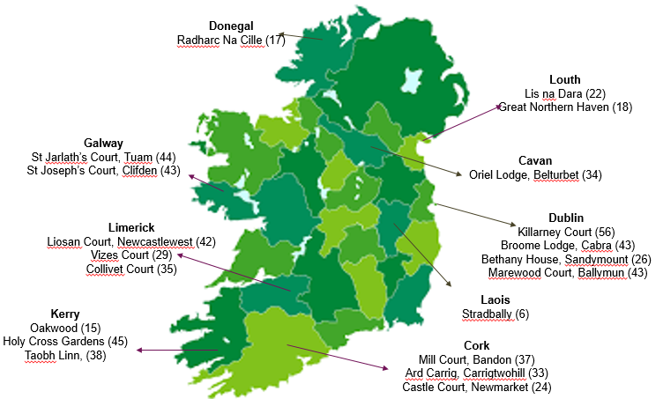
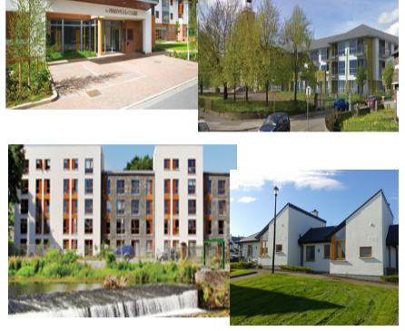
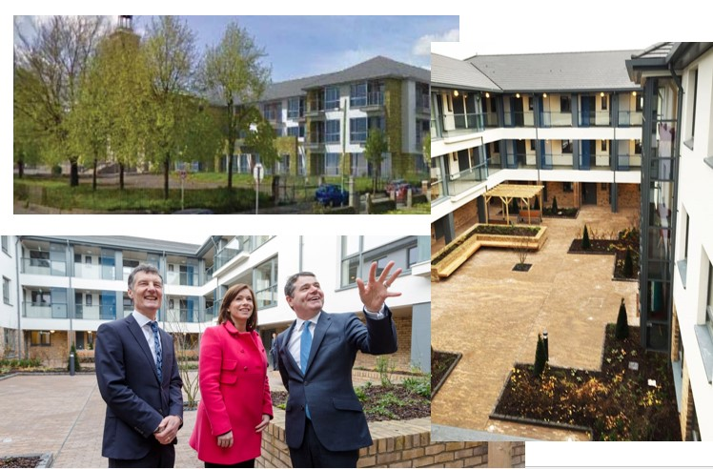
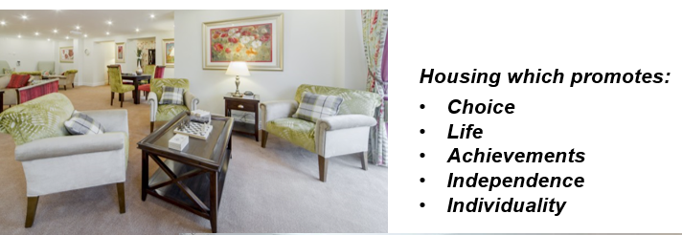
Overview of our Clann Service

Slide 8
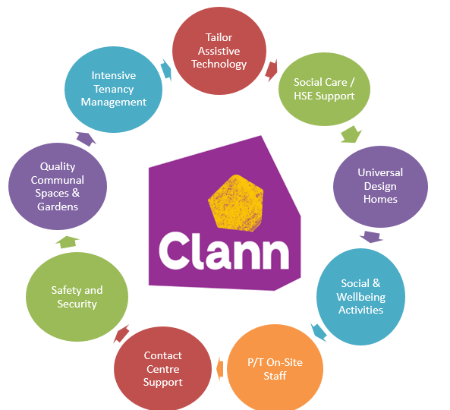
Clann’s Service Offering –
Tools which Empower Independence
Notes:
Enabling older people to stay in their homes and to age in place, as their needs change, is the key focus of our work. We believe ‘Ageing in Place’:-
Meets diverse and complex needs – hearing, mobility, intellectual, illness, mental health.
Costs less – This housing option provides a greater range of community care options which costs less than one tenth of the cost of nursing homes.
Is more comfortable – ‘There is no place like home’.
Strengthens our social network and fights isolation.
Strengthens our self-determination – we have control over our environment and independence.
Promotes our self-worth – we feel part of a community which we contribute to.

Slide 9
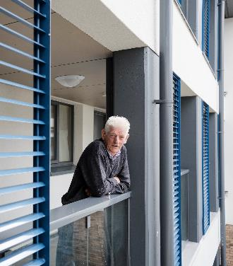
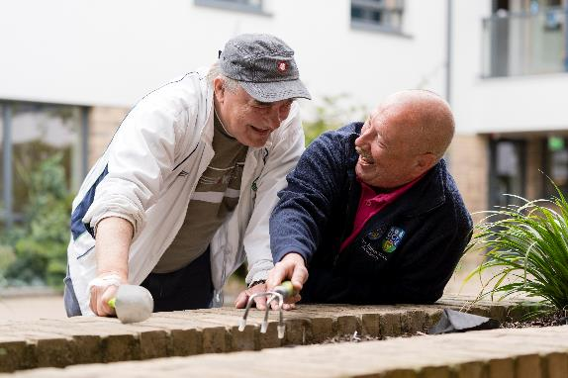
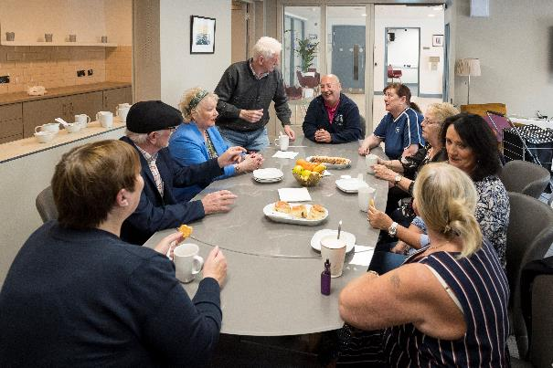
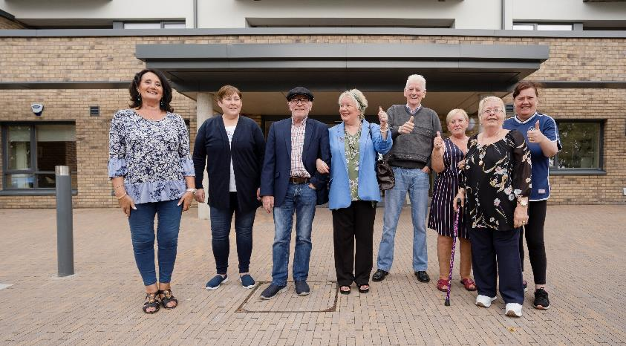
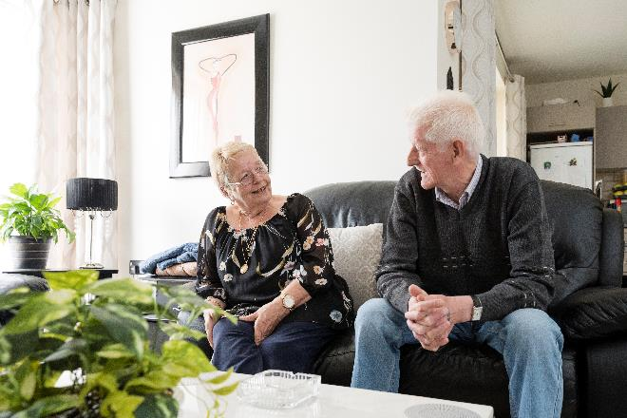
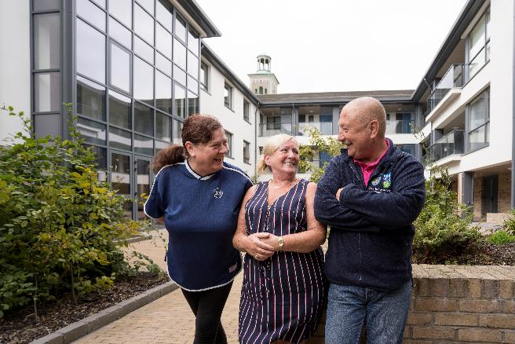
Broome Lodge Tenants – Enjoying
the ‘later part of normal life’
Notes:
Tenant Feedback

Slide 10
Partnership Strategy for Ageing Well
Prof. Seamas Donnelly
Tallaght University Hospital &
Trinity College Dublin

Slide 11
Context
Rapidly ageing population – 2030 1m+ aged 65+
aged 65 in TUH catchment +42% since 2011
High social deprivation
Older persons’ developments are opportunities for:
public health community interventions targeting lifestyle and health risk factors;
promotion of wellness and healthy ageing;
learning to inform similar practice nationally and internationally

Slide 12
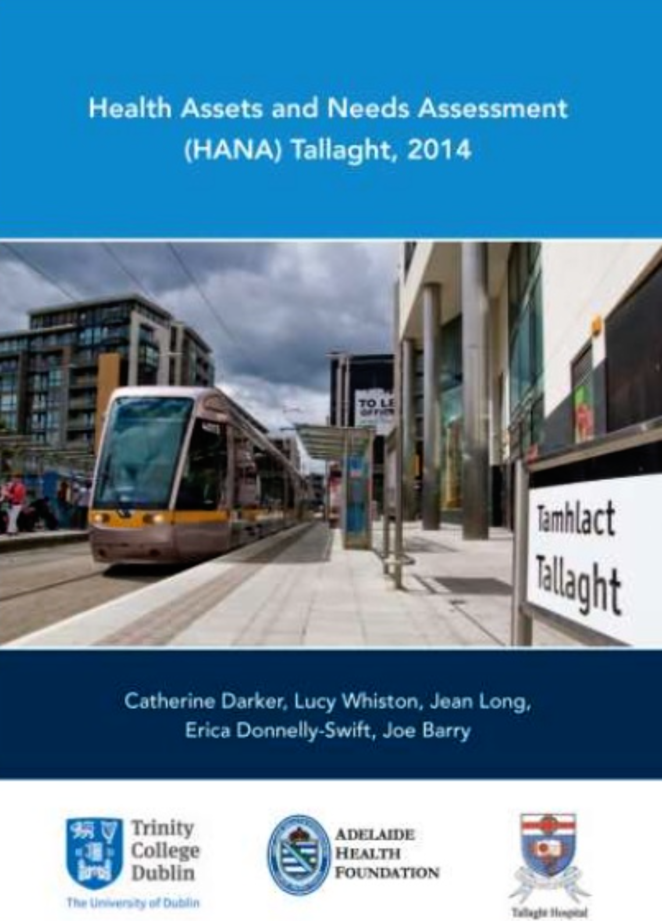
Catchment Lifestyle Demographics
(TCD Institute of Population Health)
Exercise 22% - V- 79%
Smoking 44% -V- 19%
Mental Resilience: 66%
Chronic Disease: 22%
High Social Deprivation
Low Socioeconomic Status
Lost years of functioning (6.6/4.6 years)
Accelerated decline from ages 66-85 years

Slide 13
Partnership Strategy for Ageing Well
Promotes health to prevent illness
Provides majority of care at/closer to home
Integrated system of (health & social) care
“Housing Options for Our Ageing Population” (DHPLG & Dept. of Health 2019):
Ageing in Place
Promoting Sustainable Lifetime Housing
Using Assistive Technology
Staying Socially Connected
Working Together

Slide 14
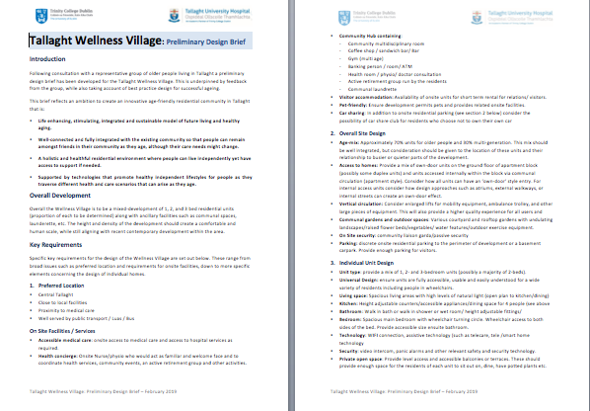
Project Objectives
Develop, implement and evaluate interventions
Prevent chronic conditions
Community based lifestyle programs
Assessing and integrating technological solutions
Support continued living in own homes

Slide 15
Focused Public Health Initiatives
Mental Health and resilience
Smoking cessation
Physical Independence, Frailty & Cognition
Cardiovascular Risk Factors & Disease
Respiratory infections & vaccinations
Healthy eating

Slide 16
Process & Outcomes
Allocation of homes
Information to residents
Invitation to participate on voluntary basis
Develop – Implement – Evaluate
Intervention strategies approved by TUH
On-site consultation space
Utilise community activity space
Tenant participation in community intervention strategies
GDPR / data anonymised
Project implementation/oversight committees

Slide 17
Questions??

