Slide 1
Allocations Update
(including Homeless Presentations & Exits)
Housing Strategic Policy Committee Meeting
20^{h} February 2020

Slide 2
Social Housing List January 2020
Total No. Applications | 6,873
North of Naas Road
1-bed | 1,703
2-bed | 1,551
3-bed | 800
4-bed | 103
Total | 4,157
South of Naas Road
1-bed | 2,246
2-bed | 1,796
3-bed | 812
4-bed | 92
Total | 4,946

Slide 3
Allocations Report
Category | 2018 | 2019 | 2020 (JAN)
CBL-General | 104 | 189 | 11
CBL-HAP | 16 | 65 | 4
CBL-RAS Fixed T/F | 24 | 38 | 2
CBL-Homeless | 13 | 8 | 0
CBL-Medical | 2 | 3 | 0
Homeless | 92 | 195 | 20
Standard Medical | 54 | 68 | 5
Priority/Older Persons | 6 | 50 | 3
Total | 311 | 616 | 45

Slide 4
Homeless Responses History
Ministerial Order May 2015
Increase in numbers presenting
Housing SPC Change Policy 2018
Significant increase in Allocations during 2018/2019
Preventative HAP & Homeless HAP
Time in EA decreasing significantly
Project forward?

Slide 5
Homeless Register
Homeless Register | Jan | Feb | Mar | Apr | May | Jun | Jul | Aug | Sep | Oct | Nov | Dec | Jan 20
No. of Registered Homeless | 624 | 620 | 630 | 639 | 638 | 627 | 607 | 614 | 624 | 625 | 613 | 588 | 587
Single Male | 264 | 268 | 274 | 285 | 289 | 282 | 265 | 277 | 284 | 289 | 279 | 277 | 279
Single Female | 59 | 59 | 62 | 64 | 66 | 62 | 58 | 58 | 62 | 64 | 60 | 57 | 55
Number of Presentations to Homeless Clinic | 507 | 425 | 527 | 455 | 522 | 406 | 557 | 444 | 506 | 493 | 380 | 286 | 374
Numbers in Self Accommodate
Self Accommodate | Jan | Feb | Mar | Apr | May | Jun | Jul | Aug | Sep | Oct | Nov | Dec | Jan 20
No. of Families | 196 | 206 | 216 | 218 | 223 | 213 | 203 | 198 | 192 | 178 | 170 | 162 | 132

Slide 6
Exits from Emergency Accommodation
Category | 2018 | 2019 | 2020 (YTD)
Allocations | 94 | 203 | 28
Homeless HAP | 131 | 146 | 16
Total Exits | 225 | 349 | 44
Preventative HAP | 346 | 389 | 28

Slide 7
Homeless Allocations

Slide 8
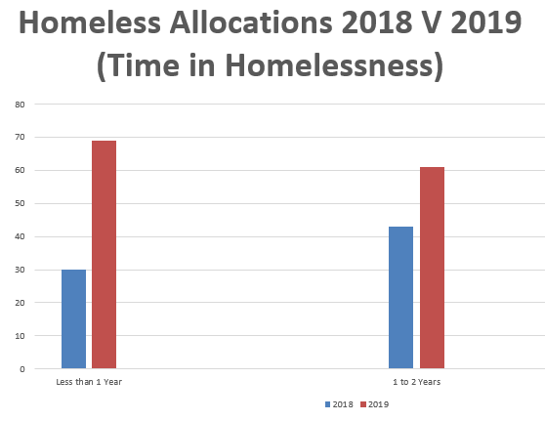
Homeless Allocations

Slide 9
HAP V Social Housing Tenancy – Time In EA

Slide 10
Improved Responses / Prevention
Current ‘time on list’ policy?
Enhanced prevention measures?
Mediation / sustainment services?
Incentivise/increase social housing tenancies for HAP transfer list?
Pathways from EA ?
Housing Support Officers
CBL engagement

