Slide 1
HOUSING SUPPLY UPDATE
Housing SPC Meeting
20th February 2020

Slide 2
2019 & 2020 Housing Supply
 | Build | Acquisition | Leasing | HAP & RAS | Total
DHPLG Targets | 435 | 76 | 150 | 1,053 | 1,704
Actual 2019 Output | 449 | 93 | 49 | 956 | 1,547
% | 103% | 122% | 33% | 91% | 91%
Projected 2020 Output | 424 | 30 | 90 | 1,000 | 1,544

Slide 3
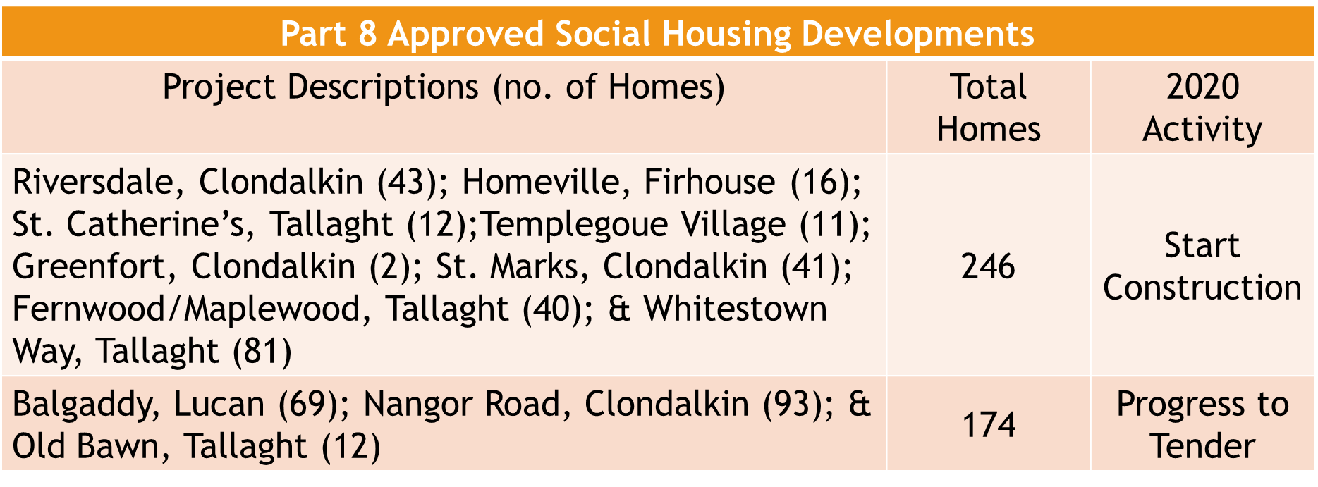
Social Housing Construction Programme
424
30
90
1,000
1,544

Slide 4
Large Capacity Sites Update
Kilcarbery: ABP approval for 1,034 homes (65% private; 30% social; 5% affordable); on site March 2020.
Killinarden: Proposal to Council in March (see separate report);
Clonburris: Masterplan finalised; costing projections to inform procurement options and phasing;
Belgard Square North: design team & AHB partner appointments for 140 affordable rental homes;
Rathcoole: traffic & ecology assessments being undertaken.
424
30
90
1,000
1,544

