Slide 1
North Clondalkin Library
NCL

Slide 2
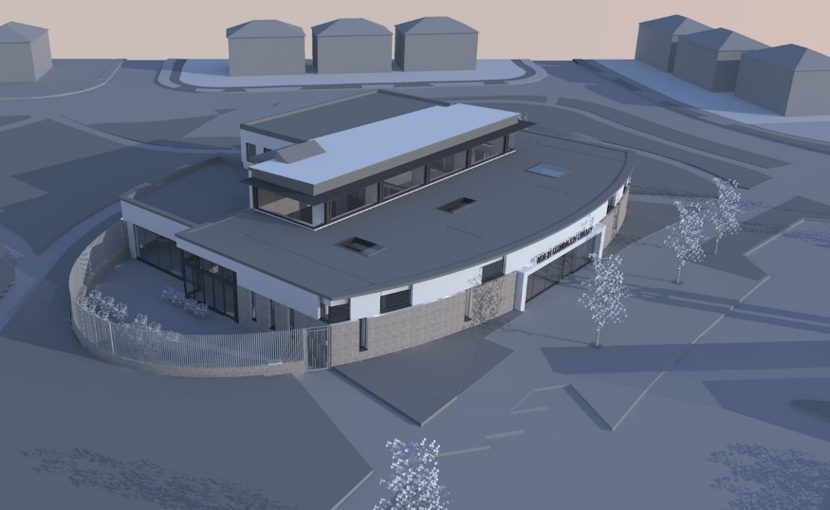
June 2018 - Detailed Design Development - Elliptical perimeter to encapsulate library and gardens - Brickwork to façade - soft landscaping - Set back from houses and edges of site North Clondalkin Library from Part 8 to Construction

Slide 3
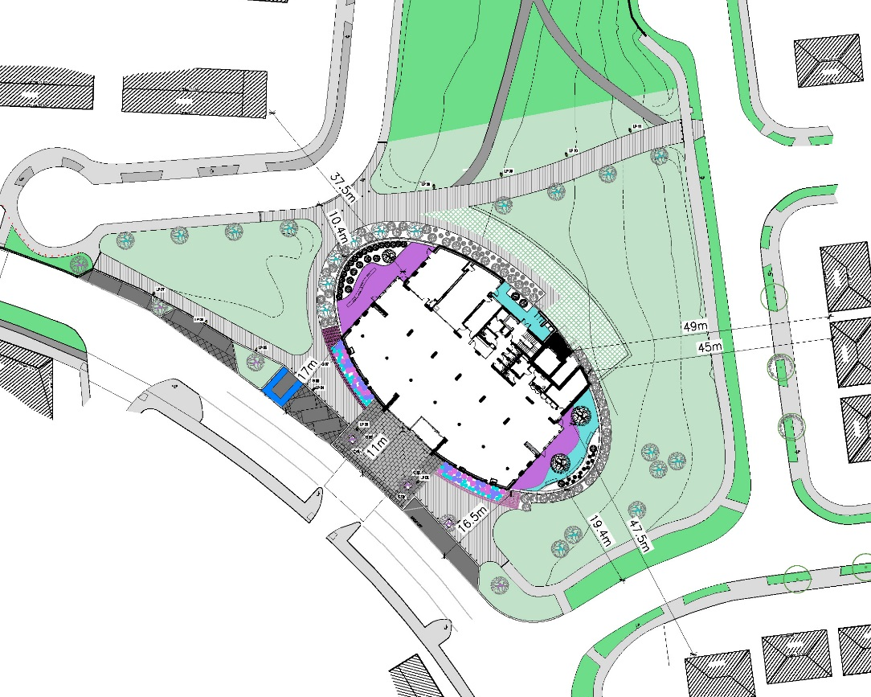
North Clondalkin Library Site Layout Development
Design Development since Part 8 - Curved geometry and compact shape of ellipse providing a soft curved elevation to all sides
- Soft landscaping within gardens and to the outside of all walls and railings helping to blend in with the soft landscaping and to soften the elevations of the building - All hardstanding and parking removed from the rear of the building providing a fully grassed area
- All parking and set-down to front of Library
- New Path linking Oatfield Park with main street, with Public Lighting to maintain access across the green space
Harelawn Crescent
Oatfield Park
CHURCH CAR-PARK
Oatfield Avenue
2018
SITE PLAN

Slide 4
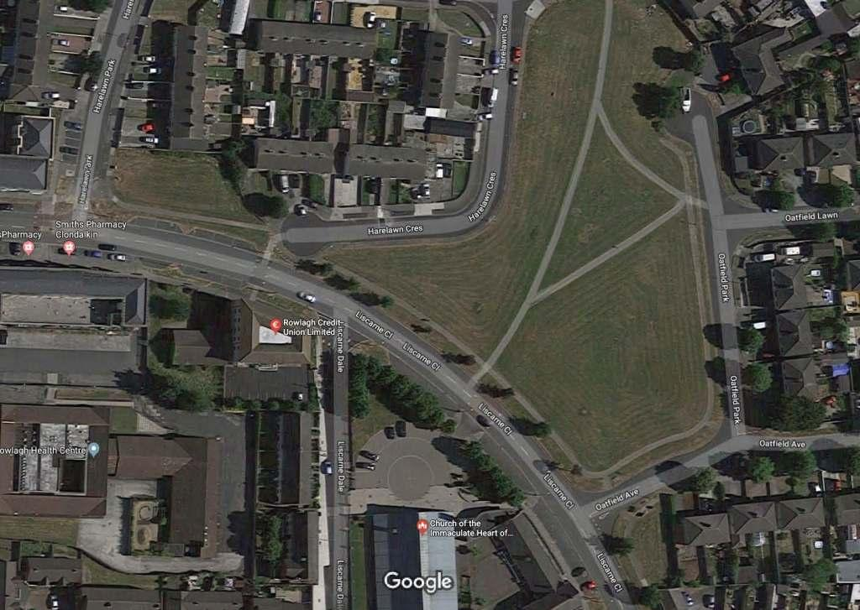
North Clondalkin Library Site Surroundings

Slide 5
North Clondalkin Library Floorplan Development
Design Development
since Part 8 The Ground Floor plan accommodation remains similar to Part 8 plan
Large Library Hall accommodating all age groups and library activities
I.T. training room
Conference room
Small meeting room for book-clubs and community groups
All access from main entrance on main street

Slide 6
North Clondalkin Library Floorplan Development
Design Development
since Part 8 The Ground Floor plan accommodation remains similar to Part 8 plan
Conference room which opens out into library for community & public events/performances/recitals
Protected gardens for Library use on three sides of the Library

Slide 7
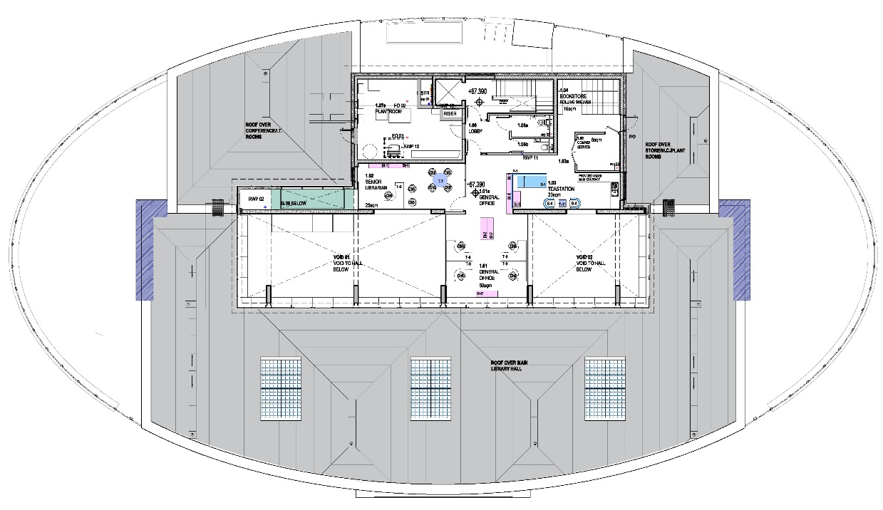
North Clondalkin Library Floorplan Development
Design Development
since Part 8 The First Floor plan accommodation remains similar to Part 8 plan
Office; Storage and Plant functions only at first floor
Staff access only
Offices overlook library hall below
No overlooking of neighbouring houses
Garden Below
Roof-space
Plantroom
Storage
Roof-space
Office
Tea-station
Main Office
Garden Below
Garden Below
Lightwell
Lightwell
Lightwell
Roof-space
2018
FIRST FLOOR PLAN
205sqm

Slide 8
Library event Rowlagh Community Centre

Slide 9
Library Event Rowlagh Community Centre

Slide 10
Circuit training Rowlagh Community Centre

Slide 11
NCL FEB 2020

Slide 12
NCL FEB 2020

Slide 13
NCL FEB 2020

Slide 14
Castletymon Library FEB 2020

Slide 15
Castletymon Library FEB 2020

Slide 16
Castletymon Library FEB 2020

Slide 17
Castletymon Library FEB 2020

Slide 18
Rathcoole Library- Planned proposal
Library to be developed as part of SDCC’s wider housing development in the Rathcoole Area.
Rathcoole is an established South Dublin village that has been, and will continue to be, subject to significant development.
The village is best located to both serve the adjacent villages of Saggart and Newcastle, and the surrounding rural hinterland.
Rathcoole is home to a cluster of existing and planned schools, both primary and secondary, with large student numbers.
The current SDCC development proposal at Rathcoole provides an opportunity to provide the service in conjunction with, and for, both the existing population and the new residents of the village.
It will add greatly to network of library services in the County.

