Slide 1
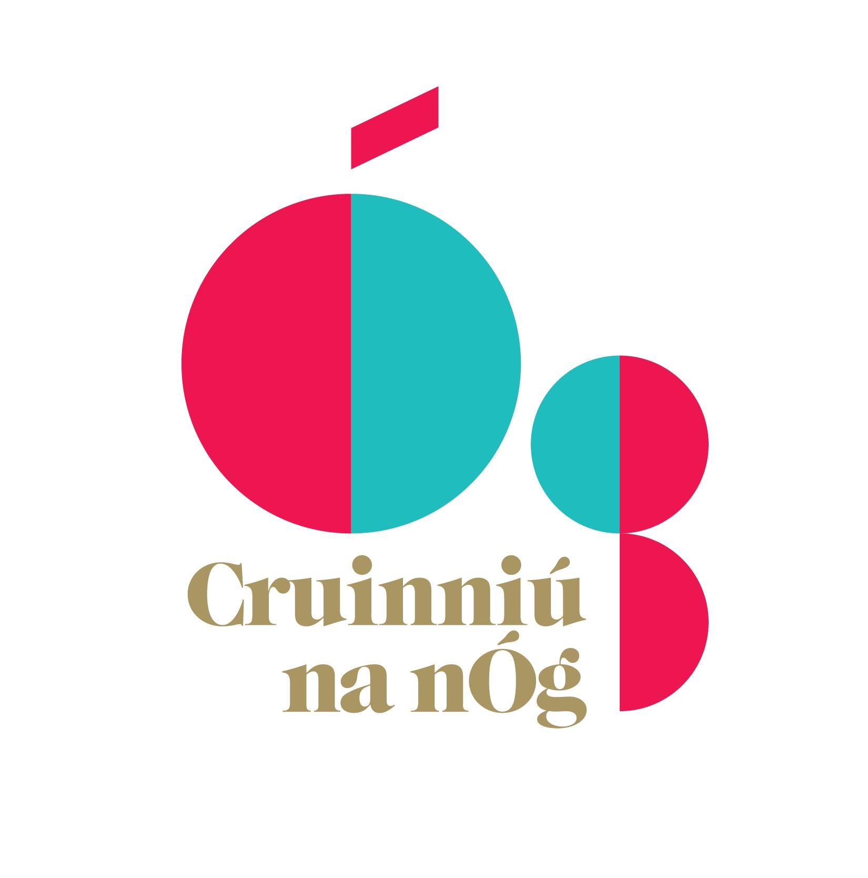
Cruinniú na nÓg 2020
South Dublin Arts Office
South Dublin County Council
Notes:
This presentation will look at what Cruinniú na nÓg is, briefly review the SDCC Arts Office’s 2019 programme and look at the overview of the Arts Office’s 2020 programme.

Slide 2
What is Cruinniú na nÓg?
Flagship of the Creative Youth Plan for Creative Ireland
Celebrates and encourages children’s and young people’s participation in arts
Notes:
Creative Ireland states Cruinniú na nÓg is Ireland’s national day of creativity for children and young people where everyone under 18 has a chance to unleash their creativity and participate in the arts.
Cruinniú na nÓg is the flagship of the Creative Youth plan which celebrates and encourages children and young people’s participation in activities such as art, music, coding and theatre workshops, performances, exhibitions, readings, film screenings and more. The activities encompass all creative fields. This particular day offers a free programme of community-based events across the nation.
Events particularly in South Dublin County include both one off activities and developmental projects that culminate on the day. This year Cruinniú na nÓg will be occurring on Saturday 13 June.

Slide 3
South Dublin County’s 2019 Programme
Activities were selected from a competitive open call
Innovative activities that foster creativity and engage a diverse audience
Held across community centres, public spaces, schools, libraries, and venues
Spanned a variety of creative forms
Notes:
For 2019, the South Dublin Arts Office held an open call to all creatives and creative communities looking for innovative activities that foster creativity and engage a diverse audience.
Activities could be held in a variety of community centres, public spaces, schools, libraries and venues and in a variety of creative forms. There was a special focus on activities led by culturally diverse facilitators and engaging a diverse audience.
Given the spread of South Dublin County, the programme focused on Creative Hubs in Tallaght, Clondalkin, and Lucan
The 2019 Programme included work from-
Community Creative Institutions including Music Generation, SDCC Libraries, Rua Red and Aras Chronain
Community based arts oganisations including Recreate, Alternative Entertainments, Studio 12, Tallaght Community Arts
Individual creatives and collectives including Freshly Ground Theatre, Olwyn Lyons, Helen Barry, Usha Ramlingham, Edel Cox, Damian Evans, and Matt Szczerek
There was also a collaboration between the 4 Dublin Local Authorities working with Early Years and Music.
The programme engaged with more than 3800 children, young people, and adults.

Slide 4
Cruinniú na nÓg 2020
Tallaght - young people making creative works for or with other young people and children
Corkagh Park Community and Family Event
Open Call to round out the programme
Notes:
Cruinniú na nÓg 2020 will take place on Saturday 13 June
This year the Arts Office will build upon the Cruinniú na nÓg programme from last year in the following ways:
The Tallaght area will be designated as a space where the aim will be young people making creative work with or for other children and young people.
Corkagh Park will play host a to family community fun event led by Tallaght based Recreate.
An open call has issued to round out a programme where activities both on off and developmental can be held throughout the county. This call out is looking to engage with diverse audiences and participants as well as hard to reach or marginalized communities. The closing date is the 12th March.

Slide 5
2020 Commissions
Freshly Ground Theatre
ReCreate
Notes:
To anchor the 2 thematic areas of Tallaght and Corkagh Park, the Arts Office has commissioned 2 creative organisations who successfully facilitated activities for Cruinniú na nÓg last year.
Freshly Ground Theatre, a young drama collective, will deliver a collaborative developmental theatre project titled, SIÓG that will be performed in Tymon Park. They will be engaging with children ages 4-12 and the wider community. Freshly Ground will be receiving mentorship from Donal Courtney and Treasa Barrett. Their work will look at fairies in Irish folklore and mythology.
Tallaght based Recreate will create an inclusive play space in Corkagh Park for families and the community at large. The play space will include an enchanted forest, a ReCreate ReFashion Station, a sustainable garden, and a Weave Area. They will be partnering with social enterprise Dabbledoo who will run musical workshops with instruments created on the day.
The South Dublin Arts Office hopes that the 2020 programme will help to further develop creativity throughout the wider county.

