Slide 1

Update on Integrated Housing System
Housing Strategic Policy Committee Meeting
20th February 2020

Slide 2

Background:
SDCC commissioned a review of housing management and maintenance procedures, processes and associated systems.
Housing Review was completed in April 2016.
Key recommendation was the installation of an Integrated Housing System with functionality to support all operational processes across the Housing service and provide the following:
    Improved management information and reporting
    Electronic forms/multiple interfaces to reduce manual/duplicate input
    Customer portal to facilitate submitting repairs, viewing rent accounts submitting queries, updating contact information and more
    Mobile working and real time information for progress monitoring

Slide 3
Integrated Housing System Project:
Completed ‘open procedure’ tender process in 2017- unsuccessful.
Completed ‘competitive with negotiation’ tender process in 2018 - tender awarded to Northgate Public Services (NPS) and contract signed on 21st September 2018.
Kick-off meeting between NPS and SDCC in October 2018.
Implementation project commenced in December 2018.
Project Team of 7 (6.2 FTE’s) & 2 IT resources (1.5 FTE’s).
First in Rep. of Ireland to go live with NPS Housing system.

Slide 4
Benefits to Key
Stakeholders post go live
Customers
Tenants can self serve 24 hours a day, 7 days a week on any device (fully mobile responsive).
Online application forms, with save & retrieve and document upload.
Higher level of customer service- through automation of mundane tasks, staff time will free up to directly help those with the greatest need.
Enhanced flexibility, real time information and mobile working.

Slide 5
Benefits to Key
Stakeholders post go live
Councillors
Improved response times to certain queries
Real time information will be available
Reduced grievances being raised from Housing customers
Faster and improved decision making informed by real time management information
Proactive rather reactive Housing department services through evidence-based insight into current trends to enable appraisal of the different strategic options

Slide 6

High level view of NPS Housing

Slide 7
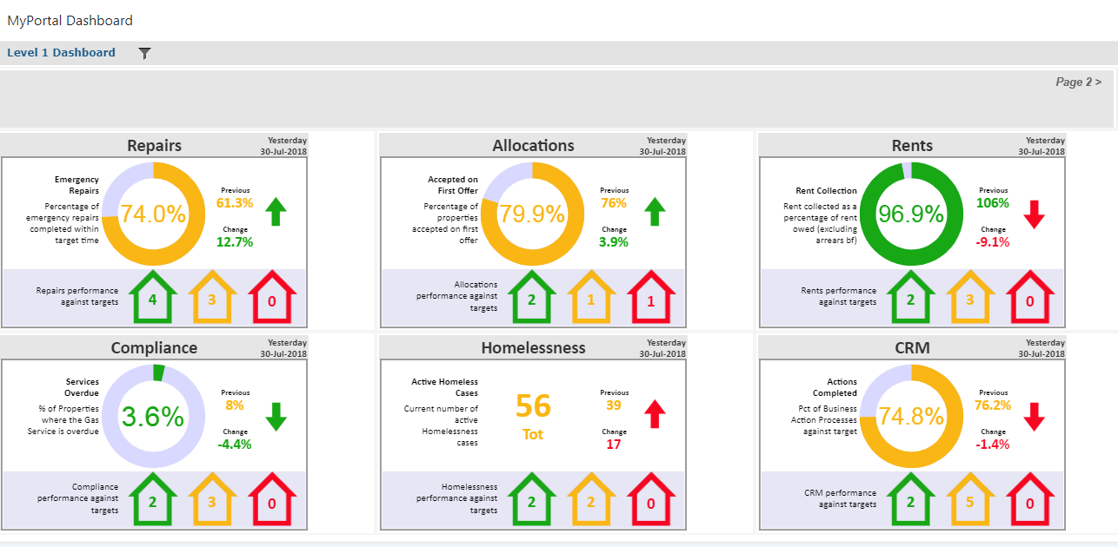
Dashboard Examples

Slide 8
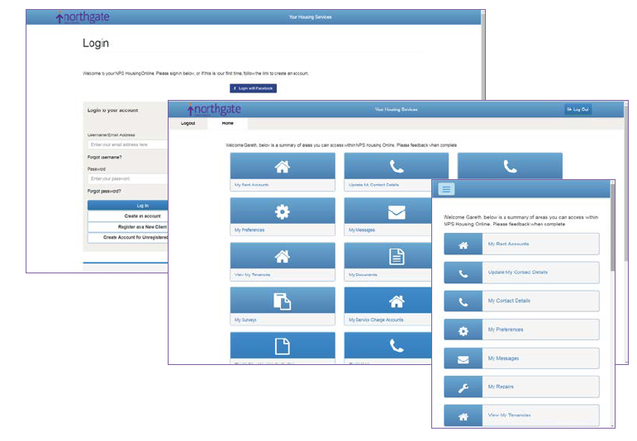
NPS Housing-
Customer Portal

Slide 9
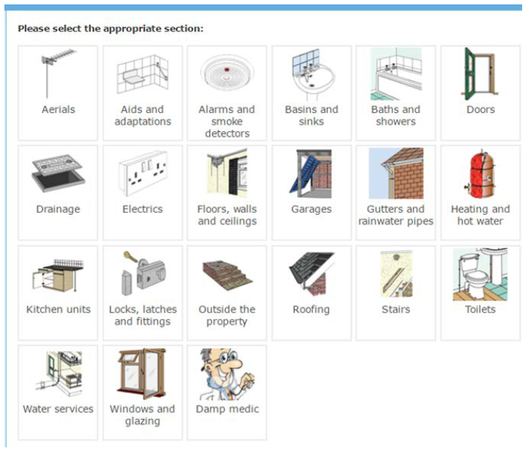
NPS Housing
Customer Portal- Repairs sample

Slide 10
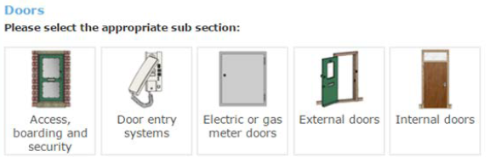
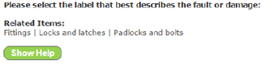

NPS Housing
Customer Portal- Repairs sample
Selecting ‘Doors’ would allow for the selection of the type of door:
The diagnosis diagram then allows for selection of the type of work actually required:

Slide 11
Key Delivery Challenges:
Only one respondent to final tender.
Disruption to whole department during implementation.
Complexity of data load files.
Data quality issues.
New systems being implemented in DEASP, DRHE and RTB & new Loans system being procured for SDCC.
New application form for Social Housing Support.

Slide 12
Progress To Date:
Configuration design, build, functional testing and User Acceptance Testing (UAT) on most modules completed.
Training course development in progress.
Key data load areas progressing, however encountering significant challenges
Reports and Template Letters encountering some delays.
System Go Live-
  Phase 1 -76% of Housing Staff 27th April 2020
  Phase 2 -24% of Housing Staff Q3 2020

Slide 13
Thank you!
Questions Welcome….

