Slide 1

SAGGART COMMUNITY CENTRE UPDATE
Social, Community & Equality
Strategic Policy Committee Meeting
18th February 2020

Slide 2
Project Milestones
Aug. 2019
Acquisition of St. Mary’s Old School House
Dec. 2019
Management Company established
Dec. 2019
LEADER EOI submitted
Feb. 2020
LEADER Application €500,000 - Feb 2020 for April LAG Meeting
Mar.–Apr. 2020
Part VIII
Sep. 2020
LEADER Final Application

Slide 3

SAGGART COMMUNITY CENTRE – SITE & SKETCH DESIGN INFORMATION- Historic Structures Fund - Application
Old St. Mary’s National School, Slade Castle Walk, Boherboy, Saggart, South County Dublin
SITE
AERIAL VIEW OF SITE
SAGGART COMMUNITY CENTRE

Slide 4
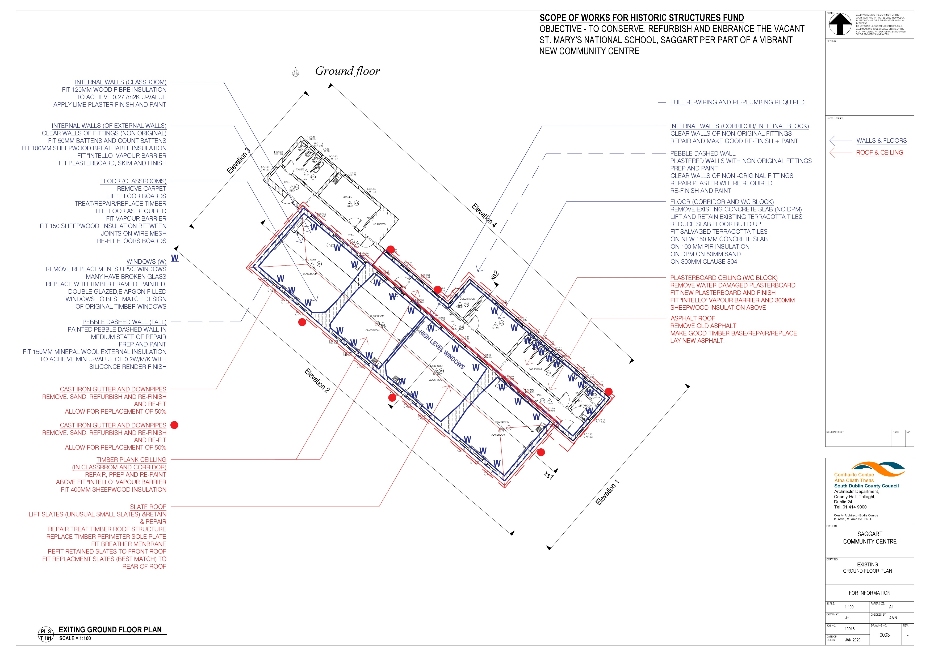
PROPOSED SCOPE OF WORKS PLAN FOR CONSERVATION, REFURBISHEMENT AND RENEWAL OF EXISTING SCHOOL BUILDING

Slide 5
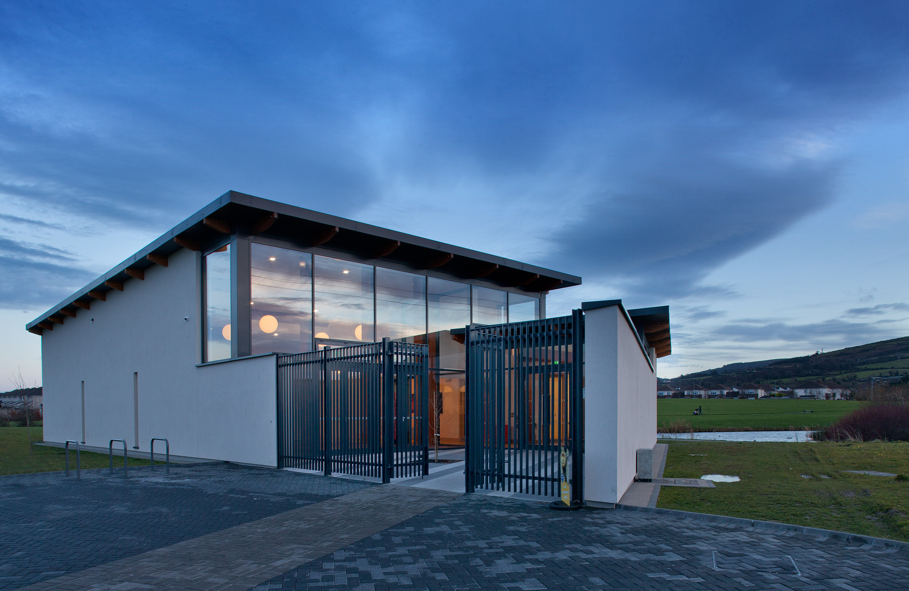
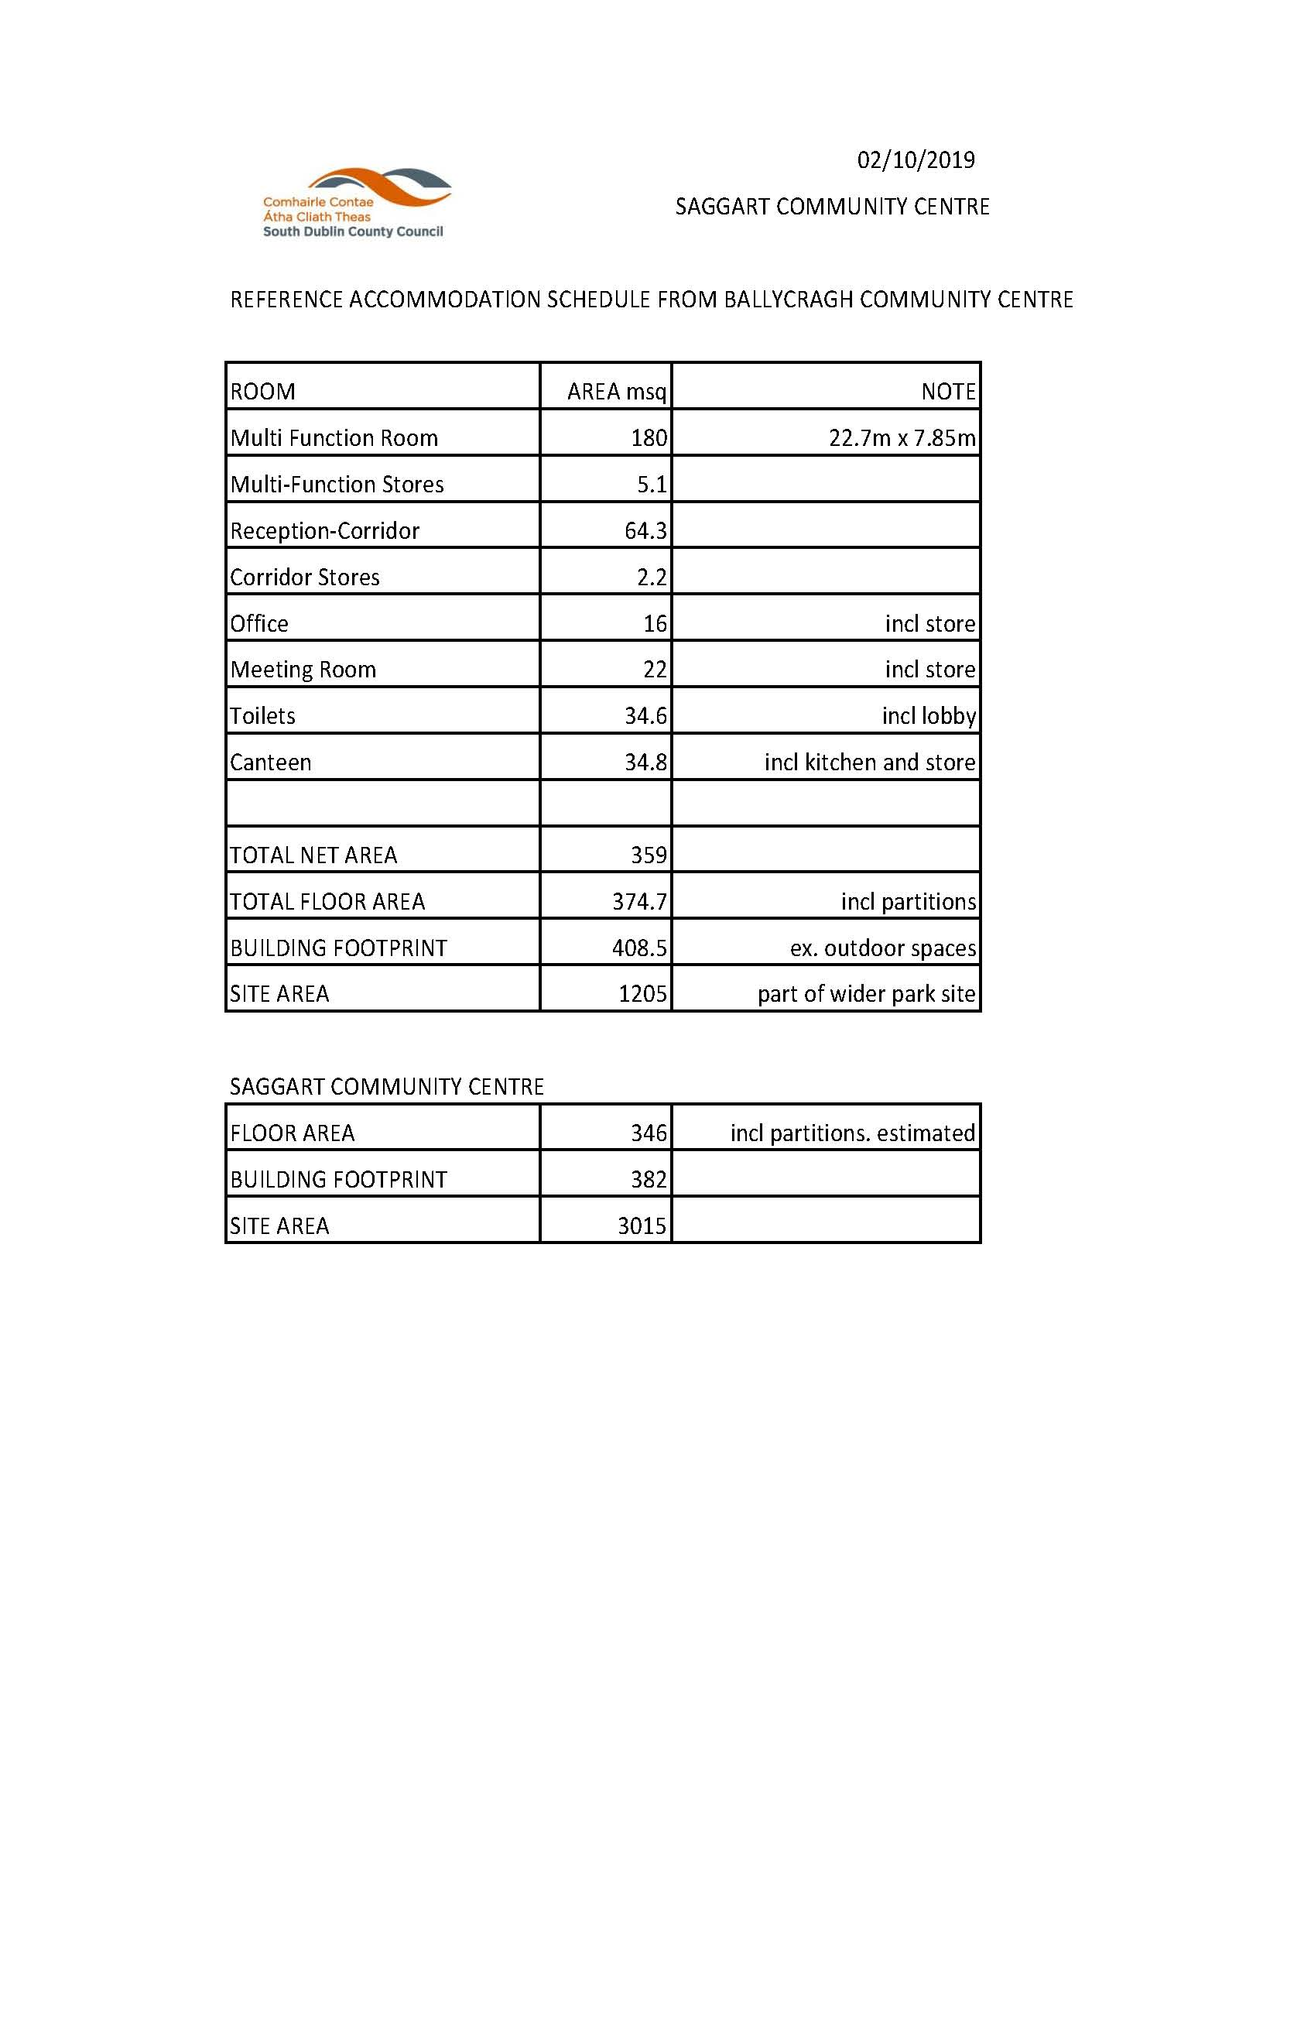
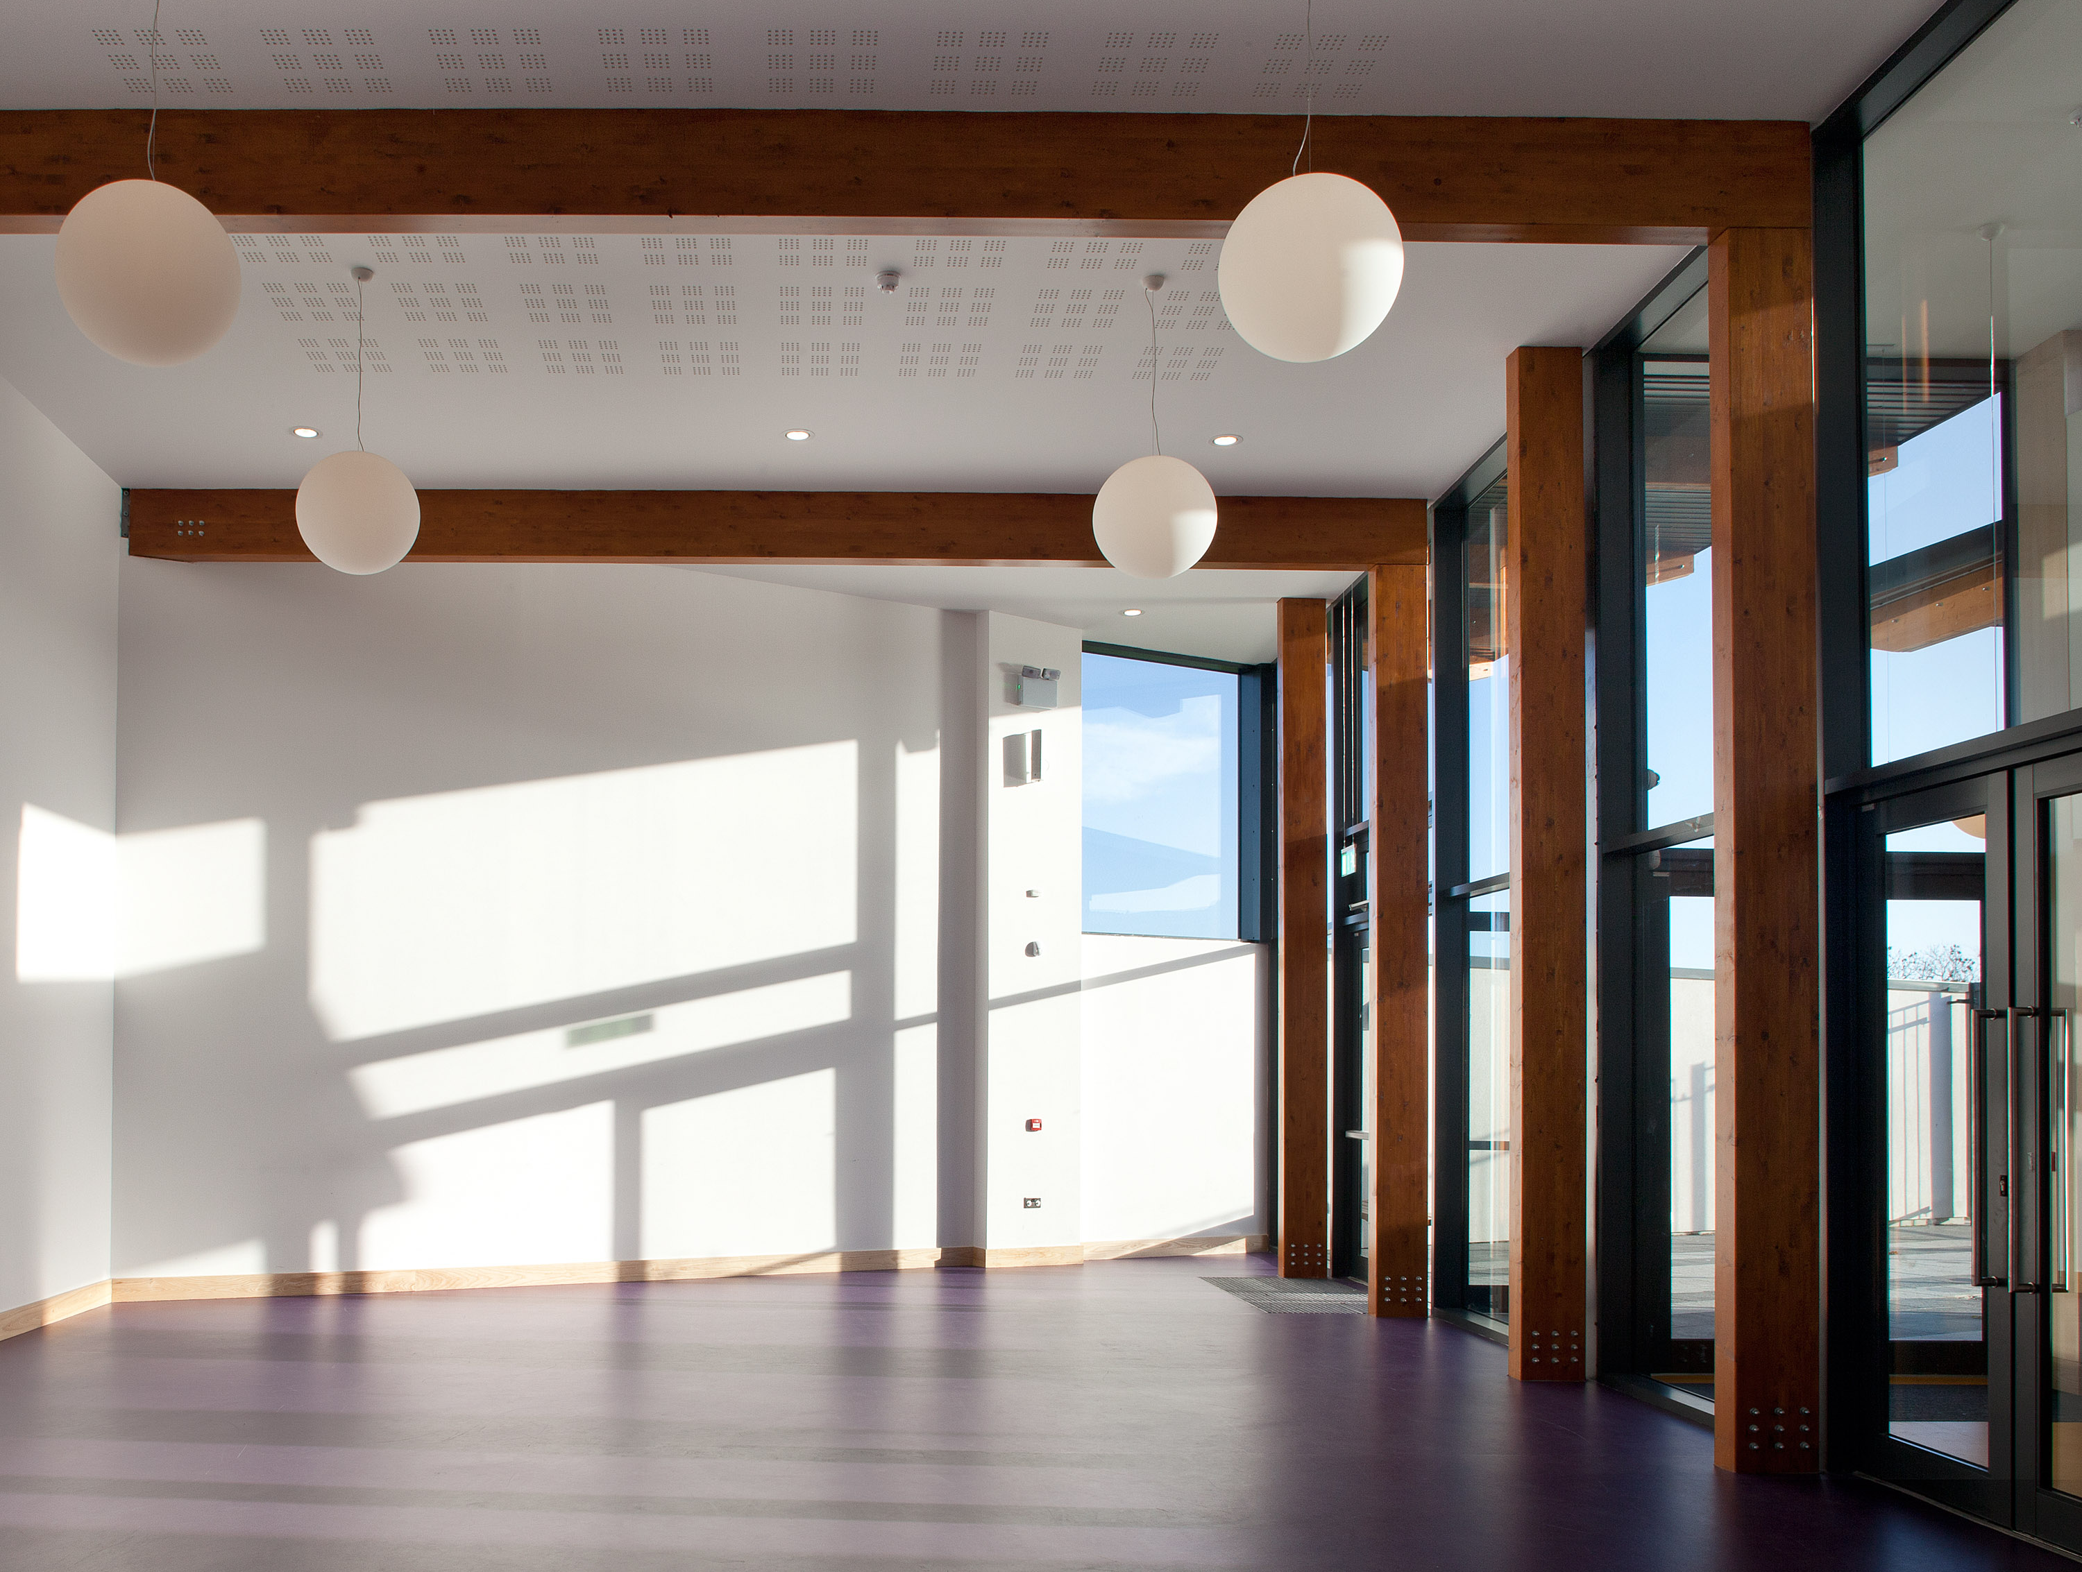
COMMUNITY CENTRE REFERENCE BALLYCRAGH COMMUNITY CENTRE
ACCOMMODATION SCHEDULE
ENTRANCE VIEW OF BALLYCRAGH COMMUNITY CENTRE
MULTI FUNCTION ROOM VIEW OF BALLYCRAGH COMMUNITY CENTRE

Slide 6
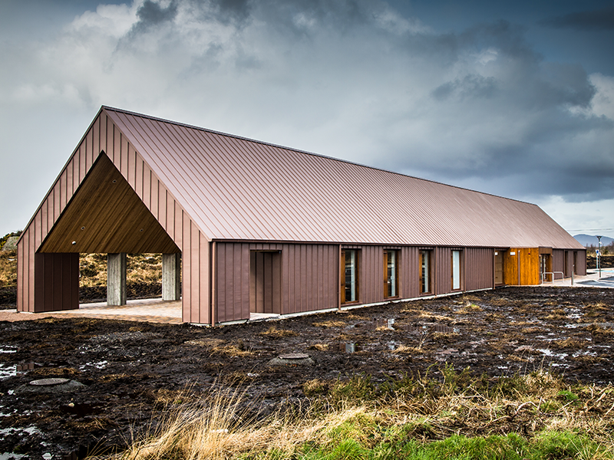
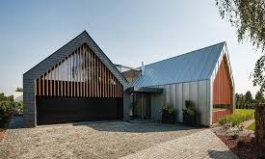
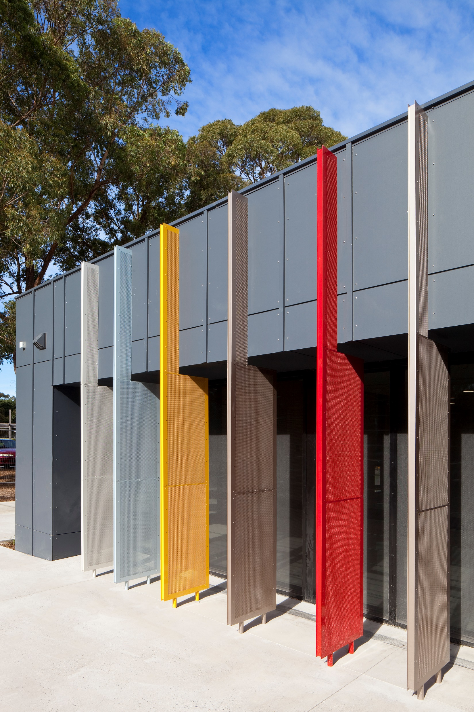
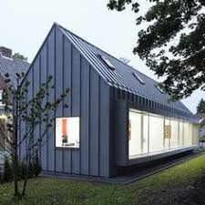
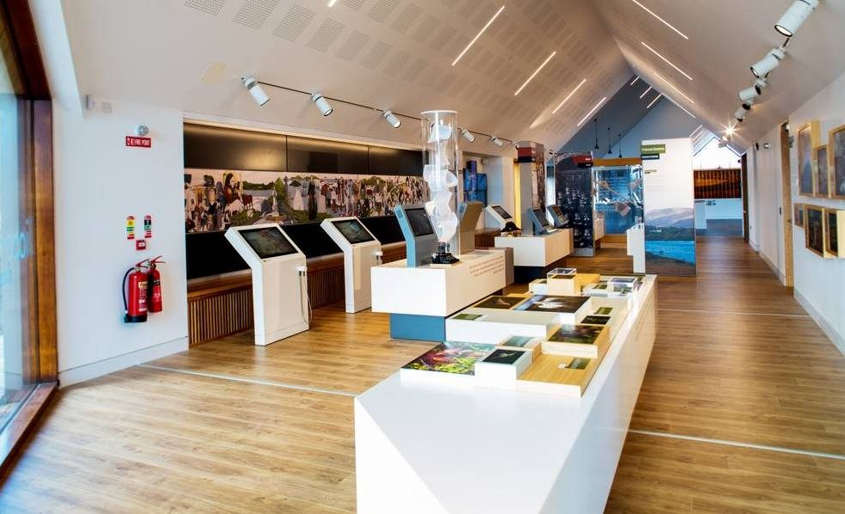
DESIGN REFERENCES KEEP
PRIMARY FORM OF MULTI FUNCTION HALL
Pitched roof for modern vernacular expression in village setting
CLADDING MATERIAL
Black zinc
MULTI FUNCTION HALL INTERNAL SPACE
Pitched roof provides ceiling height while minimising bulk
FRONT ARCADE- Fins provide colour

Slide 7
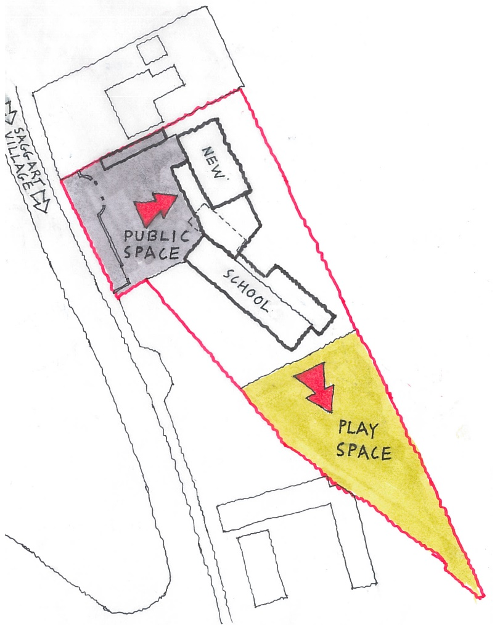
SAGGART COMMUNITY CENTRE – SITE CONCEPT
SITE
AERIAL VIEW OF SITE
SITE CONCEPT
New building to address the road and Saggart and form public space with Saggart

