Slide 1
South Dublin County Council Climate Change Action Plan 2019- 2024 Implementation Plan 2020
Teresa Walsh, Director of Services
Environment, Water and Climate Change
February 2020

Slide 2
4 Key Targets
33% improvement in the Council’s energy efficiency by 2020
Make Dublin a climate resilient region by reducing the impacts of future climate change related events
40% reduction in the Council’s greenhouse gas emissions by 2030
Actively engage and inform our citizens on climate change

Slide 3
6 Action Areas
Energy and Buildings
Transport
Flood Resilience
Nature Based Solution
Resource Management
Citizen Engagement

Slide 4
130 Actions identified to be delivered over the 5 year term of the plan
Actions include
Continued monitoring of programmes
Developing/updating management plans, strategies and policies
Public Engagement
Promoting healthy lifestyles
Delivering new innovative infrastructure
Reducing waste

Slide 5
Energy and Buildings
27 actions over the life of the plan
8 recurring actions monitored
7 additional actions to be progressed in 2020

Slide 6
Energy and Buildings
Action Progressing in 2020
Progress Heatnet project
Energy efficient upgrades to public lighting
Energy efficient upgrades to lighting in County Council public buildings
Insulation upgrades to Council’s housing stock
Identify sites for trialling renewable energy projects
Investigate the Lifecycle Assessment of traditional and new construction methods for residential projects
Assess feasibility of additional low carbon district heating schemes

Slide 7
Development of the Tallaght District Heating Scheme

Slide 8
Upgrade 4,000 Public Lights to LED and Lighting in SDCC Buildings

Slide 9
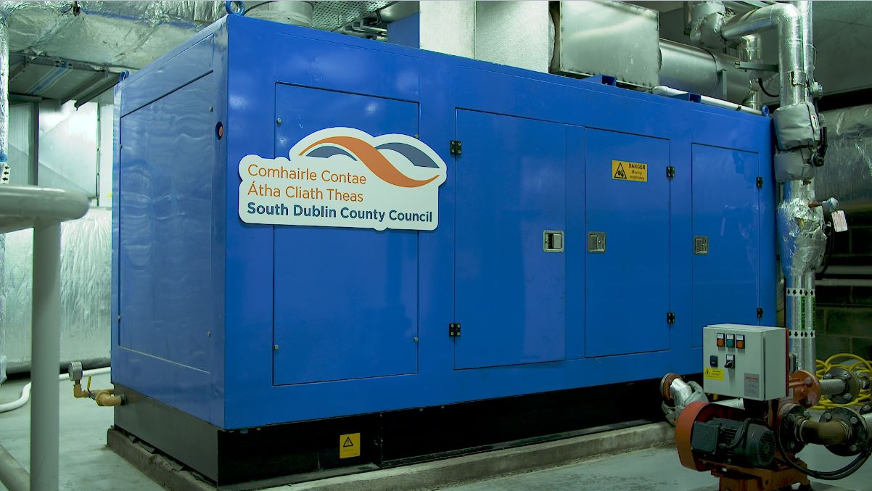
Energy Efficient Retrofits of Solar Panels to SDCC Municipal Buildings

Slide 10
Transport
21 actions over the life of the plan
8 recurring actions monitored
4 additional actions to be progressed in 2020

Slide 11
Transport
Actions Progressing in 2020
Ongoing replacement of Council vehicles with more energy-efficient alternatives, including EVs
The Council will undertake an assessment of the number of existing and potential future Electric Vehicle Charge points in its jurisdiction.
Development of cycle/pedestrian greenways.
Expand availability of EV and other facilities for non-fossil fuel powers vehicle charging points in the County.

Slide 12
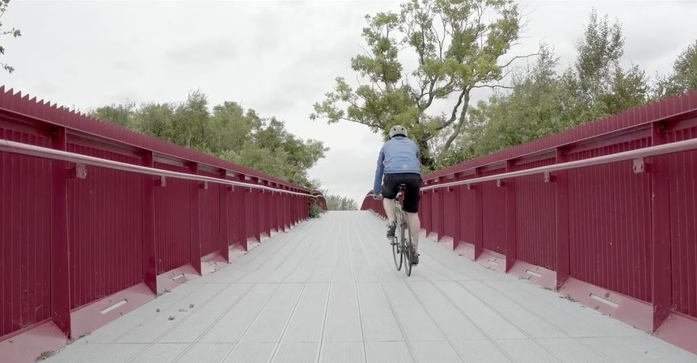
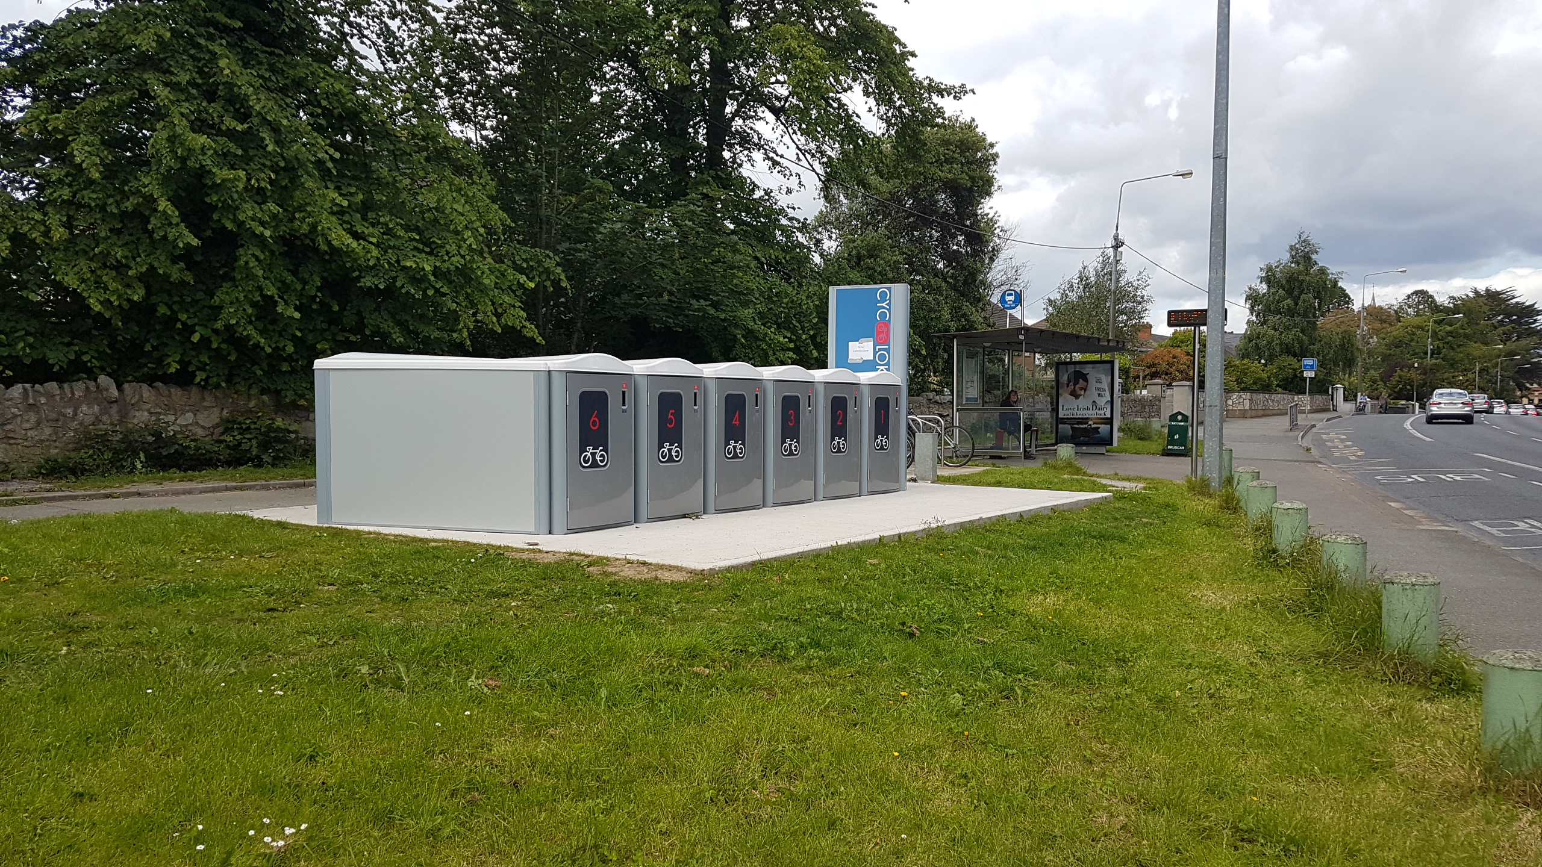
Promote Modal Shift From Single Occupancy Vehicles To More Sustainable Modes of Transport

Slide 13
Introduction of Additional Electric Vehicles to SDCC’s Fleet

Slide 14
Flood Resilience
22 Actions over the life of the plan
9 recurring actions to be monitored
9 actions to be progressed in 2020

Slide 15
Flood Resilience
Actions Progressing in 2020
Cross-boundary flood management with neighbouring local authorities.
Integrated constructed wetlands for water attenuation and purification.
Develop a Climate Change impact GIS risk map with scenarios for the Dublin Region.
Develop template to capture impacts, responses and costs (including ecosystem services/natural capital costs) for all major climate events.
Establish a working group to deal with the issue of pluvial flood risk, this shall include; How to manage Urban Creep and the increase in impermeable surfaces; Promotion of SuDS early in design process; development of pluvial flood forecasting through use of point rainfall forecasting.
Whitechurch, Poddle & Camac Flood Alleviation Schemes.
Minor flood schemes and general maintenance that are designed and implemented to promote Nature Based Solutions where practical.
Communication and awareness campaigns on flood risk management and natural flood management measures.
Promote and encourage community involvement in the retrofit of SuDS in existing developments.

Slide 16
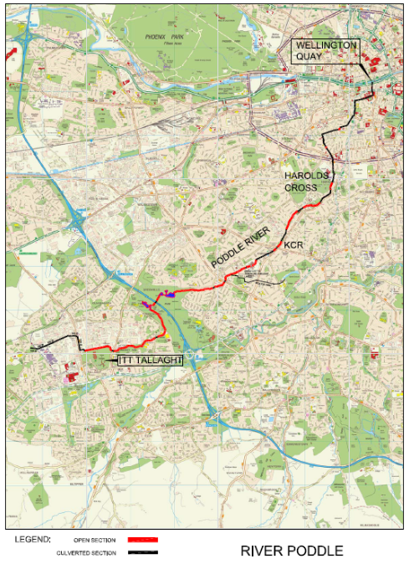
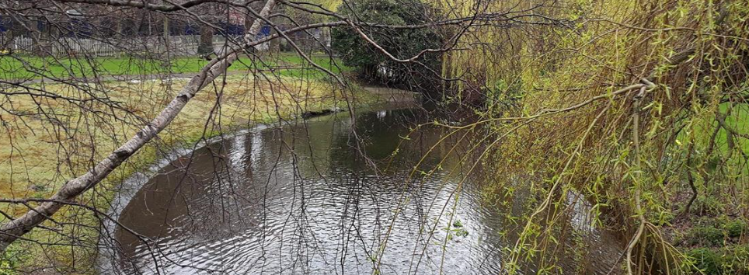
Poddle Flood Alleviation Scheme

Slide 17
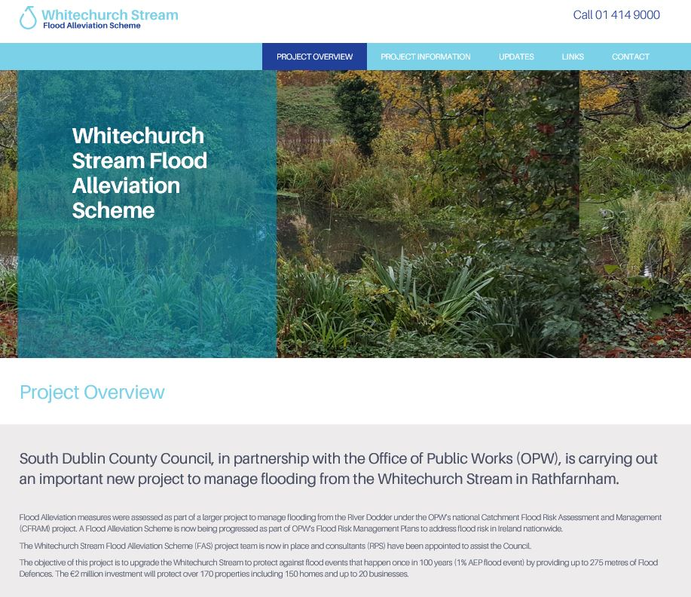
Whitechurch Stream Flood Alleviation Scheme

Slide 18
Nature Based Solutions
33 Actions over the life of the plan
16 actions to be progressed in 2020

Slide 19
Nature Based Solutions
Produce regional floodplain management guidelines.
Finalise Draft Biodiversity Action Plan.
Develop Green Infrastructure Strategy that identifies areas and priorities for green infrastructure and investment.
Develop urban woodland management strategy and action plan.
Implement Tree Management Policy.
Increase tree canopy cover in the County through annual planting and maintenance.
Develop demonstration projects for successful planting and establishment of trees in urban hardscapes.
Review and climate-proof Biodiversity Action Plan, Invasive Alien Species Plan, and tree management Policy.

Slide 20
Nature Based Solutions
Manage and monitor identified ‘pollinator protection sites’.
Maintain and expand community gardens and allotments for local food production.
Support local communities with biodiversity education.
Sustainable gardening workshops.
Deliver Green Roof on Civic Buildings.
Maintain and increase Green Schools Programme participation.
Engage with residents and relevant stakeholders on Climate Change and Biodiversity to incorporate their ideas into Council strategies and plans.
Assess the benefits of increasing buffer distances of 10m from watercourses to protect biodiversity and provide greater flood attenuation for distances of 20m, 50m and 100m.

Slide 21
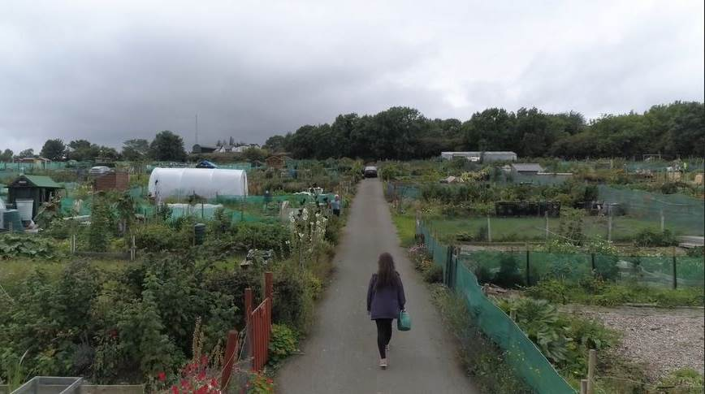
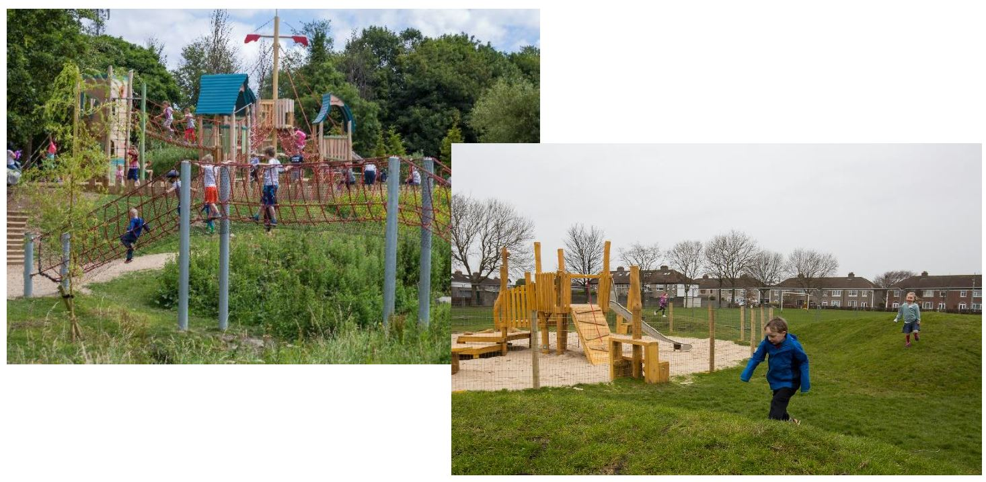
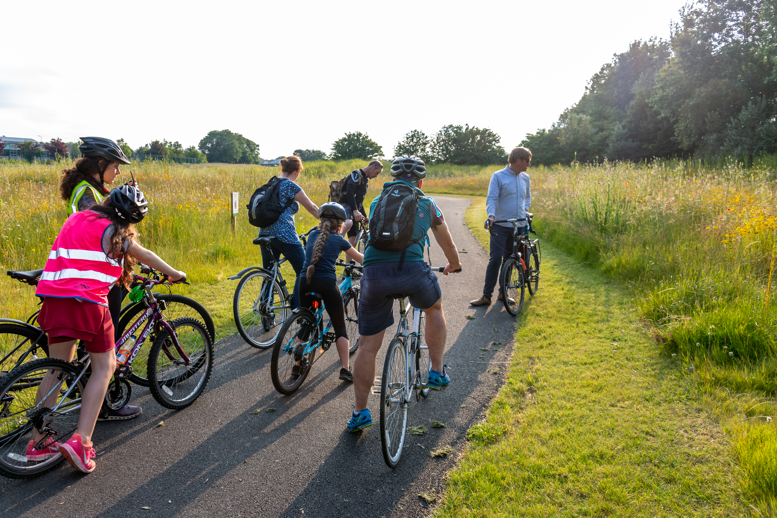
Nature Based Solutions
Promote Active Play
Expansion of Community Gardens and Allotments for Local Food Production
Promote Active Travel

Slide 22
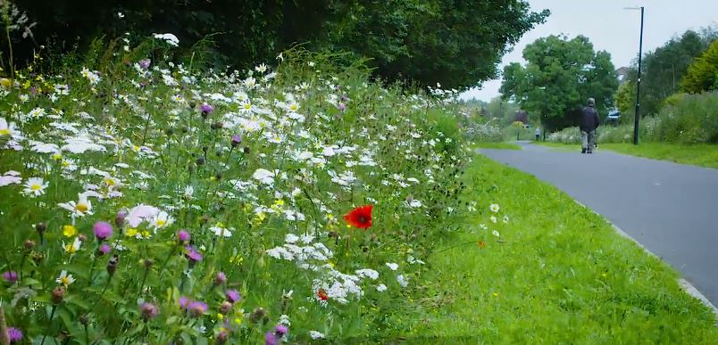
Nature Based Solutions
Wildflower Meadows to Encourage Pollination
Planting Native Tree Species

Slide 23
Resource Management
27 Actions over the life of the plan
18 recurring actions to be monitored and reviewed in 2020
6 actions to be progressed in 2020

Slide 24
Resource Management
Examine the potential of Arthurstown Landfill for development of green energy uses.
Implement water conservation campaigns in civic buildings.
Identify pilot locations for water access points (Single-use plastic elimination)
Research feasibility of rainwater harvesting in Council Buildings.
Promote recycling and the circular economy to householders through a range of workshops, talks and programmes.
Explore collaborations with stakeholders such as Refill.ie to reduce single use items.

Slide 25
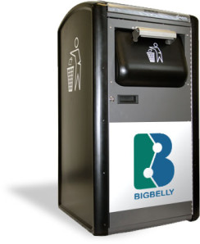
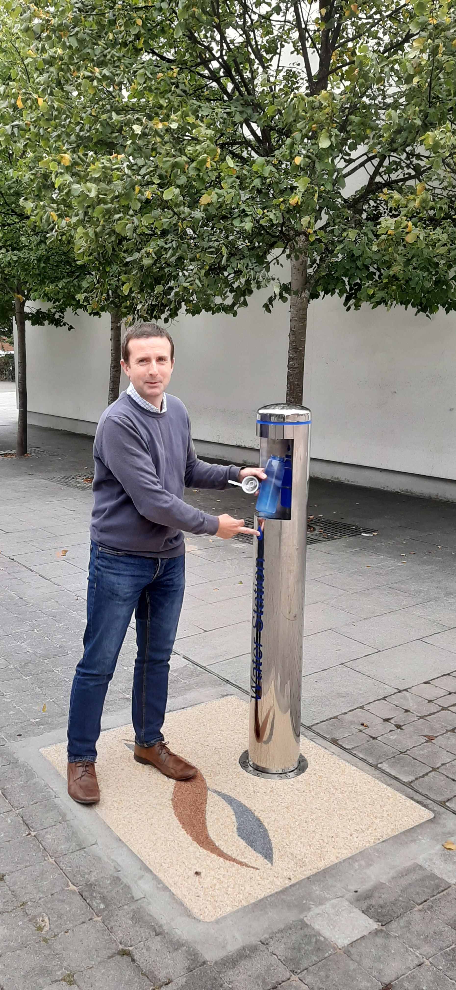
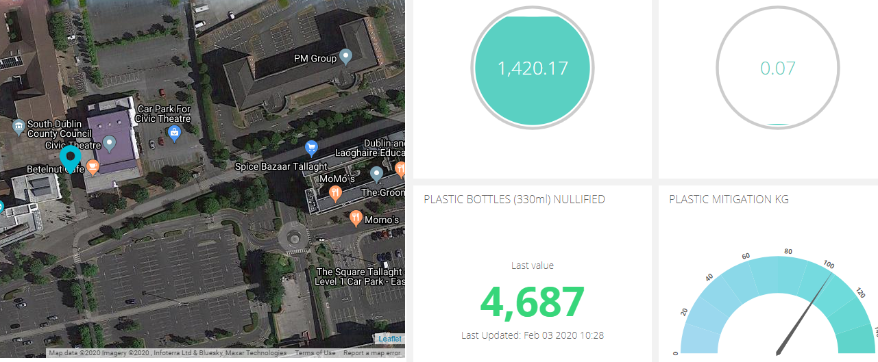
Resource Management

Slide 26
Citizen Engagement
39 Actions over the life of the plan
Public engagements to be monitored in 2020

Slide 27
Citizen Engagement

