Slide 1

South Dublin Sports Pitch Strategy
James Gregory and Matthew Eames – 4global Consulting
January 2020

Slide 2






Sports Pitch Strategy - SPS
  WHAT IS A SPORTS PITCH STRATEGY?
  An analysis of supply and demand for playing pitches (grass and artificial)
  It plans for future need and makes recommendations regarding pitch demand, capacity and future requirements
  The assessment focused on pitches used by the following sports:
    Soccer, GAA, Rugby Union, Hockey, Cricket, Athletics
  WHY IS IT NEEDED?
  SDCC provide sports pitches in parks and open spaces across the county. Clubs from a range of sports are licenced for the use of pitches on an annual basis.
  There is increasing demand on Council provided pitches to cater for increased numbers of teams and clubs. There is also an increase in the variety and types of sports being pursued.
  The SPS assesses current provision and makes recommendations to maximise capacity
  It allows the Council to strategically plan provision of active recreation in the county based on projected team generation rates
  PROCESS
  Inception meeting and National Governing Body consultations
  Site assessments
  Consultation meetings with stakeholders including clubs, schools, local sports development officers etc.
  Detailed needs analysis of each site
  Action plan, scenario testing and recommendations
  Creation of playing pitch platform and database (http://demo.playingpitchstrategy.com/auth/login)
Notes:
As per slide

Slide 3
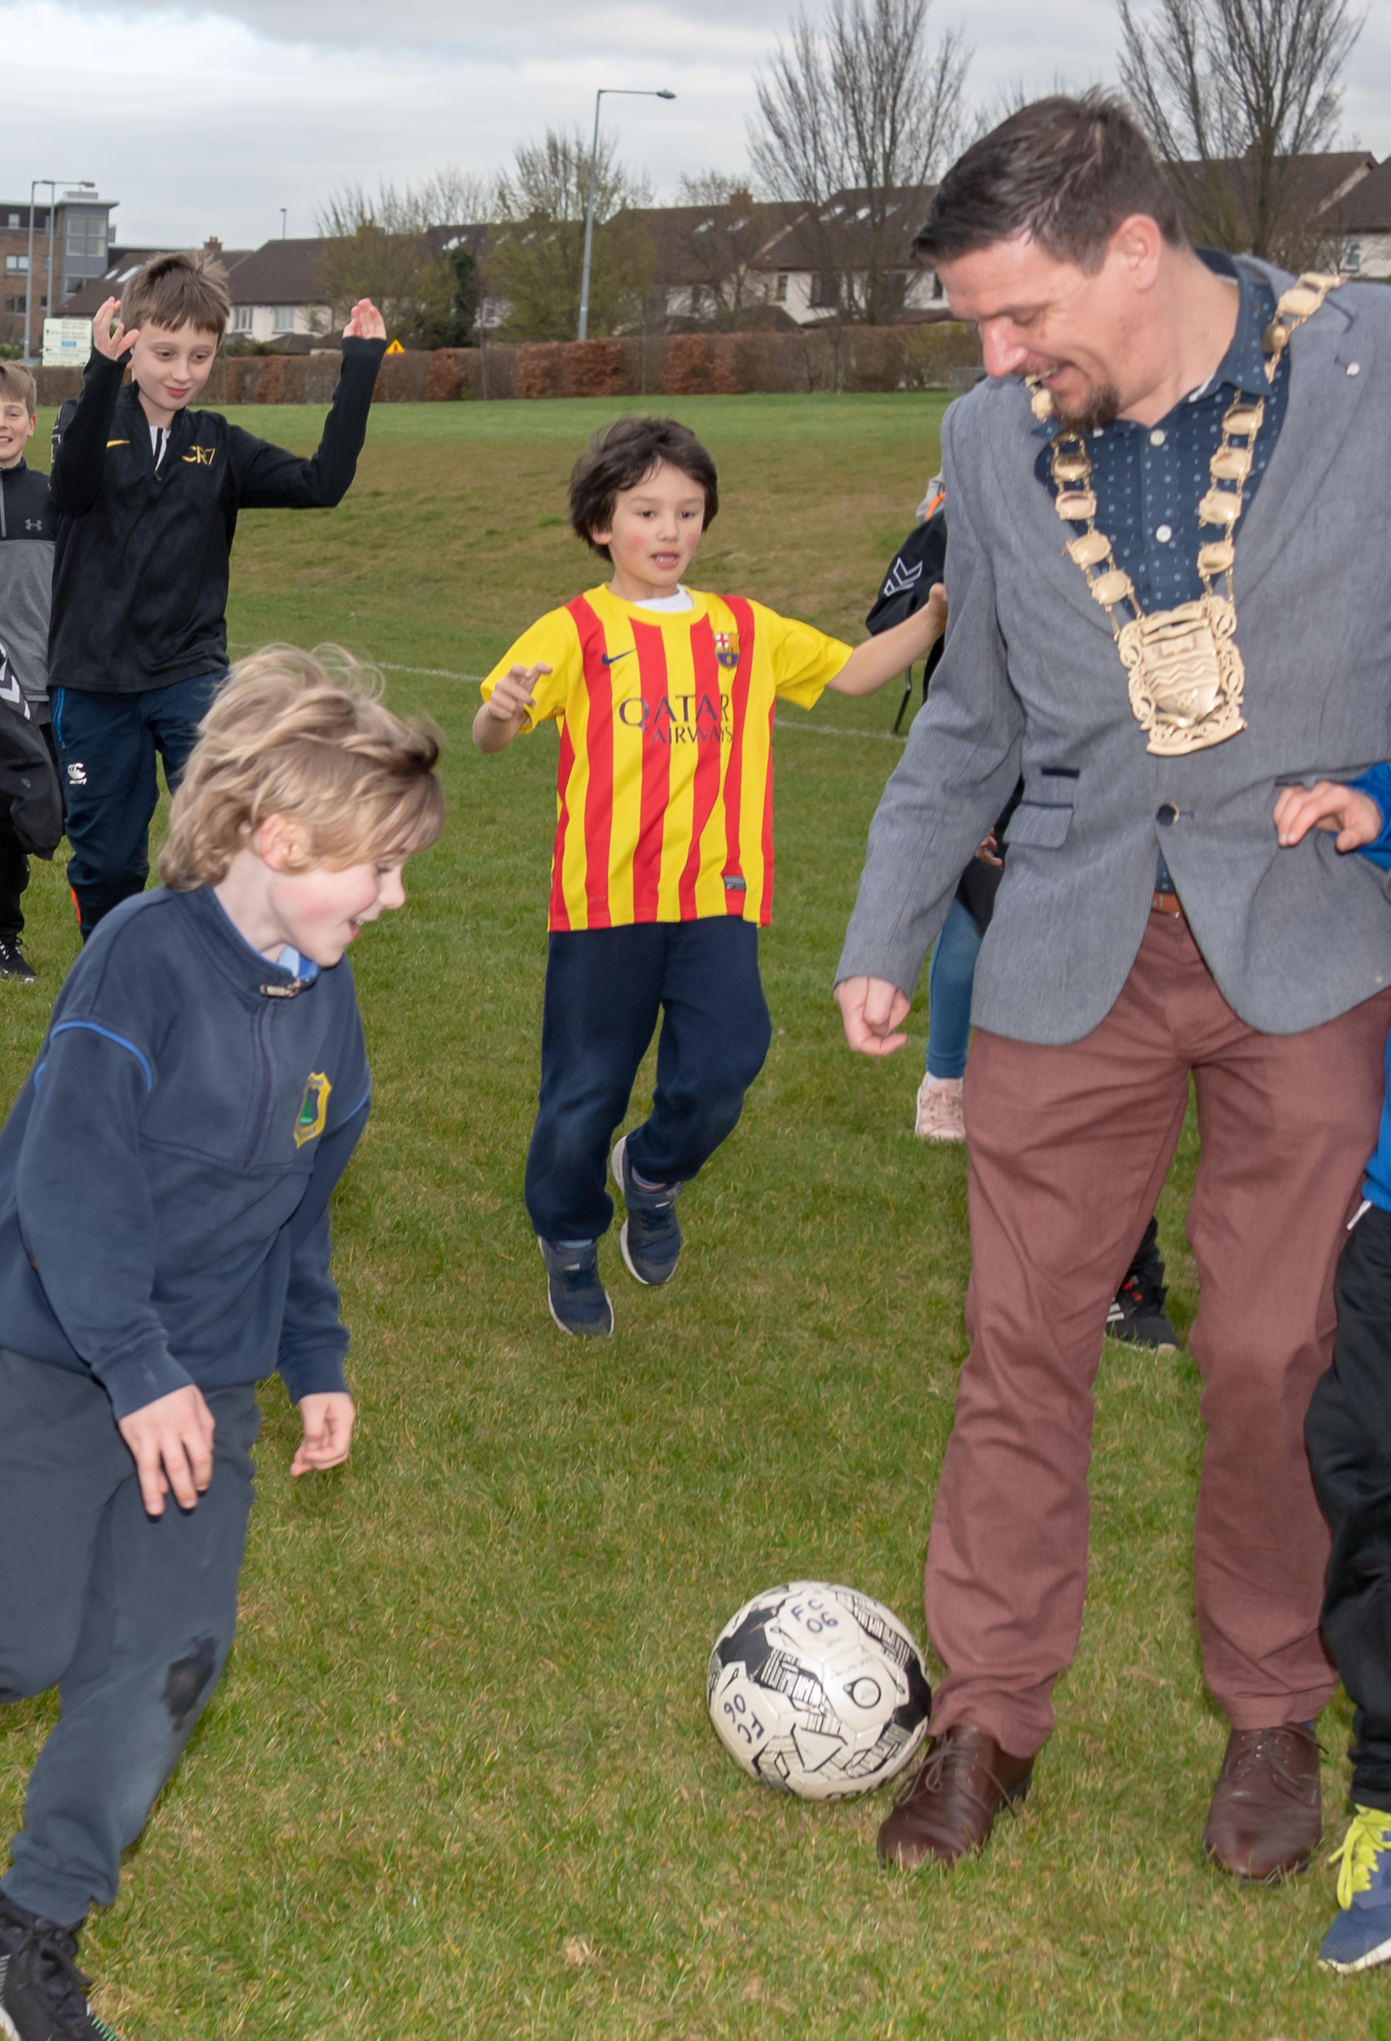
Site Assessments:
Over 300 pitch and athletic track assessments were completed by 4global’s research team.
  163 Local Authority owned grass pitches
  Private and publicly owned Artificial Grass Pitches (AGPs)
  57 school pitches (Dept. of Education and Skills)
  46 Private club pitches
  40 Commercial pitches
Notes:
As per slide

Slide 4
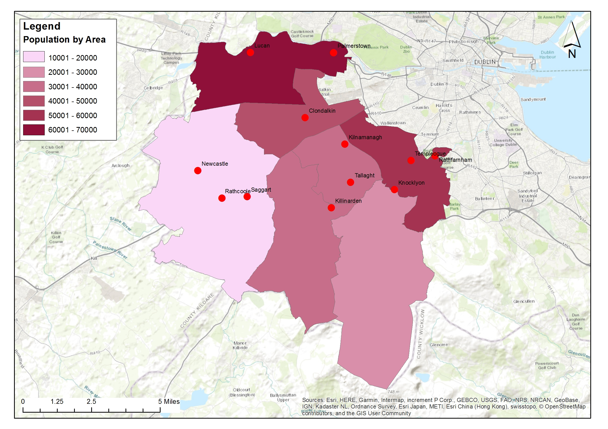
Current Population (Census 2016)
  Population of SDCC: 278,767 in 92,368 homes
  An increase of 5.1% from 2011 census
  South Dublin has the second youngest population in the State in both the 2011 and 2016 Census.
  In the period 2006-2016, the population of South Dublin increased by 32,000. South Dublin is the newest and one of the fastest growing areas within the Dublin Metropolitan Area
  The current South Dublin County Development Plan has zoned residential land capable of delivering an estimated 39,649 housing units
  For the purposes of population projection county was divided into sub areas based on census small area divisions.
Notes:
As per slide

Slide 5
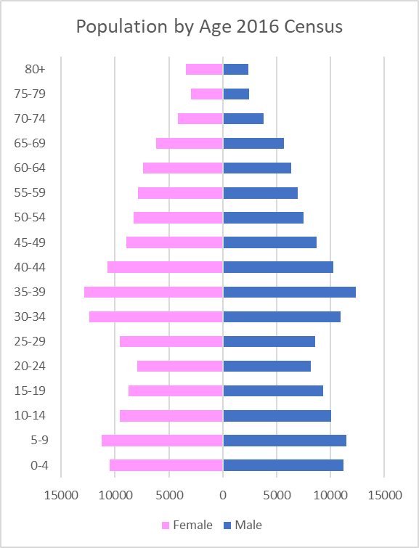
Population by age and gender for SDCC area 2016 Census
Notes:
Large numbers at 0-9 age group will move up into active play increasing demand for full size pitches.
The County also has large numbers in the 30-40 age bracket; this group led to the high demand for pitches in the last few years.
National policy seeks to extend peoples active sports participation as they get older and also encourage more women and younger children into sports.

Slide 6
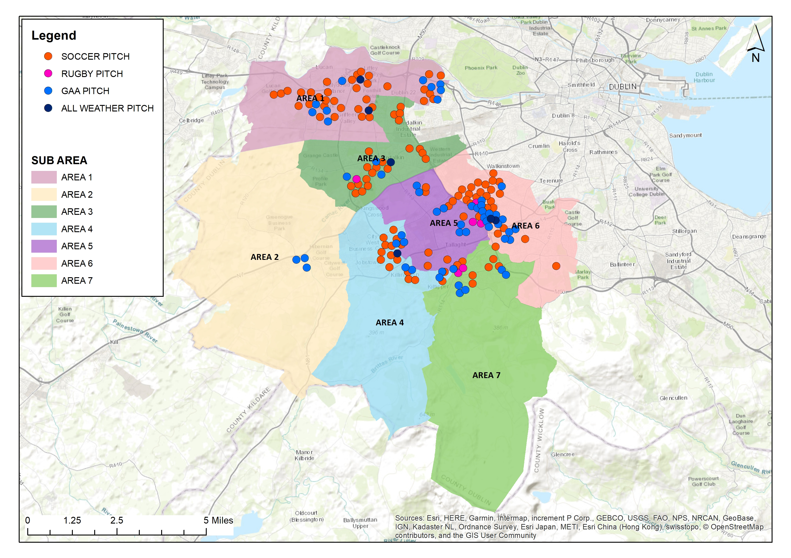
Map of Existing Pitch Provision (Local Authority Sites)
Notes:
Mix of different sports pitches across county
Pitches are well divided across sub areas with exception of Area 2; but large quantities of pitches are mainly aligned to areas of high population.
Pitches are clustered in established residential areas of high populations and aligned to where the county has large tracts of land
AGPs in an inner ring; note the AGPs shown are operated under leases or other management structures and are not under SDCC direct control in terms with exception of the Frame Football Pitch in the north of the county.

Slide 7
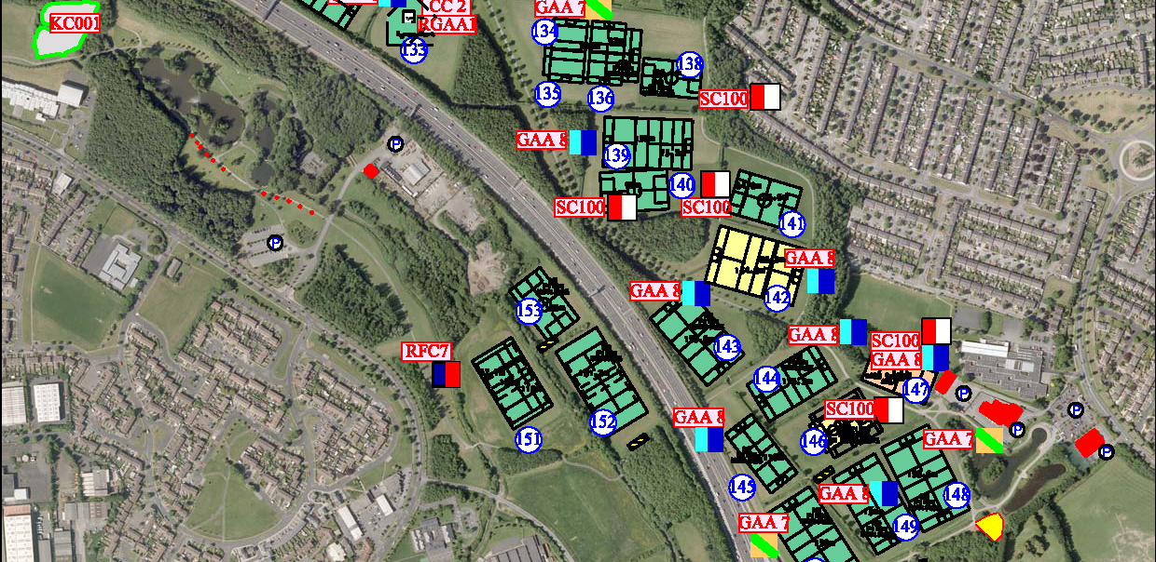
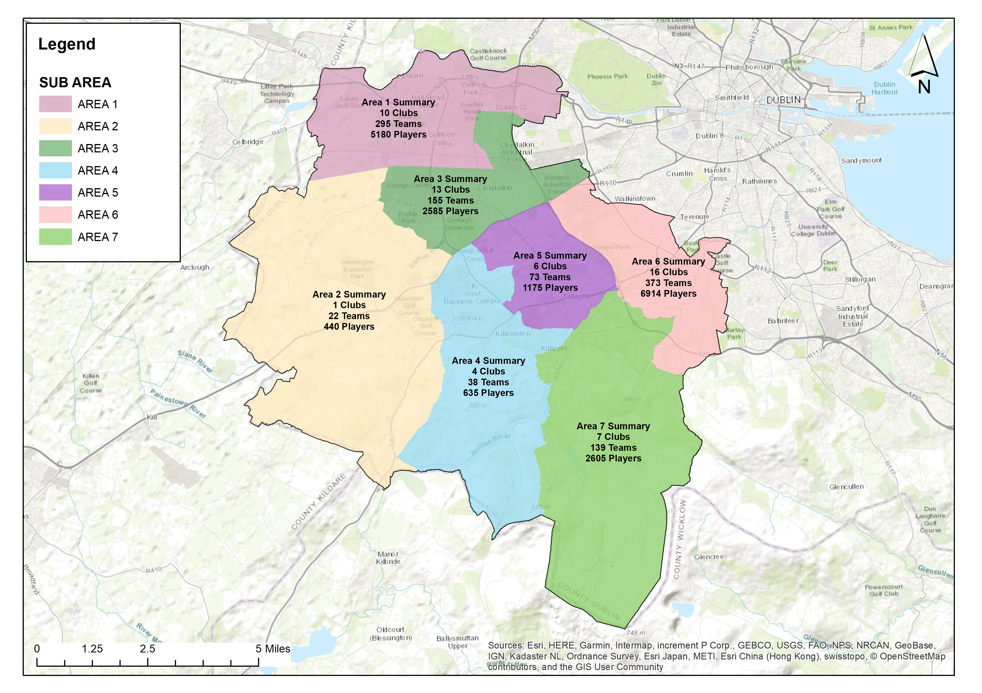
Existing distribution of pitches and activity on SDCC sites
163 local authority pitches spread over 44 different locations across the county e.g. 29 pitches in Tymon Park.
55-65 GAA, Soccer and Rugby Union clubs are licensed pitches each year; of this amount 5 GAA, 1 soccer and 3 rugby clubs also have their own grounds.
In 2019 to date: 57 clubs licenced, 1,095 teams, Estimated 19,534 players.
5 of the Councils’ pitches are currently shared between clubs .
All requests for pitches are currently being accommodated.
Most of the pitches are rated as ‘standard’ quality.
Clubs are happy with the quality of surface on offer.
The Council also provide ancillary facilites (pavilions, storage etc.) at some locations.
Maintenance of pitches is carried out by SDCC with:
  Playing pitches cut on a weekly basis.
  Annual maintenance programmes on a rolling basis.
  Planned capital investment programmes.

Slide 8
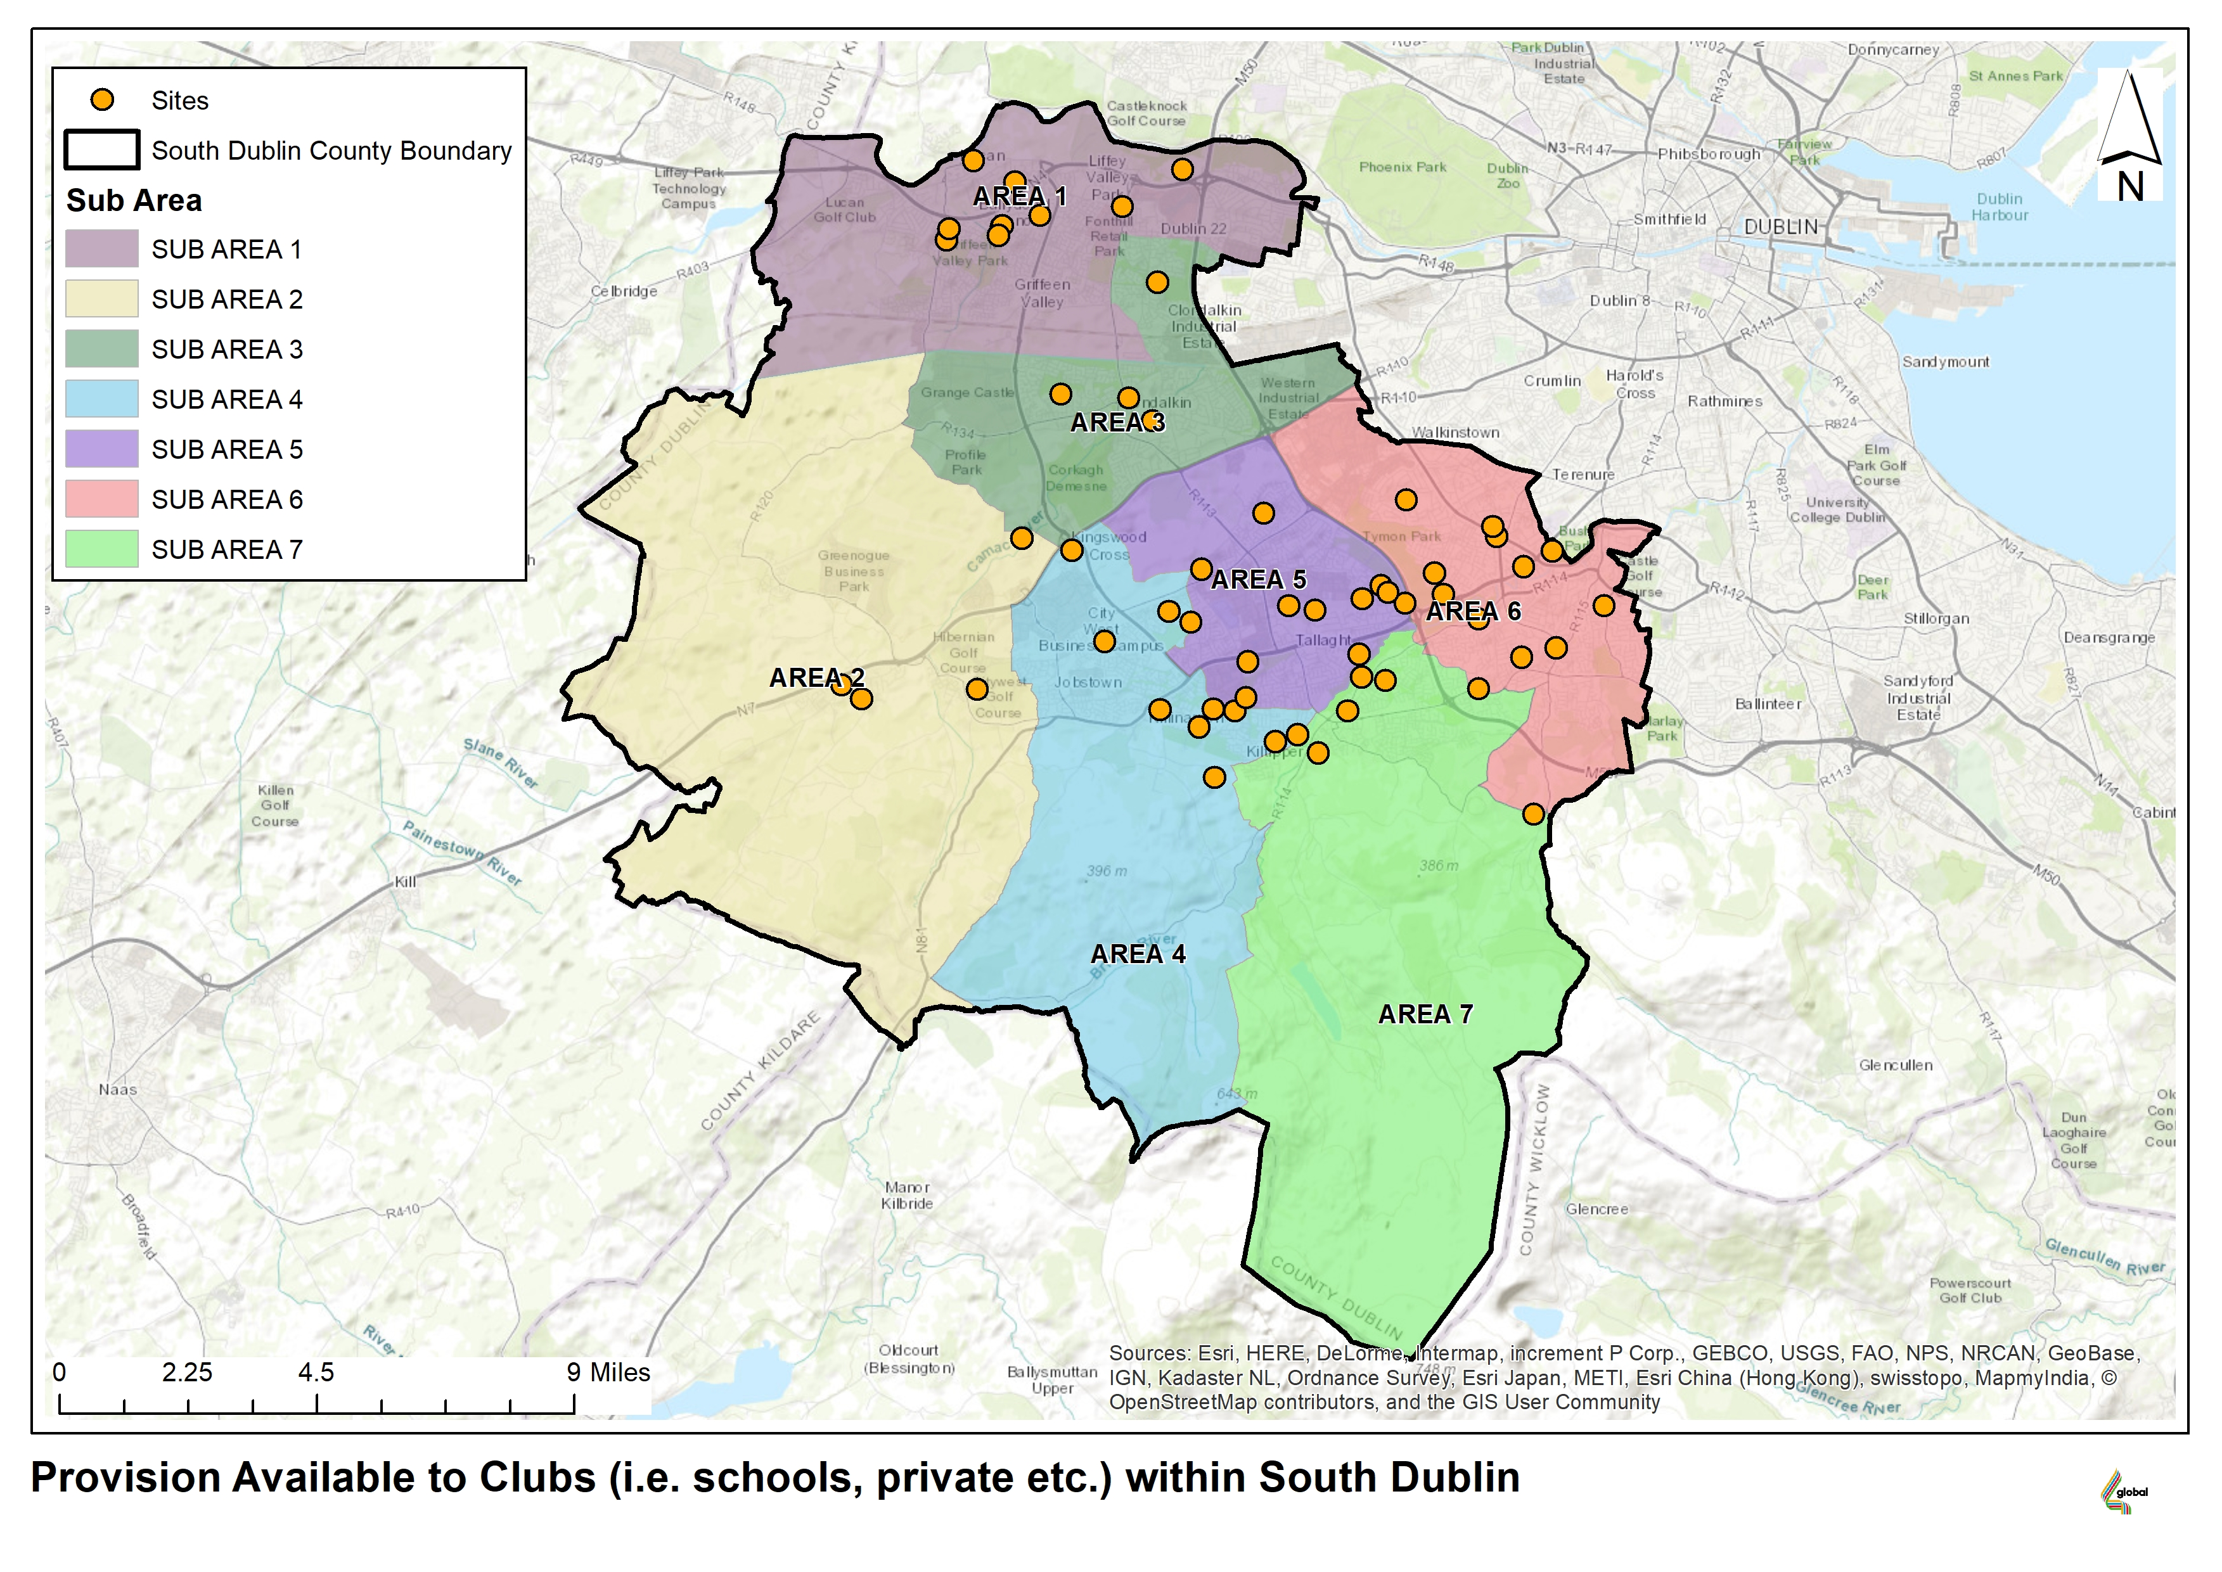
Other Provision Available to Clubs:
Notes:
Break down into:
57 pitches at Educational sites, 50 pitches at private sites (mostly small sided AGP pitches) and 46 pitches are club sites which are mostly large GAA clubs with their satellite pitches being located at local authority sites.
Rugby Union, GAA and Soccer are provided for in these external sites.
There is very limited community use located at educational sites, if at all, and many of the private sites are commercial run organisations.

Slide 9
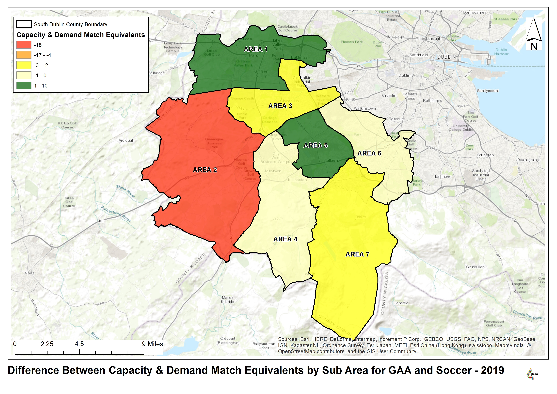
Capacity versus Demand:
GAA and Soccer
Each pitch was graded on quality of playing surface
The match equivalents generated, with the demand surveys, formed the total demand for matches in each sub area.
Each sub area’s total score for pitches was divided by match demand to generate the capacity score
Match Equivalents:
Good Pitch
3.5 GAA, 4 Rugby, 3 Soccer
Standard Pitch
2 GAA, 3 Rugby, 2 Soccer
Poor Pitch
1 GAA, 2 Rugby, 1 Soccer
AGP:
10 match equivalents (for soccer / Rugby)
40 hours training
Notes:
Explain above
James – To briefly explain the capacity of MES with GAA and Soccer in terms of available pitches and quality of pitches. The area with the largest deficit can be seen in sub area 2 due to the amount of pitches available.
This demand can be met with improvements to current pitches.

Slide 10
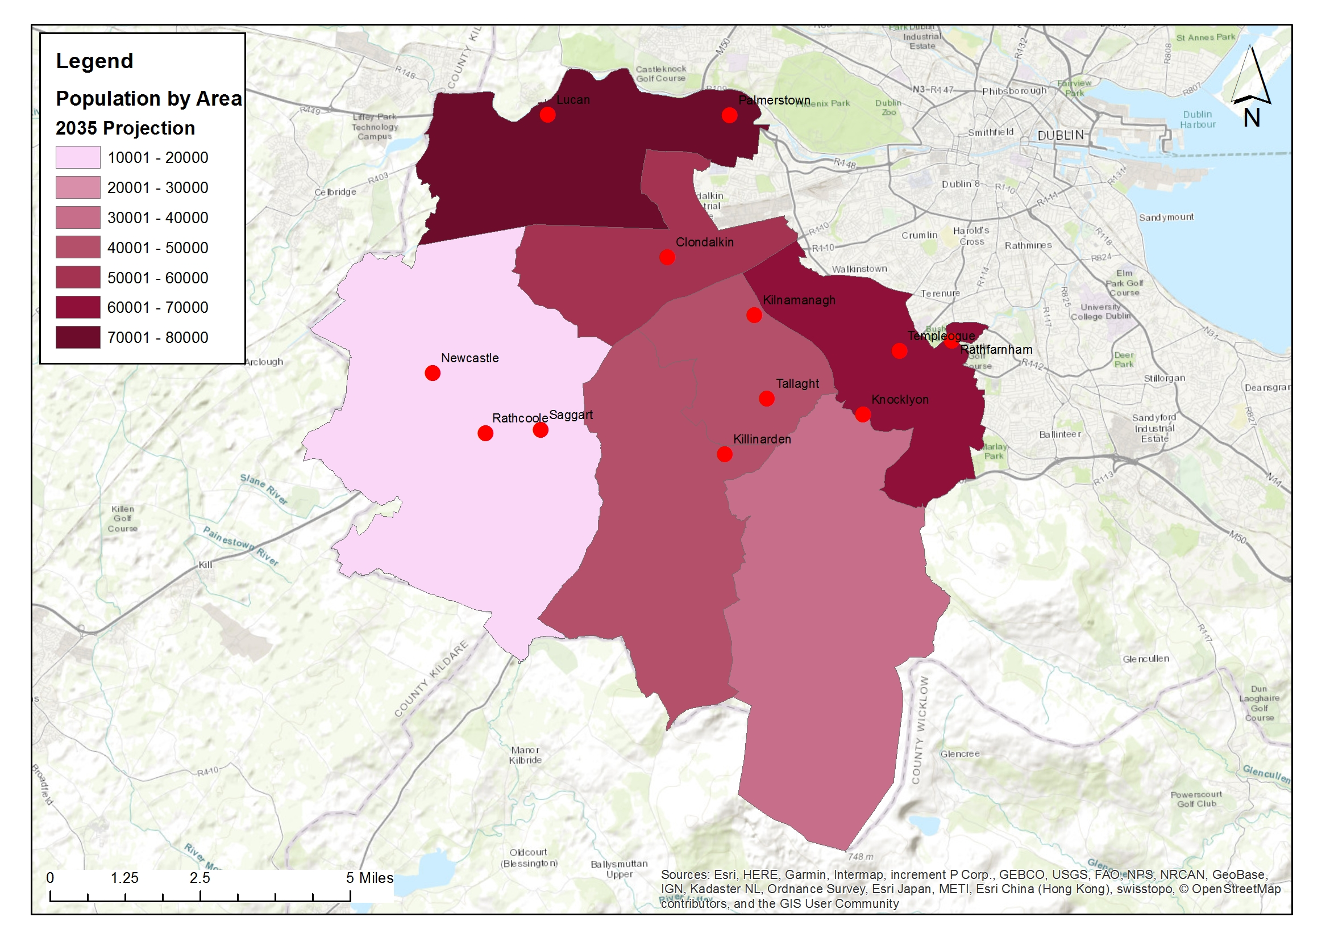
Projected population SDCC 2035
The population projects are made on the following assumptions which was available at the time of the strategy development:
2016 Census of population for base age and gender
Fertility Rate of 1.8 as per CSO assumptions for F2 regional projections
Age Distribution Fertility Rate as per CSO Assumptions for F2 Regional Projections
Life expectancy at birth: as per CSO Assumptions for Regional Projections
The age pattern of mortality is based on UN Population Division Ireland Data life tables through 2014 from the Human Mortality Database.
Infant and child mortality: Based on UN Population Division Ireland Data (a) official estimates through 2013, and (b) death rates estimated through 2014.
Net Migration has been based on anticipated housing yield and RSES Appendix B Strategic Planning Area (SPA) and County Population Tables figures for SDCC
  Expected population increase throughout the county
  Expected an overall increased of 50,958 people
  Growth expected in all areas of the county due to planned housing developments and growth in surrounding areas.
Notes:
As per slide

Slide 11
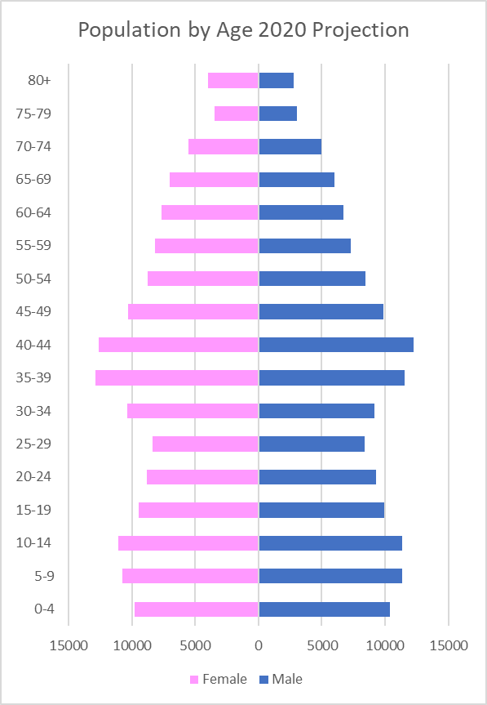
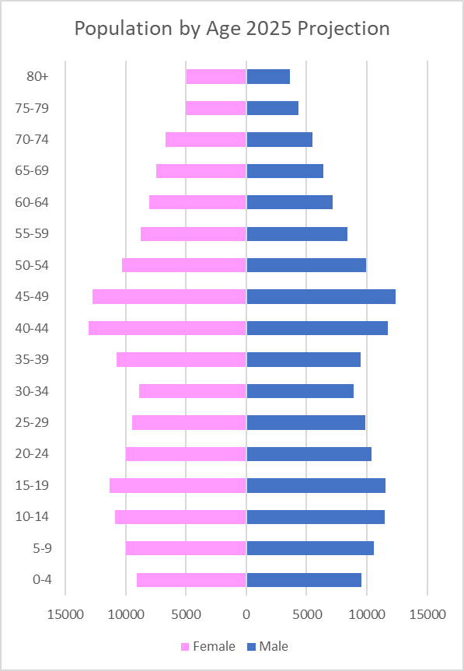
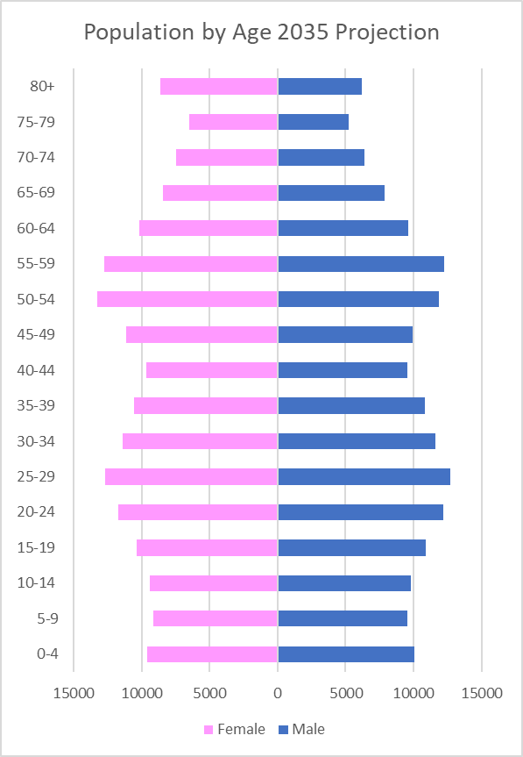
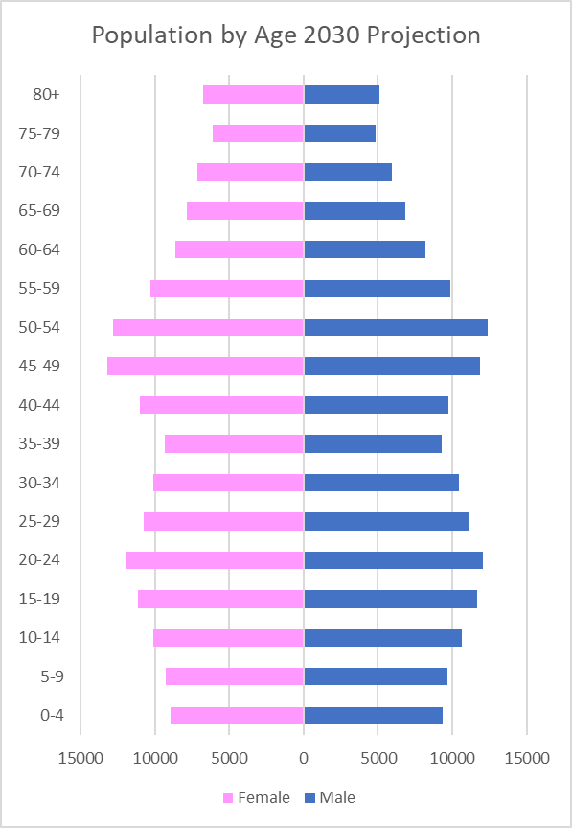
Population by age for South Dublin County
5-year projections
Notes:
Over the lifetime of the strategy the current large numbers at the very youngest age groups will progress into the age cohort that have high demand for pitch use ; leading to an increase in demand.
In addition there will be a large growth in the older age group leading to challenges to the council and sporting organisations to maintain active participation in sport and keep people active for longer.

Slide 12
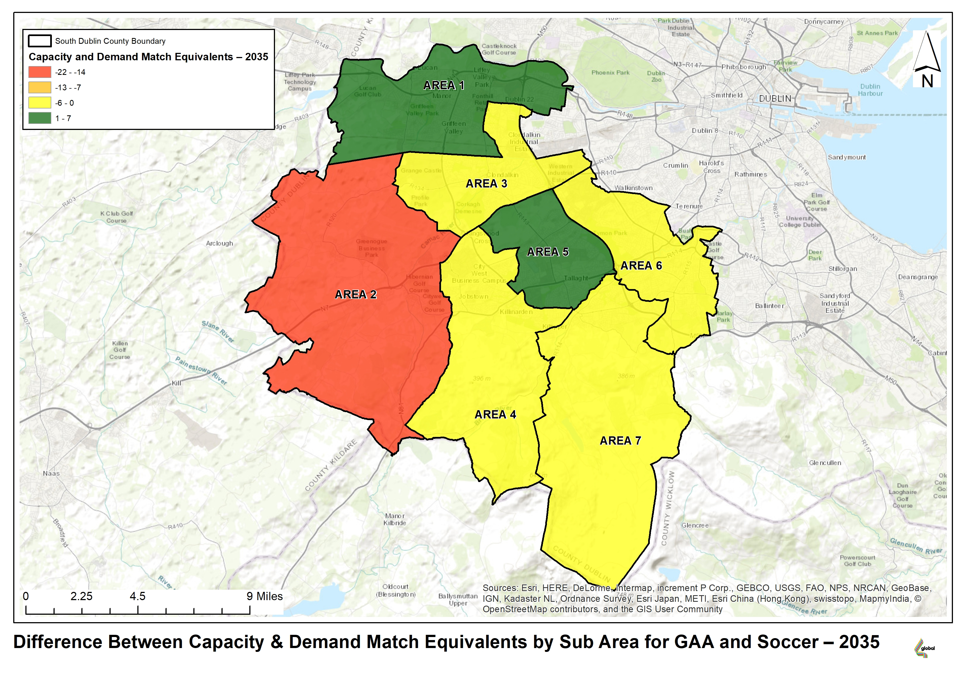
‘Do nothing’
Scenario
Pitch Capacity 2035
Notes:
If pitch numbers and pitch quality remain the same the map depicts the difference in supply versus demand in 2035. The deficit will increase due to no additional pitches or improvements made to the current supply. The increased population will lead to an increase in team which will increase demand. This means that the other sub areas will record a deficit if no additional supplied is created or pitch improvements are made.
Discuss the definition of carry capacity and why this will increase with the improvement of pitches.
Discuss the use of AGP sites to soak up the demand for training allowing great match play on pitches for weekend games.

Slide 13
SPORTS PITCH STRATEGY:
5 ACTIONS TO OPTIMISE OF CAPACITY
No.: | Action: | Location: | Priority
1 | Increase maintenance of pitches to improve match play equivalents | Targeted: Areas of high use, high demand, growing population | Ongoing Lifetime of strategy
2 | Develop revised allocation policy; including pitch sharing and multipurpose use of facilities | County wide | 2020 onwards
3 | Reserve ability to change configuration of pitches. | Targeted as tastes, demographics and / or local needs change | On-going
4 | Provide new pitches to meet capacity issues | New development areas, areas of growing population | 2020 onwards
5 | Provide AGPs to augment long term capacity and meet training need | 3-5 across county | 2020 onwards

Slide 14
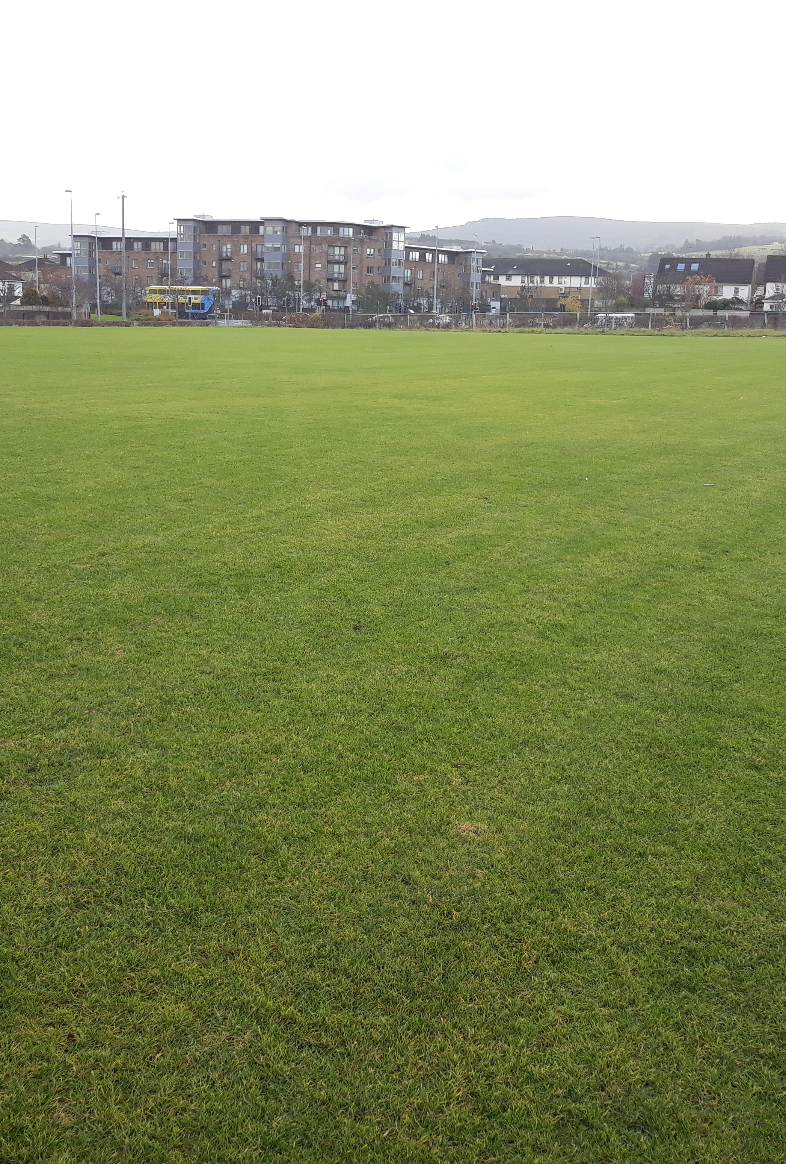
Existing Maintenance of pitches:
Annual maintenance regimes: provide intensive maintenance to existing pitches
Maintain capital investment to facilitate increased match play on existing pitches:
Firhouse pitches (3 pitches completed)
Tymon pitches (2 completed and 1 underway)
Jobstown Park and Butler McGee Park (2 pitches completed)
Dodder Valley Old Bawn (existing pitch enhancements)
Capital investment in pitches to be continued based on needs assessment.
2019 SCG allocation for pitch works: €350,000.
Continue high level of communication between the council and clubs
Target higher use sites, shared sites and sites with high amount of community use
Continue on a rolling basis.
Training pitches / facilites under-catered for; putting pressure on pitch quality
Allocation via Revenue budget (€313,000 proposed for 2020) for aeration, top dressing, goal mouth and damaged area repairs, provision / replacement of goal posts etc.)
Completion of Upgrade of Athletics Track, Lucan
Notes:
The maintenance of pitches is important in terms of increasing capacity as it impacts on the quality of the pitch.
By improving the quality of pitches, the playing capacity of each pitch is increased allowing it to accommodate more matches.
If improvements are made to the current pitches in terms of drainage or maintenance regimes this will improve the carrying capacity of each pitch and the overall supply within the area. This means that pitches will suffer less wear and tear and allow more matches throughout the season without a detriment to the surface.

Slide 15
Develop a revised allocation model in association with on-line booking system:
Review of current allocation model to increase pitch use efficiencies; consider:
Target shared usage of currently under-used or over subscribed locations
Review match fixtures to examine match pitch allocations.
Develop revised allocation policy; including pitch sharing and multipurpose use of facilities
Maintain flexibility in pitch designation and configuration to match changing demographics or local need.
Revise current charging / fee structure versus economic cost
Considerations to be included: capacity in the area, club buy-in, over usage of pitches and management of same.
Improve on-line communication. Automate pitch allocation, pitch booking and pavilion booking systems
Booking systems will generate usage reports and allow pitch provision to be planned to meet demand.
Book-a-pitch system currently tendered for
There will be an obligation to report usage.
Use of pitches and quality of pitches will be audited.
Notes:
As per slide

Slide 16
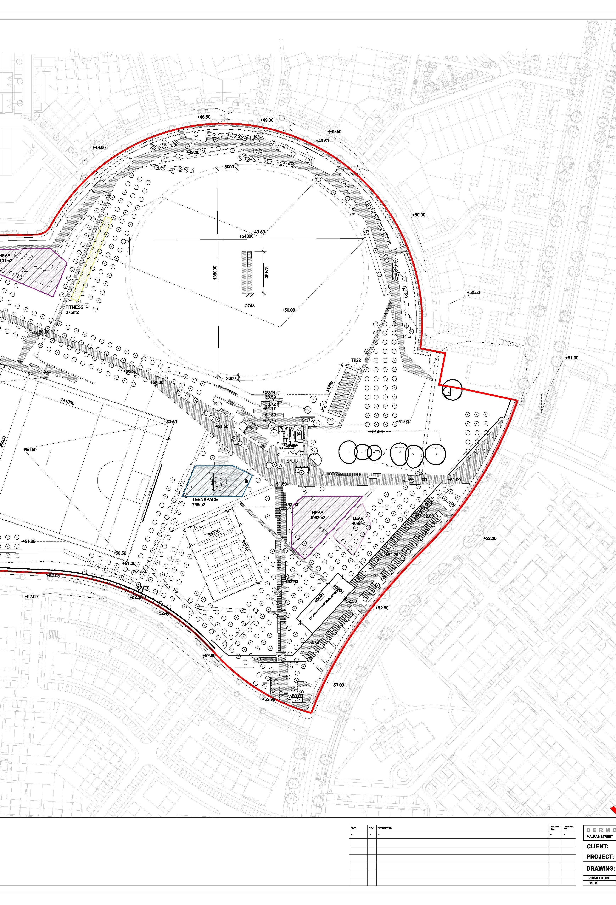
Meet the need for new pitch provision in areas of population growth
Imminent and planned recreational developments at:
Dodder Valley Mt Carmel: (1 athletics track, 1 soccer pitch)
Planned recreational provision as part of Local Area Plan (LAP) / masterplan development at:
Fortunestown LAP area (1-2 GAA sized pitches)
Firhouse/ Ballycullen LAP area (1 GAA sized pitch)
Newcastle LAP area (1 GAA sized pitch)
New pitch provision in tandem with new development
Adamstown SDZ parks (1 multi sport sized AGP, 1 GAA pitch, 1 cricket pitch)
Clonburris SDZ parks (1 multi sport sized AGP, 1 soccer sized AGP, 5 soccer pitches)
Rathcoole area (3-4 pitches in conjunction with GAA)
Review of Development Contribution Scheme (ongoing)
Kiltipper Park Phase 2 (Draft plan: 1 GAA sized pitch)
Notes:
As per slide

Slide 17
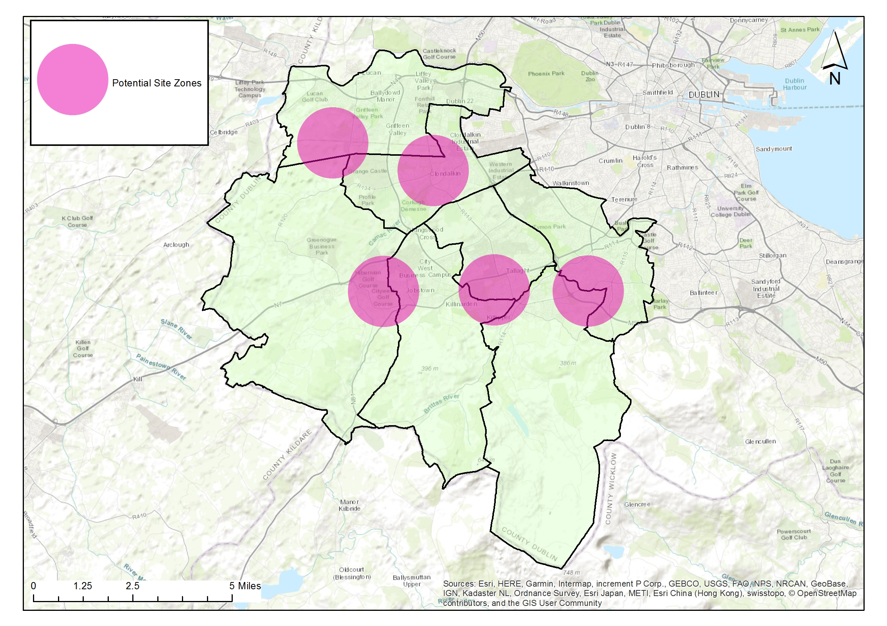
Provide 3-5 Artificial Grass Pitches (AGPs) to increase provision, usage and provide for training need.
The multi-use nature of AGP pitches should lead to sports hubs and efficiencies in use (GAA, Soccer and Rugby Union)
High capital outlay required; high use and meeting community demand shall be built into management structures
Provision to be made for replacement / repair over lifetime of the facility
AGP’s provide pitch capacity to meet increased population growth in higher density/ urban locations
AGP’s meet demand for increased match play
AGP’s remove training pressure from grass pitches with resultant higher standard of grass pitches.
Strategic locations, new development and high population areas; facilitates high use, late evening and flood lighting.
AGP’s provide all weather, year-round facilites. Provide ancillary facilites as required to maximise use.
AGP’s meet demand for training provision which is not currently being met.
AGPs:
Adamstown SDZ
Clonburris SDZ
Fortunestown LAP area / Rathcoole/ Newcastle area
Tallaght LAP
Ballycullen / Firhouse LAP
€3million provided within 2019-2021 capital budget for Astro Programme
Notes:
As per slide

Slide 18
Ancillary facilities
Current pavilion programme (subject to funding):
Dodder Valley Old Bawn (at construction stage)
Griffeen Valley Park (North) (at planning stage)
Corkagh Park (West)
Tymon Park (West of M50)
Dodder Valley Mt Carmel
Griffeen Valley Park (Arthur Griffith Park)
Collinstown Park
Changing facilites:
Provision of facilites based on:
Size of open space and number of pitches accommodated.
Nos of teams
Nos of players
Nos of clubs / community groups to be accommodated
Evidence of need
Storage Areas:
In larger parks with new pavilions:
Some storage to be provided in new changing rooms or will be provided in a railed off area adjacent to a pavilion
In open spaces without pavilions / changing rooms:
Railed off areas for storage of heavy-duty pitch infrastructure e.g. goalposts etc. will be considered.
These areas should ideally be in well overlooked areas with plenty of passive surveillance.
Hierarchy of provision: High usage areas with several clubs and pitches.
Funding:
Subject to funding:
May be sourced by sports capital grants, large scale infrastructure grants
Sports Governing body or club contributions could be facilitated
Security of Provision:
All ancillary facilites provided within public lands are linked to sports pitch use to allow for future proofing of provision and ownership of facilites is not limited to a club or sport. Facility shall remain available to SDCC.
Notes:
As per slide

Slide 19
Detail summary:
Sport | Current Requirements | Lifetime of Strategy requirement | Current Planned Provision
Soccer | Requirements being met. Demand also met by sharing pitches etc. | 5 new required or improve quality of existing pitches | 6 planned as part of new developments
GAA | Requirements being met. | 11 senior teams and 5 junior teams will be created but a reduction in mini teams. Align pitches to housing developments. 10 new required but need may also be met by improving current stock | 7-8 planned as part of new developments
Rugby | Needs being met, training need is the highest deficit | 2 additional required: 1 junior 1 senior in eastern part of county. Training need will continue to impact on grass pitch quality unless met by AGP provision. | Re configuration of pitches may be required
Cricket | Being met, deficit in northern part of county | 2 new NTP required Or Improve existing quality from standard to good. | 2 NTP about to be tendered for in Adamstown SDZ
Athletics | Under capacity due to lack of coaches and training facilites | Consider meeting training need via synthetic track. | 1 athletics track under construction at Dodder Valley Mt Carmel
Hockey | Currently adequate | A slight deficit over life time of strategy but could be facilitated by flexibility in fixtures | Consultation with clubs and pitch providers.
AGPs | Local Authority specific provision does not exist except for specialist frame football. | 3-5; include for multi use soccer and GAA at a number of locations. Allow for rugby training | Astro Pitch programme budgeted for in SDCC 3 year Capital Budget. 3 AGPS already planned for in Adamstown and Clonburris SDZs.
Population growth predicted in all areas across the county
Increase in generation of teams
Sports facility provision required to grow and adapt to meet current and future demand
Management of facilites required to adapt to meet demand.
Notes:
Requirement for pitches may be met by new provision but also may be met by increasing the quality of pitches (e.g. the improvement of a pitch from poor to good gives and extra 2 match equivalents per year) or amending pitch configuration to meet local need.
Council allocations may also allow for increased capacity by allowing for pitch sharing in under-used or over-subscribed locations
6 soccer pitches: 1 No. Dodder Valley Mt Carmel, 5 no. currently planned for Clonburris SDZ (1 planned for inclusion in Rathcoole area in conjunction with GAA)
7-8 GAA pitches: 1 No. at Adamstown SDZ, 1 No. planned at Kiltipper Park, 1-2 No. planned in Fortunestown LAP, 1 planned in Firhouse / Ballycullen LAP, 1 No. in Newcastle LAP, 2-3 No. planned in Rathcoole area in association with GAA.

Slide 20
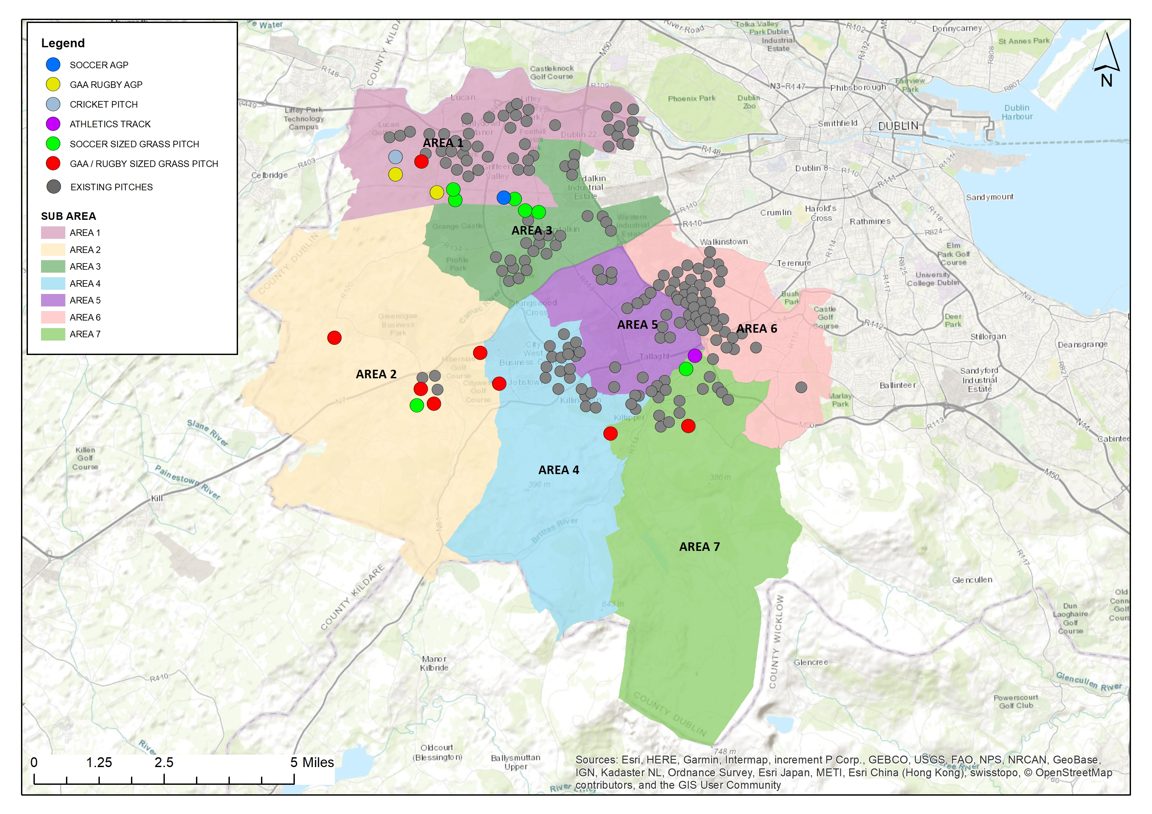
CURRENT PLANNED PROVISION OF PITCHES ON DEVELOPMENT / SDCC LAND:
Notes:
Dodder Valley Mt Carmel: (1 athletics track, 1 soccer pitch)
Adamstown SDZ parks (1 multi sport sized AGP, 1 GAA pitch, 1 cricket pitch)
Clonburris SDZ parks (1 multi sport sized AGP, 1 soccer sized AGP, 5 soccer pitches)
Kiltipper Park Phase 2 (Draft plan: 1 GAA sized pitch)
Fortunestown LAP area (1-2 GAA sized pitches)
Firhouse/ Ballycullen LAP area (1 GAA sized pitch)
Newcastle LAP area (1 GAA sized pitch)
Rathcoole area (3-4 pitches in conjunction with GAA)

