Slide 1
SHD Application Ref: SHD3ABP-305878-19
Applicant: Ardstone Homes Ltd
Site: at Scholarstown rd
Presentation to Rathfarnham/Templeogue/Firhouse/Bohernabreena ACM 10/12/2019
Jim Johnston
Senior Executive Planner

Slide 2
Timelines
SHD Lodged with ABP on 11/11/19
5 Week Obs by 5.30pm 16/12/19
8 Wks SDCC report due to ABP 14/01/20
16 Week Decision Issued by ABP 10/03/20
Consultations
Two S.247 pre-planning meetings held with SDCC on 07/02/19 and 14/03/19
A pre-planning meeting was held on 07/06/19 with An Bord Pleanala, the applicant and SDCC.

Slide 3
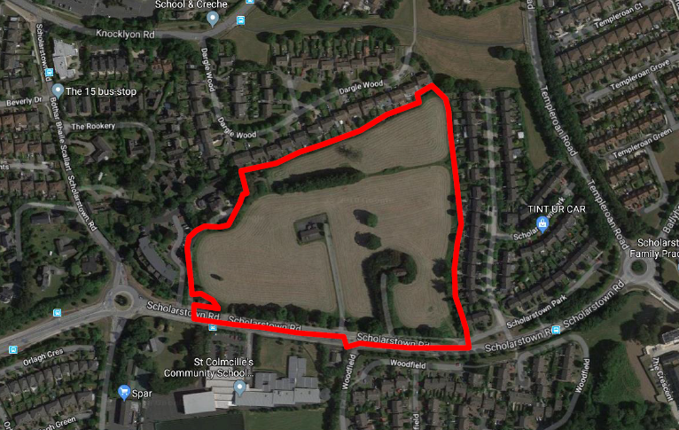

Slide 4
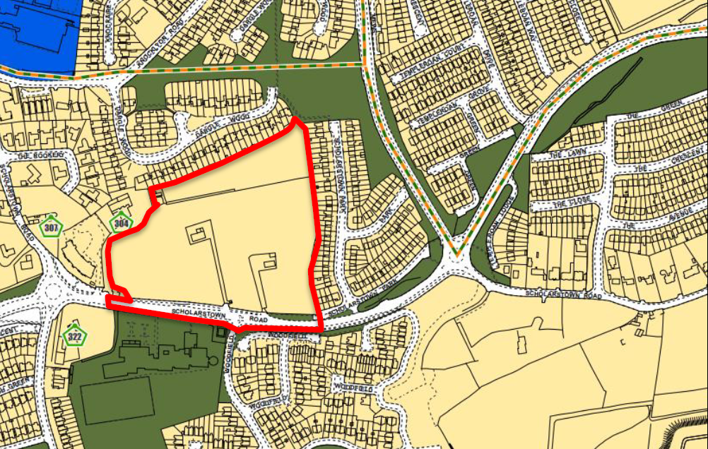

Slide 5
Proposed Development
demolition of all existing structures (a single story dwelling known as ‘Beechpark’ and 2 storey dwelling known as ‘Maryfield’ with associated garage/shed, outbuildings)
construction of 590 residential units comprising 480 Build-to-Rent apartment units and 110 Build-to Sell duplex units and apartments, ancillary residential support facilities and commercial floorspace. total gross floor space is 51,252 sq m over a partial basement of 5,888 sq m.
The 480 ‘Build-to-Rent’ units comprise 246 one beds and 234 two beds. in 8 blocks as follows:
- 7 blocks ranging in height from part 5 to 6 storeys (Blocks B1 – B5, C1 and C3)
- 1 block ranging in height from part 4 to 6 storeys (Block C2)
The 110 ‘Build-to-Sell’ units will comprise 55 two beds and 55 three beds in 9 duplex blocks which will be 3 storeys in height (Blocks A1 – A9)
a part 1/part 2 storey ancillary amenity block (Block D1) (414 sq m) within the central open space comprises a gymnasium, lobby, kitchenette and lounge at ground floor level and lounge at first floor level in addition to a roof terrace (facing north, south and west) to serve the Build-to-Rent residents;

Slide 6
a 2 storey retail/café/restaurant building (Block D2) (657 sq m) comprising 2 retail units at ground floor level (328.5 sq m) and a café/restaurant unit at first floor level (328.5 sq m);
a creche (438 sq m) within Block C2 at ground floor level;
a management suite (261 sq m) and café/restaurant (288 sq m) within Block C3 at ground floor level.
a vehicular access off Scholarstown Road between Blocks C1 and C3 towards the south-east corner of the site; a separate pedestrian access and emergency vehicular access off Scholarstown Road between Blocks A9 and C2 towards the south-west corner of the site; the facilitation of a pedestrian connection from the north-east corner of the subject site to the public open space in Dargle Park;
459 car parking spaces (178 basement and 281 surface); bicycle parking; bin storage; boundary treatments; private balconies and terraces; hard and soft landscaping; plant; services; sedum roofs; PV panels; substations; lighting; and all other associated site works above and below ground.
Works to Scholarstown Road and Woodfield junction including new traffic signals, the elimination of the left-turn slip-lane into Woodfield off Scholarstown Road, upgraded public lighting and upgraded cycle and pedestrian facilities on an area measuring 0.7 hectares,
The application contains an Environmental Impact Assessment Report

Slide 7
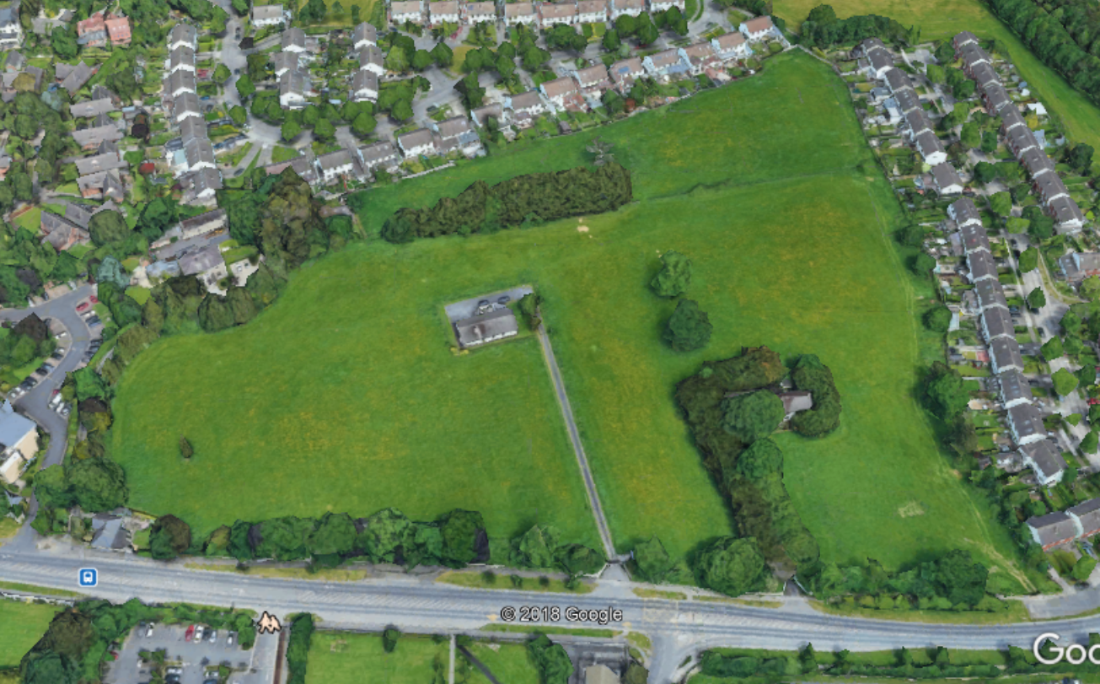

Slide 8
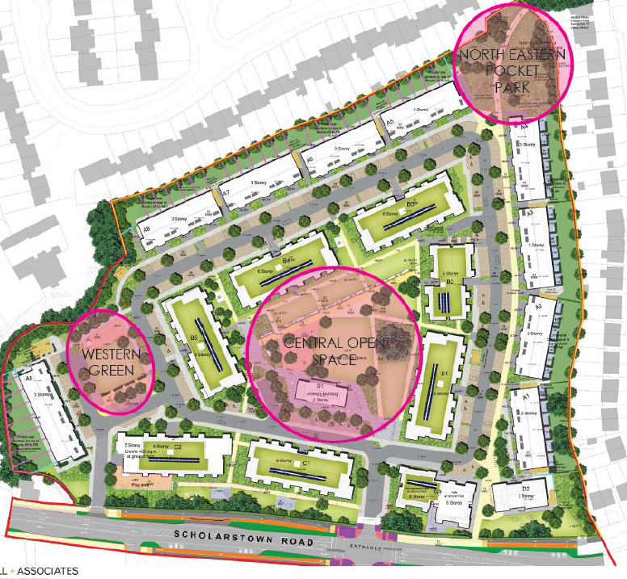

Slide 9
ABP Comments
Information on the pedestrian/cycle access to the open space to the north east and consideration of legal consents required to achieve it
Photomontages and details of materials and finishes
Report demonstrating compliance with the Building Height guidelines (Dec 2018)
Report demonstrating compliance with the Apartment Guidelines 2018
Building life cycle report
Management and operation of proposal which includes ‘build to rent’ apartments in accordance with 2018 Apartment Guidelines.
Covenant or legal agreement to which planning conditions may be attached to ensure the ‘build to rent’ endures for a minimum of 15 years
A transport impact assessment
Report demonstrating compliance with DMURS and the National Cycle Manual.
Impact on natural, archaeological, and architectural heritage to be incorporated in EIAR
Sunlight/daylight study to existing and proposed dwellings
Flood risk assessment report
Construction management plan and waste management plan
Boundary/surface treatments and landscaping

Slide 10
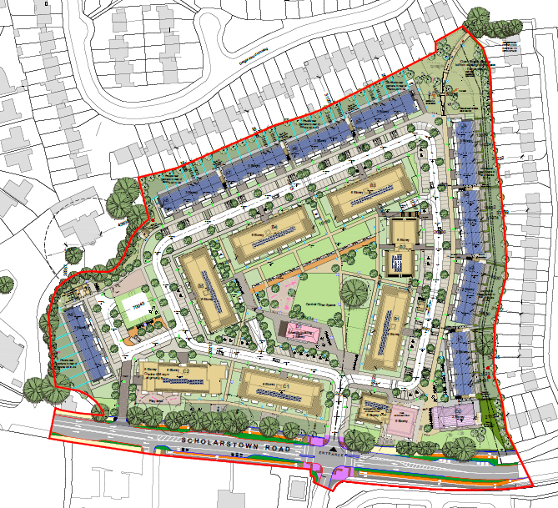

Slide 11
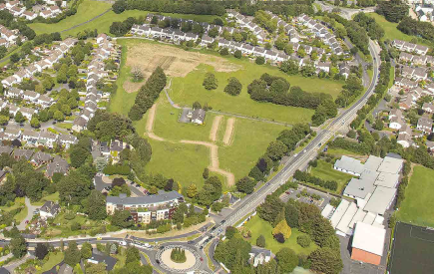

Slide 12
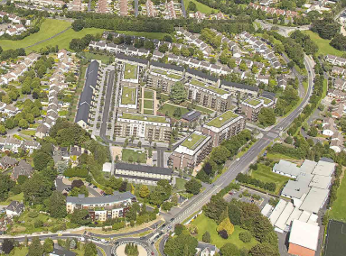

Slide 13
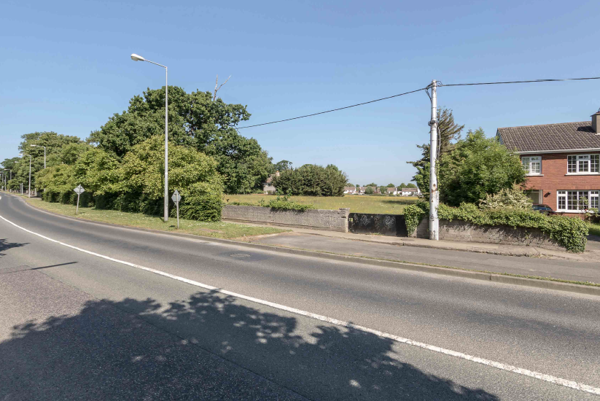

Slide 14
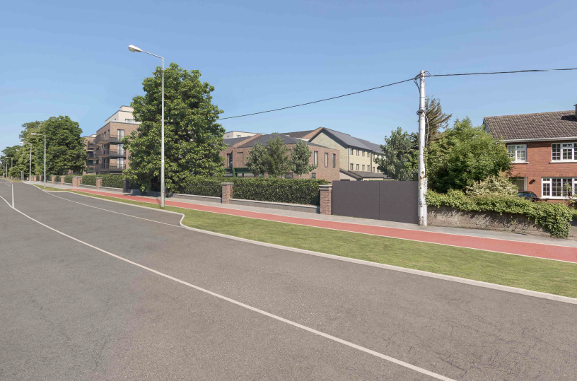

Slide 15
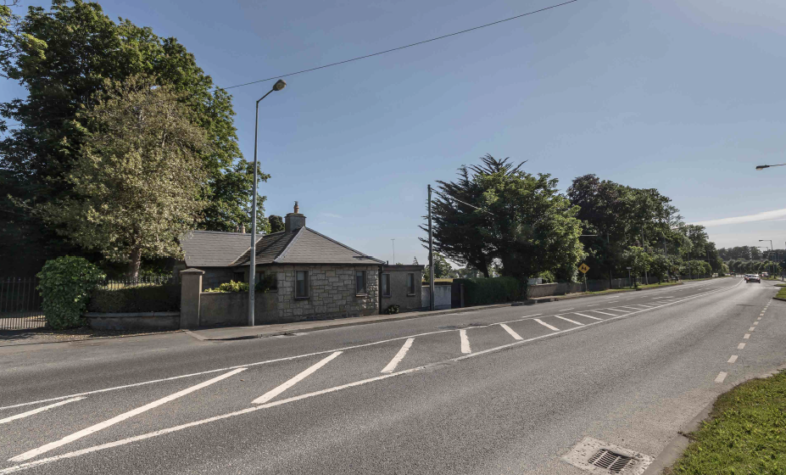

Slide 16
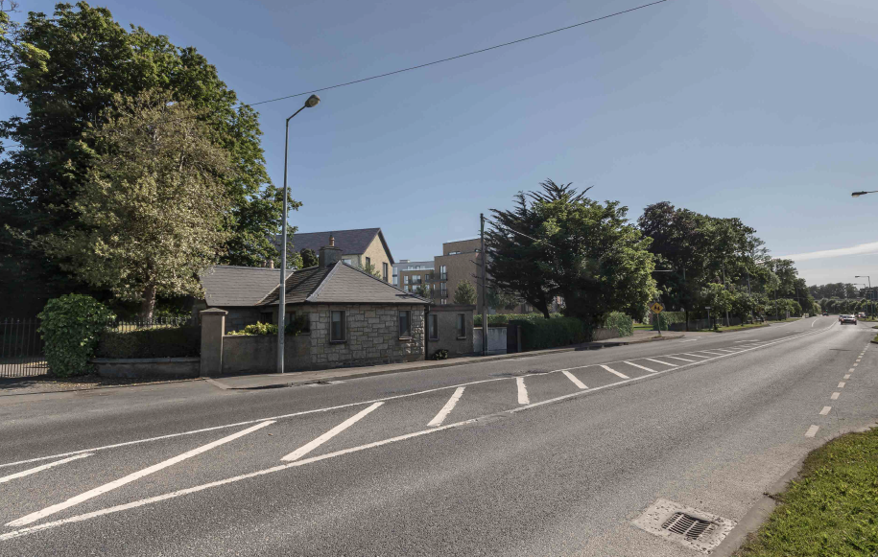

Slide 17
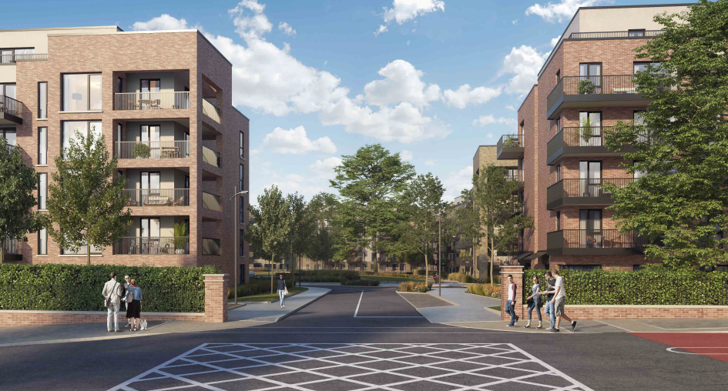
Entrance to site

Slide 18
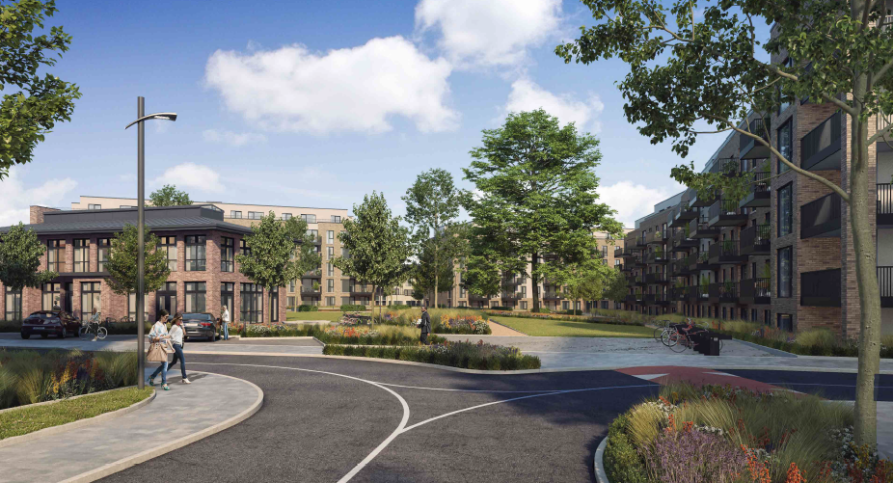
Entrance to site with amenity building on left

Slide 19
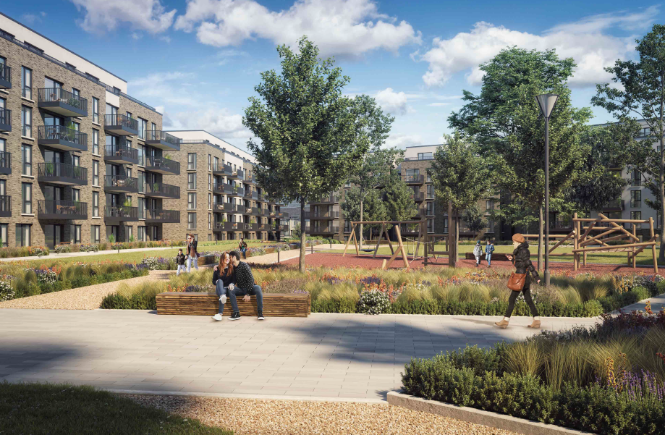
View eastwards from Block 5 looking into central open space

Slide 20
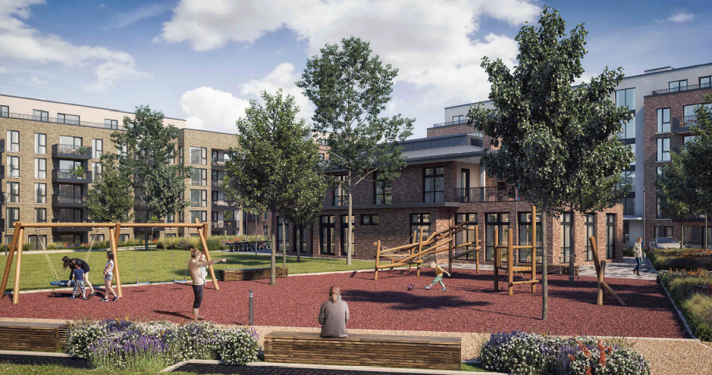
View showing playspace and rear of amenity building

Slide 21
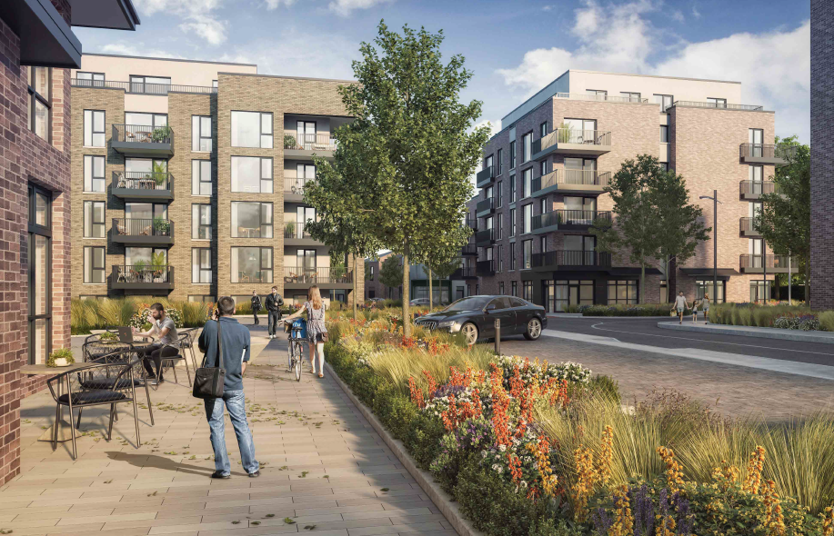
View east with amenity building on left

Slide 22
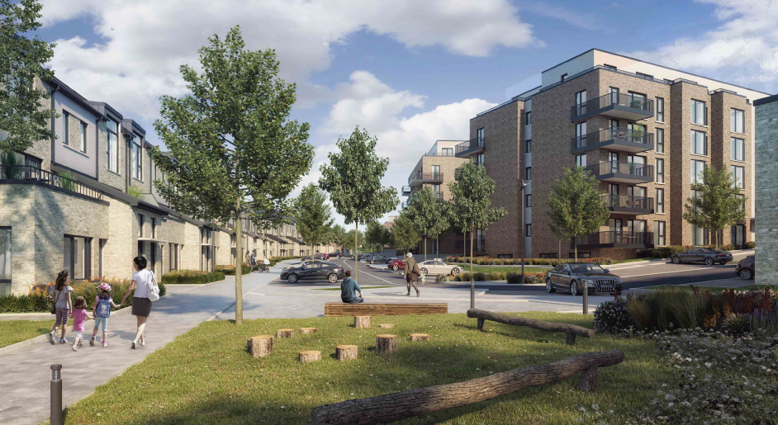
View south from north eastern pocket park

Slide 23
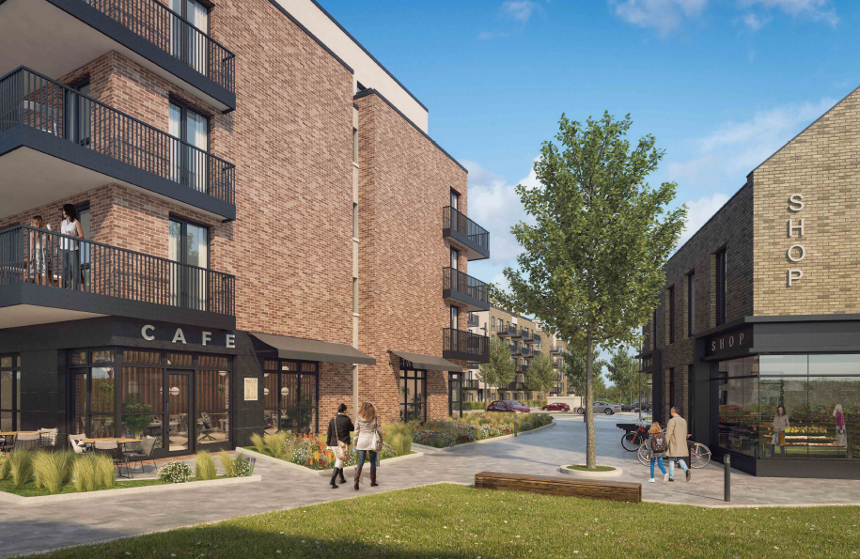
View looking north between shop and cafe

Slide 24
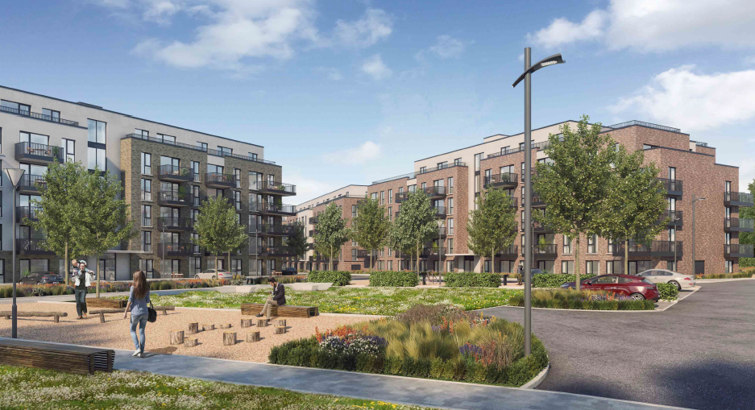
Looking south east from western green

Slide 25
Statistics for Proposed Development:
Apartments
246 1beds = 41%
289 2beds = 49%
55 3beds = 9%
Site Area: 5.35ha.
Density: 110 units per ha. (590 units on 5.35ha)
Gross Demolition Area: 434 sq.m.
Gross Floor Area: 51,252sq.m (above ground), 5,888sq.m below ground
Site coverage: 24%
Plot Ratio: 0.96
Building Height:
- Blocks B1,B2,B3,B4,B5, C1 and C3 (5 to 6 storeys)
- Block C2 (4 to 6 storeys)
- Blocks A1,A2,A3,A4,A5,A6,A7,A8, A9 (3 storeys in height)
Dual Aspect: 51%
Public Open Space: 15% (8,108sqm)
Communal Internal Amenity Space: 414 sq m (gym for BTR residents)
Communal External Amenity Space: 4,018 sq m
Total Commercial/Retail/Café/management suite 1,383 sq m
Creche 438 sq m
Car Parking Spaces: 459 (281 surface, 178 basement)
Cycle Parking Spaces: 800

Slide 26
Thank You
Questions

