Slide 1
Lucan Community Survey (Litter Aspects)
- Carried out between May and September 2019 -
455 Responses in the Lucan Area, online and handwritten –
- Many thanks to Des Ryan for analysing the raw data -

Slide 2
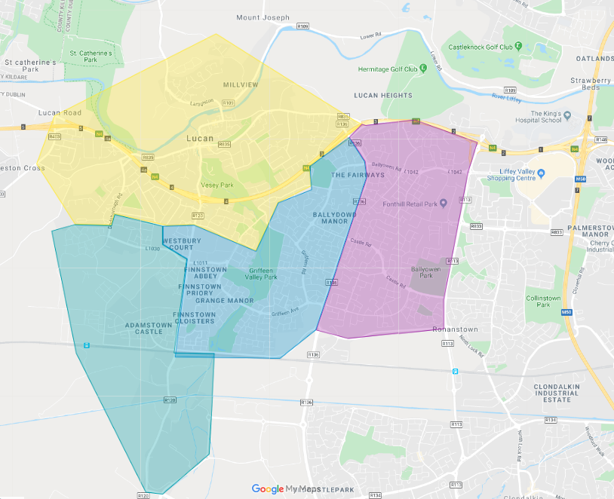
Old Lucan village area, Dodsboro and oldest areas bordering N4
Lucan East
(all in Palmerstown Fonthill LEA)
Adamstown
(all living in SDZ)
Griffeen (including Westbury and Newcastle Road and older parts south of N4

Slide 3
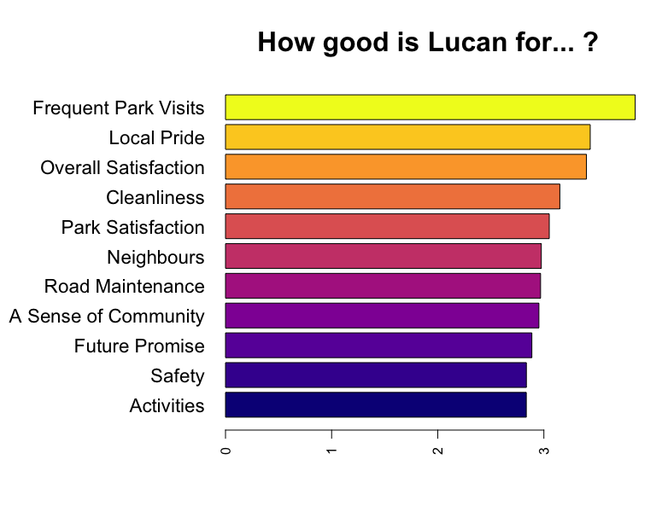

Slide 4
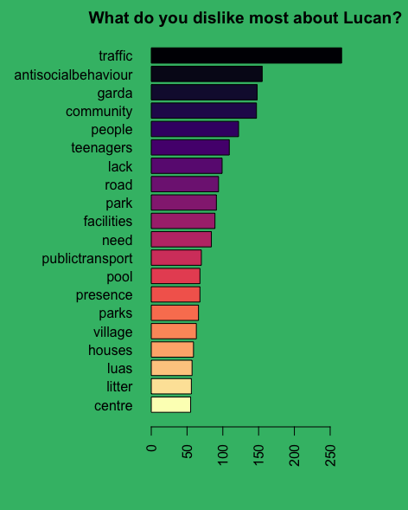

Slide 5
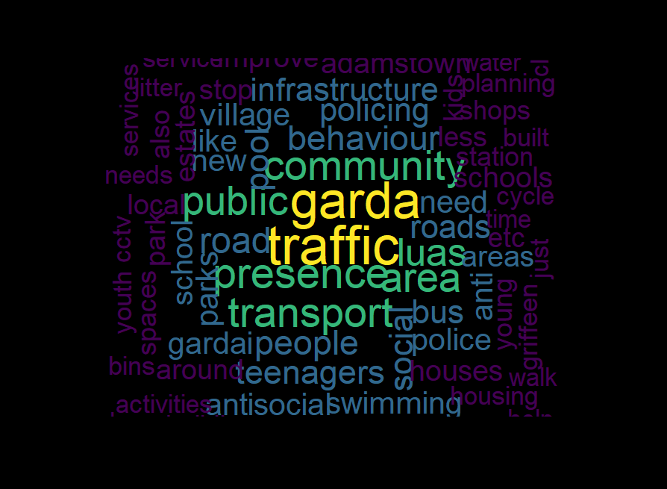
This word map of negatives associated with Lucan shows that litter and bins are mentioned frequently although not to the same extent as other issues

Slide 6
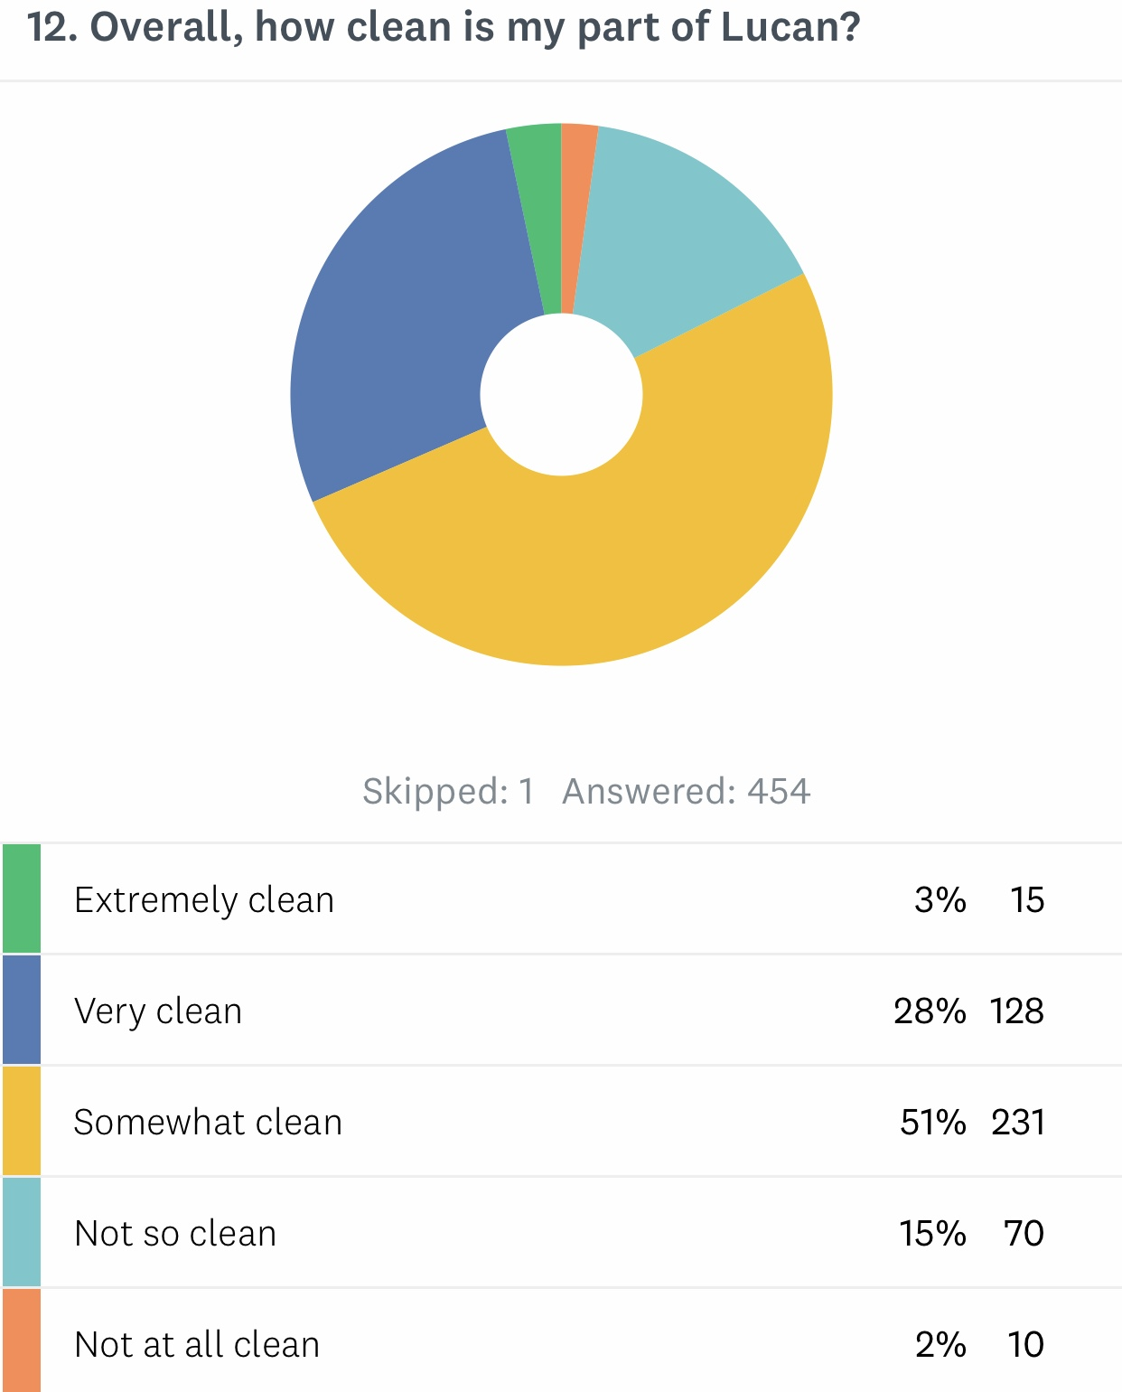

Slide 7
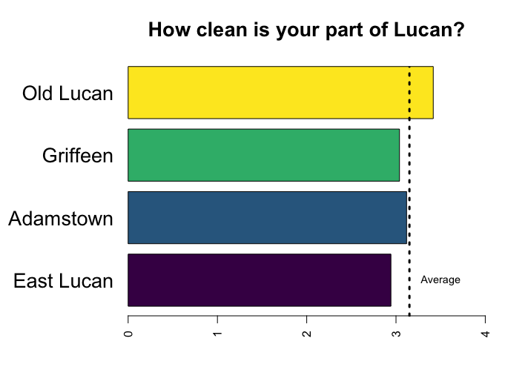

Slide 8
Summary
Some parts of Lucan are cleaner than others with Old Lucan being considered cleanest
Half of residents say that Lucan is “somewhat clean”, which suggests that while the litter problem is not chronic there are areas of concern which South Dublin County Council needs to address
Lucan East identifies itself as the least clean part of Lucan and this would tally with reports made to the Council by elected representatives about illegal dumping and rampant littering. Adamstown also mentions issues which again would feature in relation to longer-established parts of the SDZ
Recommendations
- An increased focus on the Lucan East area and southern Adamstown from Castlegate Way and Adamstown Avenue to Station Road
Mobile CCTV and blitz on local offenders and publication of same to show “zero tolerance”
More bins along routes well frequented, eg on route from Adamstown schools to Library, Griffeen Avenue from Lucan East ETNS to Balgaddy and in and around Ballyowen Park (Fonthill)
Identify Lucan East as location for pilot study on nudge theory as proposed by local TCD research student who has contacted SDCC several times and received no response as of yet (details supplied at ACM). This study would involve an installation of two SDCC bins in the designated area and equipping said bins with motion detector voice activation device

