Slide 1
SHD Application:
St Edmunds, St. Loman’s Road, Palmerstown.
SDCC Ref: SHD3ABP-305857-19
Applicant: St. Edmunds Phase 3 Limited.
26/11/2019
Fiona Redmond
Senior Executive Planner

Slide 2
Strategic Housing Development
Planning and Development (Housing) and Residential Tenancies Act 2016
Planning and Development (Strategic Housing Development) Regulations 2017
Section 4 applications for strategic housing development (SHD) are to be made directly to An Bord Pleanála.
Steps
Pre-Application Consultation with Planning Authority
Pre- Application with An Bord Pleanala (ABP) and the Planning Authority
Planning Application lodged with ABP

Slide 3
Strategic Housing Development
At the next Area Committee meeting, or the municipal district meeting for each municipal district concerned, as appropriate, the Planning Authority shall inform the relevant elected members of the following:
- The details of the application,
- The consultations that have taken place in relation to the proposed development with both the Planning Authority and An Bord Pleanála
Details of the Notice of Opinion issued by An Bord Pleanála.
A summary of the views of the relevant elected members on the proposed development as expressed at the meeting shall be attached to the report of the Chief Executive and shall be submitted within 8 weeks of the lodgement of the application to ABP.

Slide 4
Timelines
SHD Lodged with ABP on 07/11/2019.
5 Week Observations on 5.30pm on 11/12/19.
8 Wks SDCC report due to ABP 10/01/2020.
Decision due from ABP 16 weeks after
application lodged with ABP.
Consultations
S.247 Pre-Planning meeting held with SDCC on 18/01/2019.
A Pre-Planning meeting was held on 15/7/19 with An Bord Pleanala, the applicant and SDCC.

Slide 5
Site Context

Slide 6
Site Zoning in South Dublin County Development Plan 2016-2022

Slide 7
Proposed Development

Slide 8
Proposed Development (continued)

Slide 9
Key Development Statistics

Slide 10
ABP Opinion
Design and Layout - Further consideration/justification of the documents as they relate to the street level interface of units at ground level of Block 1 and materials and finishes to the proposed buildings. The further consideration of these issues may require an amendment to the documents and/or design proposals submitted.
Summary of Specific Information to be submitted with the application:
1- Site layout plan to be reviewed in context of DMURS and consideration of vehicular access to basement level to provide for HGV movement; consideration of pedestrian movement through the basement; parking provision for non-residential building and interface with the public open space to be reviewed; pedestrian movement west to the existing St. Edmund’s development to be indicated on the site plan and provision made for safe pedestrian crossing facilities.
2- TIA
3- Response to issues raised in Parks and Landscape Services/Public Realm report dated 25.06.19.
4- A life cycle report
5- A detailed analysis of car parking and bicycle parking provision and Mobility Management Plan.

Slide 11
Summary of Specific Information to be submitted with the application:
6- Detailed drawings, sections, elevations, including a CGI of the site.
7- Childcare demand analysis and the likely demand for childcare places resulting from the proposed development, including a crèche of suitable scale to meet the needs of existing St. Edmunds phase 1 as well as proposed development.
8- A detailed schedule of accommodation which shall indicate compliance with relevant standards in the Sustainable Urban Housing: Design Standards for New Apartments, Guidelines for Planning Authorities’ 2018.
9- A Detailed Landscaping Plan is required. Plan should include a management plan in relation to the existing tree line to the west providing for their phased replacement/supplementation given 10 year life span of existing trees.
10- Respond to issues raised in the Water Services Planning Report dates 21.06.19, including inter alia a detailed SUDS strategy.
11- Internal daylight/sunlight analysis
12- A site layout plan indicating what areas, if any, are to be taken in charge by the planning authority.
13- Site Specific Construction and Demolition Waste Management Plan.

Slide 12
Proposed Site Plan

Slide 14
CGI
Cre

Slide 15
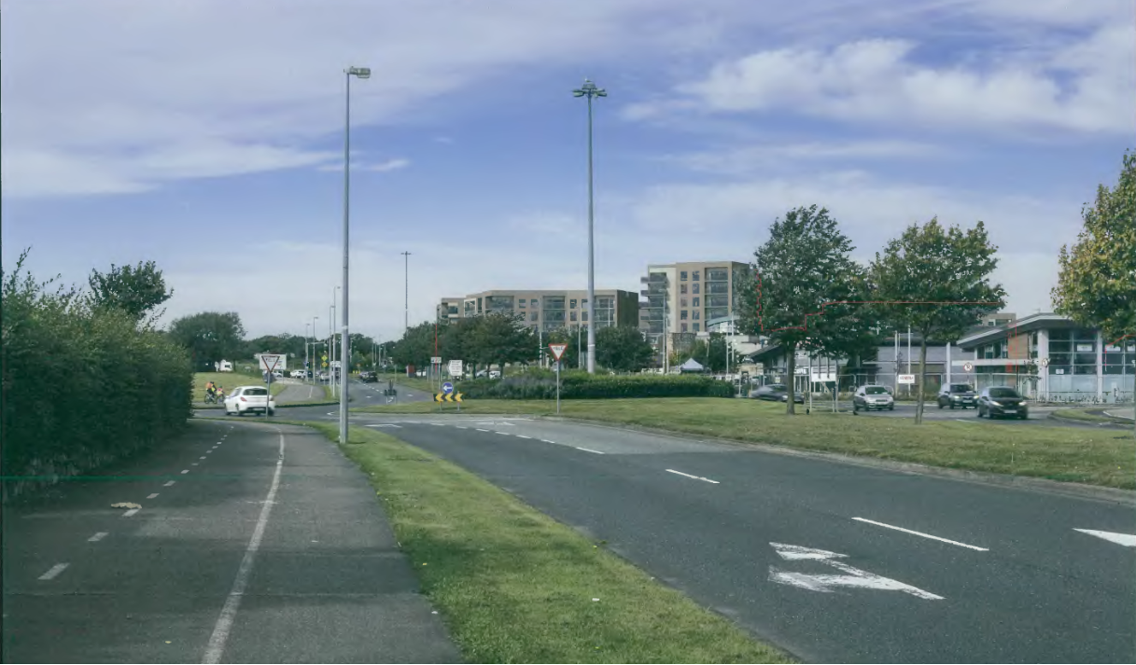
Cre

Slide 16
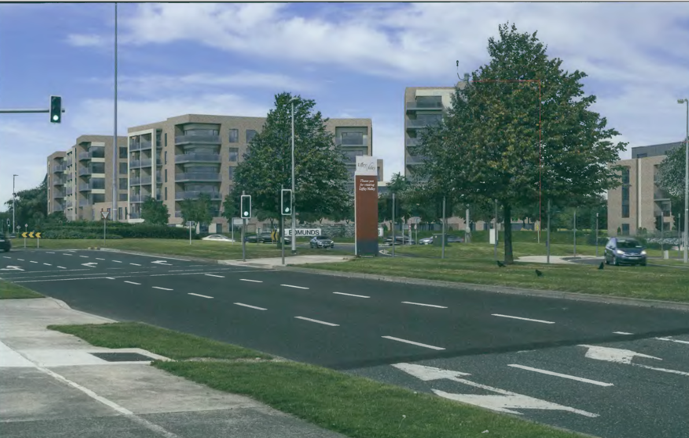
Cre

Slide 17
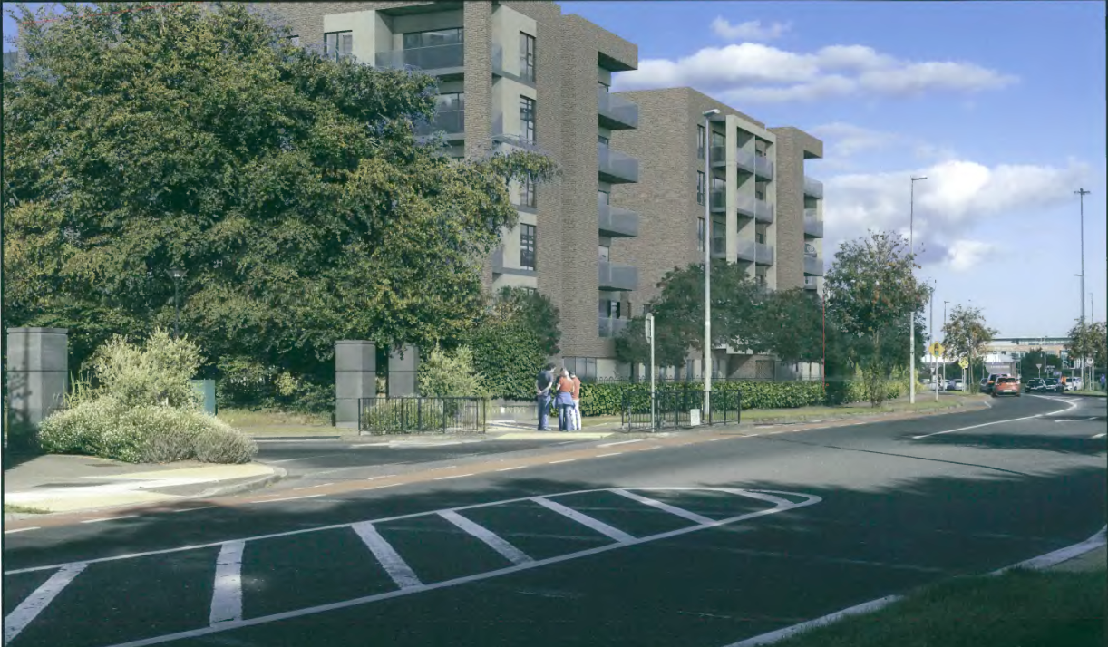
Cre

Slide 18
Thank You
Comments

Slide 19
Site Notice
Cre

