Slide 1
SHD Application
SDCC Ref:SHD3ABP-305763-19
Applicant: Power Scaffolding Supplies Ltd, Belgard rd/Airton rd,Tallaght
Presentation to Tallaght ACM 24/11/2019
Jim Johnston
Senior Executive Planner

Slide 2
Timelines
SHD Lodged with ABP on 25/10/19
5 Week Obs by 5.30pm 28/11/19
8 Wks SDCC report due to ABP 19/12/19
16 Week Decision Issued by ABP 24/02/20
Consultations
S.247 pre-planning meeting held with SDCC on 14/12/18 (SHD1-SPP020/18)
A pre-planning meeting was held on 10/05/19 with An Bord Pleanala, the applicant and SDCC.

Slide 3
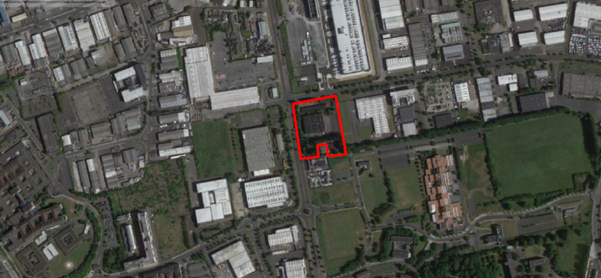

Slide 4
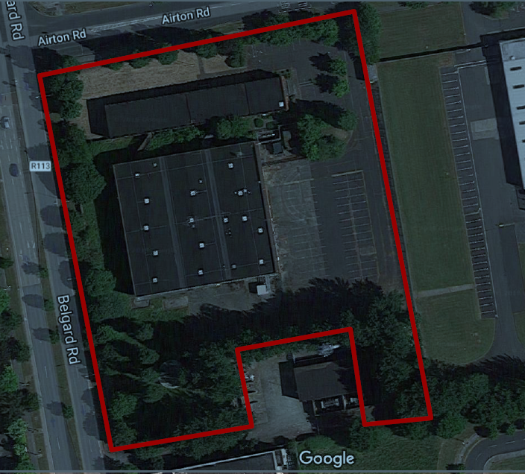

Slide 5
Proposed Development
demolition of the existing industrial buildings on site (4,800 sq m)
construction of 2 blocks comprising 328 apartments (build to sell) (93 No. 1 bed, 222 No. 2 bed and 13 No. 3 bed), ancillary residential support facilities and commercial floorspace measuring 31,147 sq m gross floor space above a single basement level measuring 5,861 sq m.
Block A is a part-5 to part-7 No. storey (13,710 sq m) over basement block comprising 149 No. apartments with office space (222 sq m).
Block B is a part-6 to part-9 storey (17,437 sq m) over basement block comprising 179 apartments, 2 double-height retail/commercial (Class 1/Class 2) units (354 sq m), a café/restaurant (313 sq m), a creche (360 sq m), internal residents amenity area (644 sq m) at ground floor including reception (37.7 sq m), residents lounge (91.3 sq m), private dining area (52.6 sq m), co-working space (45.5 sq m), games room (47.3 sq m), gym (80 sq m) and communal lounge (220 sq m) at 6th floor level.
The development also consists of the provision of a landscaped courtyard; public plaza at the corner of Airton and Belgard Road; pedestrian access from Airton Road to the Technological University campus; balconies; landscaped roof terrace at 6th floor level (7th Storey) of Block B (671 sq m); 184 No. car parking spaces at basement level including 14 club car spaces, 10 disabled parking spaces and 4 crèche parking spaces; 727 basement and surface bicycle parking spaces; 4 motorbike parking spaces; bin storage; etc

Slide 6
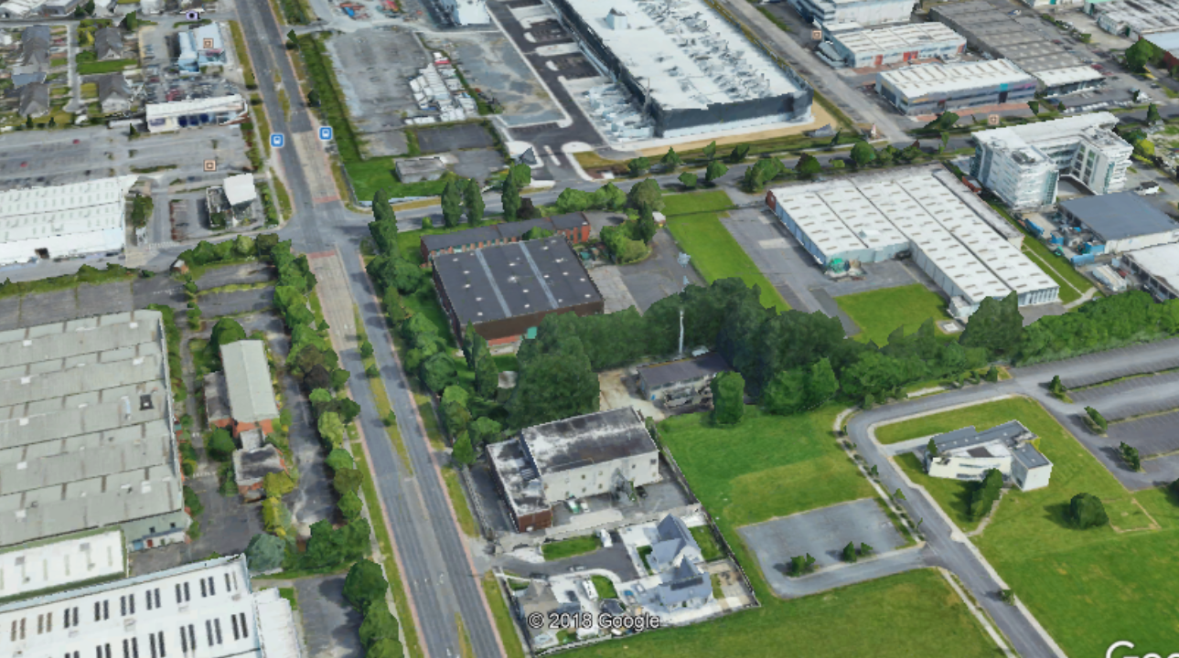

Slide 7
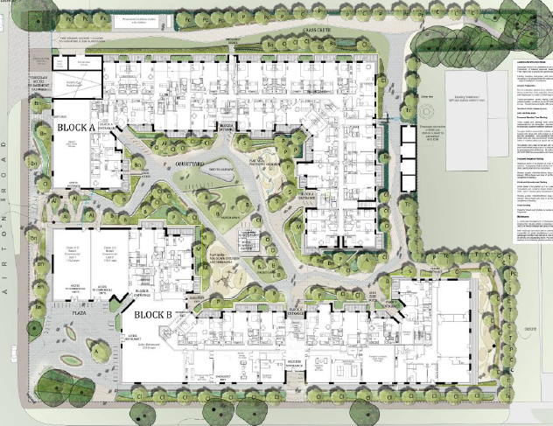

Slide 8
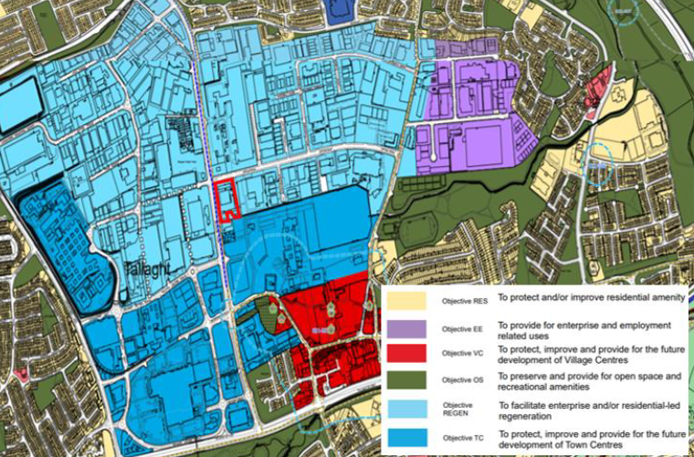

Slide 9
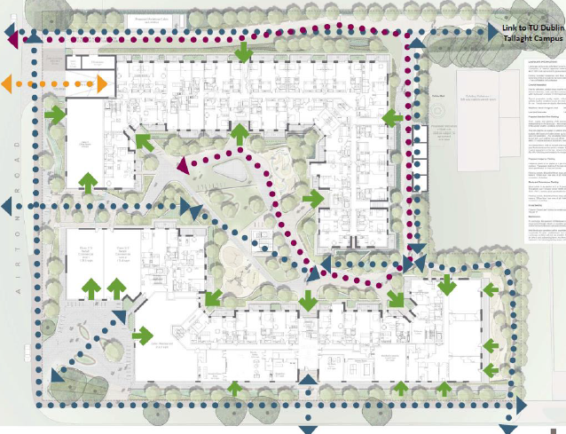

Slide 10
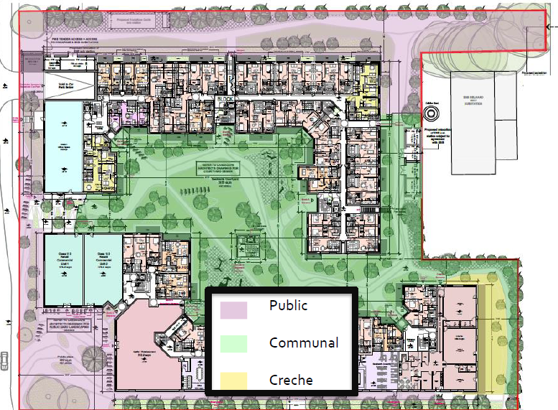

Slide 11
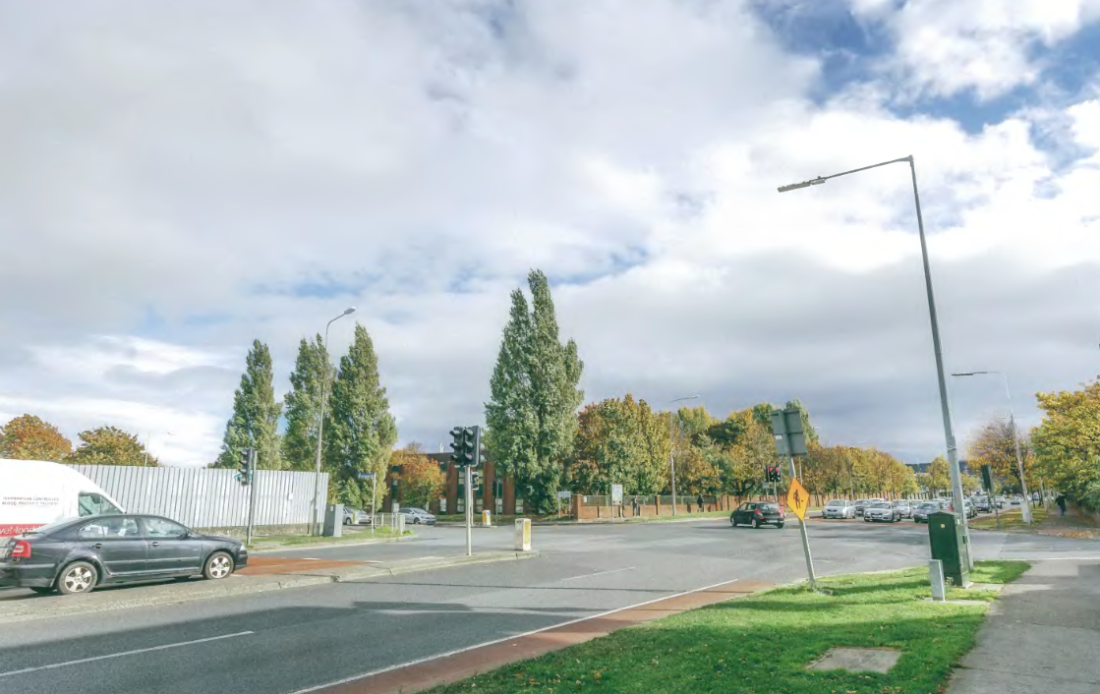

Slide 12
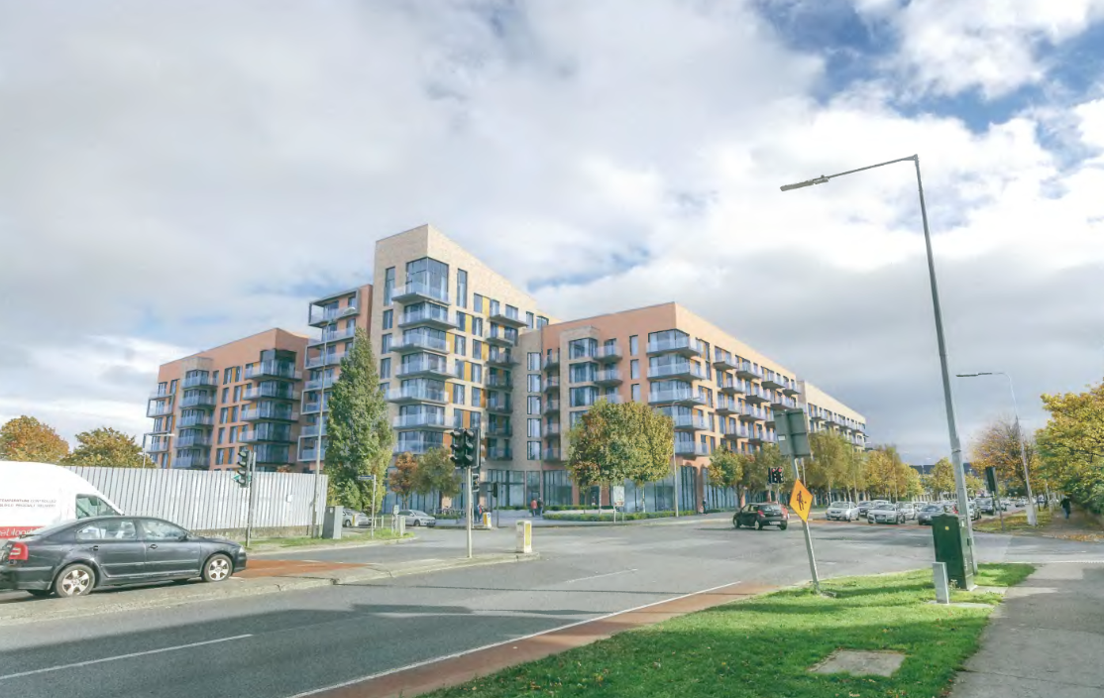

Slide 13
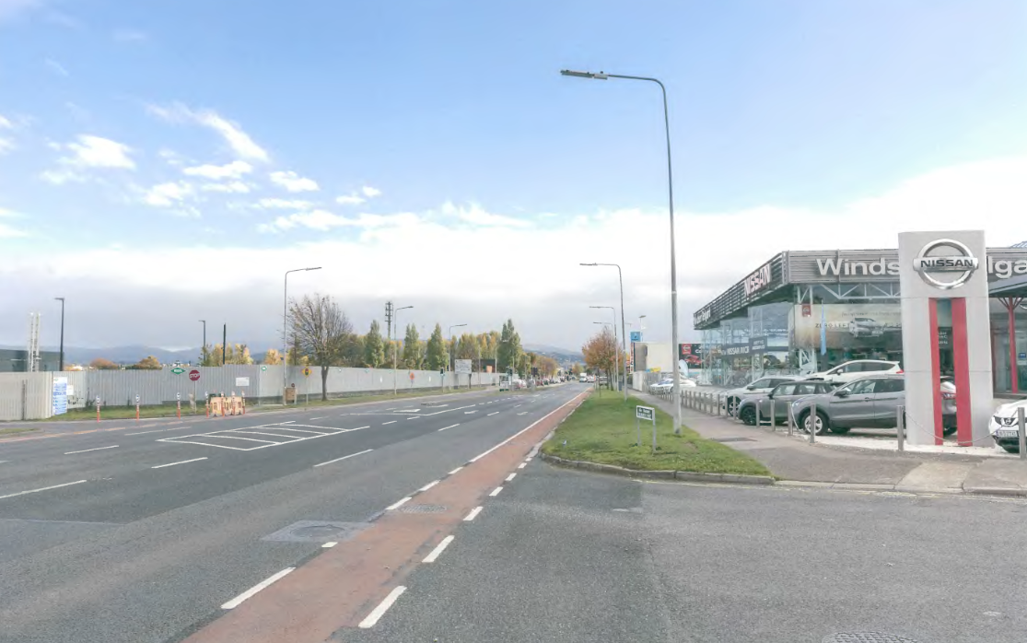

Slide 14
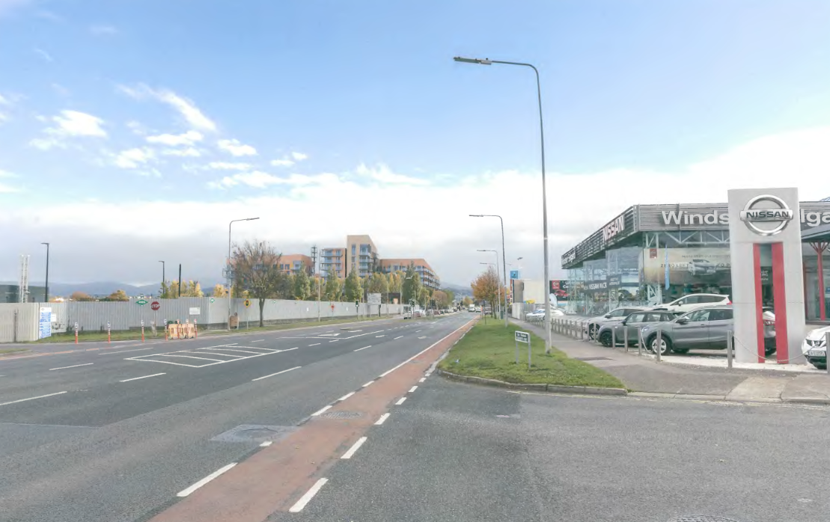

Slide 15
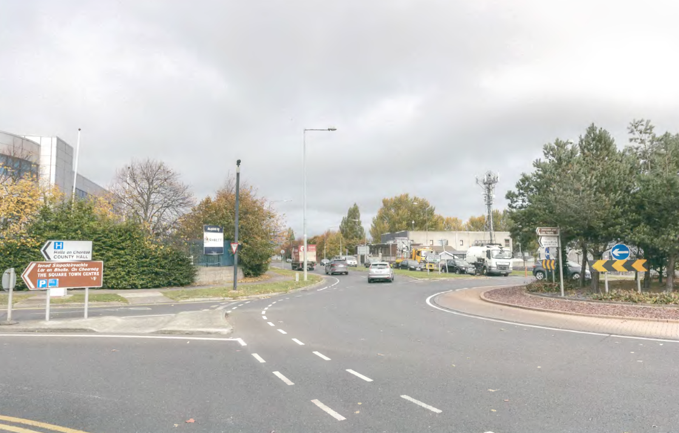

Slide 16
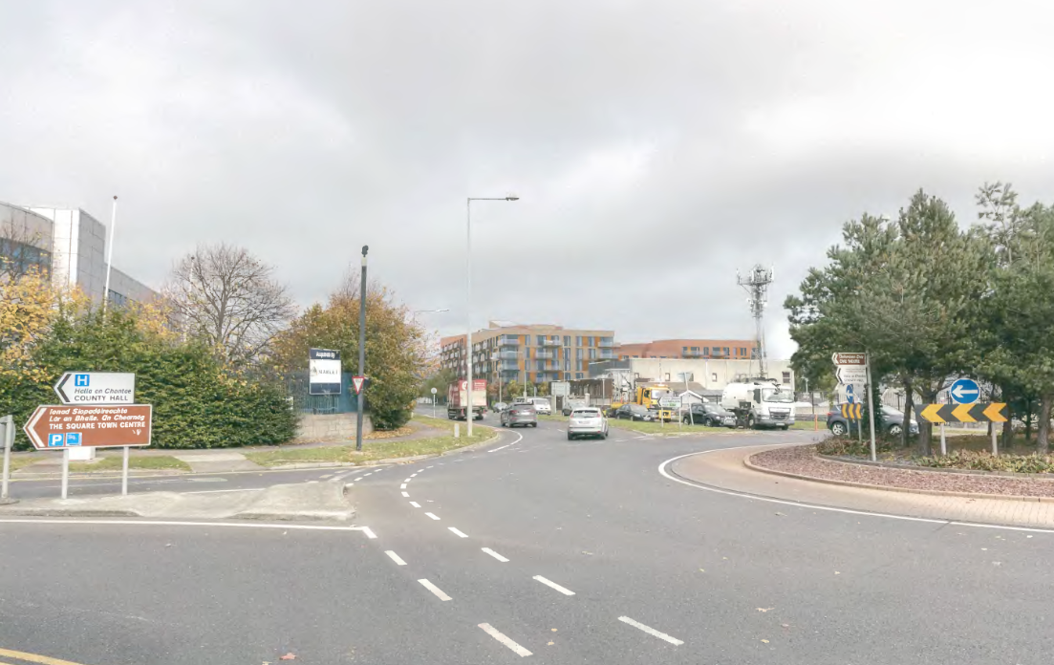

Slide 17
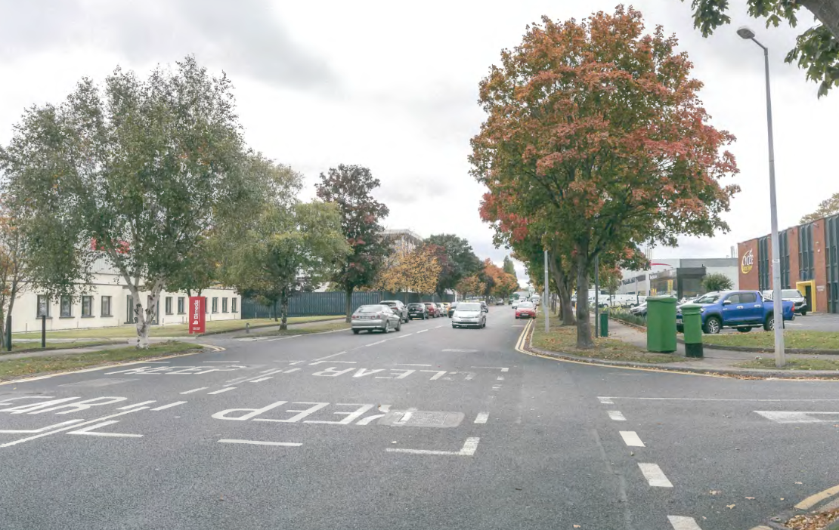

Slide 18
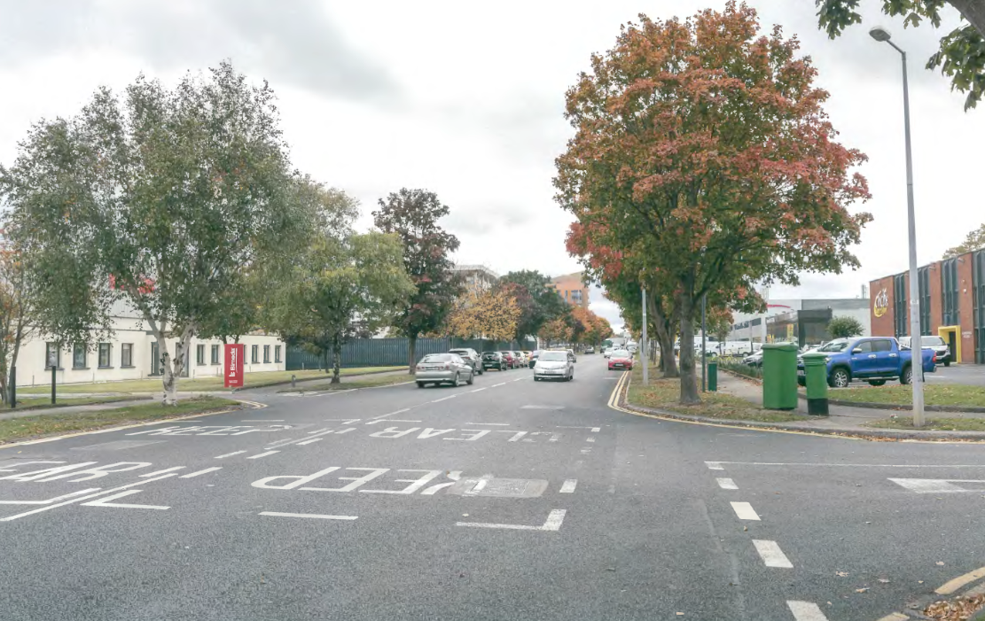

Slide 19
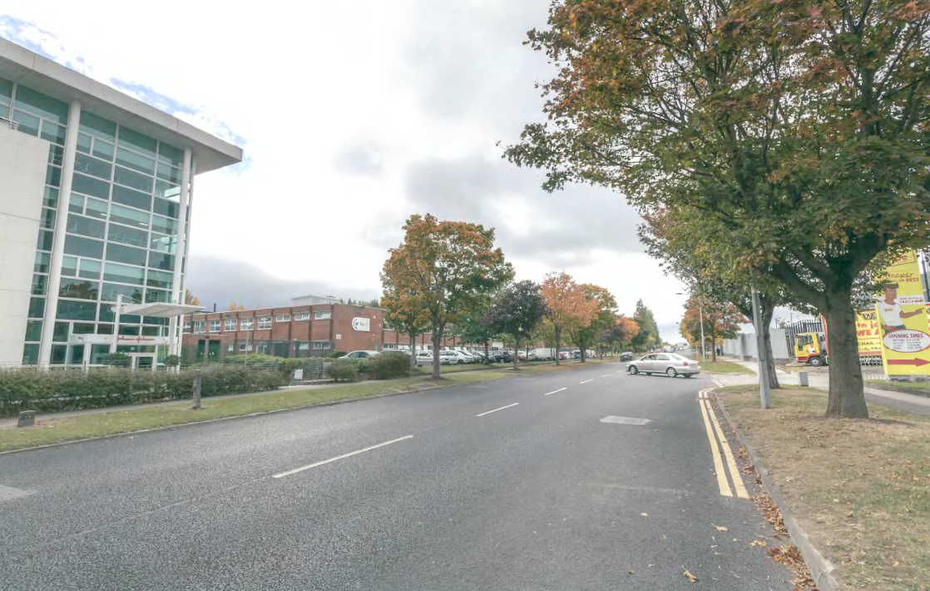

Slide 20
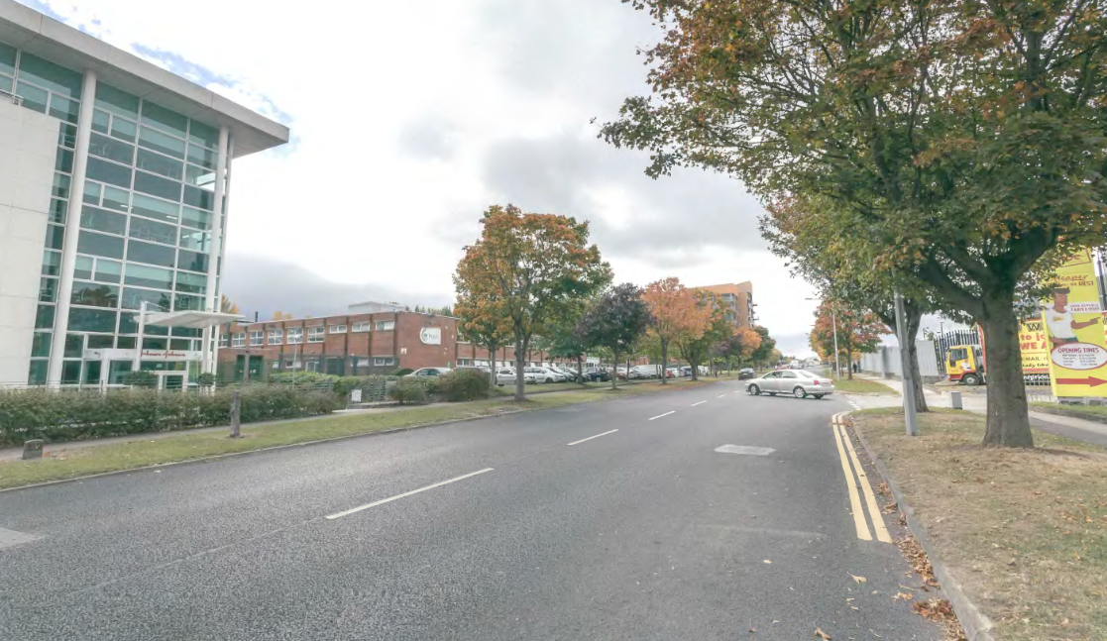

Slide 21
ABP Comments
Height, density and unit mix
Design
Residential amenity
Public and communal open space
Rationale as to how proposed uses will contribute to ‘REGEN’ zoning objective having regard to the proposed commercial uses and the presence of vacant commercial units in town centre
Photomontages and cross sections to include recently permitted unconstructed development
Indicate existing utilities on site and any proposed culverting of drains/utilities
Demonstrate that proposal would not interfere with signals to telecommunications mast in the area
Revised Traffic Impact Assessment re location of car park entrance and reduced car parking provision
Indicate areas to be taken in charge
Construction and demolition waste management plan
Water and waste water details

Slide 22
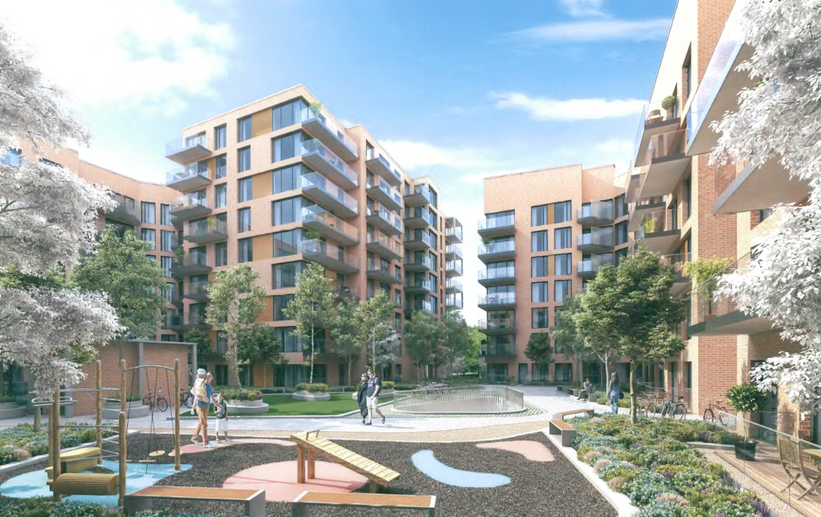

Slide 23
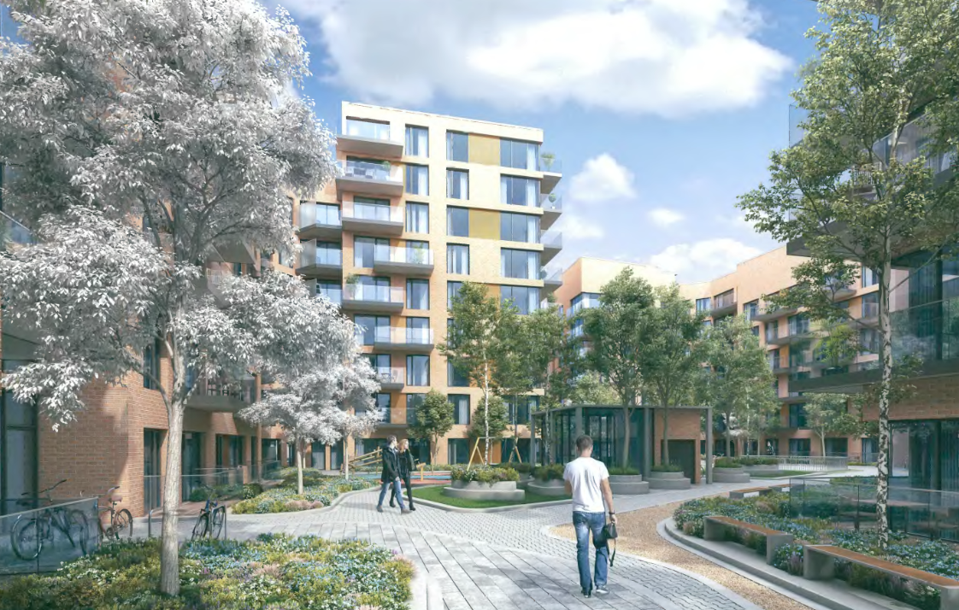

Slide 24
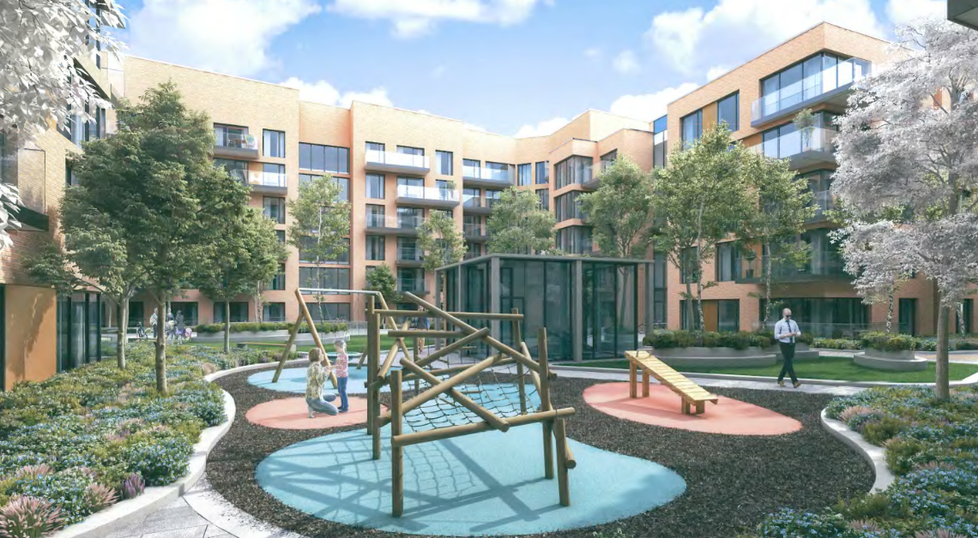

Slide 25
Statistics for Proposed Development:
Apartments
93 1beds = 21%
222 2beds = 72%
13 3beds = 6%
Site Area: 1.19ha.
Density: 276 units per ha. (276 units on 1.19ha)
Gross Demolition Area: 4,800 sq.m.
Gross Floor Area: 31,147 sq.m
Site coverage: 38%
Plot Ratio: 2.62
Building Height: Block A (5-7 storeys) Block B (6-9 storeys)
Dual Aspect: 54%
Public Open Space: public plaza
Communal Internal Amenity Space: 644 sq m
Communal External Amenity Space: 3,071 sq m
Total Commercial/Retail/Café/office 889 sq m
Creche 360 sq m (Creche Play Area 230 sq m)
Car Parking Spaces: 184
Cycle Parking Spaces: 727

Slide 26
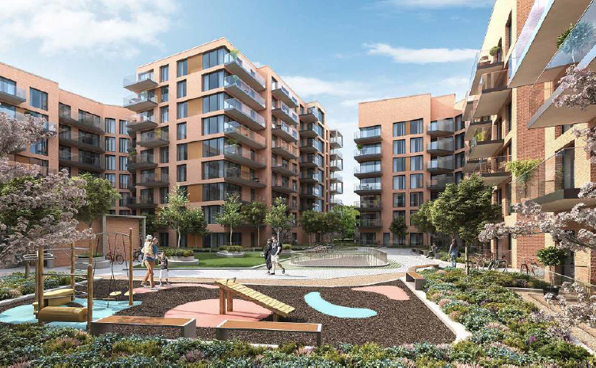

Slide 27
Thank You
Questions

