Slide 1
SHD Application
Unit 66, Fourth Avenue, Cookstown, Tallaght
SDCC Ref: SHD3ABP-305725-19
Applicant: Steelworks Property Developments Ltd
Presentation to Tallaght ACM 24/11/2019
Jim Johnston
Senior Executive Planner

Slide 2
Timelines
SHD Lodged with ABP on 18/10/19
5 Week Obs by 5.30pm 21/11/19
8 Wks SDCC report due to ABP 12/12/19
16 Week Decision Issued by ABP 17/02/20
Consultations
S.247 pre-planning meeting held with SDCC on 12/12/18 (SHD1SPP021/18)
A pre-planning meeting was held on 20/06/19 with An Bord Pleanala, the applicant and SDCC.

Slide 3
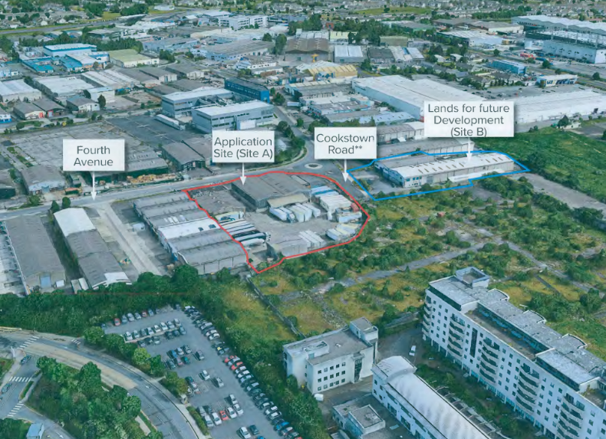

Slide 4
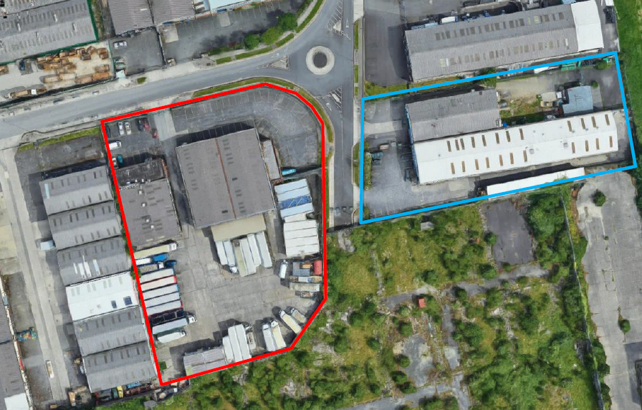

Slide 5
Proposed Development
Demolition of the existing industrial buildings (2,518sq.m);
245 apartments ‘build-to-rent’ in a six to eleven storey building over basement comprising:
- 69 studio units, 28%
- 56 one-bed units 22%
- 120 two-bed units 49%
Each apartment has associated private open space in the form of a ground floor terrace or a balcony and has access to 21 communal amenity spaces (totalling 880sqm), including a communal gym (82.5sqm), and a ground floor level landscaped courtyard.
underground carpark (accessed from the Cookstown Road extension currently under construction) providing 79 parking spaces (including 75 standard spaces and 4 mobility impaired user parking spaces), and 468 bicycle spaces (388 resident spaces at basement level and 80 visitor spaces at ground floor level in the central courtyard and on street);

Slide 6
ABP Comments
Height, density and unit mix
Roads
Site integration
Residential Amenity
Finishes and materials
Public and Communal Open Space
Photomontages and cross sections
Sunlight/daylight analysis
Traffic impact assessment
Water and wastewater details
Construction and demolition waste management plan
Legal agreement to ensure development remains as Build to Rent: requirement that the proposal remains owned/operated by an institutional entity for at least 15 years and no units to be sold/rented separately for that period

Slide 7
Statistics for Proposed Development:
245 apartments ‘build-to-rent’ in one building comprising
- 69 studio units, 28%
- 56 one-bed units 22%
- 120 two-bed units 49%
Site Area: 0.71ha.
Density: 345 per ha.
Gross Demolition Area: 2,518 sq.m.
Plot Ratio: 3.1
Site Coverage: 43%
Building Height: (6-11 storeys over basement)
Dual Aspect: 37.5%
Public Open Space: None
Communal Open Space: 2,813sq.m. located centrally within site

Slide 8
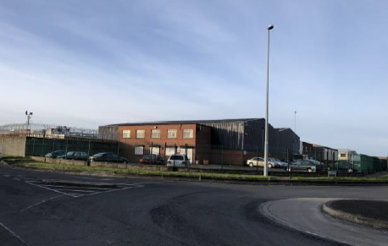

Slide 9
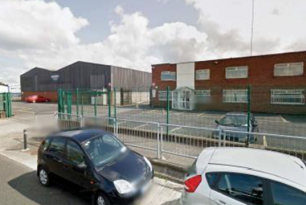

Slide 10
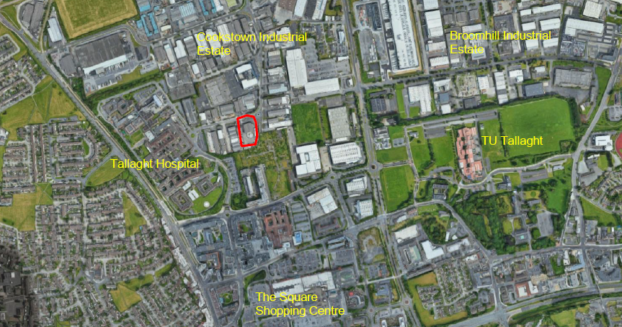

Slide 11
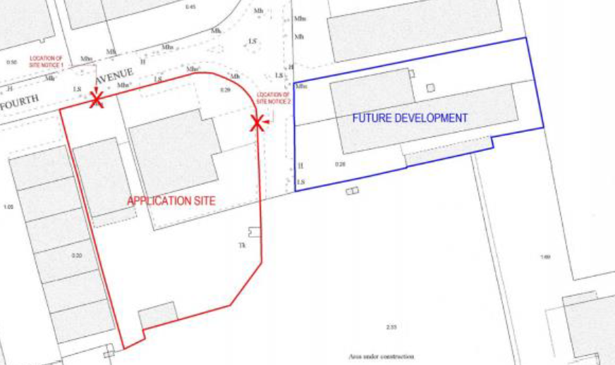

Slide 12
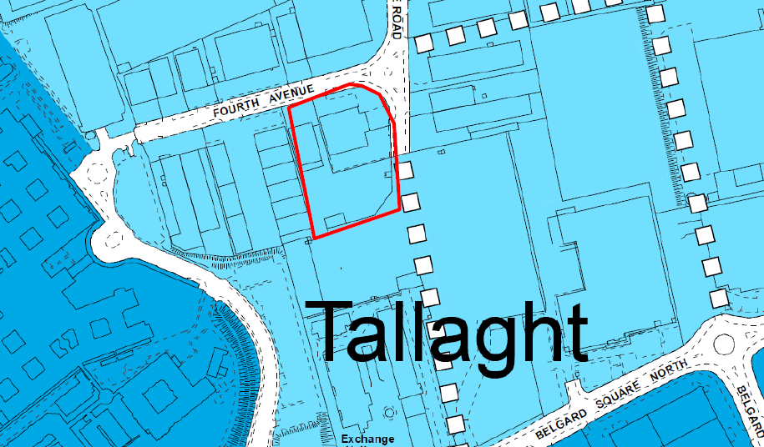

Slide 13
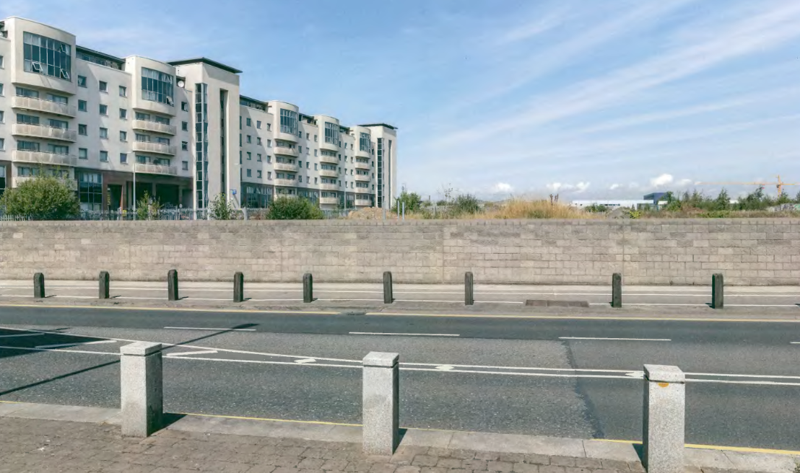

Slide 14
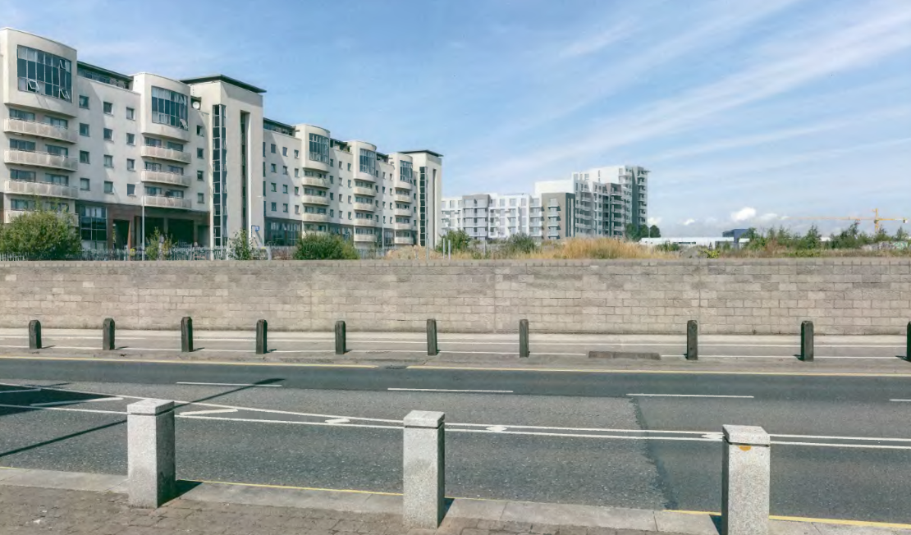

Slide 15
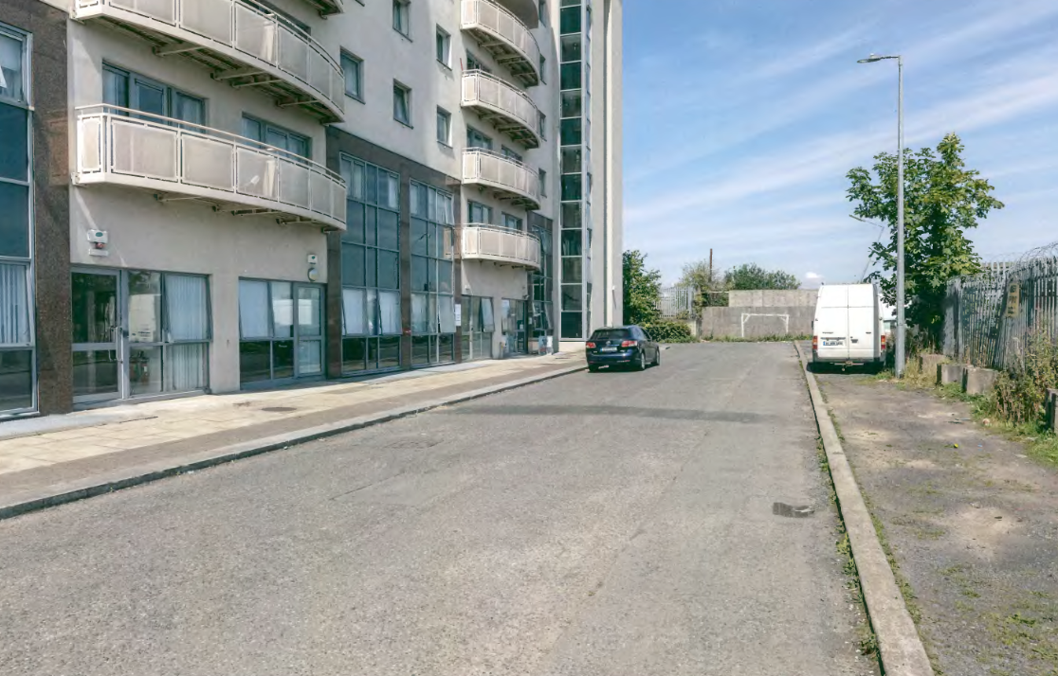

Slide 16
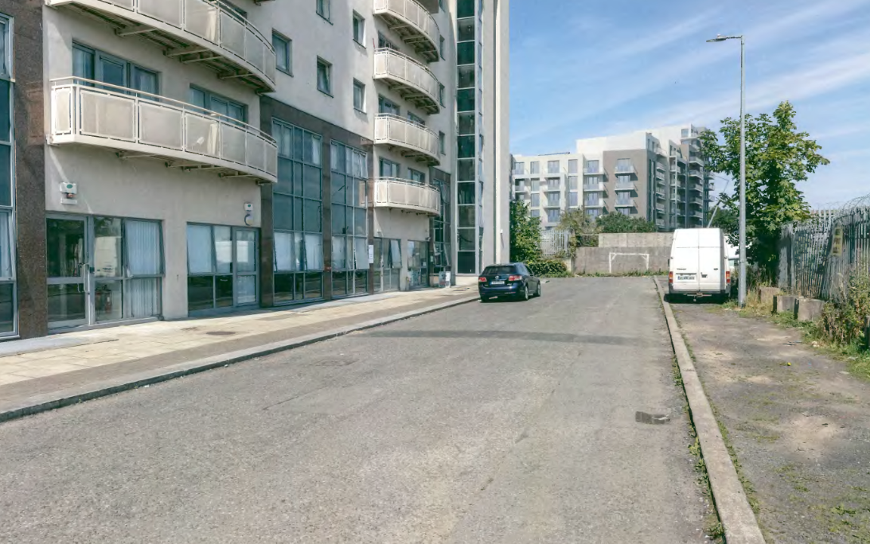

Slide 17
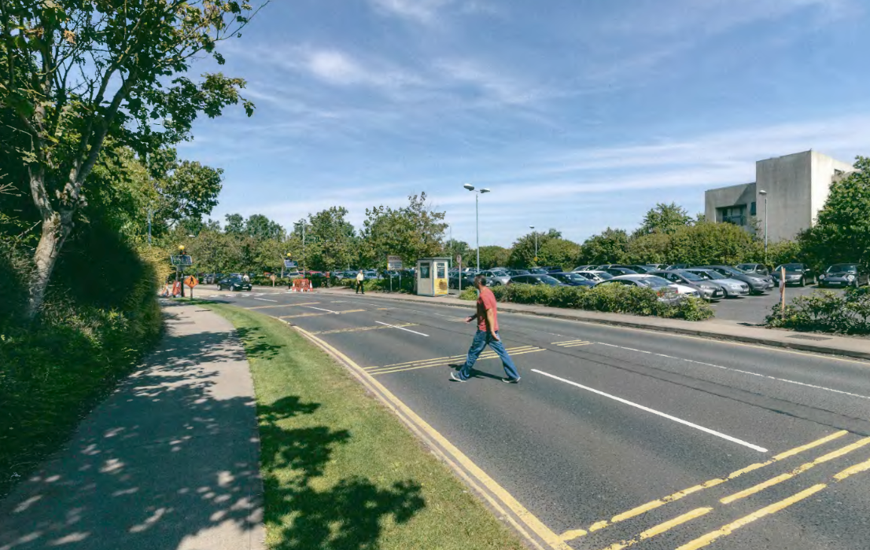

Slide 18
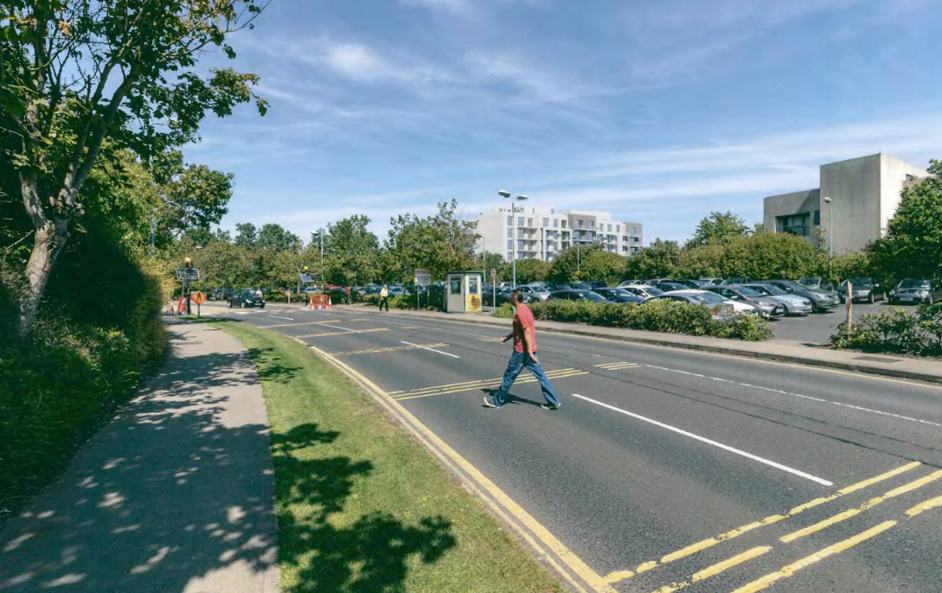

Slide 19
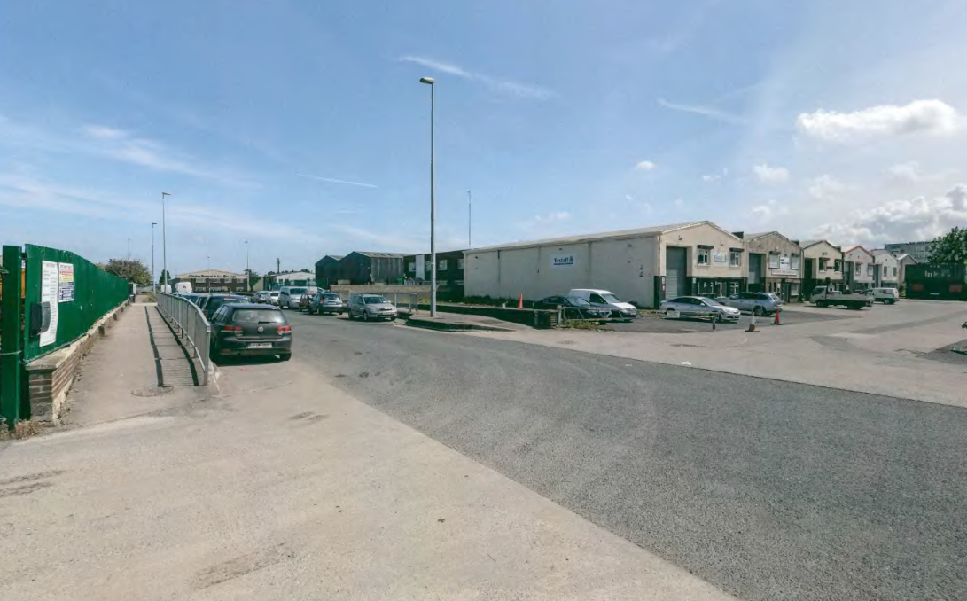

Slide 20
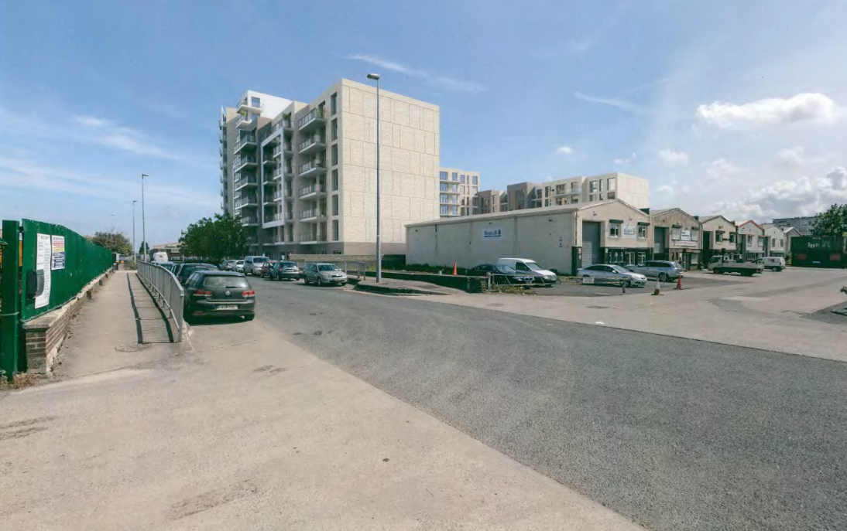

Slide 21
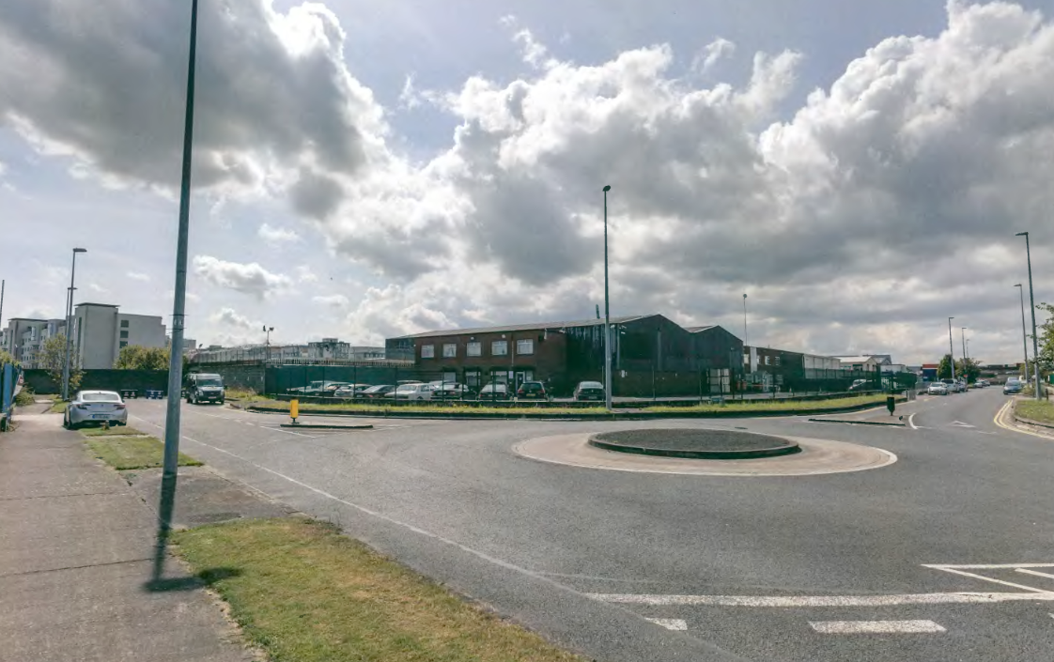

Slide 22
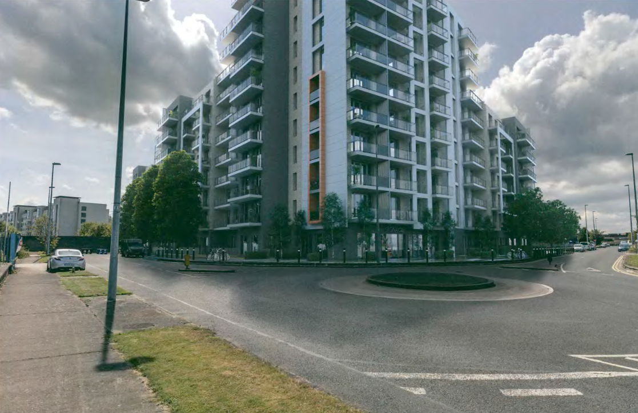

Slide 23
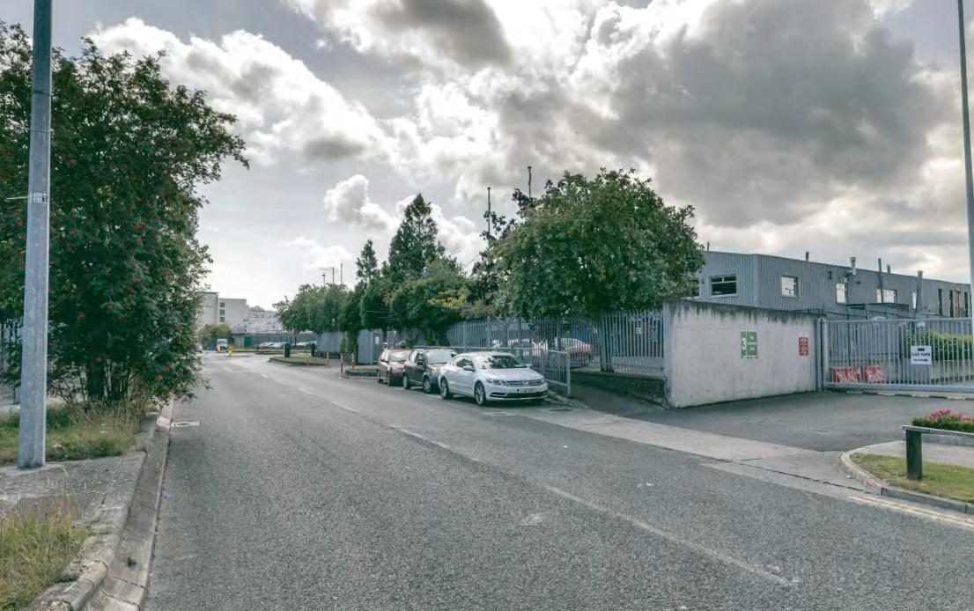

Slide 24
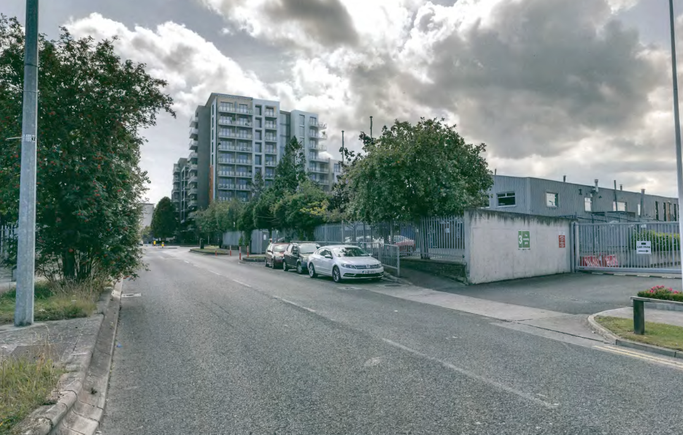

Slide 25
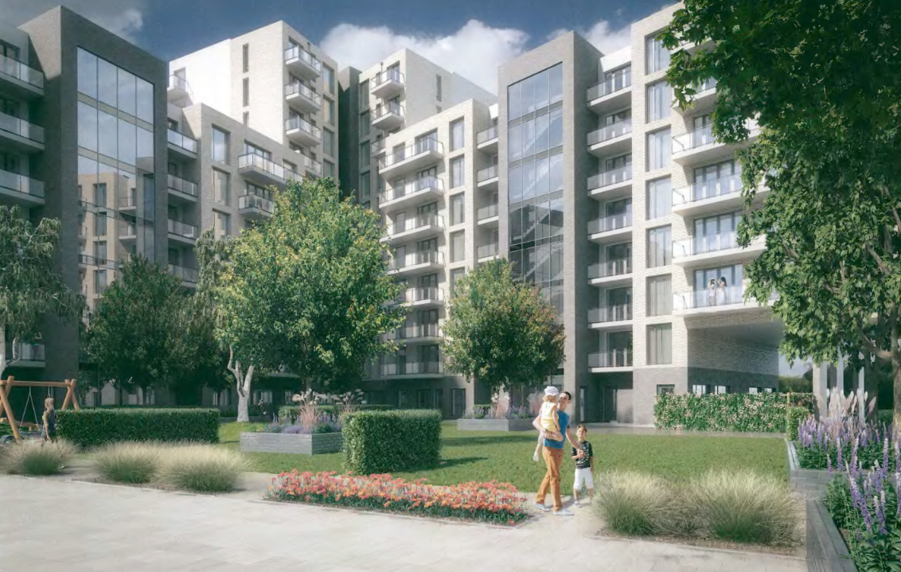

Slide 26
Thank You
Questions

