Slide 1


SHD Application Fortunestown Lane Saggart
SDCC Ref: SHD3ABP-305563-19
Applicant: Greenacre Residential
Presentation to Tallaght ACM 25/11/2019
Jim Johnston
Senior Executive Planner

Slide 2

Timelines
SHD Lodged with ABP on 07/10/19
5 Week Obs by 5.30pm weds 10/11/19
8 Wks SDCC report due to ABP 02/12/19
16 Week Decision Issued by ABP 04/02/20
Consultations
S.247 pre-planning meeting held with SDCC on 17/08/18 (SHD1SPP013/18)
A pre-planning meeting was held on 11/02/19 with An Bord Pleanala, the applicant and SDCC.

Slide 3
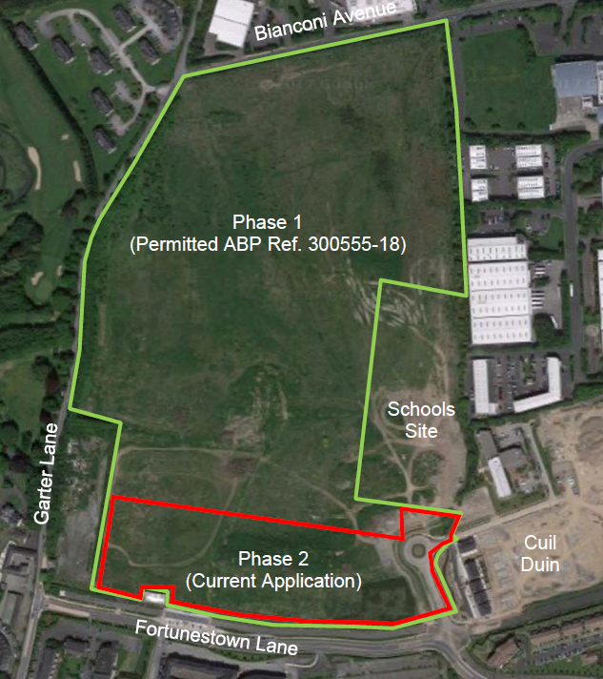

Slide 5
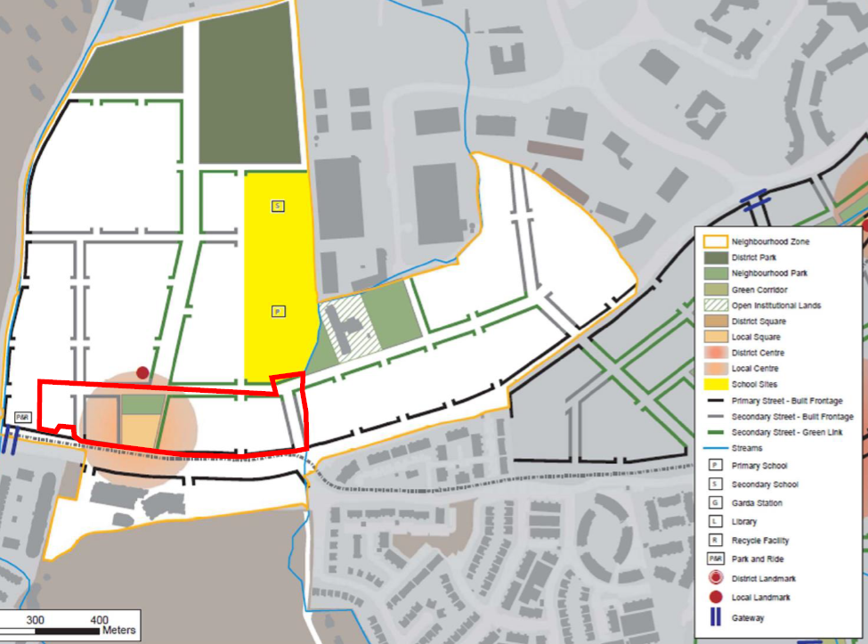

Slide 6
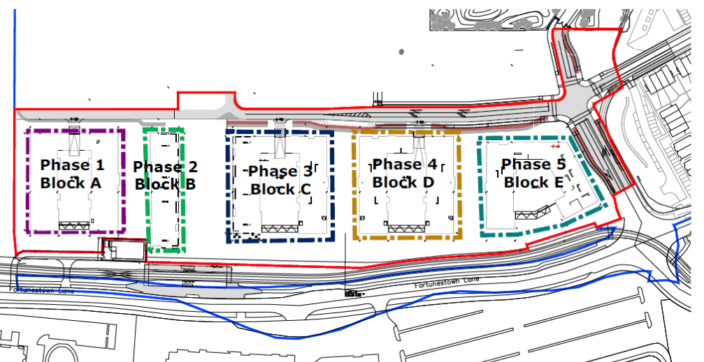

Slide 7
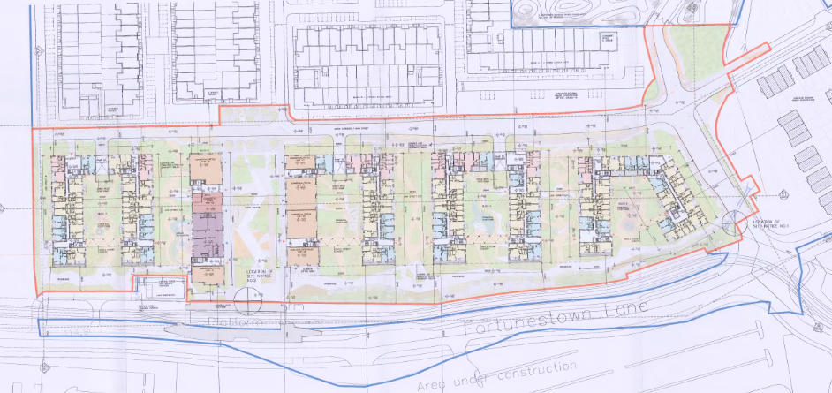
Proposed site layout

Slide 8
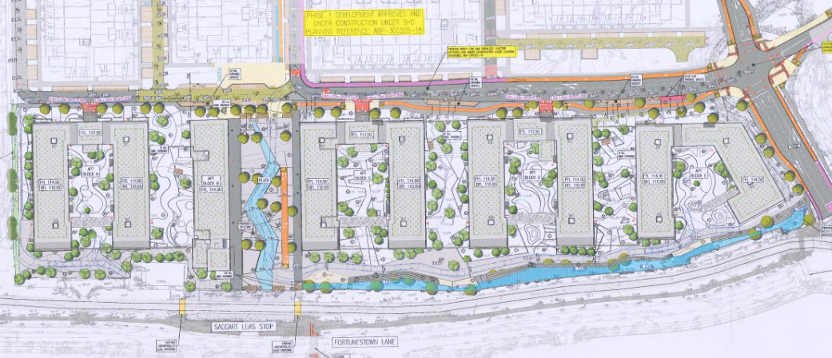
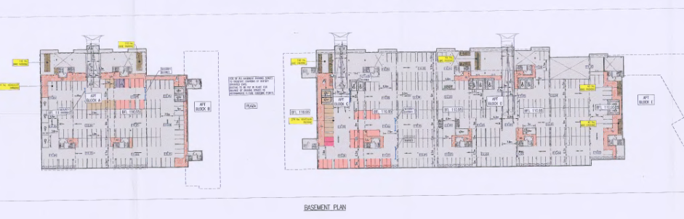

Slide 9
Proposed Development
488 apartments (build to sell) in 5 blocks (Blocks A to E over separate single levels basements – all 5 storey blocks save Block B which is 9 storey) comprising
118 1-bed units,
327 2-bed units
43 3-bed units
Within Block B, 3 units at ground floor level will contain a creche of 431sq.m gross floor area, community space of 186sq.m and 472sq.m of retail/commercial floorspace divided across.
Within Block C, 3 units will contain 708sq.m of retail/commercial floorspace. One café/bar/restaurant of 188sq.m also within Block C
Vehicular access from a signalised junction at the south-eastern corner of the site replacing the existing roundabout off Fortunestown Lane and west of Cuil Duin and an east/west distributor road all as permitted under the neighbouring development (ABP Ref. 300555-18).
418 car parking spaces including 405 basement level spaces and 13 surface level spaces and a total of 706 cycle parking spaces including 620 basement level spaces and 86 surface level spaces, bin storage areas, ESB substations, public lighting, boundary treatments, surface water drainage infrastructure including modifications to the previously permitted flood conveyancing channel (ABP Ref: 300555-18) and all associated site development and infrastructure works.

Slide 10
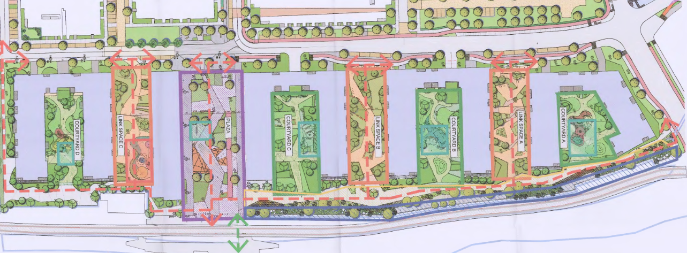
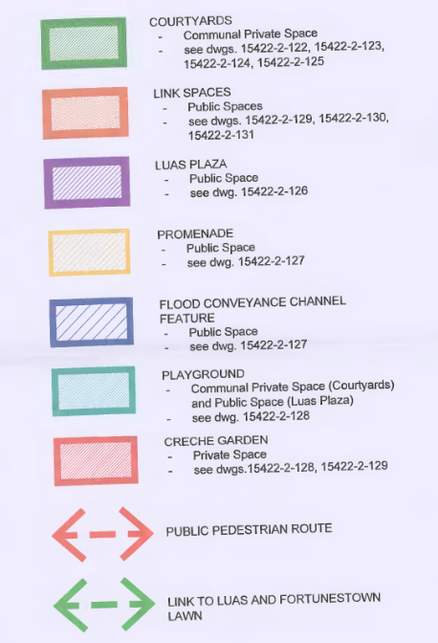

Slide 11
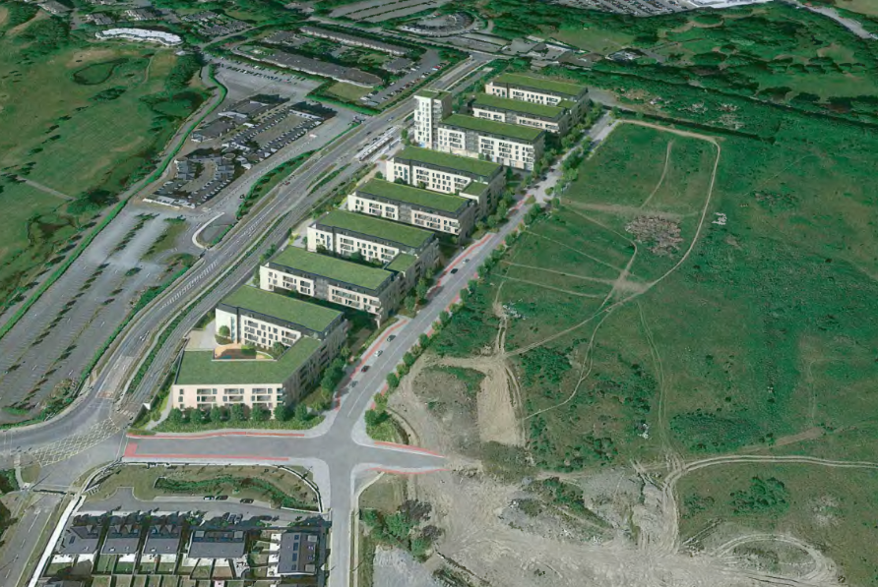

Slide 12
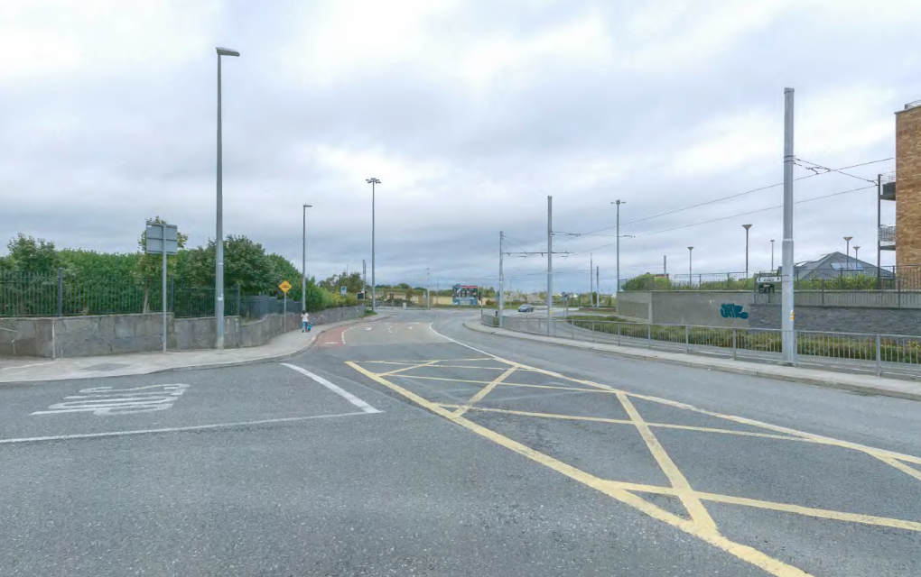

Slide 13
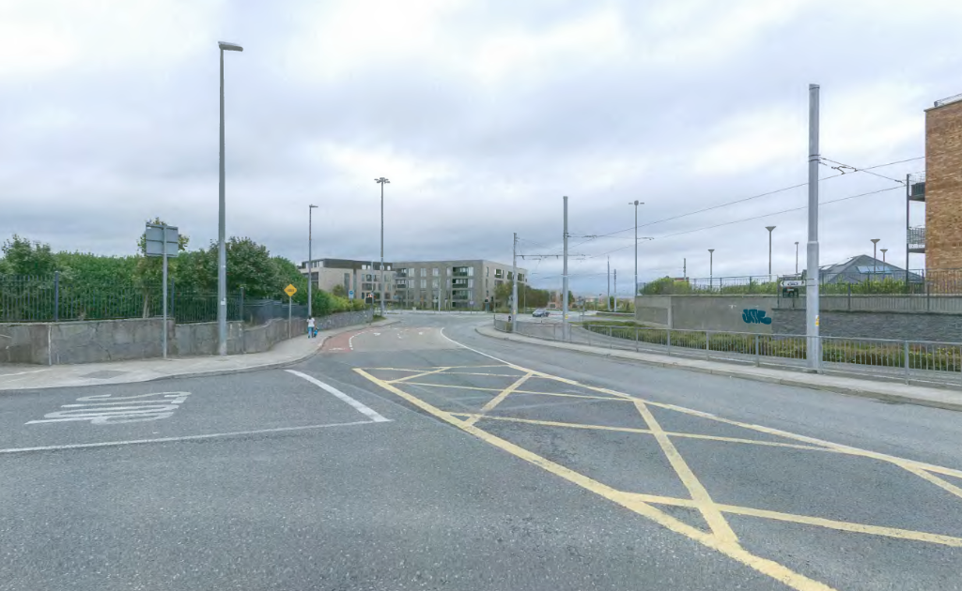

Slide 14
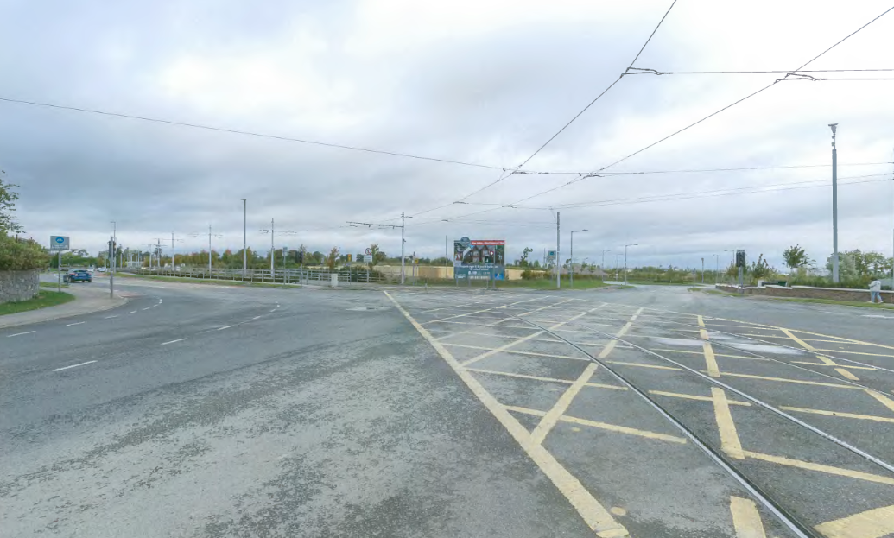

Slide 15
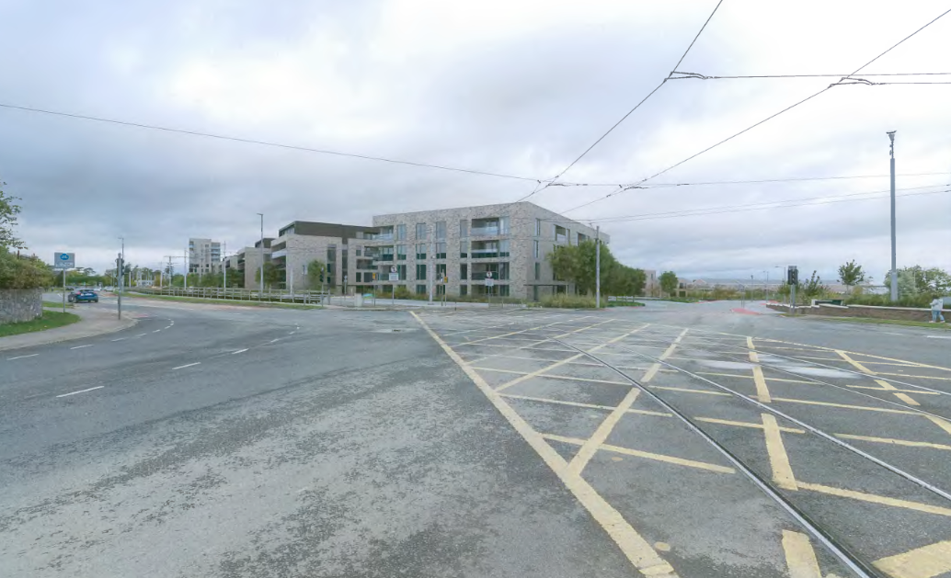

Slide 16
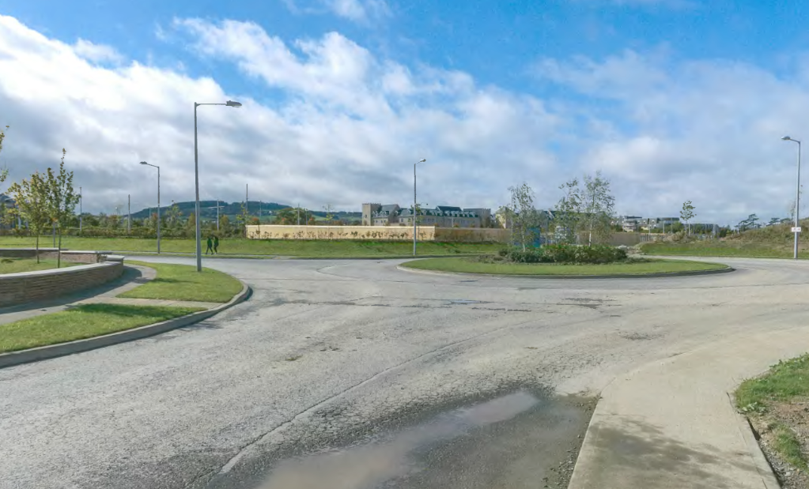

Slide 17
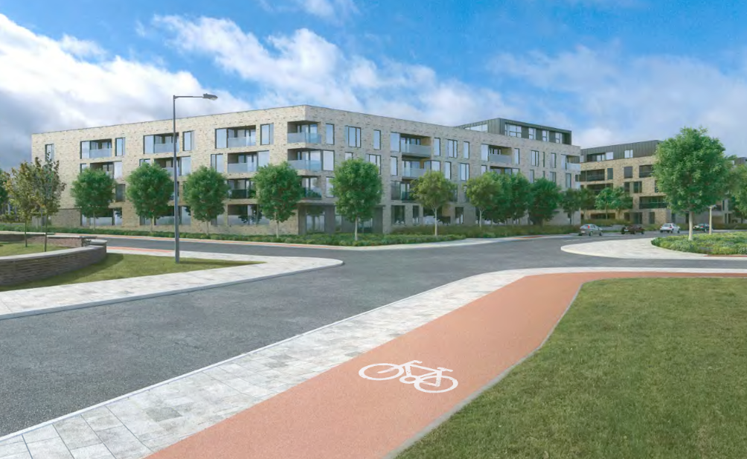
Plan of central portion of site and image of 3 storey corner building opposite two storey houses facing onto park

Slide 18
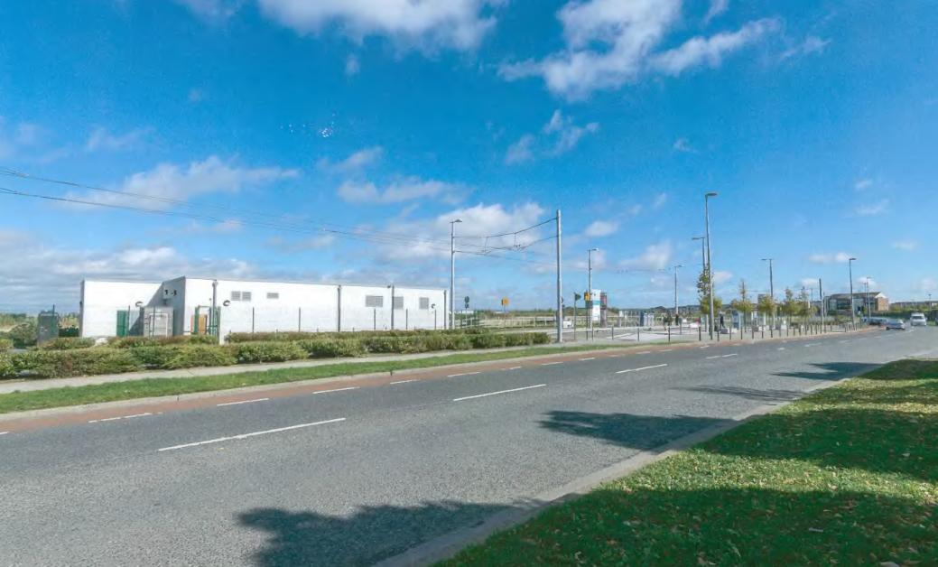
Plan of southern portion of site and image of two storey houses overlooking public amenity space and cycleway on eastern side of site

Slide 19
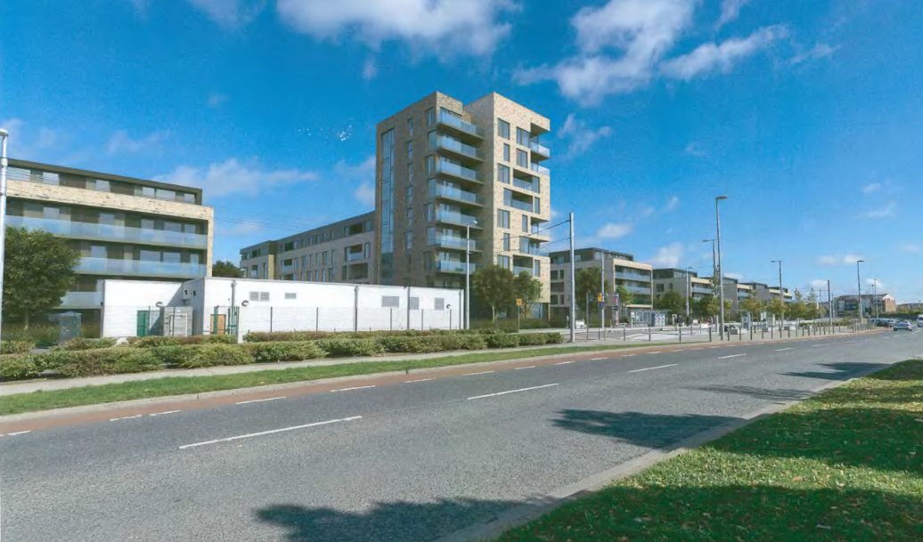

Slide 20
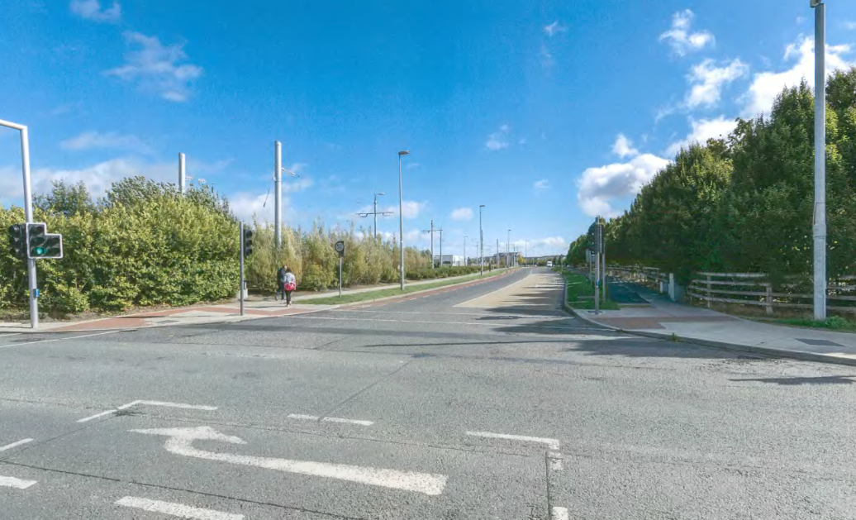
East elevation view showing lands sloping downwards from south (left) to north (right) illustrating relative height of apartment buildings
West elevation view showing lands sloping upwards from north (left) to south (right) illustrating relative height of duplex buildings

Slide 21
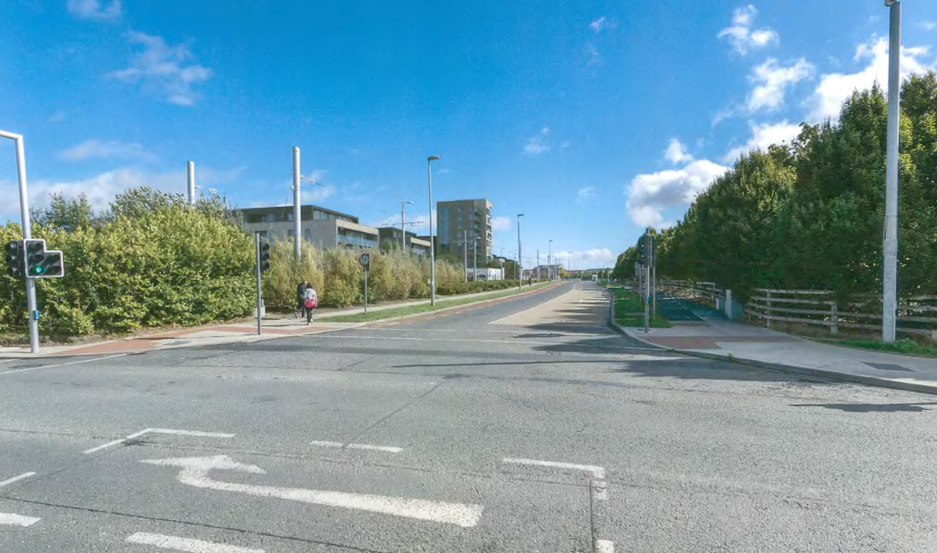

Slide 22
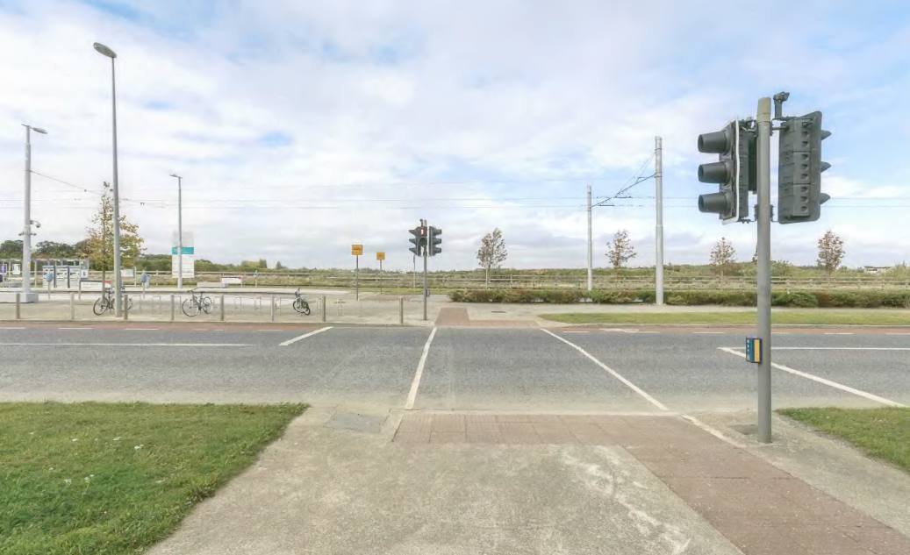
West elevation showing lands sloping up from south (left) to north (right) toward Boherboy Road (on the right hand side)

Slide 23
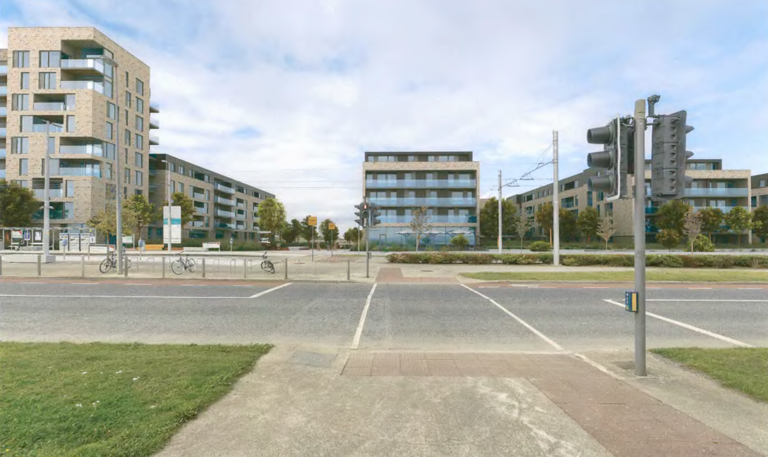

Slide 24
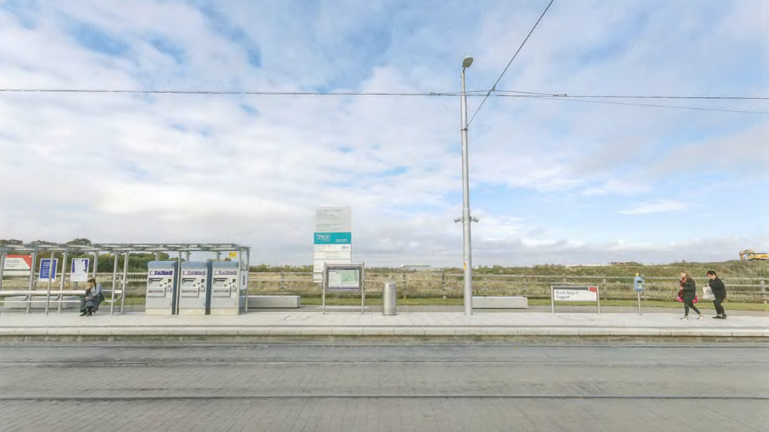

Slide 25
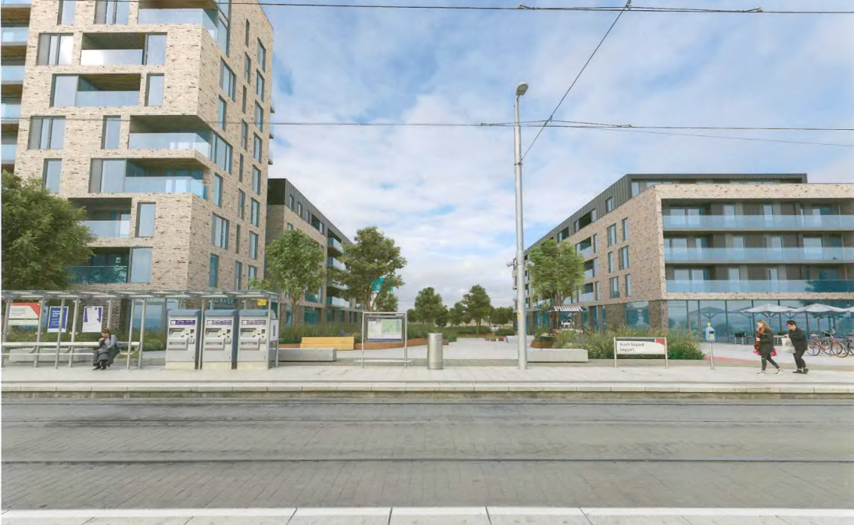

Slide 26
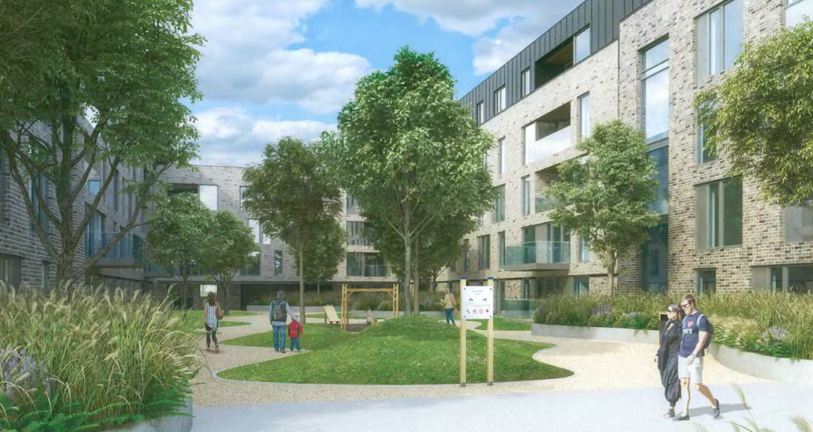

Slide 27
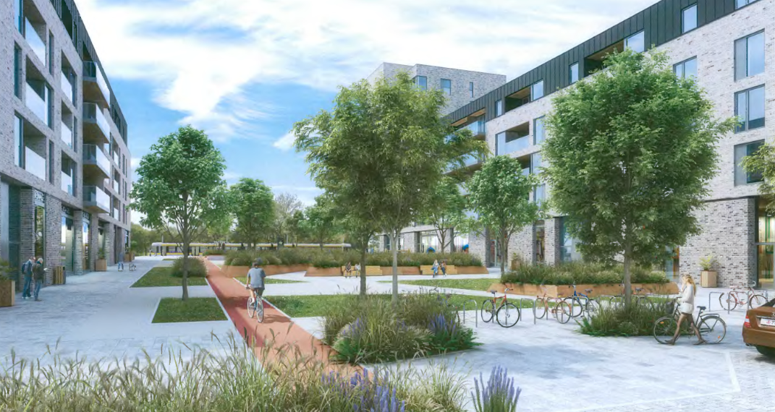

Slide 28
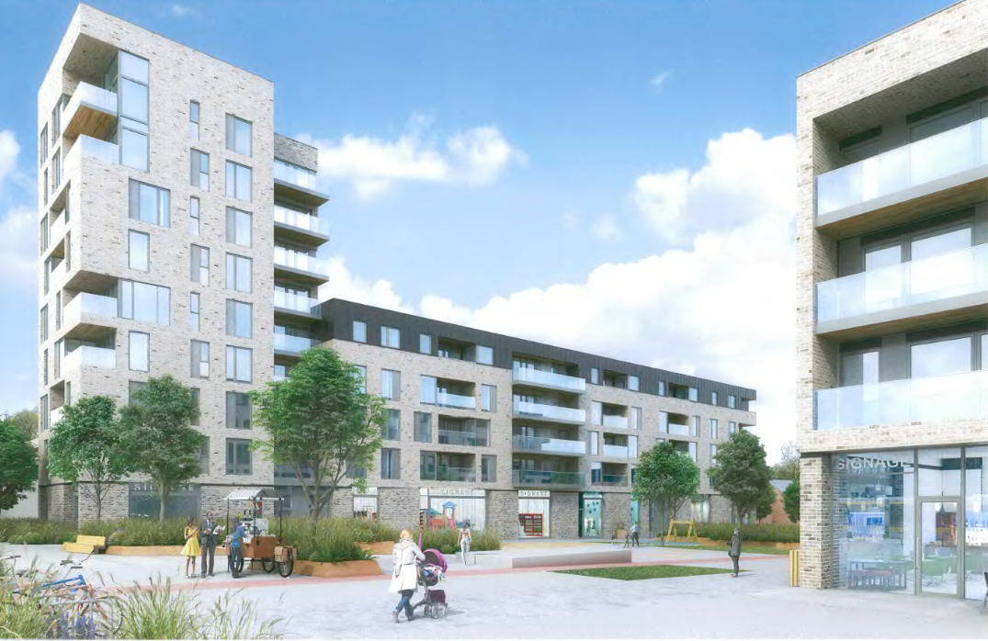

Slide 29
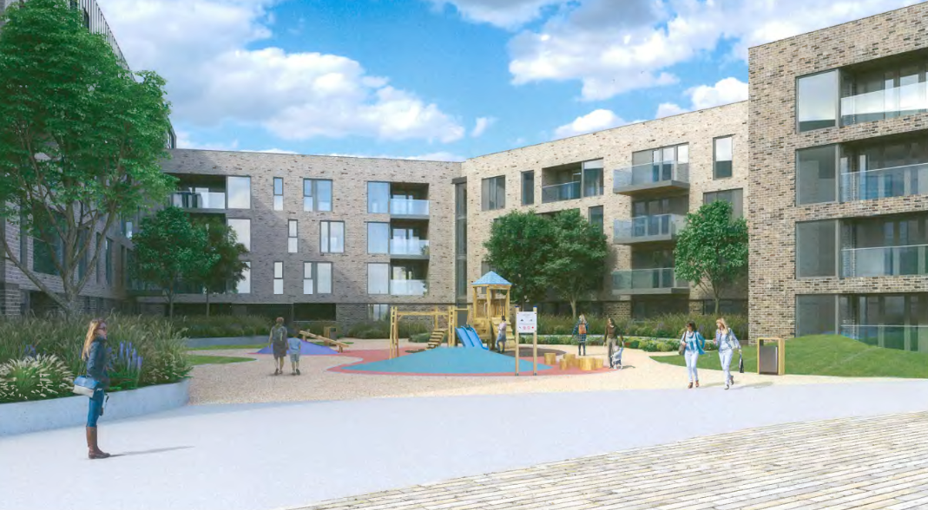

Slide 30
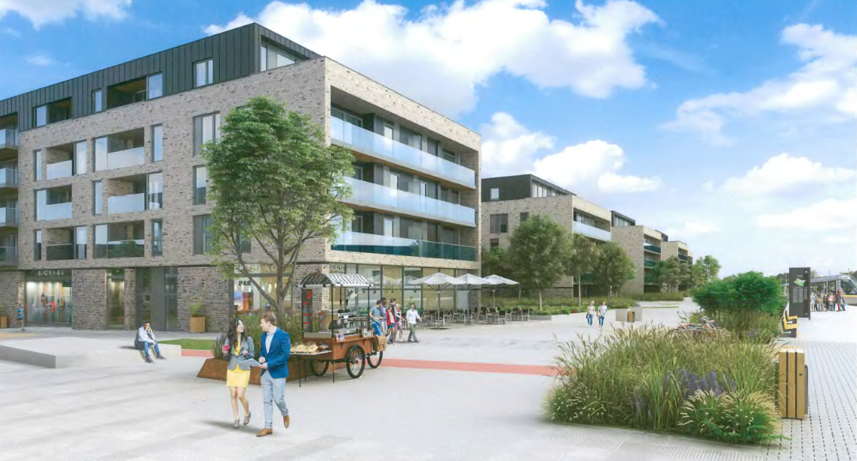

Slide 31
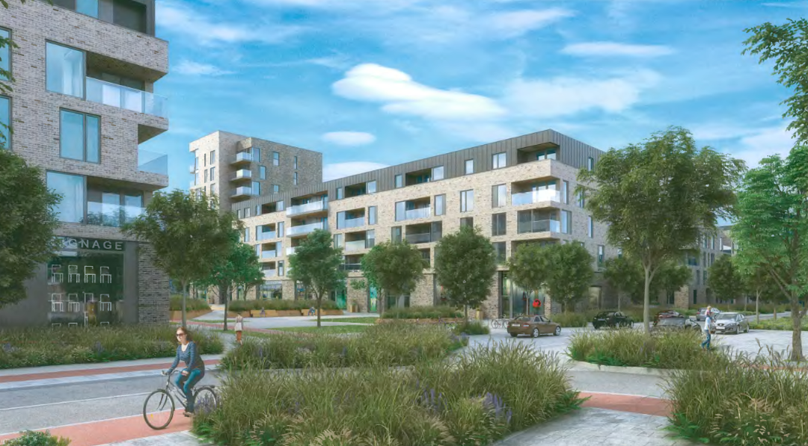

Slide 32
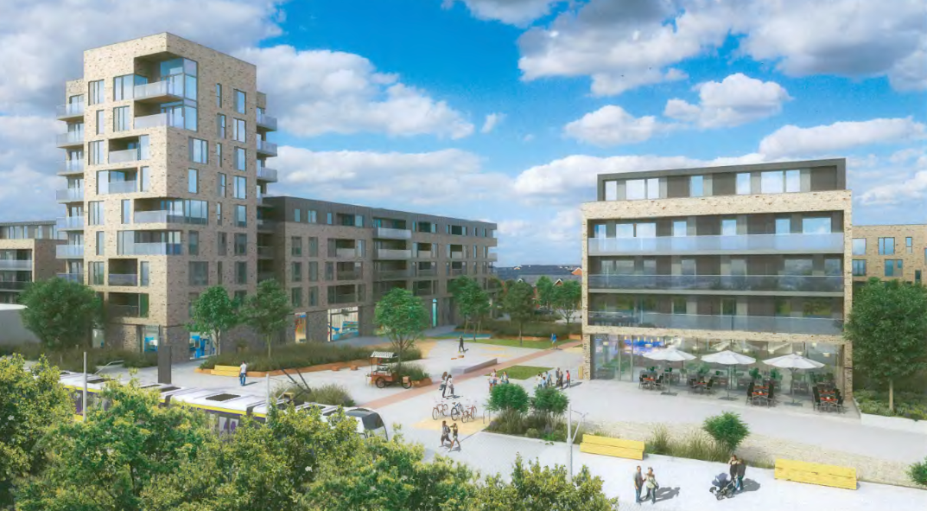

Slide 33
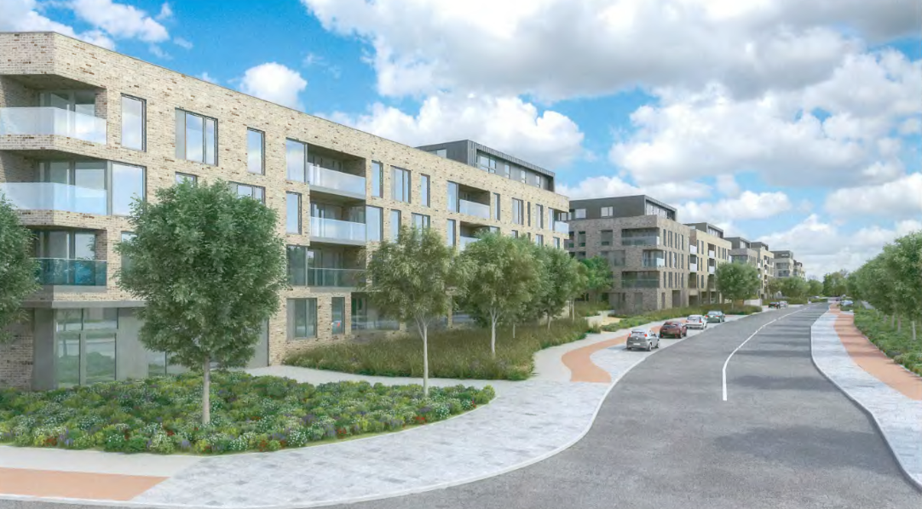

Slide 34
ABP Comments
Report showing consistency with LAP and any material contraventions thereof, including density, building mix and height
Phasing in the context of development permitted under ABP-300555-18
Drainage details
Landscaping proposals
Location of areas to be taken in charge
A site plan allowing for connectivity with site to west
Sunlight/Daylight analysis
Flooding issues
Photomontages
Archaeology
AA screening report

Slide 35
Statistics for Proposed Development:
488 apartments comprising:
  - 118 (1 bedroom apartments) 24%
  - 327 (2 bedroom apartments) 67%
  - 43 (3 bedroom apartments) 8%
Site coverage: 27%
Site Area: 3.6ha.
Plot ratio: 1:1.14
Density: 134 units per ha.
Building Height: all 5 storey except Block B which is 9 storey
Dual Aspect: 50% dual aspect
Public Open Space 10%

Slide 36
Thank You
Questions

