Slide 1
SHD Application
Citywest Shopping Centre, Fortunestown
SDCC Ref:SHD3ABP-305556-19
Presentation to Tallaght ACM 25/11/2019
Jim Johnston
Senior Executive Planner

Slide 2
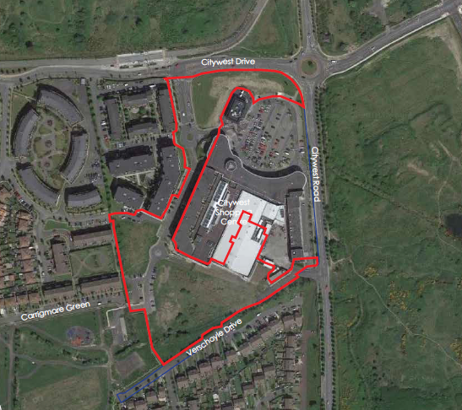

Slide 3
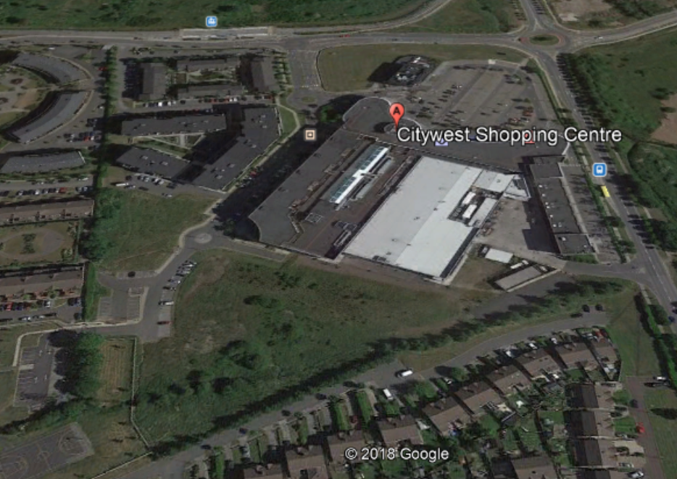

Slide 4
Timelines
SHD Lodged with ABP 04/10/19
5 Week Obs by 5.30pm 07/11/19
8 Wks SDCC report due to ABP on 28/11/19
16 Week Decision Issued by ABP 03/02/20
Consultations
S.247 pre-planning meetings held with SDCC on 06/12/18(SPP017/18) and 21/02/19 (SHD1SPP002/19)
A pre-planning meeting was held on 24/06/19 with An Bord Pleanala, the applicant and SDCC.

Slide 5
ABP Comments
Architectural response of Block E and F and A and rear of the shopping centre
Car parking and access
Open space
Residential amenity
Relevant items to be within red line site boundary
Second vehicular access from Citywest road –demonstrate requirement re TIA and reduced car parking
Schedule of accommodation to demonstrate consistency with Apartment Guidelines 2018
residential amenity – report on existing and future occupants – sunlight/daylight and noise assessment
Building Lifecycle report
Photomontage
Traffic impact assessment
Creche – justification for same and need for further community/medical facilities within the site
Public lighting
Part V provision
Public Open Space – showing public, private and semi private.
Phasing within the site.
Areas to be taken in charge
Material Contravention – a report if this is the case, and why permission should be granted

Slide 6
Proposed Development
290 apartments in 6 Blocks comprising:
106 one-beds 36%
144 two-beds 50%
40 three beds 14%
2 resident amenity facilities (c.246 sq m) and (c.93 sq m),
childcare facility (c.265 sqm) and ancillary outdoor play area (c.385 sqm).
4 retail units (c.76sqm, 54sqm, 76sqm, 78sqm
2 café / restaurant units (c. 187.7 sq m and c.18.1 sq m)
153 car parking spaces at surface level and existing basement level
new vehicular ramp and pedestrian stairway and lift egress lobby (c.21 sq m) to the Citywest Shopping Centre basement car park
relocation of a further 29 existing car parking spaces at surface level to serve their existing uses.
298 bicycle parking spaces
elevational upgrades and green wall at the south elevation of the Citywest Shopping Centre.
landscaped open spaces
alterations to existing road alignments within the site,
hard and soft landscaping, pedestrian and cycle links, etc
piped site wide services and attenuation tanks, and all ancillary works and services necessary to facilitate construction and operation.

Slide 7
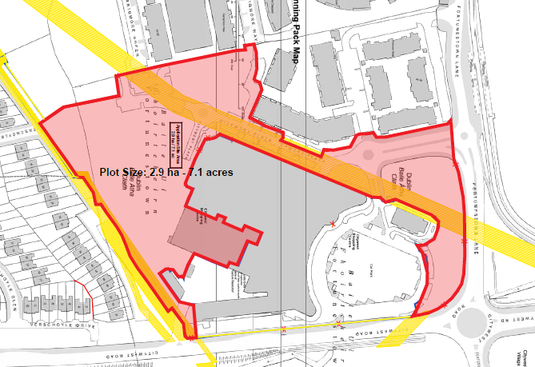

Slide 8
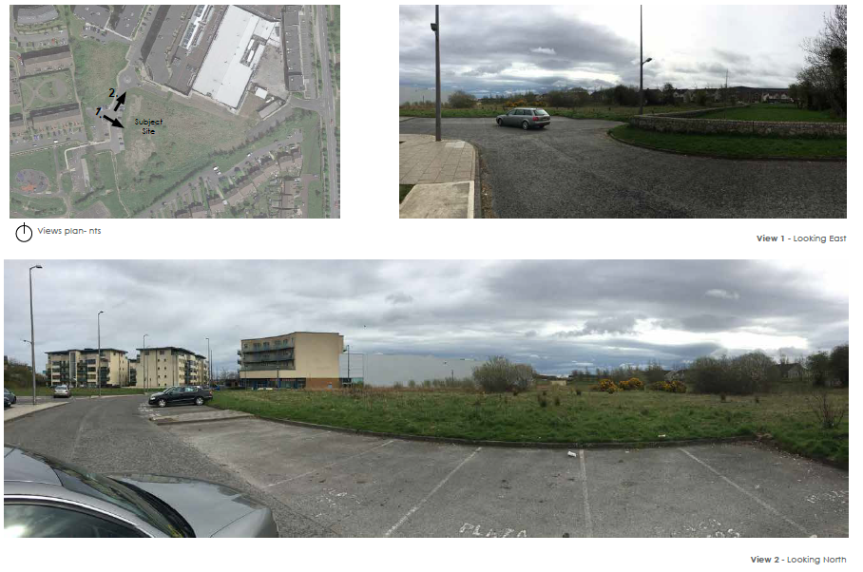

Slide 9
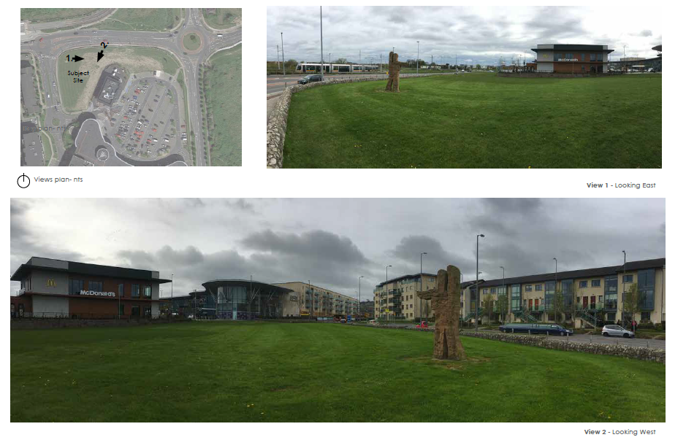

Slide 10
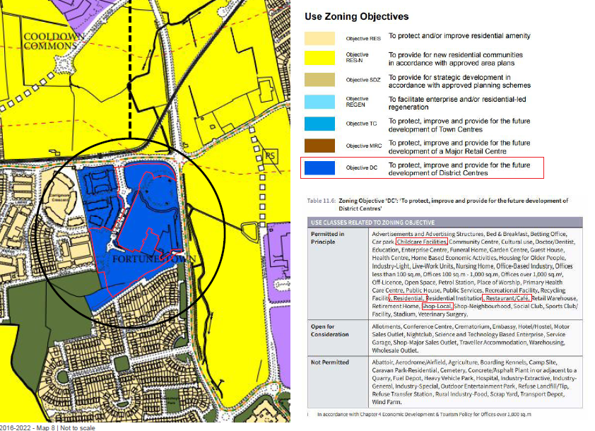

Slide 11
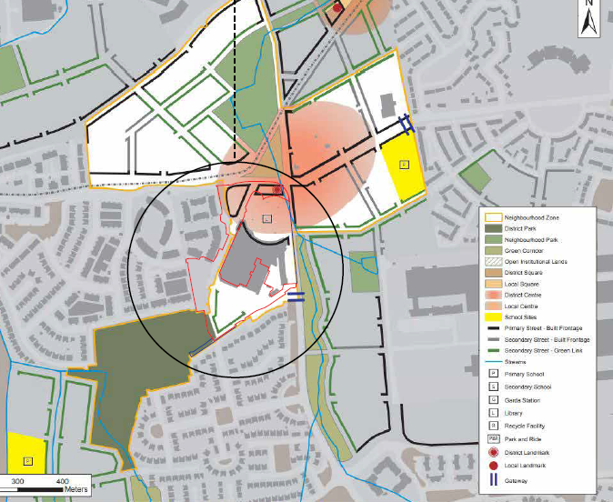
Cre

Slide 12
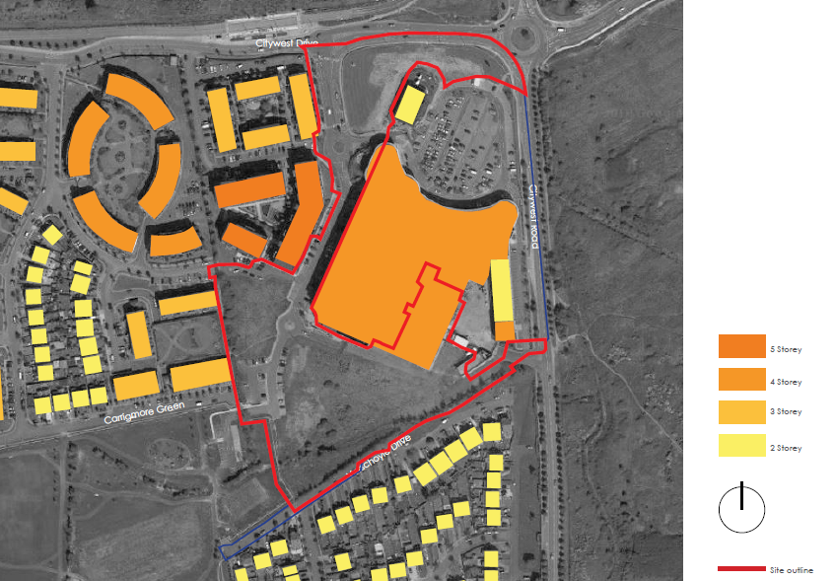
South elevation, comprising Block D

Slide 13
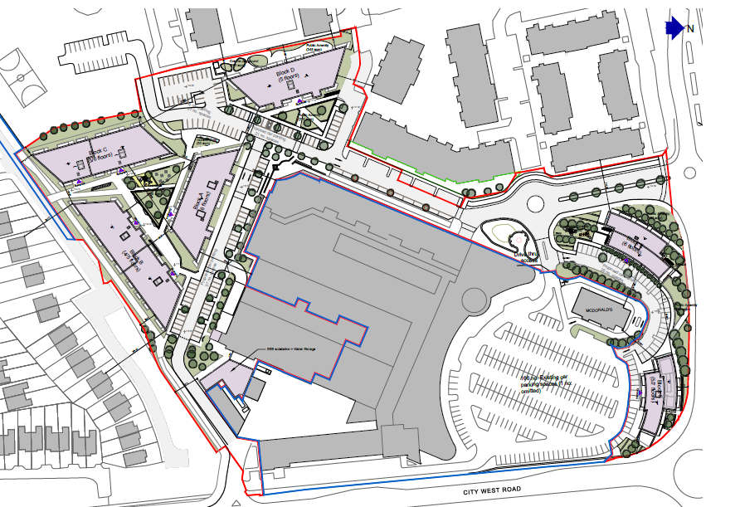
West elevation comprising Block C and part of Blocks B and D

Slide 14
Statistics for Proposed Development
Apartments (build to sell) 290 apartments in 6 Blocks comprising:
- 106 one-beds 36%
- 144 two-beds 50%
- 40 three beds 14%
6 blocks
- Block A - six storeys - 57 units
- Block B - four to five storeys - 36 units
- Block C - five to six storeys - 61 units
- Block D - five storeys - 47 units
- Block E - six storeys - 30 units
- Block F - five to seven storeys - 29 units
Site Area 2.9ha.
Density 100 units per hectare (290 units on 2.9ha)
Gross Floor Area 26,929 sqm
Plot Ratio 26,929sqm/ 28,999sqm site area = 0.92
Building Height 6 four to six storey blocks
Dual Aspect 57%
Public Open Space 0%

Slide 15
View of internal courtyard space looking towards Block A

Slide 16
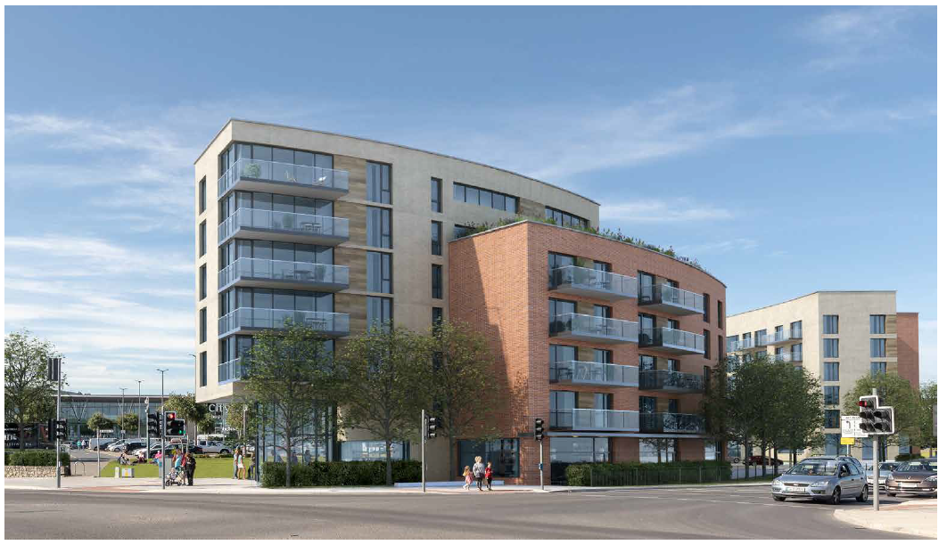
View of Block F looking south west

Slide 17
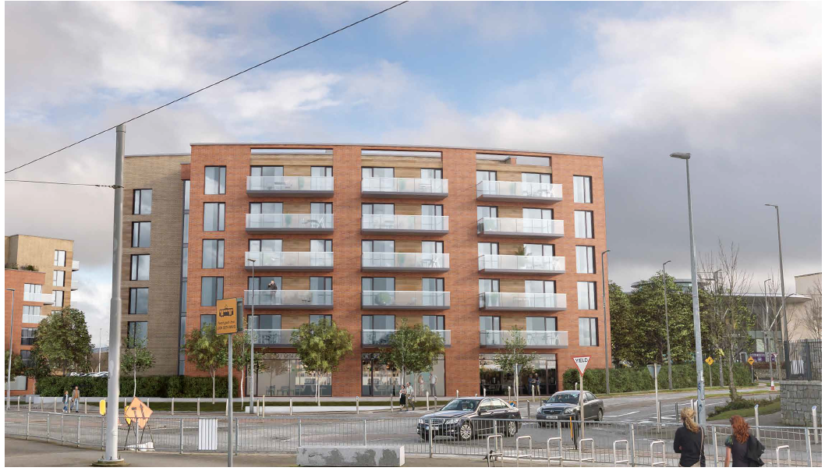
View of Block E looking south east

Slide 18
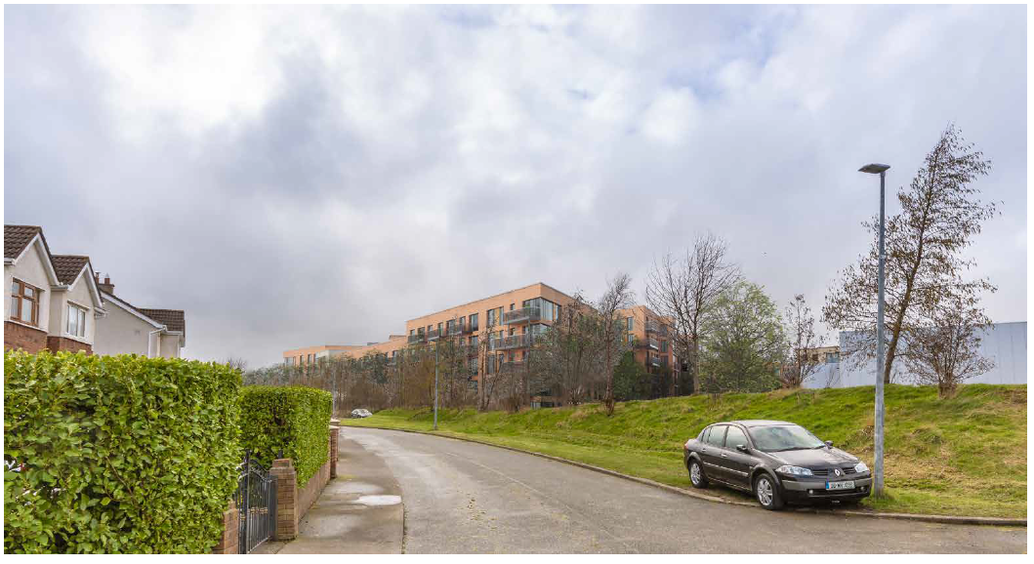
View of Block B from east end of Verschoyle Drive

Slide 19
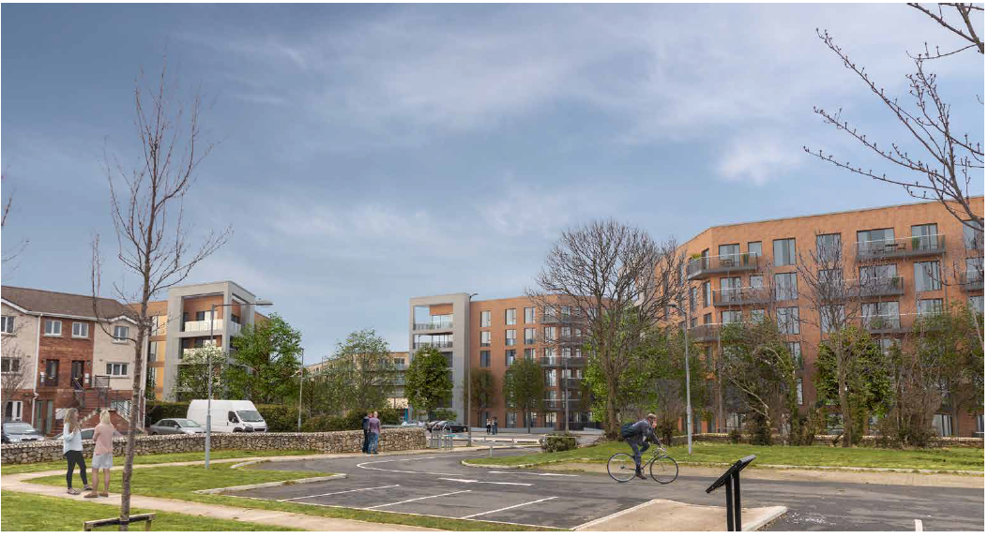
View looking east – Block C right Block A middle Block D left

Slide 20
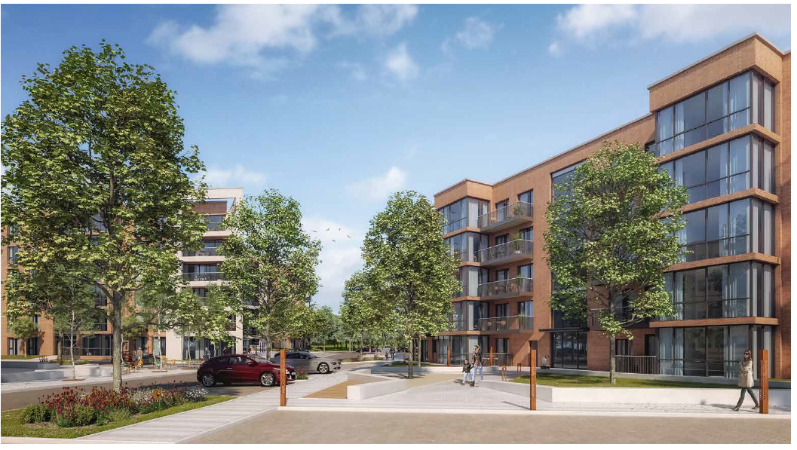
View looking south

Slide 21
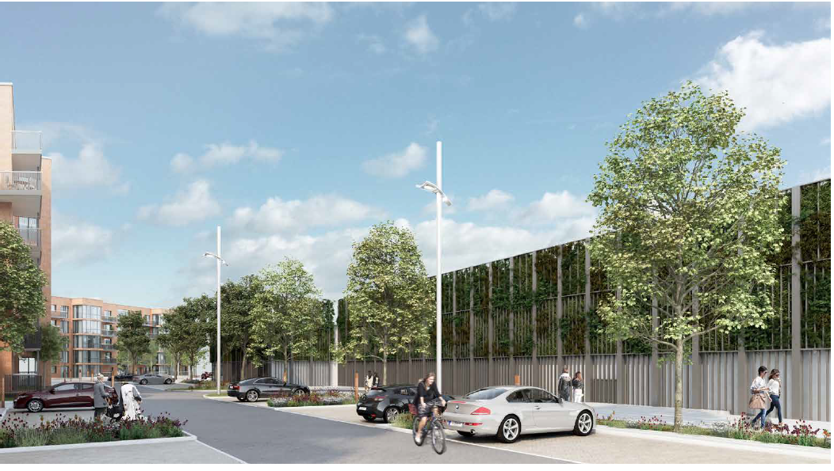
View looking south

Slide 22
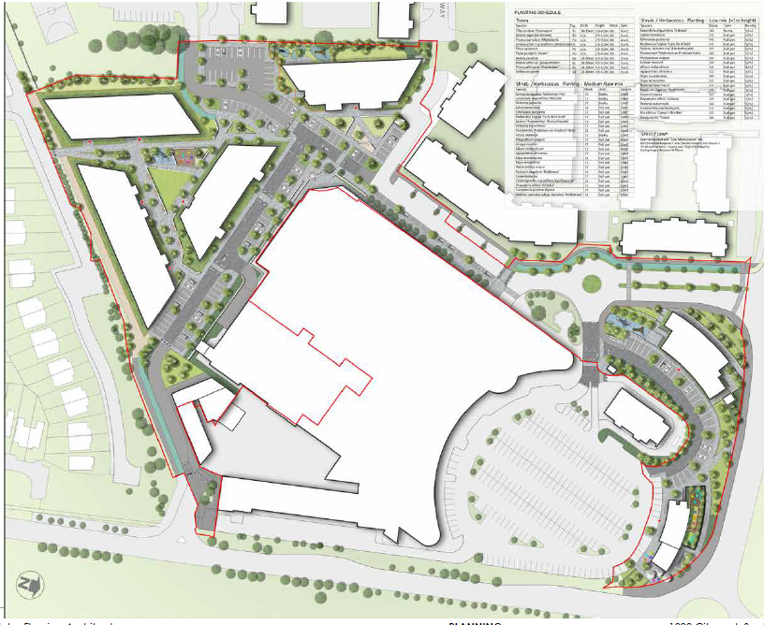

Slide 23
Thank You
Questions

