Slide 1
HOUSING SUPPLY OVERVIEW &
FOCUS ON CAPTIAL ADVANCED LEASING FACILITY (CALF)
Housing Strategic Policy Committee Meeting
18th November 2019

Slide 2
Future Housing Supply
Large mixed tenure developments on Council owned sites
Kilcarbery/Clonburris/Killinarden/Rathcoole
Part V yield, AHB delivery, turn-key & acquisitions
Leasing / RAS / HAP
Smaller infill developments (predominantly for Older Persons homes)
Support rightsizing for tenants of under-utilised Council housing stock

Slide 3
Mixed Tenure Developments on Council owned sites
Update provided to October Council Meeting
Overview of sites & indicative tenure mixes
Established level of interest for Affordable Scheme
DHPLG financial support confirmed for affordable housing delivery through Serviced Sites Fund
Site specific studies and costings

Slide 4
Clonburris (2,000+ Homes): Phase 1–approx. 270 homes: Affordable (135) & Social (135)

Slide 5
Clonburris (Phase 1–approx. 270 homes): Affordable (135) & Social (135)
Masterplan including layout & typology being finalised
Consultants engaged to bring design to Part 8
NDFA assisting with costing model
Provisional housing mix proposed as follows:
Type | Social | Affordable/ Private
1-Bed Home | 24 | 0
2 Bed Home | 55 | 47
3-Bed Home | 35 | 80
4-Bed Home | 21 | 8
Totals | 135 | 135

Slide 6
Killinarden (500 homes): Affordable (300), Social (100) & Private (100)

Slide 7
Killinarden (500 homes): Affordable (300), Social (100) & Private (100)
Masterplan including layout and typology being finalised
NDFA assisting with costing model
Provisional housing mix proposed as follows:
Home Type | Social | Affordable/Private
1-Bed Home | 20 | 0
2 Bed Home | 40 | 120
3-Bed Home | 30 | 275
4-Bed Home | 10 | 5
Totals | 100 | 400

Slide 8
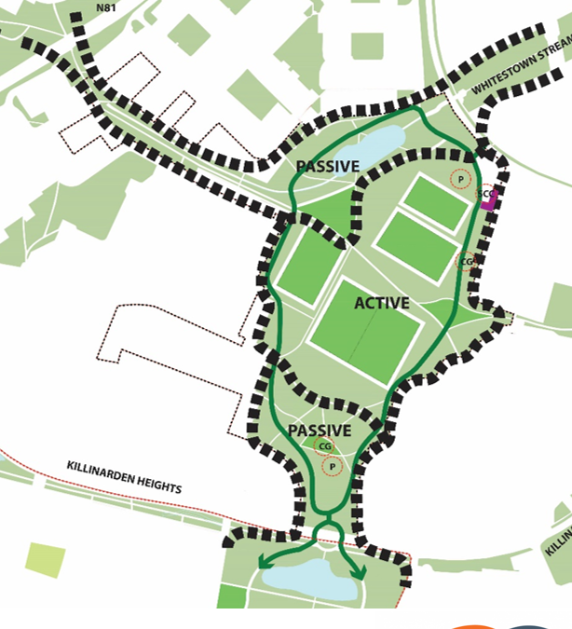
Killinarden: Community & Parkland Development
Procurement of independent facilitator to lead consultation
Consultation with local community, sporting and youth groups
Provide nature places & passive/ active, inter-generational facilities
Scope for infill housing for down-sizing & passive surveillance
Commitment to provide new community facility between proposed housing & Elder Heath

Slide 9
Rathcoole (250 homes): Affordable (100 homes), Social (100), Private (50)

Slide 10
Rathcoole (250 homes): Affordable (100 homes), Social (100), Private (50)
Provisional housing mix proposed as follows:
DES examining school site / discussions with DCB on playing facilities / Library site being scoped–predicated on housing proposal……
Traffic & transport assessment & detailed ecological/environmental assessments being conducted
NDFA assisting with costing model
Home Type | Social | Affordable/Private
1-Bed Home | 15 | 0
2 Bed Home | 30 | 40
3-Bed Home | 40 | 110
4-Bed Home | 15 | 0
Totals | 100 | 150

Slide 11
Belgard North (140 apartments): Affordable Rental

Slide 12
Belgard North (140 apartments): Affordable Rental
Outline design comprising:
Procurement commenced for design team
Expression of interest for partner Approved Housing Body
Access road commencing
Adjacent projects progressing (innovation centre, amenity park, school etc.)
Type | Rental
Studio Apartment | 12
1-bed Apartment | 53
2 Bed-Apartment | 75
Total | 140

Slide 13
Affordable Homes Portal
Portal launched on 26th September
Expressions of interest sought to take market soundings
Opportunity to express interest in each of three sites earmarked for delivery of Affordable Housing (Clonburris, Killinarden & Rathcoole)
EOIs received to date:
Clonburris:1,269/Killinarden:1,001/Rathcoole:1,347;

Slide 14
Serviced Sites Funding
Applications to DHPLG for three sites at Clonburris, Killinarden & Rathcoole
Provisional approval received in August for €18.4m in funding for infrastructure delivery:
Clonburris €6.2m
Killinarden €8.9m
Rathcoole €3.3m
Provides opportunity for €35k approx. subsidy for 535 affordable homes

Slide 15
Housing Supply 2019 Overview
Department of Housing Target 2019
Build | Acquisitions | Total
435 | 76 | 511
 | LA Build | AHB Build | Part V | Acquisition | Total
Q1 | 49 | 4 | 0 | 14 | 67
Q2 | 0 | 13 | 17 | 55 | 85
Q3 | 0 | 0 | 22 | 13 | 35
Q4 | 85 | 66 | 104 | 63 | 318
 | 134 | 83 | 143 | 145 | 505
Voids |  |  |  |  | 21
Total Delivery Projected 2019 |  |  |  |  | 526

Slide 16
What is CALF?
Capital funding provided to Approved Housing Bodies (AHBs) through Local Authorities from DHPLG
Assists with the financing of construction or acquisition of homes for social housing use.
Based on percentage of acquisition or construction costs (max. 30% can be provided over a fixed term)
Interest accrues at fixed rate of 2% per annum and must be repaid at the end of the term.

Slide 17
The Process
AHB seek Council support for construction/acquisition project
AHB submits CALF proposal to the DHPLG for consideration
If approved, AHB & Council enter into two agreements:
Capital Advance Agreement (CAA) – loan terms & conditions
- Payment & Availability Agreement (PAA) -conditions for properties to be made available for term of agreement
CALF can supplement AHB private borrowing on projects
Payment & Availability payments provide ≤ 92% of market rent for houses (≤ 95% for apartments)

Slide 18
Policy Context
Circular: Housing 31/2011
Introduced CALF as a new option for public funding of AHB construction and acquisition projects.
Up to 2011, AHB construction/acquisition programmes funded by CAS* & CLSS* (CLSS ceased in 2011)
Under both schemes, no capital repayment was due by the AHBs where homes were used for social housing.
Circular: Housing 23/ 2019
CALF review leading to revised CALF process from 1/7/19
* CAS -Capital Assistance Scheme & CLSS - Capital Loan Subsidy Scheme

Slide 19
Revised Process from 1st July 2019
Proposals submitted by AHB to Council first & then directly to DHPLG
Start-up claims costs then submitted by AHBs to Council
Council recoups costs from DHPLG (DPER Circular 13/2014)
Some communal facilities’ capital costs allowable for CALF funding
Funding appraisal based on Debt Service Coverage Ratio
P&A indexed to Harmonised Index of Consumer Prices (HICP)

Slide 20
Increased Housing Supply through CALF
Year | CALF Supply
2016 | 29
2017 | 85
2018 | 131
2019* | 273*
Year | CALF Supply
2016 | 29
2017 | 85
2018 | 131
2019* | 149*
*projected supply

Slide 21
In Summary -
Collaborative supply solution between Council, AHB & DHPLG – Council support is critical
Increased activity in AHB CALF funded projects
AHB own and maintain properties
CALF loan repayable by AHB at end of PAA term
100% nominations from Council’s housing list for all CALF funded properties.

