Slide 1
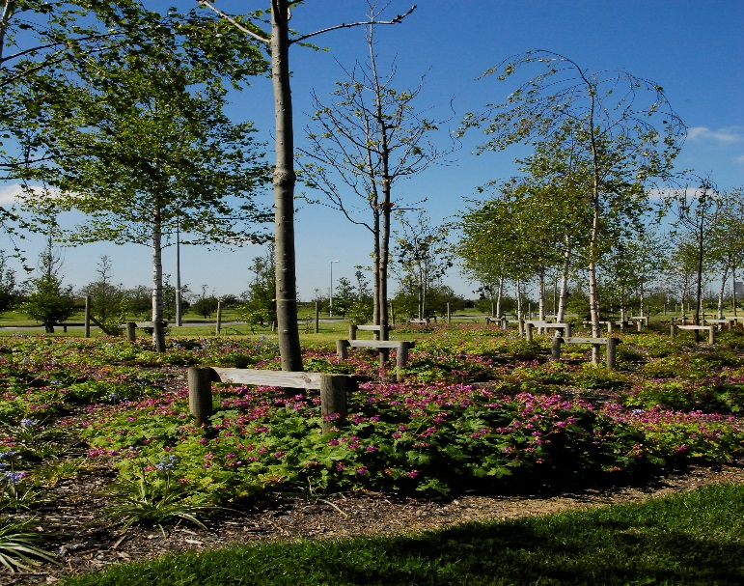
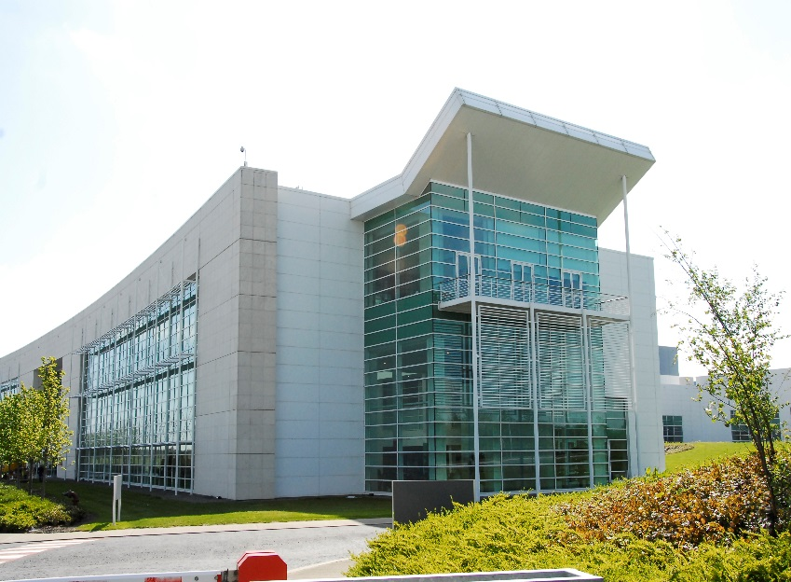
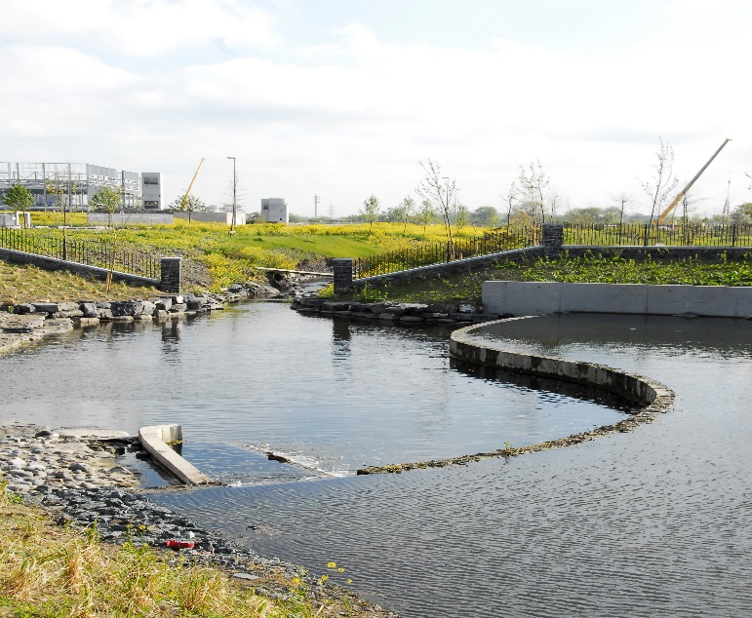
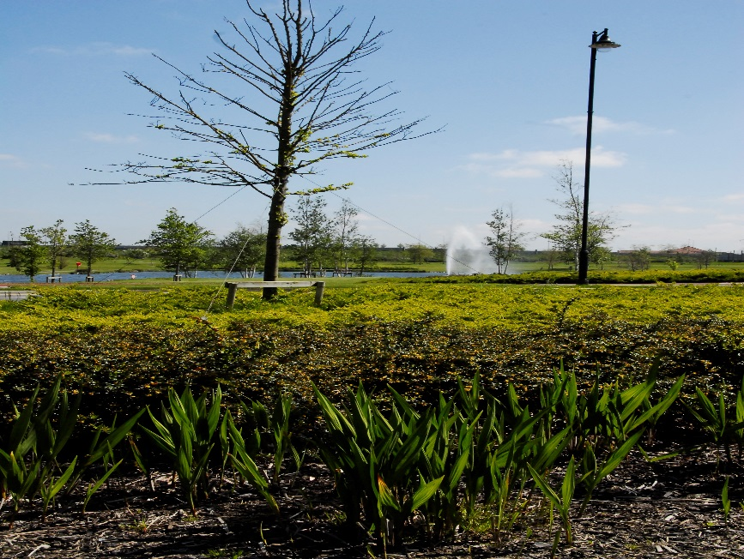
EETD SPC November 13th, 2019
Grange Castle Business Park
Notes:
Welcome to South Dublin. My name is……………………For the next 10 / 15 minutes or so I’ll give you a flavour of Grange Castle International Business Park

Slide 2
Grange Castle Business Park Overview
Cornerstone of Economic Development for SDCC
Construction of the Park commenced in 2001
200 Ha. Land
strategic business location for the County
Outer Ring Road construction Commenced
2005 - major supporting infrastructure
Wyeth (Now Pfizer) commenced
construction 2002, opened 2005
Current tenants: Pfizer, Microsoft, Takeda,
Aryzta, Microsoft, Grifols, Google – CyrusOne
( under construction) Amazon – S183 Site
> 3 Billion Euro invested in the Park - Client Companies/SDCC
Continuous Investment model
Original Business Park c.470 Acres almost at capacity
> 6000 Jobs, sustained and construction related

Slide 3
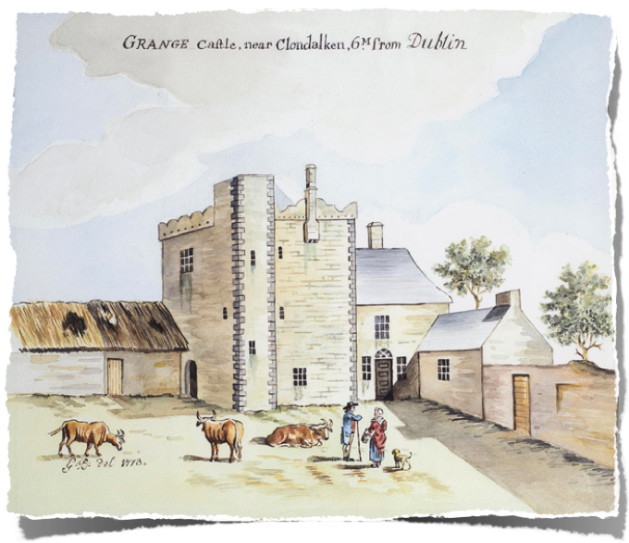
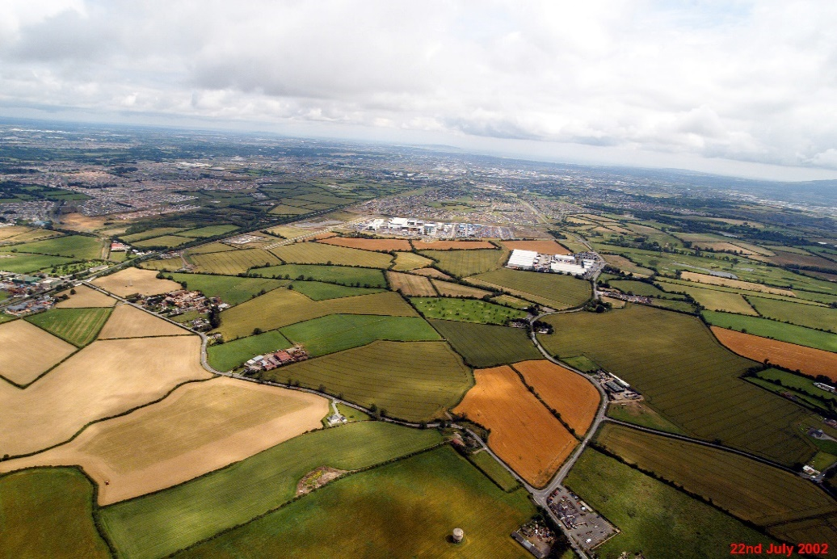
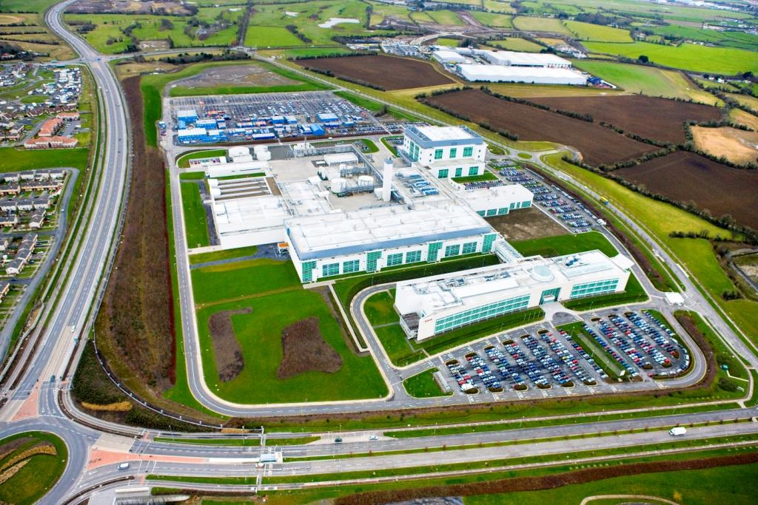
Grange Castle in 1773 – 2001 - 2018

Slide 4
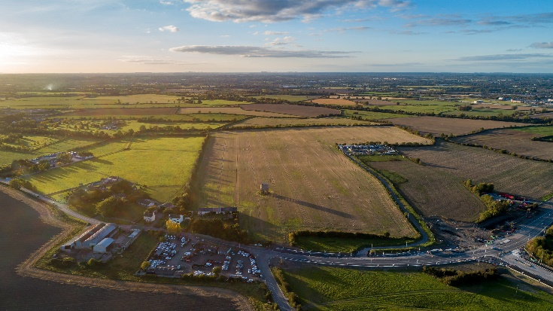
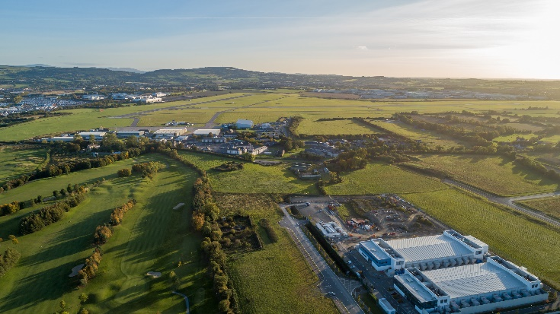
Grange Castle West – Strategic Vision
Lack of Availability of Serviced Greenfield Sites of Scale for FDI & Larger Indigenous Industry
IDA/EI Engagement: Existing & Emerging Demand
Limited Capacity in Other Business Parks to Accommodate Projects of Scale
Safeguard Future Investment & Employment Opportunities
Provides Opportunity to Identify a Coherent Land Block of Scale for Enterprise/Employment – Consistent with NPF & MASP
Proximity to SDZs, Existing Business Park & Corkagh Park Exemplifies Live/Work/Play Corporate Strategy in Practice
15 – 20 Year Managed Expansion of Enterprise/Employment Zoned Land

Slide 5
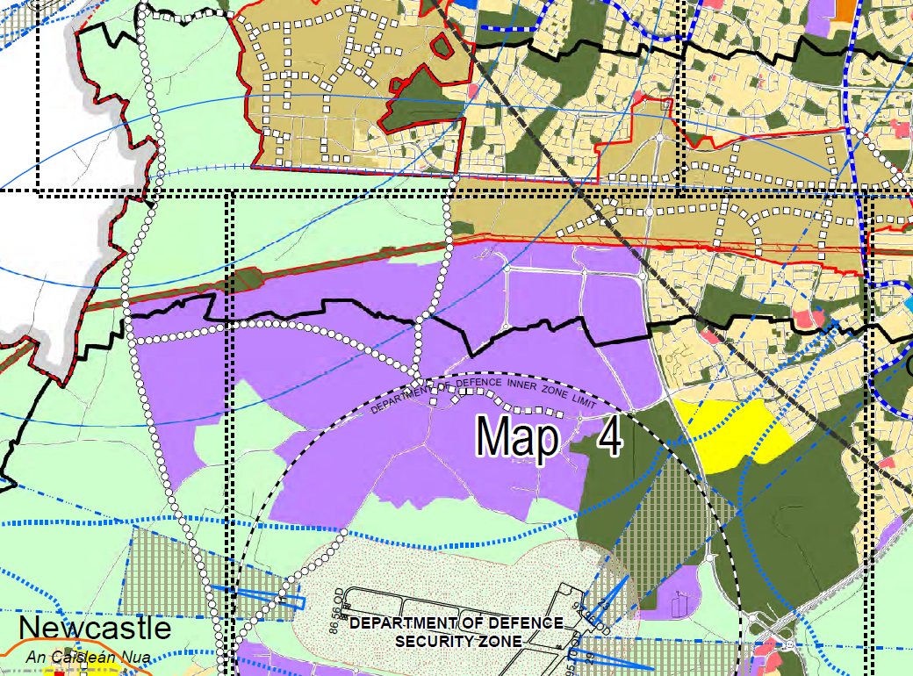
CONNECTED THINKING…
DEVELOPMENT PLAN ZONINGS
PLAY
LIVE
LIVE
WORK
PLAY

Slide 6
Grange Castle west -
Steps to secure expansion
2015 – 2018
strategic acquisitions: (Ballybane Pitch and Putt), Lands to West of R120
roads and services (Interxion access, Central Carriageway and Google Access)
R120 / Nangor Road Improvement Scheme, Aryzta entrance
Works commenced Q4 2017
Upgrades to internal park infrastructure, such as footpaths, cycle routes, pump stations, ducting etc.
Pocket Park Development at original Grange Castle
Grange Castle South Archaeological Works
Western Lands Feasibility and Infrastructural Plan lead to the rezoning of circa 500acres of land to the West in May 2018
Grange Castle West Access Road Part 8 Planning approved in December 2018
Tender issued
Utility enhancement: 220KV station in Grange Castle South

Slide 7
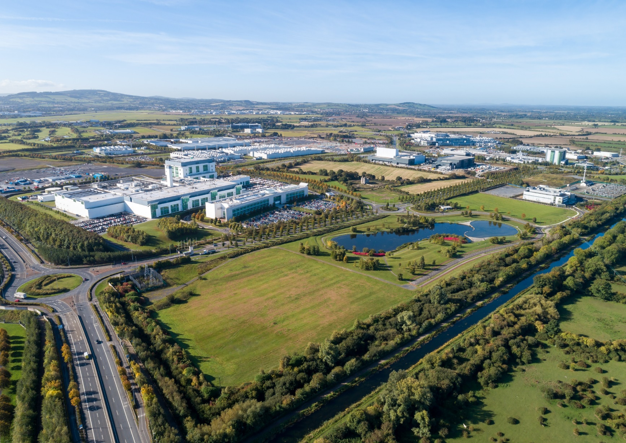
Grange Castle Today

Slide 8
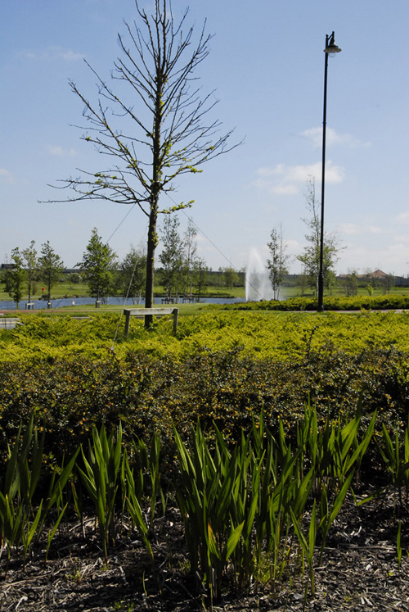
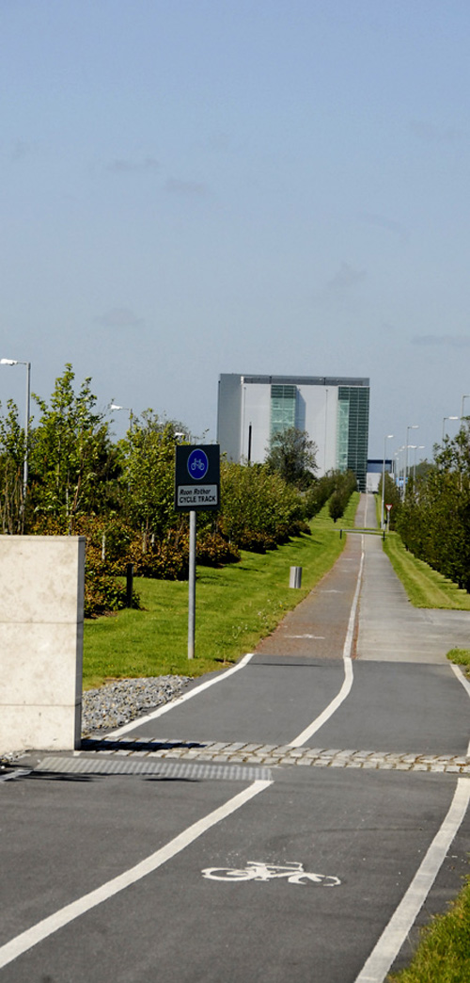
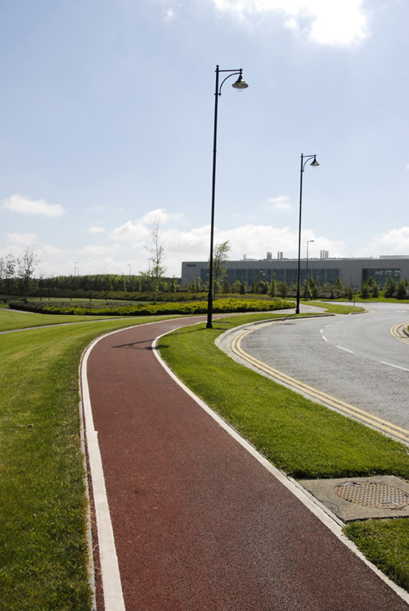
Grange Castle - Marketing
Excellent strategic &
accessible location
Connectivity to services & markets
Proven track record
Quality Environment
Park Management & Security
Competitiveness
Capacity for future growth

Slide 9
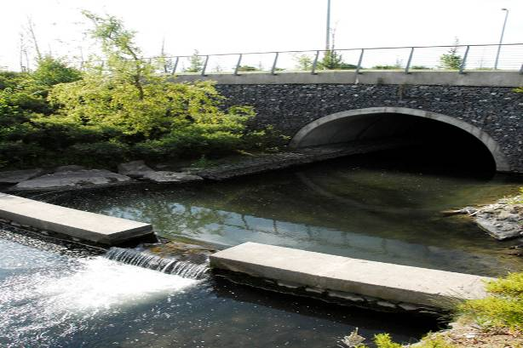
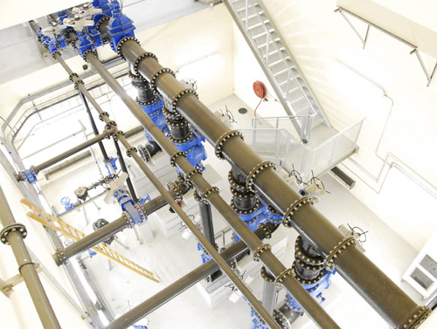
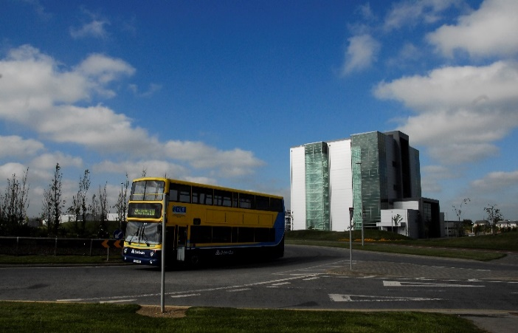
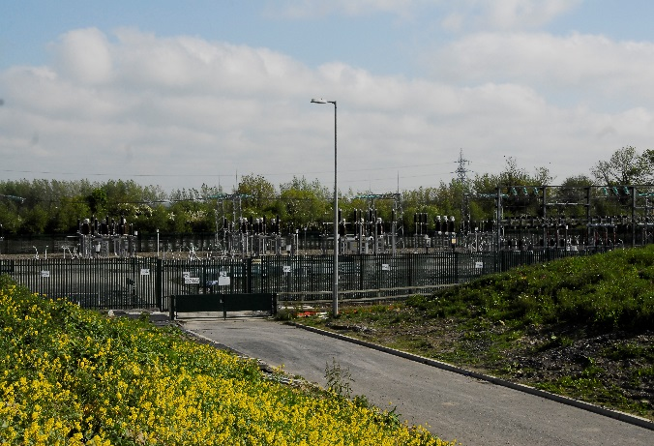
What Services are Provided
Plug in serviced sites with future proofed capacity…..
Roads
Water /Drainage
Private Pump Station
Surface Water Drainage
Bus Terminus/Rail
ESB 110kv substation with 220Kv upgrade underway
Gas AGI
Duct Infrastructure -T50 fibre network adjacent

Slide 10
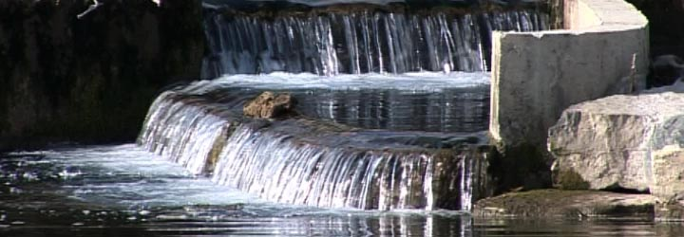
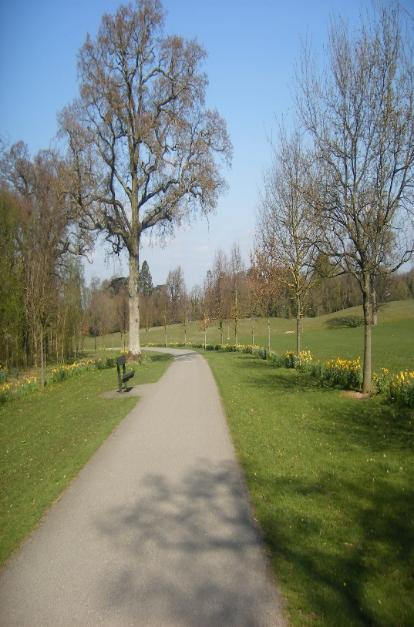
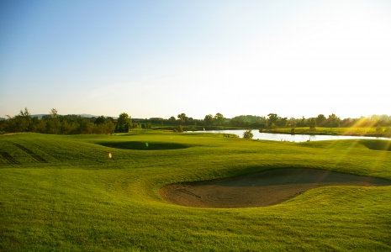
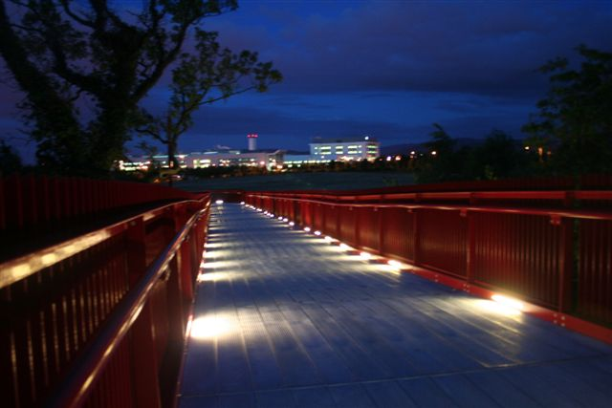
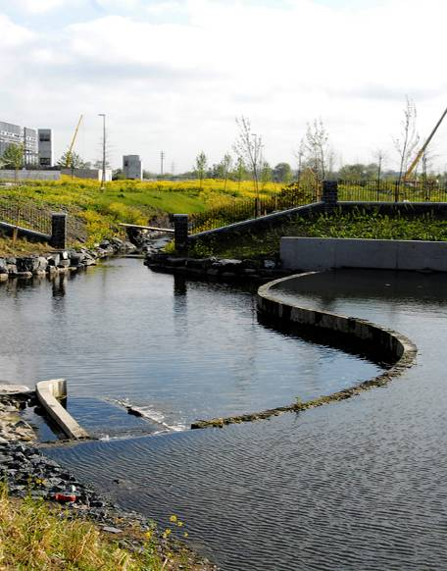
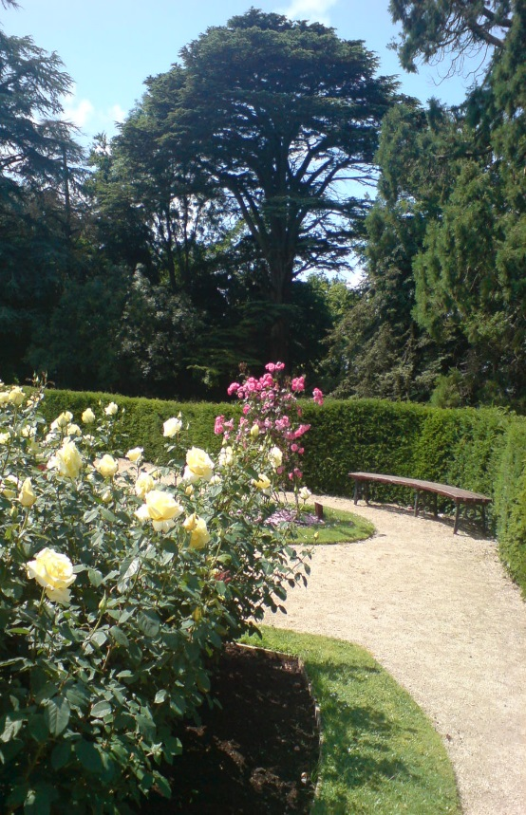
CONNECTED TO
AMENITIES
Grand Canal Way
River Griffeen/Park
Weir
Attenuation Lake
Pocket Park
Corkagh Park
Grange Castle Golf Club

Slide 11
Grange Castle Conclusion
Employment Centre of scale
Large young population
Optimum location
High End quality Jobs
Construction Jobs and materials
Managed and Owned by SDCC
International reputation
Capacity for future growth

Slide 12
Collaborative approach

