Slide 1
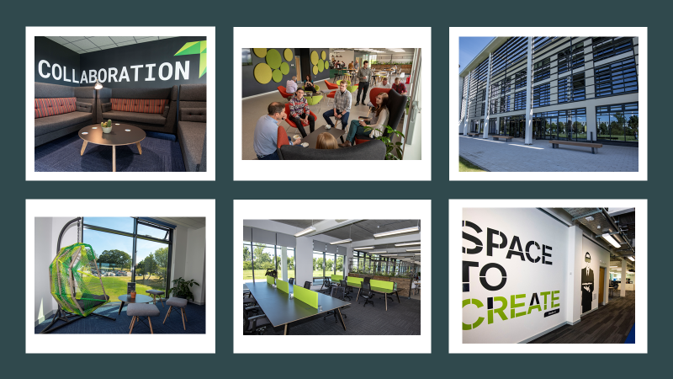

Innovation Centre Tallaght

Slide 2
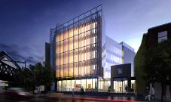
2017
South Dublin County Council procured a study for the development of new enterprise/innovation space with associated enterprise support services in the County

Slide 3
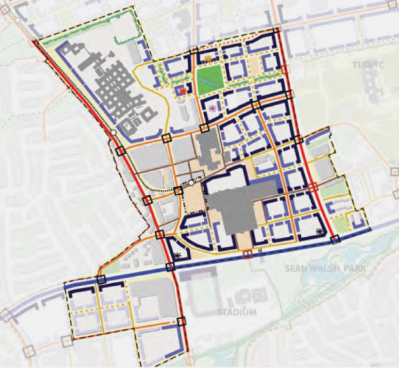
Report was presented to the members of the County Council in and its recommendations were endorsed following a number of briefings.
Primary recommendation is that a 3,000 sq. metre enterprise/innovation space be provided in the County.
    Preferred location for an innovation/enterprise space based on criteria within the report is the Tallaght Corridor, i.e., between the ITT ( now TU Dublin, Tallaght Campus) and Tallaght University Hospital.
Urban block plan of the proposed new development area, with the yellow Asterix depicting the newly proposed innovation centre

Slide 4
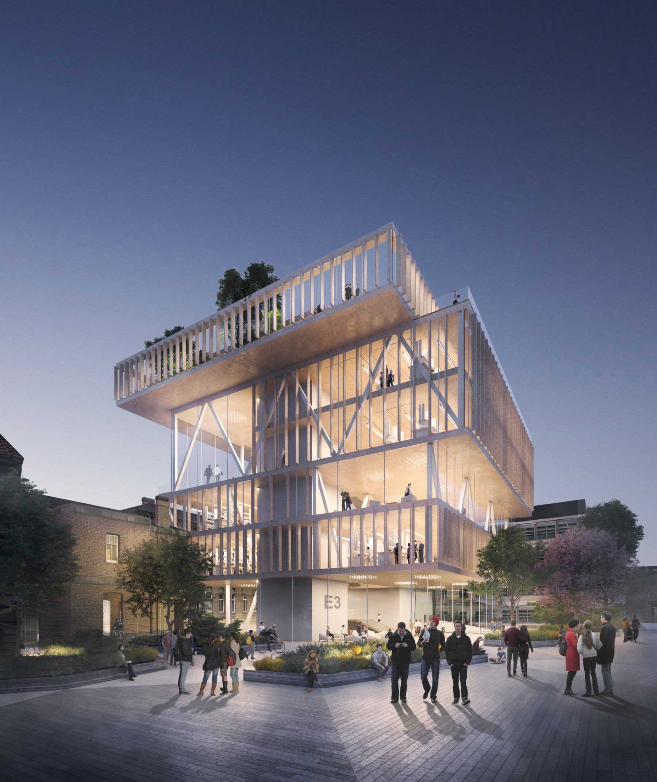
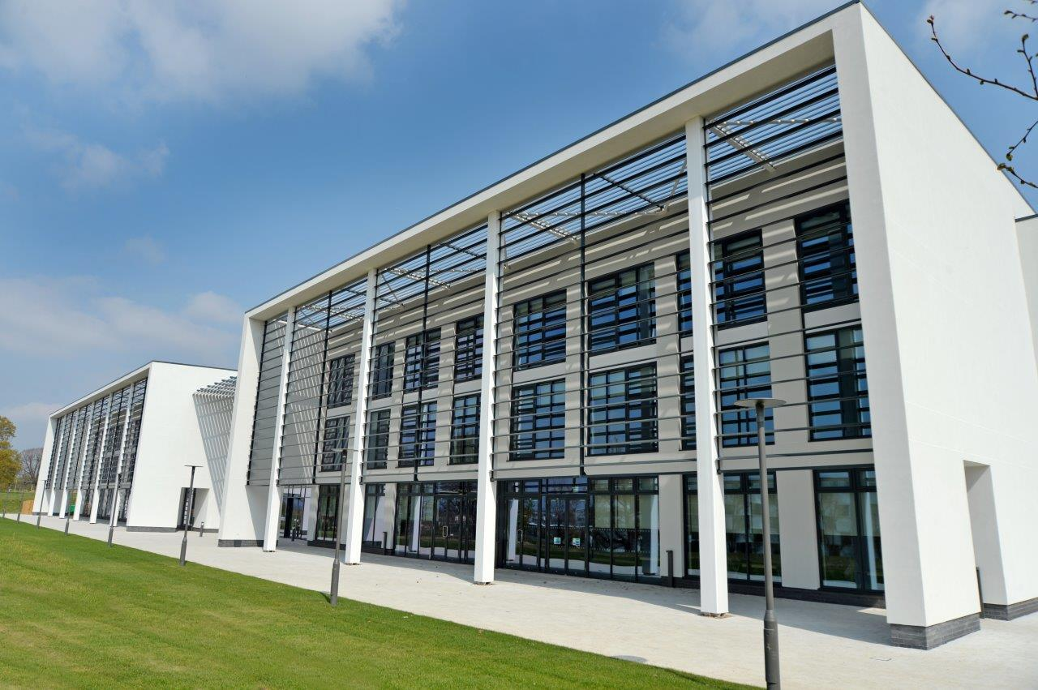

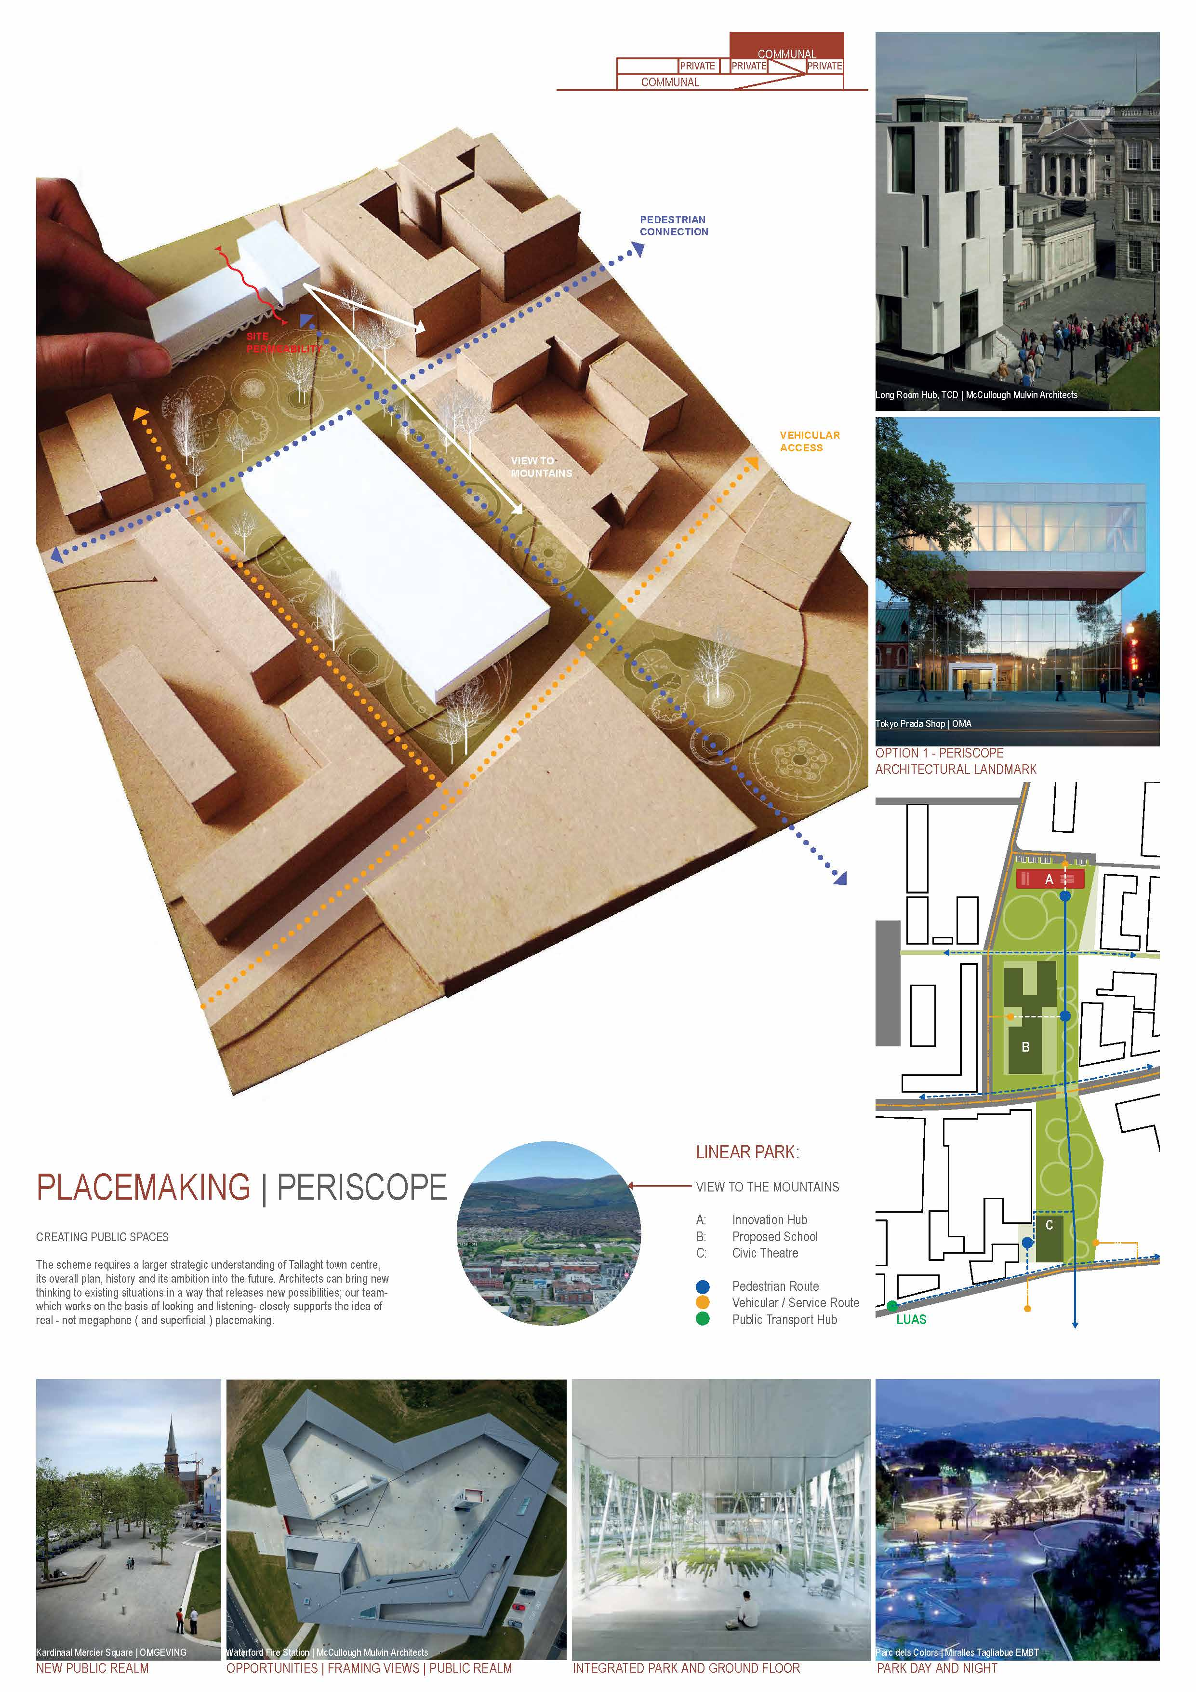
McCulloughMulvin Architects
Learning Foundry TCD
2019
Sought tenders on OJEU for :-
Project Advisor and Centre Management Team and following evaluation process selection of Oxford Innovation was completed in August and appointed September 2019
:
Architect-led Design Team and McCulloughMulvin Architects appointed October 2019
SDCC / Design Team Meetings commenced in November 2019
Progressing delivery through Planning and subject to same, to construction stage in 2020.
Notes:
Oxford Innovation has an outstanding track record of success in incubating and accelerating high growth businesses through our network of Innovation Centres, providing the provision of specialist coaching services and funding support through our established investor networks.
With over thirty years of experience, the Oxford Innovation network continues to thrive and help in the development of businesses all over the UK. From children’s bionic arms to space exploration, Oxford Innovation has provided the community, network and knowledge to accelerate their customer journey.

Slide 5
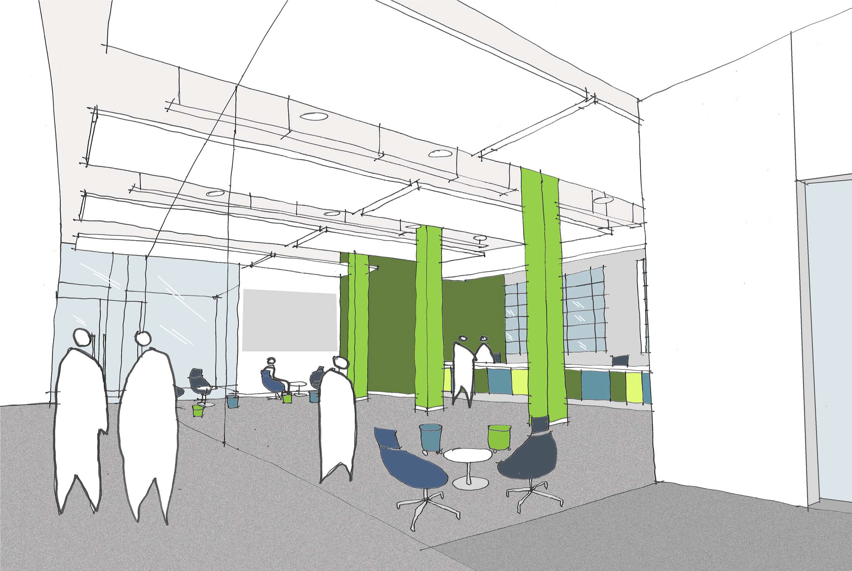
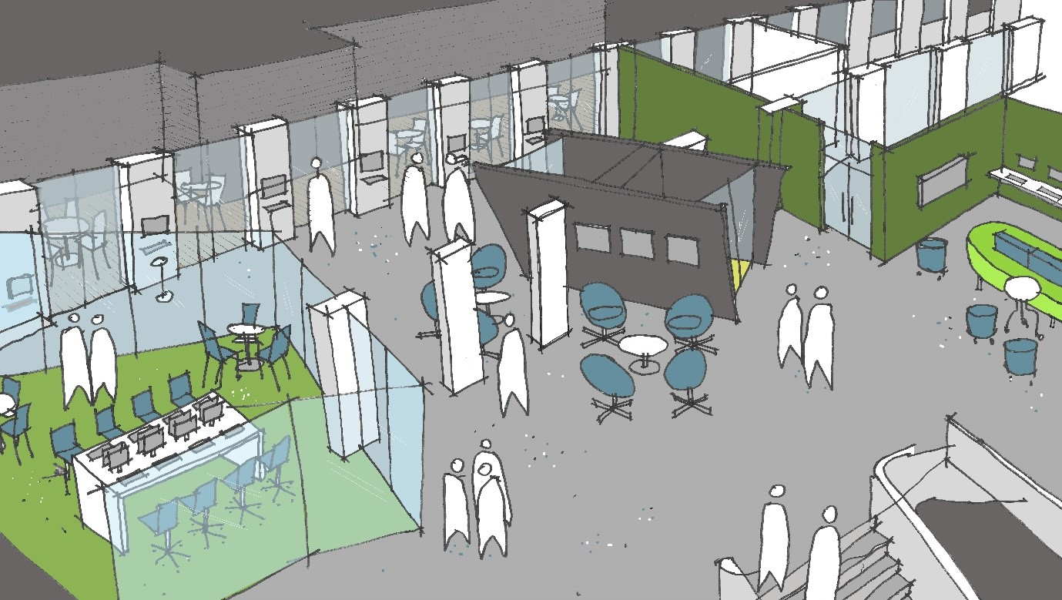
Vision for Innovation Centre Tallaght
Flexible space for Start-up and Scale-up companies while also supporting Community Development within the centre
Ensure that the centre is an economic development catalyst for South Dublin
Design features into building design and brand to aid community development and drive aspiration and entrepreneurial culture

Slide 6
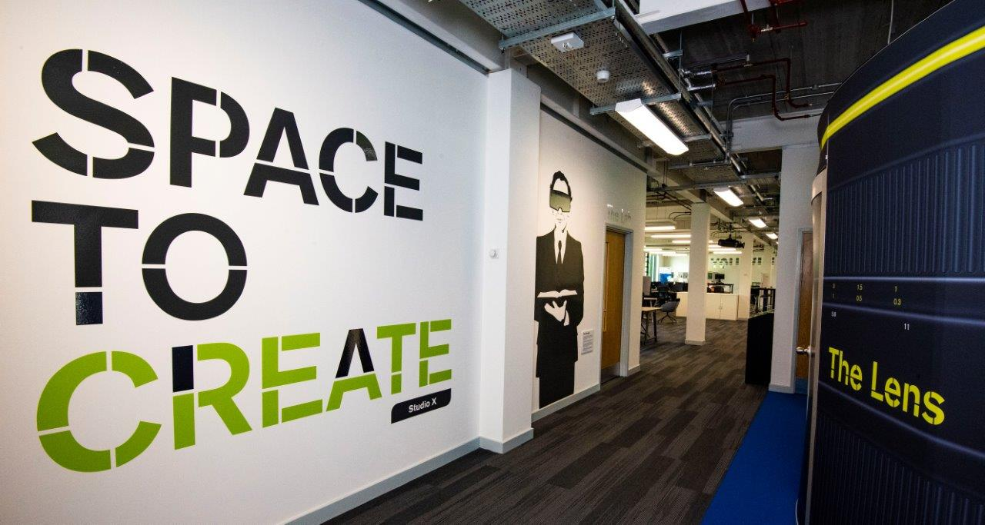
OBJECTIVES
“.. South Dublin…….A COMMUNITY OF BUSINESSES…”
Support enterprise & innovation culture.
Attractive space for innovative entrepreneurs to locate in SDC.
A “hub” for innovation in the County.
On the map as “business destination”
Retain and embed supply chain of innovators.
“..Maximise productivity growth…”

