Slide 1
Corporate Plan
2020-2024

Slide 2
Outline
Key achievements under the current plan
Current operating environment
Implementation and Monitoring

Slide 3
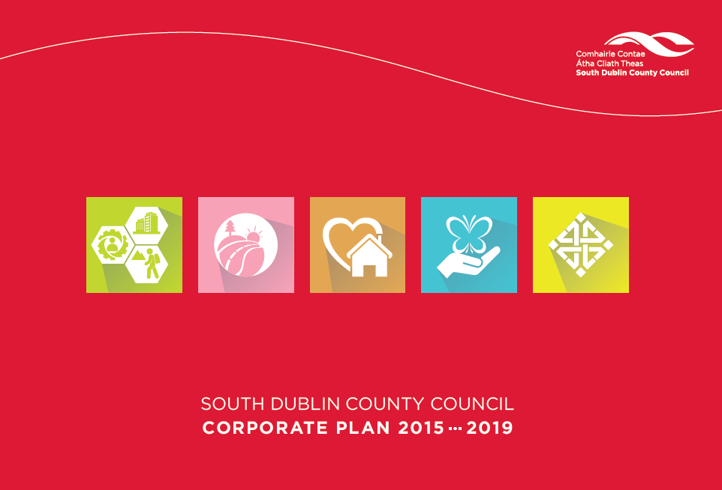
Commitments in 2015-19 plan
–
Did we deliver?

Slide 4
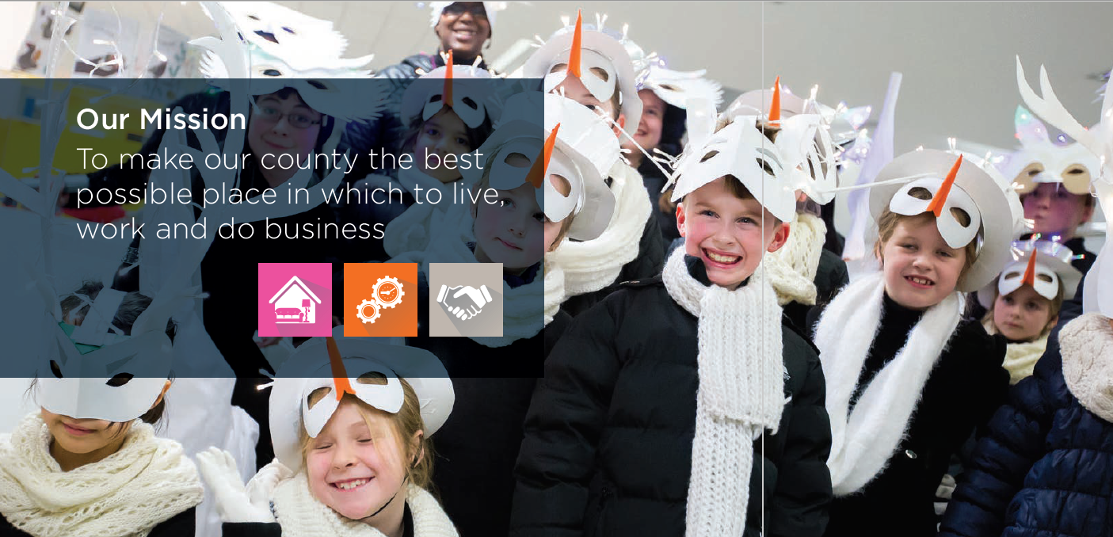

Slide 5
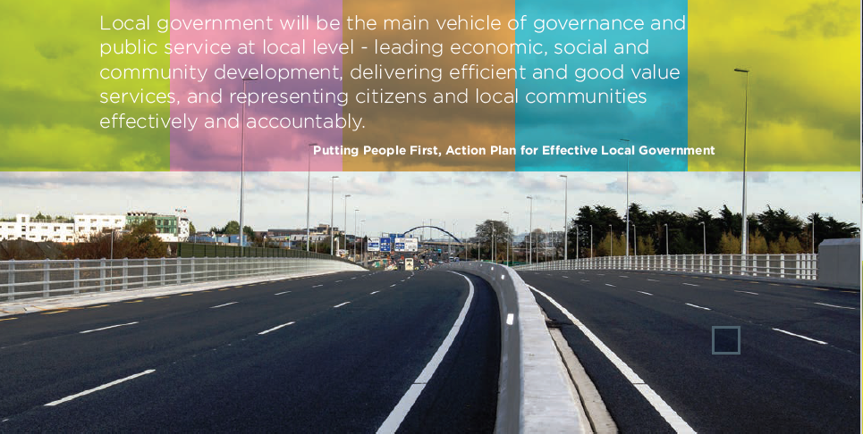

Slide 6
1. Corporate Plan Achievements 2015 – 2019?
Delivery of:
Strategies and Plans
Programmes
Infrastructure
Events & Festivals
Systems improvements

Slide 7
Corporate Plan Achievements 2015-19 :
Strategies and Plans implemented
Dublin Regional Enterprise Strategy 2017-2019
Library Development Plan 2018-2022
Tourism Marketing Strategy
Local Economic and Community Plan 2016-2021
Anti-Social Behaviour Strategy
Joint Policing Committee 2017- 2022 Strategic Plan
Climate Change Action Plan 2019 – 2024
County Development Plan 2016-2022
Road Safety Strategy for 2016-2020 and Road Safety Together Working Group
Arts Strategy 2016-2020
SDCC Disability Accommodation Strategy and Disability Accommodation Committee
Integration Strategy
Healthy South Dublin County 2019 - 2022

Slide 8
Corporate Plan Achievements 2015 – 2019 :
Programmes developed
Food Academy
Accelerate Programmes
Healthy South Dublin under Healthy Ireland
South Dublin Age Friendly initiatives
Summer Projects/Camps
First Marathon Kids School Programme
Tidy Town Groups & pride of place supports
Supports and training to Community Centre Management Boards
South Dublin County Education Bursary Awards
Connecting for Life Dublin South- the Suicide Prevention Action Plan 2018-2020
Coach training programme
Community Safety Booklet
Community Infrastructure Fund
Community Initiative Fund
Public Realm Minor Improvement Works Programme
Living with Trees - SDCC’s Tree Management Policy and Programme
Green Flags in parks
Programmable Audio Devices for litter and waste enforcement
South Dublin Canvas pilot
River clearing programme
Green Schools Programme
‘€300k Have Your Say’ Participatory Budgeting initiative
2 Irish language Schemes
Network of Enterprising Women in South Dublin (NEWS)
New Local Action Group for Dublin Rural areas
Business support helpline
Global Garden Project

Slide 9
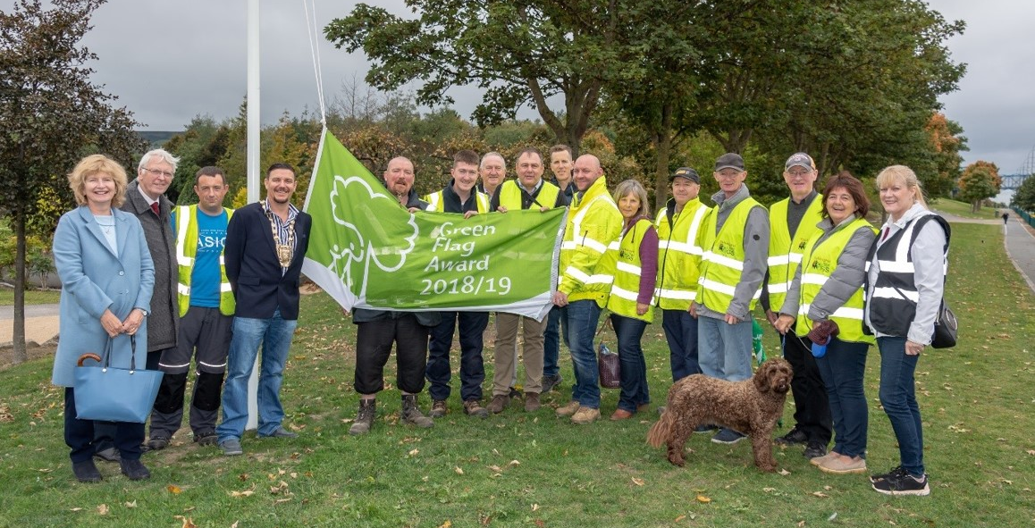

Slide 10
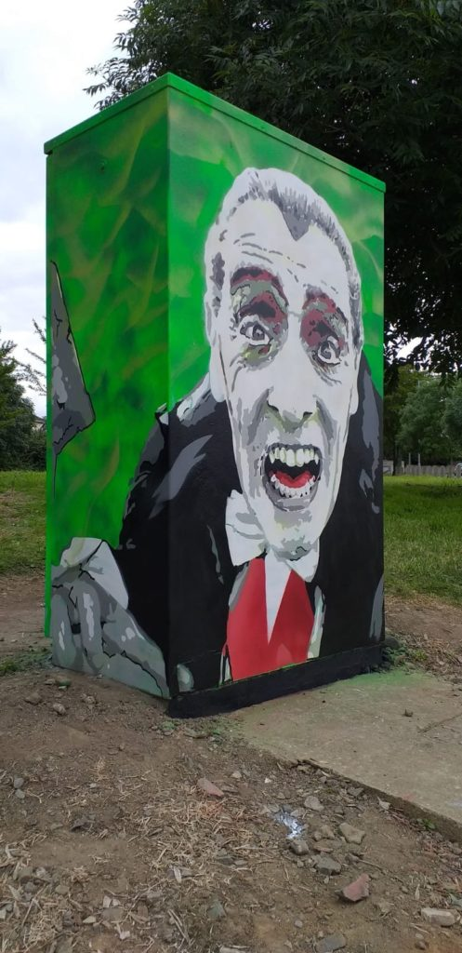
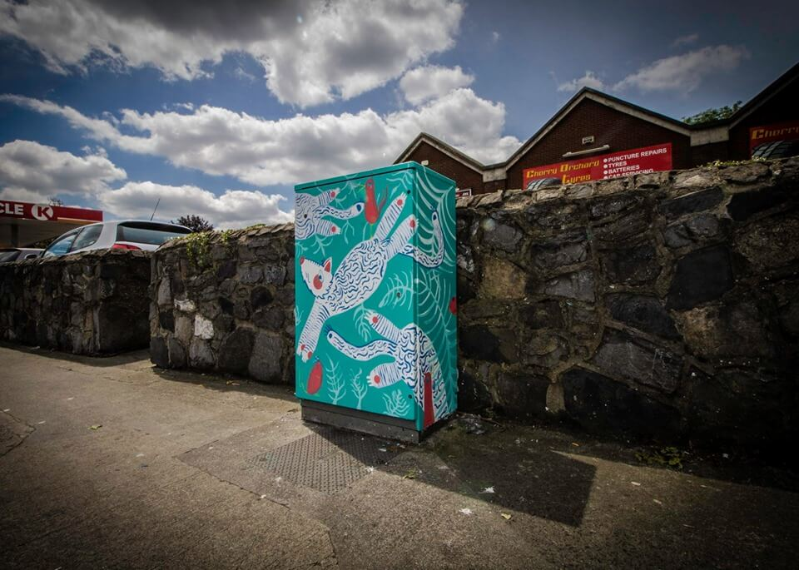

Slide 11


Slide 12
Corporate Plan Achievements 2015-19 : Infrastructure delivered
3rd Stand, Tallaght Stadium completed, 4th Stand design & Western Stand improvements
Grange Castle clients expansion / development Interxion, Grifols, Microsoft and Takeda; Amazon Data Services and Interxion Ireland and Grange Back up Power; CyrusOne Datacentre Holdings
Grange Castle West Infrastructure Masterplan
Tallaght Innovation Centre
North Clondalkin and Tymon libraries
Digital hub in Palmerstown
Dublin Mountains project ABP hearing & response
Clondalkin Round Tower Visitor Centre
Grand Canal Greenway to Hazelhatch - part of the Dublin Docklands to Shannon Harbour Greenway
Grand / Royal Canal Loop study
Rathfarnham Castle Stables Tourism / Retail opportunity
Liffey Blueway Study
Corkagh Park / Camac Valley Tourism cluster study
Dodder Valley Greenway project
Public Water fountains
Public Lighting Improvement LED upgrade Programme
Local Housing Infrastructure Activation Fund – (€27 m) Celbridge Link Road and Tandy’s Lane Park
Way-Finding signage
Cycle lanes
€3 m from Urban Regeneration and Development Fund for projects in Tallaght and feasibility study for Naas Road
Tallaght District Heating project
R120 Adamstown Road Improvement Scheme
Celbridge link road
Belgard to Cookstown link road
Tallaght Transport Hub
Built Heritage Investment Scheme
Village Enhancement Works programme
Local Neighbourhoods Improvement Scheme
Social Housing Construction programme
Lucan swimming pool
Adamstown School Sports Hall & Community facility
N81 Landscape Improvement Scheme
Roundabout Sponsorship Scheme
River Poddle, Balycullen and Camac Flood Alleviation Schemes
Playspace programme 43 delivered (49 by year end)
Teenspace Programme 5 projects in design stage
Ballwall at Griffeen
Two sand based pitches in Tymon Park & Lucan Athletics track
Hermitage Frame Football all weather pitch
Pavilions programme
Ballymount Fishing Lake completed
Business Support Fund Area Improvement works
Surface Water Schemes
River Dodder bank stabilisation
Equine Facility at Ballyowen Park
Heritage tracks and trails
Adamstown - by end 2018 – 2,000 units now complete, 1,499 active permissions
Clonburris SDZ Planning Scheme Adopted
Local Area Plan for Tallaght

Slide 13
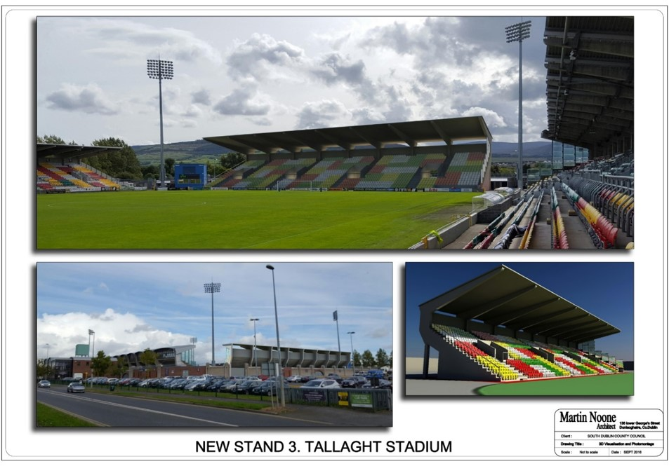

Slide 14
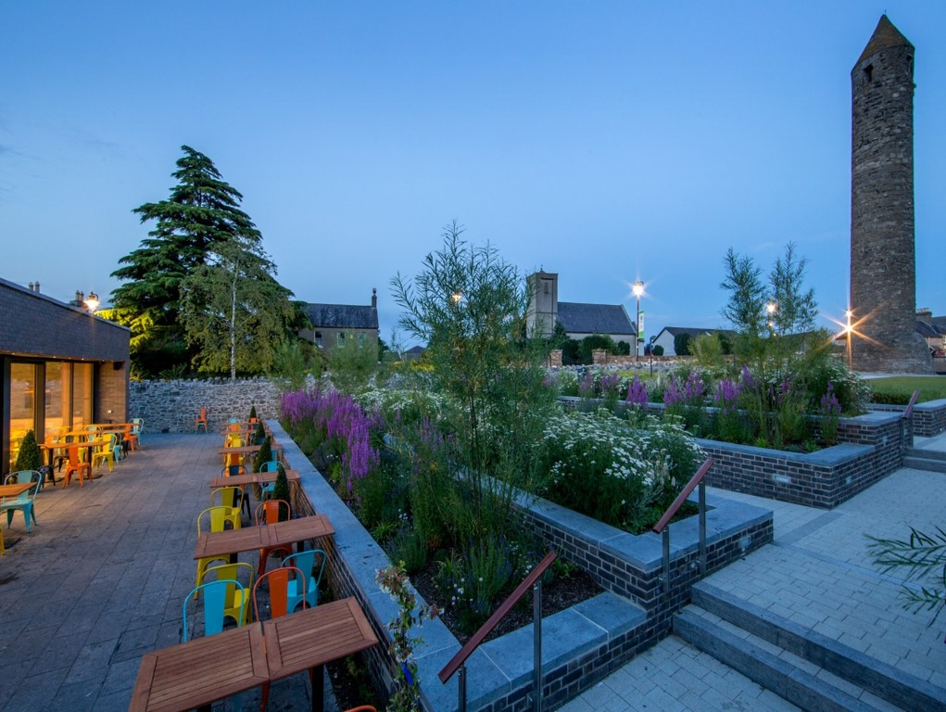

Slide 15
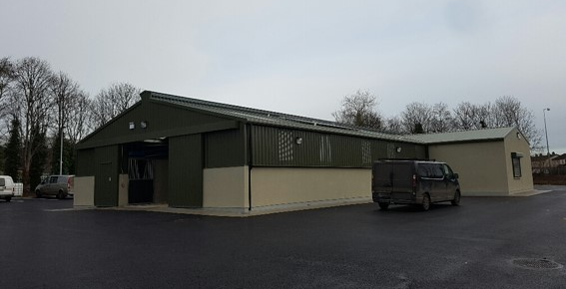

Slide 16
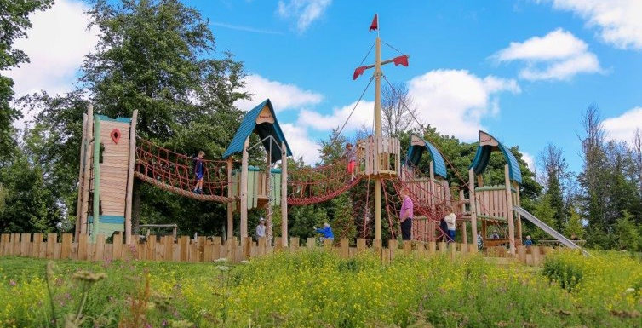

Slide 17
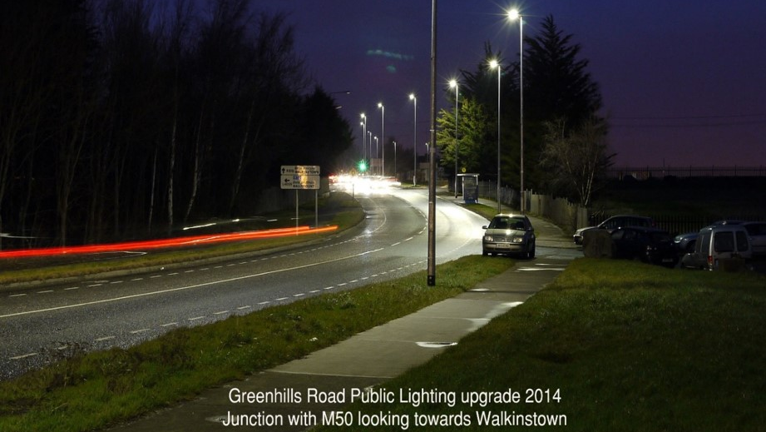

Slide 18
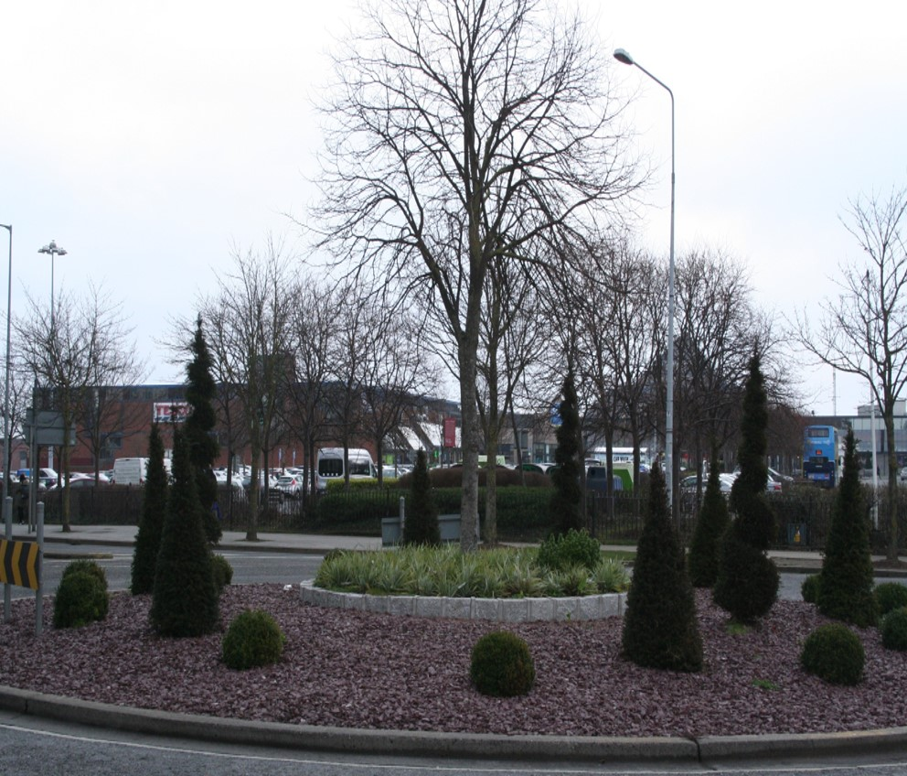

Slide 19
Corporate Plan
Achievements 2015-19 :
Events & Festivals
Red Line Book Festival
Summer Stars Reading Adventure
Gaelforce Dublin
Bealtaine Festival
Host to the UEFA European U17 Championship
Engineers Week
First Fortnight Festival
National Accessibility week
Flavours of South Dublin Intercultural Festival
Tallaght Stadium events programme
South Dublin Amateur Sports Awards
Community Endeavour Awards
#YourCouncilDay
Dublin Community Clean-up Day
Local Enterprise Week
National Tree Week
National Spring Clean
Seachtain na Gaeilge Átha Cliath Theas
Cruinniú na nÓg
South Dublin Chamber Business Awards
2016 Centenary Programme
Social Inclusion Week
Health & Wellbeing Week
European Week against Racism
Eco Week
Science Week
TedX events
Storm Emma!

Slide 20
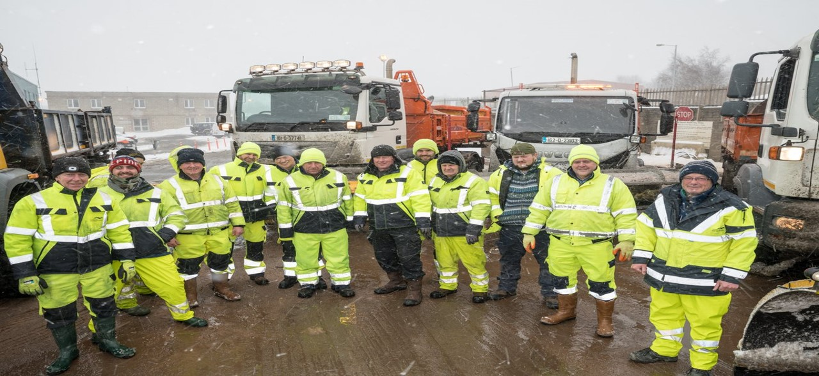

Slide 21
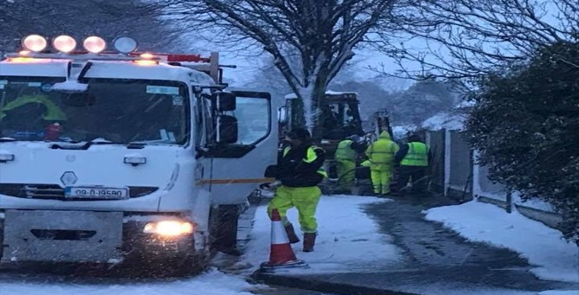

Slide 22
Corporate Plan Achievements 2015-19 :
Systems improvements
New Integrated Housing Computer System
New Council website
New intranet
MyDoorStep.ie
Affordable Homes portal
Library Management System
HR, Payroll and Superannuation Shared Service - MyPay
Online Consultation portal
eRecruitment
County Development Plan website and consultation
Mental Health mobile app

Slide 23
2. Current Operating Environment
Legal & Regulatory
Financial
Political
Socio-economic
Technology
Environmental
Governance

Slide 24
Operating Environment:
Legal & Regulatory
  Local Government Reform Act 2014
  General Data Protection Regulations
  Data Protection Act 2018
  Irish Human Rights and Equality Act Section 42 - direct implication in the Corporate Plan
  Lobbying Act 2015
  Protected Disclosures Act 2014
  Children First Act 2015
  EU Procurement regs

Slide 25
Operating Environment:
Financial
  Annual Budget
  Capital Programme
  Local property tax
  Commercial rates revaluation
  Procurement EU regulations
  3 year Corporate Procurement plan
  Local Government Strategic Procurement Centre & Local Government Operational Procurement Office
  Public Spending Code – annual Quality Assurance reporting
  Public Services Stability Plan commitments
  Brexit

Slide 26
Operating Environment:
Political
  Local electoral area changes to 7 LEAs and boundary changes
  New Council – 17 new councillors and new ruling group
  Upcoming by-election for Dublin West
  New regional government structures– three Regional Assemblies
  Increasing participative democracy and accountability through LCDC and PPN, and SDCC Participative Budgeting initiative
  Stronger role for Corporate Policy Group

Slide 27
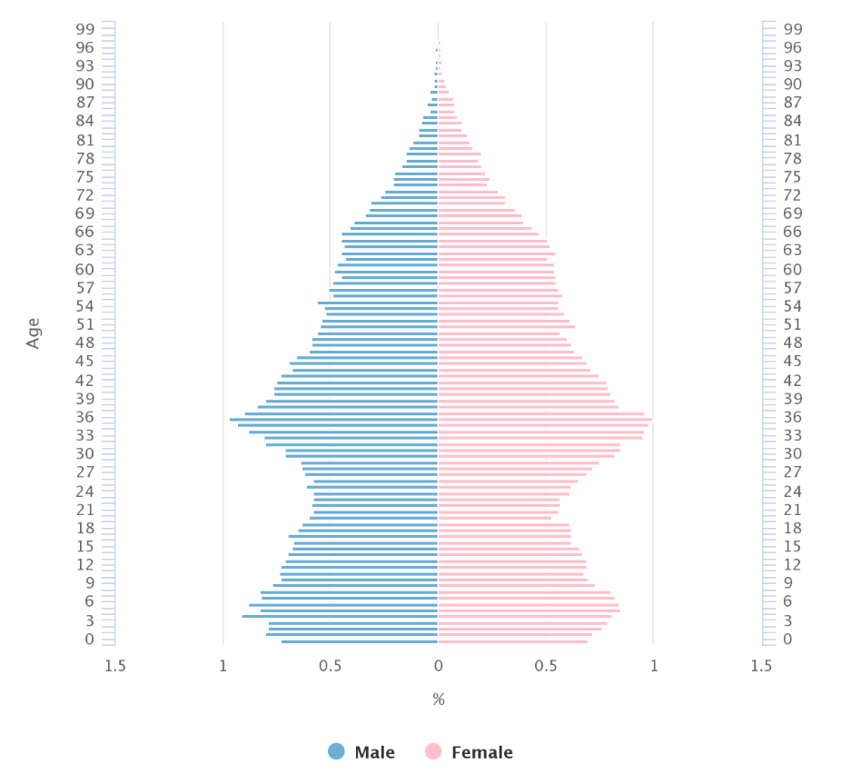
Operating Environment: Socio-economic
Population by age for South Dublin County 2016 Census
278,767 Population 2016 Census (5% increase on 2011) 3rd most populous county in the state

Slide 28
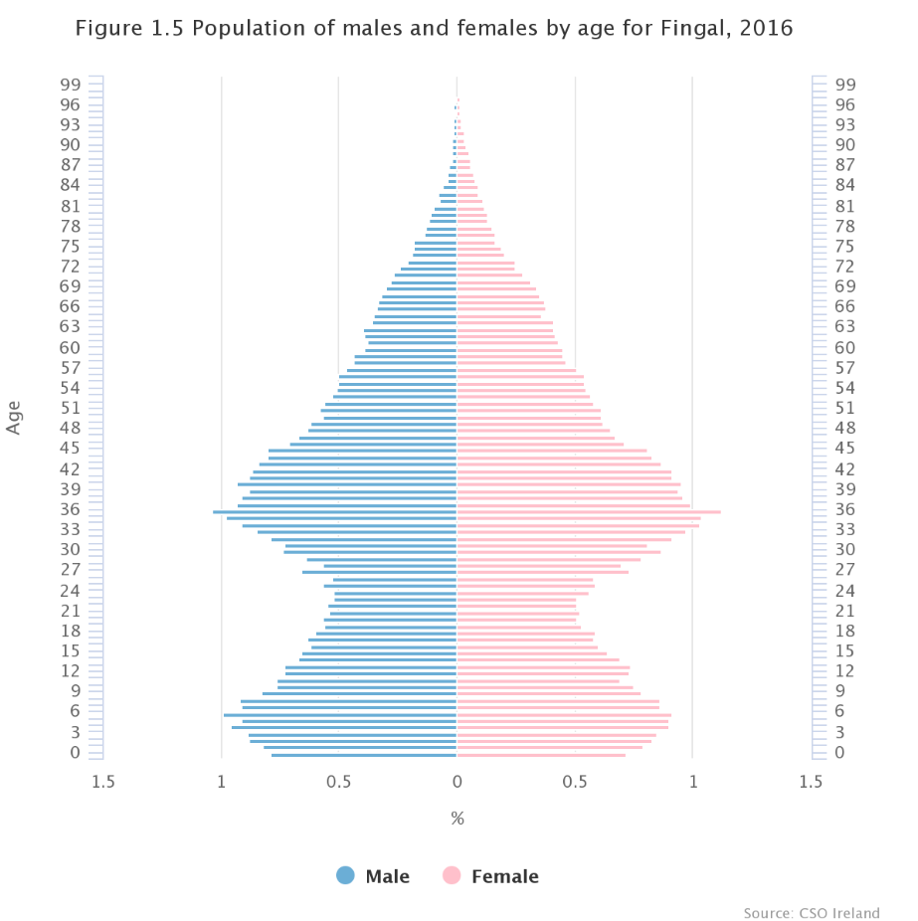

Slide 29
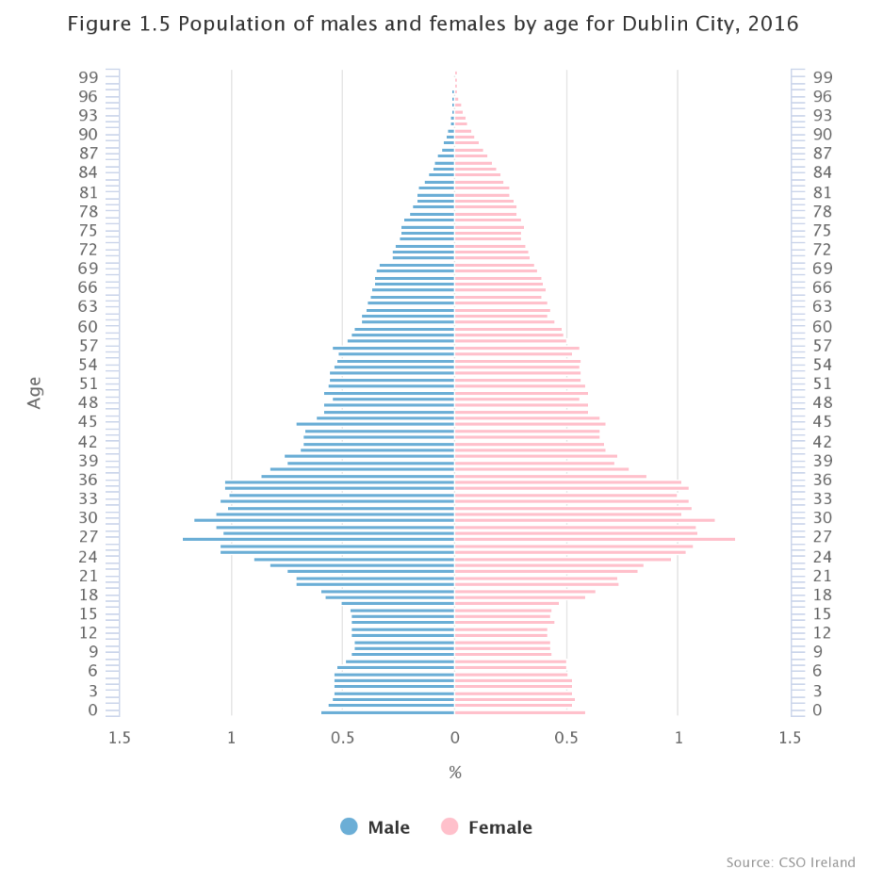

Slide 30
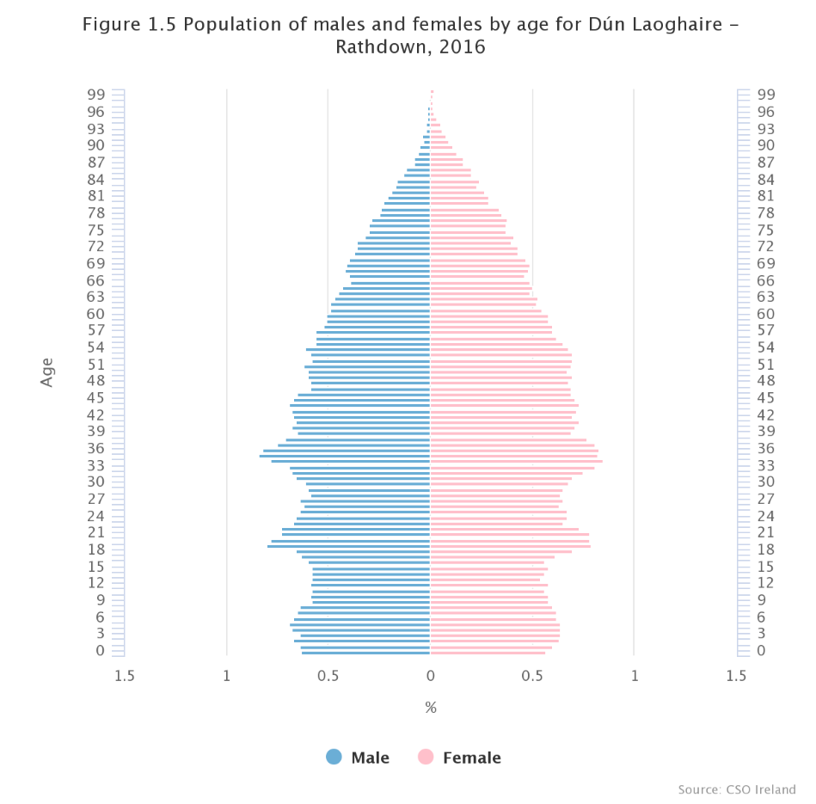

Slide 31
Operating Environment:
Socio-economic
Only 25.6% of all commuters in the county use public transport, cycle or walk
More people work in the county than leave it for work (84,627 people work in the county between those who live in and those who commute into South Dublin)
South Dublin has the smallest %’age of children cycling to school in both primary and second level age categories and the 2nd highest going to school by car in both categories
2nd highest home ownership in the Dublin Region at 68%
Total housing stock 98,387, of which vacant households (excluding holiday homes) numbered 3,495

Slide 32
Operating Environment:
Technology
  Cyber security
  Digital services
  e-Payments
  Mobile applications
  Social media
  Smart Dublin
  Open Data
  Document Management
  Local government ICT Strategy implementation Plan
  Local Digital Strategy in preparation

Slide 33
Operating Environment:
Environment
  Climate Change Action Plan – Targets:
        33% improvement in the Council’s energy efficiency by 2020
        40% reduction in the Councils’ greenhouse gas emissions by 2030
        To make Dublin a climate resilient region, by reducing the impacts of future climate change -related events
        To actively engage and inform citizens on climate change
  EU 2020 Energy Targets
        20% reduction in greenhouse gas emissions by 2020
        20% energy efficiency by 2020
        20% of the EU’s energy consumption to be from renewable sources by 2020
  Increasing number of extreme weather events
  Eastern - Midlands Regional Waste Management Plan 2015/2021
  Irish Water service level agreement
  Sean Walsh Park: lake cleaning v. ‘wetlands’!

Slide 34
Operating Environment:
Governance
  National Oversight and Audit Commission
  New Audit Committee
  Local Government Auditor
  Local Authority Governance Framework
  Revised Code of Conduct for Elected Members
  Transparency International Ireland report
  Anti-fraud and Corruption policy
  Protected Disclosures policy
  Ethics Registrar & annual declaration

Slide 35
Implementation and Monitoring
Monthly management report
Annual budget
Annual service delivery plan and targets set
Performance management and development system
Risk assessment
Annual progress report on achievement of the corporate plan
Annual report
Performance indicator – baseline stats for 2019 in appendix

Slide 36
Thank you!
Please complete the online survey available at our website www.sdcc.ie

