Slide 1
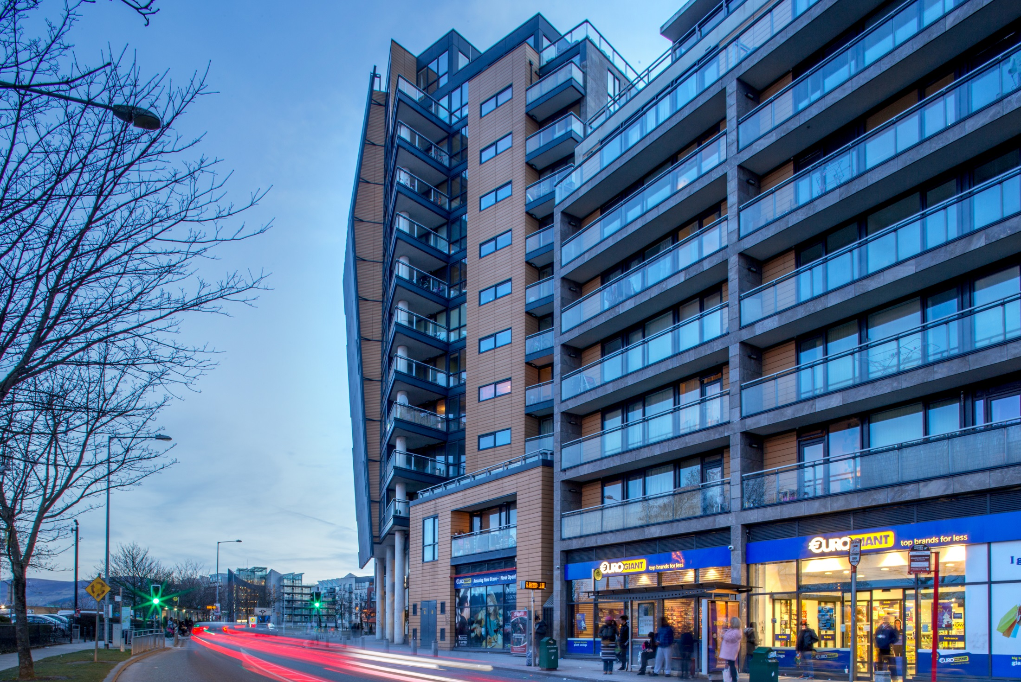

Land Use Planning & Transportation
Proposed Draft Tallaght Town Centre Local Area Plan
Public Consultation Briefing
November 2019

Slide 2
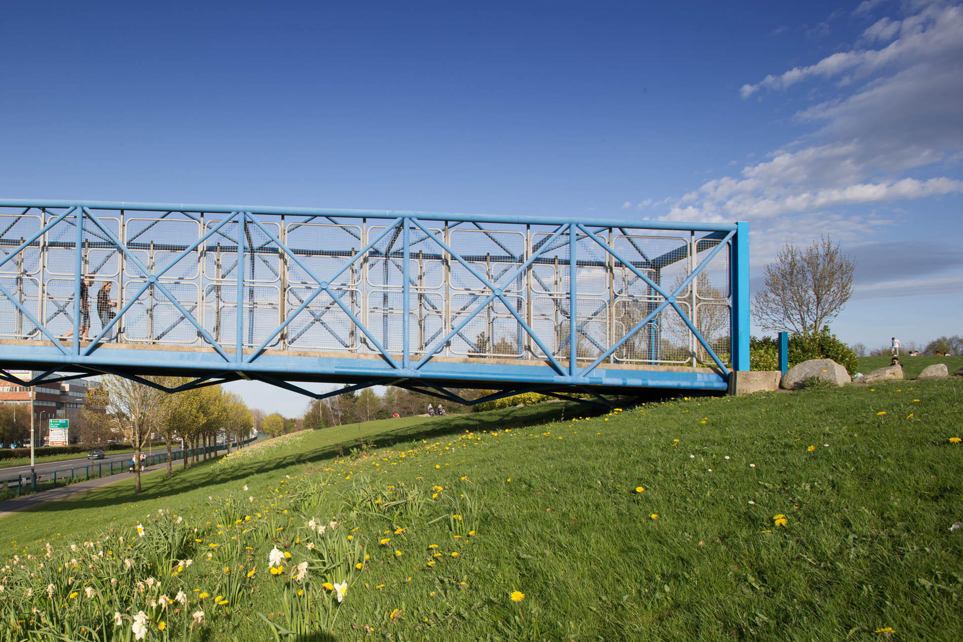
Contents
Process & Role of Elected Members
Public Consultation
Issues Raised
Key Challenges
Next Steps

Slide 3
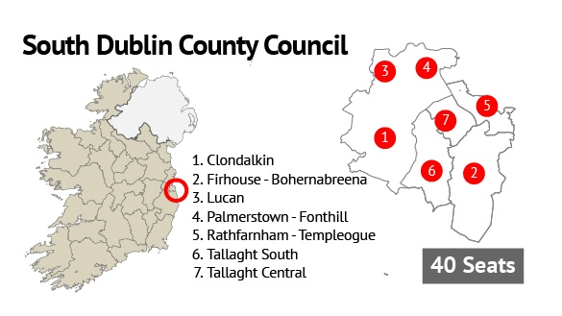
Timeframe & Elected Members Role
Stage | Timeframe
Draft Consultation (6 Weeks) COMPLETED | 12th September - 24th October
CE Report to Council (6 Weeks) | 5th December
Decision by Council (6 Weeks) Or | 13th January + 4 weeks: Adopted 10th February
+3 weeks (Assessments) | 3th February
Material Amendments Public Display (4 Weeks) | 3th February – 2nd March
CE Report to Council (4 Weeks) | 30th March
Decision (6 Weeks) | 11th May + 4 weeks: Adopted 8th June
* Indicative Timeline

Slide 4
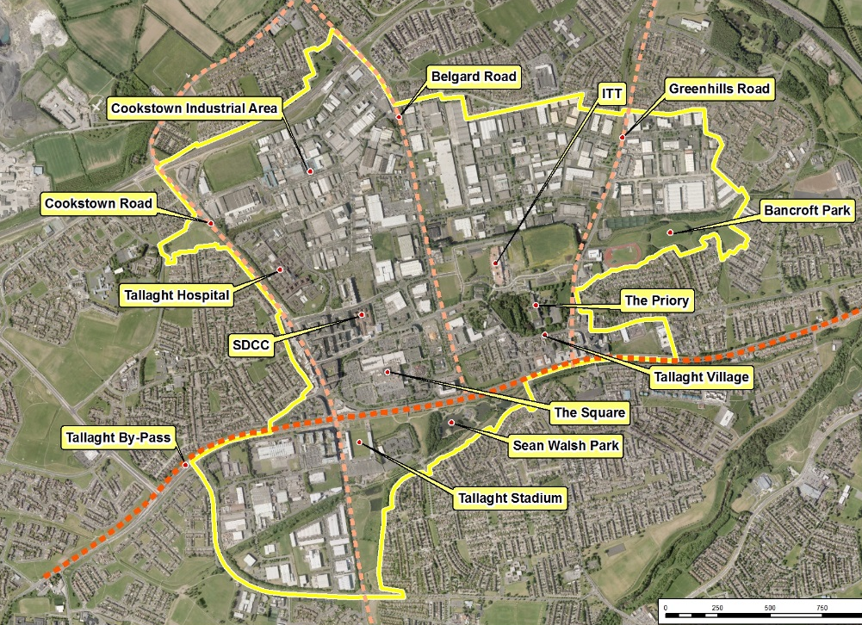
LAP Boundary
370 Hectares

Slide 5
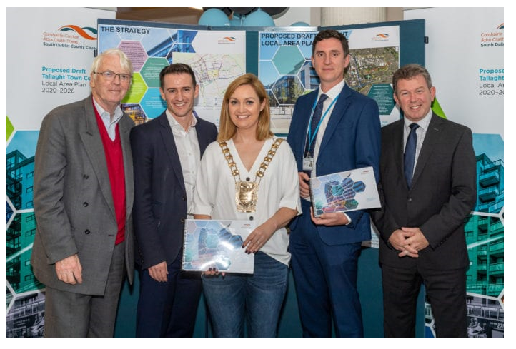
Public Consultation
12th September -
24th October
Publicly Launched on 12th September in County Hall
Public Information Sessions
4 afternoon and evening sessions held in Tallaght Library
1 – 1 Briefings
Planners available at the public counter to discuss Plan during consultation period
Community and Business
Presentations and Q&A sessions held
Strong turnout of community and business representatives at breakfast briefing facilitated by South Dublin Chamber
Social Media
Ongoing promotion of consultation on Twitter, Facebook, council website, etc. throughout the consultation period
Media
News of Draft LAP reported in local and national news

Slide 6
Summary of Submissions
49 Submissions
294 Issues
A total of 49 submissions were received raising issues in relation to the following:
Building Heights and Density of Development;
Housing and Tenure Mix;
Access and Movement;
Community facilities;
Implementation and Sequencing;
Open Spaces, Public Realm, Design and Materials;
Economic Development, Tourism and Retail;
Land Use and Urban Functions and changes;
Climate Change; and
Strategic Environmental Assessment - Environmental Report.
Submissions varied widely in support and opposition to the above elements of the Plan. Many recommendations were proposed.
Source of Submissions:
Landowners/Developers – 16
Statutory Bodies – 11
Individuals – 10
Community Groups – 9
Business Interests – 3

Slide 7
Summary of Submissions
49 Submissions
The 49 submissions were reviewed and broken down into multiple issues:
Neighbourhoods (46 times / 15.7%), particularly The Centre, Cookstown and The Village
Housing Mix (28 times / 9.5%)
Access & Movement (22 Times / 7.5%)
Community Facilities (19 Times / 6.5%)
Height and Built Form (19 Times / 6.5%)
Implementation and Sequencing (27 Times / 5.8%)
Public Realm & Open Space (15 Times / 5.1%)
Residential Development (15 Times / 5.1%)
Others: Density; Economic Development and Tourism; Land Use and Urban Functions; Urban Framework; Vision; Heritage and Conservation; Climate Change; Design, Built Form and Finishes; Strategic Environmental Assessment; Flood Risk; Biodiversity; Social Infrastructure Audit
294 Issues
Land use
Site specific
Viability / Deliverability
Consistency with National Guidelines
Family Homes
Filtered permeability
Transport Interchange
N81
Capacity for taller buildings
Consistency with National Guidelines
More compact growth
Quality public realm and spaces
Feature attractions
Flexibility in provision
Attract employment
Welcome climate change chapter
Quality design
Conserve Village character

Slide 8
Next Steps
Step 1
Complete
Public Consultation
12th September 2019
24th October
Step 2
Underway
CE Report to Council
5th December 2019
6 Weeks
Council Decision
13th January 2020
Council Meeting
Step 3
Approval (If No Material Alterations)
4 Weeks
February 2020
Step 4

Slide 9
Thank You
Questions

Slide 10

Proposed Variation No. 4 and 5 of the South Dublin County Development Plan 2016-2022
Strategic Policy Committee Meeting
November 2019

Slide 11
Overview
Variation No. 4 – Alignment of CDP 2016-2022 with the Regional Spatial and Economic Strategy (RSES)
Variation No. 5 – Outdoor Advertising Strategy
Timelines
Public Display – 7th of October 2019 to 4th November 2019 (4 weeks)
CE Report (in progress) – to be issued to Elected Members by 25th November 2019
December Council Meeting - CE Report to be considered

Slide 12
Key Issues Raised Variation No. 4 (RSES)
12 submissions received in relation to Proposed Variation No. 4
Consistency in terms of use of terminology
Reference to the preparation of a HNDA for all Dublin region
Alignment with national commitments on climate change mitigation and adaptation
Key Issues Raised Variation No. 5 (Outdoor Advertising)
10 submissions received in relation to Proposed Variation No. 5
Principle of Advertising Strategy generally accepted
TII recommendations regarding wording and reference to specific guidelines
Concerns raised regarding visual impact / clutter and type of advertisements displayed
Issues raised regarding removal / upgrade of existing signage in inappropriate locations

