Slide 1
A Place of Possibility in the of Tallaght

Slide 2
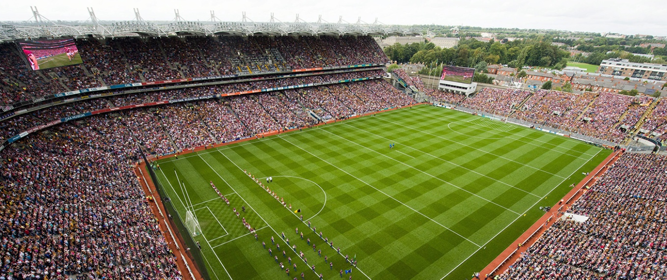
29% of Ireland went to the theatre in 2014. That's 1,332,550 people. That's more than inter-county GAA, basketball, tennis, cricket, and cycling events combined.

Slide 3
Entertainment on Your Doorstep
20 Years old Opened March 1999
55,000 tickets sold in 2019
70% SDCC Households
2 Spaces Studio (60) Main Auditorium (309)
Drama, comedy, music, dance, schools, families, panto, workshops.
Main Catchment is D24, D14, D16, D22, D12, D6w, D6
Also D8, D10, Lucan, Blessington, North Kildare, North Wicklow.

Slide 4
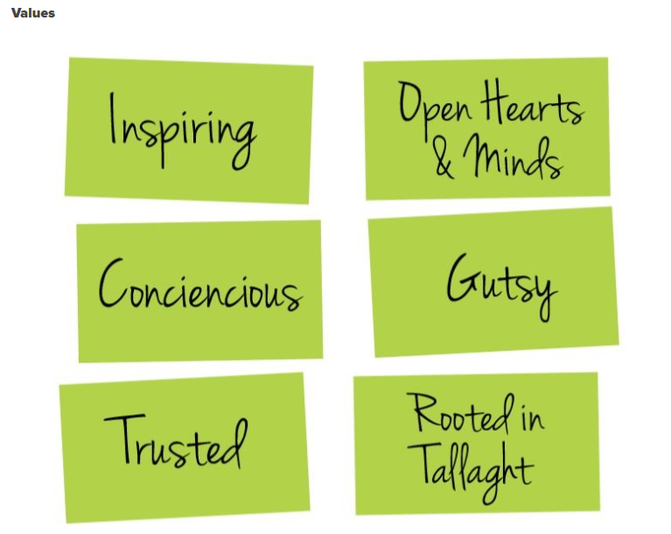
Vision, Mission & Values
Vision
A place of possibility, opportunity and transformation, where all people are inspired and nurtured to play a creative and civic role in our world.
Mission
To enrich the lives of all of the people in South Dublin County and beyond, by crafting and staging a range of shared cultural experiences that invite and provoke a meaningful journey of transformation.

Slide 5
Creating Impact
Since 2018 patrons of The Civic Have Funded over 1000 FREE theatre trips & experiences for children
https://www.youtube.com/watch?v=uJiyckSHEDQ

Slide 6
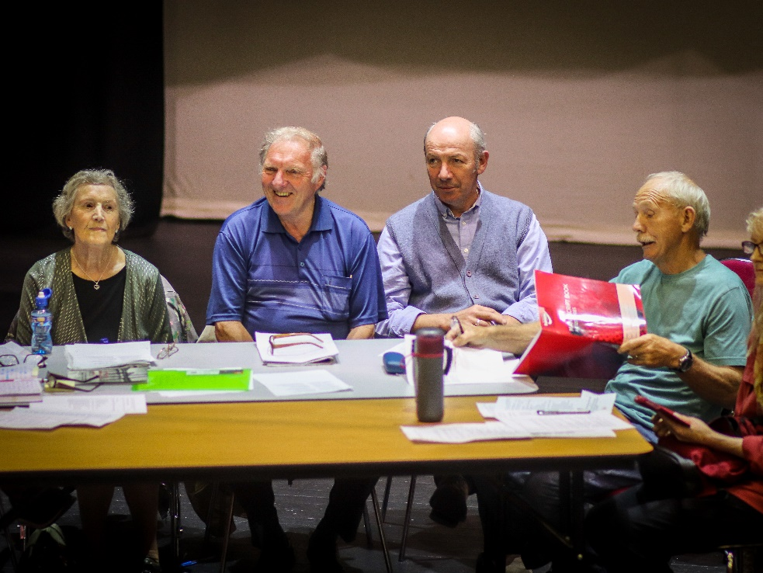
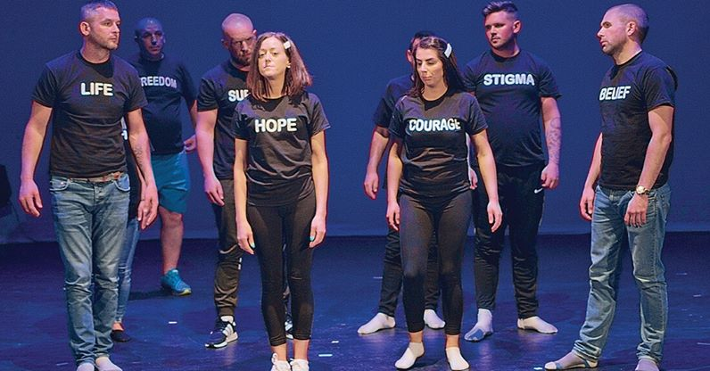
Creating Impact
Tenderfoot
TRP
Freshly Ground
TUD Tallaght
Solo Sirens
TCS Project
Second Wind
Bard School
Early Years Initiatives

Slide 7
KEY STAKEHOLDERS
Turnover €1.55 million, 2019 - €1.28 million, 2018.
Our audience – 60% of income via box office.
South Dublin County Council – 100% owned by. 20% of our income.
Arts Council – 7% direct funding.
Artists – local and national; huge reputation for artist support.
Staff – highly committed team. Full time ‘Lifers’. Part time ‘Givers’.

Slide 8
