Slide 1
South Dublin Libraries Development Plan 2018-2023

Slide 2
Mission Statement
To enrich the quality of life in South Dublin County by promoting access to a broad range of knowledge, information, technology, culture and heritage, in a welcoming, inclusive, and supportive way.

Slide 3
The Communities We Serve
Total Population: 278,767
Children: 82,115
0-4 years: 21,733
Nationalities: 120
Education:
20,772 (11.9%) aged over 15 years of age have either only primary education or no formal education at all
Economic Activity:
6,000 businesses in the County;
85,000 work in South Dublin County
Computer access:
10.6% do not have internet access;
23.4% do not have a personal computer
Fastest Growing Areas: Saggart, Rathcoole, and Tallaght

Slide 4
6 Key Objectives
Reading and Literacy
Marketing and Promotion
History and Heritage
Information and Communication Technology
Information and Lifelong Learning
Community and Culture

Slide 5
Objective 1: Reading and Literacy
Appointed a Right to read Co-ordinator and compile a Right to Read Action Plan annually
Develop and deliver programmes for adult and family literacy
Participation of all service points in Spring into Storytime and Summer Stars national programmes
Organise and facilitate creative writing groups for diverse groups
Delivery of programmes from basic to advanced , designed to develop and enhance digital literacy skills, with particular focus on adult and older users

Slide 6
Objective 2: Marketing and Promotion
Redevelop the existing South Dublin Libraries website to offer customer focussed, interactive, easily accessed and streamlined information
Develop and implement a social media marketing strategy to advertise and continuously update the range and extent of services and programmes on offer in South Dublin Libraries

Slide 7
Objective 3: History and Heritage
Continue to develop the Local Studies collection and regularly review the Collection Development Policy
Actively develop collections relating to the centenaries of the War of Independence and Civil war – sourcing memorabilia, photographs pertaining to this period of our history, and utilise these materials in exhibitions, talks and publications
Collaborate on joint projects with the Heritage Officer and provide research support to the County Promotions Unit in the delivery of heritage tourism projects, e.g. Clondalkin Round Tower

Slide 8
Objective 4: Information and Communication Technology (ICT)
Create and maintain clearly branded dedicated Work Matters spaces for hot-desking in all of our libraries
Redesign the South Dublin Libraries website
Maintain the national library management system, including support to staff and liaison with colleagues nationwide
Management of Data Protection requirements

Slide 9
Objective 5: Information and Lifelong Learning
Full participation in the National Work matters in the Library programme, building on the working relationship with South Dublin LEO and other relevant agencies
Participate in the Healthy Ireland at your Library programme to inform the public about health issues and encourage them to make positive changes in their lives
Deliver Festivals, Exhibitions, Talks, Cultural Events and Readings reaching out to different audiences and meeting diverse needs

Slide 10
Objective 6: Community and Culture
Continue to expand and develop the Red Line Book Festival
Expand and develop the unique role of the library as an important Community Hub serving as a meeting place for community clubs and groups
Support the delivery of the Creative Ireland Programme 2017-2022 including collaboration on the Cultural Quarter

Slide 11
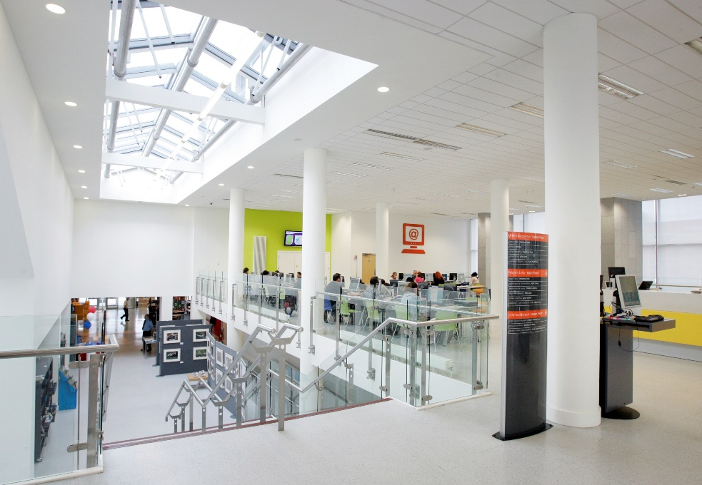
Capital Programmes
Completion of a purpose-built library at North Clondalkin, the first library for this community
Replacement of the leased library building at Castletymon with a new purpose-built library at a central location
Explore the possibility of regional service points in densely or fast-growing areas of population

Slide 12
Dormant Account Funding
Balgaddy Women’s Writing Group
Intercultural Programme
Toys Training and Technology
Local Studies
Young Entrepreneurs
Creative Campus
Transport – bring me to the Library Bus

