Slide 1
Arts Overview 2019
Arts Act 2003
Arts Development Strategy 2016 – 2020
Youth Arts Policy
Public Arts Policy
Children’s and Early Childhood Arts Policy & Strategy 2020
South Dublin Culture & Creativity Strategy 2018 – 2022
Music Generation South Dublin 5 Year Plan

Slide 2
Role of the Arts Office
Researcher
Leadership
Advocacy
Advice
Information
Resource Management
Producer
Funding organisations and venues
Targeted delivery to various groups
Support for artists
Flagship projects and programmes

Slide 3
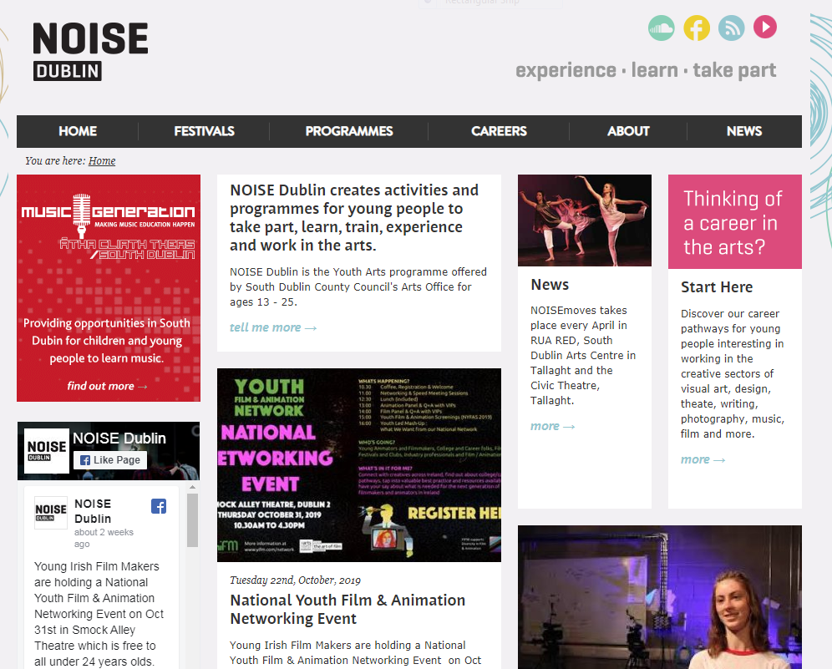

Slide 4
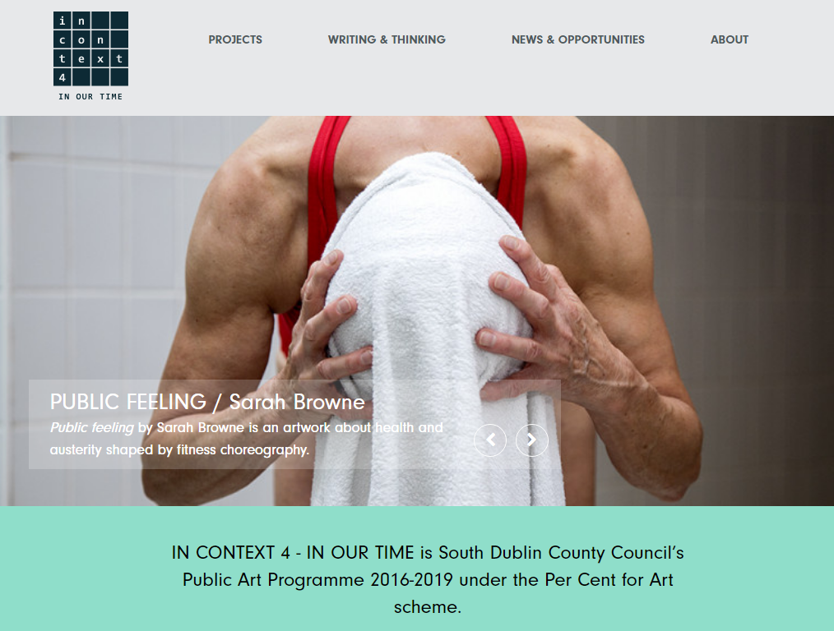

Slide 5

To develop a sustainable music education service in South Dublin County that engages children and young people in active, inspirational music-making in a musical county
Creative Ireland Programme
Arts Grants & Bursaries

Slide 6
Creative Ireland South Dublin
Legacy programme of 1916 Commemorative programme
- Investing in Culture & Creativity Strategies
- Advancing the Understanding of Creativity
Funding cross sectoral projects (across cultural and creative sectors)
- Projects of scale and ambitions
- Projects that might otherwise have fallen through the cracks
- projects that support innovation

Slide 7
Culture & Creative Strategy 2018- 2022
Creative Communities
Sustaining Creativity
Re-imagining Place
Cultural Hubs
Creative Citizens
Networks & Partnership

Slide 8
Culture & Creative Strategy 2018- 2019
Projects, Awards & Events | Expenditure | Participation and Engagement
13 Schools Cultural Awards | 20,000 | 5,100
4 Incubation Awards | 19,000 | 25,408
3 Artists & Creatives in Collaborative Practice | 34,000 | 1,749
23 Projects | 191,000 | 5,554 (*)
70 Cruinniú na nÓg(*) | 85,000 | 4112
Decade of Commemorations | 15,000 | 9150 (*)
Total | 364,000 | 51,073

Slide 9
Delivering the Strategy 2019
Developing Capacity and Programming for Children with Complex Needs
Story telling & Local Myth/legend
Architecture & public engagement
Literature (Writer-in Residence)
Connecting the Unconnected – through technology, music, and universal languages
Multilingual Cultural Festival – Mother Tongues Festival
Dance with Mixed Martial Arts Community
Visual Art with Irish Prisoners
Devised theatre
Ensemble of differently abled actors and makers

Slide 10
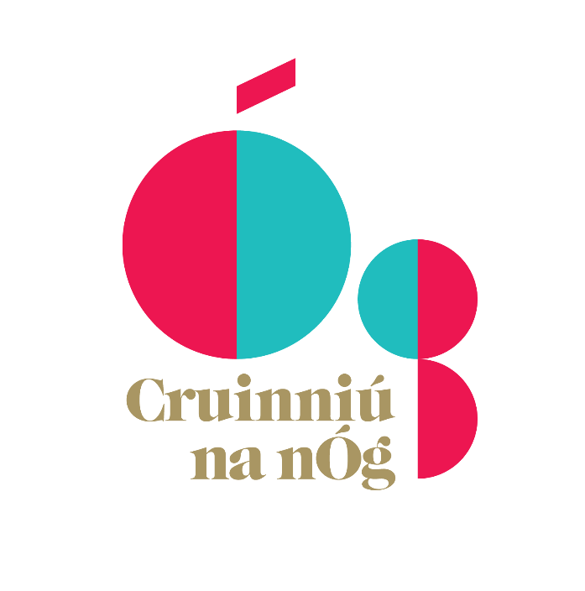
Cruinniú na nÓg – A Day to Create 2020
Cruinniú na nÓg celebrates and encourages children and young people’s participation in culture and creativity. Events are free, local and activity-based. It’s a day for ‘doing’, ‘making’ and ‘creating’! Audience & participants 3825
Funding €75,000 confirmed for 2020
Cruinniú Co-ordinator: Carla Fazio
Consultation with Comhairle na nÓg
Competitive Process €50,000 Cruinniú Open call for proposals : Awards between €500 and €10,000.
Sat June 13th 2020
Looking for innovative activities that foster creativity and engage a diverse audience
May have a focus on hard to reach children in developmental projects

Slide 11
Decade of Commemorations 2020
Decade of Commemorations
- Community Strand €15,000 (led by South Dublin Libraries)
Project Awards 2020
Project Funding – Direct Invitation internal to Cultural Team
Deepening existing projects and looking at a shortlist from others that may be in the pipeline. €64,000
Schools Cultural Awards 2020
Open Call
Project Funding up to €2,000
Budget €10,000
Visual, Dance & Theatre
Closing Date: December 6th

