Slide 1
Griffeen Valley Park Pavilion ACM Consultation
Briefing Presentation to ACM
on Consultation Process for Approval
24, Sep 2019

Slide 2
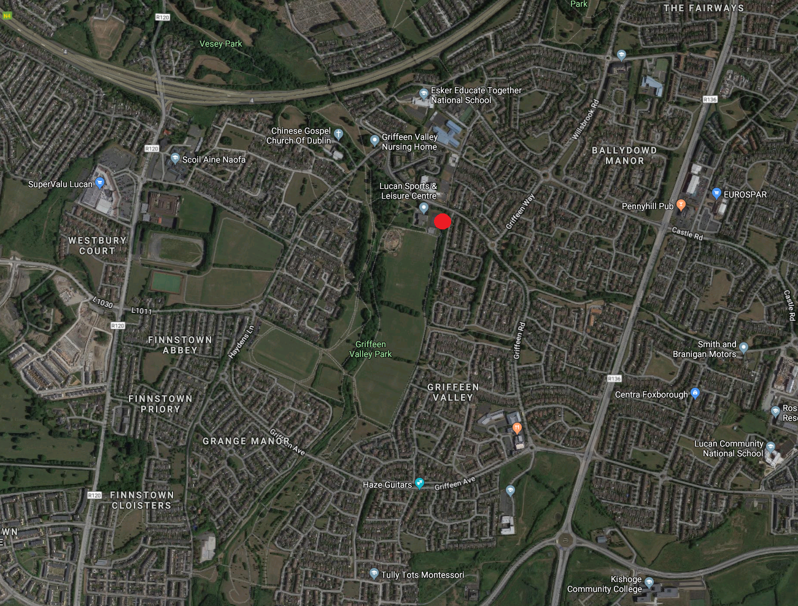
SURROUNDING AREA MAP

Slide 3
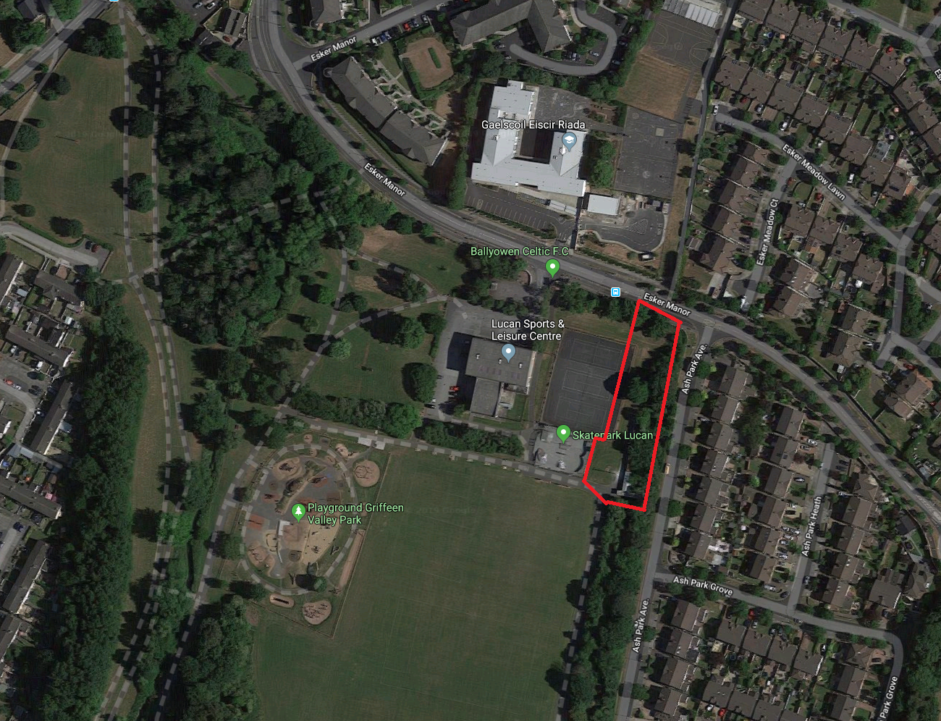
SITE LOCATION MAP

Slide 4
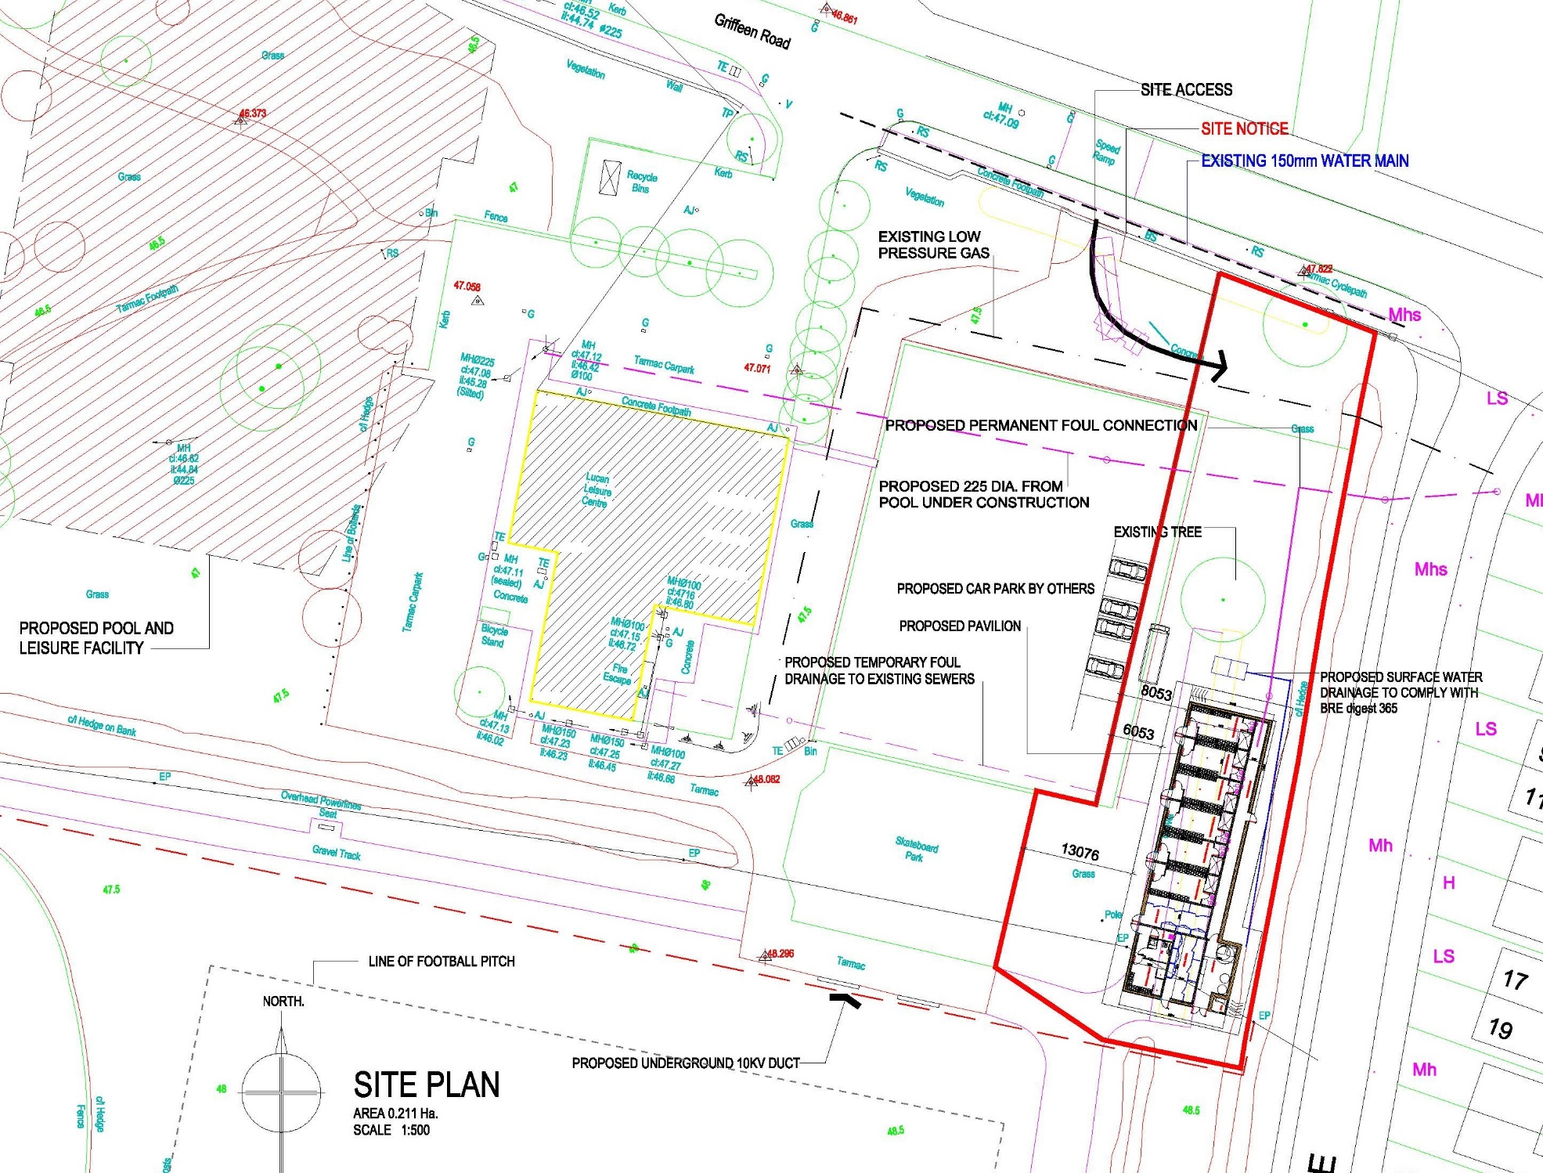
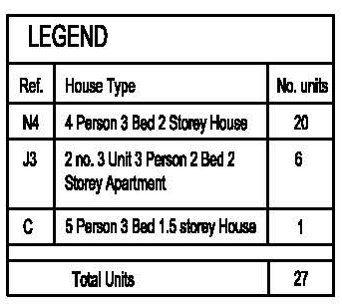
SITE PLAN

Slide 5
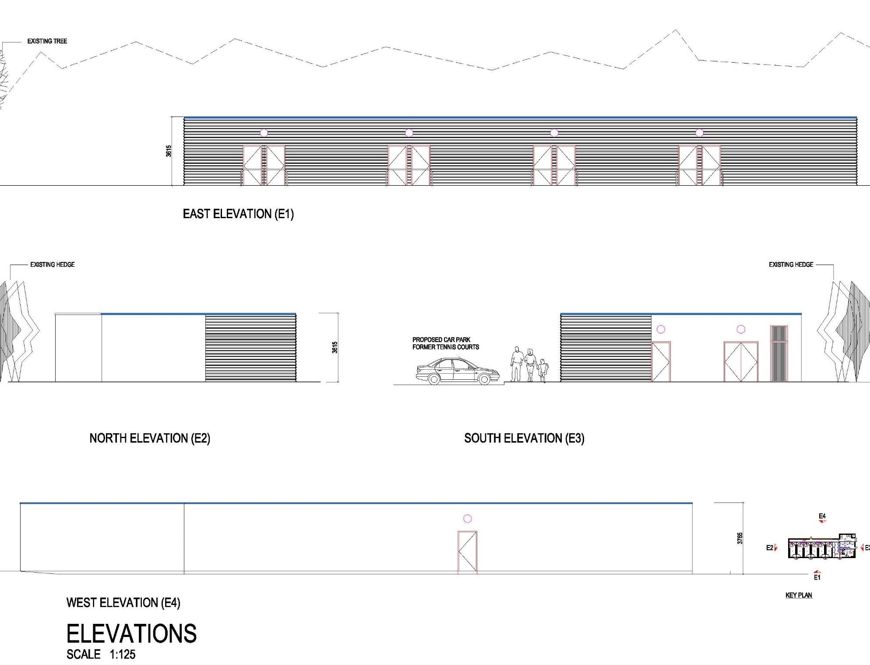
SITE ELEVATION

Slide 6
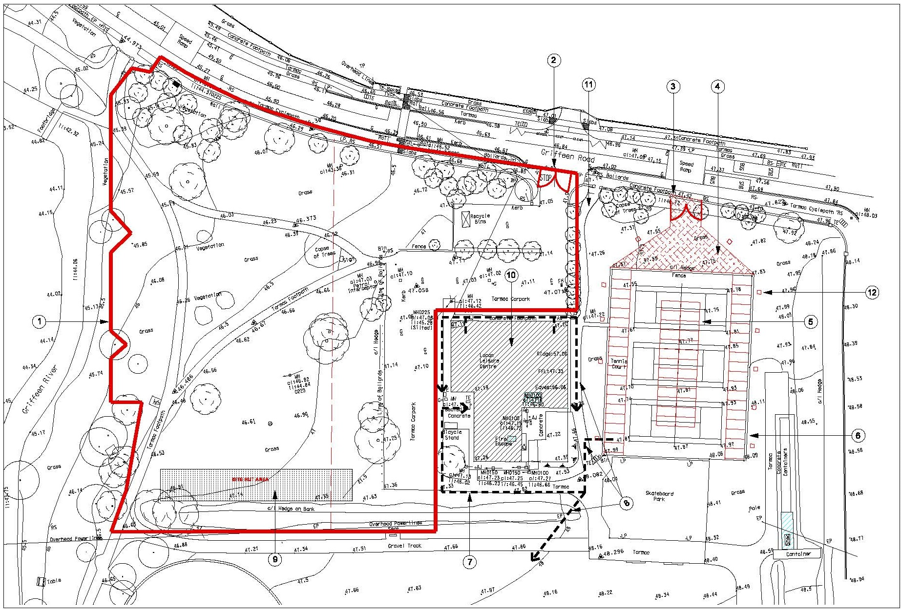
LUCAN SWIMMING POOL: PHASE-1

Slide 7
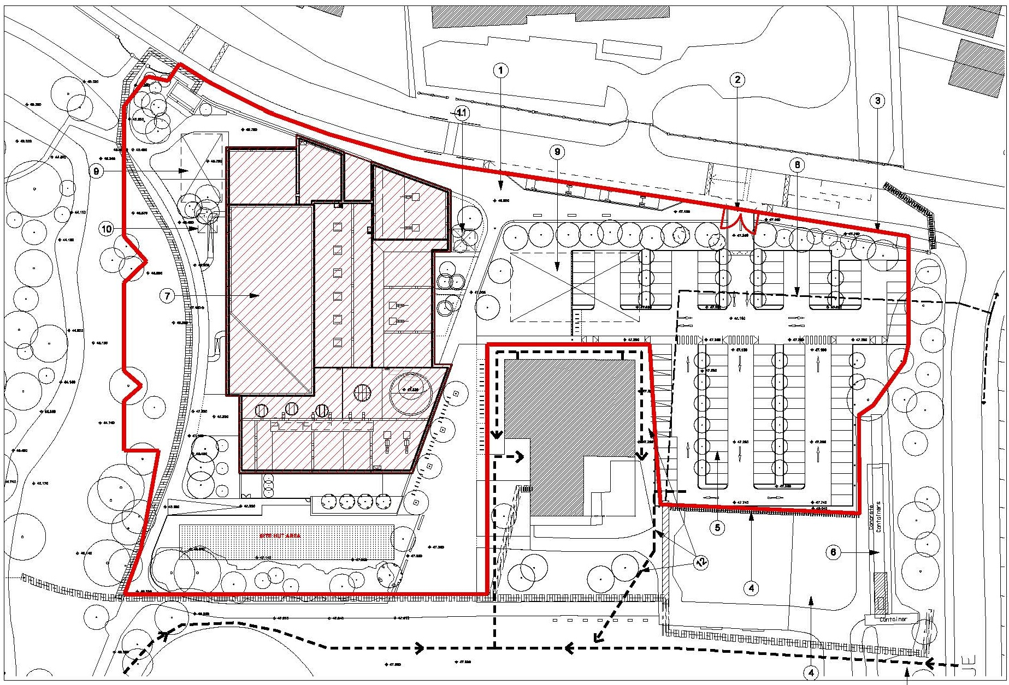
LUCAN SWIMMING POOL: PHASE-4 [Sep 2020]
Car Park: 109 (6-Disable)

