Slide 1
SHD Application Newcastle South & Ballynakelly, Newcastle.
SDCC Ref: SHD3ABP-305343-19
Applicant: Cairn Homes Properties Ltd.
18/09/2019
Fiona Redmond
Senior Executive Planner

Slide 2
Strategic Housing Development
Planning and Development (Housing) and Residential Tenancies Act 2016
Planning and Development (Strategic Housing Development) Regulations 2017
Section 4 applications for strategic housing development (SHD) are to be made directly to An Bord Pleanála.
Steps
Pre-Application Consultation with Planning Authority
Pre- Application with An Bord Pleanala (ABP) and the Planning Authority
Planning Application lodged with ABP

Slide 3
Strategic Housing Development
At the next Area Committee meeting, or the municipal district meeting for each municipal district concerned, as appropriate, the Planning Authority shall inform the relevant elected members of the following:
- The details of the application,
- The consultations that have taken place in relation to the proposed development with both the Planning Authority and An Bord Pleanála
Details of the Notice of Opinion issued by An Bord Pleanála.
A summary of the views of the relevant elected members on the proposed development as expressed at the meeting shall be attached to the report of the Chief Executive and shall be submitted within 8 weeks of the lodgement of the application to ABP.

Slide 4
Timelines
SHD Lodged with ABP on 4th Sept. 2019.
5 Week Observations on 8th Oct. 2019.
8 Wks SDCC report due to ABP 29/10/19
16 Week Decision by ABP due
on 2nd Jan. 2020.
Consultations
S.247 Pre-Planning meeting held with SDCC on 27/6/2018 & 26/2/19.
A Pre-Planning meeting was held on 7th January & 30th April 2019 with An Bord Pleanala, the applicant and SDCC.

Slide 6
Proposed Development

Slide 7
Site Zoning in South Dublin County Development Plan 2016-2022

Slide 8
Newcastle Local Area Plan

Slide 9
ABP Opinion:
Urban Design/ Layout:
Further consideration in relation to achievement of acceptable standard of urban design.
Integration with existing permitted and planned development on adjoining land.
Compliance with provision of DMURS, the development plan and the LAP.
Provide suitable street frontage along the main street through the site and along the eastern and southern side of the planned square around the area zoned as open space along the western site boundary.
Omitting the doubling up of parallel carriageways.
Show how links would be provided to streets in existing/ permitted housing and to future residential development on lands zoned for such.

Slide 10
Specific Information to be submitted with the application:
Site Layout overlaid with CDP zoning and roads objectives and LAP indicative layout.
Housing Quality Assessment & Building Lifecycle Report.
Report demonstrating compliance with design principles and DMURS and the National Cycle Manual.
A Site Specific Flood Risk Assessment.
A Phasing Scheme and Taking in charge Plan.
Details of boundary & surface treatments, landscaping, planting.
Draft Construction Management Plan.
Draft Waste Management Plan.

Slide 11
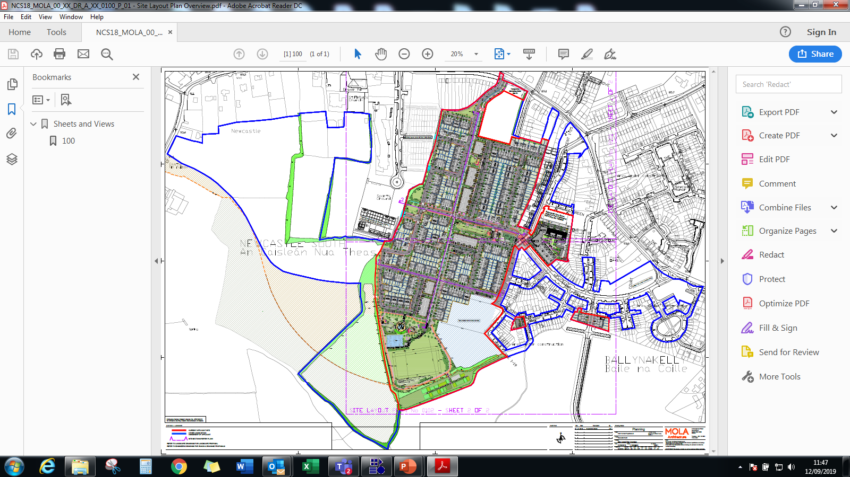
Proposed Site Plan

Slide 12
Layout
Cre

Slide 13
Ballynakelly Site (C1)
Cre

Slide 14
Ballynakelly Rise (C2)
Cre

Slide 15
Ballynakelly Site (C3)
Cre

Slide 16
Thank You
Comments

Slide 17
Site Notice
Cre

