Slide 1
SHD Application
Kilcarberry, Corkagh Demesne, Deansrath, Nangor, Clondalkin, D22.
SDCC Ref: SHD3ABP-305267-19
Applicant: Adwood Limited
18/09/2019
Fiona Redmond
Senior Executive Planner

Slide 2
Timelines
SHD Lodged with ABP on 26th Aug. 2019
5 Week Observations by 30th Sept. 2019
8 Wks SDCC report due to ABP 20/10/19
16 Week Decision due from ABP 16/12/19
Consultations
S.247 Pre-Planning meeting held with SDCC on 13/11/18.
A pre-planning meeting was held on 11th February 2019 with An Bord Pleanala, the applicant and SDCC.

Slide 3
Site Context

Slide 4
Proposed Development

Slide 5
Site Zoning in South Dublin County Development Plan 2016-2022

Slide 6
ABP Meeting held 11th February 2019
ABP Opinion:
Design Layout & Unit Mix:
Justification of Layout in relation to criteria set out in the Urban Design Manual
Density:
Further consideration/ justification in relation to the density, in particular that the density is sustainable to provide efficiency in serviceable land usage balanced with the context within which the site is located. Clear rationale for the site boundary in relation to calculations.
Surface Water Management & Flooding:
Seek to maximise SUDS measures.

Slide 7
Specific Information to be submitted with the application:
Details of materials and finishes for structures and private amenity areas etc. to create a distinctive character for the development.
A mobility management framework & car parking rationale.
A public realm & permeability strategy which addresses connections to and from the site and treatment with the interface with Corkagh Park to the south.
Report including levels & cross sections showing the relationship between the development and the adjacent residential units, public paths and interfaces with public realm.
Detailed schedule of accommodation indicating compliance with the Sustainable Urban Hosing: Design Standards for New Apartments, Guidelines for Planning Authorities 2018.
A life cycle report.
A site layout addressing areas to be taken in charge.

Slide 8
Statistics for Proposed Development

Slide 9
Statistics for Proposed Development

Slide 10
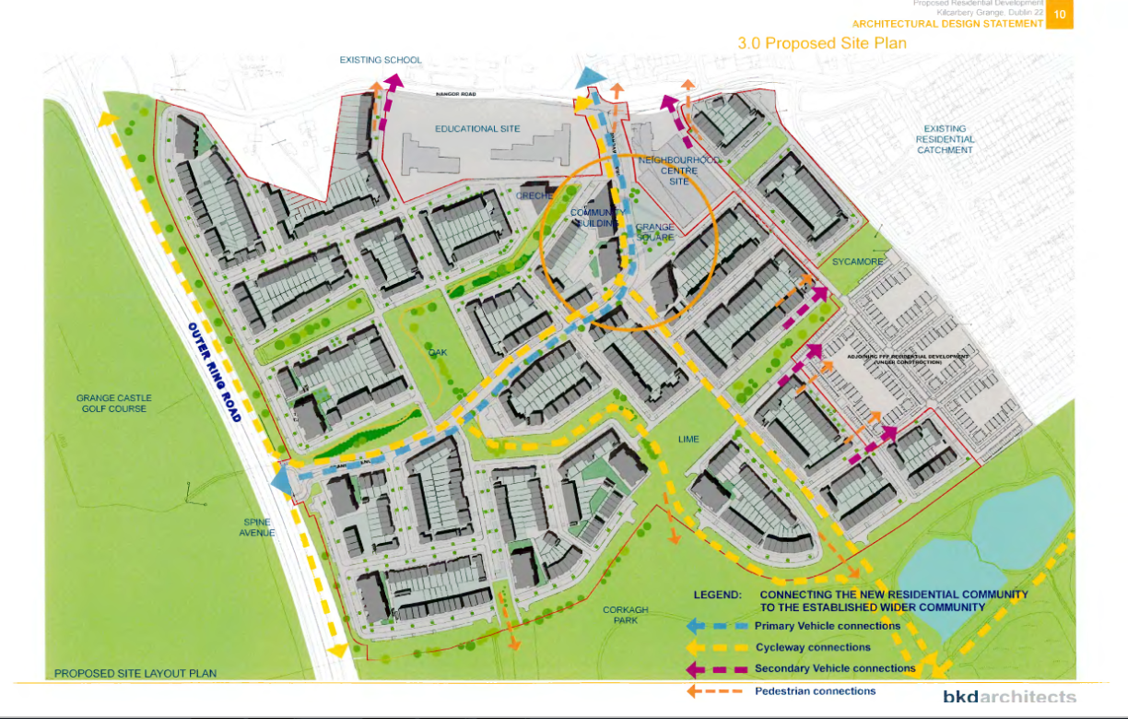
Proposed Site Plan

Slide 11
Character Areas
Cre

Slide 12
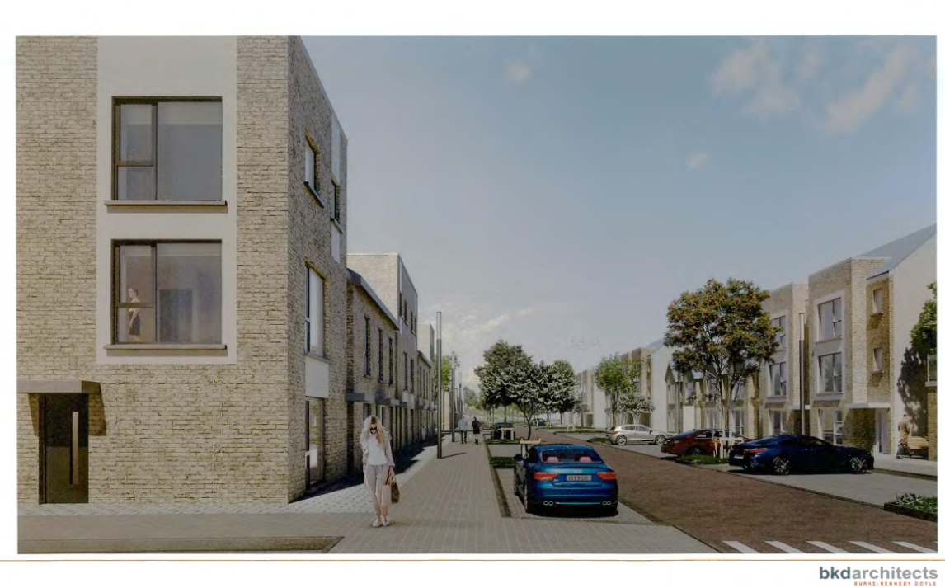
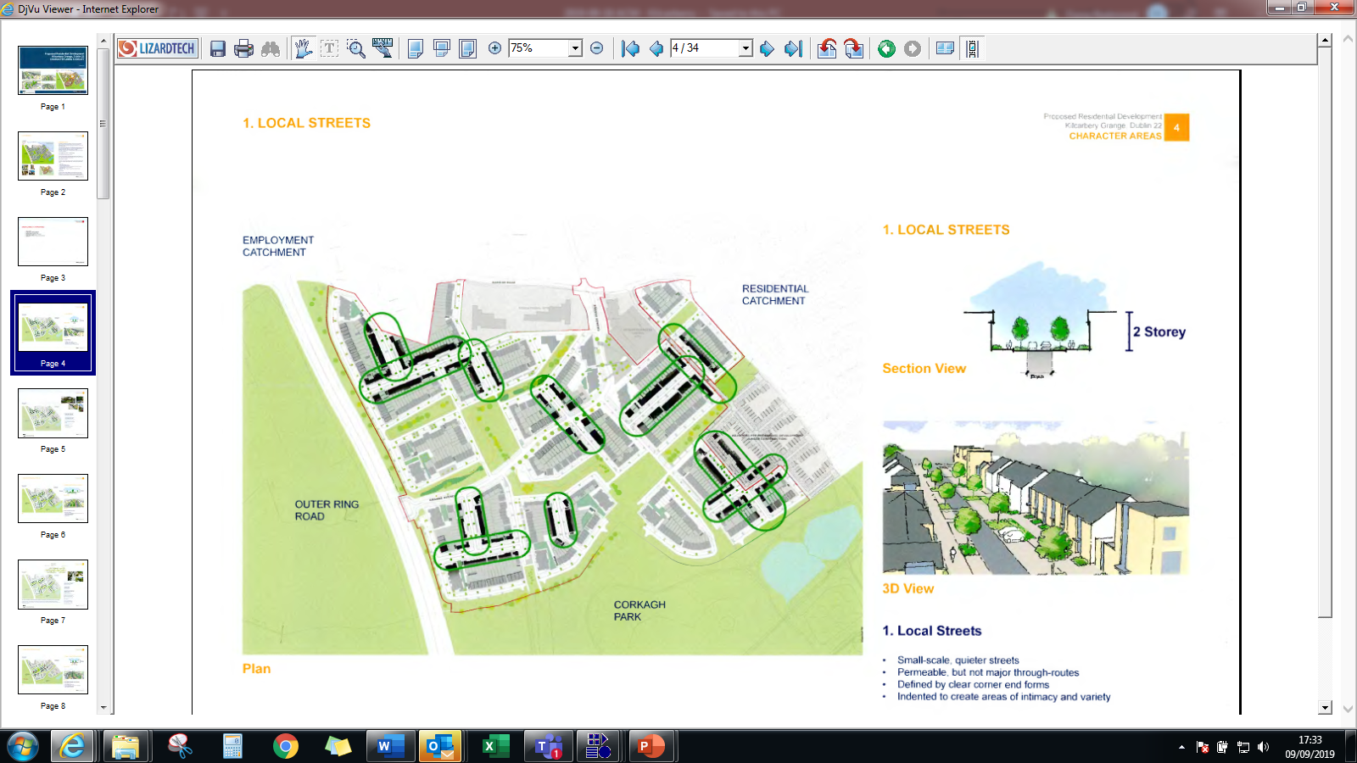
Cre

Slide 13
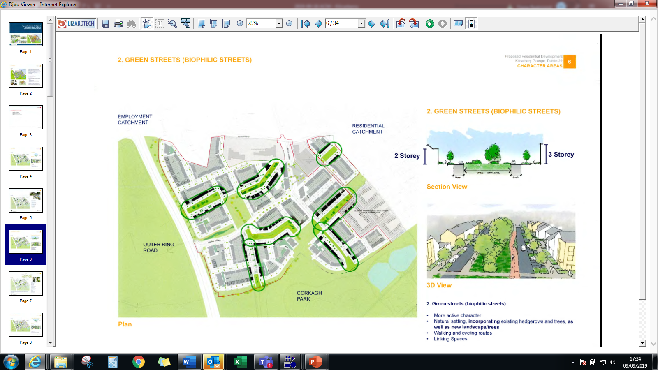
Cre

Slide 14
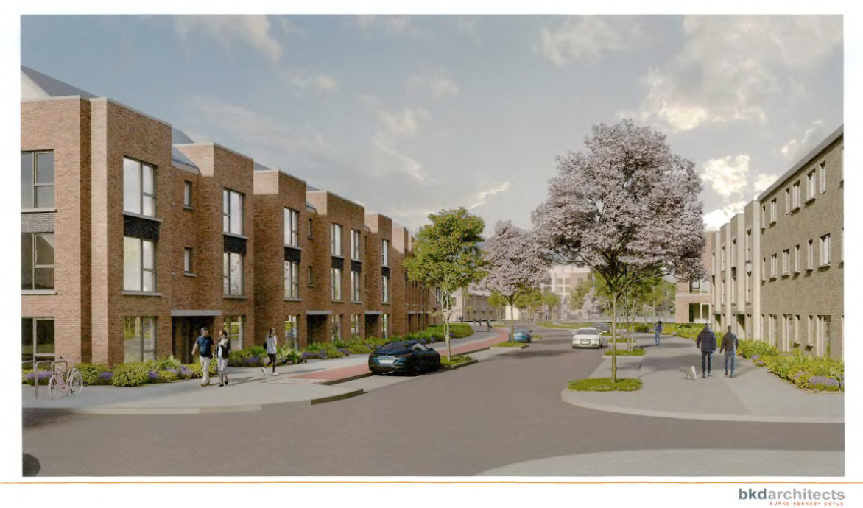
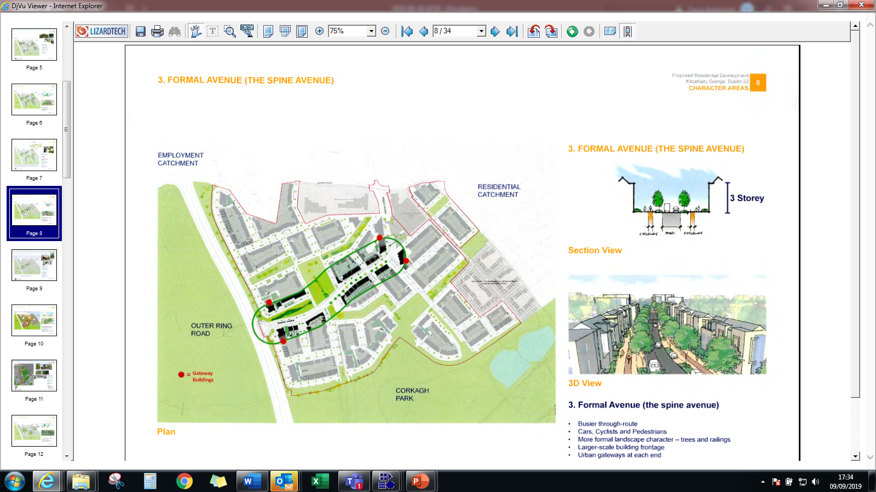
Cre

Slide 15
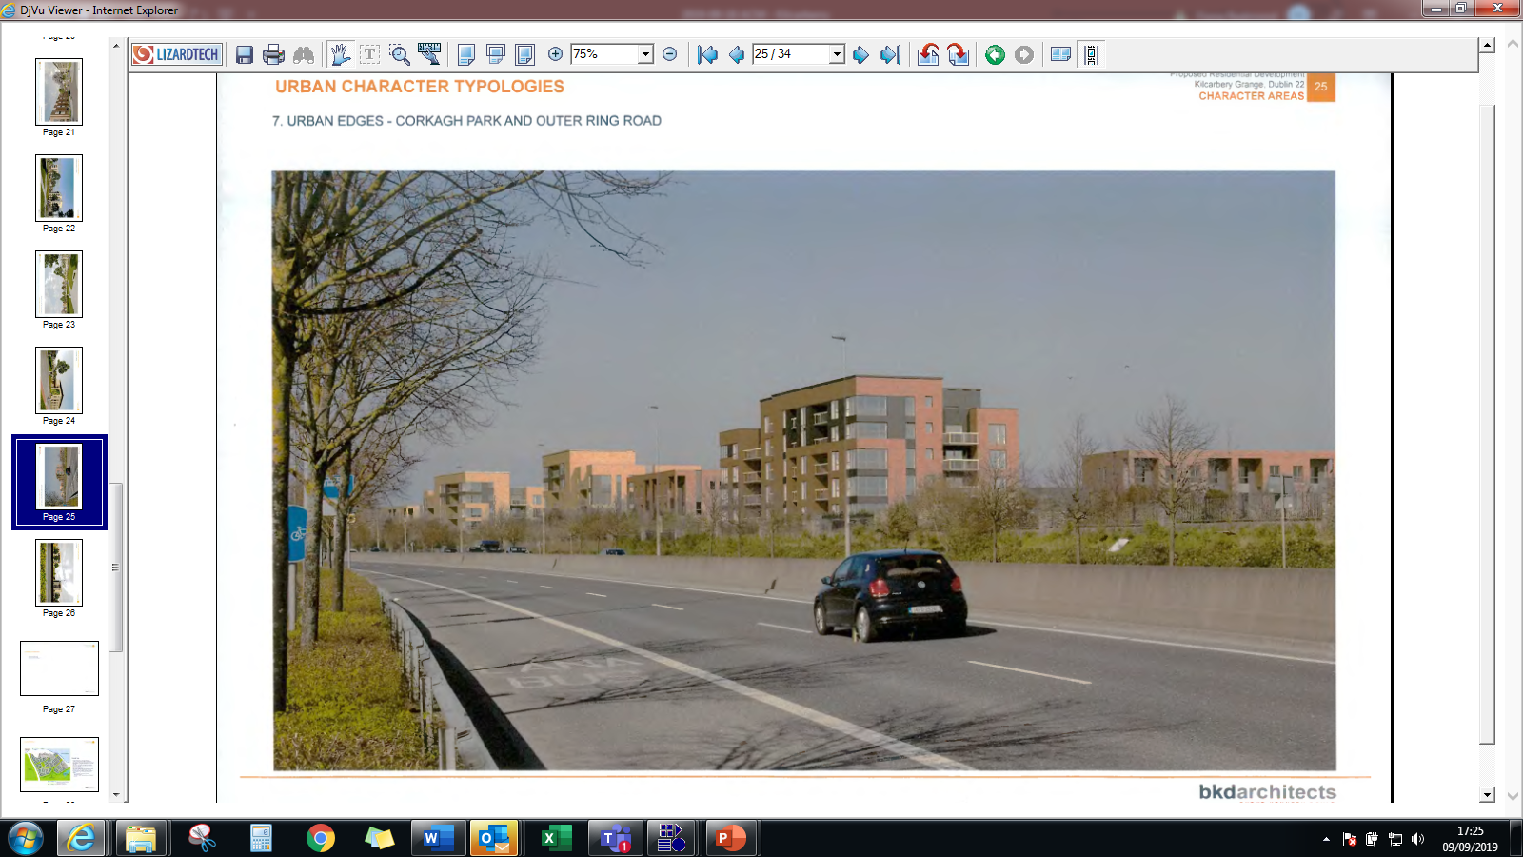
Urban edges – Corkagh Park & Outer Ring
Cre

Slide 16
Thank You
Comments

Slide 17
Cre

