Slide 1


Whitechurch Stream
Flood Alleviation Scheme
Presentation to RTFB Area Committee September 2019 by David Grant, Project Resident Engineer

Slide 2

History
The Office of Public Works (OPW) in partnership with South Dublin County Council (SDCC) and Dublin City Council (DCC) carried out a Catchment Flood Risk Assessment and Management (CFRAM) Study for the River Dodder Catchment.
Whitechurch Stream was included as part of the study as it is a sub catchment of the Dodder Catchment.
The River Dodder Catchment Flood Risk Management Plan (CFRMP) which was published in November 2014 identified a preferred flood risk management option for the Area of Potential Significant Risk (APSR) named as Tara Hill and St. Enda’s, now referred to as Whitechurch Stream.
SDCC and the OPW have initiated the development of a Flood Alleviation Scheme for Whitechurch Stream to alleviate fluvial flooding for the Tara Hill and St. Enda’s APSR.

Slide 3
Study Area
The Whitechurch is a tributary of the Owendoher and rises between Tibradden and Kilmashogue Mountains at an elevation of approximately 480 mOD. It flows in a northerly direction through Marley Park and St. Enda’s Park and onto Willbrook where it meets the Owendoher. The stream is approximately 7.7 km in length, falls at an average gradient of 1 in 18 and drains a catchment of approximately 8.9 km2
The study area considered for the purpose of the flood alleviation scheme runs from the upstream end of St. Enda’s Park at Taylor’s Lane to the streams confluence with the Owendoher River where Whitechurch Road merges onto Willbrook Road.
No flood risk management measures will be considered upstream of St. Enda’s Park or for the Owendoher River as part of this flood alleviation scheme.

Slide 4
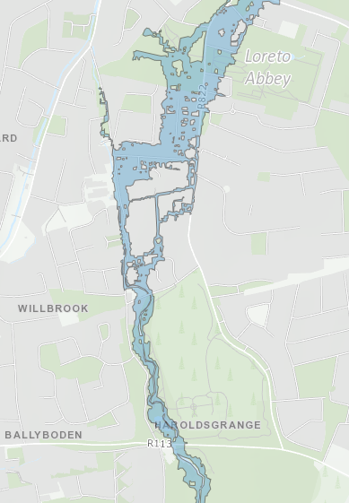
Recent Flood Events
24/10/2011 – 90mm of rainfall in 6 hour period
05/09/2008 – 58mm of rainfall over 11 hour period
06/11/2000 – 103mm of rainfall in 48hr period.
25/08/1986 – Hurricane Charlie
Flood Map for a 1 in 100 year Event

Slide 5
Whitechurch Stream Flood Alleviation Scheme
Devised from 2014 River Dodder CFRAM Study
Dual-Agency Input – OPW funded; Project Managed and led by SDCC
Consultant Appointed in Q4 2018 – RPS Group Ltd
Preliminary Design carried by OPW Hydrological Team with 30% Blockage analysis
No option for Inline or Offline storage due to the Urban nature
Designed to protect up to 150 Properties

Slide 6
Proposed Scope of Scheme
Main intervention area from St Enda’s Park to conflux with Owendoher River
Combination of Hard Defences (avg 1.2m high) with Debris Management
Introduction of Debris Traps and Trash Screens
Minor re-alignment of River Channel
Assessment of local Drainage Networks and introduction of Non Return Flap Valves
Removal of Bankside Vegetation
Localised Erosion Measures
Maintenance Plan

Slide 7
Main Elements of Proposed Works
Hard Defences 1.2m -1.9m high:
87m Right Bank between Sarah Curran Ave to St Gatiens Court
110m Right Bank between St Gatiens Court to Ford Garage Culvert
240m Right and Left Bank from Ford Garage to Willbrook Lawn
Trash Screens:
2no. Whitechurch Rd Crossing and Ford Garage Culvert inlet
Bank Protection:
65m at St Enda’s Park
100m Sarah Curran Ave to Whitechurch Road
200m Willbrook Lawn to Whitechurch Rd Crossing
Debris Poles:
2no. St Enda’s Park and prior to Whitechurch Rd Crossing
Other proposed works:
Removal of Japanese Knotweed at Whitechurch Rd Crossing
150m possible Wall Remediation works
Tree Removal/Tree Replacement Programme and Bankside Maintenance to accommodate works
2no. Water level gauges with Telemetry

Slide 8
Proposed Works
Flood Alleviation Measures within St Enda’s Park

Slide 9
Proposed Works
Sarah Curran Bridge to Weir at Whitechurch Rd

Slide 10
Proposed Works
Weir at Whitechurch Rd to St Gatien’s Court

Slide 11
Proposed Works
St Gatien’s Court to Ford Garage Culvert Inlet

Slide 12
Proposed Works
Ford Garage Culvert Outlet to Willbrook Lawn Culvert

Slide 13
Proposed Works
Willbrook Lawn Culvert Outlet to Whitechurch Road Crossing

Slide 14
Proposed Works
Junction of Ballyboden Road and Whitechurch Road

Slide 15
Planning
Part 8 Planning originally envisaged as scheme is inside the Threshold for Part 10 Planning and Environmental Impact Assessment Report not required.
Following Sweetman v Coillte case in June 2018; Environmental Mitigation Measures cannot be included at Appropriate Assessment Stage so Natura Impact Statement required - Advice on Sweetman v Coillte June 2018
An Bord Pleanala - Section 177AE - APB Section 177AE Guidelines
Public Information Events to be held in Q4 2019
Estimated time for Planning – 6 months

Slide 16
Current Status
Preferred Option Selected
Rainfall and Flow Monitoring Surveys completed
Hydraulic Modelling and Hydrological Analysis completed
Cost Benefit Analysis Completed
CCTV and Manhole Surveys completed
Structural Condition Surveys completed
Environmental Screening and Assessment have commenced
Topography and Threshold Surveys Completed
Project Website Live www.whitechurchfas.ie
Site Investigation Surveys to commence in October 2019
Planning Submission to An Bord Pleanala expected in Q4 2019
Works to commence in Q2 2020
Estimated Construction Cost of €1.75 million

Slide 17
Thank You
Any Questions?

