Slide 1

SOUTH DUBLIN COUNTY COUNCIL
CLIMATE CHANGE
ACTION PLAN

Slide 2


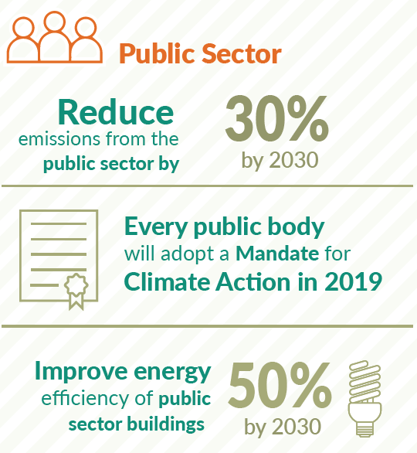
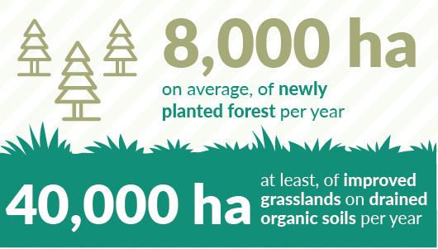
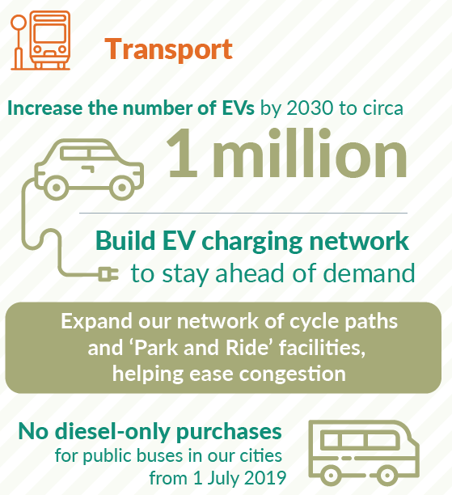
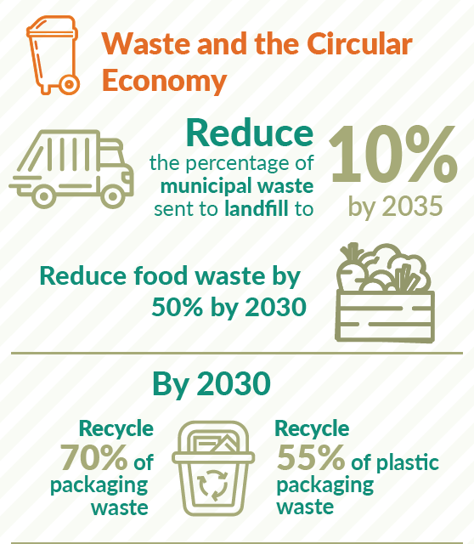
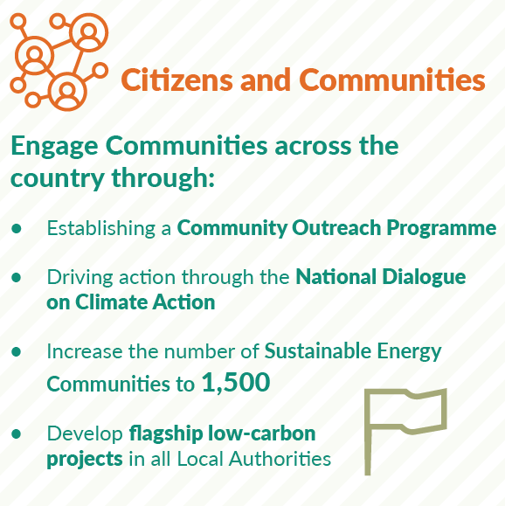

National Context 2019 - 2030

Slide 3

Our Mission – ‘To lead and transform South Dublin into a carbon neutral and climate resilient county’
Our Plan
Adaptation Baseline
Mitigation Baseline
4 Key Targets
5 Action Areas
Monitoring and Iteration

Slide 4
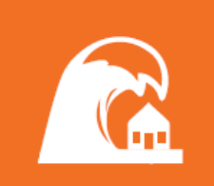
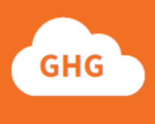
Key Targets of the CCAP
4 KEY TARGETS .
33%
Improvement in the
Council’s energy
efficiency by 2020
Make Dublin a climate-
resilient region by
reducing the impacts
of future climate
change-related events
40%
Reduction in the
Council’s greenhouse
gas emissions by 2030
Actively engage and
inform our citizens
on climate change

Slide 5
5 Action Areas
CLIMATE CHANGE
ACTION PLAN

Slide 6
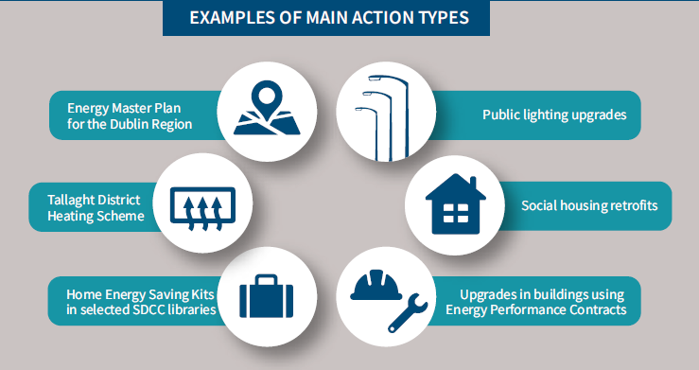
SDCC CCAP 2019-2024
Energy and Buildings - 27 Actions

Slide 7
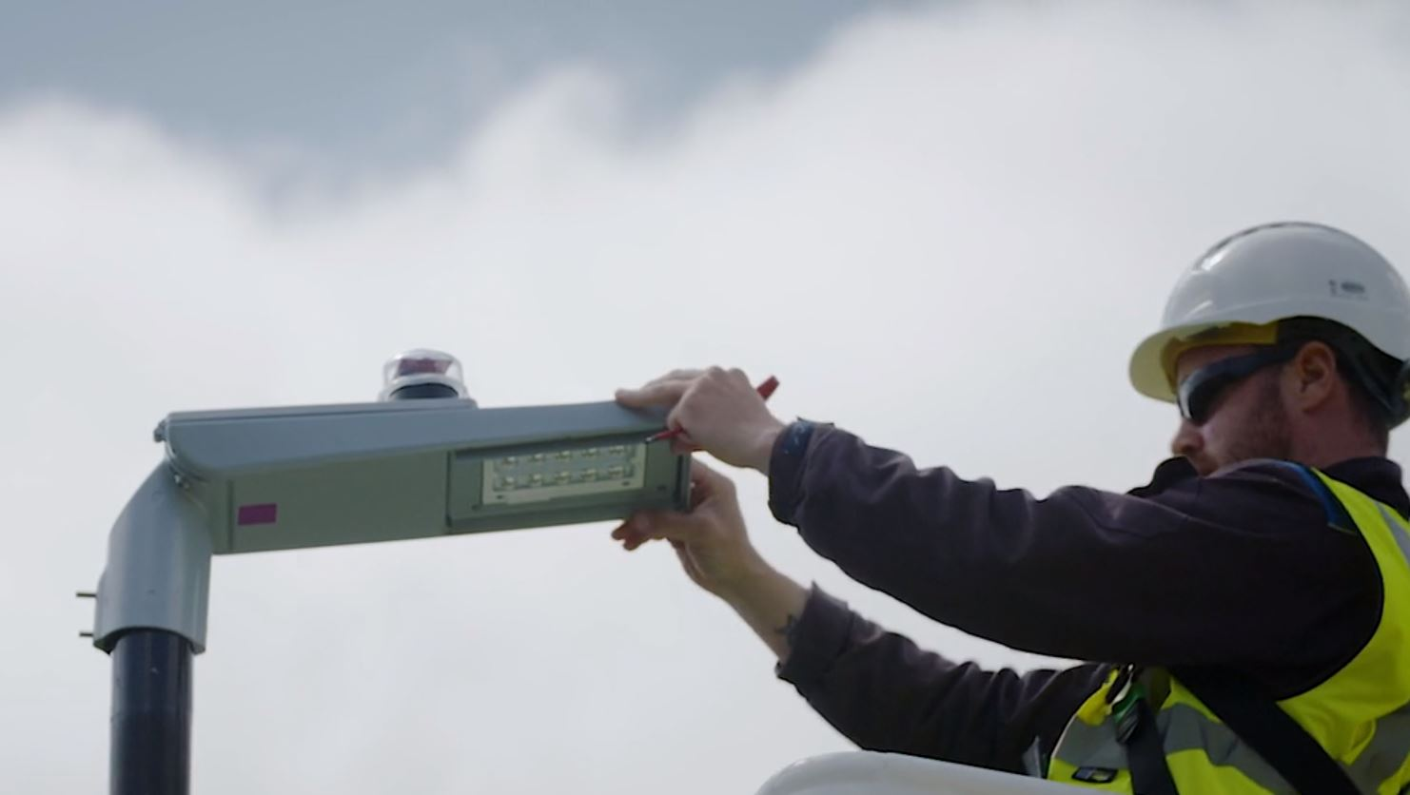
Upgrade 4,000 Public Lights to LED and Lighting in SDCC Buildings

Slide 8
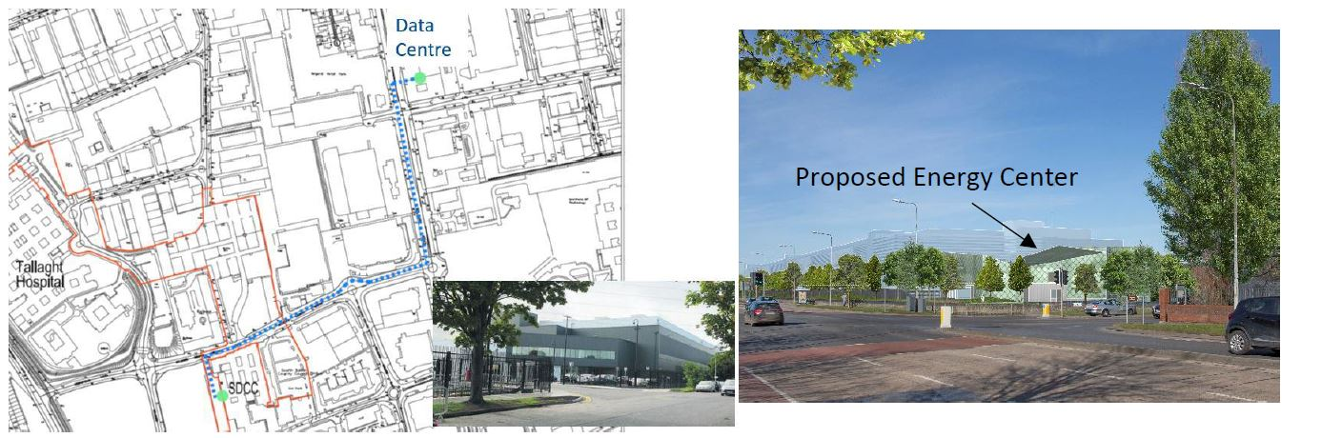
Development of the Tallaght District Heating Scheme

Slide 9
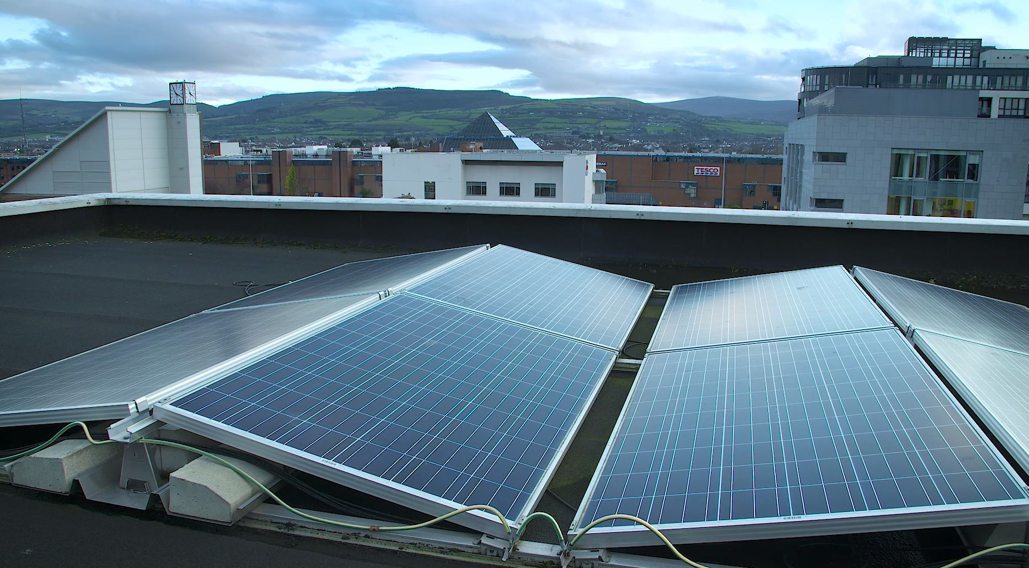
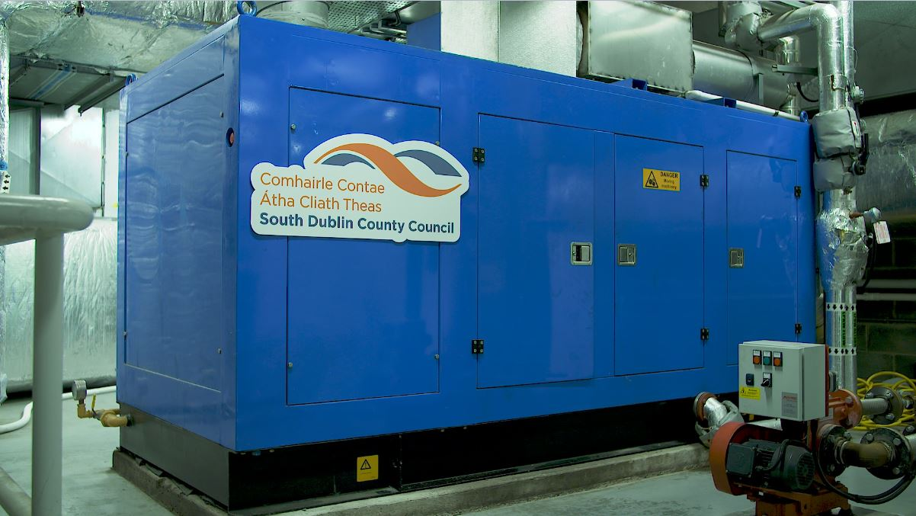
Energy Efficient Retrofits of Solar Panels to SDCC Municipal Buildings
Combined Heat & Power Unit at Tallaght Leisure Centre

Slide 10
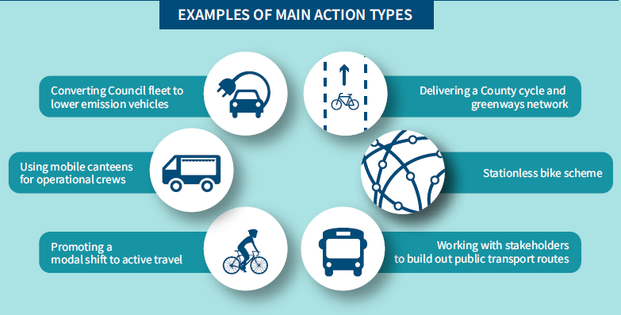
SDCC CCAP 2019-2024
Transport - 21 Actions

Slide 11
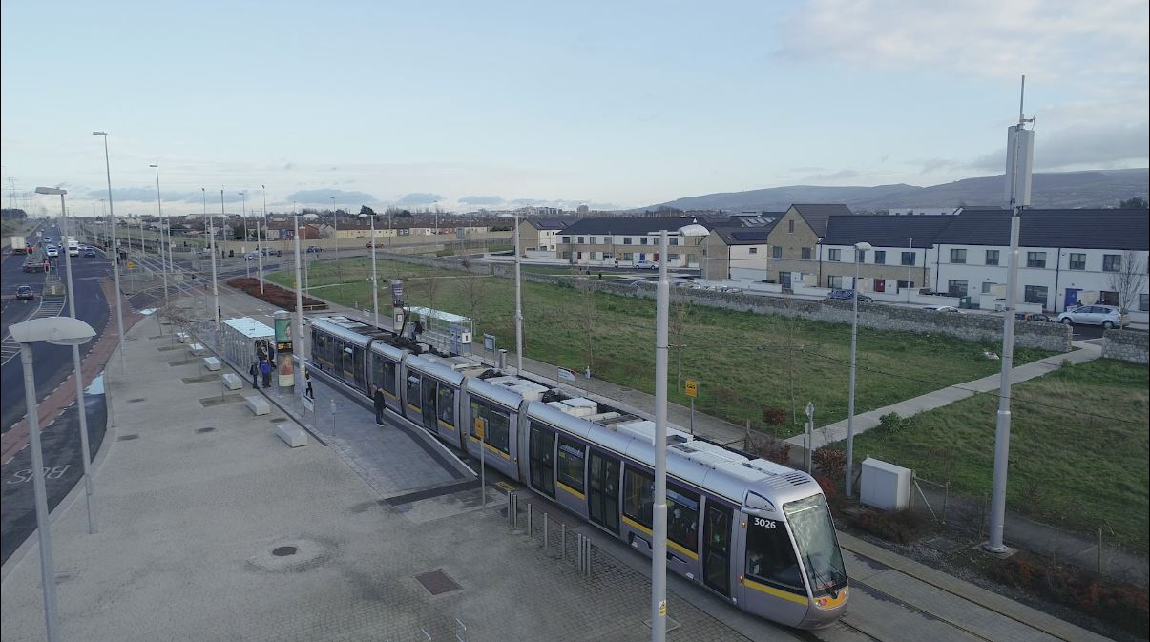
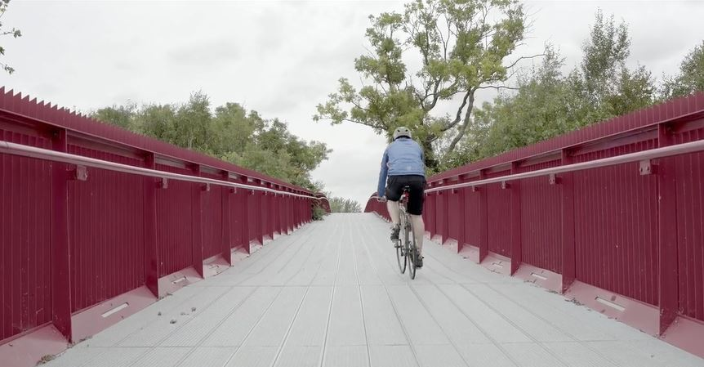
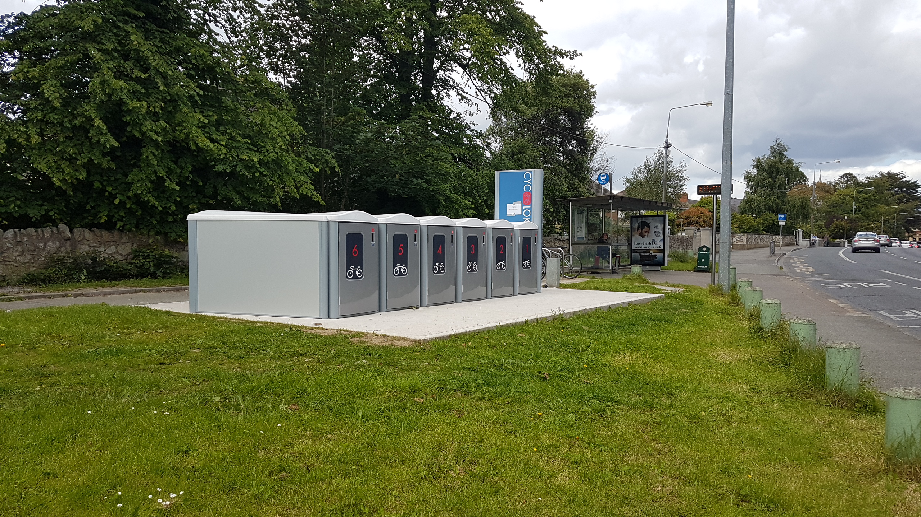
Promote Modal Shift From Single Occupancy Vehicles To More
Sustainable Modes of Transport
Bicycle Storage Facilities
Expand the County’s Green Routes and Cycle Networks

Slide 12
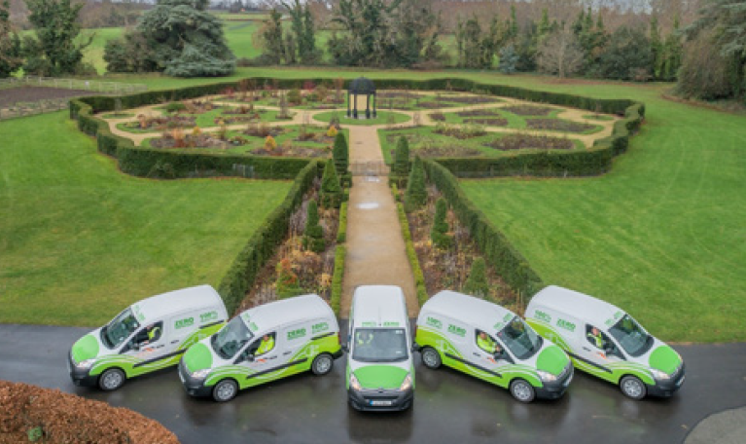
Introduction of Additional Electric Vehicles to SDCC’s Fleet

Slide 13
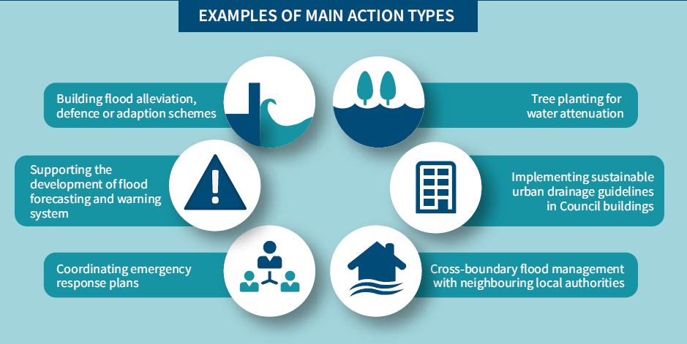
SDCC CCAP 2019-2024
Flood Resilience - 22 Actions

Slide 14
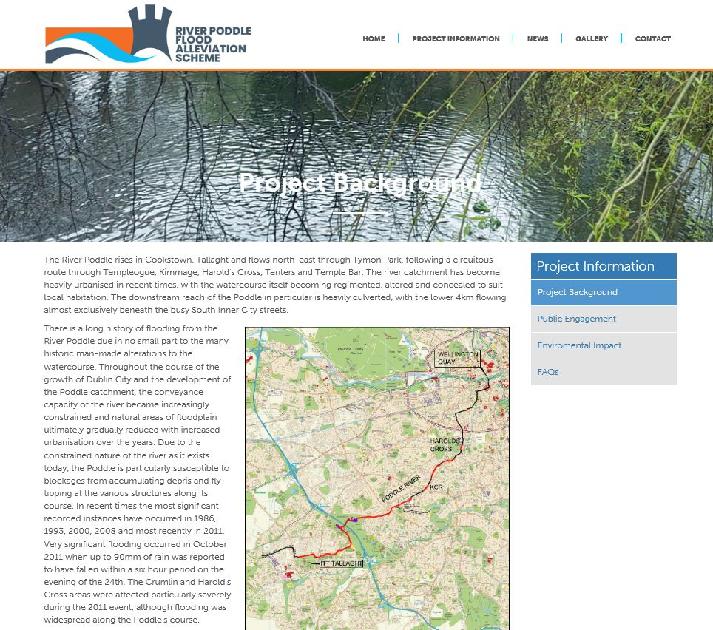
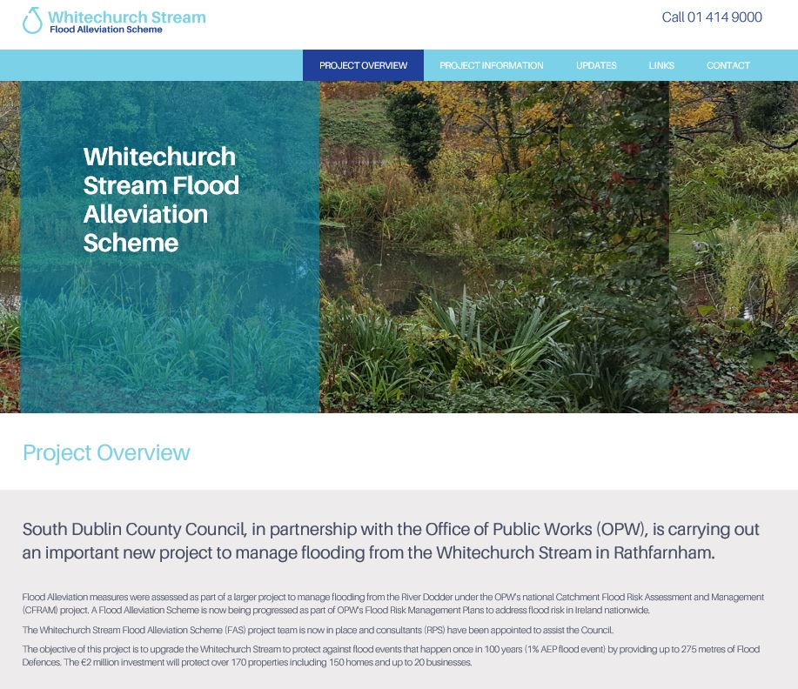
Cross-Boundary Flood Management with Neighbouring LAs

Slide 15
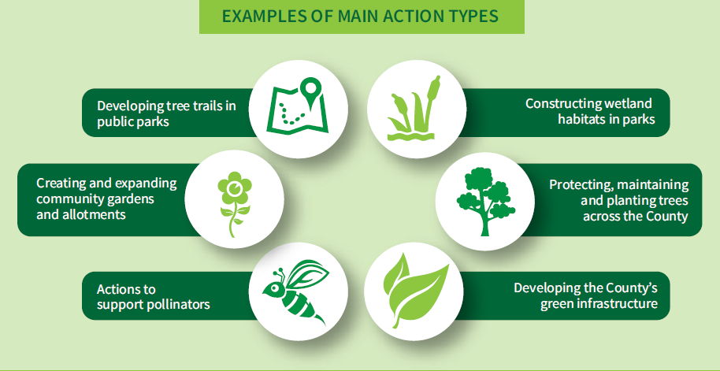
SDCC CCAP 2019-2024
Nature based Solutions - 33 Actions

Slide 16
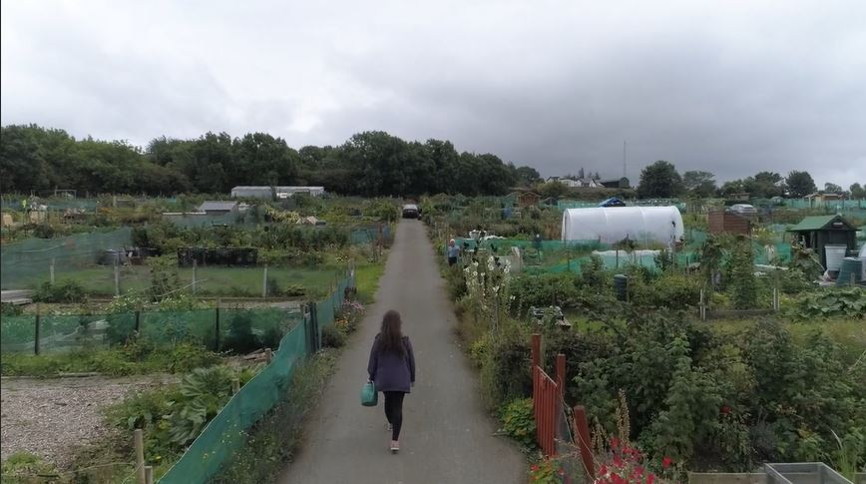
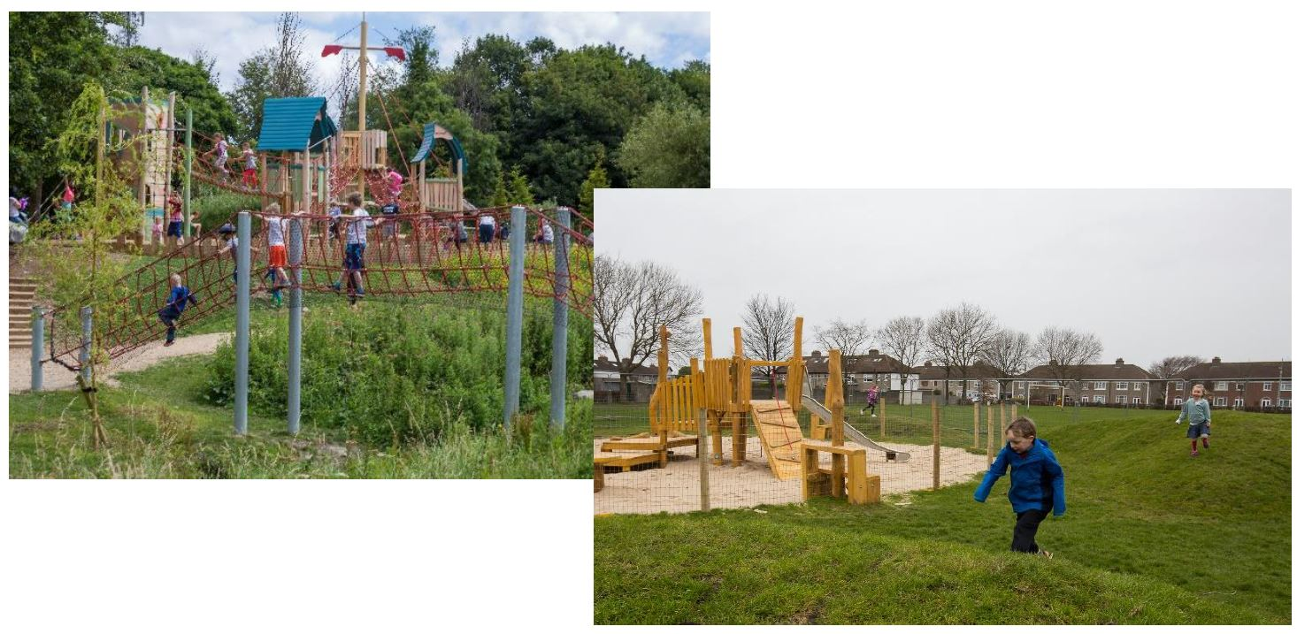
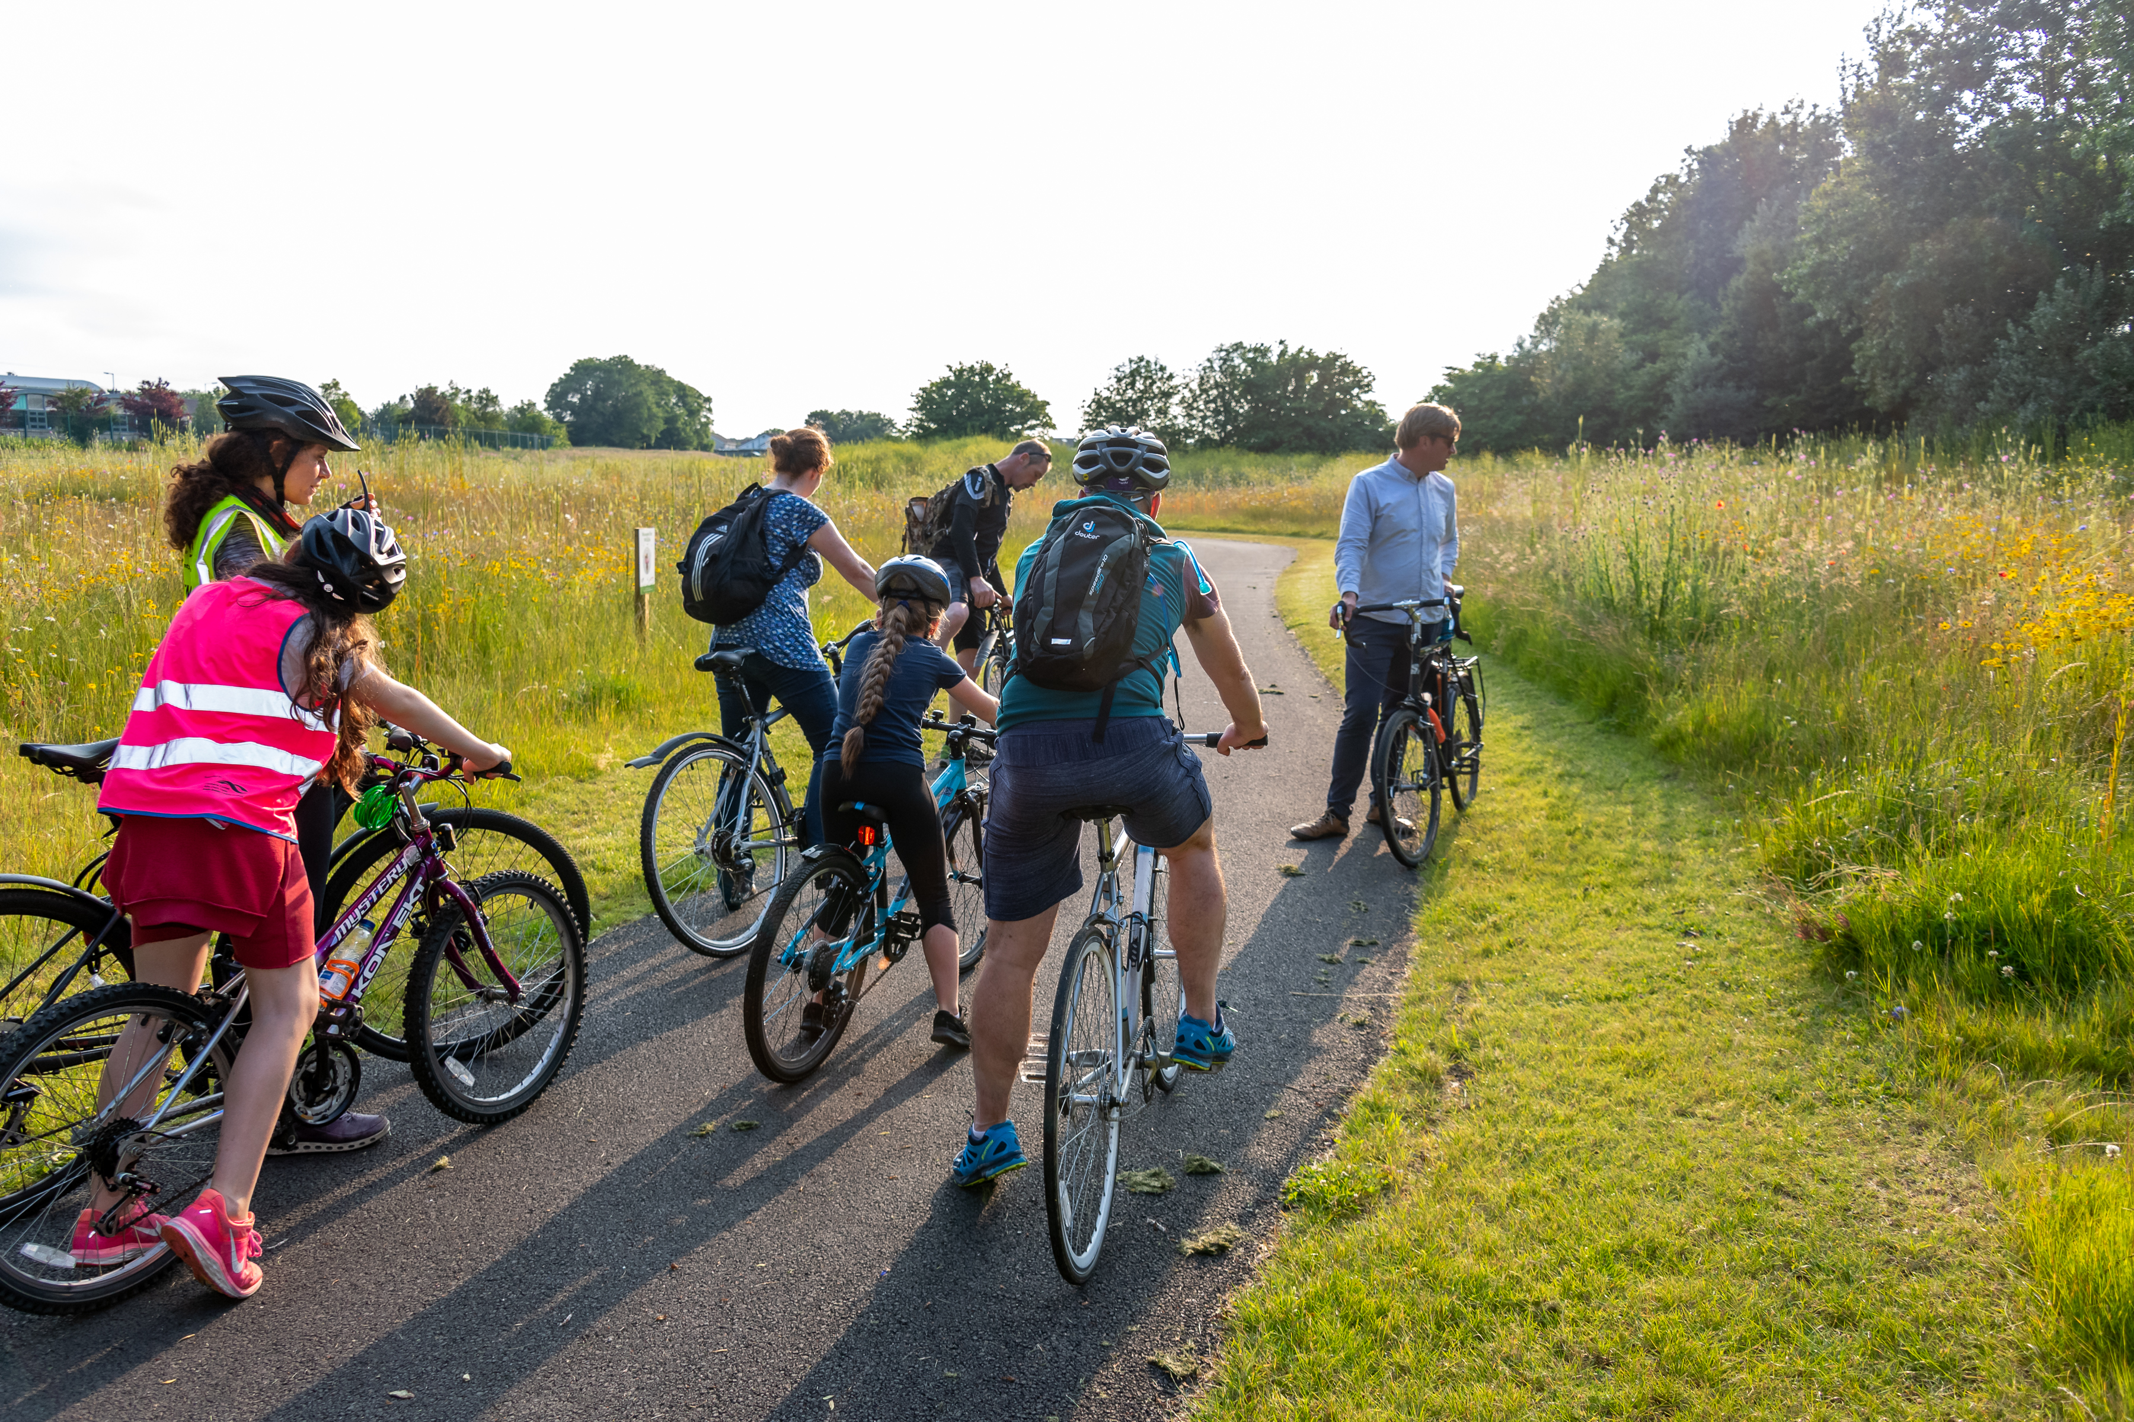
Expansion of Community Gardens and Allotments for Local Food Production
Promote Active Play
Promote Active Travel
Promote Active Travel
Promote Active Travel
Promote Active Travel

Slide 17
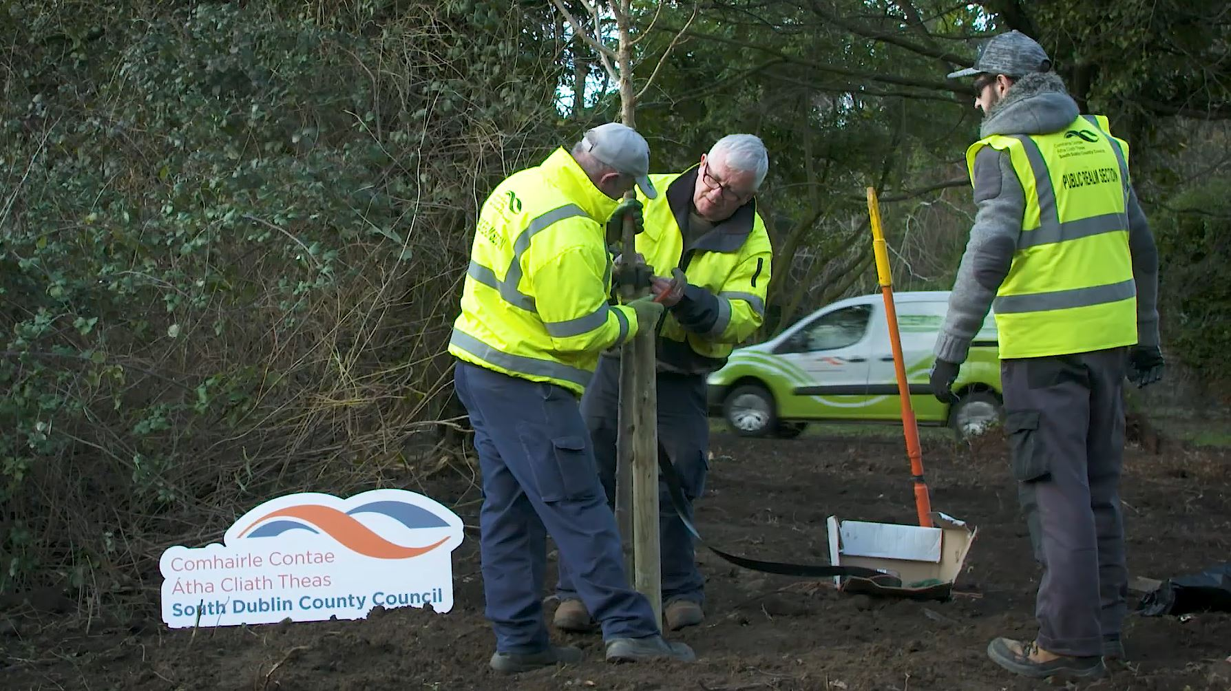
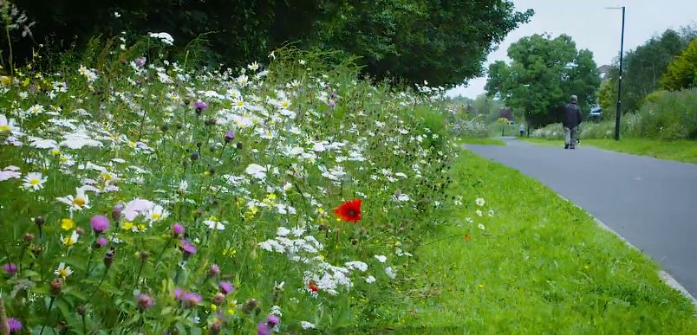
Planting Native Tree Species
Wildflower Meadows to Encourage Pollination

Slide 18
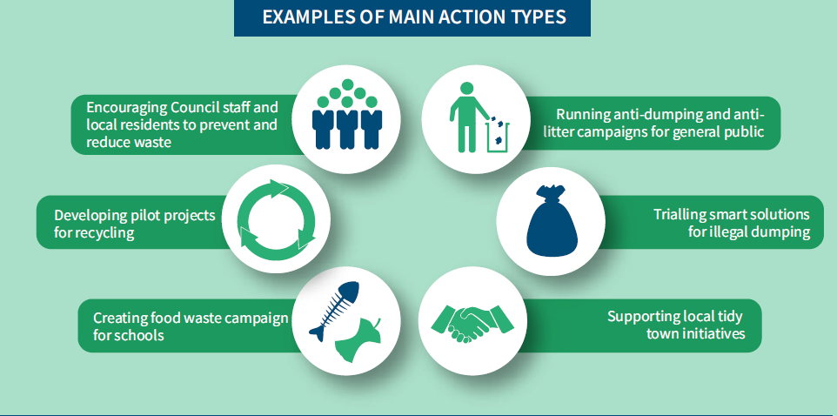
SDCC CCAP 2019-2024
Resource management - 27 Actions

Slide 19
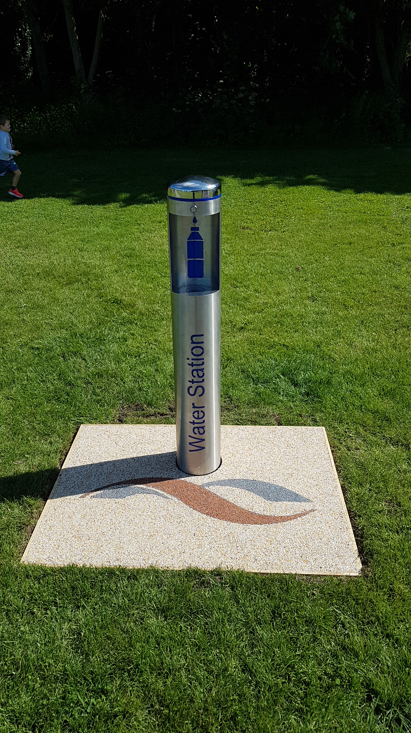
Introduction of Public Water Fountains to Reduce Reliance on Single use Plastics

Slide 20
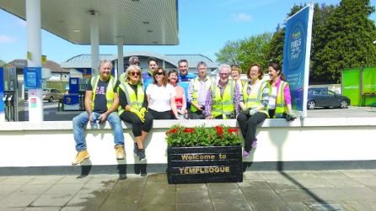
Continued Support and Promotion of Local Tidy Towns Initiatives

Slide 21
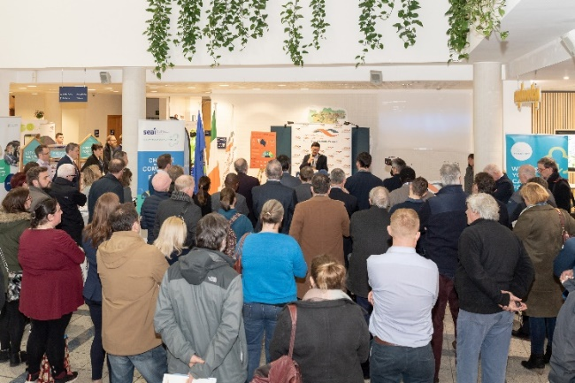
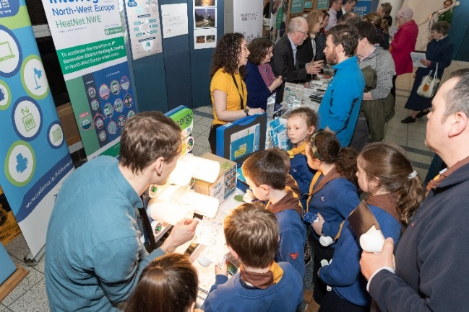
6th Action Area – Citizen Engagement
UPCOMING EVENTS
October
Climate Action Week
Re-use month
Leaf Campaign
November
Deadline for Green Flag Applications
European Waste Reduction Week
Climate awareness workshops
Multiple Events & Strategic Social Media
Campaign
#Councils4ClimateAction
www.dublinclimatechange.ie

Slide 22
Teams are Key to CCAP Implementation
COUNCIL
SPC
EUROPEAN
COVENANT OF MAYORS
CARO
DCCAE
LGMA
REPORTING
CLIMATE ACTION STEERING GROUP
Director of Services EWCC
Director of Services LUTP
County Architect
Chairs of Action Area Teams
ACTION TEAM 1
ENERGY & BUILDINGS
ACTION TEAM 6
CITIZEN
ENGAGEMENT
ACTION UPDATES
ACTION TEAM 2
TRANSPORT
ACTION TEAM 5
RESOURCE MANAGEMENT
ACTION TEAM 4
NATURE BASED SOLUTIONS
ACTION TEAM 3
FLOOD RESILIENCE

Slide 23
Implementation of the CCAP
Action Team Meetings – nomination of team members required , Track progress
5 Action Areas – 6 Action Teams, including
Action Team 6 Citizen Engagement
Risk – assess future potential climate impacts, develop risk register for each Action Team, prioritise climate risks
Budget – €250K Allocated in 2019
Continuous and on-going public awareness and interaction with our citizens

Slide 24
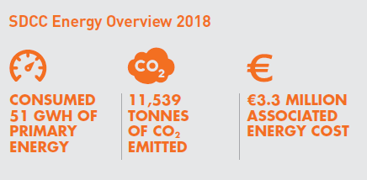
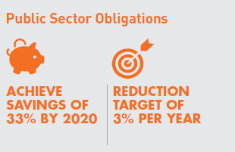
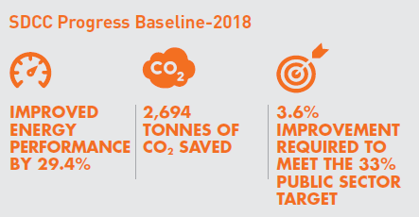
How we are doing on Energy Targets

Slide 25
2019 Key Targets
Development of Heatnet
Replace existing SOX public Lighting with LEDs
Identify locations for EV charging stations
Increase bicycle parking facilities
Flood Alleviation Schemes (Poddle, Whitechurch, Camac)
Plant 1,500 trees
Introduce additional pollinator planters
90 Hectares reserved for flower meadows
Reduce Single Use Plastic – provide 9 water fountains

Slide 26
2019 Climate Action Budget - €250K
EV Charging enabling works €30,000
Eco Driver Training €5,000
Piloting Sustainable Drainage Systems €90,000
Pollinator and native hedgerow re-establishment €40,000
Reduce single use plastic – provision of water fountains €55,000
Citizen Engagement €30,000
  video, workshops, Tidy Towns Seminars and information materials

